Slide 1
Section 4-3 Rotations

Slide 2
Warm Up
Trapezoid ABCD has vertices A(–1, 4), B(2, 4), C(3, 1), and D(–2, 1).
Find the coordinates of the image after each translation.
1. 3 units right
2. 5 units down
3. 4 units up
4. 2 units left
5. 2 units right and 3 units down
6. 4 units left and 3 units up

Slide 3
Warm Up
Trapezoid ABCD has vertices A(–1, 4), B(2, 4), C(3, 1), and D(–2, 1).
Find the coordinates of the image after each translation.
1. 3 units right A′(2, 4), B′(5, 4), C′(6, 1), and D′(1, 1)
2. 5 units down A′(−1, −1), B′(2, −1), C′(3, −4), and D′(−2, −4)
3. 4 units up A′(−1, 8), B′(2, 8), C′(3, 5), and D′(−2, 5)
4. 2 units left A′(−3, 4), B′(0, 4), C′(1, 1), and D′(−4, 1)
5. 2 units right and 3 units down A′(1, 1), B′(4, 1), C′(5, −2), and D′(0, −2)
6. 4 units left and 3 units up A′(−5, 7), B′(−2, 7), C′(−1, 4), and D′(−6, 4)
Notes:
A′(2, 4), B′(5, 4), C′(6, 1), and D′(1, 1)
A′(−1, −1), B′(2, −1), C′(3, −4), and D′(−2, −4)
A′(−1, 8), B′(2, 8), C′(3, 5), and D′(−2, 5)
A′(−3, 4), B′(0, 4), C′(1, 1), and D′(−4, 1)
A′(1, 1), B′(4, 1), C′(5, −2), and D′(0, −2)
A′(−5, 7), B′(−2, 7), C′(−1, 4), and D′(−6, 4)

Slide 4
Florida’s B.E.S.T. Standards for Mathematics
MA.912.GR.2.1 Given a preimage and image, describe the transformation and represent the transformation algebraically using coordinates.
MA.912.GR.2.3 Identify a sequence of transformations that will map a given figure onto itself or onto another congruent or similar figure.

Slide 5
Florida’s Mathematical Thinking and Reasoning Standards
MA.K12.MTR.1.1
Actively participate in effortful learning both individually and collectively.
MA.K12.MTR.7.1
Apply mathematics to real-world contexts.

Slide 6
Lesson Objectives
Content Objectives
Students will use rigid transformations to rotate figures on the coordinate plane and describe the effects of the rotations.
Language Objectives
Students describe the effects of rotations from rigid transformations using compare and the same and different.
To maximize linguistic and cognitive meta-awareness, students participate in MLR5: Co-Craft Questions and Problems.

Slide 7
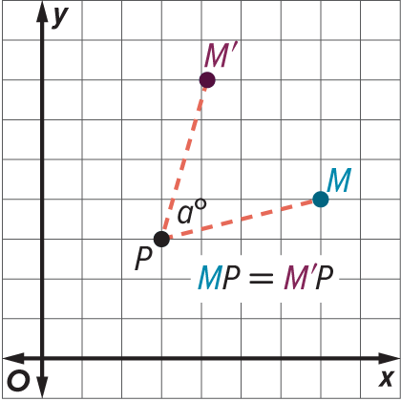
Learn
Rotations About Points on a Figure
Key Concept: Rotation
A rotation about a fixed point P through an angle of a° is a function that maps point M to point M′ such that:
point P does not move,
m∠MPM′ is a°, and
MP = M′P

Slide 8
Learn
Rotations About Points on a Figure
When a point is rotated 90°, 180°, or 270° clockwise or counterclockwise about the origin, you can use the following rules to determine the coordinates of an image. If the direction of a rotation is not given, it should be assumed that the rotation is counterclockwise. A rotation of 360° will map an image onto the preimage.

Slide 9
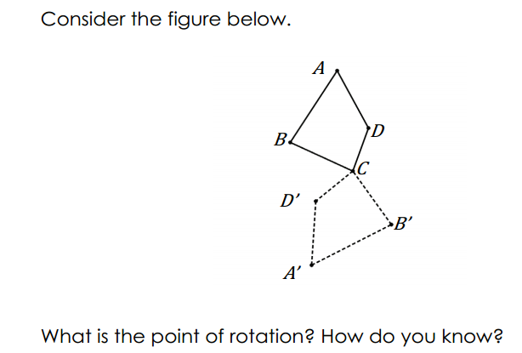
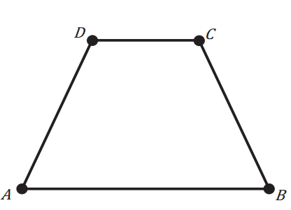
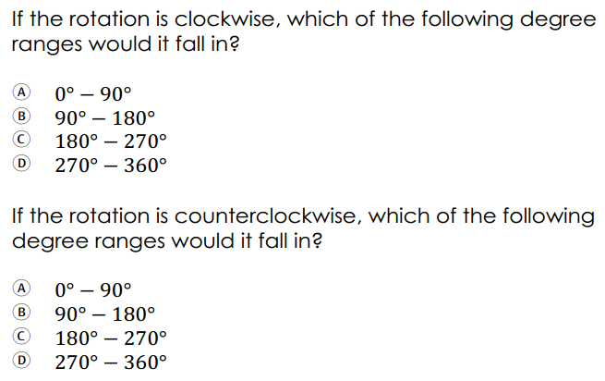
pg.99
pg.98

Slide 10
Learn
Rotations About Points on a Figure
Counterclockwise Rotation | Clockwise Rotation | Coordinate Rule
90° counterclockwise | 270° clockwise | (x, y) → (−y, x)
180° counterclockwise | 180° clockwise | (x, y) → (−x, −y)
270° counterclockwise | 90° clockwise | (x, y) → (y, −x)
When combined with translations, these rules can also be used to rotate figures about points that are not the origin, like a point on the figure.

Slide 11
Learn
Rotations About Points on a Figure
Talk About It!
Why does MP have to be equal to M′P for the rotation to occur?

Slide 12
Example 1
Rotation About a Point on the Figure
Triangle ABC has vertices A(−3, 2), B(−2, 4), and C(2, 1). Graph △ABC and its image after a rotation of 90° clockwise about C.

Slide 13
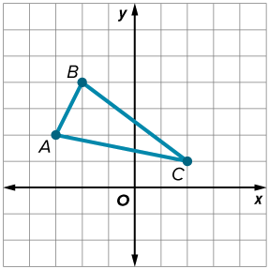
Example 1
Rotation About a Point on the Figure
Step 1 Graph △ABC.

Slide 14
Example 1
Rotation About a Point on the Figure
Step 2 Map the center of rotation to the origin.
To map the center of rotation to the origin, translate C to the origin. Then translate the vertices A and B using the same rule.
(x, y) → (x − 2, y − 1)
A(−3, 2) → (−5, 1) B(−2, 4) → (−4, 3) C(2, 1) → (0, 0)

Slide 15
Example 1
Rotation About a Point on the Figure
Step 3 Rotate 90° clockwise about the origin.
(x, y) | → | (y, −x)
A(−5, 1) | → | (1, 5)
B(−4, 3) | → | (3, 4)
C(0, 0) | → | (0, 0)

Slide 16
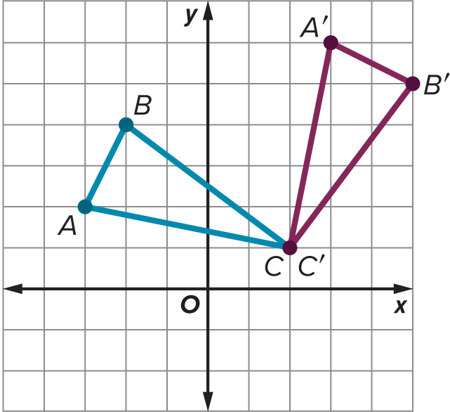
Example 1
Rotation About a Point on the Figure
Step 4 Map the center of rotation to its original position.
To map the center of rotation to its original position, translate the point at the origin back to (2, 1). Then translate the remaining vertices using the same rule.
(x, y) | → | (x + 2, y + 1)
A (1, 5) | → | A′ (3, 6)
B (3, 4) | → | B′ (5, 5)
C(0, 0) | → | C′(2, 1)

Slide 17
Example 1
Rotation About a Point on the Figure
Check
Triangle PQR has vertices P(2, 1), Q(2, 4), and R(5, 1). Graph △PQR and its image after a rotation 90° counterclockwise about Q.

Slide 18
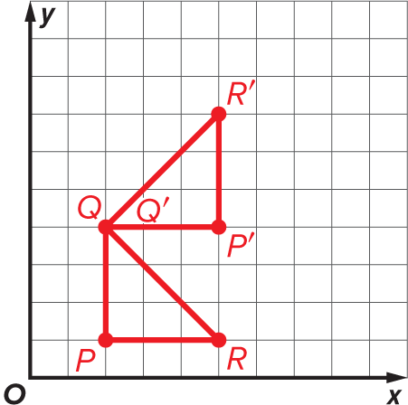
Example 1
Rotation About a Point on the Figure
Check
Triangle PQR has vertices P(2, 1), Q(2, 4), and R(5, 1). Graph △PQR and its image after a rotation 90° counterclockwise about Q.

Slide 19
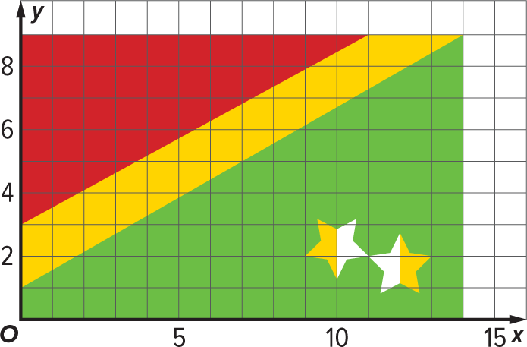
Example 2
Describe a Rotation
FLAGS Kendrick is working with a team in his social studies class to create a new country and its government. Kendrick is responsible for creating the country’s flag. He is using geometry software to design the flag on the coordinate plane. Kendrick wants to test the positions of the stars by rotating them as a single object. Describe the rotation that will map the star design onto itself.

Slide 20
Example 2
Describe a Rotation
The left star is upside down when compared to the right star, so this appears to be a rotation 180° counterclockwise. If the two stars are rotated about the center of rotation at (11, 2), where the two stars intersect, then the star design will map onto itself.

Slide 21
Example 2
Describe a Rotation
Talk About It!
Find other examples of flags that have elements that can be created using a rotation. Explain why the design is a rotation by describing the center and angle of rotation.

Slide 22
Exit Ticket
Quadrilateral ABCD has coordinates A(0, 2), B(3, 4), C(4, 2), and D(3, 0).
1. Determine the coordinates of the vertices of A′B′C′D′ after a rotation of 180° about (3, −2).
2. Rotate A′B′C′D′ 90° counterclockwise about (−2, −1). Determine the coordinates of the vertices of A″B″C″D″.

Slide 23
Exit Ticket
Quadrilateral ABCD has coordinates A(0, 2), B(3, 4), C(4, 2), and D(3, 0).
1. Determine the coordinates of the vertices of A′B′C′D′ after a rotation of 180° about (3, −2).
A′(6, −6), B′(3, −8), C′(2, −6), D′(3, −4)
2. Rotate A′B′C′D′ 90° counterclockwise about (−2, −1). Determine the coordinates of the vertices of A″B″C″D″. A″(3, 7), B″(5, 4), C″(3, 3), D″(1, 4)
Notes:
A′(6, −6), B′(3, −8), C′(2, −6), D′(3, −4)
A″(3, 7), B″(5, 4), C″(3, 3), D″(1, 4)

