Slide 1
Tangents

Slide 2
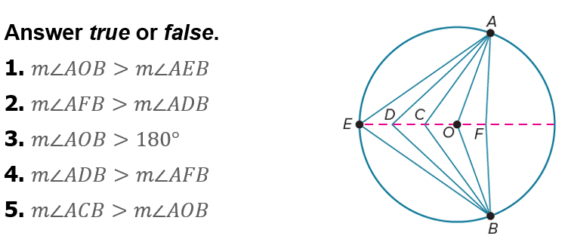
Warm Up

Slide 3
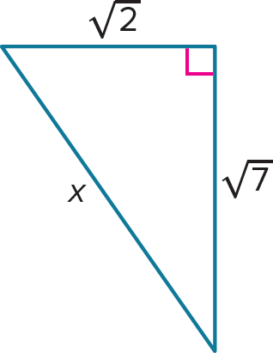
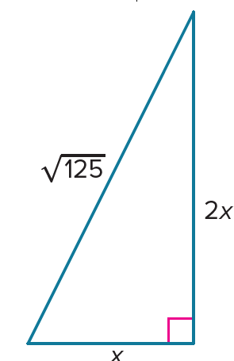
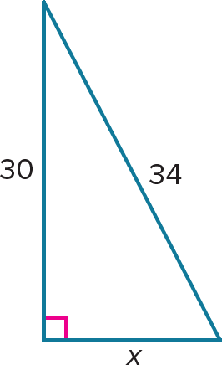
Warm Up
Solve for x. Leave irrational numbers in simplified radical form.
1.
2.
3.

Slide 4
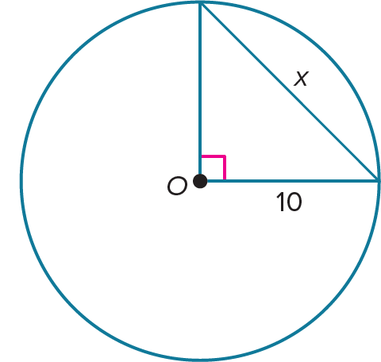
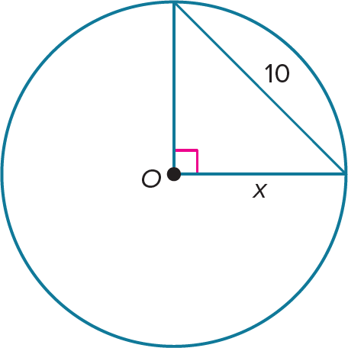
Warm Up
Solve for x. Leave irrational numbers in simplified radical form.
4.
5.

Slide 5
Warm Up
Solve for x. Leave irrational numbers in simplified radical form.
1. 16
2. 3
3. 5
Notes:
16
3
5

Slide 6
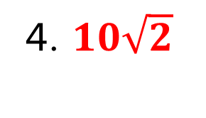
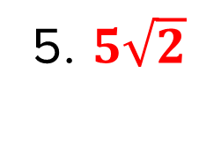
Warm Up
Solve for x. Leave irrational numbers in simplified radical form.
4. $10\sqrt{2}$
5. $5\sqrt{2}$
Notes:
$$10\sqrt{2}$$
$$5\sqrt{2}$$

Slide 7
Florida’s B.E.S.T. Standards for Mathematics
MA.912.GR.5.3
Construct the inscribed and circumscribed circles of a triangle.
MA.912.GR.6.1
Solve mathematical and real-world problems involving the length of a secant, tangent, segment or chord in a given circle.
MA.912.GR.6.2
Solve mathematical and real-world problems involving the measures of arcs and related angles.

Slide 8
Florida’s Mathematical Thinking and Reasoning Standards
MA.K12.MTR.1.1
Actively participate in effortful learning both individually and collectively.
MA.K12.MTR.4.1
Engage in discussions that reflect on the mathematical thinking of self and others.
MA.K12.MTR.6.1
Assess the reasonableness of solutions.

Slide 9
Lesson Objectives
Content Objective
Students solve problems using relationships between circles and tangents and investigate constructions with circles.
Language Objectives
Students use to talk about tangents using perpendicular and congruent.
To maximize linguistic and cognitive meta-awareness, students participate in MLR5: Co-Craft Questions and Problems.

Slide 10
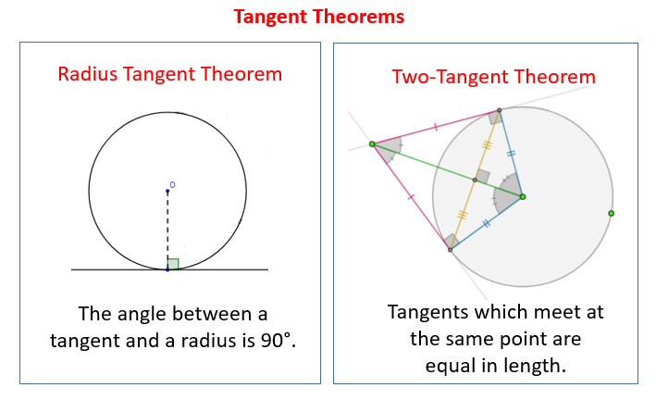
A tangent to a circle is a line or segment in the plane of a circle that intersects the circle in exactly one point and does not contain any points in the interior of the circle. For a line that intersects a circle in one point, the point of tangency is the point at which they intersect.
Learn
Tangents

Slide 11
Learn
Tangents
A common tangent is a line or segment that is tangent to two circles in the same plane. More than one line can be tangent to the same circle, and the shortest distance from a tangent to the center of a circle is the radius drawn to the point of tangency.

Slide 12
Learn
Tangents
Theorem 10.11
In a plane, a line is tangent to a circle if and only if it is perpendicular to a radius drawn to the point of tangency.
Theorem 10.12: Tangent to a Circle Theorem
If two segments from the same exterior point are tangent to a circle, then they are congruent.

Slide 13
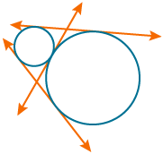
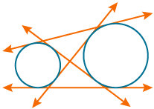
Example 1
Identify Common Tangents
Identify the number of common tangents that exist between each pair of circles. If no common tangent exists, state no common tangent.
a.
b.

Slide 14
Example 1
Identify Common Tangents
a.
b.
3 common tangents
4 common tangents

Slide 15
Example 1
Identify Common Tangents
Talk About It!
What is the relationship between a circle and its tangent? When will two circles not have a common tangent? Justify your argument.

Slide 16
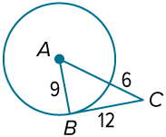
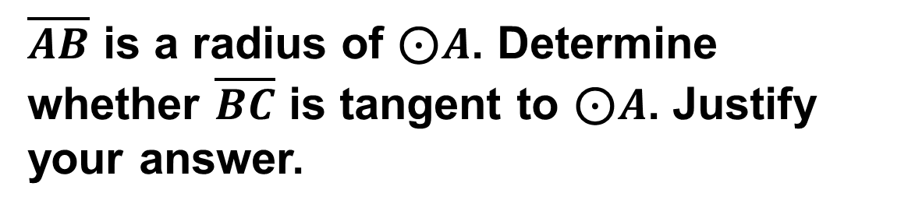
Example 2
Identify a Tangent
$\overline{AB}$ is a radius of $\text{⊙}A$. Determine whether $\overline{BC}$ is tangent to $\text{⊙}A$. Justify your answer.

Slide 17
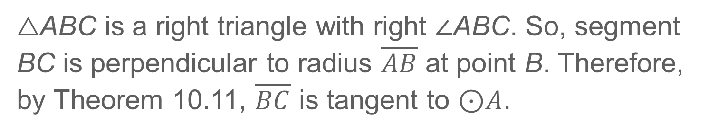
Example 2
Identify a Tangent
Test to see if △ABC is a right triangle.
9² + 12² | ≟ (9 + 6)² | Pythagorean Theorem
81 + 144 | ≟ 15² | Multiply and add.
225 | = 255 ✓ | Simplify.
△ABC is a right triangle with right ∠ABC. So, segment BC is perpendicular to radius $\overline{AB}$ at point B. Therefore, by Theorem 10.11, $\overline{BC}$ is tangent to $\text{⊙}A$.

Slide 18
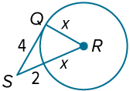
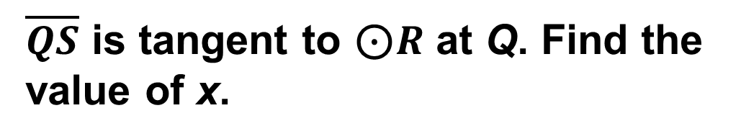
Example 3
Use a Tangent to Find Missing Values
$\overline{QS}$ is tangent to $\text{⊙}R$ at Q. Find the value of x.

Slide 19

Example 3
Use a Tangent to Find Missing Values
By Theorem 10.11, $\overline{RQ} \text{⊥} \overline{QS}$ . So, $\text{△}RQS$is a right triangle.
RQ² + QS² | = RS² | Pythagorean Theorem
x² + 4² | = (x + 2)² | RQ = x, QS = 4, and RS = x + 2
x² + 16 | = x² + 4x + 4 | Multiply.
12 | = 4x | Simplify.
3 | = x | Divide each side by 4.

Slide 20
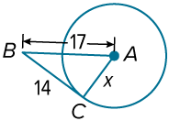
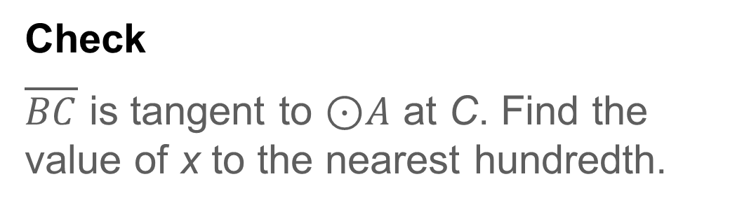
Example 3
Use a Tangent to Find Missing Values
Check
$\overline{BC}$ is tangent to $\text{⊙}A$ at C. Find the value of x to the nearest hundredth.

Slide 21
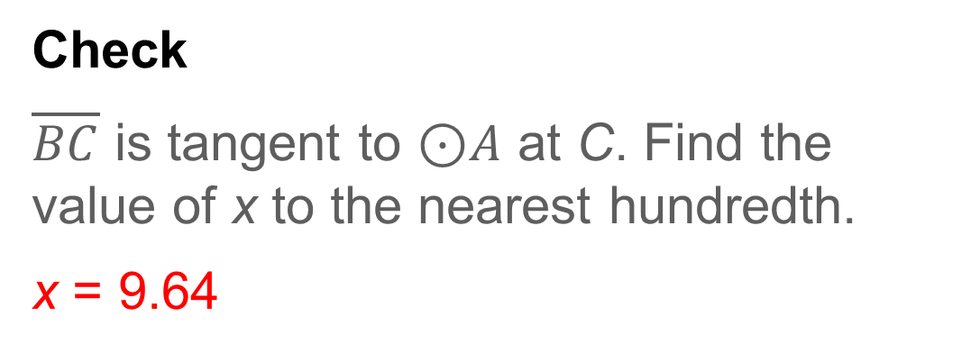
Example 3
Use a Tangent to Find Missing Values
Check
$\overline{BC}$ is tangent to $\text{⊙}A$ at C. Find the value of x to the nearest hundredth.
x = 9.64
Notes:
x = 9.64

Slide 22
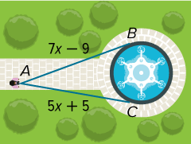
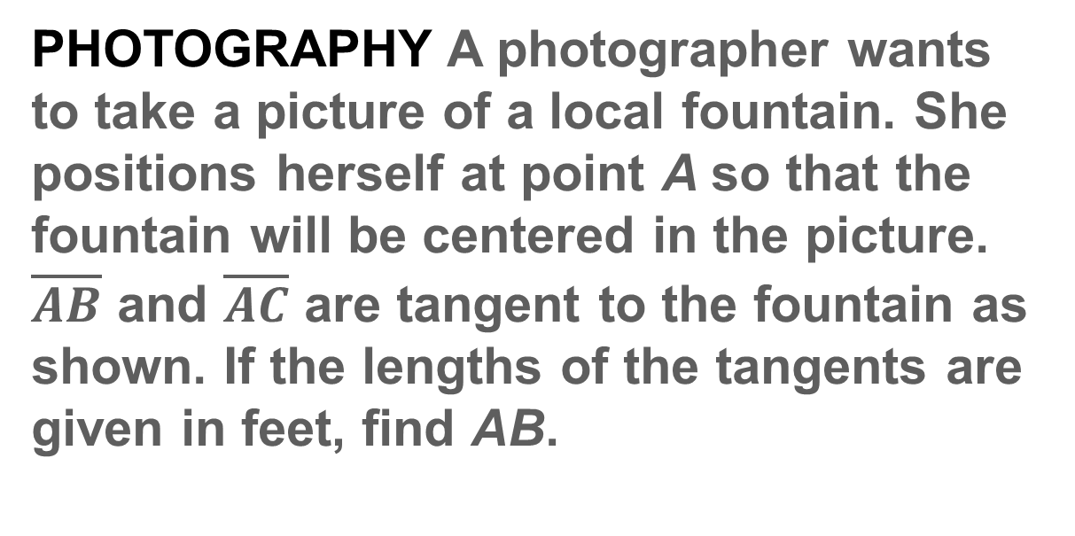
Example 4
Use Congruent Tangents to Find Measures
PHOTOGRAPHY A photographer wants to take a picture of a local fountain. She positions herself at point A so that the fountain will be centered in the picture. $\overline{AB}$ and $\overline{AC}$ are tangent to the fountain as shown. If the lengths of the tangents are given in feet, find AB.

Slide 23
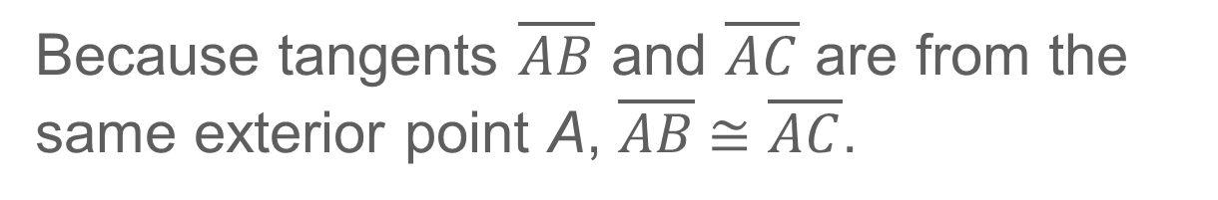

Example 4
Use Congruent Tangents to Find Measures
Because tangents $\overline{AB}$ and $\overline{AC}$ are from the same exterior point A, $\overline{AB} \text{≅} \overline{AC}$.
AB | = AC | Definition of congruent segments
7x – 9 | = 5x + 5 | Substitution
x | = 7 | Solve.
So, AB = 7(7) – 9 or 40 feet$.$

Slide 24
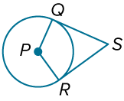
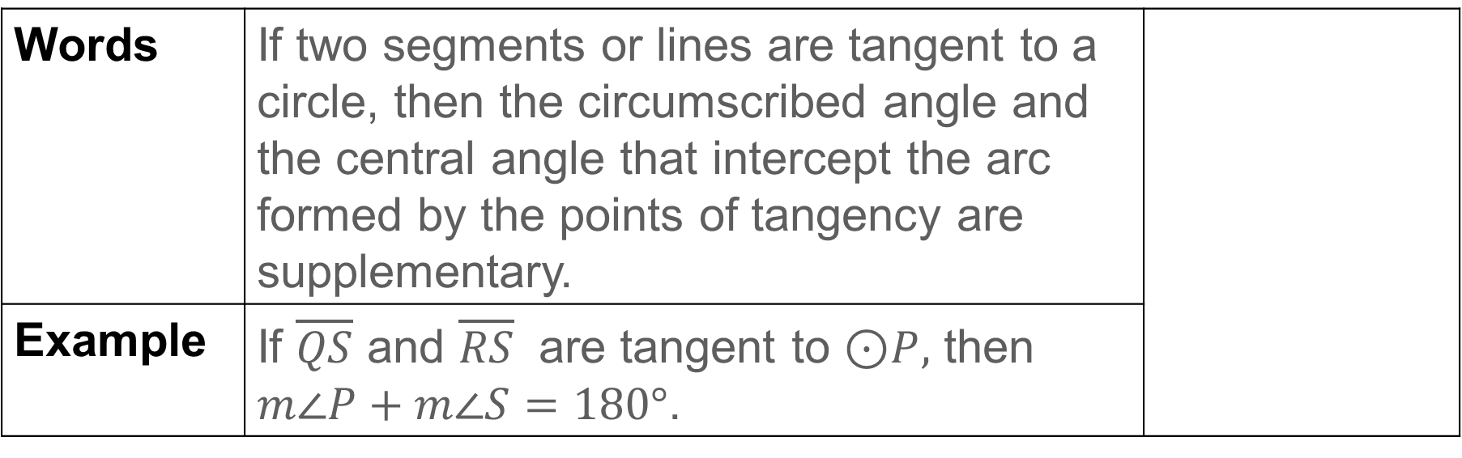
Learn
Circumscribed Angles
A circumscribed angle is an angle with sides that are tangent to a circle.
Theorem 10.13
Words | If two segments or lines are tangent to a circle, then the circumscribed angle and the central angle that intercept the arc formed by the points of tangency are supplementary.
Example | If $\overline{QS}$ and $\overline{RS}$ are tangent to $\text{⊙}P,$ then $m\text{∠}P+m\text{∠}S=180°$.

Slide 25






Learn
Circumscribed Angles
A circumscribed polygon has vertices outside the circle and sides that are tangent to the circle.
Circumscribed Polygons | Polygons Not Circumscribed

Slide 26
Learn
Circumscribed Angles
An inscribed circle is a circle in the interior of a polygon that intersects each side of the polygon at a single point. You can use many different tools to construct the inscribed circle of a triangle. The incenter of a triangle is the center of the inscribed circle. Open a new file in your dynamic geometry software to begin.

Slide 27
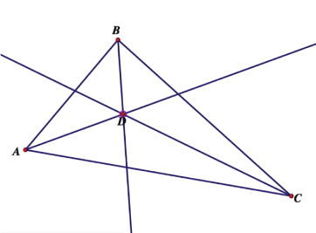
Learn
Circumscribed Angles
Construction: Inscribed Circle of a Triangle
STEP 1 Draw △ABC. Construct the angle bisectors of the three angles. Label the incenter D.

Slide 28
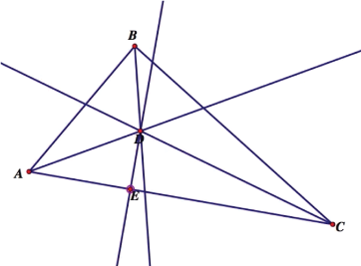
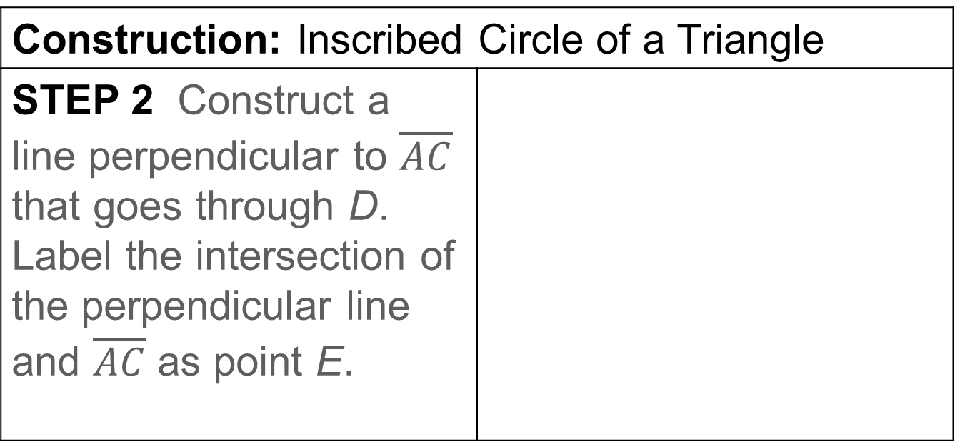
Learn
Circumscribed Angles
Construction: Inscribed Circle of a Triangle
STEP 2 Construct a line perpendicular to $\overline{AC}$ that goes through D. Label the intersection of the perpendicular line and $\overline{AC}$ as point E.

Slide 29
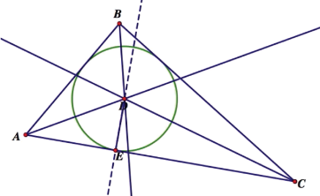
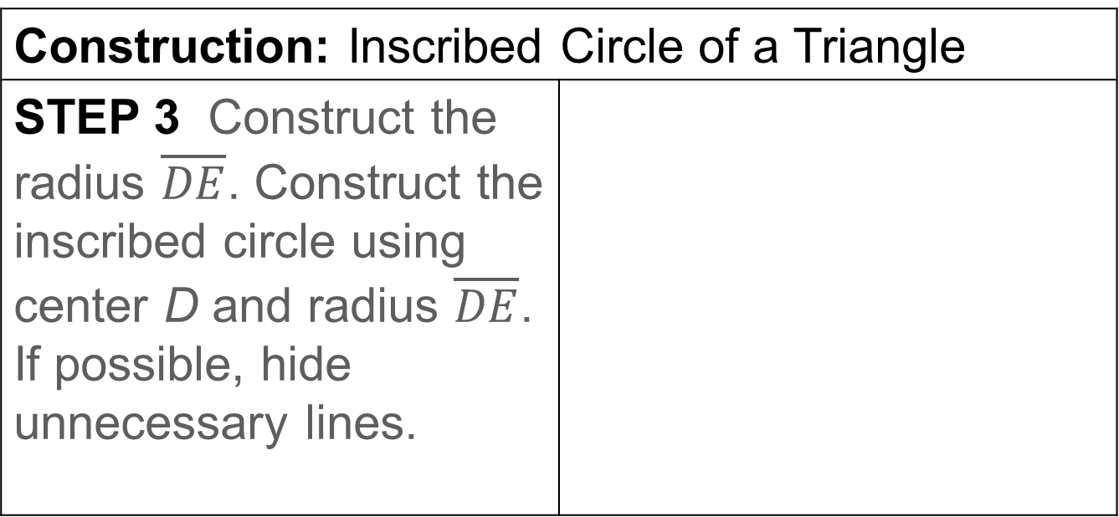
Learn
Circumscribed Angles
Construction: Inscribed Circle of a Triangle
STEP 3 Construct the radius $\overline{DE}$. Construct the inscribed circle using center D and radius $\overline{DE}$. If possible, hide unnecessary lines.

Slide 30
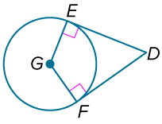
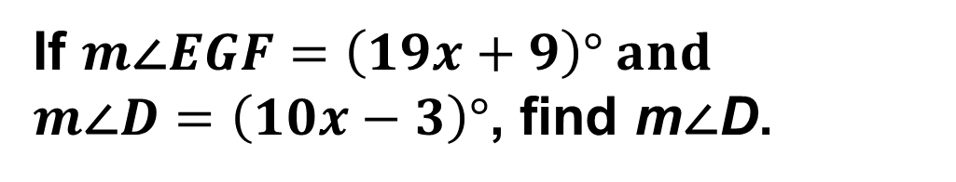
Example 5
Use Circumscribed Angles to Find Measures
If $m\text{∠}EGF=\left(19x+9\right)° and$
$m\text{∠}D=\left(10x−3\right)°$, find m∠D.

Slide 31
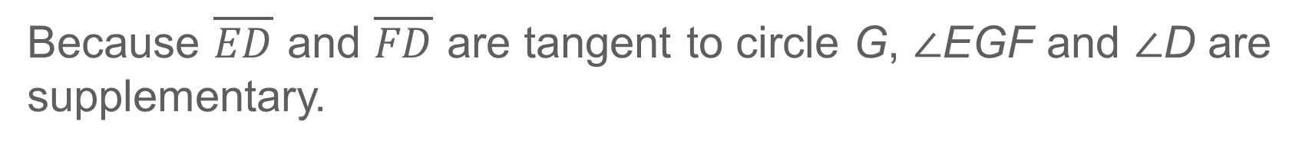

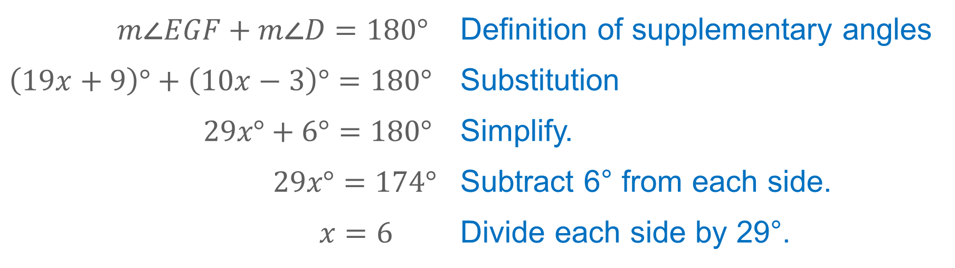
Example 5
Use Circumscribed Angles to Find Measures
Because $\overline{ED}$ and $\overline{FD}$ are tangent to circle G, ∠EGF and ∠D are supplementary.
$$m\text{∠}EGF+m\text{∠}D=180°$$ | Definition of supplementary angles
$$\left(19x+9\right)°+\left(10x−3\right)°=180°$$ | Substitution
$$29x°+6°=180°$$ | Simplify.
$$29x°=174°$$ | Subtract 6° from each side.
$$x=6$$ | Divide each side by 29°.
So, $m\text{∠}D=\left[10\left(6\right)−3\right]°$ or 57°$.$

Slide 32
Example 5
Use Circumscribed Angles to Find Measures
Think About It!
Without Theorem 10.13, how can you use logic to determine the relationship between a central angle and a circumscribed angle that intercept the same arc?

Slide 33
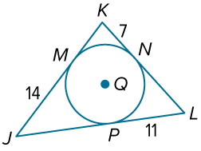
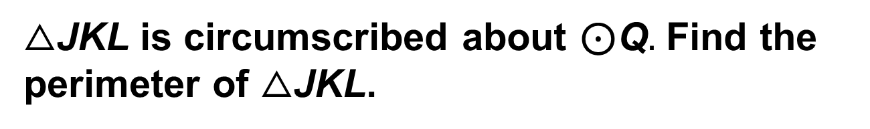
Example 6
Find Measures in Circumscribed Polygons
△JKL is circumscribed about ⊙Q$.$ Find the perimeter of △JKL.

Slide 34
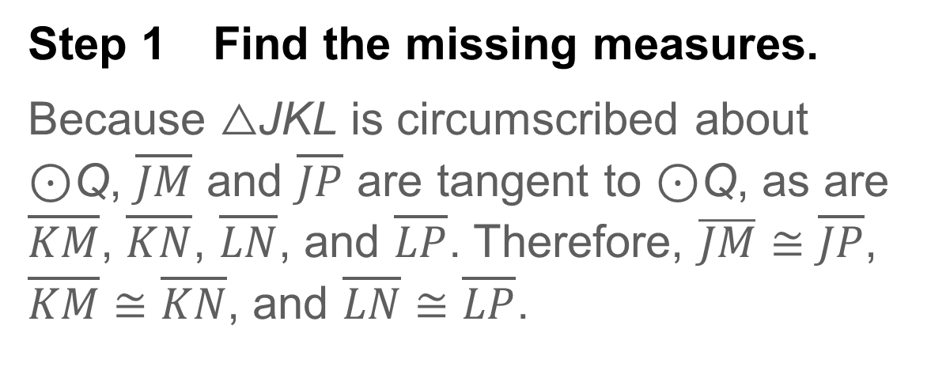
Example 6
Find Measures in Circumscribed Polygons
Step 1 Find the missing measures.
Because △JKL is circumscribed about ⊙Q, $\overline{JM}$ and $\overline{JP}$ are tangent to ⊙Q, as are $\overline{KM}$, $\overline{KN}$, $\overline{LN}$, and $\overline{LP}$. Therefore, $\overline{JM}≅\overline{JP}$, $\overline{KM}≅\overline{KN}$, and $\overline{LN}≅\overline{LP}$.
So, JM = JP = 14 feet, KM = KN = 7 feet, and LN = LP = 11 feet.

Slide 35
Example 6
Find Measures in Circumscribed Polygons
Step 2 Find the perimeter of △JKL.
By the Segment Addition Postulate, JK = JM + KM = 14 + 7 or 21 feet,
KL= KN + LN = 7 + 11 or 8 feet, and
JL = JP + LP = 14 + 11 or 25 feet.
perimeter | = JK + KL + JL
 | = 21 + 18 + 25 or 64 feet
So, the perimeter of △JKL is 64 feet.

Slide 36
Example 6
Find Measures in Circumscribed Polygons
Think About It!
How can you check your answer? Justify your results.

Slide 37
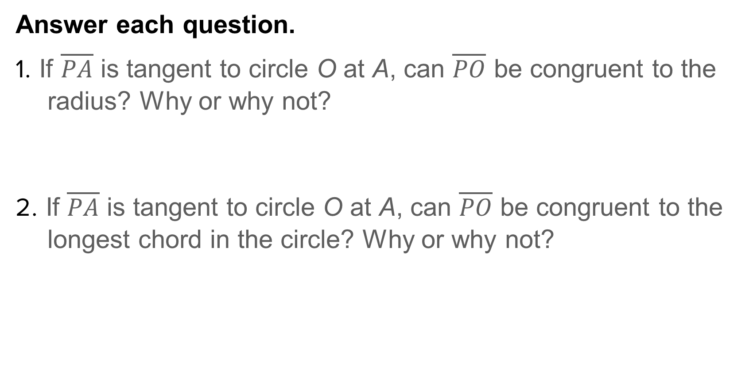
Exit Ticket
Answer each question.
1. If $\overline{PA}$ is tangent to circle O at A, can $\overline{PO}$ be congruent to the radius? Why or why not?
2. If $\overline{PA}$ is tangent to circle O at A, can $\overline{PO}$ be congruent to the longest chord in the circle? Why or why not?

Slide 38
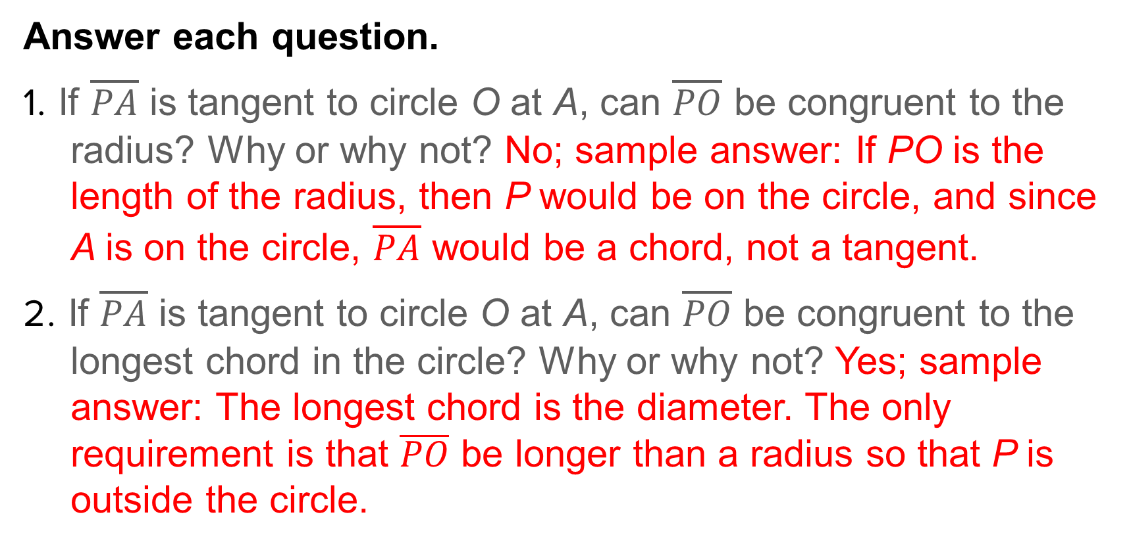
Exit Ticket
Answer each question.
1. If $\overline{PA}$ is tangent to circle O at A, can $\overline{PO}$ be congruent to the radius? Why or why not? No; sample answer: If PO is the length of the radius, then P would be on the circle, and since A is on the circle, $\overline{PA}$ would be a chord, not a tangent.
2. If $\overline{PA}$ is tangent to circle O at A, can $\overline{PO}$ be congruent to the longest chord in the circle? Why or why not? Yes; sample answer: The longest chord is the diameter. The only requirement is that $\overline{PO}$ be longer than a radius so that P is outside the circle.
Notes:
No; sample answer: If PO is the length of the radius, then P would be on the circle, and since A is on the circle, $\overline{PA}$ would be a chord, not a tangent.
Yes; sample answer: The longest chord is the diameter. The only requirement is that $\overline{PO}$ be longer than a radius so that P is outside the circle.

