Slide 1
6-2 Angle Bisectors

Slide 2
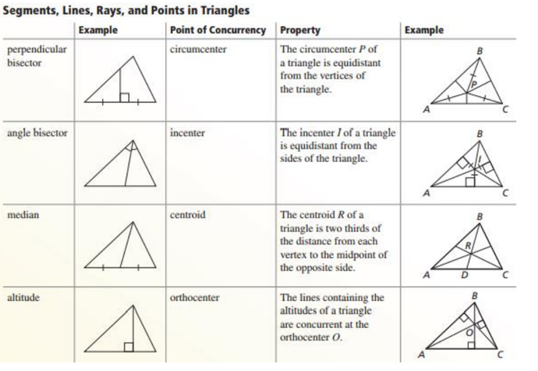
6-2 Angle Bisectors

Slide 3
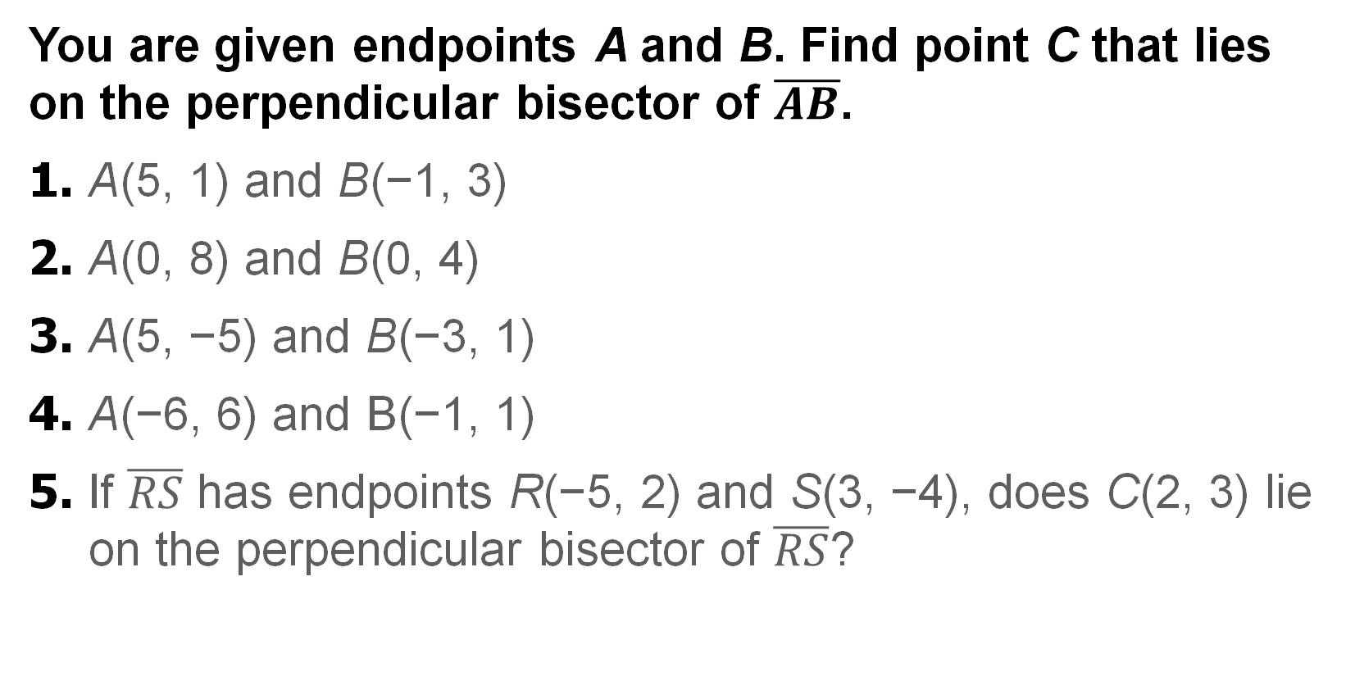
Warm Up
You are given endpoints A and B. Find point C that lies on the perpendicular bisector of $\overline{AB}$.
1. A(5, 1) and B(−1, 3)
2. A(0, 8) and B(0, 4)
3. A(5, −5) and B(−3, 1)
4. A(−6, 6) and B(−1, 1)
5. If $\overline{RS}$ has endpoints R(−5, 2) and S(3, −4), does C(2, 3) lie on the perpendicular bisector of $\overline{RS}$?

Slide 4
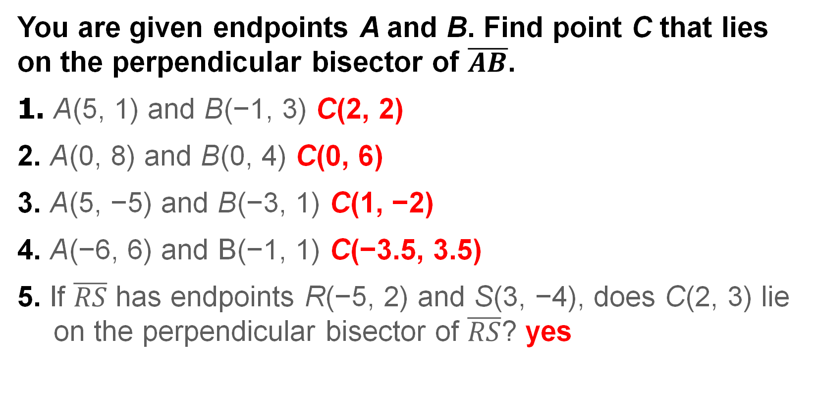
Warm Up
You are given endpoints A and B. Find point C that lies on the perpendicular bisector of $\overline{AB}$.
1. A(5, 1) and B(−1, 3) C(2, 2)
2. A(0, 8) and B(0, 4) C(0, 6)
3. A(5, −5) and B(−3, 1) C(1, −2)
4. A(−6, 6) and B(−1, 1) C(−3.5, 3.5)
5. If $\overline{RS}$ has endpoints R(−5, 2) and S(3, −4), does C(2, 3) lie on the perpendicular bisector of $\overline{RS}$? yes
Notes:
C(2, 2)
C(0, 6)
C(1, −2)
C(−3.5, 3.5)
yes

Slide 5
Florida’s B.E.S.T. Standards for Mathematics
MA.912.GR.1.1 Prove relationships and theorems about lines and angles. Solve mathematical and real-world problems involving postulates, relationships and theorems of lines and angles.
MA.912.GR.3.3 Use coordinate geometry to solve mathematical and real-world geometric problems involving lines, circles, triangles and quadrilaterals.

Slide 6
Florida’s Mathematical Thinking and Reasoning Standards
MA.K12.MTR.4.1
Engage in discussions that reflect on the mathematical thinking of self and others.

Slide 7
Lesson Objectives
Content Objective
Students solve problems using angle bisectors.
Language Objectives
Students explain how to solve problems involving angle bisectors and the incenter of a triangle using from and to.
To maximize linguistic and cognitive meta-awareness, students participate in MLR3: Critique, Correct, and Clarify.

Slide 8
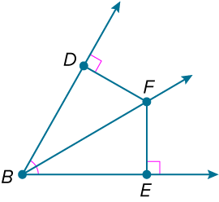
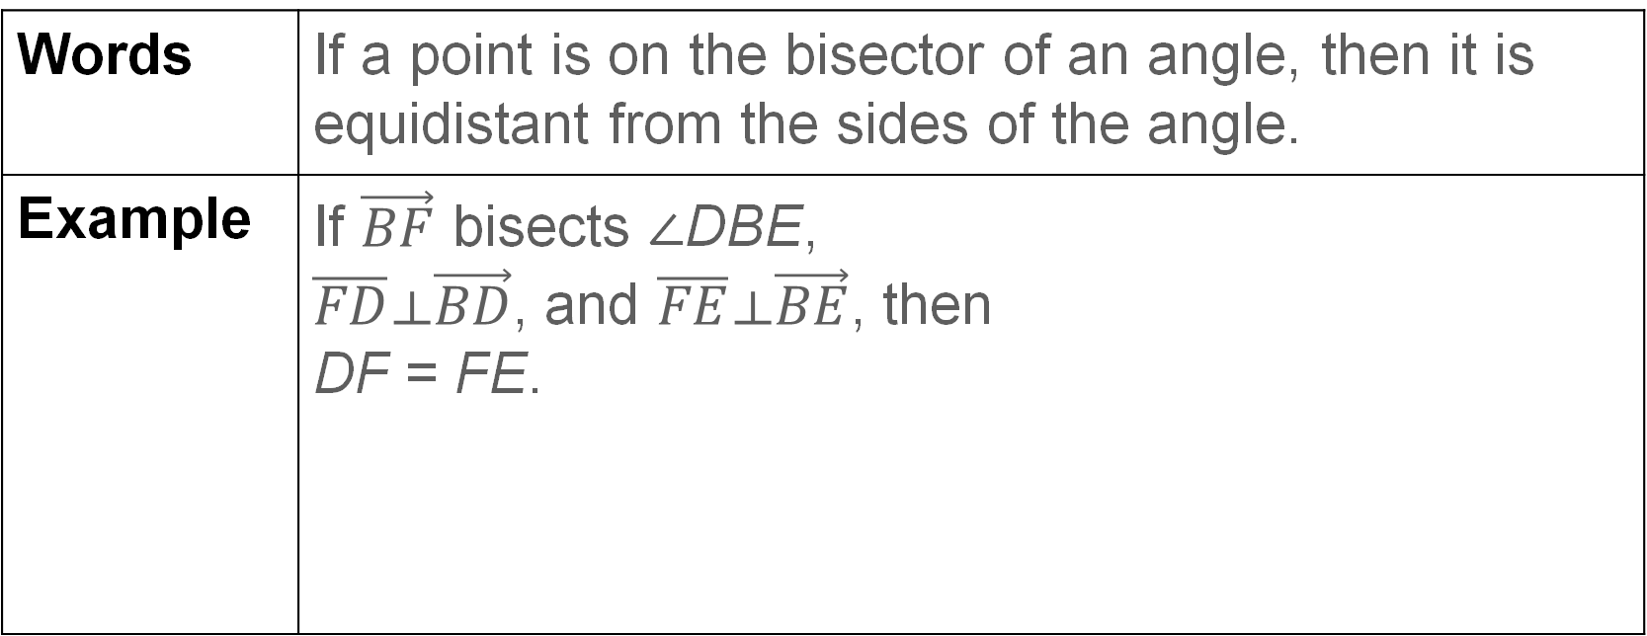
Learn
Angle Bisectors
Theorem 6.4: Angle Bisector Theorem
Words | If a point is on the bisector of an angle, then it is equidistant from the sides of the angle.
Example | If $\vec{BF}$ bisects ∠DBE, $\overline{FD}⟂\vec{BD}$, and $\overline{FE}⟂\vec{BE}$, then DF = FE.

Slide 9
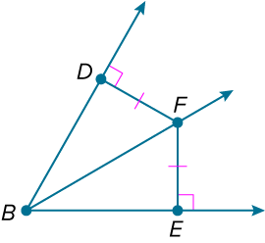
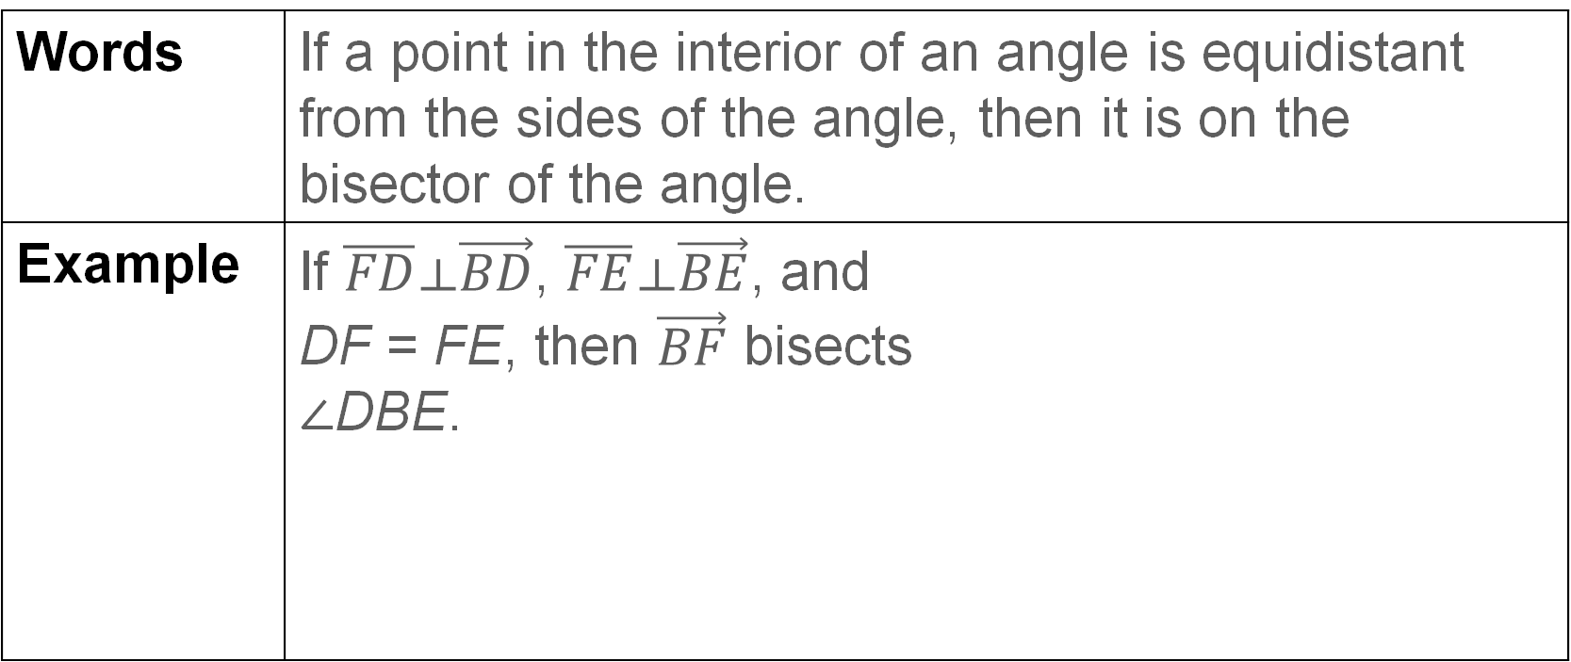
Learn
Angle Bisectors
Theorem 6.5: Converse of the Angle Bisector Theorem
Words | If a point in the interior of an angle is equidistant from the sides of the angle, then it is on the bisector of the angle.
Example | If $\overline{FD}⟂\vec{BD}$, $\overline{FE}⟂\vec{BE}$, and DF = FE, then $\vec{BF}$ bisects ∠DBE.

Slide 10
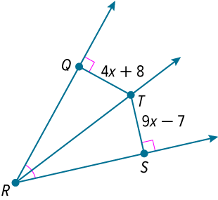
Example 1
Use the Angle Bisector Theorem
Find QT.

Slide 11
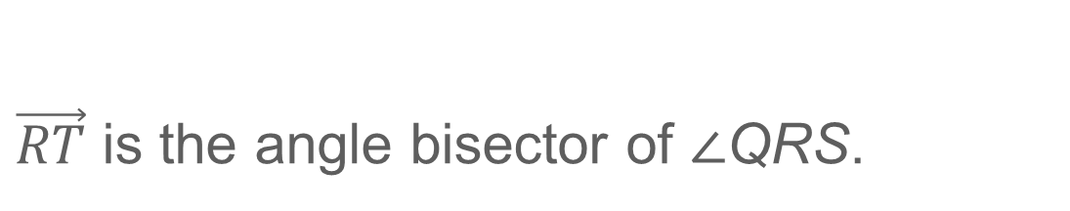
Example 1
Use the Angle Bisector Theorem
$\vec{RT}$ is the angle bisector of ∠QRS.
QT | = ST | Angle Bisector Theorem
4x + 8 | = 9x − 7 | Substitution
−5x | = −15 | Simplify.
x | = 3 | Simplify.
So, QT = 4(3) + 8 or 20.

Slide 12
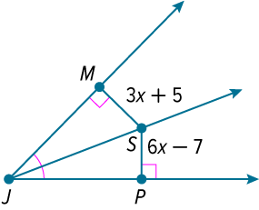
Example 1
Use the Angle Bisector Theorem
Check
Find SP.

Slide 13
Example 1
Use the Angle Bisector Theorem
Check
Find SP.
SP = 17
Notes:
SP = 17

Slide 14
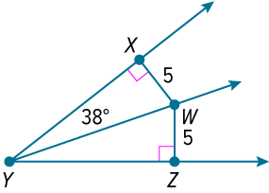
Example 2
Use the Converse of the Angle Bisector
Theorem
Find m∠ZYW.

Slide 15
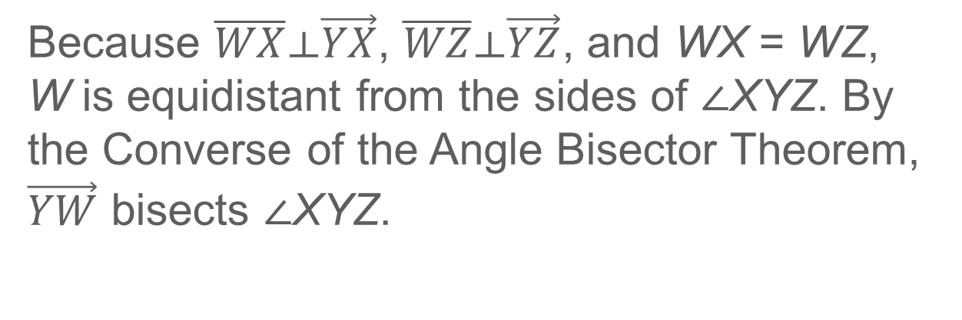
Example 2
Use the Converse of the Angle Bisector
Theorem
Because $\overline{WX}⟂\vec{YX}$, $\overline{WZ}⟂\vec{YZ}$, and WX = WZ, W is equidistant from the sides of ∠XYZ. By the Converse of the Angle Bisector Theorem, $\vec{YW}$ bisects ∠XYZ.
∠ZYW | ≅ ∠XYW | Definition of angle bisector
m∠ZYW | = m∠XYW | Definition of congruent angles
m∠ZYW | = 38° | Substitution

Slide 16
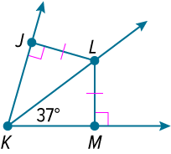
Example 2
Use the Converse of the Angle Bisector
Theorem
Check
Find m∠JKL.

Slide 17
Example 2
Use the Converse of the Angle Bisector
Theorem
Check
Find m∠JKL.
m∠JKL = 37°
Notes:
m∠JKL = 37°

Slide 18
Learn
Angle Bisectors of Triangles
Because a triangle has three angles, it also has three angle bisectors. The angle bisectors of a triangle are concurrent, and their point of concurrency is called the incenter of a triangle.

Slide 19
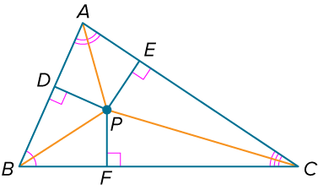
Learn
Angle Bisectors of Triangles
Theorem 6.6: Incenter Theorem
Words | The angle bisectors of a triangle intersect at a point called the incenter that is equidistant from the sides of the triangle.
Example | If P is the incenter of △ABC, then PD = PE = PF.

Slide 20
Learn
Angle Bisectors of Triangles
Talk About It!
Determine whether the statement is sometimes, always, or never true. Justify your argument.
The angle bisectors of a triangle intersect at a point that is equidistant from the vertices of the triangle.

Slide 21
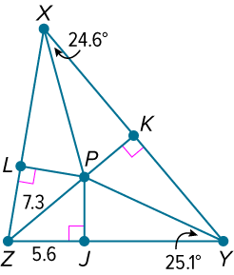
Example 3
Use the Incenter Theorem
P is the incenter of △XYZ. Find each measure.
a. PK
b. m∠LZP

Slide 22
Example 3
Use the Incenter Theorem
a. PK
P is the incenter of △XYZ, so by the Incenter Theorem, P is equidistant from the sides of the triangle. Therefore, PK = PJ. Find PJ by using the Pythagorean Theorem.

Slide 23
Example 3
Use the Incenter Theorem
a² + b² | = c² | Pythagorean Theorem
PJ² + 5.6² | = 7.3² | Substitution
PJ² | = 21.93 | Simplify and subtract.
PJ | ≈ 4.7 | Take the positive square root.
Because PK = PJ, PK ≈ 4.7.

Slide 24
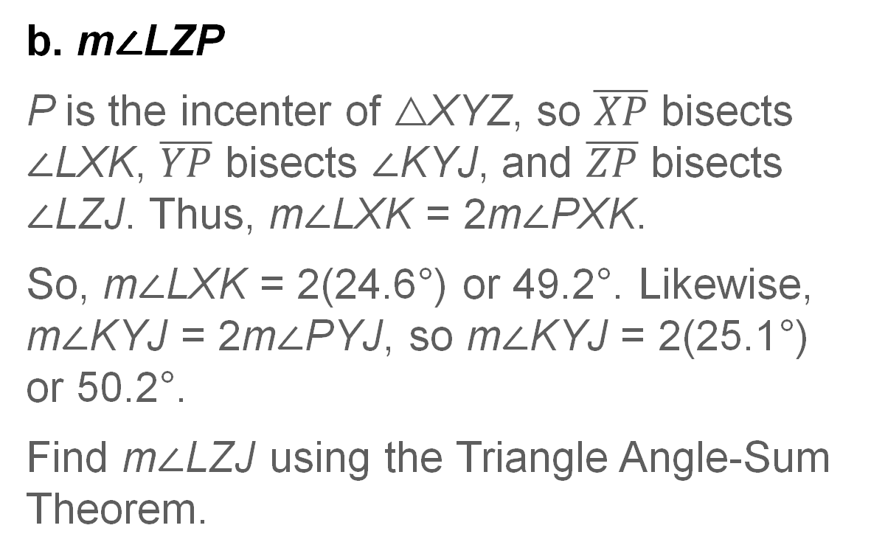
Example 3
Use the Incenter Theorem
b. m∠LZP
P is the incenter of △XYZ, so $\overline{XP}$ bisects ∠LXK, $\overline{YP}$ bisects ∠KYJ, and $\overline{ZP}$ bisects ∠LZJ. Thus, m∠LXK = 2m∠PXK.
So, m∠LXK = 2(24.6°) or 49.2°. Likewise, m∠KYJ = 2m∠PYJ, so m∠KYJ = 2(25.1°) or 50.2°.
Find m∠LZJ using the Triangle Angle-Sum Theorem.

Slide 25
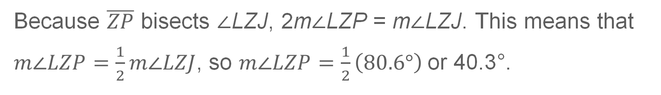
Example 3
Use the Incenter Theorem
m∠LXK + m∠KYJ + m∠LZJ | = 180° | Triangle Angle-Sum Theorem
49.2° + 50.2° + m∠LZJ | = 180° | Substitution
m∠LZJ | = 80.6° | Simplify.
Because $\overline{ZP}$ bisects ∠LZJ, 2m∠LZP = m∠LZJ. This means that
$m∠LZP=\frac{1}{2}m∠LZJ$, so $m∠LZP=\frac{1}{2}\left(80.6°\right)$or 40.3°.

Slide 26
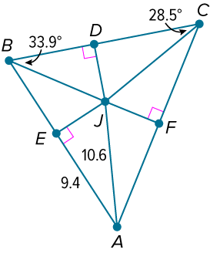
Example 3
Use the Incenter Theorem
Check
Find each measure if J is the incenter of △ABC.
a. JF
b. m∠JAC

Slide 27
Example 3
Use the Incenter Theorem
Check
Find each measure if J is the incenter of △ABC.
a. JF ≈ 4.9
b. m∠JAC = 27.6°
Notes:
≈ 4.9
= 27.6°

Slide 28
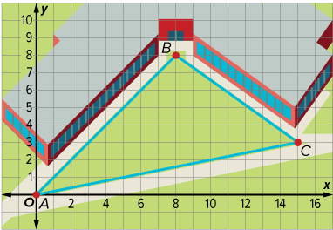
Example 4
Use Angle Bisectors in Design Problems
COURTYARD A new art sculpture will be placed in the courtyard of a high school. The entrances to the courtyard are located at points A, B, and C. Find the location of the center of the sculpture so that it is equidistant from the sides of the courtyard.

Slide 29
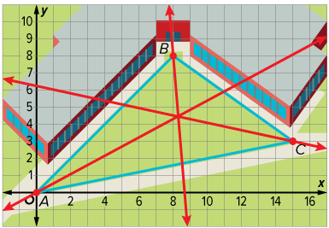
Example 4
Use Angle Bisectors in Design Problems
The incenter of a triangle is equidistant from the sides of the triangle. Use a compass and straightedge or dynamic geometry software to construct the angle bisectors of △ABC. Find the intersection point of the angle bisectors to determine where the center of the sculpture should be located.
The intersection of the angle bisectors appears to be at about (8.3, 4.4). So, the center of the sculpture should be located at (8.3, 4.4).

Slide 30
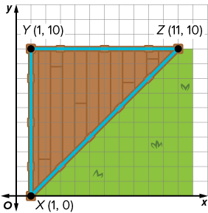
Example 4
Use Angle Bisectors in Design Problems
Check
HOME IMPROVEMENT Tyrice’s parents want to install a hot tub on the back deck of their house. The vertices of the deck are located at points X, Y, and Z. Find the location of the center of the hot tub so it is equidistant from the edges of the deck. If necessary, round your answer to the nearest whole number.

Slide 31
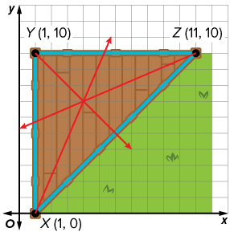
Example 4
Use Angle Bisectors in Design Problems
Check
HOME IMPROVEMENT Tyrice’s parents want to install a hot tub on the back deck of their house. The vertices of the deck are located at points X, Y, and Z. Find the location of the center of the hot tub so it is equidistant from the edges of the deck. If necessary, round your answer to the nearest whole number. (4, 7)
Notes:
(4, 7)

Slide 32
Exit Ticket
Complete each sentence with the correct word or phrase.
1. The point of concurrency of the angle bisectors of a triangle is called the ?.
This point is equidistant from each ?.
2. The point of concurrency of the perpendicular bisectors of a triangle is called the ?.
This point is equidistant from each ?.

Slide 33
Exit Ticket
3. Complete the table to show where the points of concurrency lie in each type of triangle.
Triangle | Circumcenter | Incenter
acute
obtuse
right

Slide 34
Exit Ticket
Complete each sentence with the correct word or phrase.
1. The point of concurrency of the angle bisectors of a triangle is called the ?. incenter
This point is equidistant from each ?. side of the triangle
2. The point of concurrency of the perpendicular bisectors of a triangle is called the ?. circumcenter
This point is equidistant from each ?. vertex
Notes:
incenter
side of the triangle
circumcenter
vertex

Slide 35
Exit Ticket
3. Complete the table to show where the points of concurrency lie in each type of triangle.
Triangle | Circumcenter | Incenter
acute | interior | interior
obtuse | exterior | interior
right | on | interior
Notes:
interior; interior
exterior; interior
on; interior

