Slide 1
Parallelograms

Slide 2
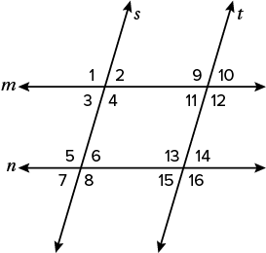
Warm Up
In the figure, parallel lines m and n are cut by transversals s and t. Write true or false.
1. ∠6 ≅ ∠1
2. ∠12 ≅ ∠13
3. ∠4 and ∠11 are supplementary.
In the figure, suppose lines m and n are parallel and that lines s and t are parallel. Write true or false.
4. ∠6 ≅ ∠15
5. ∠4 ≅ ∠13
6. ∠4 and ∠11 are supplementary.

Slide 3
Warm Up
In the figure, parallel lines m and n are cut by transversals s and t. Write true or false.
1. ∠6 ≅ ∠1 false
2. ∠12 ≅ ∠13 true
3. ∠4 and ∠11 are supplementary. false
In the figure, suppose lines m and n are parallel and that lines s and t are parallel. Write true or false.
4. ∠6 ≅ ∠15 true
5. ∠4 ≅ ∠13 true
6. ∠4 and ∠11 are supplementary. true
Notes:
1. false
2. true
3. false
4. true
5. true
6. true

Slide 4
Florida’s B.E.S.T. Standards for Mathematics
MA.912.GR.1.4
Prove relationships and theorems about parallelograms. Solve mathematical and real-world problems involving postulates, relationships and theorems of parallelograms.
MA.912.GR.3.3
Use coordinate geometry to solve mathematical and real-world geometric problems involving lines, circles, triangles and quadrilaterals.

Slide 5
Florida’s Mathematical Thinking and Reasoning Standards
MA.K12.MTR.4.1
Engage in discussions that reflect on the mathematical thinking of self and others.
MA.K12.MTR.5.1
Use patterns and structure to help understand and connect mathematical concepts.

Slide 6
Lesson Objectives
Content Objective
Students apply and prove theorems about the properties of parallelograms.
Language Objectives
Students talk about applying and proving theorems about the properties of parallelograms using complex sentences with connecting words such as so and because.
To maximize linguistic and cognitive meta-awareness, students participate in MLR7: Compare and Connect.

Slide 7
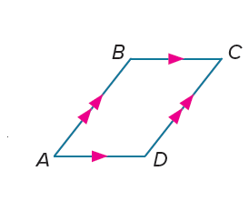
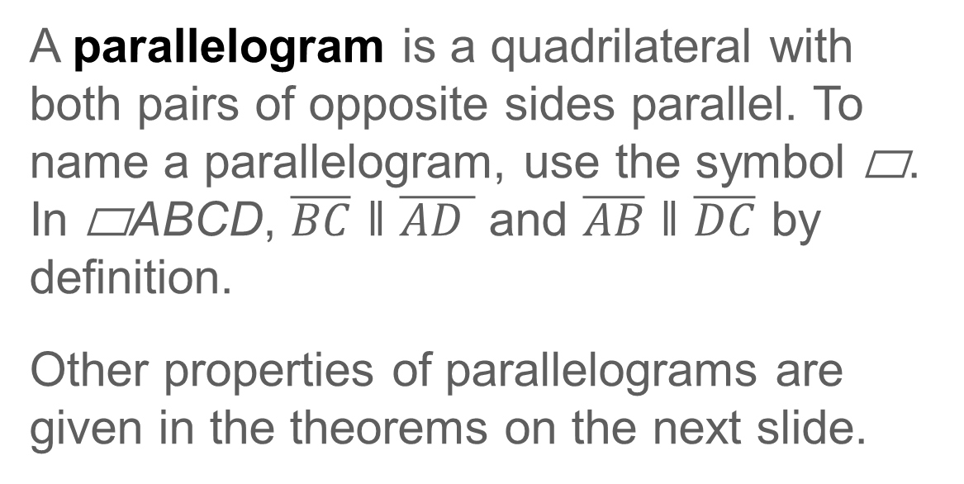
Learn
Parallelograms
A parallelogram is a quadrilateral with both pairs of opposite sides parallel. To name a parallelogram, use the symbol ▭. In ▭ABCD, $\overline{BC}$ ǁ $\overline{AD }$ and $\overline{AB}$ ǁ $\overline{DC}$ by definition.
Other properties of parallelograms are given in the theorems on the next slide.

Slide 8
Learn
Parallelograms
Theorems: Properties of Parallelograms
Theorem 7.3
If a quadrilateral is a parallelogram, then its opposite sides are congruent.
Theorem 7.4
If a quadrilateral is a parallelogram, then its opposite angles are congruent.
Theorem 7.5
If a quadrilateral is a parallelogram, then its consecutive angles are supplementary.
Theorem 7.6
If a parallelogram has one right angle, then it has four right angles.

Slide 9
Learn
Parallelograms
Talk About It!
Thiago states that because all parallelograms are quadrilaterals, all quadrilaterals are parallelograms. Do you agree? Justify your answer.

Slide 10
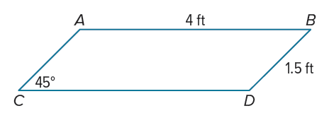
Example 1
Use Properties of Parallelograms
Given ▭ ABDC, find CD.

Slide 11
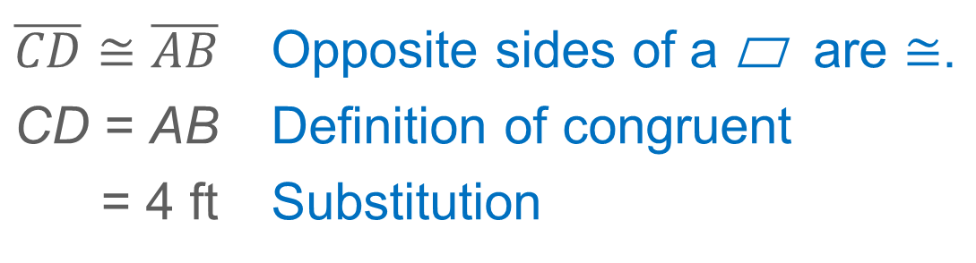
Example 1
Use Properties of Parallelograms
$$\overline{CD}≅\overline{AB}$$ | Opposite sides of a ▭ are $≅$.
CD = AB | Definition of congruent
= 4 ft | Substitution

Slide 12
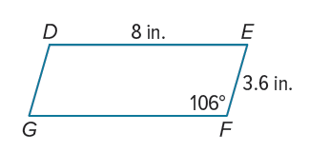
Example 1
Use Properties of Parallelograms
Check
Given ▭DEFG, find each measure.
a. m∠D
b. FG

Slide 13
Example 1
Use Properties of Parallelograms
Check
Given ▭DEFG, find each measure.
a. m∠D 106°
b. FG 8 in.
Notes:
106°
8 in.

Slide 14
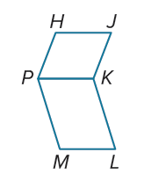
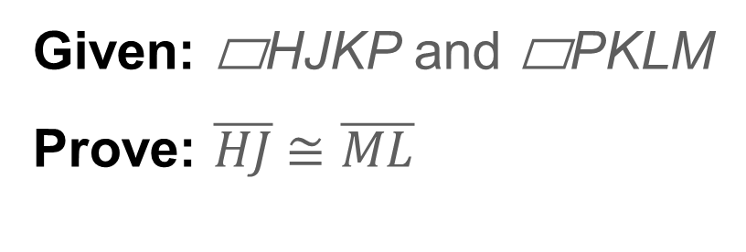
Example 2
Proofs Using the Properties of Parallelograms
Write a two-column proof.
Given: ▭HJKP and ▭PKLM
Prove: $\overline{HJ}$≅ $\overline{ML}$

Slide 15
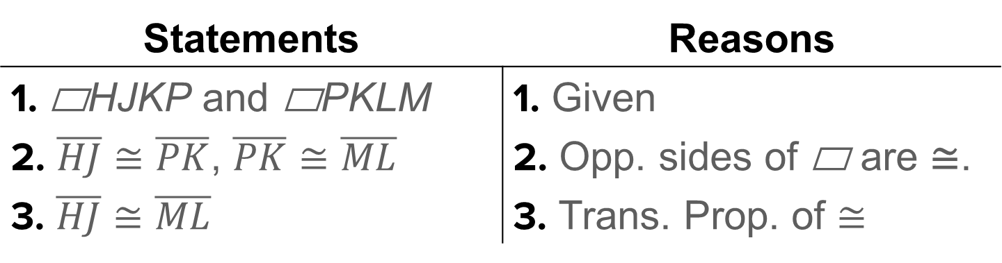
Example 2
Proofs Using the Properties of Parallelograms
Statements | Reasons
1. ▭HJKP and ▭PKLM | 1. Given
2. $\overline{HJ}$ ≅ $\overline{PK}$, $\overline{PK}$ ≅ $\overline{ML}$ | 2. Opp. sides of ▭ are ≅.
3. $\overline{HJ}$ ≅ $\overline{ML}$ | 3. Trans. Prop. of ≅

Slide 16
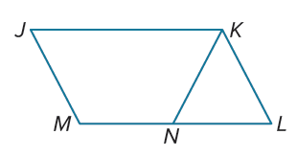

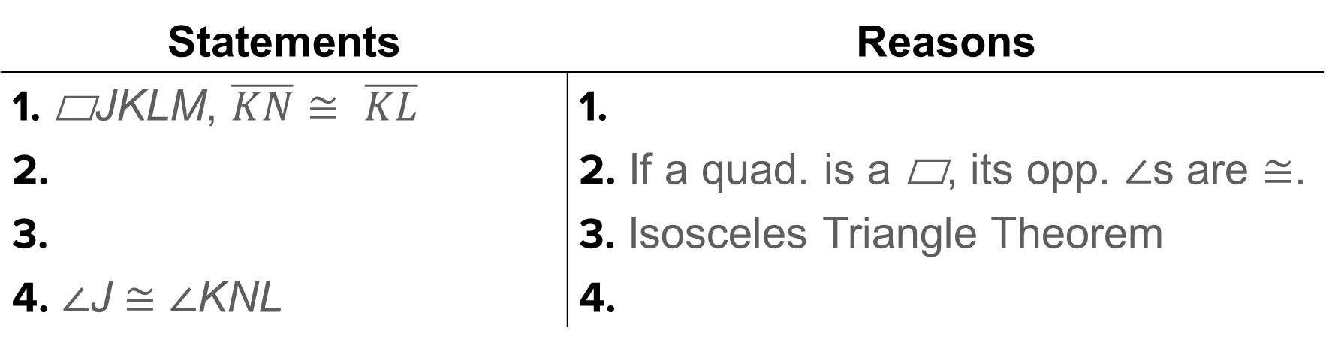
Example 2
Proofs Using the Properties of Parallelograms
Check
Complete the two-column proof.
Given: ▭JKLM, $\overline{KN}$ ≅ $\overline{KL}$
Prove: ∠J ≅ ∠KNL
Statements | Reasons
1. ▭JKLM, $\overline{KN}$ ≅ $\overline{KL}$ | 1.
2. | 2. If a quad. is a ▭, its opp. ∠s are ≅.
3. | 3. Isosceles Triangle Theorem
4. ∠J ≅ ∠KNL | 4.

Slide 17
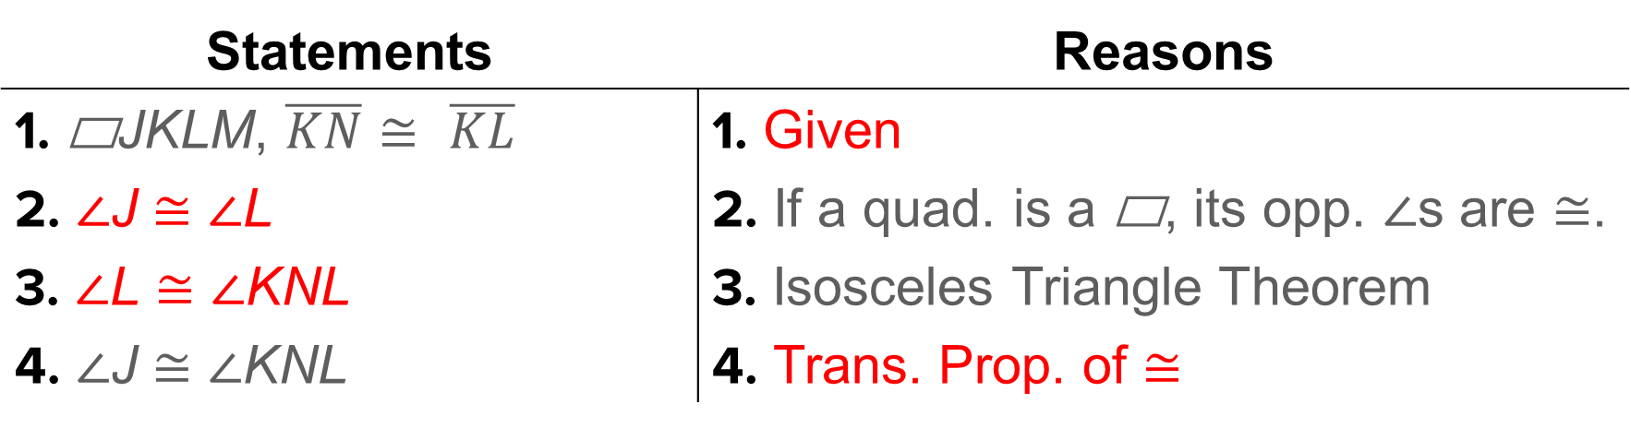
Example 2
Proofs Using the Properties of Parallelograms
Check
Complete the two-column proof.
Given: ▭JKLM, $\overline{KN}$ ≅ $\overline{KL}$
Prove: ∠J ≅ ∠KNL
Statements | Reasons
1. ▭JKLM, $\overline{KN}$ ≅ $\overline{KL}$ | 1. Given
2. ∠J ≅ ∠L | 2. If a quad. is a ▭, its opp. ∠s are ≅.
3. ∠L ≅ ∠KNL | 3. Isosceles Triangle Theorem
4. ∠J ≅ ∠KNL | 4. Trans. Prop. of ≅
Notes:
Statements
2. ∠J ≅ ∠L
3. ∠L ≅ ∠KNL
Reasons
1. Given
4. Trans. Prop. of ≅

Slide 18
Learn
Diagonals of Parallelograms
The diagonals of parallelograms have special properties.
Theorems: Diagonals of Parallelograms
Theorem 7.7
If a quadrilateral is a parallelogram, then its diagonals bisect each other.
Theorem 7.8
If a quadrilateral is a parallelogram, then each diagonal separates the parallelogram into two congruent triangles.

Slide 19
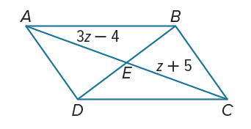
Example 3
Use Properties of Parallelograms and Algebra
Find the values of x and z in ▭ABCD if m∠ADC = 4x° and m∠DAB = (2x − 6)°.
Part A Find the value of x.
Part B Find the value of z.

Slide 20
Example 3
Use Properties of Parallelograms and Algebra
Part A Find the value of x.
180° = m∠ADC + m∠DAB | Consec. ∠s in a ▭ are supplementary.
180° = 4x° + (2x − 6)° | Substitution
x = 31 | Solve.

Slide 21
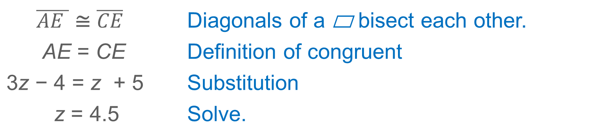
Example 3
Use Properties of Parallelograms and Algebra
Part B Find the value of z.
$\overline{AE }$ ≅ $\overline{CE}$ | Diagonals of a ▭ bisect each other.
AE = CE | Definition of congruent
3z − 4 = z + 5 | Substitution
z = 4.5 | Solve.

Slide 22
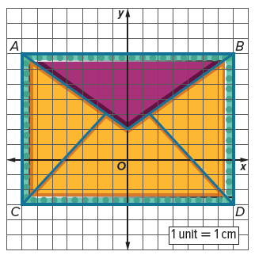
Example 4
Parallelograms and Coordinate Geometry
SCRAPBOOKING Tomas is making envelopes to sell with handmade cards. He uses a different style of paper to create the flap of the envelope, and he edges the envelopes with washi tape. The envelopes are parallelograms, and the edges of the flaps lie along the diagonals of the parallelograms. Find the area of the flap and the perimeter of the envelope.
Part A Find the amount of paper needed to create the flap.
Part B Find the length of washi tape needed to create the border.

Slide 23
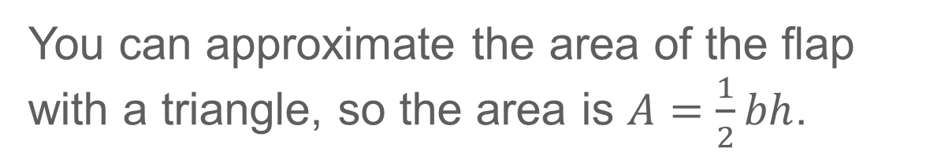
Example 4
Parallelograms and Coordinate Geometry
Part A Find the amount of paper needed to create the flap.
You can approximate the area of the flap with a triangle, so the area is $A=\frac{1}{2}bh$.

Slide 24
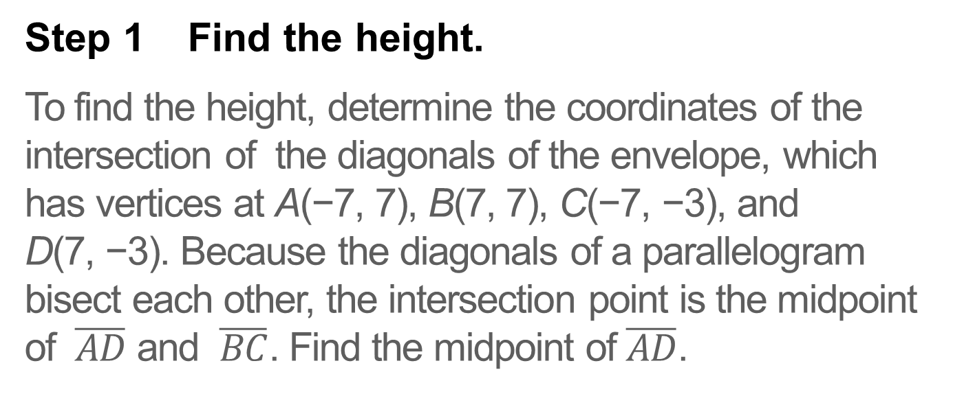
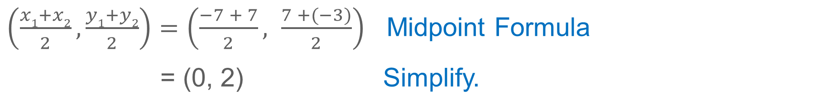
Example 4
Parallelograms and Coordinate Geometry
Step 1 Find the height.
To find the height, determine the coordinates of the intersection of the diagonals of the envelope, which has vertices at A(−7, 7), B(7, 7), C(−7, −3), and D(7, −3). Because the diagonals of a parallelogram bisect each other, the intersection point is the midpoint of $\overline{AD}$ and $\overline{BC}$. Find the midpoint of $\overline{AD}$.
$\left(\frac{x1+x2}{2}, \frac{y1+y2}{2}\right)=\left(\frac{−7 + 7}{2}, \frac{7 +(−3)}{2}\right)$ Midpoint Formula
= (0, 2) Simplify.

Slide 25
Example 4
Parallelograms and Coordinate Geometry
The height is the difference in the y-coordinates of the intersection of the diagonals and the vertices of the top edge of the envelope.
h = 7 − 2 or 5 cm
Step 2 Find the base.
The base of the flap is the length of the top edge of the envelope. You can count the units to determine the base.
b = 14 cm

Slide 26
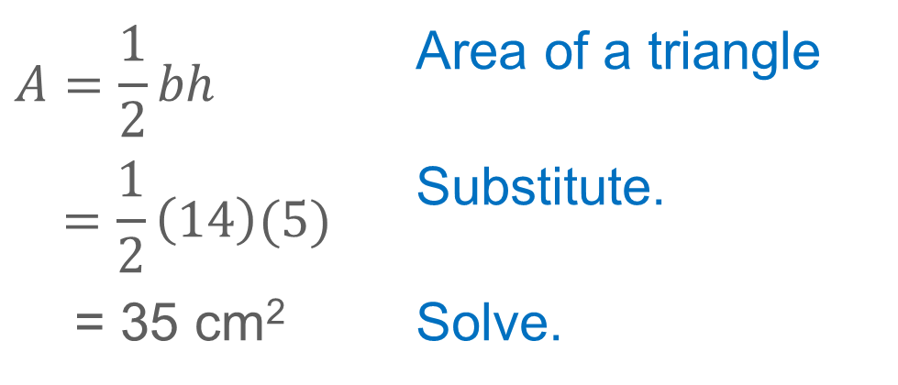
Example 4
Parallelograms and Coordinate Geometry
Step 3 Find the area of the flap.
$$A=\frac{1}{2}bh$$ | Area of a triangle
$$=\frac{1}{2}\left(14\right)(5)$$ | Substitute.
= 35 cm² | Solve.

Slide 27
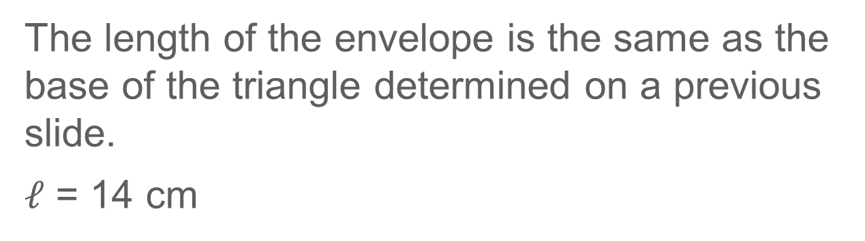
Example 4
Parallelograms and Coordinate Geometry
Part B Find the length of washi tape needed to create the border.
Step 1 Find the length.
The length of the envelope is the same as the base of the triangle determined on a previous slide.
$ℓ$ = 14 cm

Slide 28
Example 4
Parallelograms and Coordinate Geometry
Step 2 Find the width.
The width of the envelope is the distance between the top edge and the bottom edge of the envelope.
w = 7 − (−3) = 10 cm

Slide 29
Example 4
Parallelograms and Coordinate Geometry
Step 3 Find the perimeter.
Because the envelope is a parallelogram, opposite sides are congruent. So, the perimeter is given by P = 2ℓ + 2w.
P = 2ℓ + 2w | Perimeter formula
= 2(14) + 2(10) | Substitute.
= 48 cm | Solve.

Slide 30
Example 4
Parallelograms and Coordinate Geometry
Think About It!
What assumptions did you make when calculating the area of the paper and the length of washi tape?

Slide 31
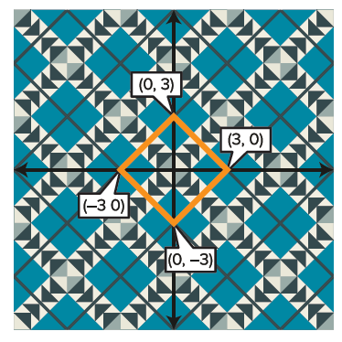
Example 4
Parallelograms and Coordinate Geometry
Check
QUILTING Jimena is making a quilt. Each block is a parallelogram made of a single piece of patterned fabric and is trimmed with a gray border. Find the area of the fabric used to make the block. Find the length of fabric used to make the border of the block. Round to the nearest tenth if necessary.

Slide 32
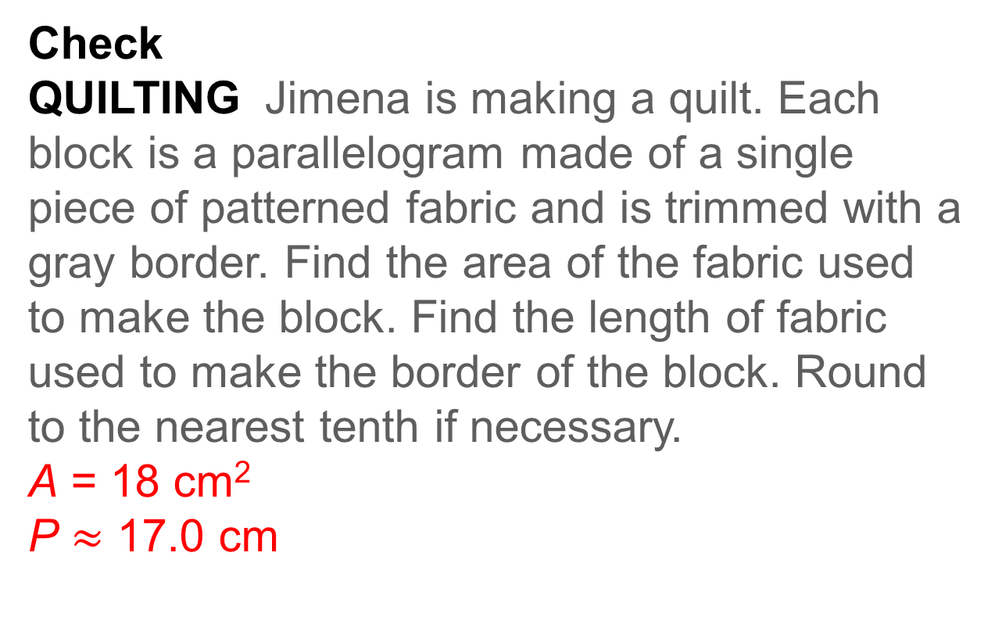
Example 4
Parallelograms and Coordinate Geometry
Check
QUILTING Jimena is making a quilt. Each block is a parallelogram made of a single piece of patterned fabric and is trimmed with a gray border. Find the area of the fabric used to make the block. Find the length of fabric used to make the border of the block. Round to the nearest tenth if necessary.
A = 18 cm²
P $≈$ 17.0 cm
Notes:
A = 18 cm²
P $≈$ 17.0 cm

Slide 33
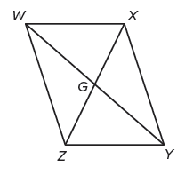
Exit Ticket
Use parallelogram WXYZ to find each measure.
1. If WZ = 12, what is XY?
2. If WY = 14, what is GY?
3. If m∠XWZ = 82°, what is m∠ZYX?
4. If m∠WZY = 112°, what is m∠XYZ?

Slide 34
Exit Ticket
Use parallelogram WXYZ to find each measure.
1. If WZ = 12, what is XY? 12
2. If WY = 14, what is GY? 7
3. If m∠XWZ = 82°, what is m∠ZYX? 82°
4. If m∠WZY = 112°, what is m∠XYZ? 68°
Notes:
12
7
3. 82°
4. 68°

