Slide 1
6-6 The Triangle Inequality

Slide 2
Warm Up
Solve each inequality.
1. −3 ≤ 5x + 7 < 2
2. x − 6 < 12 and x + 2 > 4
3. 1 < 3x + 1 < 13
4. 3(x − 3) > −3 or −8x ≥ 24
5. SCIENCE The temperature in a mixture in a chemical experiment must be between 18°C and 25°C. Write a compound inequality to show the required temperatures.

Slide 3
Warm Up
Solve each inequality.
1. −3 ≤ 5x + 7 < 2 −2 ≤ x < −1
2. x − 6 < 12 and x + 2 > 4 2 < x < 18
3. 1 < 3x + 1 < 13 0 < x < 4
4. 3(x − 3) > −3 or −8x ≥ 24 x > 2 or x ≤ −3
5. SCIENCE The temperature in a mixture in a chemical experiment must be between 18°C and 25°C. Write a compound inequality to show the required temperatures. 18 < x < 25
Notes:
−2 ≤ x < −1
2 < x < 18
0 < x < 4
x > 2 or x ≤ −3
18 < x < 25

Slide 4
Florida’s B.E.S.T. Standards for Mathematics
MA.912.GR.1.3 Prove relationships and theorems about triangles. Solve mathematical and real-world problems involving postulates, relationships and theorems of triangles.

Slide 5
Florida’s Mathematical Thinking and Reasoning Standards
MA.K12.MTR.3.1
Complete tasks with mathematical fluency.

Slide 6
Lesson Objectives
Content Objective
Students prove and apply the Triangle Inequality Theorem.
Language Objectives
Students explain how to prove and apply the Triangle Inequality Theorem using If…, then… statements.
To optimize output, students participate in MLR7: Compare and Connect.

Slide 7
Learn
The Triangle Inequality
In order for three segments to form a triangle, a special relationship must exist among their lengths.
Theorem 6.11: Triangle Inequality Theorem
The sum of the lengths of any two sides of a triangle must be greater than the length of the third side.

Slide 8
Example 1
Identify Possible Triangles Given Side Lengths
Is it possible to form a triangle with the given side lengths? If not, explain why not.
a. 9 cm, 12 cm, 18 cm
b. 3 in., 5 in., 8 in.

Slide 9
Example 1
Identify Possible Triangles Given Side Lengths
a. 9 cm, 12 cm, 18 cm
Check each inequality.
9 + 12 > 18 12 + 18 > 9 9 + 18 > 12
Because the sum of each pair of side lengths is greater than the third side length, sides with lengths 9, 12, and 18 centimeters will form a triangle.

Slide 10
Example 1
Identify Possible Triangles Given Side Lengths
b. 3 in., 5 in., 8 in.
3 + 5 ≯ 8
Because the sum of one pair of side lengths is not greater than the third side length, sides with lengths 3, 5, and 8 inches will not form a triangle.

Slide 11
Example 1
Identify Possible Triangles Given Side Lengths
Talk About It!
How can you eliminate triangle side length possibilities by looking at only one inequality?

Slide 12
Example 1
Identify Possible Triangles Given Side Lengths
Check
Is it possible to form a triangle with the given side lengths? If not, explain why not.
a. 2 mm, 5 mm, 6 mm
b. 3 yd, 4 yd, 8 yd

Slide 13
Example 1
Identify Possible Triangles Given Side Lengths
Check
Is it possible to form a triangle with the given side lengths? If not, explain why not.
a. 2 mm, 5 mm, 6 mm yes
b. 3 yd, 4 yd, 8 yd
No; because 3 + 4 ≯ 8, the side lengths will not form a triangle.
Notes:
yes
No; because 3 + 4 ≯ 8, the side lengths will not form a triangle.

Slide 14
Example 2
Find Possible Side Lengths
When the lengths of two sides of a triangle are known, the third side can be any length in a range of values.
DRONES A delivery company uses drones to make speedy deliveries around the city. A drone leaves the home office and flies 8 miles east to its first delivery and then 4 more miles southwest to a second delivery. What is the least possible whole-number distance the drone will fly to return to the home office?

Slide 15
Example 2
Find Possible Side Lengths
Let x represent the length of the third side of a triangle with sides that measure 8 miles and 4 miles. Set up and solve each of the three triangle inequalities.
The least whole-number value between 4 and 12 is 5. The drone has to fly at least 5 miles to the home office after the two deliveries.
4 + 8 | > x | 4 + x | > 8 | x + 8 | > 4
12 | > x | x | > 4 | x | > −4

Slide 16
Example 2
Find Possible Side Lengths
Think About It!
What is the greatest possible whole-number measure for the third side?

Slide 17
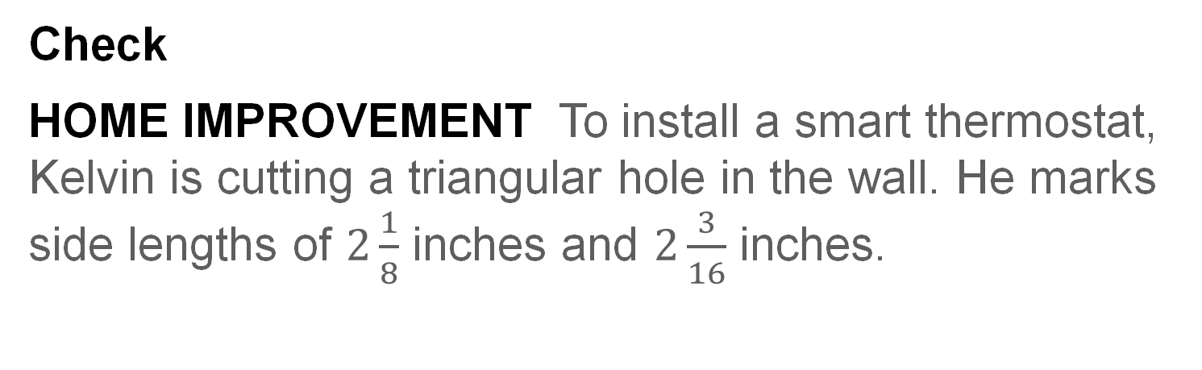
Example 2
Find Possible Side Lengths
Check
HOME IMPROVEMENT To install a smart thermostat, Kelvin is cutting a triangular hole in the wall. He marks side lengths of $2\frac{1}{8}$ inches and $2\frac{3}{16}$ inches.

Slide 18
Example 2
Find Possible Side Lengths
Part A Which assumption do you need to make to determine the range for the measure of the third side of the hole?
A. The triangular hole is not equiangular.
B. The smart thermostat requires a triangular hole.
C. Kelvin measured the side lengths accurately.
D. Two sides of the hole are longer than the third side.
Part B What is the possible range for the third side length?

Slide 19
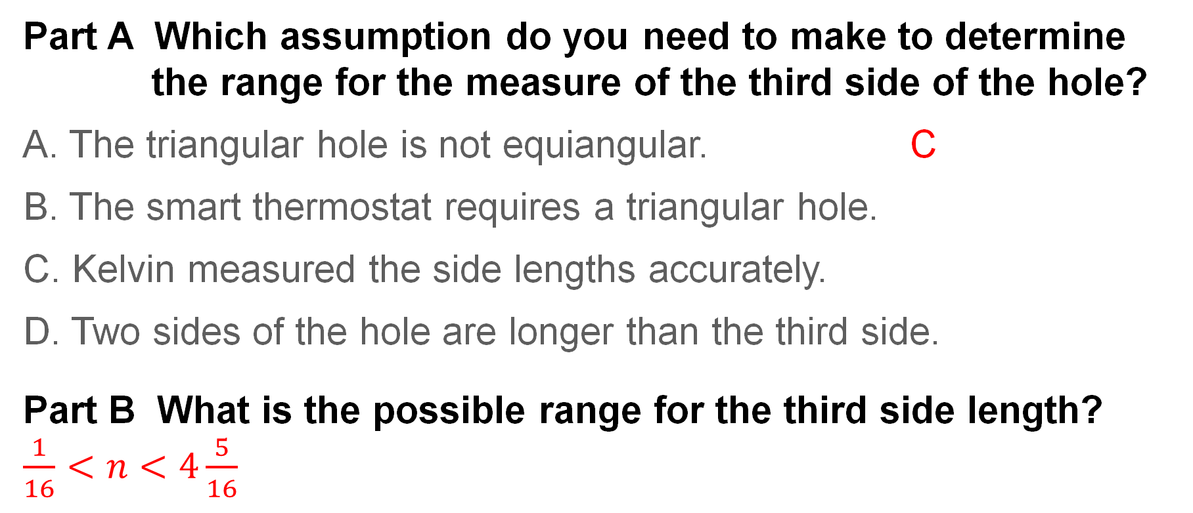
Example 2
Find Possible Side Lengths
Part A Which assumption do you need to make to determine the range for the measure of the third side of the hole?
A. The triangular hole is not equiangular. C
B. The smart thermostat requires a triangular hole.
C. Kelvin measured the side lengths accurately.
D. Two sides of the hole are longer than the third side.
Part B What is the possible range for the third side length?
$\frac{1}{16}<n<4\frac{5}{16}$
Notes:
C
$\frac{1}{16}<n<4\frac{5}{16}$

Slide 20
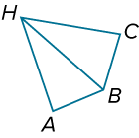
Example 3
Use the Triangle Inequality Theorem
△HAB and △HCB share side HB, and HC = HB. Prove that HA + AB > HC.

Slide 21
Example 3
Use the Triangle Inequality Theorem
Given: HC = HB
Prove: HA + AB > HC
Proof:
Statements | Reasons
1. HC = HB 2. HA + AB > HB 3. HA + AB > HC | 1. Given 2. Triangle Inequality Theorem 3. Substitution

Slide 22
Exit Ticket
The coordinates of the vertices of △XYZ are given. List the angles in order from least to greatest measure.
1. X(1, 3), Y(1, 8), Z(13, 8)
2. X(−3, −4), Y(−1, −9), Z(3, −3)

Slide 23
Exit Ticket
Suppose a stick 8 inches long is broken into three pieces, and the length of each piece is an integer measure.
3. What are the possible lengths of the three pieces?
4. What are the lengths of the three pieces that can actually form a triangle?

Slide 24
Exit Ticket
The coordinates of the vertices of △XYZ are given. List the angles in order from least to greatest measure.
1. X(1, 3), Y(1, 8), Z(13, 8) ∠Z, ∠X, ∠Y
2. X(−3, −4), Y(−1, −9), Z(3, −3) ∠Z, ∠Y, ∠X
Notes:
∠Z, ∠X, ∠Y
∠Z, ∠Y, ∠X

Slide 25
Exit Ticket
Suppose a stick 8 inches long is broken into three pieces, and the length of each piece is an integer measure.
3. What are the possible lengths of the three pieces?
1 in., 1 in., 6 in.; 1 in., 2 in., 5 in.; 1 in., 3 in., 4 in.; 2 in., 2 in., 4 in.; 2 in., 3 in., 3 in.
4. What are the lengths of the three pieces that can actually form a triangle?
2 in., 3 in., 3 in.
Notes:
1 in., 1 in., 6 in.; 1 in., 2 in., 5 in.; 1 in., 3 in., 4 in.; 2 in., 2 in., 4 in.; 2 in., 3 in., 3 in.
2 in., 3 in., 3 in.

