Slide 1
Section 2-4
Transformations in the Plane

Slide 2
Warm Up
Answer each question.
1. What is the area of a square with a side measure of
11 inches?
2. A rectangle has a perimeter of 60 feet and a length of 21 feet. What is the width of the rectangle?
3. A square has an area of 64 square meters. What is the length of its side?
4. A rectangle has a length of 12 centimeters and a width of
7.5 centimeters. What is the area of the rectangle?
5. A rectangle has an area of 120 square feet and a width of 3 feet. What is the length of the rectangle?

Slide 3
Florida’s B.E.S.T. Standards for Mathematics
MA.912.GR.2.2
Identify transformations that do or do not preserve distance.

Slide 4
Florida’s Mathematical Thinking and Reasoning Standards
MA.K12.MTR.2.1
Demonstrate understanding by representing problems in multiple ways.
MA.K12.MTR.4.1
Engage in discussions that reflect on the mathematical thinking of self and others.

Slide 5
Lesson Objectives
Content Objective
Students identify transformations and represent reflections, translations, and rotations.
Language Objectives
Students use both and each to talk about transformations in the plane.
To support conversation, students participate in MLR1: Stronger and Clearer Each Time.

Slide 6
Learn
Identifying Transformations
A transformation is a function that takes points in the plane as inputs and gives other points as outputs. In a transformation, the preimage is mapped onto the image. A rigid transformation, also called a congruence transformation or an isometry, is a transformation that preserves distance and angle measure.
The three main types of rigid transformations are shown on the next few slides. The preimage is shown in blue, and the image is shown in purple. Prime notation is used to indicate transformations. If A is the preimage, then A′ is the image after one transformation.

Slide 7
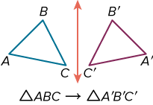
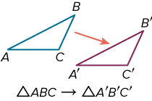
Learn
Identifying Transformations
Key Concept: Reflections, Translations, and Rotations
A reflection or flip is a transformation in a line called the line of reflection. Each point of the preimage and its image are the same distance from the line of reflection.
A translation or slide is a transformation that moves all points of the original figure the same distance in the same direction.

Slide 8
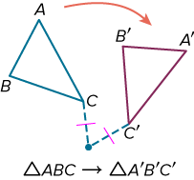
Learn
Identifying Transformations
Key Concept: Reflections, Translations, and Rotations
A rotation or turn is a transformation about a fixed point (called the center of rotation), through a specific angle, and in a specific direction. Each point of the original figure and its image are the same distance from the center.

Slide 9

Example 1
Identify Transformations in the Real World
HOBBIES Identify the type of rigid transformation shown in the photo as a reflection, translation, or rotation.

Slide 10
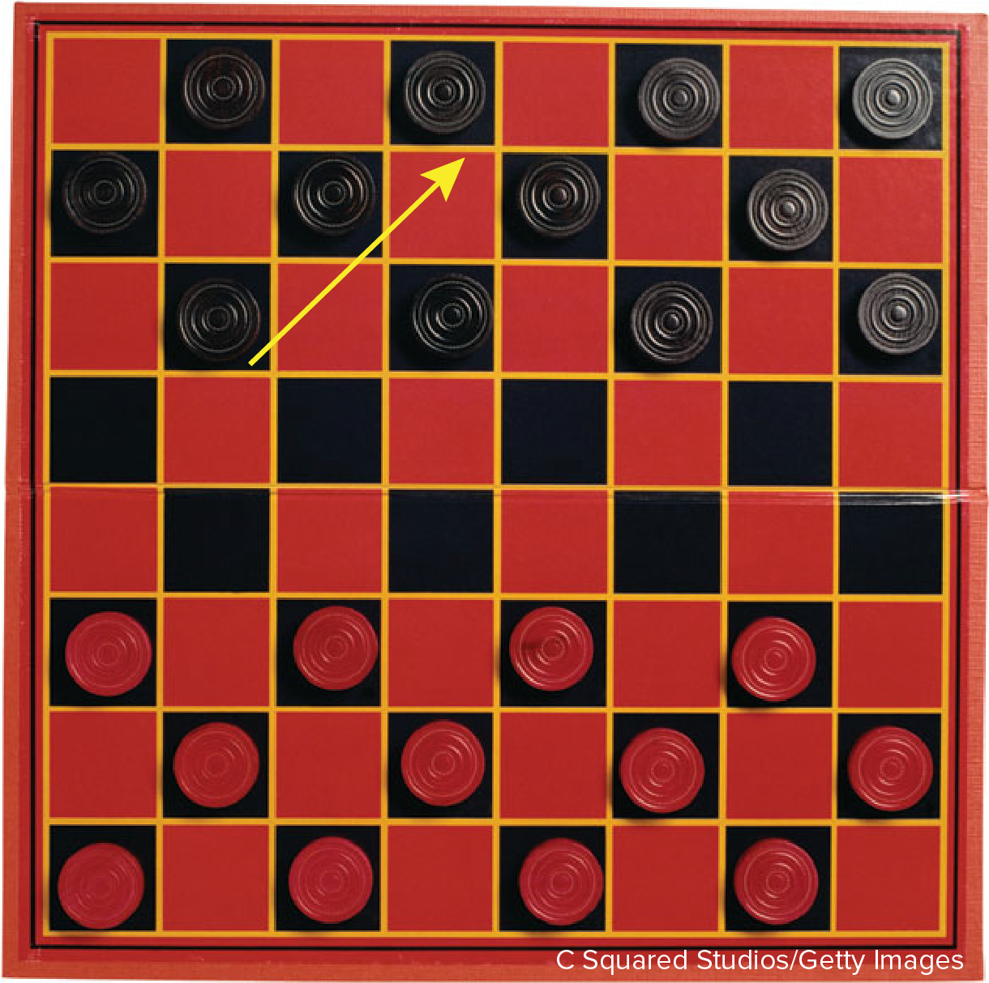
Example 1
Identify Transformations in the Real World
Check
CHECKERS In the game of checkers, players move their pieces on the diagonal. Identify the type of rigid transformation shown as a reflection, translation, or rotation.
.

Slide 11
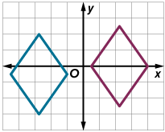
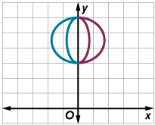
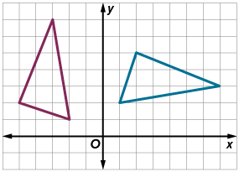
Example 2
Identify Transformations on the Coordinate Plane
Identify the type of rigid transformation shown as a reflection, translation, or rotation.
a. b. c.

Slide 12
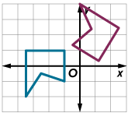
Example 2
Identify Transformations on the Coordinate Plane
Check
Which type of rigid transformation is shown?

Slide 13
Learn
Representing Reflections
In a reflection, each point of the preimage and its corresponding point on the image are the same distance from the line of reflection. The segment that connects a point on the preimage to its corresponding point on the image is perpendicular to the line of reflection.

Slide 14
Learn
Representing Reflections
A reflection can be described as a function in which the preimage is reflected in the line of reflection. The points of the preimage are the input, and the corresponding points on the image are the output. A coordinate rule uses symbols to describe how the coordinates of the points of the preimage change to create the coordinates of the corresponding points on the image.

Slide 15
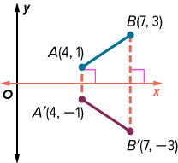
Learn
Representing Reflections
Key Concept: Reflections in the x- or y-axis
 | Words | Coordinate Rule | Example
Reflections in the x-axis | To reflect a point in the x-axis, multiply its y-coordinate by −1. | (x, y) → (x, −y)

Slide 16
Example 3
Reflection in the x- or y-Axis
Triangle ABC has coordinates A(3, 2), B(2, −2), and C(4, −5).
Part A Determine the coordinates of the vertices of the image after a reflection in the x-axis.
Part B Reflect △ABC in the y-axis. Determine the coordinates of the image.

Slide 17
Example 3
Reflection in the x- or y-Axis
Check
Triangle JKL has coordinates J(2, −8), K(6, −7), and L(4, −2). Determine the coordinates of the vertices of the image after a reflection in the x-axis.
A. J'(2, 8), K'(6, 7), L'(4, 2)
B. J'(−2, −8), K'(−6, −7), L'(−4, −2)
C. J'(−2, 8), K'(−6, 7), L'(−4, 2)
D. J'(2, −8), K'(6, −7), L'(4, −2)

Slide 18
Learn
Representing Translations
A translation is a function in which all of the points of a figure move the same distance in the same direction.
A preimage is translated along a translation vector. The translation vector describes the magnitude and direction of the slide if the magnitude is the length of the vector from its initial point to its terminal point.

Slide 19
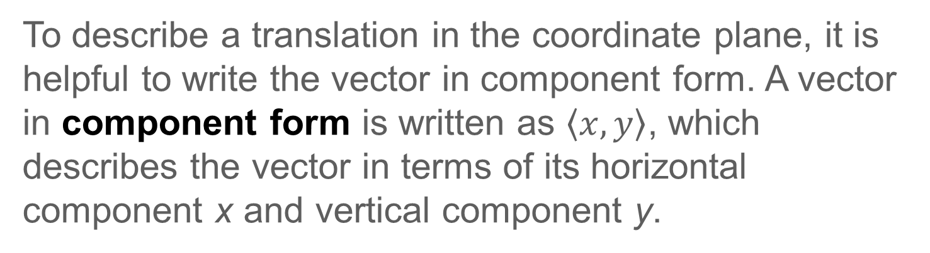
Learn
Representing Translations
To describe a translation in the coordinate plane, it is helpful to write the vector in component form. A vector in component form is written as $\left\langle x,y\right\rangle$, which describes the vector in terms of its horizontal component x and vertical component y.

Slide 20
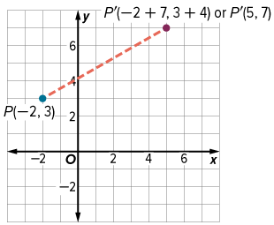
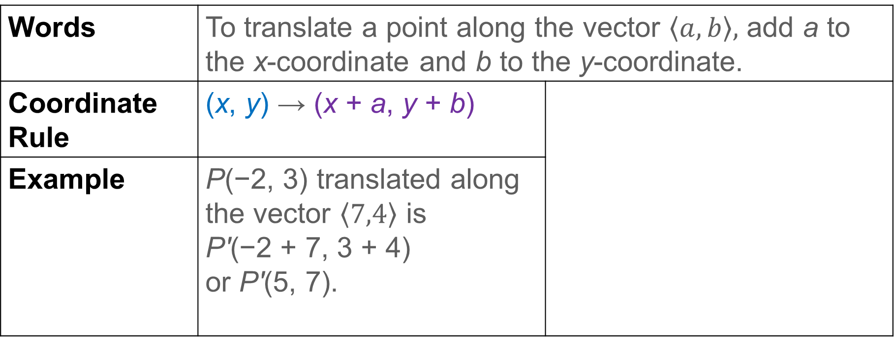
Learn
Representing Translations
Key Concept: Translations
Words | To translate a point along the vector $\left\langle a,b\right\rangle ,$ add a to the x-coordinate and b to the y-coordinate.
Coordinate Rule | (x, y) → (x + a, y + b)
Example | P(−2, 3) translated along the vector $\left\langle 7,4\right\rangle$ is P'(−2 + 7, 3 + 4) or P'(5, 7).

Slide 21
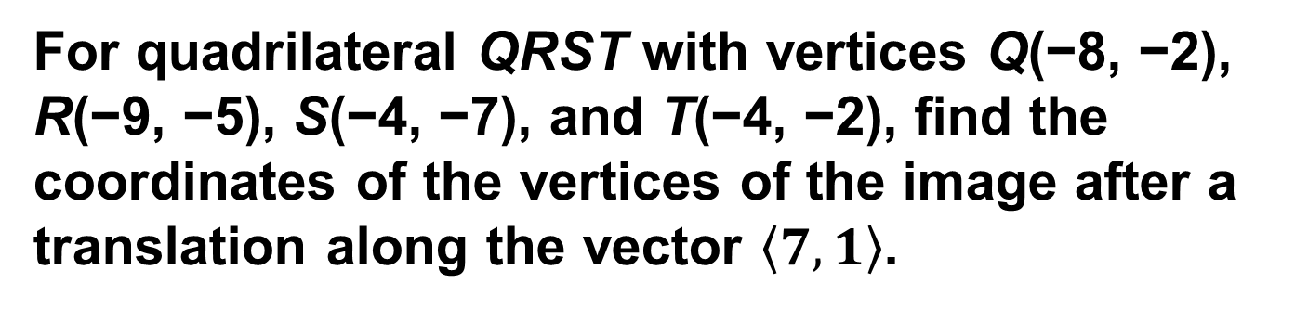
Example 4
Translations
For quadrilateral QRST with vertices Q(−8, −2), R(−9, −5), S(−4, −7), and T(−4, −2), find the coordinates of the vertices of the image after a translation along the vector $\left\langle 7,1\right\rangle$.

Slide 22
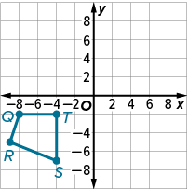
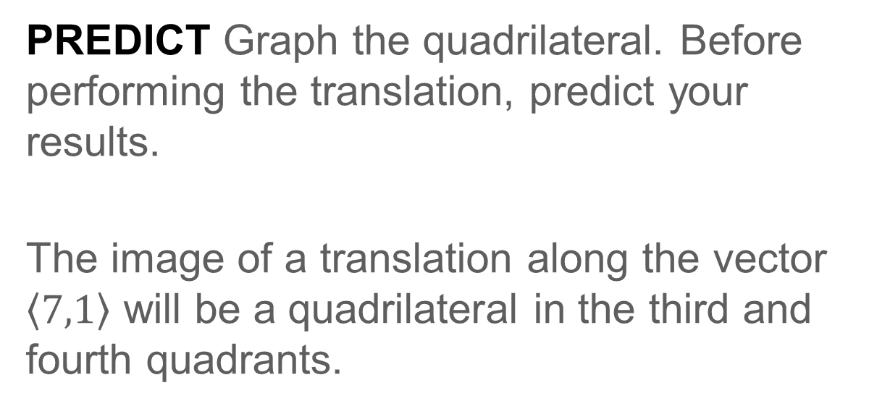
Example 4
Translations
PREDICT Graph the quadrilateral. Before performing the translation, predict your results.
The image of a translation along the vector $\left\langle 7,1\right\rangle$ will be a quadrilateral in the third and fourth quadrants.

Slide 23
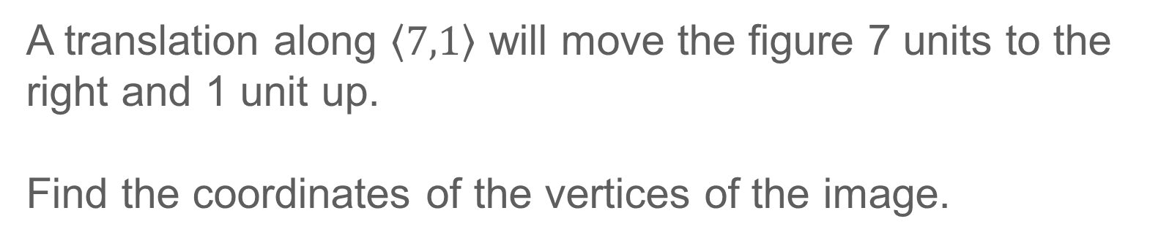
Example 4
Translations
A translation along $\left\langle 7,1\right\rangle$ will move the figure 7 units to the right and 1 unit up.
Find the coordinates of the vertices of the image.
(x, y) | → | (x + 7, y + 1)
Q(−8, −2) | → | Q'(−8 + 7, −2 + 1) or Q'(−1, −1)
R(−9, −5) | → | R'(−9 + 7, −5 + 1) or R'(−2, −4)
S(−4, −7) | → | S'(−4 + 7, −7 + 1) or S'(3, −6)
T(−4, −2) | → | T'(−4 + 7, −2 + 1) or T'(3, −1)
CHECK The image matches the prediction.

Slide 24
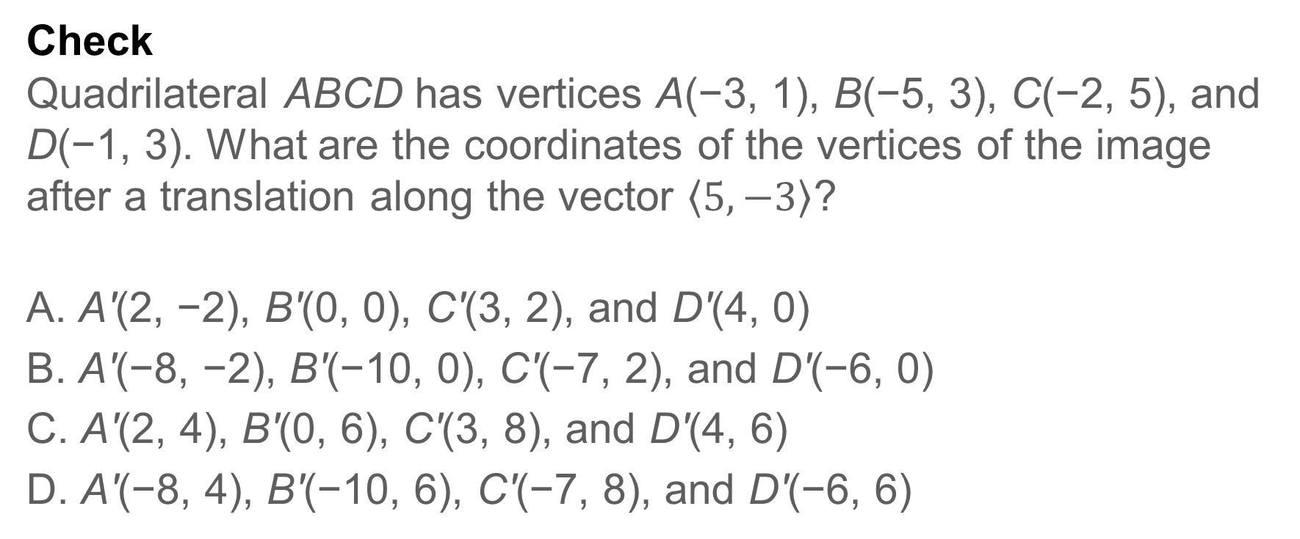
Example 4
Translations
Check
Quadrilateral ABCD has vertices A(−3, 1), B(−5, 3), C(−2, 5), and D(−1, 3). What are the coordinates of the vertices of the image after a translation along the vector $\left\langle 5,−3\right\rangle$?
A. A'(2, −2), B'(0, 0), C'(3, 2), and D'(4, 0)
B. A'(−8, −2), B'(−10, 0), C'(−7, 2), and D'(−6, 0)
C. A'(2, 4), B'(0, 6), C'(3, 8), and D'(4, 6)
D. A'(−8, 4), B'(−10, 6), C'(−7, 8), and D'(−6, 6)

Slide 25
Learn
Representing Rotations
A rotation is a function that moves every point of a preimage through a specified angle and direction about a fixed point, called the center of rotation. Under a rotation, each point and its image are the same distance from the center of rotation. In this lesson, you can assume that the origin is the center of rotation. The specified angle is called the angle of rotation.

Slide 26

Learn
Representing Rotations
The direction of a rotation can be clockwise or counterclockwise. In this course, you can assume that all rotations are counterclockwise unless stated otherwise.
When a point is rotated 90°, 180°, or 270° counterclockwise about the origin, you can use the following rules. A rotation of 360° will map the image onto the preimage.

Slide 27
Learn
Representing Rotations
Talk About It!
Would two successive 90° rotations counterclockwise about the origin result in the same image as a 180° rotation clockwise about the origin? Explain.

Slide 28
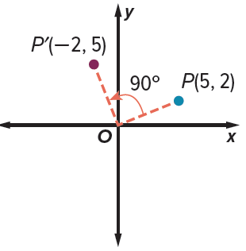
Learn
Representing Rotations
Key Concept: Rotations in the Coordinate Plane
90° Counterclockwise Rotation To rotate a point 90° counterclockwise about the origin, multiply the y-coordinate by −1 and then interchange the x- and y-coordinates. Coordinate Rule (x, y) → (−y, x) | Example

Slide 29
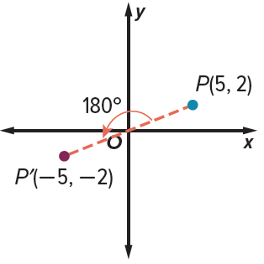
Learn
Representing Rotations
180° Counterclockwise Rotation To rotate a point 180° counterclockwise about the origin, multiply the x- and y-coordinates by −1. Coordinate Rule (x, y) → (−x, −y) | Example

Slide 30
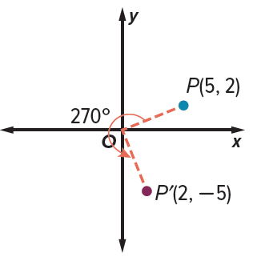
Learn
Representing Rotations
270° Counterclockwise Rotation To rotate a point 270° counterclockwise about the origin, multiply the x-coordinate by −1 and then interchange the x- and y-coordinates. Coordinate Rule (x, y) → (y, −x) | Example

Slide 31
Example 5
Rotations
Parallelogram FGHJ has vertices F(2, 1), G(7, 1), H(6, −3), and J(1, −3). What are the coordinates of the vertices of its image after a rotation of 180° about the origin?

Slide 32
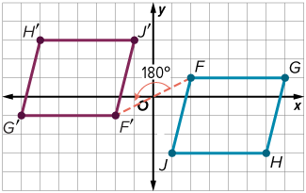
Example 5
Rotations
PREDICT Graph parallelogram FGHJ.
Before performing the rotation, predict your results.
The image of the parallelogram rotated 180° will be a parallelogram in the second and third quadrants.

Slide 33
Example 5
Rotations
To rotate a point 180° counterclockwise about the origin, multiply the x- and y-coordinates by −1. Find the coordinates of the vertices of the image.
(x, y) | → | (−x, −y)
F(2, 1) | → | F'(−2, −1)
G(7, 1) | → | G'(−7, −1)
H(6, −3) | → | H'(−6, 3)
J(1, −3) | → | J'(−1, 3)
CHECK The image meets the prediction.

Slide 34
Example 5
Rotations
Check
Quadrilateral JKLM has coordinates J(1, 2), K(4, 3), L(6, 1), and M(3, 1). Determine the coordinates of the vertices of the image after a 270° rotation about the origin.
A. J'(2, −1), K'(3, −4), L'(1, −6), and M'(1, −3)
B. J'(2, 1), K'(3, 4), L'(1, 6), and M'(1, 3)
C. J'(−2, 1), K'(−3, 4), L'(−1, 6), and M'(−1, 3)
D. J'(−2, −1), K'(−3, −4), L'(−1, −6), and M'(−1, −3)

Slide 35
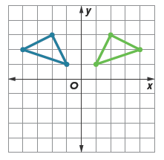
Exit Ticket
1. | Which rigid transformation is shown in the diagram?
2. | A translation moves B(−6, 2) to B′(3, 1). What is the image of (x, y) under this translation?
3. | What are the coordinates of (−3, 7) after a counterclockwise rotation of 90° about the origin?
4. | What is the image of A(−4, 9) when it is reflected in the y-axis?

