Slide 1
Section 4-5 - Symmetry

Slide 2
Warm Up
Find the coordinates of the vertices of each image after the given rotation about the origin.
1. A(1, 3), B(3, 1), C(1, 1), rotated 90° clockwise
2. A(−4, 3), B(3, 4), C(1, 2), rotated 90° clockwise
3. A(2, 1), B(4, 2), C(1, 3), rotated 180°

Slide 3
Warm Up
4. A(1, −2), B(3, −2), C(4, 1), rotated 90° counterclockwise
5. A(4, 4), B(4, 1), C(1, 1), rotated 180°

Slide 4
Warm Up
Find the coordinates of the vertices of each image after the given rotation about the origin.
1. A(1, 3), B(3, 1), C(1, 1), rotated 90° clockwise
A′(3, −1), B′(1, −3), C′(1, −1)
2. A(−4, 3), B(3, 4), C(1, 2), rotated 90° clockwise
A′(3, 4), B′(4, −3), C′(2, −1)
3. A(2, 1), B(4, 2), C(1, 3), rotated 180°
A′(−2, −1), B′(−4, −2), C′(−1, −3)
Notes:
A′(3, −1), B′(1, −3), C′(1, −1)
A′(3, 4), B′(4, −3), C′(2, −1)
A′(−2, −1), B′(−4, −2), C′(−1, −3)

Slide 5
Warm Up
4. A(1, −2), B(3, −2), C(4, 1), rotated 90° counterclockwise
A′(2, 1), B′(2, 3), C′(−1, 4)
5. A(4, 4), B(4, 1), C(1, 1), rotated 180°
A′(−4, −4), B′(−4, −1), C′(−1, −1)
Notes:
A′(2, 1), B′(2, 3), C′(−1, 4)
A′(−4, −4), B′(−4, −1), C′(−1, −1)

Slide 6
Florida’s B.E.S.T. Standards for Mathematics
MA.912.GR.2.4 Determine symmetries of reflection, symmetries of rotation and symmetries of translation of a geometric figure.

Slide 7
Florida’s Mathematical Thinking and Reasoning Standards
MA.K12.MTR.2.1
Demonstrate understanding by representing problems in multiple ways.
MA.K12.MTR.4.1
Engage in discussions that reflect on the mathematical thinking of self and others.
MA.K12.MTR.5.1
Use patterns and structure to help understand and connect mathematical concepts.

Slide 8
Lesson Objectives
Content Objective
Students will identify line and rotational symmetries
and identify transformations in tessellations.
Language Objectives
Students use can and cannot to identify line and rotational symmetries and transformations in tessellations.
To optimize output, students participate in MLR1: Stronger and Clearer Each Time.

Slide 9
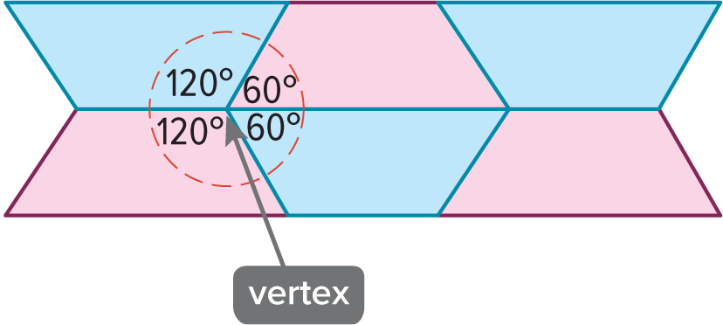
Learn
Types of Tessellations
Compositions of transformations can be used to create patterns from polygons. A tessellation is a repeating pattern of one or more figures that covers a plane with no overlapping or empty spaces. A tessellation can be created by transforming the same figure or set of figures in a plane. The sum of the measures of the angles around a vertex of a tessellation is 360°.

Slide 10
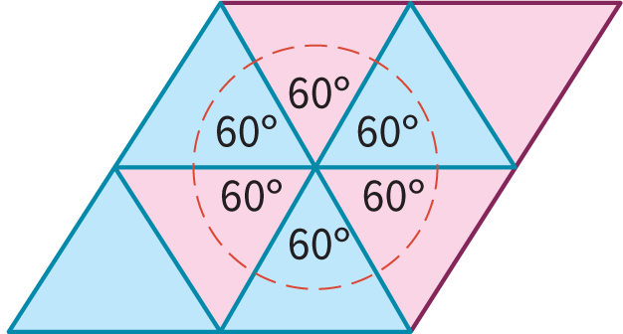
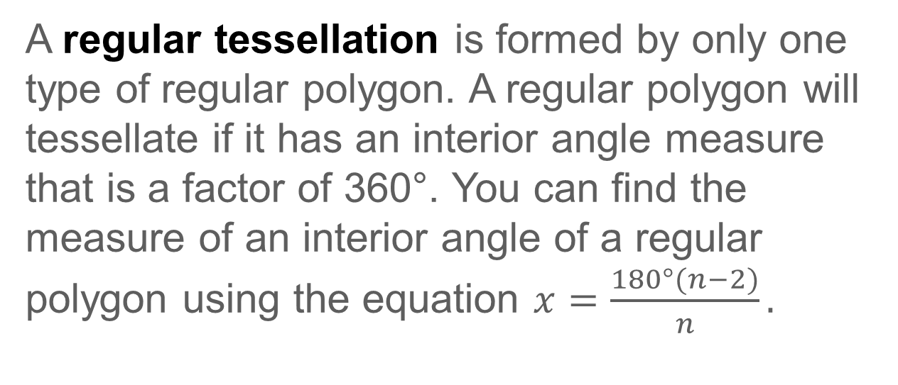
Learn
Types of Tessellations
A regular tessellation is formed by only one type of regular polygon. A regular polygon will tessellate if it has an interior angle measure that is a factor of 360°. You can find the measure of an interior angle of a regular polygon using the equation $x=\frac{180°(n−2)}{n}.$

Slide 11
Example 1
Regular Tessellation
Determine whether a regular 16-gon will tessellate the plane. Explain.

Slide 12
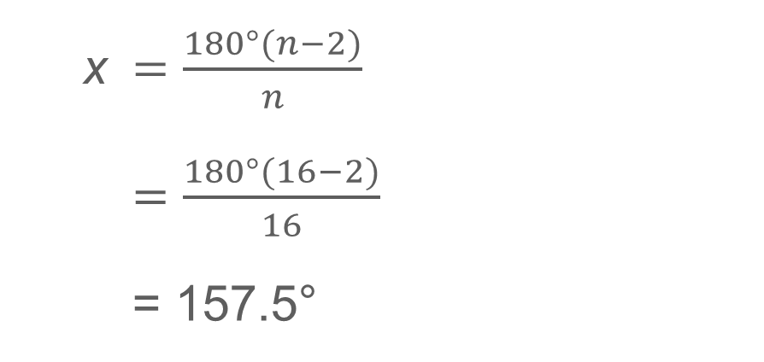
Example 1
Regular Tessellation
Let x represent the measure of an interior angle of a regular 16-gon.
x | $=\frac{180°(n−2)}{n}$
 | $=\frac{180°(16−2)}{16}$
 | = 157.5°
Because 157.5° is not a factor of 360°, a regular 16-gon will not tessellate the plane.

Slide 13
Example 1
Regular Tessellation
Check
Determine whether a regular decagon will tessellate the plane. Explain.

Slide 14
Example 1
Regular Tessellation
Check
Determine whether a regular decagon will tessellate the plane. Explain.
Because 144° is not a factor of 360°, a regular decagon will not tessellate the plane.
Notes:
Because 144° is not a factor of 360°, a regular decagon will not tessellate the plane.

Slide 15
Learn
Transformations in Tessellations
Not all polygons have to be regular to tessellate the plane. Any triangle is capable of tessellating the plane because the sum of the measures of its interior angles is 180°.
Any quadrilateral is capable of tessellating the plane. Because a quadrilateral can be formed by two triangles, the sum of the interior angles of a quadrilateral is 2 ⋅ 180° or 360°.

Slide 16
Learn
Transformations in Tessellations
Even though all triangles and quadrilaterals can tessellate the plane, not all polygons can. Only fifteen known types of convex pentagons and three types of convex hexagons can tessellate the plane. If a convex polygon has seven or more sides, then it cannot tessellate the plane.

Slide 17
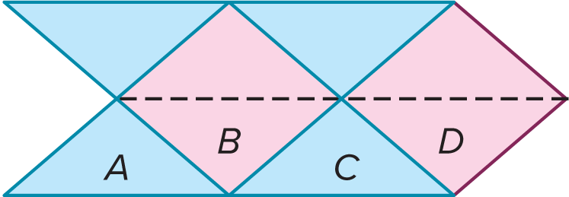
Example 2
Identify Transformations in a Tessellation
Will an isosceles triangle sometimes, always, or never tessellate the plane? Describe the transformation(s) that can be used to create the tessellation shown below.

Slide 18
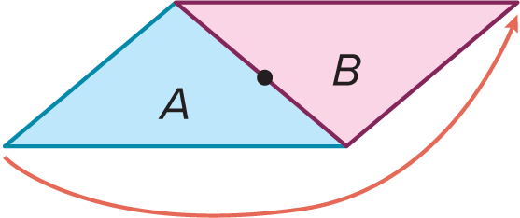
Example 2
Identify Transformations in a Tessellation
Because all triangles tessellate the plane, an isosceles triangle will always tessellate the plane.
Triangle A can be rotated 180° about the midpoint of its right leg to create Triangle B.

Slide 19
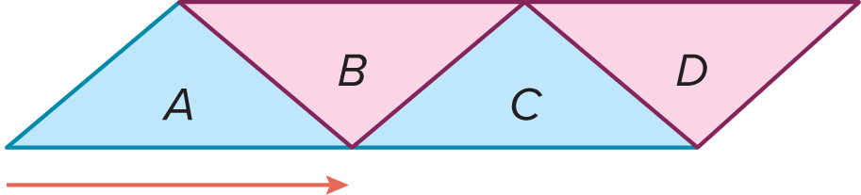
Example 2
Identify Transformations in a Tessellation
Triangles C and D can be created by translating A and B along a vector.

Slide 20
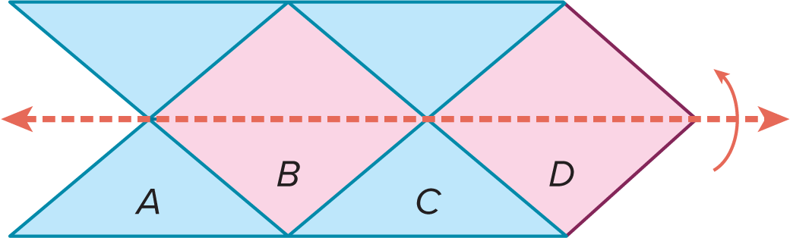
Example 2
Identify Transformations in a Tessellation
Triangles A, B, C, and D can be reflected in the line that contains the bases of Triangles B and D to create the tessellation.
So, the tessellation can be created using rotations, translations, and reflections.

Slide 21
Learn
Line Symmetry
A figure has symmetry if there exists a rigid transformation—reflection, translation, rotation, or glide reflection—that maps the figure onto itself. Figures that have symmetry are self-congruent. One type of symmetry is line symmetry.

Slide 22
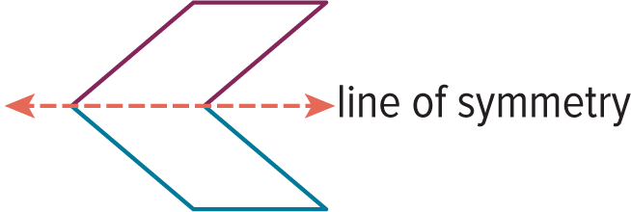
Learn
Line Symmetry
A figure in the plane has line symmetry (or reflectional symmetry) if each half of the figure matches the other side exactly. When a figure has line symmetry, the figure can be mapped onto itself by a reflection in a line, called the line of symmetry (or axis of symmetry).

Slide 23


Example 3
Identify Line Symmetry
Determine whether each figure has a line of symmetry. If so, draw the lines of symmetry and state how many lines of symmetry it has.
a.
b.

Slide 24
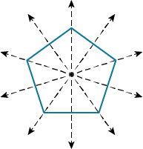
Example 3
Identify Line Symmetry
a. b.
5 lines of symmetry 0 lines of symmetry

Slide 25
Example 3
Identify Line Symmetry
Talk About It!
Ask a partner to provide feedback on your work. Are there ways in which you can improve your process?

Slide 26
Example 3
Identify Line Symmetry
Think About It!
Josefina argues that you can count the number of lines of symmetry in a circle. Do you agree or disagree? Justify your argument.

Slide 27



Example 3
Identify Line Symmetry
Check
Determine whether each figure has a line of symmetry. If so, draw the lines of symmetry and state how many lines of symmetry it has.

Slide 28
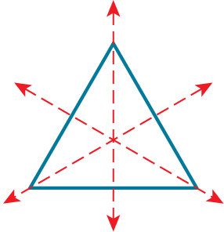
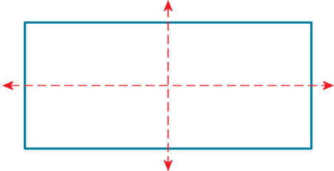
Example 3
Identify Line Symmetry
Check
Determine whether each figure has a line of symmetry. If so, draw the lines of symmetry and state how many lines of symmetry it has.
2 lines of symmetry
3 lines of symmetry
0 lines of symmetry
Notes:
2 lines of symmetry
3 lines of symmetry
0 lines of symmetry

Slide 29

Learn
Rotational Symmetry
A figure in the plane has rotational symmetry (or radial symmetry) if the figure can be mapped onto itself by being rotated less than 360° clockwise or counterclockwise about the center of the figure so the image and the preimage are indistinguishable. The point in which a figure can be rotated onto itself is called the center of symmetry (or point of symmetry).
This figure has rotational symmetry because a rotation of 90°, 180°, or 270° maps the figure onto itself.

Slide 30
Learn
Rotational Symmetry
The number of times that a figure maps onto itself as it rotates from 0° to 360° is called the order of symmetry. The magnitude of symmetry (or angle of rotation) is the smallest angle through which a figure can be rotated so that it maps onto itself. The order and magnitude of a rotation are related by the following equation.
magnitude = 360° ÷ order

Slide 31
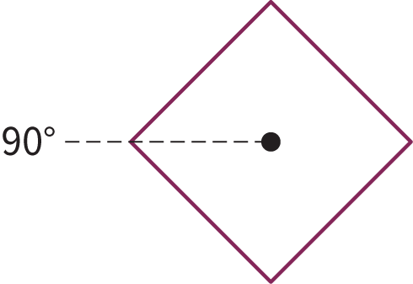
Learn
Rotational Symmetry
This figure has order 4 and magnitude 90°. So, this figure can map onto itself with a composition of rotations clockwise or counterclockwise if each angle of rotation is a multiple of the magnitude, or a multiple of 90°.

Slide 32
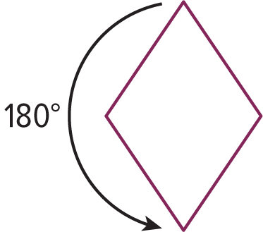
Learn
Rotational Symmetry
Key Concept: Point Symmetry
A figure has point symmetry if it can be mapped onto itself by a rotation of 180°. If a figure has point symmetry, then the center of symmetry in the figure is called the point of symmetry.
Example A rhombus has point symmetry because it looks the same right-side up as upside down.

Slide 33



Example 4
Identify Rotational Symmetry
NATURE Objects found in nature often have rotational symmetry. Determine whether each figure has rotational symmetry. Explain.
a. b. c.

Slide 34
Example 4
Identify Rotational Symmetry
a. b. c.
No; no rotation less than 360° maps the leaf onto itself.
Yes; the flower can map onto itself with a rotation that is less than 360°.
Yes; the clover can map onto itself with a rotation that is less than 360°.

Slide 35



Example 4
Identify Rotational Symmetry
Check
HOUSEHOLD Below are several objects that you might find around your house. Determine whether each figure has rotational symmetry. Explain.

Slide 36
Example 4
Identify Rotational Symmetry
Yes; the orange slice can map onto itself with a rotation that is less than 360°.
No; no rotation less than 360° maps the pair of scissors onto itself.
Yes; the tablet can map onto itself with a rotation that is less than 360°.
Notes:
Yes; the orange slice can map onto itself with a rotation that is less than 360°.
No; no rotation less than 360° maps the pair of scissors onto itself.
Yes; the tablet can map onto itself with a rotation that is less than 360°.

Slide 37
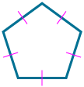


Example 5
Determine Order and Magnitude of Symmetry
Part A State the order and magnitude of symmetry.
Determine whether each figure has rotational symmetry. If so, locate the center of symmetry and state the order and magnitude of symmetry.
a. b. c.
Part B Identify point symmetry. Which figure(s) in Part A has point symmetry? Justify your reasoning.

Slide 38
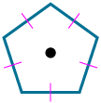

Example 5
Determine Order and Magnitude of Symmetry
a. b. c.
Part A
rotational symmetry: yes
order = 5
magnitude = 72°
rotational symmetry: no
order = none
magnitude = none
rotational symmetry: yes
order = 2
magnitude = 180°

Slide 39
Example 5
Determine Order and Magnitude of Symmetry
Part B Identify point symmetry. Which figure(s) in Part A has point symmetry? Justify your reasoning.
a. b. c.
The parallelogram has point symmetry because it can be rotated 180° about its center so that it maps onto itself.

Slide 40
Example 5
Determine Order and Magnitude of Symmetry
Think About It!
If a figure has line symmetry and rotational symmetry, what composition of transformations will map the figure onto itself?

Slide 41


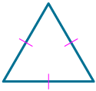
Example 5
Determine Order and Magnitude of Symmetry
Check
Determine whether each figure has rotational symmetry. If so, locate the center of symmetry and state the order and magnitude of symmetry.
a. b. c.

Slide 42
Example 5
Determine Order and Magnitude of Symmetry
Which figure(s) has point symmetry? Justify your answer.
a. b. c.

Slide 43

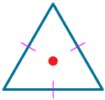
Example 5
Determine Order and Magnitude of Symmetry
Check
Determine whether each figure has rotational symmetry. If so, locate the center of symmetry and state the order and magnitude of symmetry.
a. b. c.
rotational symmetry: yes
order = 2
magnitude = 180°
rotational symmetry: no
order = none
magnitude = none
rotational symmetry: yes
order = 3
magnitude = 120°
Notes:
rotational symmetry: yes; order = 2; magnitude = 180°
rotational symmetry: no; order = none; magnitude = none
rotational symmetry: yes; order = 3; magnitude = 120°

Slide 44
Example 5
Determine Order and Magnitude of Symmetry
Which figure(s) has point symmetry? Justify your answer.
a. b. c.
The rectangle has point symmetry because it can be rotated 180° about its center so that it maps onto itself.
Notes:
The rectangle has point symmetry because it can be rotated 180° about its center so that it maps onto itself.

Slide 45

Learn
Translational Symmetry
A pattern has translational symmetry if it can be created by translating a figure or a group of figures without using a reflection or rotation.

Slide 46
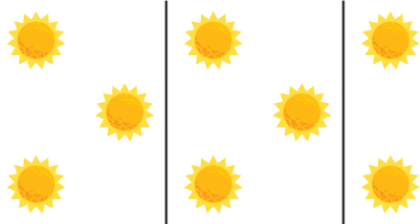
Learn
Translational Symmetry
Tessellations often have translational symmetry, but patterns that are not tessellations, like the sun pattern, can also have translational symmetry.

Slide 47
Learn
Translational Symmetry
Talk About It!
Your classmate says that both patterns have translational symmetry and both patterns are tessellations. What questions can you ask to help your classmate recognize their mistake?

Slide 48

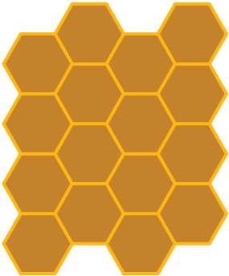
Example 6
Identify Translational Symmetry
Determine whether each figure or pattern has translational symmetry. If so, draw the translation vectors. Explain your reasoning.
a. b.

Slide 49
Example 6
Identify Translational Symmetry
a.
No; The top left figure has been rotated to create each additional figure.

Slide 50
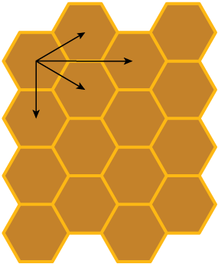
Example 6
Identify Translational Symmetry
b.
Yes; The pattern is a tessellation, and the top left hexagon can be translated in many directions to create the tessellation.

Slide 51
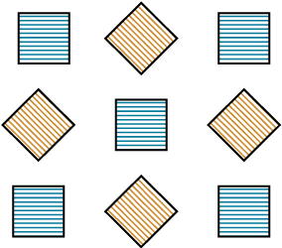

Example 6
Identify Translational Symmetry
Check
Determine whether each pattern has translational symmetry. If so, draw the translation vectors. Explain your reasoning.
a. b.

Slide 52
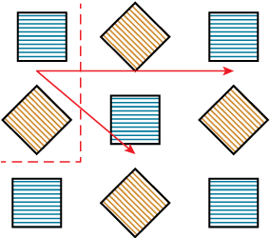
Example 6
Identify Translational Symmetry
a.
Yes; sample answer: If the top left and center left squares are grouped, then these squares can be translated down and to the right or translated to the far right. If the pattern is extended further, then the squares can also be translated up, translated down, or translated up and to the right to continue the pattern.
Notes:
Yes; sample answer: If the top left and center left squares are grouped, then these squares can be translated down and to the right or translated to the far right. If the pattern is extended further, then the squares can also be translated up, translated down, or translated up and to the right to continue the pattern.

Slide 53
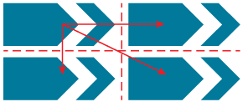
Example 6
Identify Translational Symmetry
b.
Yes; sample answer: Draw a horizontal and a vertical line through the center of the pattern. The figure that is translated consists of the pentagon and hexagon in the top left corner. These two shapes can be translated right, down, or diagonally.
Notes:
Yes; sample answer: Draw a horizontal and a vertical line through the center of the pattern. The figure that is translated consists of the pentagon and hexagon in the top left corner. These two shapes can be translated right, down, or diagonally.

Slide 54
Pause and Reflect
Did you struggle with anything in this lesson? If so, how did you deal with it?

Slide 55
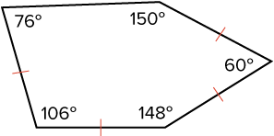
Exit Ticket
1. In this lesson, you learned that a regular pentagon will not tessellate the plane. Will the nonregular pentagon shown tessellate the plane? If you think so, draw the tessellation. If not, why not?

Slide 56
Exit Ticket
Name a triangle and a convex quadrilateral that satisfy each condition.
2. has exactly one line of symmetry
3. has no lines of symmetry
4. has rotational symmetry

Slide 57
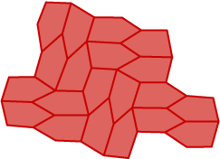
Exit Ticket
1. In this lesson, you learned that a regular pentagon will not tessellate the plane. Will the nonregular pentagon shown tessellate the plane? If you think so, draw the tessellation. If not, why not? yes
Notes:
yes

Slide 58
Exit Ticket
Name a triangle and a convex quadrilateral that satisfy each condition.
2. has exactly one line of symmetry isosceles triangle; kite, isosceles trapezoid
3. has no lines of symmetry scalene triangle; parallelogram
4. has rotational symmetry equilateral triangle; parallelogram
Notes:
isosceles triangle; kite, isosceles trapezoid
scalene triangle; parallelogram, nonisosceles trapezoid
equilateral triangle; parallelogram

