Slide 1
Surface Area

Slide 2
Warm Up
Answer each question.
1. What is the area of a square with a side length of 12 inches?
2. A rectangle has a length of 10 feet and an area of 330 square feet. What is the width of the rectangle?
3. A circle has a diameter of 12 meters. A square has a side length of 12 meters. Which has the greater area?

Slide 3
Warm Up
4. A circle has an area of 12 square feet. What is the area of half of the circle?
5. A circle has a diameter of 30 centimeters. What is the circumference of the circle to the nearest tenth?

Slide 4
Warm Up
Answer each question.
1. What is the area of a square with a side length of 12 inches?
2. A rectangle has a length of 10 feet and an area of 330 square feet. What is the width of the rectangle?
3. A circle has a diameter of 12 meters. A square has a side length of 12 meters. Which has the greater area?
144 in²
33 ft
square
Notes:
144 in²
33 ft
square

Slide 5
Warm Up
4. A circle has an area of 12 square feet. What is the area of half of the circle?
5. A circle has a diameter of 30 centimeters. What is the circumference of the circle to the nearest tenth?
6 ft²
94.2 cm
Notes:
6 ft²
94.2 cm

Slide 6
Florida’s B.E.S.T. Standards for Mathematics
MA.912.GR.4.6
Solve mathematical and real-world problems involving the surface area of three-dimensional figures limited to cylinders, pyramids, prisms, cones and spheres.

Slide 7
Florida’s Mathematical Thinking and Reasoning Standards
MA.K12.MTR.4.1
Engage in discussions that reflect on the mathematical thinking of self and others.

Slide 8
Lesson Objectives
Content Objective
Students find surface areas of three-dimensional figures.
Language Objectives
Students explain how to find surface areas of three-dimensional figures using from … to ... .
To maximize linguistic and cognitive meta-awareness, students participate in MLR3: Critique, Correct, and Clarify.

Slide 9
Learn
Surface Areas of Prisms and Cylinders
The lateral area L of a solid is the sum of the areas of the lateral faces or lateral surfaces of the solid. The lateral faces of a prism are the faces that join the bases of the prism. The lateral surface of a cylinder is the curved surface that joins the bases of the cylinder. The altitude of a prism or cylinder is the segment perpendicular to the bases that joins the planes of the bases. The height of a solid is the length of the altitude.

Slide 10
Learn
Surface Areas of Prisms and Cylinders
Key Concept: Lateral Area and Surface Area of a Right Prism
Words | The lateral area L of a right prism is L = Ph, where h is the height of the prism and P is the perimeter of a base. The surface area S of a right prism is S = L + 2B, where L is the lateral area and B is the area of a base. By substituting L = Ph into the equation, S = Ph + 2B, where P is the perimeter of a base and h is the height of the prism.

Slide 11
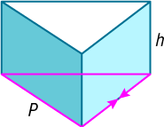
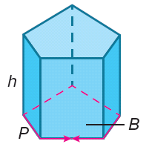
Learn
Surface Areas of Prisms and Cylinders
Symbols | L = Ph S = L + 2B or S = Ph + 2B
Examples | Lateral Area Surface Area

Slide 12
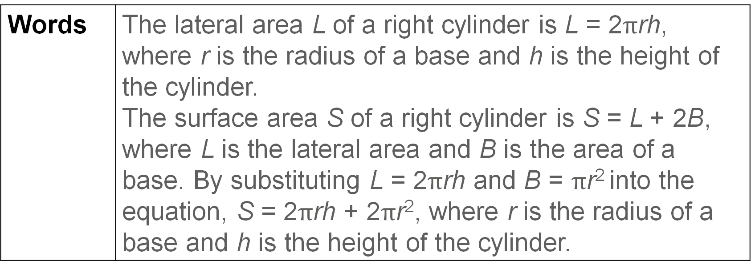
Learn
Surface Areas of Prisms and Cylinders
Key Concept: Lateral Area and Surface Area of a Right Cylinder
Words | The lateral area L of a right cylinder is L = 2$π$rh, where r is the radius of a base and h is the height of the cylinder. The surface area S of a right cylinder is S = L + 2B, where L is the lateral area and B is the area of a base. By substituting L = 2$π$rh and B = $π$r² into the equation, S = 2$π$rh + 2$π$r², where r is the radius of a base and h is the height of the cylinder.

Slide 13
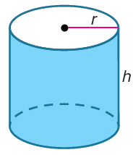
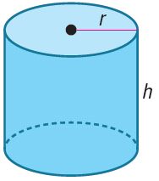
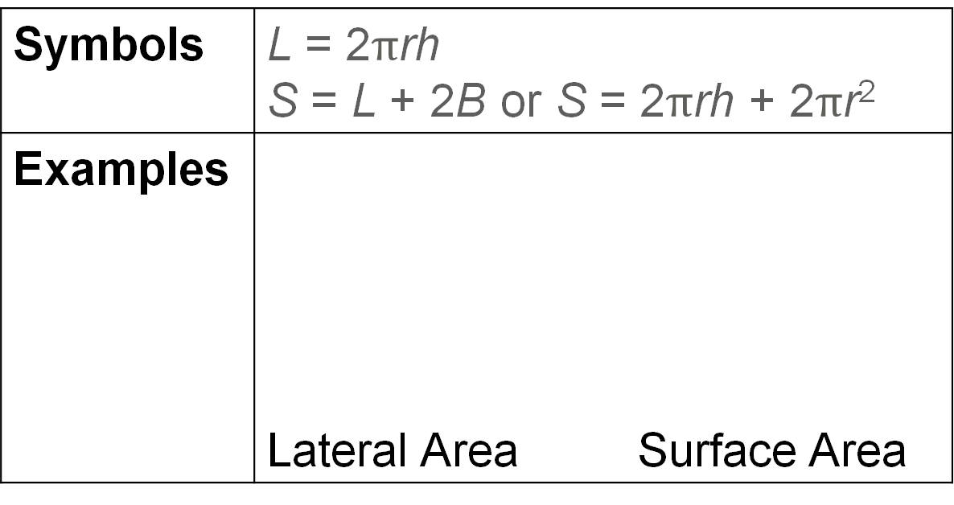
Learn
Surface Areas of Prisms and Cylinders
Symbols | L = 2$π$rh S = L + 2B or S = 2$π$rh + 2$π$r²
Examples | Lateral Area Surface Area

Slide 14
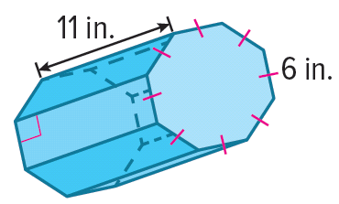
Example 1
Lateral Area and Surface Area of a Prism
Find the lateral area and surface area of the prism. Round to the nearest tenth, if necessary.
Part A Find the lateral area.
Part B Find the surface area.

Slide 15
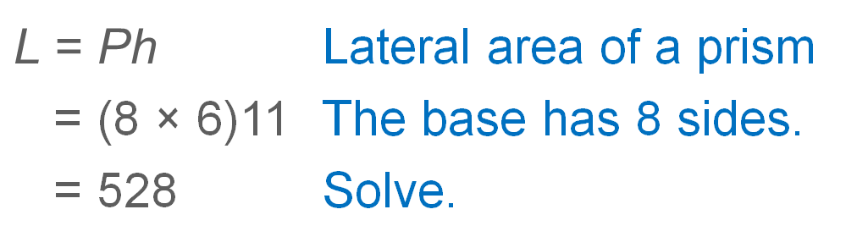
Example 1
Lateral Area and Surface Area of a Prism
Part A Find the lateral area.
$$\text{L} \text{= }\text{Ph}$$ | Lateral area of a prism
= (8 × 6)11 | The base has 8 sides.
= 528 | Solve.
So, the lateral area of the prism is 528 square inches.

Slide 16
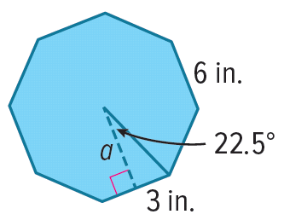
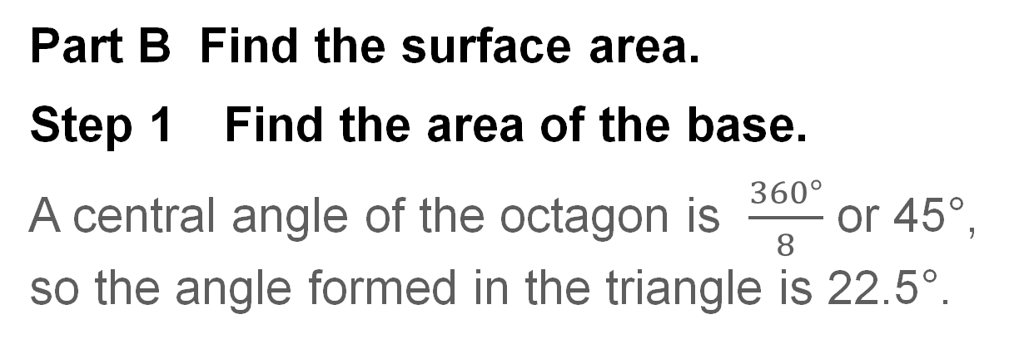
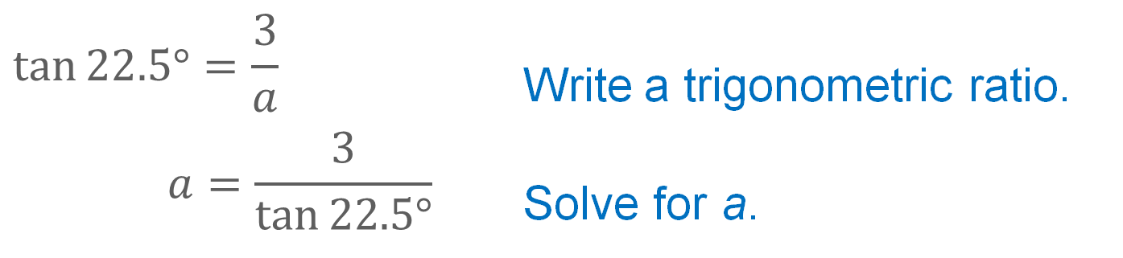
Example 1
Lateral Area and Surface Area of a Prism
Part B Find the surface area.
Step 1 Find the area of the base.
A central angle of the octagon is $\frac{360°}{8}$ or 45°, so the angle formed in the triangle is 22.5°.
$$\tan{22.5°}=\frac{3}{a}$$ | Write a trigonometric ratio.
$$a=\frac{3}{\tan{22.5°}}$$ | Solve for a.

Slide 17
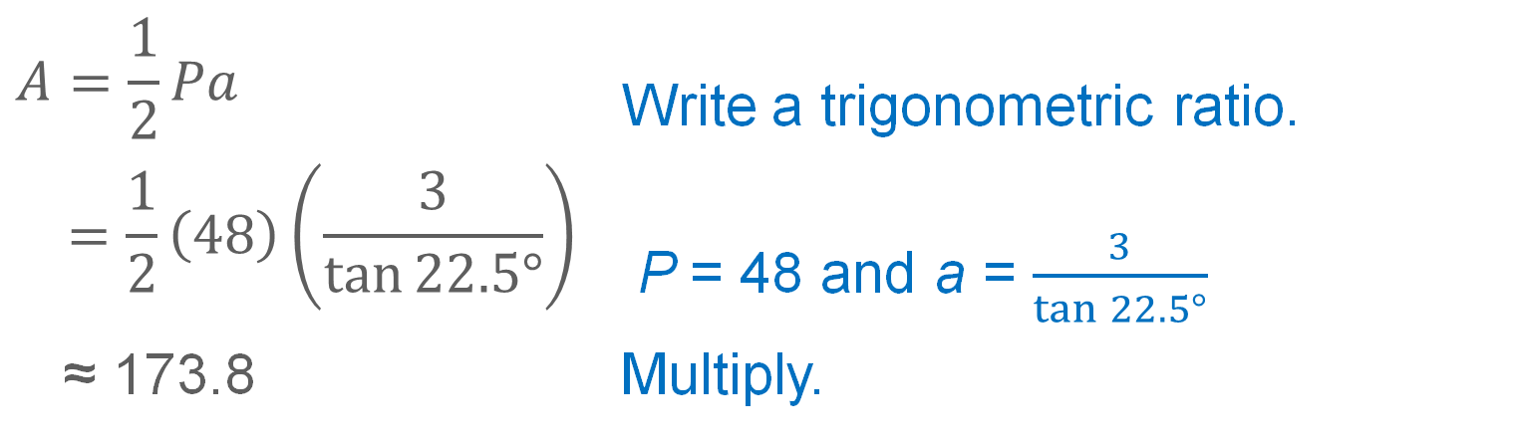
Example 1
Lateral Area and Surface Area of a Prism
$$A=\frac{1}{2}Pa$$ | Write a trigonometric ratio.
$$=\frac{1}{2}\left(48\right)\left(\frac{3}{\tan{22.5°}}\right)$$ | P = 48 and a = $\frac{3}{\tan{22.5°}}$
≈ 173.8 | Multiply.
So, the area of the base B is approximately 173.8 square inches.

Slide 18
Example 1
Lateral Area and Surface Area of a Prism
Step 2 Find the surface area of the prism.
S = L + 2B | Surface area of a right prism
≈ 528 + 2(173.8) | L = 528 and B ≈ 173.8
≈ 875.6 | Simplify.
The surface area of the prism is about 875.6 square inches.

Slide 19
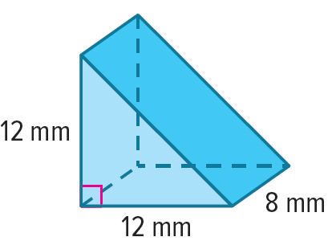
Example 1
Lateral Area and Surface Area of a Prism
Check
Find the lateral area and surface area of the prism rounded to the nearest millimeter.

Slide 20
Example 1
Lateral Area and Surface Area of a Prism
Check
Find the lateral area and surface area of the prism rounded to the nearest millimeter.
L = 328 mm²
S = 472 mm²
Notes:
L = 328 mm²
S = 472 mm²

Slide 21
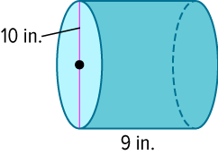
Example 2
Lateral Area and Surface Area of a Cylinder
Find the lateral area and surface area of the cylinder. Round to the nearest tenth.
Part A Find the lateral area.
Part B Find the surface area.

Slide 22
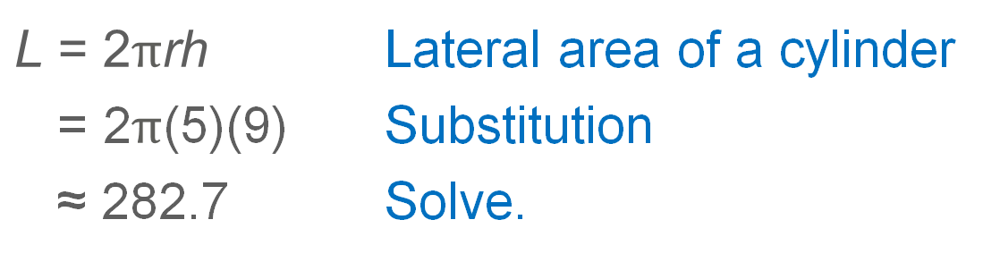
Example 2
Lateral Area and Surface Area of a Cylinder
Part A Find the lateral area.
$$\text{L} \text{= 2}π\text{rh}$$ | Lateral area of a cylinder
= 2$π$(5)(9) | Substitution
≈ 282.7 | Solve.
So, the lateral area of the cylinder is 282.7 square inches.

Slide 23
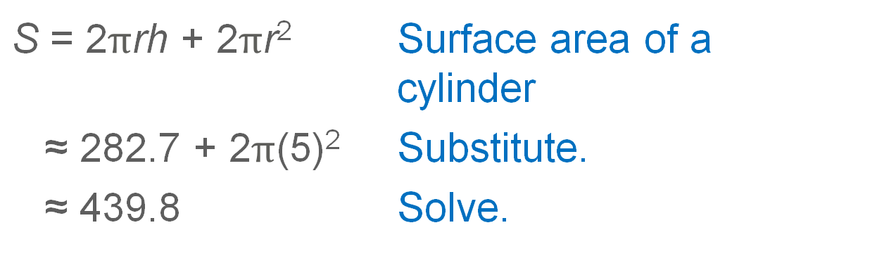
Example 2
Lateral Area and Surface Area of a Cylinder
Part B Find the surface area.
S = 2$π$rh + 2$π$r² | Surface area of a cylinder
≈ 282.7 + 2$π$(5)² | Substitute.
≈ 439.8 | Solve.
The surface area of the cylinder is about 439.8 square inches.

Slide 24
Learn
Surface Areas of Pyramids and Cones
A regular pyramid is a pyramid with a base that is a regular polygon. The lateral faces of a pyramid are the faces that join the base of the pyramid to the vertex. The lateral surface of a cone is the curved surface that joins the base of the cone to the vertex. The height of a pyramid or cone is the length of the altitude of the pyramid or cone, which is the segment perpendicular to the base that has the vertex as one endpoint and a point in the plane of the base as the other endpoint.

Slide 25
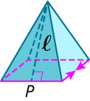
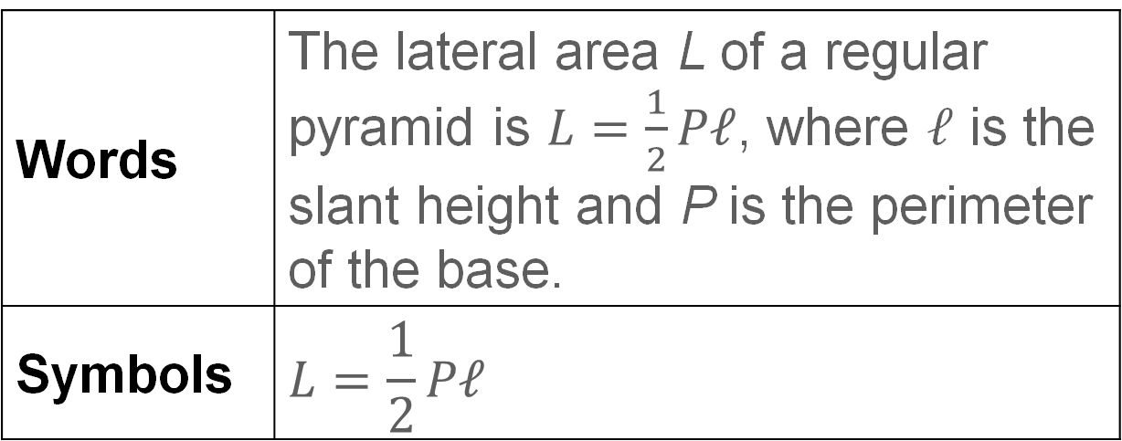
Learn
Surface Areas of Pyramids and Cones
Key Concept: Lateral Area of a Regular Pyramid
Words | The lateral area L of a regular pyramid is $L=\frac{1}{2}P𝓁$, where 𝓁 is the slant height and P is the perimeter of the base.
Symbols | $$L=\frac{1}{2}P𝓁$$

Slide 26
Learn
Surface Areas of Pyramids and Cones
Talk About It!
Describe the similarities and differences between finding the lateral area of a pyramid and the lateral area of a prism.

Slide 27
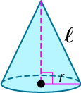
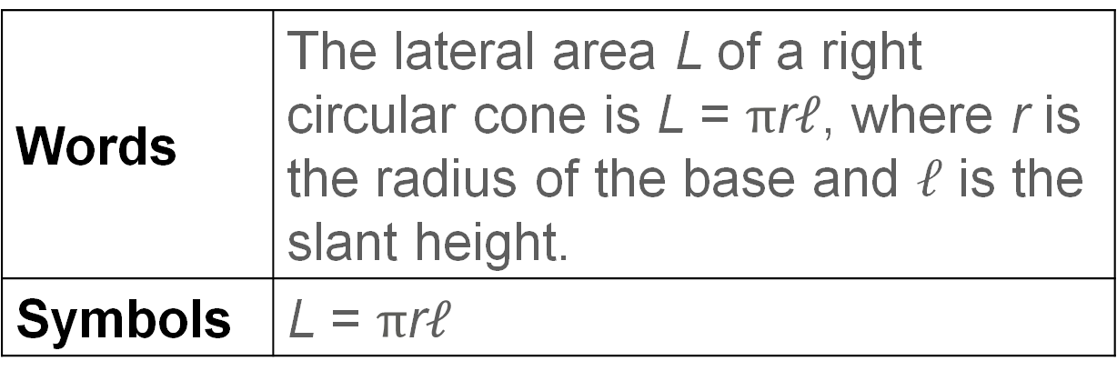
Learn
Surface Areas of Pyramids and Cones
Key Concept: Lateral Area of a Right Cone
Words | The lateral area L of a right circular cone is L = $π$r$𝓁$, where r is the radius of the base and 𝓁 is the slant height.
Symbols | L = $π$r$𝓁$

Slide 28
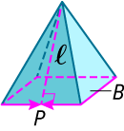
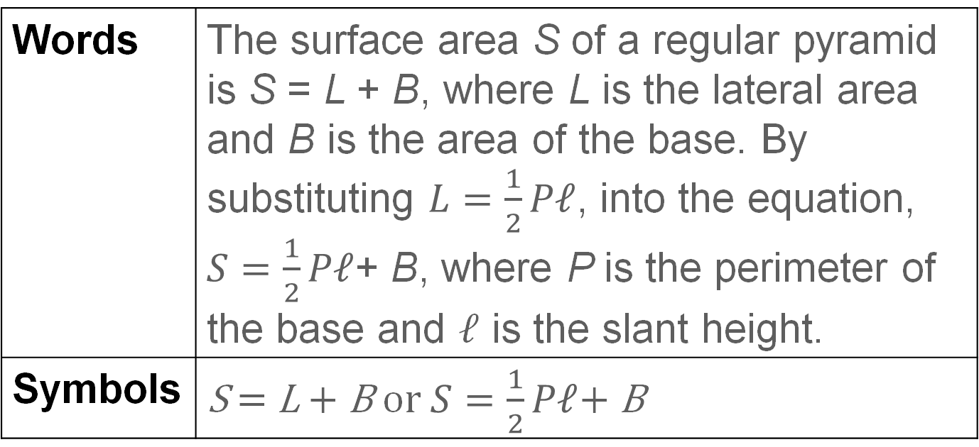
Learn
Surface Areas of Pyramids and Cones
Key Concept: Surface Area of a Regular Pyramid
Words | The surface area S of a regular pyramid is S = L + B, where L is the lateral area and B is the area of the base. By substituting $L=\frac{1}{2}P𝓁$, into the equation, $S=\frac{1}{2}P𝓁$+ B, where P is the perimeter of the base and 𝓁 is the slant height.
Symbols | S = L + B or $S=\frac{1}{2}P𝓁$+ B

Slide 29
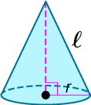
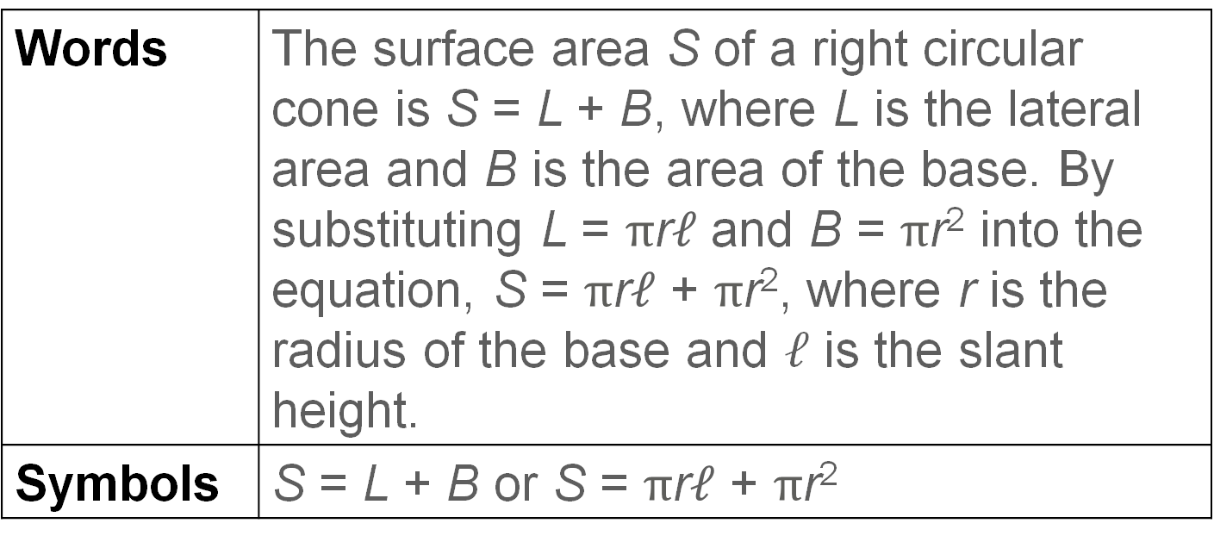
Learn
Surface Areas of Pyramids and Cones
Key Concept: Surface Area of a Right Cone
Words | The surface area S of a right circular cone is S = L + B, where L is the lateral area and B is the area of the base. By substituting L = $π$r$𝓁$ and B = $π$r² into the equation, S = $π$r$𝓁$ + $π$r², where r is the radius of the base and 𝓁 is the slant height.
Symbols | S = L + B or S = $π$r$𝓁$ + $π$r²

Slide 30
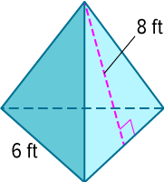
Example 3
Lateral Area and Surface Area of a Regular Pyramid
Find the lateral area and surface area of the regular pyramid. Round to the nearest tenth, if necessary.
Part A Find the lateral area.
Part B Find the surface area.

Slide 31
Example 3
Lateral Area and Surface Area of a Regular Pyramid
Part A Find the lateral area.
Step 1 Find the perimeter of the base.
The perimeter of the base is 6 × 3 or 18 feet.

Slide 32
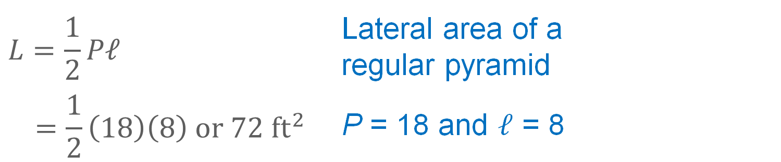
Example 3
Lateral Area and Surface Area of a Regular Pyramid
Step 2 Find the lateral area of the pyramid.
$$L=\frac{1}{2}P\text{𝓁}$$ | Lateral area of a regular pyramid
$$=\frac{1}{2}\left(18\right)\left(8\right) or 72 {ft}^{2}$$ | P = 18 and 𝓁 = 8

Slide 33
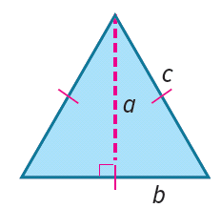
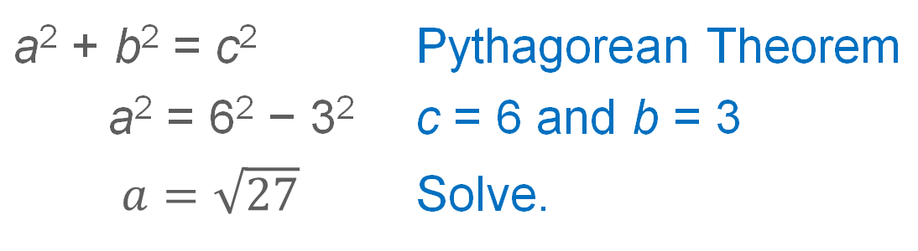
Example 3
Lateral Area and Surface Area of a Regular Pyramid
Part B Find the surface area.
Step 1 Find the length of the height of the triangular base and the area of the base.
a² + b² = c² | Pythagorean Theorem
a² = 6² − 3² | c = 6 and b = 3
$a=\sqrt{27}$ | Solve.

Slide 34
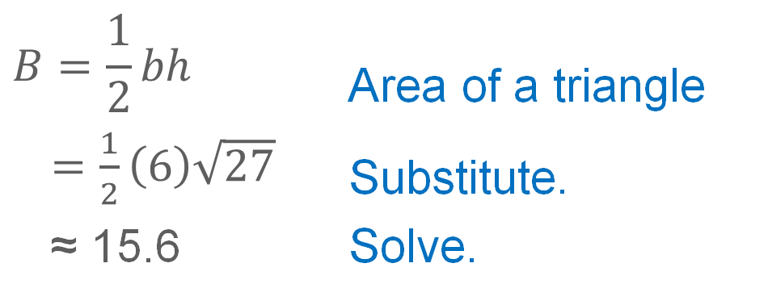
Example 3
Lateral Area and Surface Area of a Regular Pyramid
Calculate the area of the base B.
$$B=\frac{1}{2}bh$$ | Area of a triangle
$=\frac{1}{2}\left(6\right)\sqrt{27}$ | Substitute.
≈ 15.6 | Solve.
So, the area of the base B is approximately 15.6 square feet.

Slide 35
Example 3
Lateral Area and Surface Area of a Regular Pyramid
Step 2 Find the surface area of the pyramid.
S = L + B | Surface area of a regular pyramid
≈ 72 + 15.6 | L = 72 and B ≈ 15.6
≈ 87.6 | Simplify.
The surface area of the pyramid is about 87.6 square feet.

Slide 36
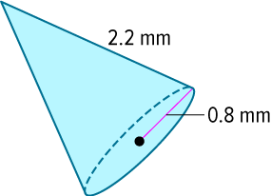
Example 4
Lateral Area and Surface Area of a Right Cone
Find the lateral area and surface area of the cone rounded to the nearest tenth.
Part A Find the lateral area.
Part B Find the surface area.

Slide 37
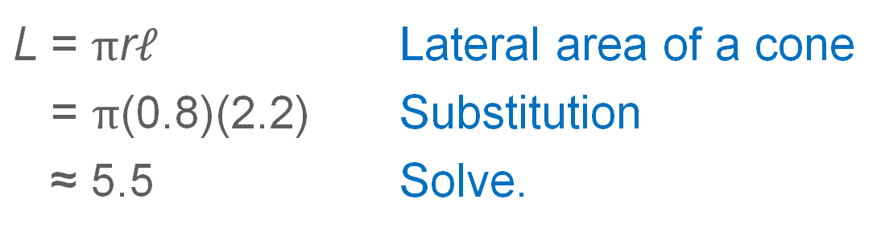
Example 4
Lateral Area and Surface Area of a Right Cone
Part A Find the lateral area.
L = $π$r$𝓁$ | Lateral area of a cone
= $π$(0.8)(2.2) | Substitution
≈ 5.5 | Solve.
So, the lateral area of the cone is 5.5 square millimeters.

Slide 38
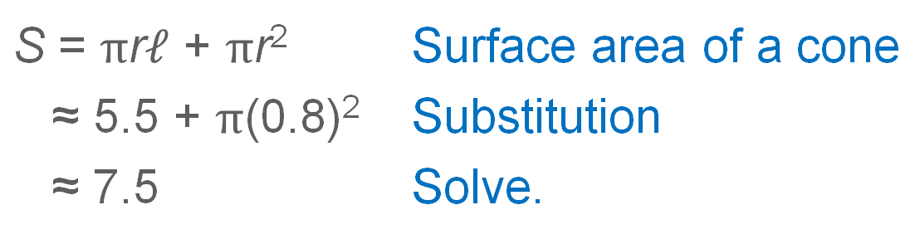
Example 4
Lateral Area and Surface Area of a Right Cone
Part B Find the surface area.
S = $π$r$𝓁$ + $π$r² | Surface area of a cone
≈ 5.5 + $π$(0.8)² | Substitution
≈ 7.5 | Solve.
The surface area of the cone is about
7.5 square millimeters.

Slide 39
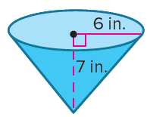
Example 4
Lateral Area and Surface Area of a Right Cone
Check
Find the lateral area and surface area of the cone rounded to the nearest tenth.

Slide 40
Example 4
Lateral Area and Surface Area of a Right Cone
Check
Find the lateral area and surface area of the cone rounded to the nearest tenth.
L ≈ 173.8 in²
S ≈ 286.9 in²
Notes:
L ≈ 173.8 in²
S ≈ 286.9 in²

Slide 41
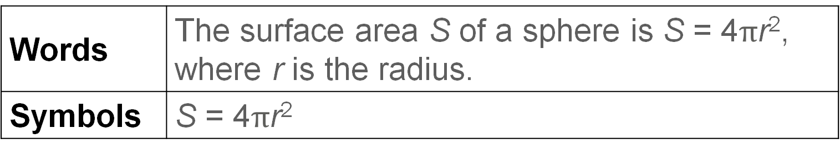
Learn
Surface Areas of Spheres
A sphere is the set of all points in space that are a given distance from a given point called the center of the sphere.
Key Concept: Surface Area of a Sphere
Words | The surface area S of a sphere is S = 4$π$r², where r is the radius.
Symbols | S = 4$π$r²

Slide 42
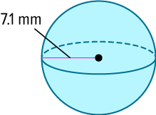
Example 5
Surface Area of a Sphere
Find the surface area of the sphere to the nearest tenth.

Slide 43
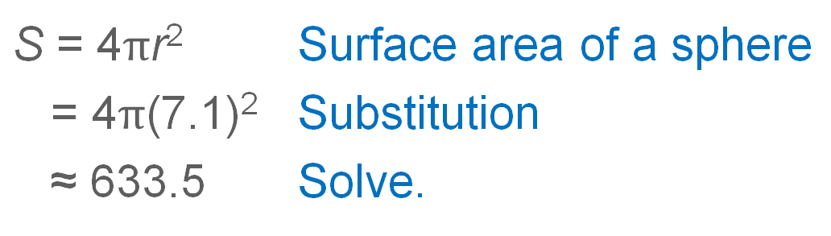
Example 5
Surface Area of a Sphere
S = 4$π$r² | Surface area of a sphere
= 4$π$(7.1)² | Substitution
≈ 633.5 | Solve.
The surface area of the sphere is about 633.5 square millimeters.

Slide 44
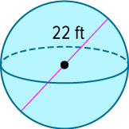
Example 5
Surface Area of a Sphere
Check
Find the surface area of the sphere to the nearest tenth.

Slide 45
Example 5
Surface Area of a Sphere
Check
Find the surface area of the sphere to the nearest tenth.
S ≈ 1520.5 ft²
Notes:
S ≈ 1520.5 ft²

Slide 46
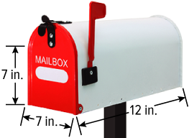
Example 6
Surface Area of a Composite Solid
A composite solid is a three-dimensional solid that is composed of simpler solids. You can use the formulas you know for calculating the surface areas of prisms, pyramids, cylinders, cones, and spheres to calculate the surface areas of composite solids.
MANUFACTURING A manufacturer wants to
know the approximate area of the metal used
to create a basic mailbox. Calculate the surface
area of the mailbox.

Slide 47
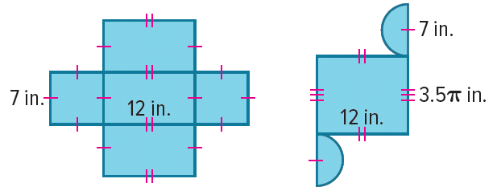
Example 6
Surface Area of a Composite Solid
Step 1 Choose a model.
The mailbox can be modeled by a square prism without a top face and one half of a cylinder.
Step 2 Draw a net of the composite solid.

Slide 48
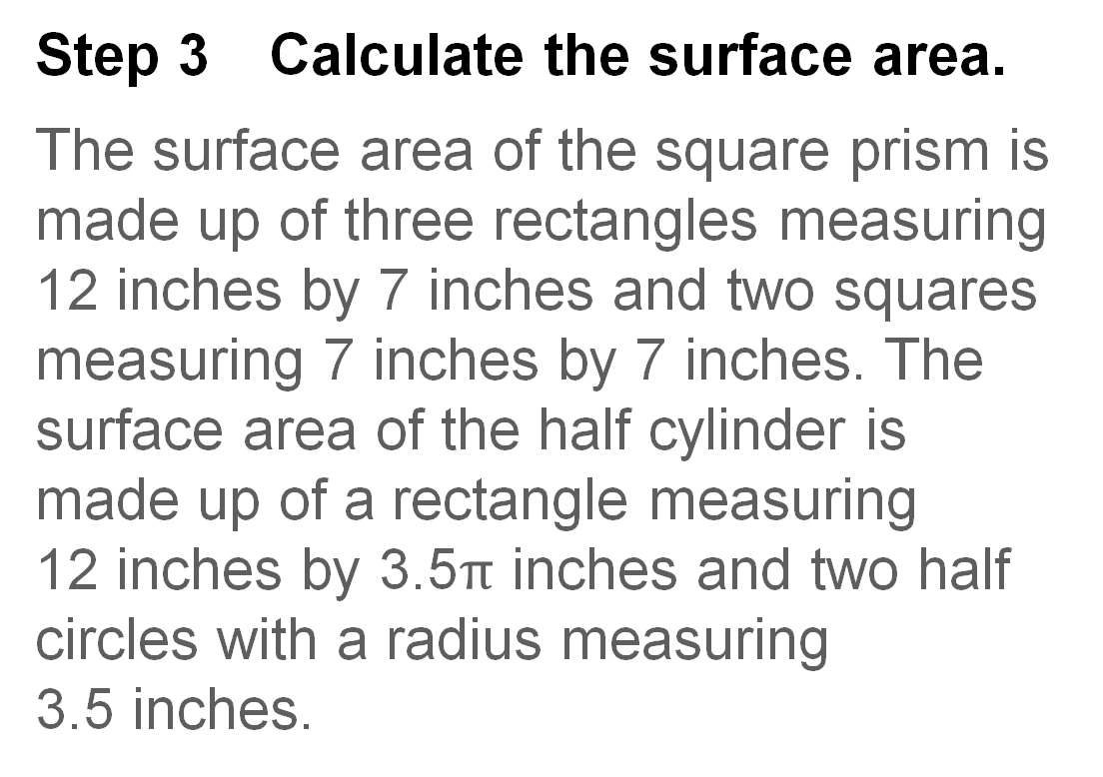
Example 6
Surface Area of a Composite Solid
Step 3 Calculate the surface area.
The surface area of the square prism is made up of three rectangles measuring 12 inches by 7 inches and two squares measuring 7 inches by 7 inches. The surface area of the half cylinder is made up of a rectangle measuring
12 inches by 3.5$π$ inches and two half circles with a radius measuring
3.5 inches.

Slide 49
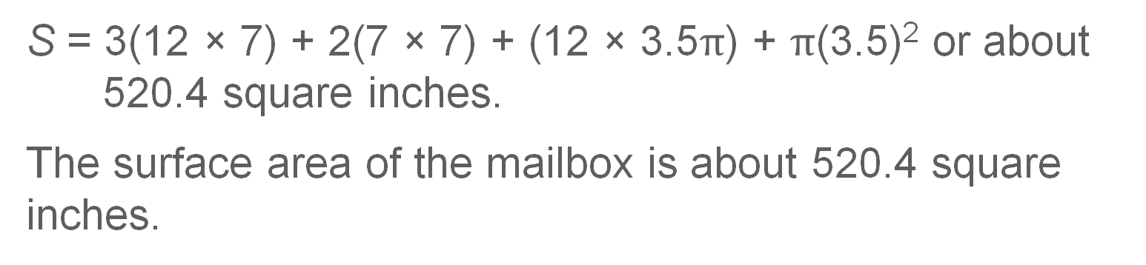
Example 6
Surface Area of a Composite Solid
S = 3(12 × 7) + 2(7 × 7) + (12 × 3.5$π$) + $π$(3.5)² or about 520.4 square inches.
The surface area of the mailbox is about 520.4 square inches.

Slide 50

Example 6
Surface Area of a Composite Solid
Check
CAKE DECORATING Jaylen is decorating a cake shaped like a rocket ship. He will ice the lateral surface and the top of the bottom layer, which has a radius of 4 inches and a height of 3 inches. He will ice the lateral surface and the top of the second layer, which has a radius of 2 inches and a height of 12 inches. The top layer has a radius of 2 inches and a height of 4 inches. Jaylen will ice only the lateral surface of the top layer. Approximate the surface area that will be covered by icing.

Slide 51
Example 6
Surface Area of a Composite Solid
Check
CAKE DECORATING Jaylen is decorating a cake shaped like a rocket ship. He will ice the lateral surface and the top of the bottom layer, which has a radius of 4 inches and a height of 3 inches. He will ice the lateral surface and the top of the second layer, which has a radius of 2 inches and a height of 12 inches. The top layer has a radius of 2 inches and a height of 4 inches. Jaylen will ice only the lateral surface of the top layer. Approximate the surface area that will be covered by icing.
S ≈ 317.1 in²
Notes:
S ≈ 317.1 in²

Slide 52

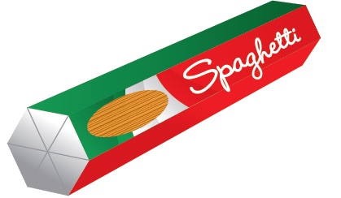
Exit Ticket
Find the surface area of each object to the nearest tenth.
1. lid of nail polish (not including the bottom) height 2 in., diameter 1.25 in.
2. box of spaghetti length 10 in., side length 2.5 in.

Slide 53


Exit Ticket
3. water bottle height 7.3 in., radius 1.125 in.
4. box of tea height 3 in., side length 3.75 in.

Slide 54
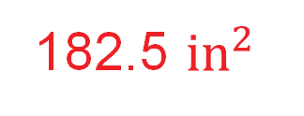

Exit Ticket
Find the surface area of each object to the nearest tenth.
1. lid of nail polish (not including the bottom) height 2 in., diameter 1.25 in.
2. box of spaghetti length 10 in., side length 2.5 in.
4.1 ${in}^{2}$
182.5 ${in}^{2}$
Notes:
4.1 in²
182.5 in²

Slide 55
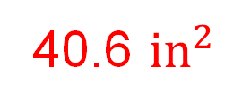
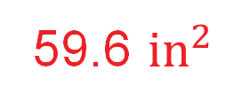
Exit Ticket
3. water bottle height 7.3 in., radius 1.125 in.
4. box of tea height 3 in., side length 3.75 in.
59.6 ${in}^{2}$
40.6 ${in}^{2}$
Notes:
59.6 in²
40.6 in²

