Slide 1

Section 3-7
Parallel Lines and Transversals

Slide 2
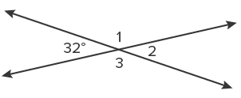
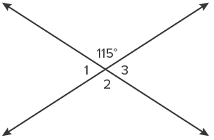
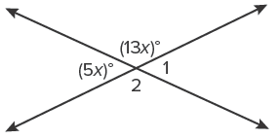
Warm Up
Find the missing angle measures.
1. 2.
3.

Slide 3
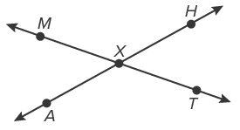
Warm Up
Use the figure to name the angle pairs.
4. vertical angles
5. linear pair

Slide 4
Warm Up
Find the missing angle measures.
1. 2.
3.
m∠1 = m∠3 = 148°, m∠2 = 32°
m∠1 = m∠3 = 65°,
m∠2 = 115°
x = 10; m∠1 = (5x)° = 50°,
m∠2 = (13x)° = 130°
Notes:
m∠1 = m∠3 = 65°, m∠2 = 115°
m∠1 = m∠3 = 148°, m∠2 = 32°
x = 10; m∠1 = (5x)° = 50°, m∠2 = (13x)° = 130°

Slide 5
Warm Up
Use the figure to name the angle pairs.
4. vertical angles
∠MXH, ∠AXT; ∠MXA, ∠HXT
5. linear pair
∠MXH, ∠HXT; ∠HXT, ∠TXA;
∠TXA, ∠AXM; ∠AXM, ∠MXH
Notes:
∠MXH, ∠AXT; ∠MXA, ∠HXT
∠MXH, ∠HXT; ∠HXT, ∠TXA; ∠TXA, ∠AXM; ∠AXM, ∠MXH

Slide 6
Florida’s B.E.S.T. Standards for Mathematics
MA.912.GR.1.1
Prove relationships and theorems about lines and angles. Solve mathematical and real-world problems involving postulates, relationships and theorems of lines and angles.

Slide 7
Florida’s Mathematical Thinking and Reasoning Standards
MA.K12.MTR.4.1
Engage in discussions that reflect on the mathematical thinking of self and others.

Slide 8
Lesson Objectives
Content Objective
Students identify and use relationships between parallel lines and transversals.
Language Objectives
• Students explain how to identify and use relationships between parallel lines and transversals using when… statements.
• To maximize linguistic and cognitive meta-awareness, students participate in MLR7: Critique, Correct, and Clarify.

Slide 9
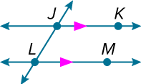
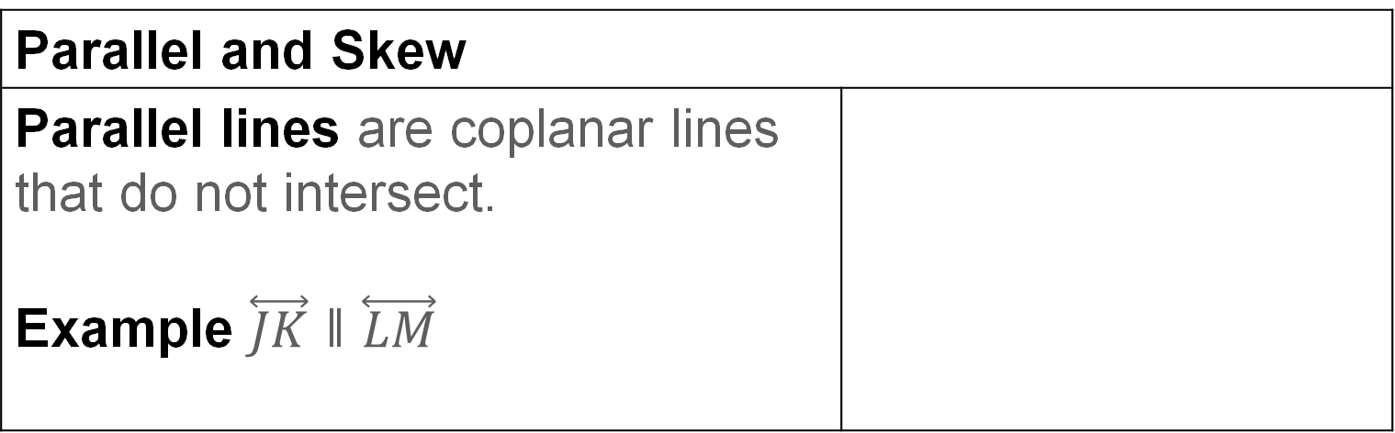
Learn
Parallel Lines and Transversals
If two lines do not intersect, then they are either parallel or skew.
Parallel and Skew
Parallel lines are coplanar lines that do not intersect. Example $\overset{⃡}{JK}$ ǁ $\overset{⃡}{LM}$

Slide 10
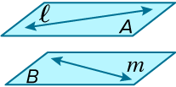
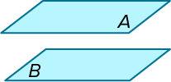
Learn
Parallel Lines and Transversals
Parallel and Skew
Skew lines are lines that do not intersect and are not coplanar. Example Lines 𝓁 and 𝓂 are skew.
Parallel planes are planes that do not intersect. Example Planes 𝒜 and ℬ are parallel.

Slide 11
Learn
Parallel Lines and Transversals
A line that intersects two or more lines in a plane at different points is called a transversal. In the diagram below, line 𝓉 is a transversal of lines 𝓆 and 𝓇. Line 𝓉 forms a total of eight angles with lines 𝓆 and 𝓇. These angles and specific pairings of these angles are given special names.

Slide 12
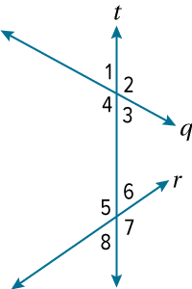
Learn
Parallel Lines and Transversals
Transversal Angle Pair Relationships
Four interior angles lie in the region between lines 𝓆 and 𝓇. | ∠3, ∠4, ∠5, ∠6
Four exterior angles lie in the two regions that are not between lines 𝓆 and 𝓇. | ∠1, ∠2, ∠7, ∠8
Consecutive interior angles are interior angles that lie on the same side of transversal 𝓉. | ∠4 and ∠5, ∠3 and ∠6

Slide 13
Learn
Parallel Lines and Transversals
Transversal Angle Pair Relationships
Alternate interior angles are nonadjacent interior angles that lie on opposite sides of transversal 𝓉. | ∠3 and ∠5, ∠4 and ∠6
Alternate exterior angles are nonadjacent exterior angles that lie on opposite sides of transversal 𝓉. | ∠1 and ∠7, ∠2 and ∠8

Slide 14
Learn
Parallel Lines and Transversals
Transversal Angle Pair Relationships
Corresponding angles lie on the same side of transversal 𝓉 and on the same side of lines 𝓆 and 𝓇. | ∠1 and ∠5, ∠2 and ∠6, ∠3 and ∠7, ∠4 and ∠8

Slide 15
Transversal
Interior angles
Exterior angles
Consecutive Interior angles
Alternate Interior angles
Alternate Exterior angles

Slide 16
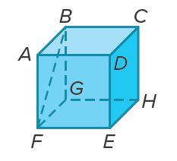
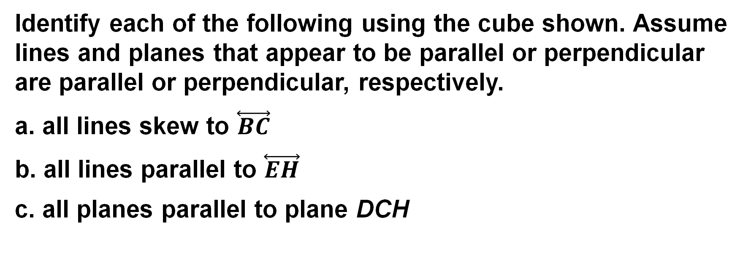
Example 1
Identify Parallel and Skew Relationships
Identify each of the following using the cube shown. Assume lines and planes that appear to be parallel or perpendicular are parallel or perpendicular, respectively.
a. all lines skew to $\overset{⃡}{BC}$
b. all lines parallel to $\overset{⃡}{EH}$
c. all planes parallel to plane DCH

Slide 17
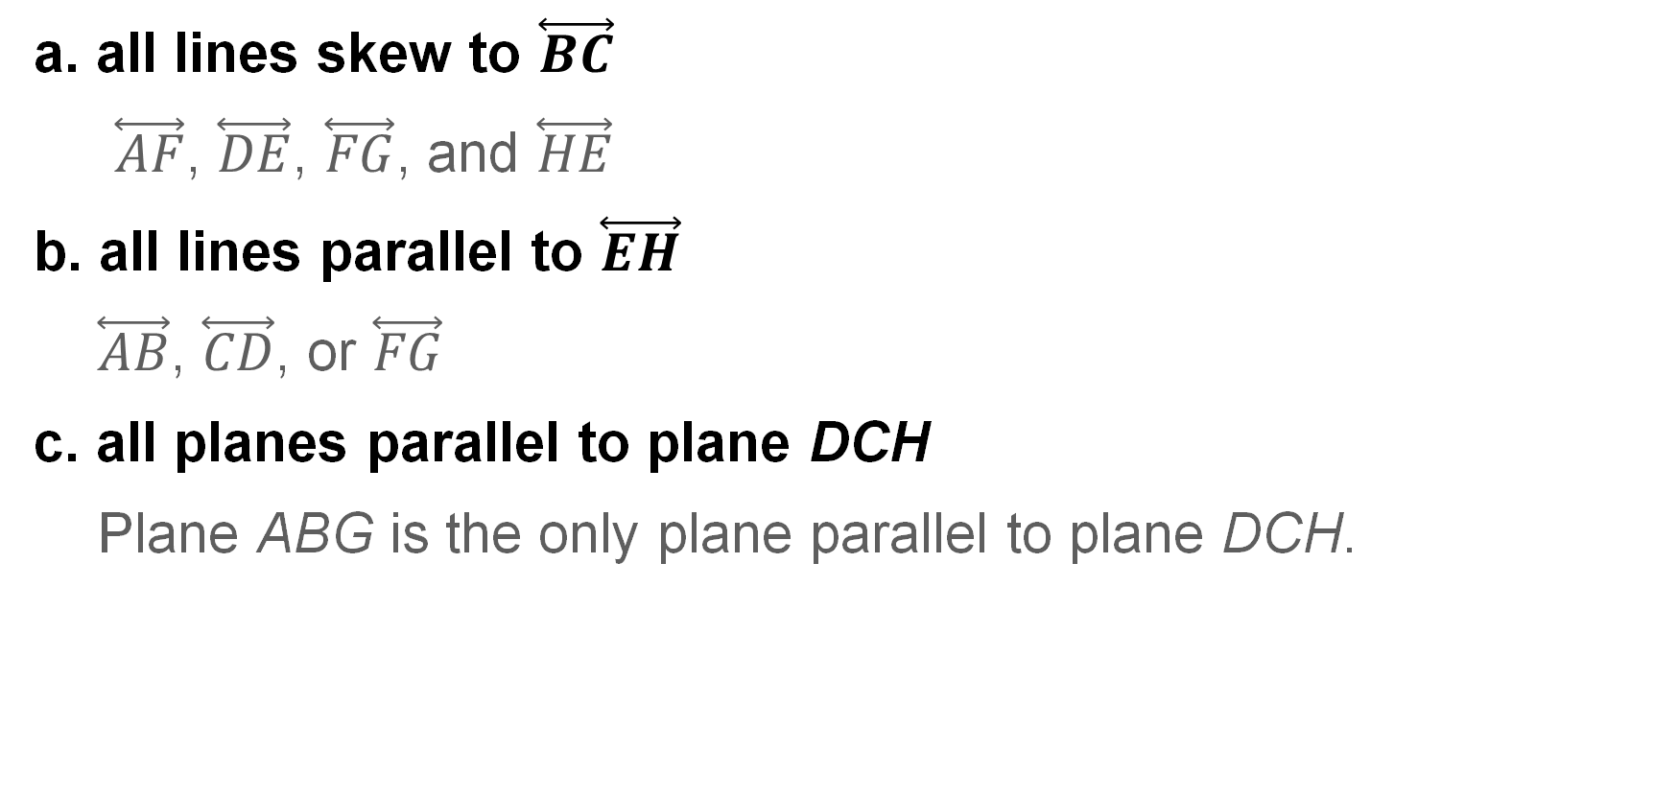
Example 1
Identify Parallel and Skew Relationships
a. all lines skew to $\overset{⃡}{BC}$
$\overset{⃡}{AF}$, $\overset{⃡}{DE}$, $\overset{⃡}{FG}$, and $\overset{⃡}{HE}$
b. all lines parallel to $\overset{⃡}{EH}$
$\overset{⃡}{AB}$, $\overset{⃡}{CD}$, or $\overset{⃡}{FG}$
c. all planes parallel to plane DCH
Plane ABG is the only plane parallel to plane DCH.

Slide 18
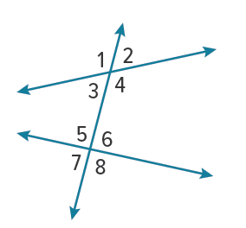
Example 2
Classify Angle Pair Relationships
Classify the relationship between each pair of angles as alternate interior, alternate exterior, corresponding, or consecutive interior angles.
∠4 and ∠5
∠3 and ∠7
∠3 and ∠5
∠1 and ∠8

Slide 19
Example 2
Classify Angle Pair Relationships
∠4 and ∠5 are alternate interior angles.
∠3 and ∠7 are corresponding angles.
∠3 and ∠5 are consecutive interior angles.
∠1 and ∠8 are alternate exterior angles.

Slide 20
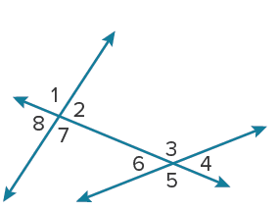
Example 2
Classify Angle Pair Relationships
Check
Classify the relationship between each pair of angles as alternate interior, alternate exterior, corresponding, or consecutive interior angles.
a. ∠1 and ∠5
b. ∠2 and ∠4

Slide 21
Example 2
Classify Angle Pair Relationships
Check
Classify the relationship between each pair of angles as alternate interior, alternate exterior, corresponding, or consecutive interior angles.
a. ∠1 and ∠5
b. ∠2 and ∠4
alternate exterior angles
corresponding angles
Notes:
alternate exterior angles
corresponding angles

Slide 22
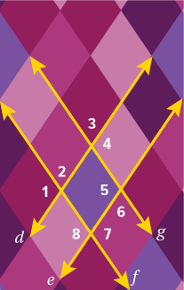
Example 3
Identify Transversals and Classify Angle Pairs
Identify the transversal connecting each pair of angles in the photo. Then classify the relationship between each pair of angles.
∠1 and ∠8
∠3 and ∠6
∠6 and ∠7

Slide 23
Example 3
Identify Transversals and Classify Angle Pairs
The transversal connecting ∠1 and ∠8 is line 𝒻.
These are corresponding angles.
The transversal connecting ∠3 and ∠6 is line ℊ.
These are alternate exterior angles.
The transversal connecting ∠6 and ∠7 is line ℯ.
These are consecutive interior angles.

Slide 24
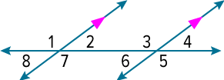
Learn
Angles and Parallel Lines
If two lines are parallel and cut by a transversal, then there are special relationships in the angle pairs formed by the lines.
Theorem 3.14: Corresponding Angles Theorem
If two parallel lines are cut by a transversal, then each pair of corresponding angles is congruent. | ∠1 ≅ ∠3, ∠2 ≅ ∠4, ∠5 ≅ ∠7, ∠6 ≅ ∠8

Slide 25
Learn
Angles and Parallel Lines
Theorem 3.15: Alternate Interior Angles Theorem
If two parallel lines are cut by a transversal, then each pair of alternate interior angles is congruent. | ∠2 ≅ ∠6, ∠3 ≅ ∠7
Theorem 3.16: Consecutive Interior Angles Theorem
If two parallel lines are cut by a transversal, then each pair of consecutive interior angles is supplementary. | ∠2 and ∠3, ∠6 and ∠7

Slide 26
Learn
Angles and Parallel Lines
Theorem 3.17: Alternate Exterior Angles Theorem
If two parallel lines are cut by a transversal, then each pair of alternate exterior angles is congruent. | ∠1 ≅ ∠5, ∠4 ≅ ∠8

Slide 27
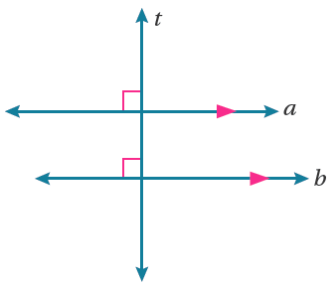
Learn
Angles and Parallel Lines
A special relationship also exists when the transversal of two parallel lines is a perpendicular line.
Theorem 3.18: Perpendicular Transversal Theorem
In a plane, if a line is perpendicular to one of two parallel lines, then it is perpendicular to the other. Example If 𝒶 ∥ 𝒷 and 𝒶 ⊥ 𝓉, then 𝒷 ⊥ 𝓉.

Slide 28
Learn
Proof of the Corresponding Angles Theorem
One method for proving theorems is to use an indirect proof, which begins by assuming that the prove statement is false. This proof method will be covered in more detail in a later module.
The father of modern geometry, Euclid (c. 300 BCE), realized that only a few postulates were needed to prove theorems. The Parallel Postulate is one of Euclid’s five original postulates and is needed to prove the Corresponding Angles Theorem.

Slide 29
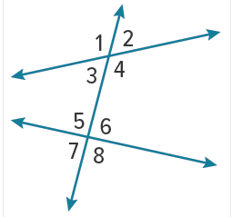
Learn
Proof of the Corresponding Angles Theorem
Postulate 3.12: Parallel Postulate
If a transversal intersects two lines so that the sum of the measures of the interior angles on one side of the transversal is less than 180°, the lines will intersect on that side of the transversal. Example If m∠3 + m∠5 < 180°, then the lines intersect to the left of the transversal.

Slide 30
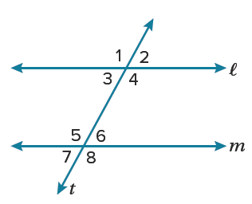
Learn
Proof of the Corresponding Angles Theorem
Given: 𝓁 ∥ 𝓂
Prove: ∠1 ≅ ∠5
Proof: We are given that 𝓁 ∥ 𝓂. Assume that ∠1 ≇ ∠5. If this is true, then m∠1 ≠ m∠5, so either m∠1 > m∠5 or m∠1 < m∠5.

Slide 31
Learn
Proof of the Corresponding Angles Theorem
Step 1 Assume m∠1 > m∠5.
Assume m∠1 > m∠5. Because ∠1 and ∠3 are a linear pair, m∠1 + m∠3 = 180°.
m∠1 > m∠5, so m∠5 + m∠3 < 180°. Because the interior angles on the same side of the transversal add up to less than 180°, by the Parallel Postulate, lines 𝓁 and 𝓂 will intersect on that side. Because lines 𝓁 and 𝓂 intersect, the lines are not parallel. The assumption leads to a contradiction of the given, so m∠1 cannot be greater than m∠5.

Slide 32
Learn
Proof of the Corresponding Angles Theorem
Step 2 Assume m∠1 < m∠5.
Now, assume m∠1 < m∠5. By the Vertical Angles Theorem, ∠1 ≅ ∠4. So, m∠1 = m∠4 by the definition of congruent angles. Because ∠5 and ∠6 are a linear pair, m∠5 + m∠6 = 180°. By substitution, m∠4 < m∠5, so m∠4 + m∠6 < 180°. Because the interior angles on the same side of the transversal add up to less than 180°, by the Parallel Postulate, lines 𝓁 and 𝓂 will intersect on that side. Because the lines intersect, 𝓁 and 𝓂 are not parallel, which is a contradiction of the given. So, m∠1 cannot be less than m∠5.

Slide 33
Learn
Proof of the Corresponding Angles Theorem
Step 3 Make a Conclusion
In both cases, 𝓁 and 𝓂 are not parallel by the definition of parallel, contradicting the given that 𝓁 ∥ 𝓂. Because the assumption that ∠1 ≇ ∠5 leads to a contradiction, ∠1 ≅ ∠5.

Slide 34
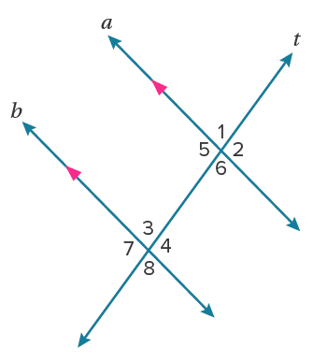
Learn
Proof of the Alternate Interior Angles Theorem
Because theorems can be proven using other theorems, the Corresponding Angles Theorem can be used to prove the Alternate Interior Angles Theorem.
Given: 𝒶 ∥ 𝒷; 𝓉 is a transversal of 𝒶 and 𝒷.
Prove: ∠4 ≅ ∠5, ∠6 ≅ ∠3

Slide 35
Learn
Proof of the Alternate Interior Angles Theorem
Step 1 Find a starting point.
When two parallel lines are cut by a transversal, what type of angle pair is formed by the angles on the same side of the transversal and on the same side of the parallel lines? consecutive interior angles
How can you use the Corresponding Angles Theorem to determine congruent angles in the diagram?
If two parallel lines are cut by a transversal, then each pair of corresponding angles is congruent.

Slide 36
Learn
Proof of the Alternate Interior Angles Theorem
In the diagram, if you know that ∠2 ≅ ∠4 and ∠5 ≅ ∠2, what can you say about the relationship between ∠4 and ∠5? Justify your reasoning.
By the Transitive Property of Congruence, ∠5 ≅ ∠4.

Slide 37
Learn
Proof of the Alternate Interior Angles Theorem
Step 2 Identify relationships.
Identify all the angle relationships that can be proven true using the diagram and these theorems.
Corresponding Angles Theorem: ∠2 ≅ ∠4, ∠6 ≅ ∠8
Vertical Angles Theorem: ∠5 ≅ ∠2, ∠8 ≅ ∠3

Slide 38
Learn
Proof of the Alternate Interior Angles Theorem
Step 3 Write the proof.
Proof: We are given that 𝒶 ∥ 𝒷 with a transversal 𝓉. By the Corresponding Angles Theorem, corresponding angles are congruent. So, ∠2 ≅ ∠4 and ∠6 ≅ ∠8. Also,
∠5 ≅ ∠2 and ∠8 ≅ ∠3 by the Vertical Angles Theorem. Therefore, ∠5 ≅ ∠4 and ∠6 ≅ ∠3 by the Transitive Property of Congruence.

Slide 39
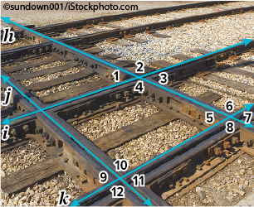
Example 4
Use Theorems About Parallel Lines
RAILROADS Crossties 𝒾 and 𝓀 are parallel. Both crossties are intersected by crosstie 𝒽. If m∠1 = 42°, find m∠7.

Slide 40
Example 4
Use Theorems About Parallel Lines
∠7 ≅ ∠1 | Alternate Exterior Angles Theorem
m∠7 = m∠1 | Definition of congruent angles
m∠7 = 42° | Substitution
The measure of ∠7 is 42°.

Slide 41
Example 4
Use Theorems About Parallel Lines
Alternate Method
∠1 ≅ ∠3 | Vertical Angles Theorem
∠3 ≅ ∠7 | Corresponding Angles Theorem
∠1 ≅ ∠7 | Transitive Property of Congruence
m∠1 = m∠7 | Definition of congruent angles
42° = m∠7 | Substitution
The measure of ∠7 is 42°.

Slide 42
Example 4
Use Theorems About Parallel Lines
Talk About It!
Compare and contrast the methods. Which method do you think is more efficient?

Slide 43
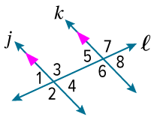
Example 5
Find Values of Variables
Use the figure to find the value of the indicated variable. Justify your reasoning.
a. If m∠3 = (4x + 7)° and m∠6 = (5x − 13)°, find the value of x.
b. Find the value of y if m∠8 = 68° and m∠3 = (3y − 2)°.

Slide 44
Example 5
Find Values of Variables
a. If m∠3 = (4x + 7)° and m∠6 = (5x − 13)°, find the value of x.
∠3 ≅ ∠6 | Alternate Interior Angles Theorem
m∠3 = m∠6 | Definition of congruent angles
(4x + 7)° = (5x − 13)° | Substitution
x = 20 | Solve.

Slide 45
Example 5
Find Values of Variables
b. Find the value of y if m∠8 = 68° and m∠3 = (3y − 2)°.
∠5 ≅ ∠8 | Vertical Angles Theorem
m∠5 = m∠8 | Definition of congruent angles
m∠5 = 68° | Substitution

Slide 46
Example 5
Find Values of Variables
Because lines 𝒿 and 𝓀 are parallel, ∠5 and ∠3 are supplementary by the Consecutive Interior Angles Theorem.
m∠3 + m∠5 = 180° | Definition of supplementary angles
(3y − 2)°+ 68° = 180° | Substitution
3y° + 66° = 180° | Simplify.
y = 38 | Solve.

Slide 47
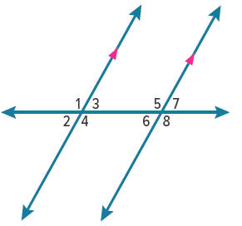
Exit Ticket
Use the figure to complete the table.
 | Angles | Name | Relationship
1. | ∠1 and ∠5
2. | ∠3 and ∠6
3. | ∠2 and ∠7
4. | ∠6 and ∠8
5. | ∠2 and ∠3
6. How many different angle measures are there among the eight angles formed when two parallel lines are cut by a transversal?
Notes:
two

Slide 48
Exit Ticket
Use the figure to complete the table.
 | Angles | Name | Relationship
1. | ∠1 and ∠5 | corresponding | congruent
2. | ∠3 and ∠6 | alternate interior | congruent
3. | ∠2 and ∠7 | alternate exterior | congruent
4. | ∠6 and ∠8 | consecutive | supplementary
5. | ∠2 and ∠3 | vertical | congruent
6. How many different angle measures are there among the eight angles formed when two parallel lines are cut by a transversal? two
Notes:
corresponding; congruent
alternate interior; congruent
alternate exterior; congruent
consecutive; supplementary
vertical; congruent
two

