Slide 1
Midpoints and Bisectors

Slide 2
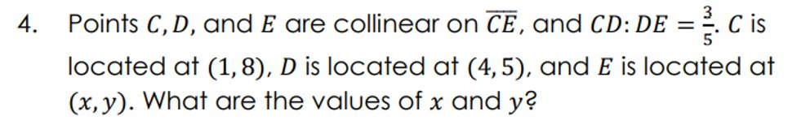
Warm Up

Slide 3
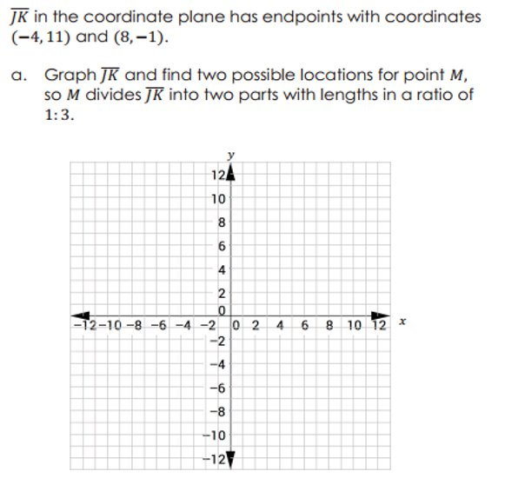
Warm Up

Slide 4
Florida’s B.E.S.T. Standards for Mathematics
MA.912.GR.3.3
Use coordinate geometry to solve mathematical and real-world geometric problems involving lines, circles, triangles and quadrilaterals.
MA.912.GR.5.2
Construct the bisector of a segment or an angle, including the perpendicular bisector of a line segment.

Slide 5
Florida’s Mathematical Thinking and Reasoning Standards
MA.K12.MTR.1.1
Actively participate in effortful learning both individually and collectively.
MA.K12.MTR.4.1
Engage in discussions that reflect on the mathematical thinking of self and others.
MA.K12.MTR.7.1
Apply mathematics to real-world contexts.

Slide 6
Lesson Objectives
Content Objective
Students will find midpoints and bisect line segments.
Language Objectives
Students use If…, then… statements to talk about midpoints and bisecting line segments.
To maximize linguistic and cognitive meta-awareness, students participate in MLR5: Co-Craft Questions and Problems.

Slide 7
Learn
Midpoints on a Number Line
The midpoint of a segment is the point halfway between the endpoints of the segment. A point is equidistant from other points if it is the same distance from them. The midpoint separates the segment into two segments with a ratio of 1:1. So, you can use the Section Formula which is used to calculate the coordinate of a point that separates a line segment into a given ratio, to derive the Midpoint Formula.

Slide 8

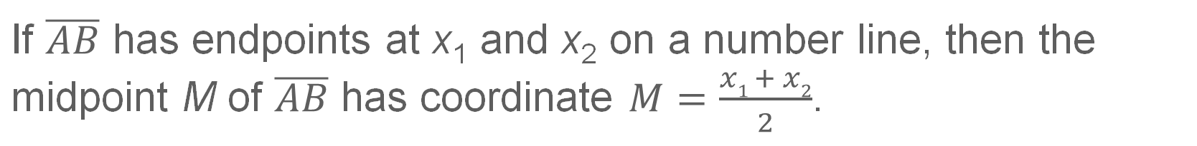
Learn
Midpoints on a Number Line
Key Concept: Midpoint on a Number Line
If $\overline{AB}$ has endpoints at x₁ and x₂ on a number line, then the midpoint M of $\overline{AB}$ has coordinate $M=\frac{x1 + x2}{2}$.

Slide 9

Example 1
Find the Midpoint on a Number Line
Find the coordinate of the midpoint of $\overline{XZ}$.

Slide 10

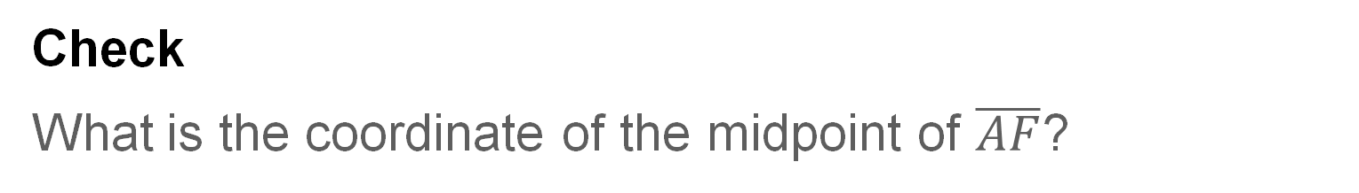
Example 1
Find the Midpoint on a Number Line
Check
What is the coordinate of the midpoint of $\overline{AF}$?

Slide 11
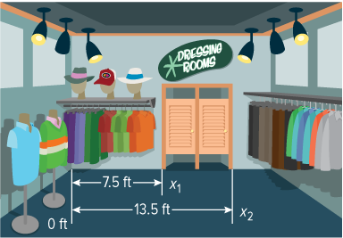
Example 2
Midpoints in the Real World
SIGNS Mariella works at a vintage clothing store. She wants to hang a new sign so it is centered above the dressing-room doors. Given that the dressing-room doors have the same width, find the point along the wall that Mariella should hang the new sign.

Slide 12
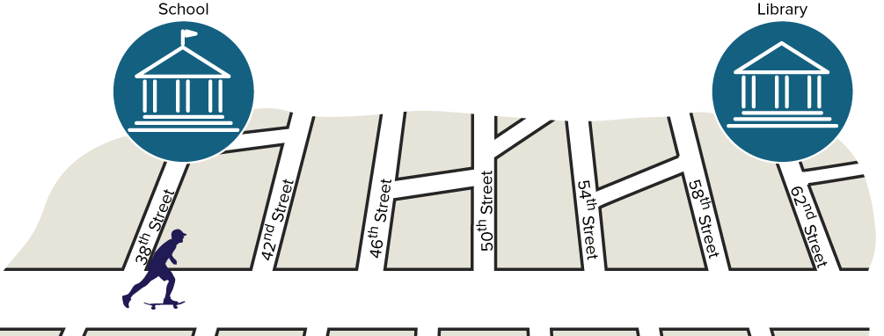
Example 2
Midpoints in the Real World
Check
DISTANCE Kenneth travels from his school on 38th Street to the library on 62nd Street. He stops halfway there to take a break. Where does Kenneth stop to rest?

Slide 13
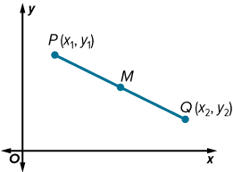
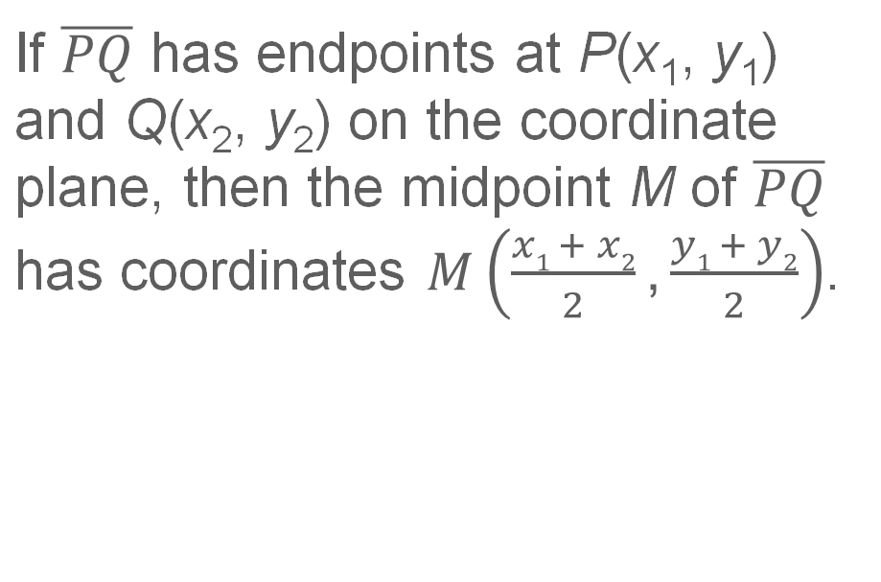
Learn
Midpoints on the Coordinate Plane
Key Concept: Midpoint Formula on the Coordinate Plane
If $\overline{PQ}$ has endpoints at P(x₁, y₁) and Q(x₂, y₂) on the coordinate plane, then the midpoint M of $\overline{PQ}$ has coordinates $M\left(\frac{x1 + x2}{2}\text{,}\frac{y1 + y2}{2}\right)$.

Slide 14
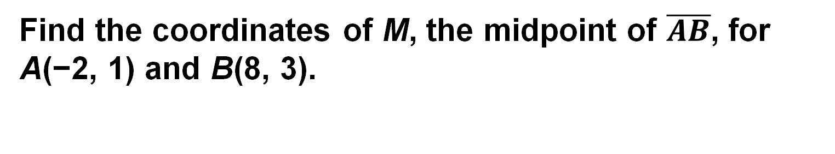
Example 3
Find the Midpoint on the Coordinate Plane
Find the coordinates of M, the midpoint of $\overline{AB}$, for A(−2, 1) and B(8, 3).

Slide 15
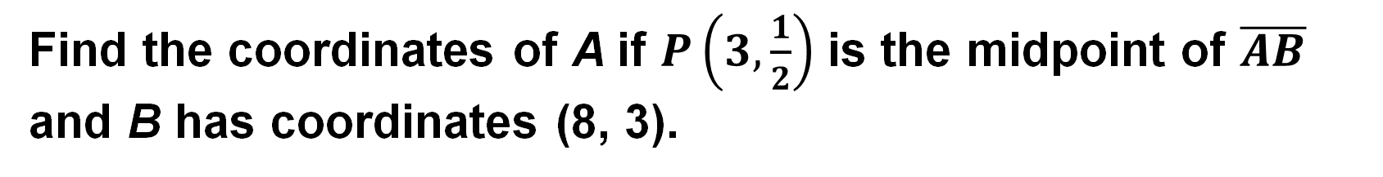
Example 4
Find Missing Coordinates
Find the coordinates of A if $P\left(3,\frac{1}{2}\right)$ is the midpoint of $\overline{AB}$ and B has coordinates (8, 3).

Slide 16
Learn
Bisectors
Because the midpoint separates a segment into two congruent segments, we can say that the midpoint bisects the segment. Any segment, line, plane, or point that bisects a segment is called a segment bisector.

Slide 17
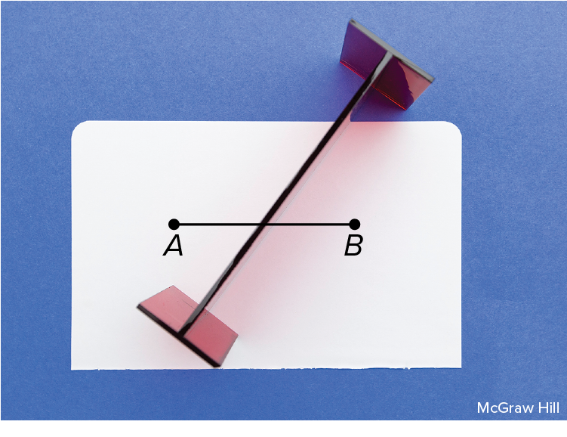
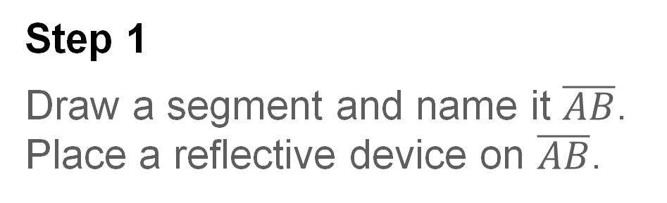
Learn
Bisectors
Construction: Bisect a Segment
Step 1
Draw a segment and name it $\overline{AB}$. Place a reflective device on $\overline{AB}$.

Slide 18
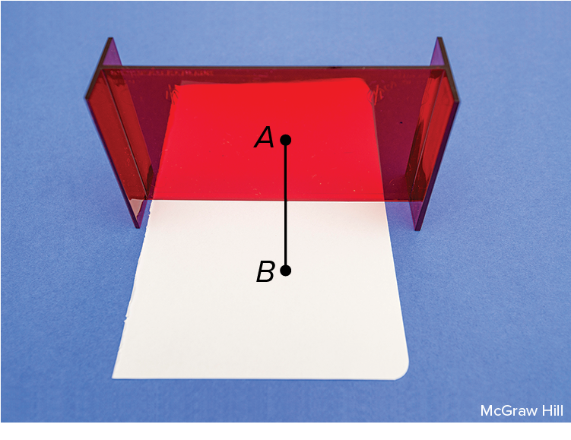
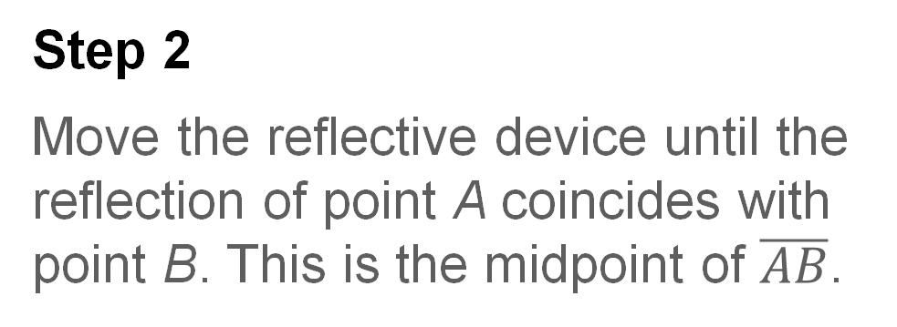
Learn
Bisectors
Construction : Bisect a Segment
Step 2
Move the reflective device until the reflection of point A coincides with point B. This is the midpoint of $\overline{AB}$.

Slide 19
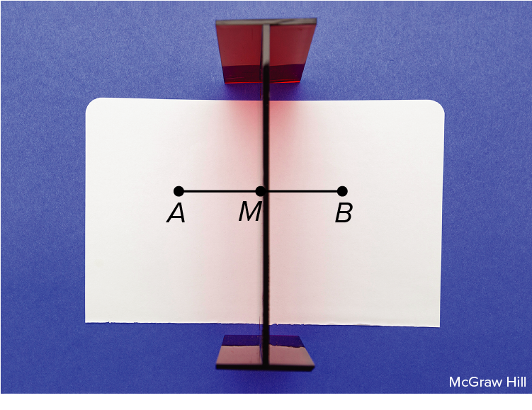
Learn
Bisectors
Construction : Bisect a Segment
Step 3
Label this point M. Any segment bisector will pass through M.

Slide 20
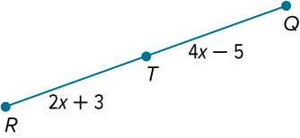
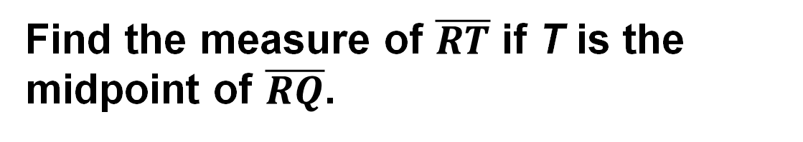
Example 5
Find Missing Measures
Find the measure of $\overline{RT}$ if T is the midpoint of $\overline{RQ}$.

Slide 21

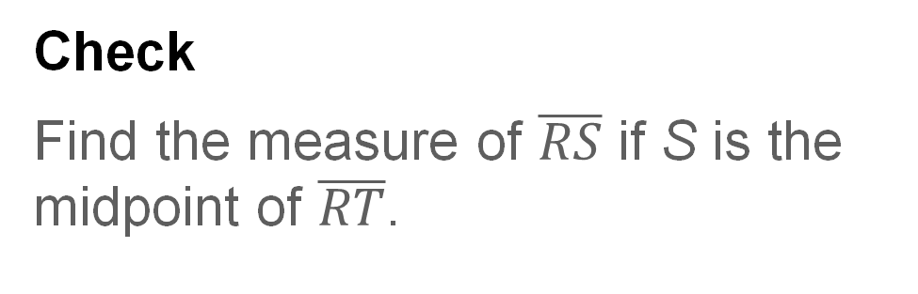
Example 5
Find Missing Measures
Check
Find the measure of $\overline{RS}$ if S is the midpoint of $\overline{RT}$.
56
B. 58
C. 112
D. 116

Slide 22

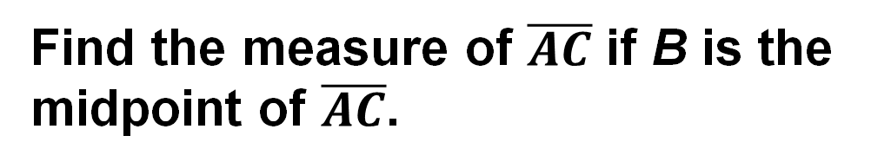
Example 6
Find the Total Length
Find the measure of $\overline{AC}$ if B is the midpoint of $\overline{AC}$.

Slide 23
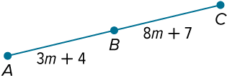
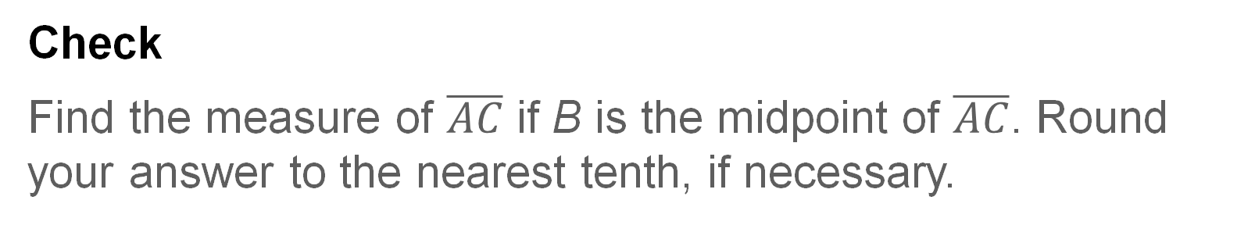
Example 6
Find the Total Length
Check
Find the measure of $\overline{AC}$ if B is the midpoint of $\overline{AC}$. Round your answer to the nearest tenth, if necessary.

Slide 24
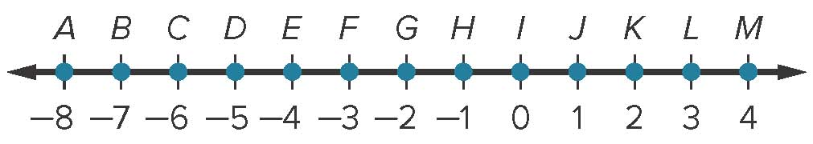
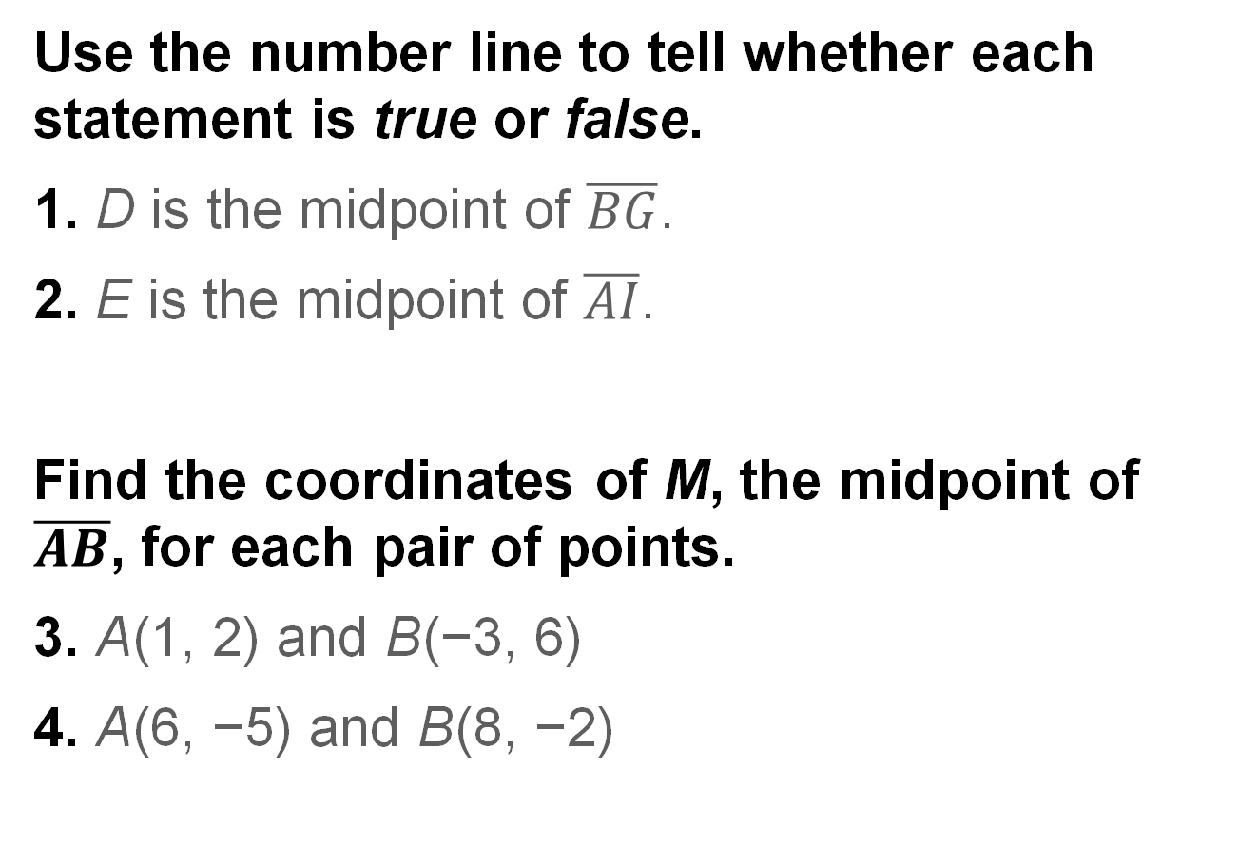
Exit Ticket
Use the number line to tell whether each statement is true or false.
1. D is the midpoint of $\overline{BG}$.
2. E is the midpoint of $\overline{AI}$.
Find the coordinates of M, the midpoint of $\overline{AB}$, for each pair of points.
3. A(1, 2) and B(−3, 6)
4. A(6, −5) and B(8, −2)

