Slide 1
5-7 Triangles and Coordinate Proof

Slide 2
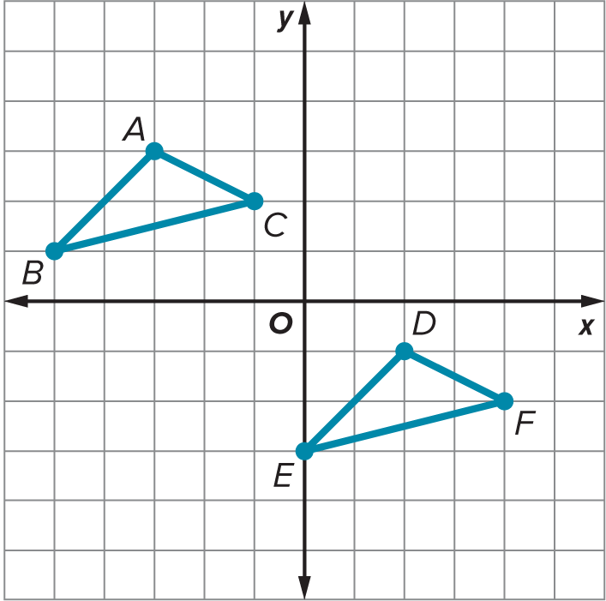
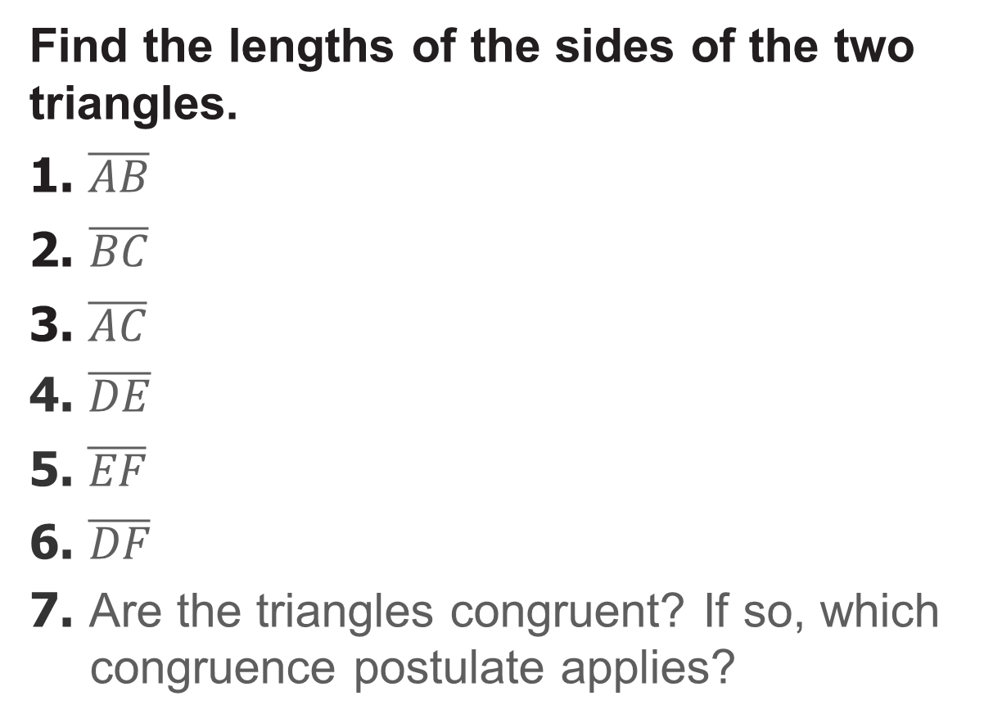
Warm Up
Find the lengths of the sides of the two triangles.
1. $\overline{AB}$
2. $\overline{BC}$
3. $\overline{AC}$
4. $\overline{DE}$
5. $\overline{EF}$
6. $\overline{DF}$
7. Are the triangles congruent? If so, which congruence postulate applies?

Slide 3
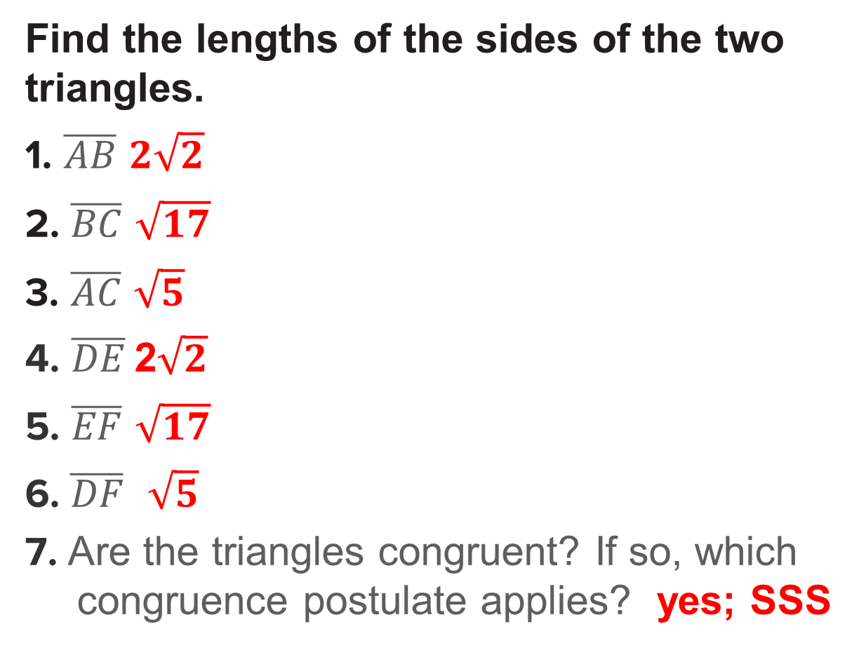
Warm Up
Find the lengths of the sides of the two triangles.
1. $\overline{AB}$ $2\sqrt{2}$
2. $\overline{BC}$ $\sqrt{17}$
3. $\overline{AC}$ $\sqrt{5}$
4. $\overline{DE}$ 2$\sqrt{2}$
5. $\overline{EF}$ $\sqrt{17}$
6. $\overline{DF}$ $\sqrt{5}$
7. Are the triangles congruent? If so, which congruence postulate applies? yes; SSS
Notes:
$$2\sqrt{2}$$
$$\sqrt{17}$$
$$\sqrt{5}$$
2$\sqrt{2}$
$$\sqrt{17}$$
$$\sqrt{5}$$
yes; SSS

Slide 4
Florida’s B.E.S.T. Standards for Mathematics
MA.912.GR.3.2 Given a mathematical context, use coordinate geometry to classify or justify definitions, properties and theorems involving circles, triangles or quadrilaterals.
MA.912.GR.3.3 Use coordinate geometry to solve mathematical and real-world geometric problems involving lines, circles, triangles and quadrilaterals.

Slide 5
Florida’s Mathematical Thinking and Reasoning Standards
MA.K12.MTR.3.1
Complete tasks with mathematical fluency.

Slide 6
Lesson Objectives
Content Objective
Students will prove theorems about triangles using coordinates.
Language Objectives
Students talk about using coordinates to prove theorems using represent and determine.
To optimize output, students participate in MLR1: Stronger and Clearer Each Time.

Slide 7
Learn
Position and Label Triangles
Coordinate proofs use figures in the coordinate plane and algebra to prove geometric concepts. The first step in a coordinate proof is placing the figure on the coordinate plane.

Slide 8
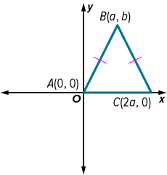
Learn
Position and Label Triangles
Key Concept: Placing Triangles on the Coordinate Plane
1. Use the origin as a vertex, or the center of the triangle.
2. Place at least one side of the triangle on an axis.
3. Keep the triangle within the first quadrant if possible.
4. Use coordinates that make computations as simple as possible.

Slide 9

Example 1
Position and Label a Triangle
Position and label right △ABC with legs $\overline{AC}$ and $\overline{AB}$ so that $\overline{AC}$ is 2a units long and $\overline{AB}$ is 2b units long.

Slide 10
Example 1
Position and Label a Triangle
Step 1 Position the triangle.
Position the triangle in the first quadrant.
Placing the right angle of the triangle, ∠A, at the origin will allow the two legs to be along the x- and y-axes.

Slide 11
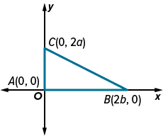
Example 1
Position and Label a Triangle
Step 2 Determine the coordinates.
Because C is on the y-axis, its
x-coordinate is 0. Its y-coordinate is 2a because the leg is 2a units long.
Because B is on the x-axis, its y-coordinate is 0. Its x-coordinate is 2b because the leg is 2b units long.

Slide 12
Example 1
Position and Label a Triangle
Talk About It!
Ask a partner to provide feedback on the placement of your triangle. How can you improve your process to make proving relationships easier?

Slide 13
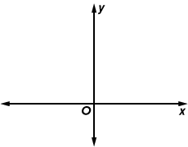
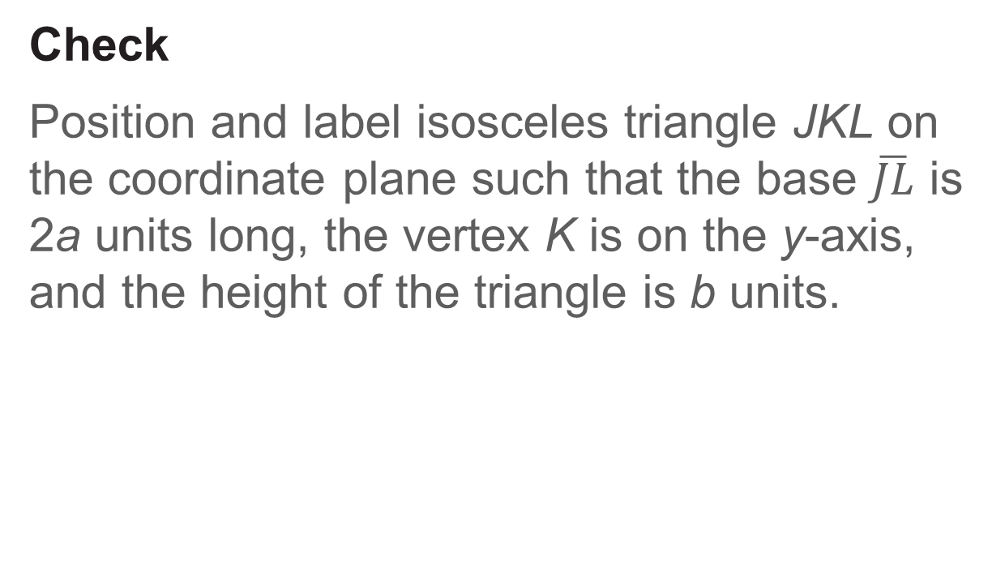
Example 1
Position and Label a Triangle
Check
Position and label isosceles triangle JKL on the coordinate plane such that the base $\overline{JL}$ is 2a units long, the vertex K is on the y-axis, and the height of the triangle is b units.

Slide 14
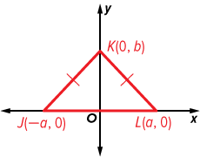
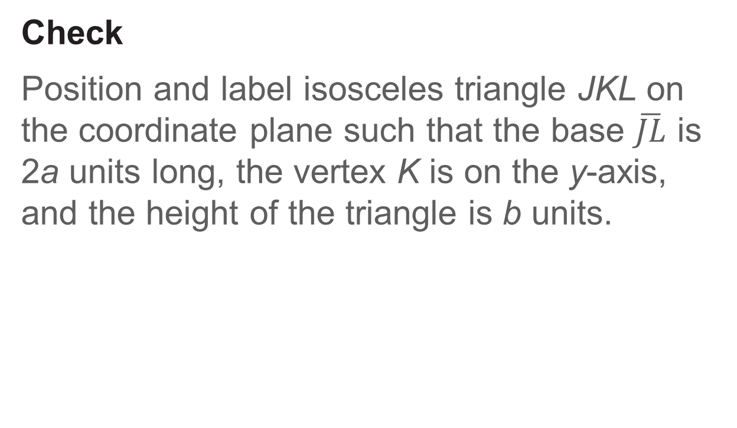
Example 1
Position and Label a Triangle
Check
Position and label isosceles triangle JKL on the coordinate plane such that the base $\overline{JL}$ is 2a units long, the vertex K is on the y-axis, and the height of the triangle is b units.

Slide 15
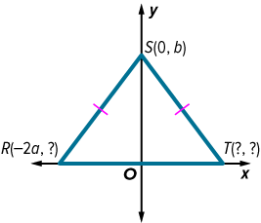
Example 2
Identify Missing Coordinates
Name the missing coordinates of isosceles △RST.

Slide 16
Example 2
Identify Missing Coordinates
Step 1 Find the y-coordinates of R and T.
The base of the triangle is positioned on the x-axis. So, the y-coordinate of R is 0, and the y-coordinate of T is 0.

Slide 17
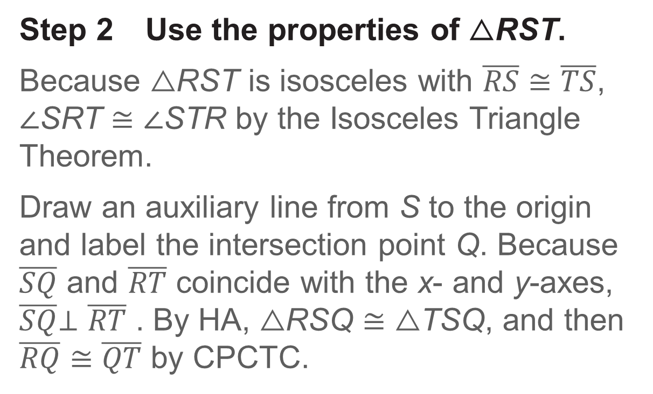
Example 2
Identify Missing Coordinates
Step 2 Use the properties of △RST.
Because △RST is isosceles with $\overline{RS}≅\overline{TS}$, ∠SRT ≅ ∠STR by the Isosceles Triangle Theorem.
Draw an auxiliary line from S to the origin and label the intersection point Q. Because $\overline{SQ}$ and $\overline{RT}$ coincide with the x- and y-axes, $\overline{SQ}$⊥ $\overline{RT}$ . By HA, △RSQ ≅ △TSQ, and then $\overline{RQ}$ $≅$ $\overline{QT}$ by CPCTC.

Slide 18

Example 2
Identify Missing Coordinates
Step 3 Find the x-coordinate of T.
So, because the x-coordinate of R is $\text{−}$2a, the x-coordinate of T must be 2a.

Slide 19
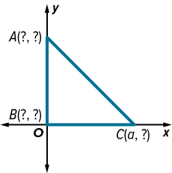
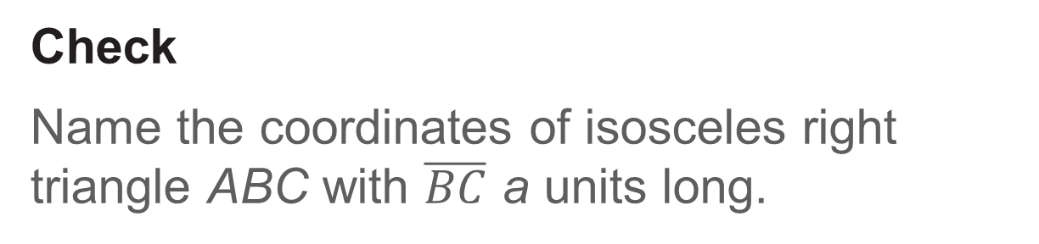
Example 2
Identify Missing Coordinates
Check
Name the coordinates of isosceles right triangle ABC with $\overline{BC}$ a units long.

Slide 20

Example 2
Identify Missing Coordinates
Check
Name the coordinates of isosceles right triangle ABC with $\overline{BC}$ a units long.
A(0, a); B(0, 0); C(a, 0)
Notes:
A(0, a); B(0, 0); C(a, 0)

Slide 21
Learn
Triangles and Coordinate Proof
Coordinate proofs use figures on the coordinate plane to prove geometric concepts and theorems.
Key Concept: Writing a Coordinate Proof
Step 1 Place the figure on the coordinate plane.
Step 2 Label the coordinates of the vertices of the figure.
Step 3 Use algebra to prove properties or theorems.

Slide 22
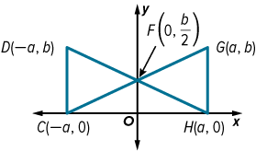
Example 3
Write a Coordinate Proof
Write a coordinate proof to show that △FGH ≅ △FDC.

Slide 23
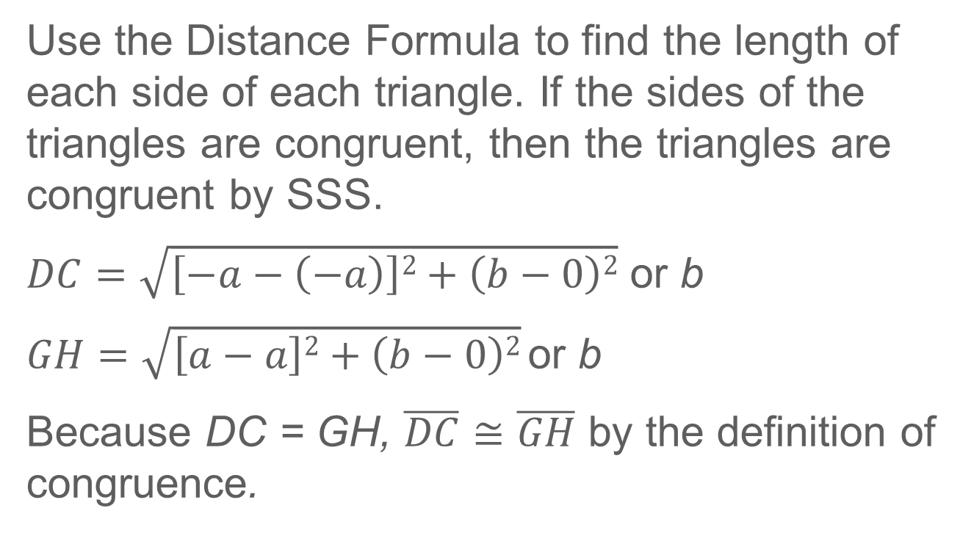
Example 3
Write a Coordinate Proof
Use the Distance Formula to find the length of each side of each triangle. If the sides of the triangles are congruent, then the triangles are congruent by SSS.
$DC=\sqrt{\left[−a−\left(−a\right)\right]2+\left(b−0\right)2}$ or b
$GH=$ $\sqrt{\left[a−a\right]2+\left(b−0\right)2} \text{or} \text{b}$
Because DC = GH, $\overline{DC}$≅ $\overline{GH}$ by the definition of congruence.

Slide 24
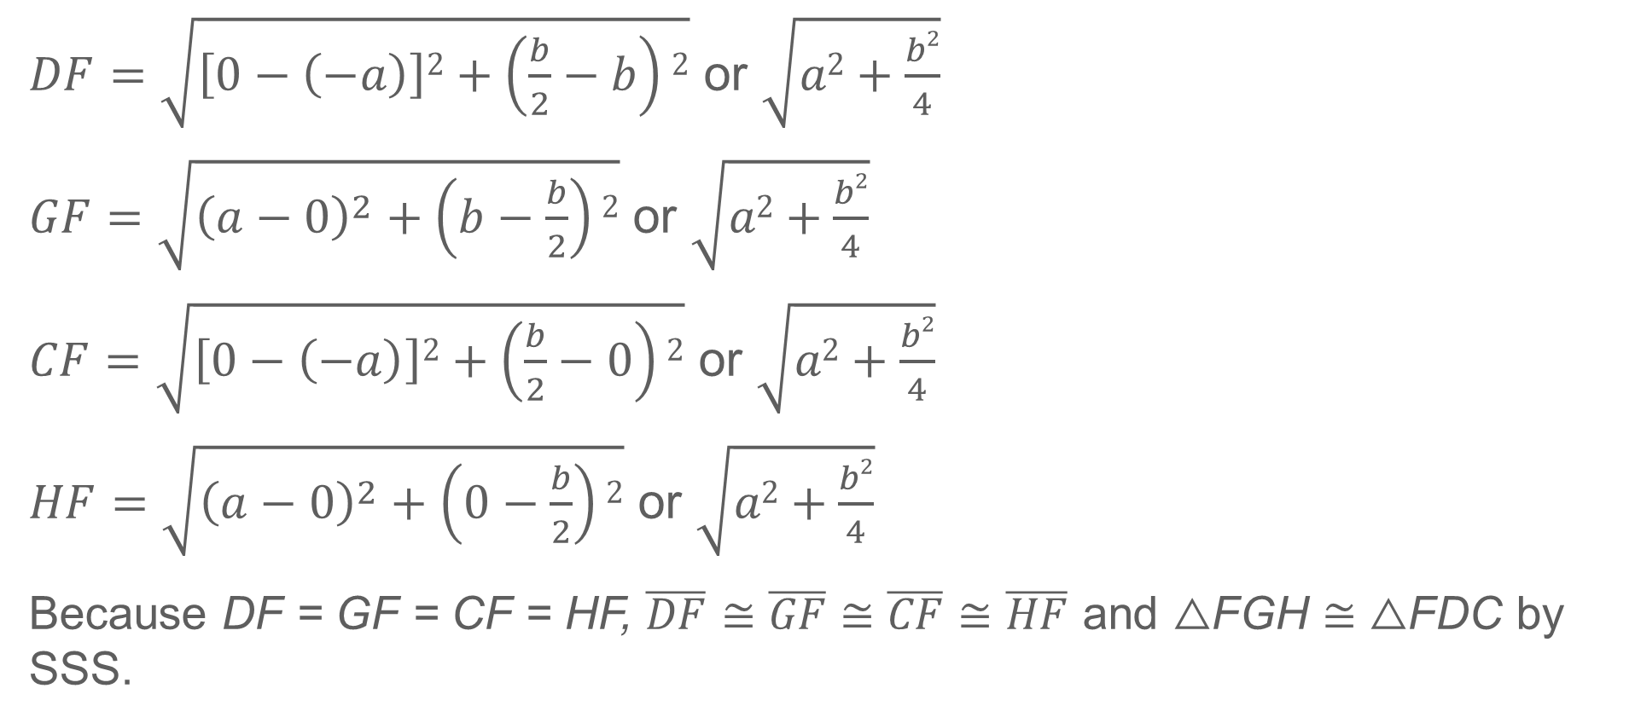
Example 3
Write a Coordinate Proof
$DF=\sqrt{\left[0−\left(−a\right)\right]2+\left(\frac{b}{2}−b\right)2}$ or $\sqrt{a2+\frac{b2}{4}}$
$GF=\sqrt{{\left(a−0\right)}^{2}+\left(b−\frac{b}{2}\right)2}$ or $\sqrt{a2+\frac{b2}{4}}$
$CF=\sqrt{\left[0−\left(−a\right)\right]2+\left(\frac{b}{2}−0\right)2}$ or $\sqrt{a2+\frac{b2}{4}}$
$HF=\sqrt{{\left(a−0\right)}^{2}+\left(0−\frac{b}{2}\right)2}$ or $\sqrt{a2+\frac{b2}{4}}$
Because DF = GF = CF = HF, $\overline{DF}$ ≅ $\overline{GF}$≅ $\overline{CF}$≅ $\overline{HF}$ and △FGH ≅ △FDC by SSS.

Slide 25
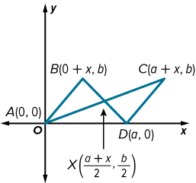
Example 3
Write a Coordinate Proof
Check
Write a coordinate proof to show that △ABX ≅ △CDX.

Slide 26
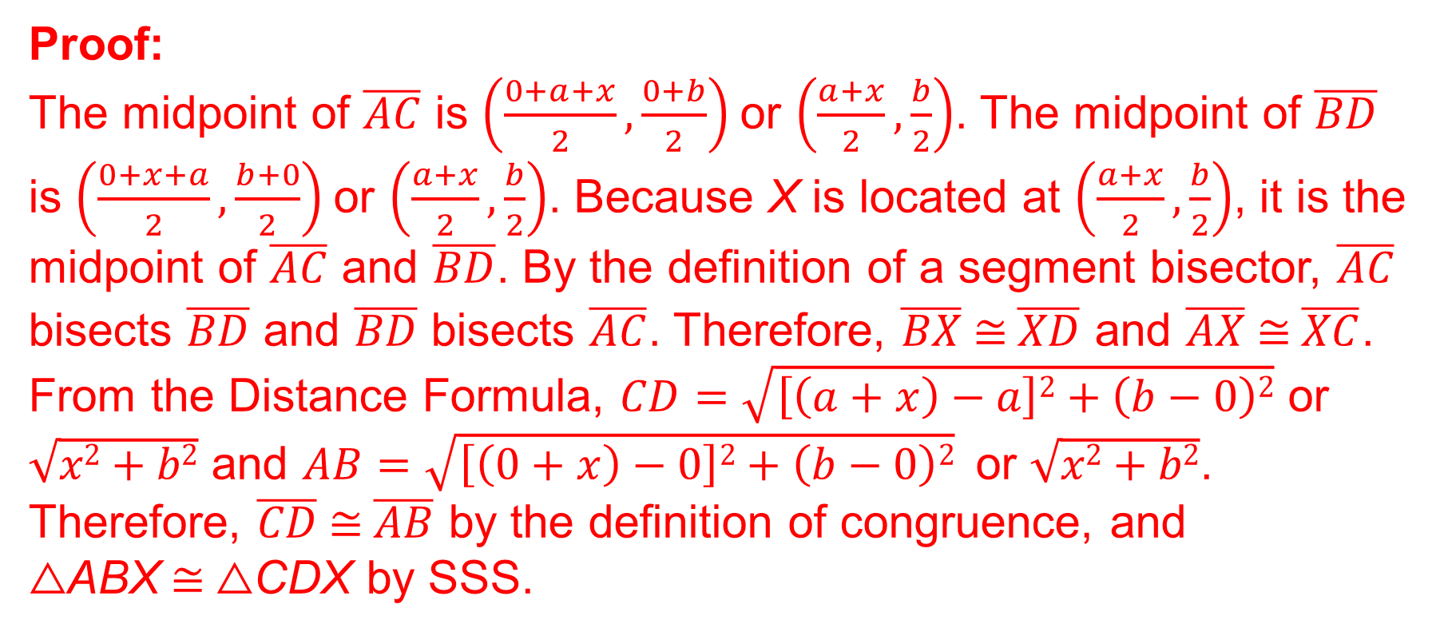
Example 3
Write a Coordinate Proof
Proof:
The midpoint of $\overline{AC}$ is $\left(\frac{0+a+x}{2},\frac{0+b}{2}\right)$or $\left(\frac{a+x}{2},\frac{b}{2}\right)$. The midpoint of $\overline{BD}$ is $\left(\frac{0+x+a}{2},\frac{b+0}{2}\right)$or $\left(\frac{a+x}{2},\frac{b}{2}\right)$. Because X is located at $\left(\frac{a+x}{2},\frac{b}{2}\right)$, it is the midpoint of $\overline{AC}$ and $\overline{BD}$. By the definition of a segment bisector, $\overline{AC}$ bisects $\overline{BD}$ and $\overline{BD}$ bisects $\overline{AC}$. Therefore, $\overline{BX}$≅$\overline{XD}$ and $\overline{AX}$≅$\overline{XC}$. From the Distance Formula, $CD=\sqrt{\left[\left(a+x\right)−a\right]2+\left(b−0\right)2}$ or $\sqrt{x2+b2}$ and $AB=\sqrt{\left[\left(0+x\right)−0\right]2+\left(b−0\right)2}$or $\sqrt{x2+b2}$. Therefore, $\overline{CD}$≅$\overline{AB}$ by the definition of congruence, and △ABX ≅ △CDX by SSS.
Notes:
Proof:
The midpoint of $\overline{AC}$ is $\left(\frac{0+a+x}{2},\frac{0+b}{2}\right)$or $\left(\frac{a+x}{2},\frac{b}{2}\right)$. The midpoint of $\overline{BD}$ is $\left(\frac{0+x+a}{2},\frac{b+0}{2}\right)$or $\left(\frac{a+x}{2},\frac{b}{2}\right)$. Because X is located at $\left(\frac{a+x}{2},\frac{b}{2}\right)$, it is the midpoint of $\overline{AC}$ and $\overline{BD}$. By the definition of a segment bisector, $\overline{AC}$ bisects $\overline{BD}$ and $\overline{BD}$ bisects $\overline{AC}$. Therefore, $\overline{BX}$≅$\overline{XD}$ and $\overline{AX}$≅$\overline{XC}$. From the Distance Formula, $CD=\sqrt{\left[\left(a+x\right)−a\right]2+\left(b−0\right)2}$ or $\sqrt{x2+b2}$ and $AB=\sqrt{\left[\left(0+x\right)−0\right]2+\left(b−0\right)2}$or $\sqrt{x2+b2}$. Therefore, $\overline{CD}$≅$\overline{AB}$ by the definition of congruence, and △ABX ≅ △CDX by SSS.

Slide 27
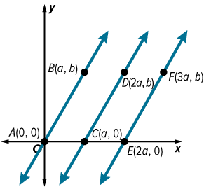
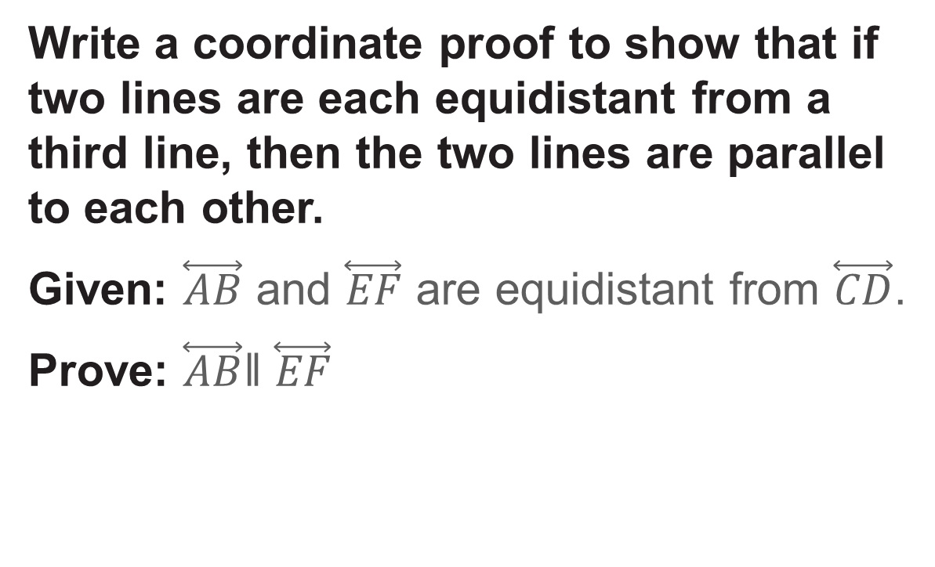
Example 4
Prove a Theorem by Using Coordinate Geometry
Write a coordinate proof to show that if two lines are each equidistant from a third line, then the two lines are parallel to each other.
Given: $\overset{⃡}{AB}$ and $\overset{⃡}{EF}$ are equidistant from $\overset{⃡}{CD}$.
Prove: $\overset{⃡}{AB}$ǁ $\overset{⃡}{EF}$

Slide 28
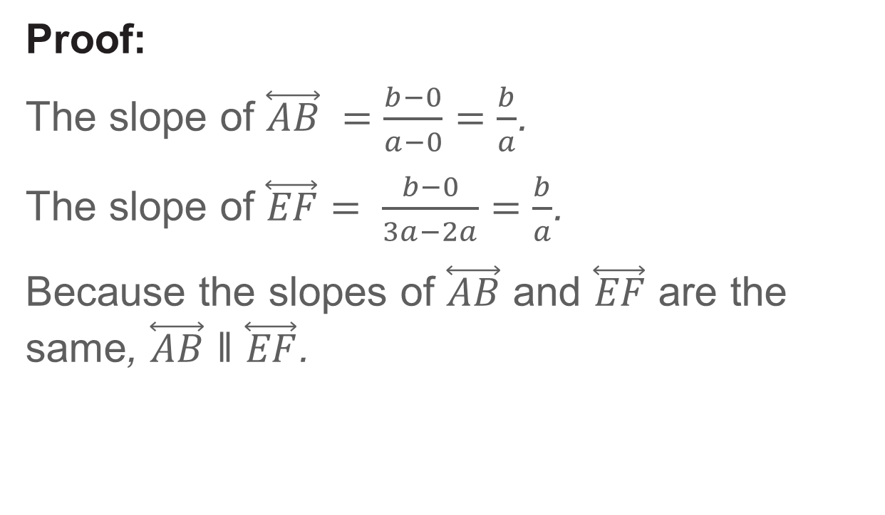
Example 4
Prove a Theorem by Using Coordinate Geometry
Proof:
The slope of $\overset{⃡}{AB} =\frac{b−0}{a−0}=\frac{b}{a}$.
The slope of $\overset{⃡}{EF}$ $= \frac{b−0}{3a−2a}=\frac{b}{a}$.
Because the slopes of $\overset{⃡}{AB}$ and $\overset{⃡}{EF}$ are the same, $\overset{⃡}{AB}$ ǁ $\overset{⃡}{EF}$.

Slide 29
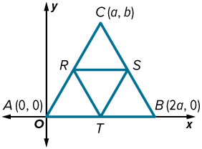
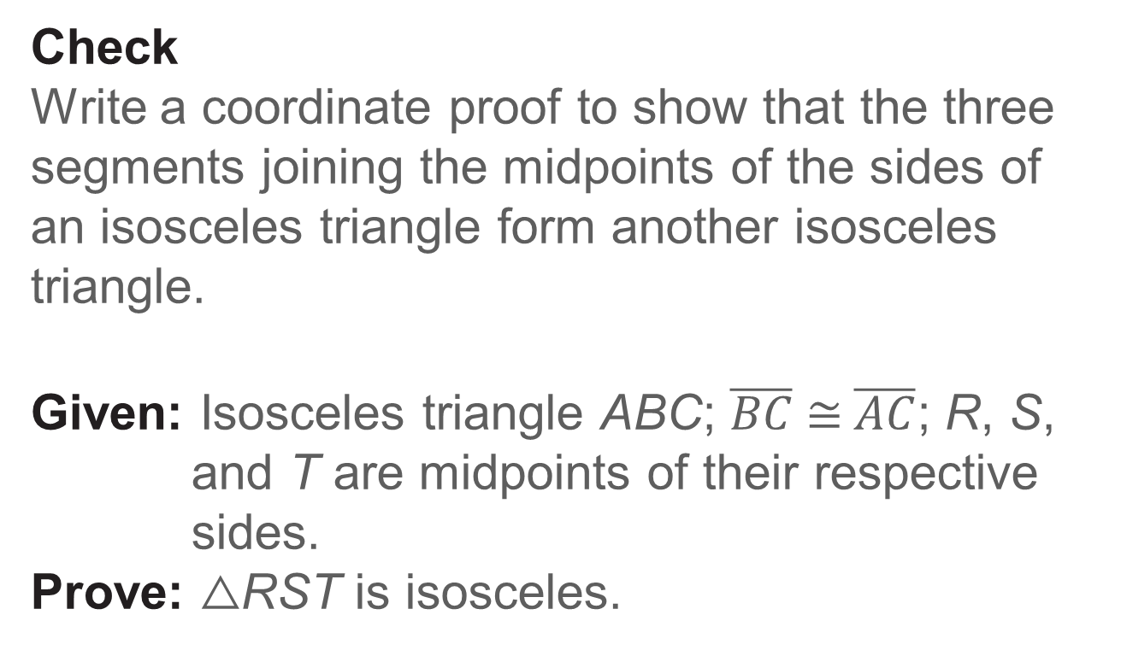
Example 4
Prove a Theorem by Using Coordinate Geometry
Check
Write a coordinate proof to show that the three segments joining the midpoints of the sides of an isosceles triangle form another isosceles triangle.
Given: Isosceles triangle ABC; $\overline{BC}$≅$\overline{AC}$; R, S, and T are midpoints of their respective sides.
Prove: △RST is isosceles.

Slide 30
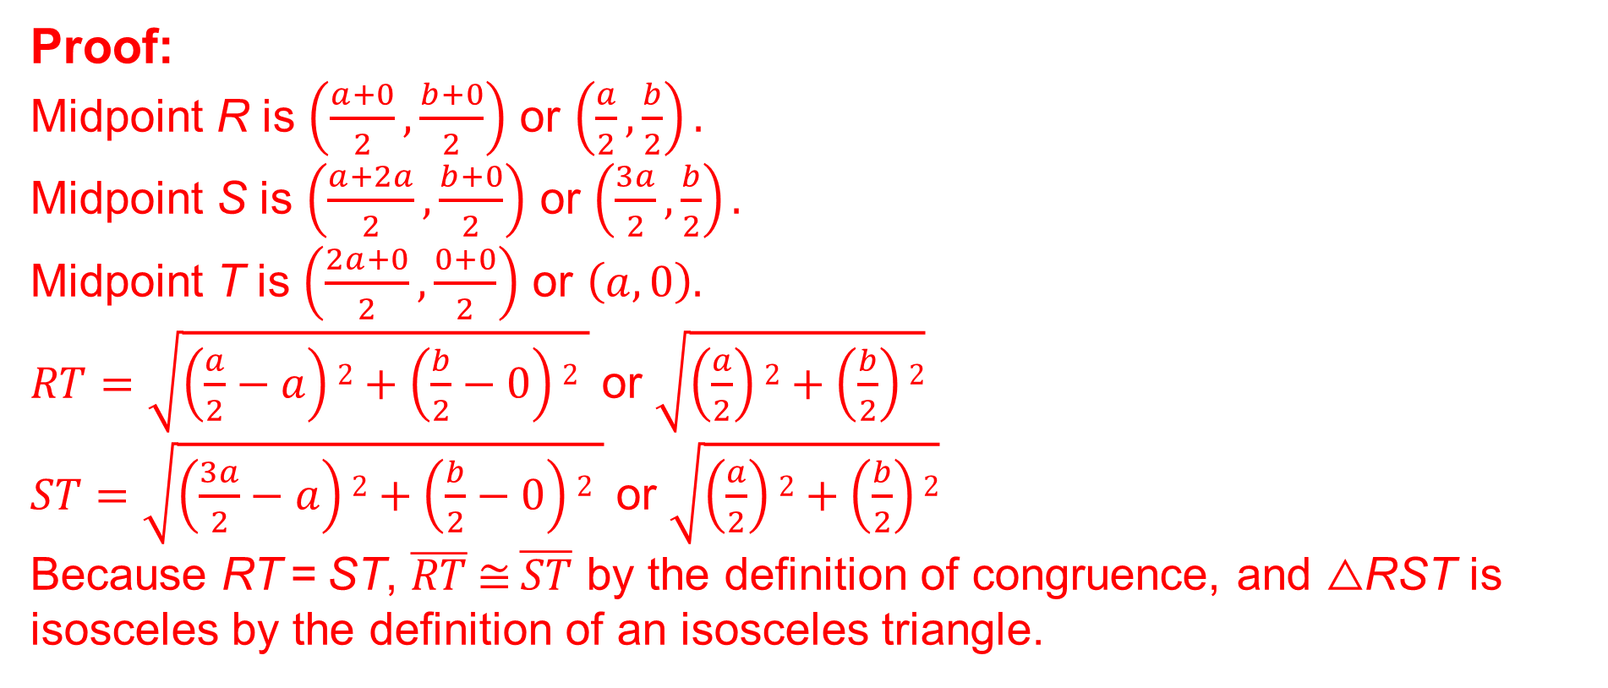
Example 4
Prove a Theorem by Using Coordinate Geometry
Proof:
Midpoint R is $\left(\frac{a+0}{2},\frac{b+0}{2}\right)$ or $\left(\frac{a}{2},\frac{b}{2}\right).$
Midpoint S is $\left(\frac{a+2a}{2},\frac{b+0}{2}\right)$ or $\left(\frac{3a}{2},\frac{b}{2}\right).$
Midpoint T is $\left(\frac{2a+0}{2},\frac{0+0}{2}\right)$ or $\left(a, 0\right).$
$RT=\sqrt{\left(\frac{a}{2}−a\right)2+\left(\frac{b}{2}−0\right)2 }$ or $\sqrt{\left(\frac{a}{2}\right)2+\left(\frac{b}{2}\right)2}$
$ST=\sqrt{\left(\frac{3a}{2}−a\right)2+\left(\frac{b}{2}−0\right)2 }$ or $\sqrt{\left(\frac{a}{2}\right)2+\left(\frac{b}{2}\right)2}$
Because RT = ST, $\overline{RT}$≅$\overline{ST}$ by the definition of congruence, and △RST is isosceles by the definition of an isosceles triangle.
Notes:
Proof:
Midpoint R is $\left(\frac{a+0}{2},\frac{b+0}{2}\right)$ or $\left(\frac{a}{2},\frac{b}{2}\right).$
Midpoint S is $\left(\frac{a+2a}{2},\frac{b+0}{2}\right)$ or $\left(\frac{3a}{2},\frac{b}{2}\right).$
Midpoint T is $\left(\frac{2a+0}{2},\frac{0+0}{2}\right)$ or $\left(a, 0\right).$
$RT=\sqrt{\left(\frac{a}{2}−a\right)2+\left(\frac{b}{2}−0\right)2 }$ or $\sqrt{\left(\frac{a}{2}\right)2+\left(\frac{b}{2}\right)2}$
$ST=\sqrt{\left(\frac{3a}{2}−a\right)2+\left(\frac{b}{2}−0\right)2 }$ or $\sqrt{\left(\frac{a}{2}\right)2+\left(\frac{b}{2}\right)2}$
Because RT = ST, $\overline{RT}$≅$\overline{ST}$ by the definition of congruence, and △RST is isosceles by the definition of an isosceles triangle.

Slide 31
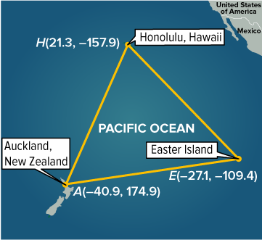
Example 5
Classify a Triangle
NAVIGATION The Polynesian Triangle is a triangle formed between the three Pacific island groups that form the South Pacific region known as Polynesia. The approximate coordinates in latitude and longitude of each vertex are Auckland, New Zealand (−40.9, 174.9), Honolulu, Hawaii (21.3, −157.9), and Easter Island (−27.1, −109.4).
Use coordinate geometry to determine the type of triangle formed.

Slide 32
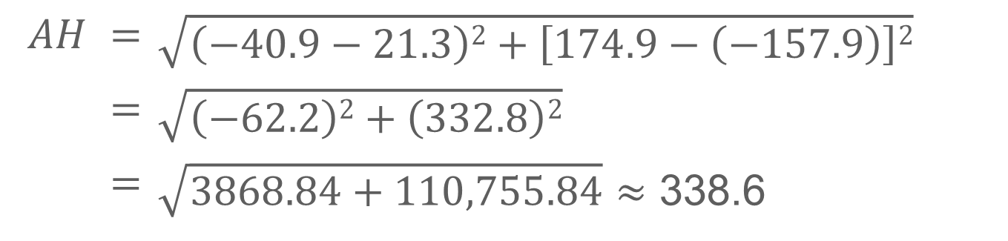
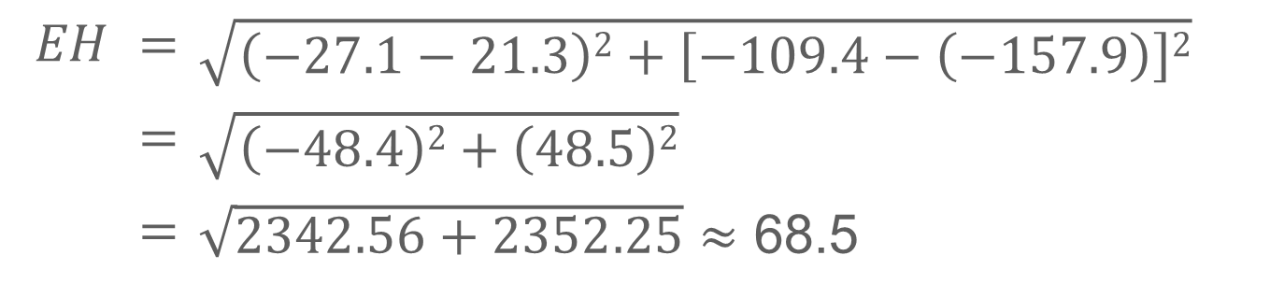
Example 5
Classify a Triangle
$$EH$$ | $$=$$ | $$\sqrt{\left(−27.1−21.3\right)2+\left[−109.4−\left(−157.9\right)\right]2}$$
 | $$=$$ | $$\sqrt{\left(−48.4\right)2+\left(48.5\right)2}$$
 | $$=$$ | $\sqrt{2342.56+2352.25}$ $≈$ 68.5
Because the length of each side is different, the triangle is scalene.
$$AH$$ | $$=$$ | $$\sqrt{\left(−40.9−21.3\right)2+\left[174.9−\left(−157.9\right)\right]2}$$
 | $$=$$ | $$\sqrt{\left(−62.2\right)2+\left(332.8\right)2}$$
 | $$=$$ | $\sqrt{3868.84+110,755.84}$ $≈$ 338.6

Slide 33
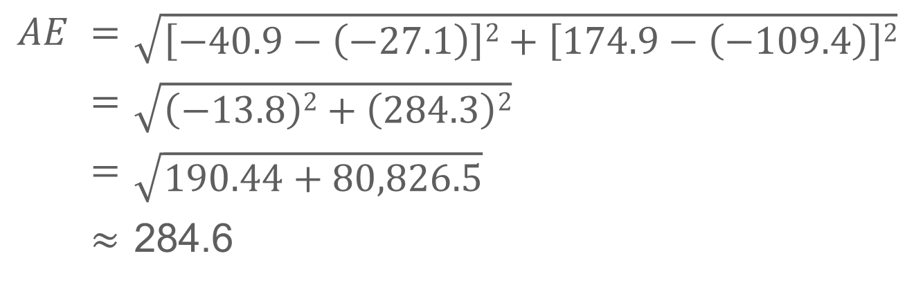
Example 5
Classify a Triangle
Use the Distance Formula to determine the length of each side of the triangle.
Round to the nearest tenth.
$$AE$$ | $$=$$ | $$\sqrt{\left[−40.9−\left(−27.1\right)\right]2+\left[174.9−\left(−109.4\right)\right]2}$$
 | $$=$$ | $$\sqrt{\left(−13.8\right)2+\left(284.3\right)2}$$
 | $$=$$ | $$\sqrt{190.44+80,826.5}$$
 | $$≈$$ | 284.6

Slide 34
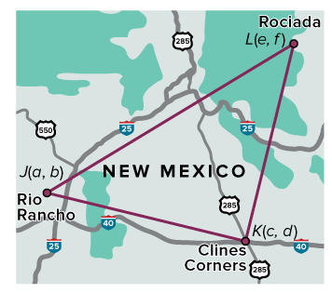
Example 5
Classify a Triangle
Check
GEOGRAPHY Eldora’s family lives in New Mexico. She lives southwest of Rio Rancho, her uncle lives in Clines Corners, and her grandparents live in Rociada. Eldora has assigned coordinates to each location.

Slide 35
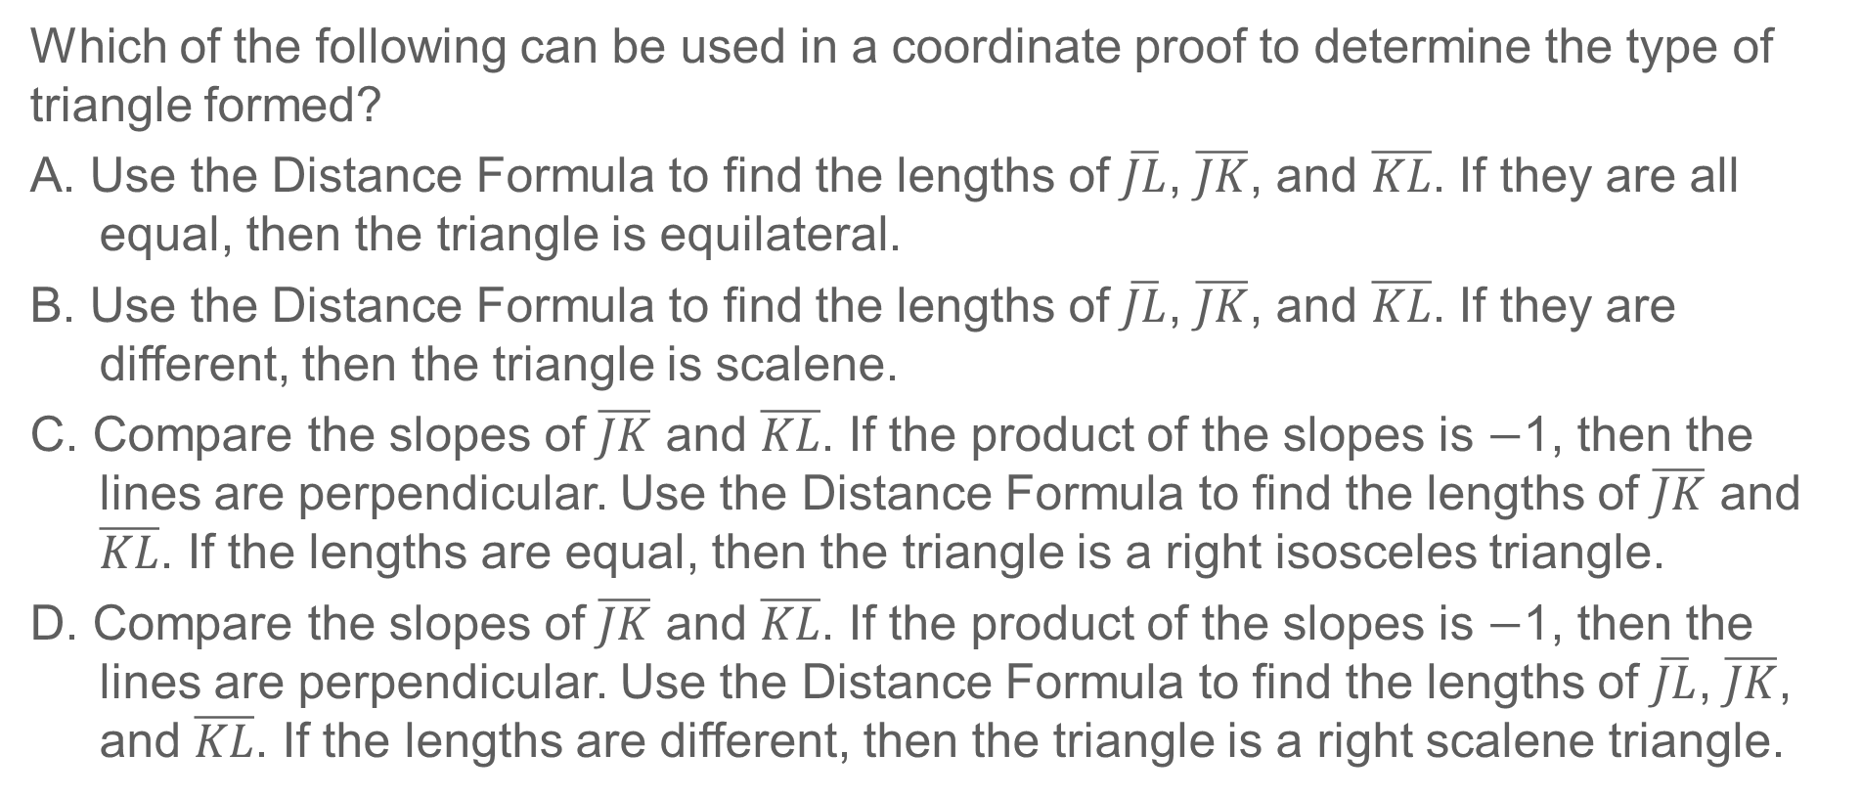
Example 5
Classify a Triangle
Which of the following can be used in a coordinate proof to determine the type of triangle formed?
A. Use the Distance Formula to find the lengths of $\overline{JL}$, $\overline{JK}$, and $\overline{KL}$. If they are all equal, then the triangle is equilateral.
B. Use the Distance Formula to find the lengths of $\overline{JL}$, $\overline{JK}$, and $\overline{KL}$. If they are different, then the triangle is scalene.
C. Compare the slopes of $\overline{JK}$ and $\overline{KL}$. If the product of the slopes is $−$1, then the lines are perpendicular. Use the Distance Formula to find the lengths of $\overline{JK}$ and $\overline{KL}$. If the lengths are equal, then the triangle is a right isosceles triangle.
D. Compare the slopes of $\overline{JK}$ and $\overline{KL}$. If the product of the slopes is $−$1, then the lines are perpendicular. Use the Distance Formula to find the lengths of $\overline{JL}$, $\overline{JK}$, and $\overline{KL}$. If the lengths are different, then the triangle is a right scalene triangle.

Slide 36
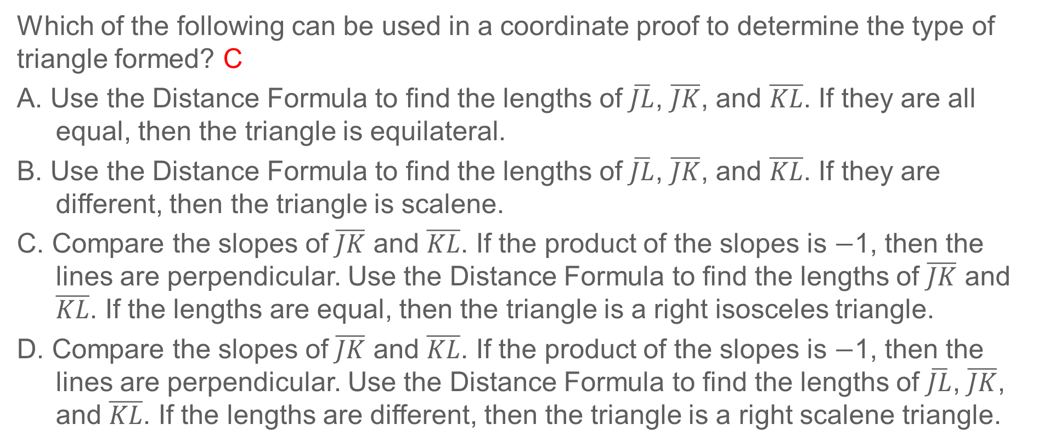
Example 5
Classify a Triangle
Which of the following can be used in a coordinate proof to determine the type of triangle formed? C
A. Use the Distance Formula to find the lengths of $\overline{JL}$, $\overline{JK}$, and $\overline{KL}$. If they are all equal, then the triangle is equilateral.
B. Use the Distance Formula to find the lengths of $\overline{JL}$, $\overline{JK}$, and $\overline{KL}$. If they are different, then the triangle is scalene.
C. Compare the slopes of $\overline{JK}$ and $\overline{KL}$. If the product of the slopes is $−$1, then the lines are perpendicular. Use the Distance Formula to find the lengths of $\overline{JK}$ and $\overline{KL}$. If the lengths are equal, then the triangle is a right isosceles triangle.
D. Compare the slopes of $\overline{JK}$ and $\overline{KL}$. If the product of the slopes is $−$1, then the lines are perpendicular. Use the Distance Formula to find the lengths of $\overline{JL}$, $\overline{JK}$, and $\overline{KL}$. If the lengths are different, then the triangle is a right scalene triangle.
Notes:
C

Slide 37
Pause and Reflect
Did you struggle with anything in this lesson? If so, how did you deal with it?

Slide 38
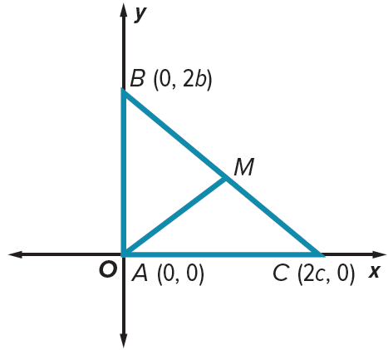
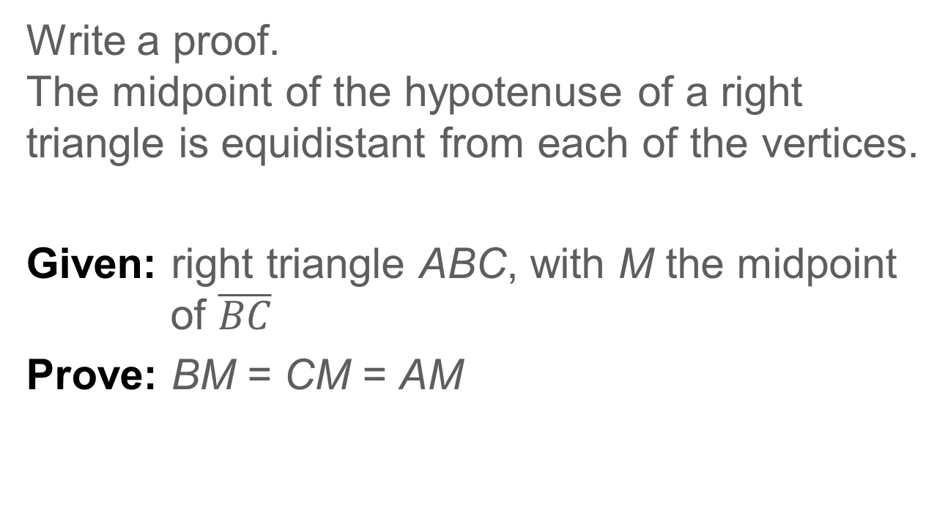
Exit Ticket
Write a proof.
The midpoint of the hypotenuse of a right triangle is equidistant from each of the vertices.
Given: right triangle ABC, with M the midpoint of $\overline{BC}$
Prove: BM = CM = AM

Slide 39
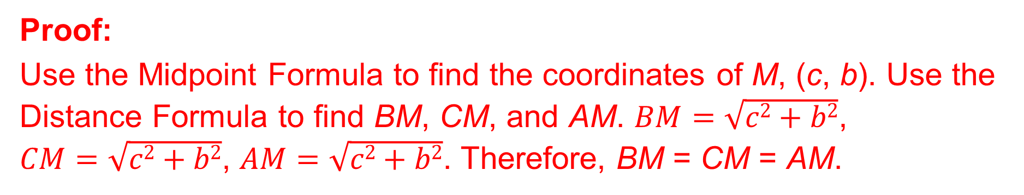
Exit Ticket
Write a proof.
The midpoint of the hypotenuse of a right triangle is equidistant from each of the vertices.
Given: right triangle ABC, with M the midpoint of $\overline{BC}$
Prove: BM = CM = AM
Proof:
Use the Midpoint Formula to find the coordinates of M, (c, b). Use the Distance Formula to find BM, CM, and AM. $BM=\sqrt{c2+b2}$,
$CM=\sqrt{c2+b2}$, $AM=\sqrt{c2+b2}$. Therefore, BM = CM = AM.
Notes:
Proof:
Use the Midpoint Formula to find the coordinates of M, (c, b). Use the Distance Formula to find BM, CM, and AM. $BM=\sqrt{c2+b2}$, $CM=\sqrt{c2+b2}$, $AM=\sqrt{c2+b2}$. Therefore, BM = CM = AM.

