Slide 1
Similar Triangles: SSS and SAS Similarity

Slide 2
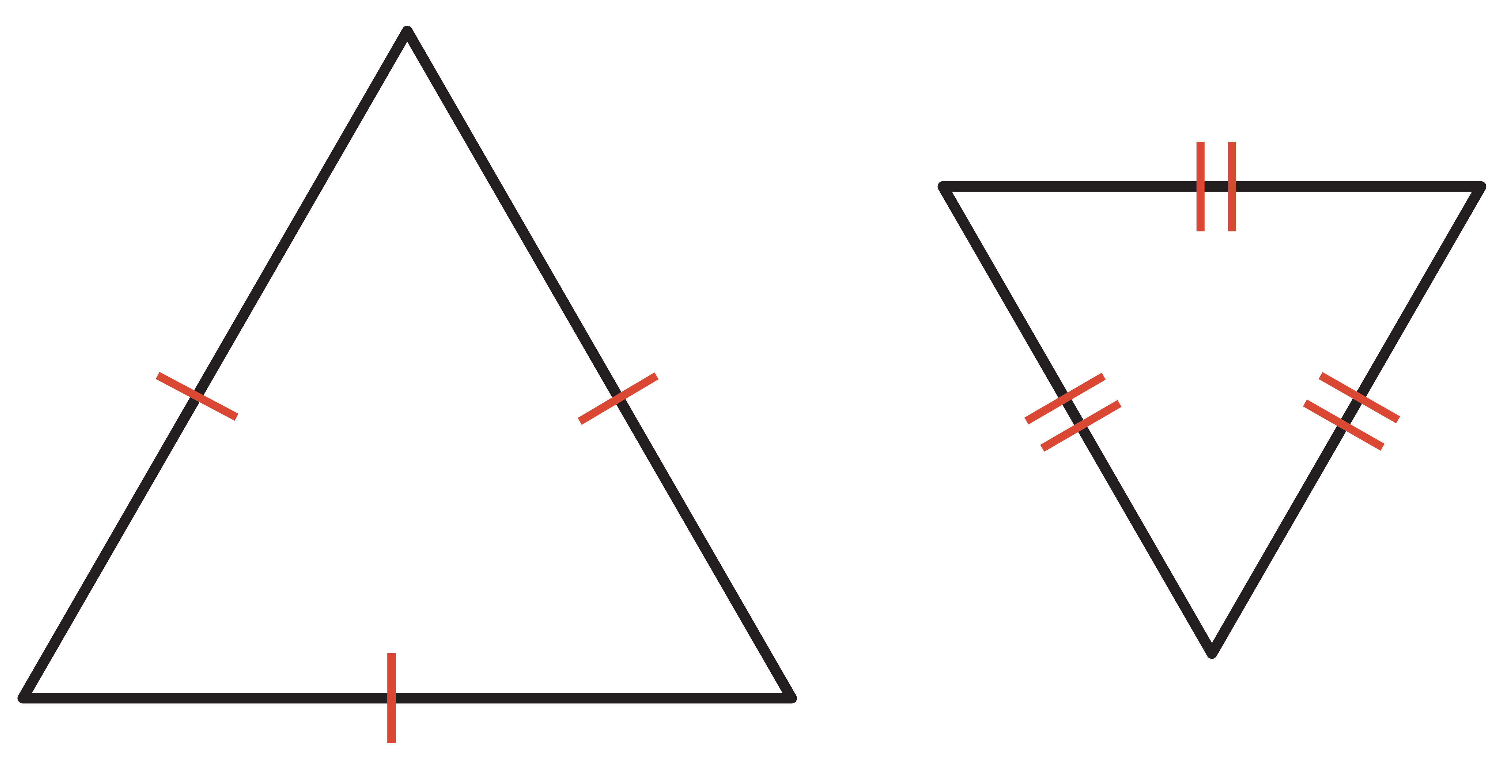
Warm Up
Are the triangles similar? Justify your answer.
1. 2.

Slide 3
Warm Up
Are the triangles congruent? Justify your answer.
3. 4.
5. What shortcuts can be used to prove that two triangles are congruent?

Slide 4
Warm Up
Are the triangles similar? Justify your answer.
1. 2.
yes; SSS
yes; Sample answer: AA
Notes:
yes; SSS
yes; Sample answer: AA

Slide 5
Warm Up
Are the triangles congruent? Justify your answer.
3. 4.
yes; SAS
yes; SSS
5. What shortcuts can be used to prove that two triangles are congruent? SAS, SSS, ASA, AAS, HL, HA, LL, LA
Notes:
yes; SAS
yes; SSS
SAS, SSS, ASA, AAS, HL, HA, LL, LA

Slide 6
Florida’s B.E.S.T. Standards for Mathematics
MA.912.GR.1.2 Prove triangle congruence or similarity using Side-Side- Side, Side-Angle-Side, Angle-Side-Angle, Angle-Angle-Side, Angle-Angle and Hypotenuse-Leg.
MA.912.GR.1.6 Solve mathematical and real-world problems involving congruence or similarity in two-dimensional figures.

Slide 7
Florida’s Mathematical Thinking and Reasoning Standards
MA.K12.MTR.2.1
Demonstrate understanding by representing problems in multiple ways.
MA.K12.MTR.4.1
Engage in discussions that reflect on the mathematical thinking of self and others.

Slide 8
Lesson Objectives
Content Objectives
Students use the SSS and SAS Similarity criteria to solve problems and prove triangles similar.
Language Objectives
Students use if and because to talk about using the SSS and SAS Similarity criteria to solve problems and prove triangles similar.
To optimize output, students participate in MLR3: Three Reads.

Slide 9
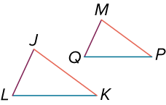
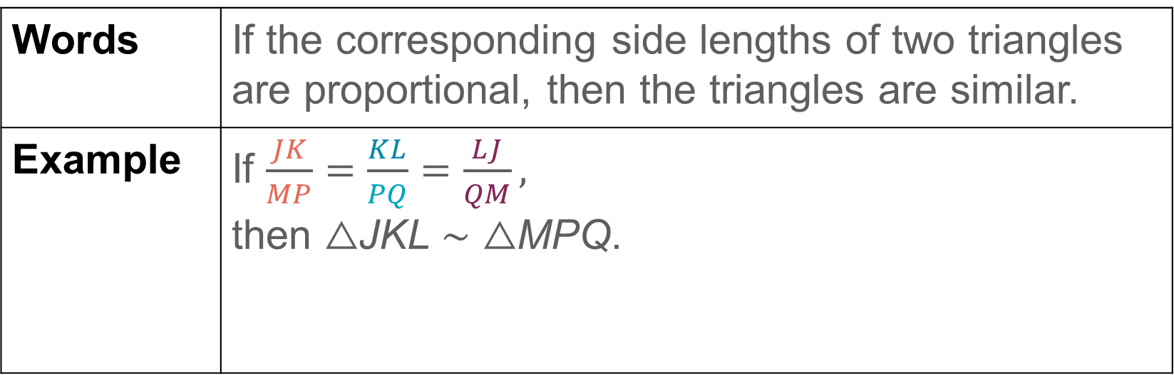
Learn
Similar Triangles: SSS and SAS Similarity
You can use the AA Similarity Postulate to prove the following two theorems.
Theorem 8.4: Side-Side-Side (SSS) Similarity
Words | If the corresponding side lengths of two triangles are proportional, then the triangles are similar.
Example | If $\frac{JK}{MP}=\frac{KL}{PQ}=\frac{LJ}{QM},$ then △JKL ∼ △MPQ.

Slide 10
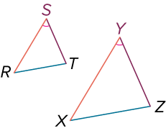
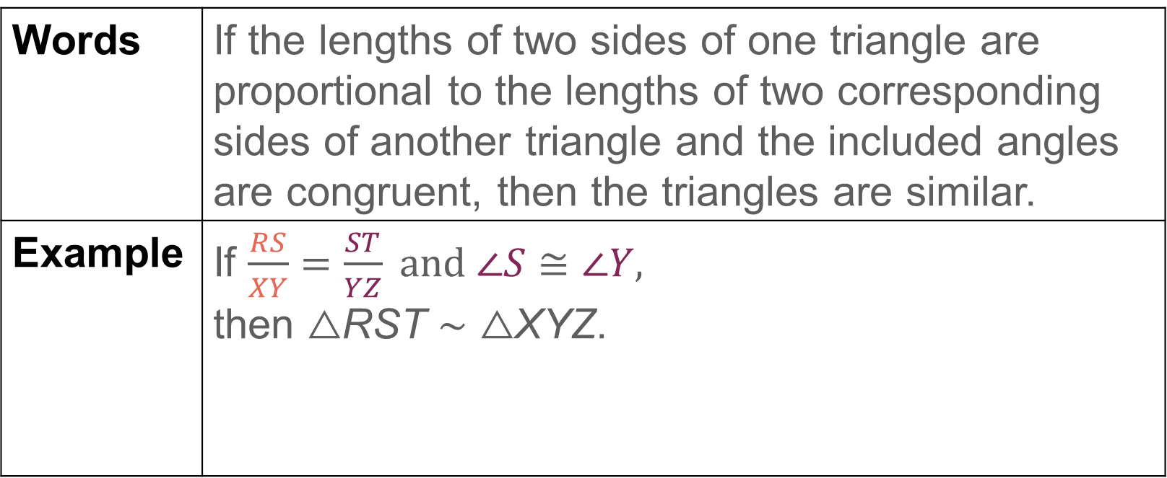
Learn
Similar Triangles: SSS and SAS Similarity
Theorem 8.5: Side-Angle-Side (SAS) Similarity
Words | If the lengths of two sides of one triangle are proportional to the lengths of two corresponding sides of another triangle and the included angles are congruent, then the triangles are similar.
Example | If $\frac{RS}{XY}=\frac{ST}{YZ} and ∠S≅∠Y,$ then △RST ∼ △XYZ.

Slide 11
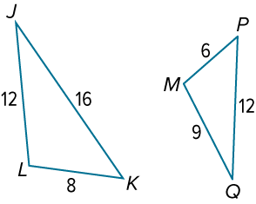
Example 1
Use the SSS and SAS Similarity Theorems
Determine whether the triangles are similar. Explain your reasoning.

Slide 12
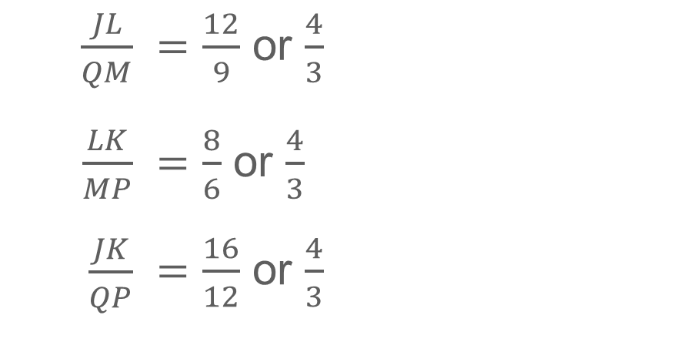
Example 1
Use the SSS and SAS Similarity Theorems
$\frac{JL}{QM}$ | $=\frac{12}{9}$ or $\frac{4}{3}$
$\frac{LK}{MP}$ | $=\frac{8}{6}$ or $\frac{4}{3}$
$\frac{JK}{QP}$ | $=\frac{16}{12}$ or $\frac{4}{3}$
By the SSS Similarity Theorem, △ JLK ∼ △QMP.

Slide 13
Example 1
Use the SSS and SAS Similarity Theorems
Check
Determine whether the triangles are similar. Explain your reasoning.

Slide 14
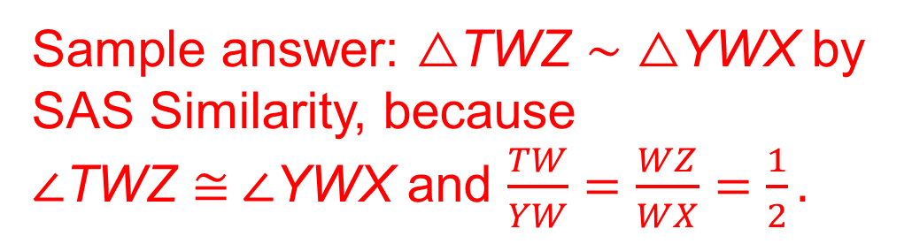
Example 1
Use the SSS and SAS Similarity Theorems
Check
Determine whether the triangles are similar. Explain your reasoning.
Sample answer: △TWZ ∼ △YWX by SAS Similarity, because ∠TWZ ≅ ∠YWX and $\frac{TW}{YW}=\frac{WZ}{WX}=\frac{1}{2}.$
Notes:
Sample answer: △TWZ ∼ △YWX by SAS Similarity, because ∠TWZ ≅ ∠YWX and $\frac{TW}{YW}=\frac{WZ}{WX}=\frac{1}{2}.$

Slide 15
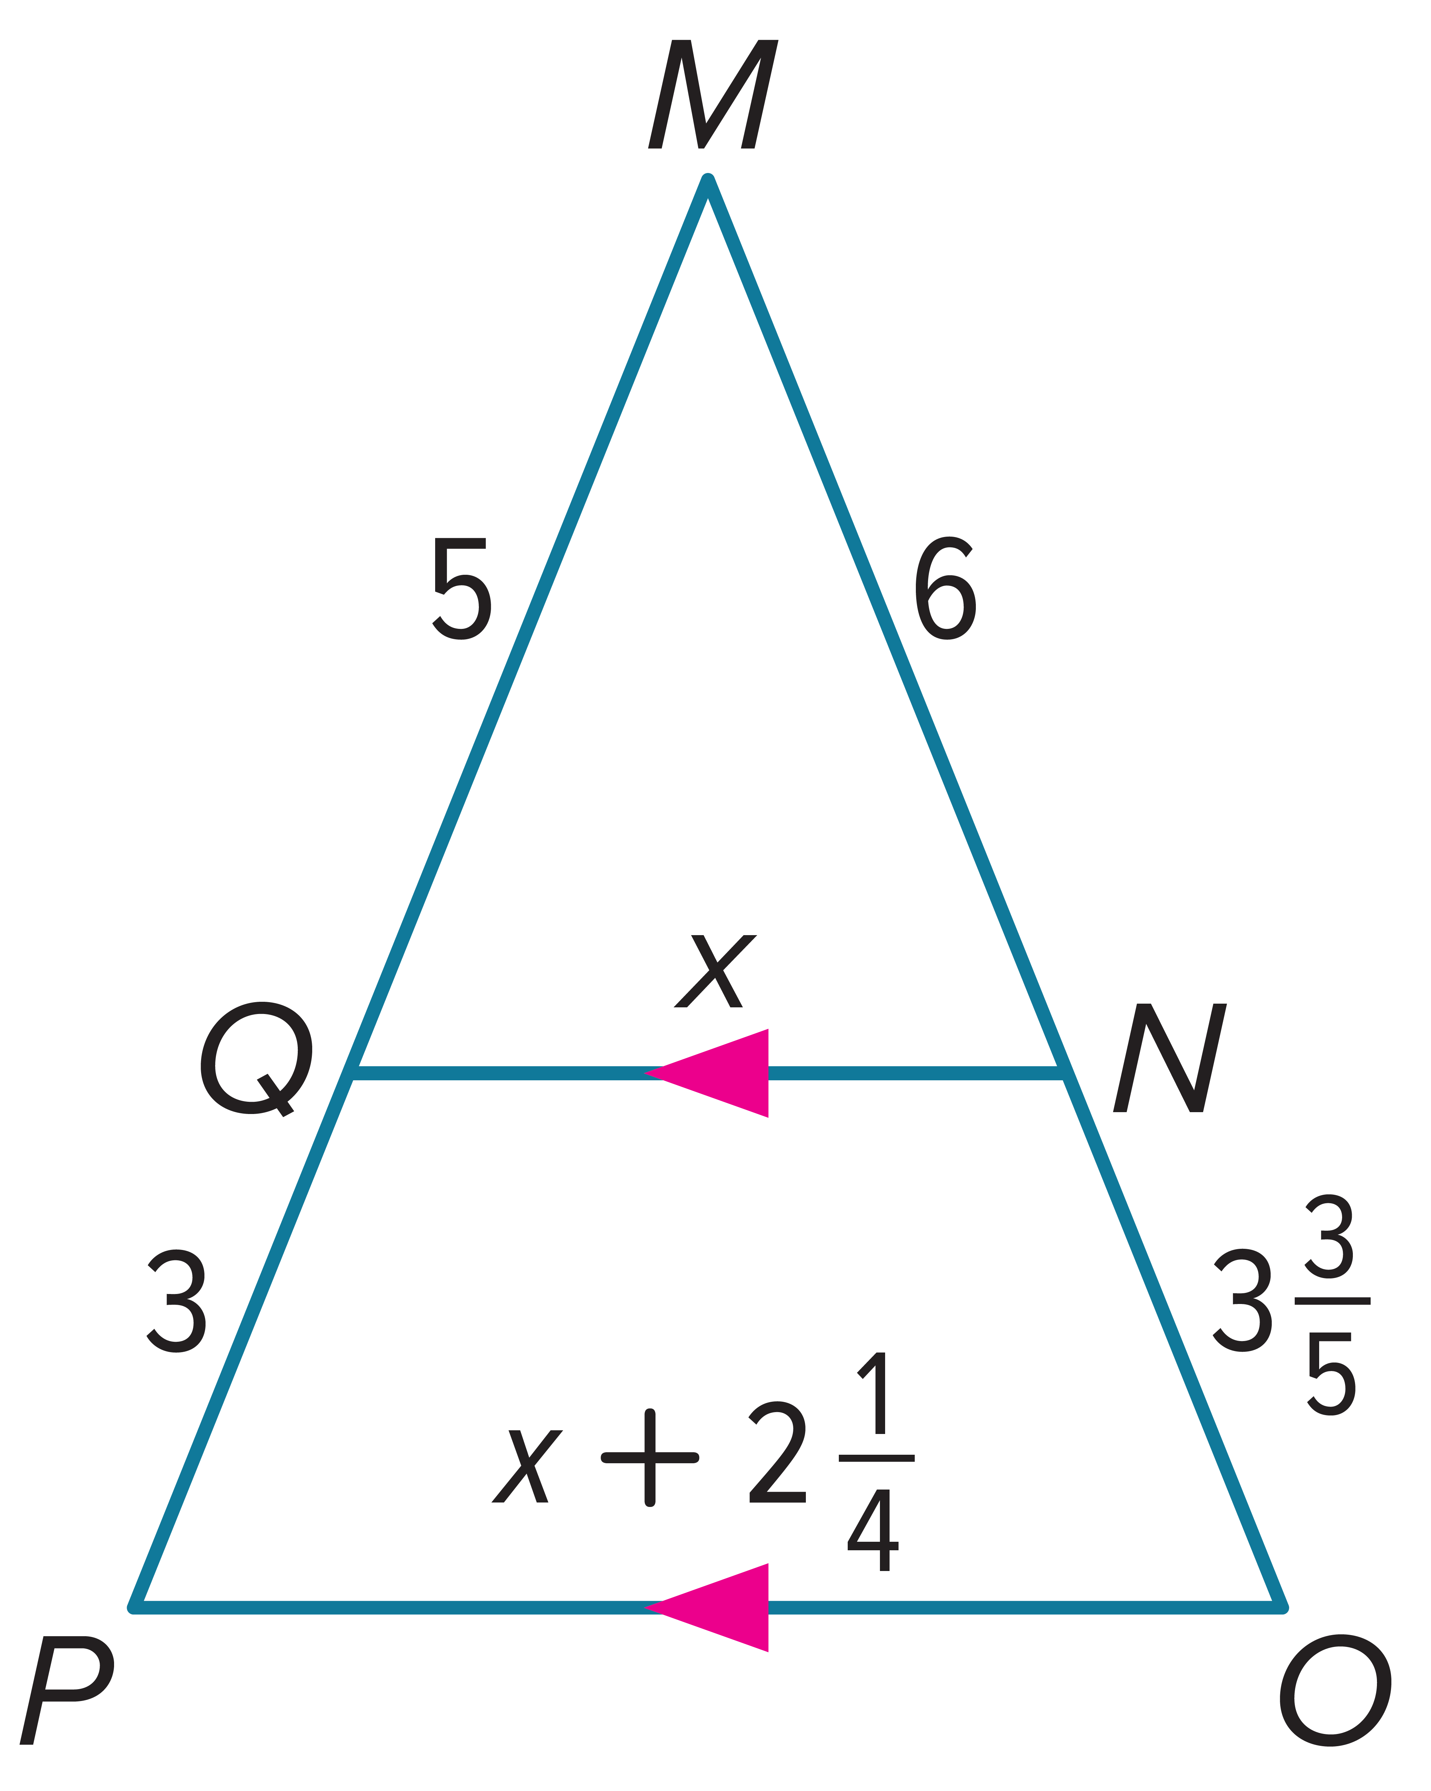
Example 2
Parts of Similar Triangles
Find QN and PO. Justify your answer.

Slide 16
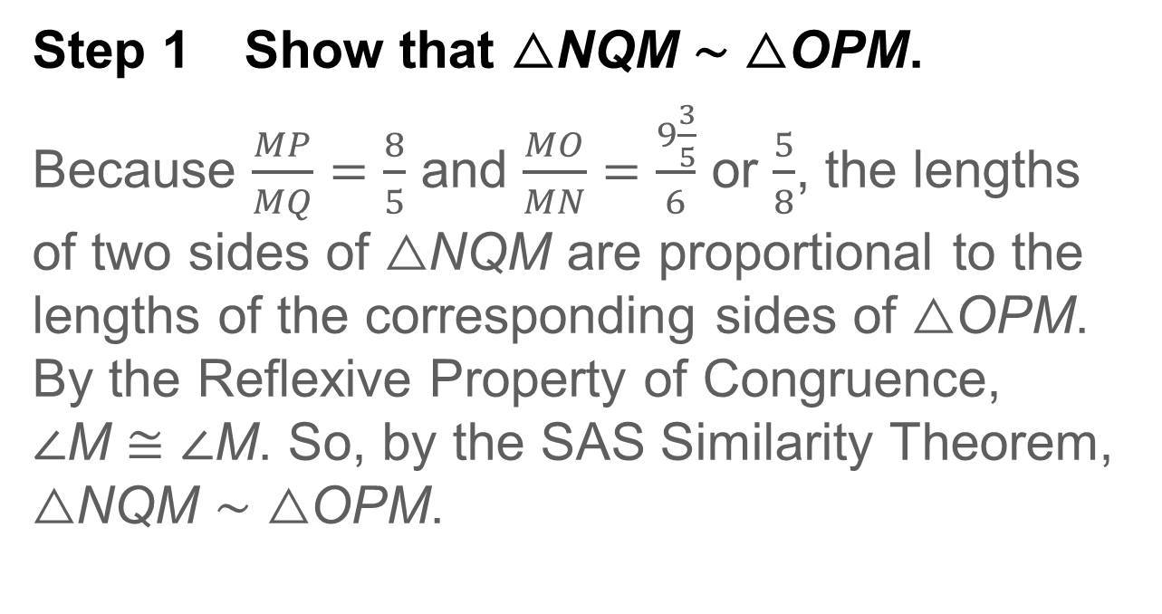
Example 2
Parts of Similar Triangles
Step 1 Show that △NQM ∼ △OPM.
Because $\frac{MP}{MQ}=\frac{8}{5}$ and $\frac{MO}{MN}=\frac{9\frac{3}{5}}{6}$ or $\frac{5}{8}$, the lengths of two sides of △NQM are proportional to the lengths of the corresponding sides of △OPM. By the Reflexive Property of Congruence, ∠M ≅ ∠M. So, by the SAS Similarity Theorem, △NQM ∼ △OPM.

Slide 17
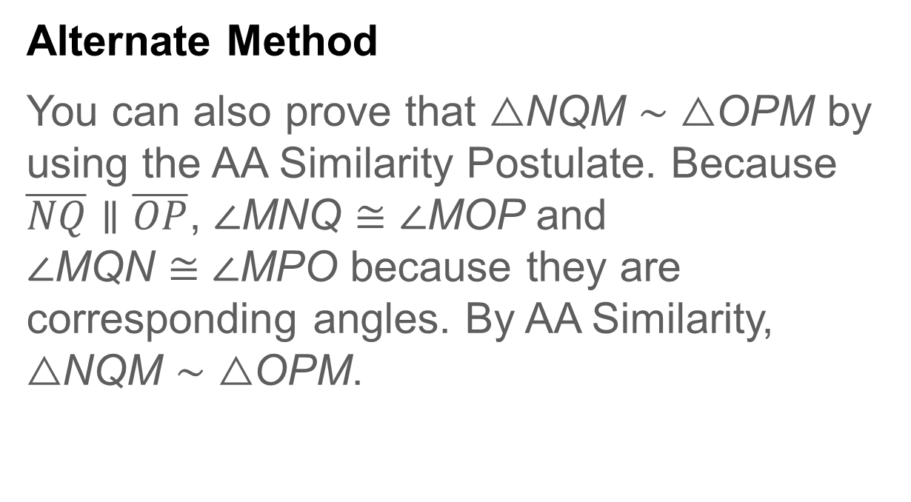
Example 2
Parts of Similar Triangles
Alternate Method
You can also prove that △NQM ∼ △OPM by using the AA Similarity Postulate. Because $\overline{NQ}∥\overline{OP}$, ∠MNQ ≅ ∠MOP and ∠MQN ≅ ∠MPO because they are corresponding angles. By AA Similarity, △NQM ∼ △OPM.

Slide 18
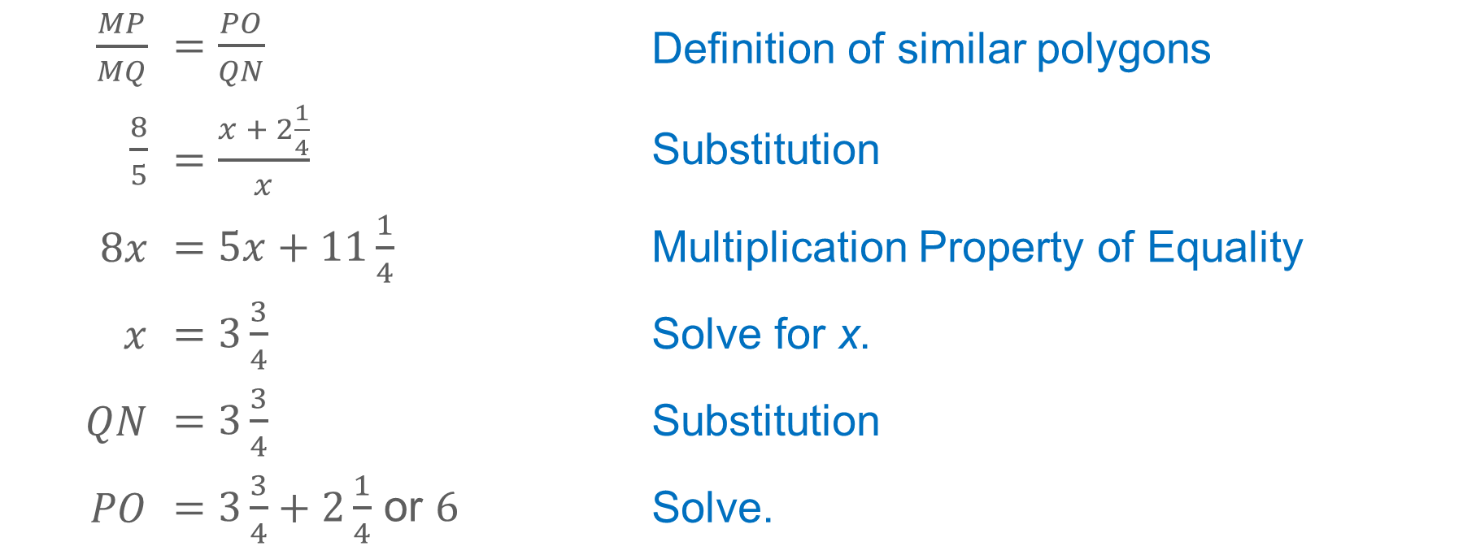
Example 2
Parts of Similar Triangles
Step 2 Find QN and PO.
$\frac{MP}{MQ}$ | $=\frac{PO}{QN}$ | Definition of similar polygons
$\frac{8}{5}$ | $=\frac{x + 2\frac{1}{4}}{x}$ | Substitution
$8x$ | $=5x+11\frac{1}{4}$ | Multiplication Property of Equality
$x$ | $=3\frac{3}{4}$ | Solve for x.
$QN$ | $=3\frac{3}{4}$ | Substitution
$PO$ | $=3\frac{3}{4}+2\frac{1}{4}$ or $6$ | Solve.

Slide 19
Example 2
Parts of Similar Triangles
Think About It!
Describe the dilation that maps △NQM onto △OPM.

Slide 20
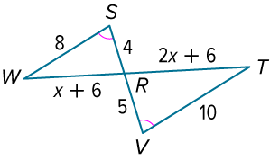
Example 2
Parts of Similar Triangles
Check
Find WR and RT.

Slide 21
Example 2
Parts of Similar Triangles
Check
Find WR and RT.
WR = 8
RT = 10
Notes:
WR = 8
RT = 10

Slide 22
Example 3
Use Similar Triangles to Solve Problems
ARCHITECTURAL DESIGN Julia is designing an A-frame house. The entire house will be 40 feet tall and the base of the house will be 60 feet long. She will build a second-floor balcony along the front of the house, 15 feet above the ground. The left side of the house will be 50 feet long and the balcony will intersect the side 18.75 feet from the bottom. The peak of the house is directly above the midpoints of the base of the house and the balcony. Calculate the total length of the balcony.

Slide 23
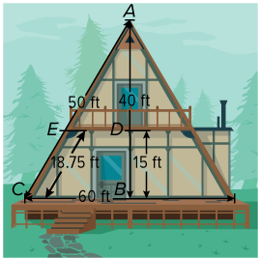
Example 3
Use Similar Triangles to Solve Problems
Step 1 Draw a diagram.

Slide 24
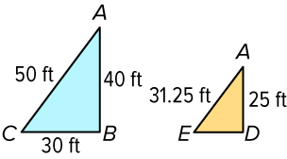
Example 3
Use Similar Triangles to Solve Problems
Step 2 Create a model.
You can model the side of the house with two triangles. Use the information that you know to label the triangles.

Slide 25
Example 3
Use Similar Triangles to Solve Problems
Talk About It!
What assumptions did you make when creating your model for the side of the house?

Slide 26
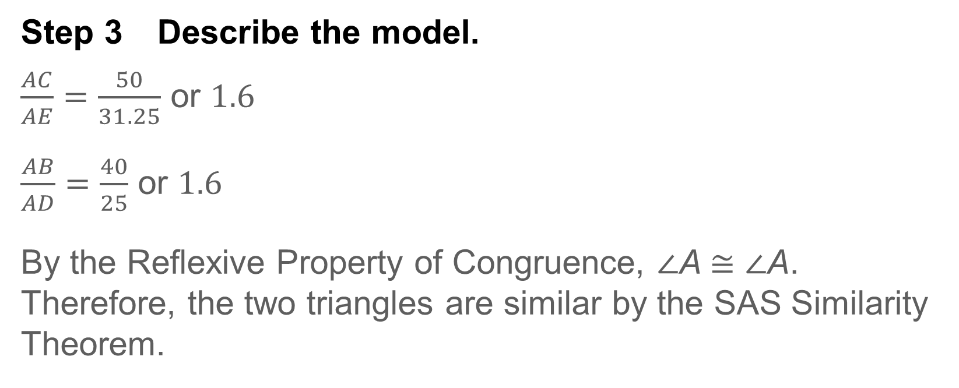
Example 3
Use Similar Triangles to Solve Problems
Step 3 Describe the model.
$\frac{AC}{AE}=\frac{50}{31.25}$ or $1.6$
$\frac{AB}{AD}=\frac{40}{25}$ or $1.6$
By the Reflexive Property of Congruence, ∠A ≅ ∠A. Therefore, the two triangles are similar by the SAS Similarity Theorem.

Slide 27
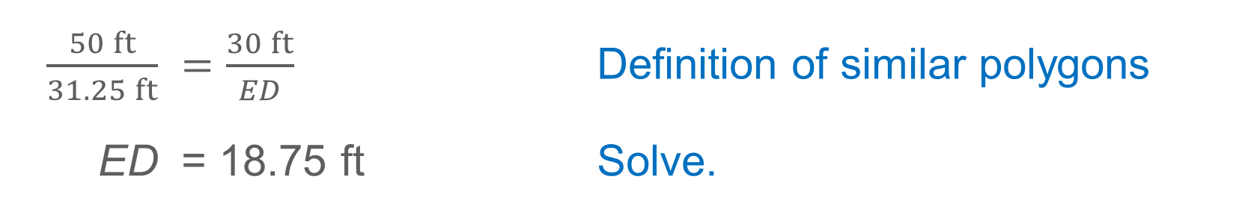
Example 3
Use Similar Triangles to Solve Problems
Step 4 Solve.
Because the two triangles are similar, the corresponding sides are proportional.
$\frac{50 ft}{31.25 ft}$ | $=\frac{30 ft}{ED}$ | Definition of similar polygons
ED | = 18.75 ft | Solve.
Point D is the midpoint of the balcony, so the total length of the balcony is 2(18.75) or 37.5 feet.

Slide 28
Example 3
Use Similar Triangles to Solve Problems
Check
TENNIS Justin is playing tennis. When serving, he stands 12 feet away from the net, which is 3 feet tall. The ball is served from a height of 7.5 feet. Justin thinks the ball travels about 21.4 feet before it hits the ground 8 feet from the net on the opposite side.

Slide 29
Example 3
Use Similar Triangles to Solve Problems
Part A How far does the ball travel before it reaches the net? Round your answer to the nearest tenth, if necessary.
Part B What assumptions did you make to solve for the distance that the ball travels?

Slide 30
Example 3
Use Similar Triangles to Solve Problems
Part A How far does the ball travel before it reaches the net? Round your answer to the nearest tenth, if necessary. 12.8 ft
Part B What assumptions did you make to solve for the distance that the ball travels?
Sample answer: I assumed that the ball traveled in a straight line and barely passed over the net. I assumed that the measure of the angle between the net and the ground was 90°, and I assumed that the measure of the angle between Justin and the ground was 90°.
Notes:
12.8 ft
Sample answer: I assumed that the ball traveled in a straight line and barely passed over the net. I assumed that the measure of the angle between the net and the ground was 90°, and I assumed that the measure of the angle between Justin and the ground was 90°.

Slide 31
Pause and Reflect
Did you struggle with anything in this lesson? If so, how did you deal with it?

Slide 32
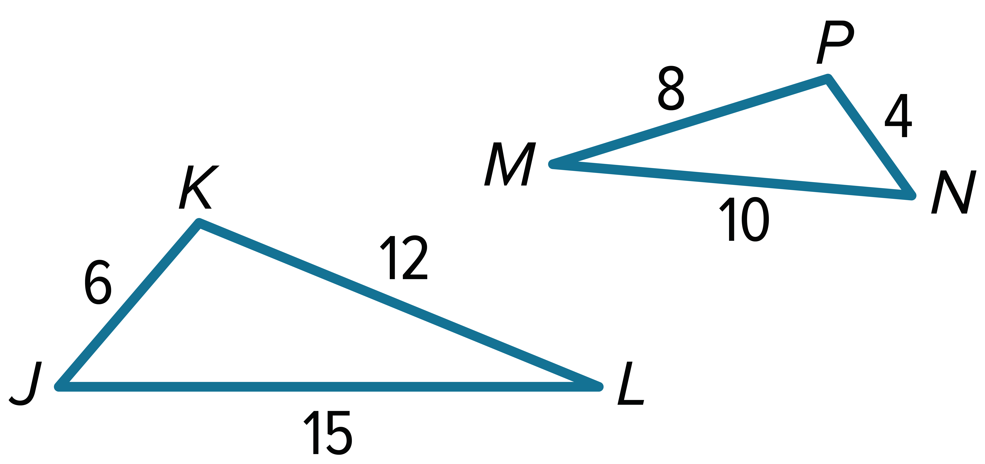
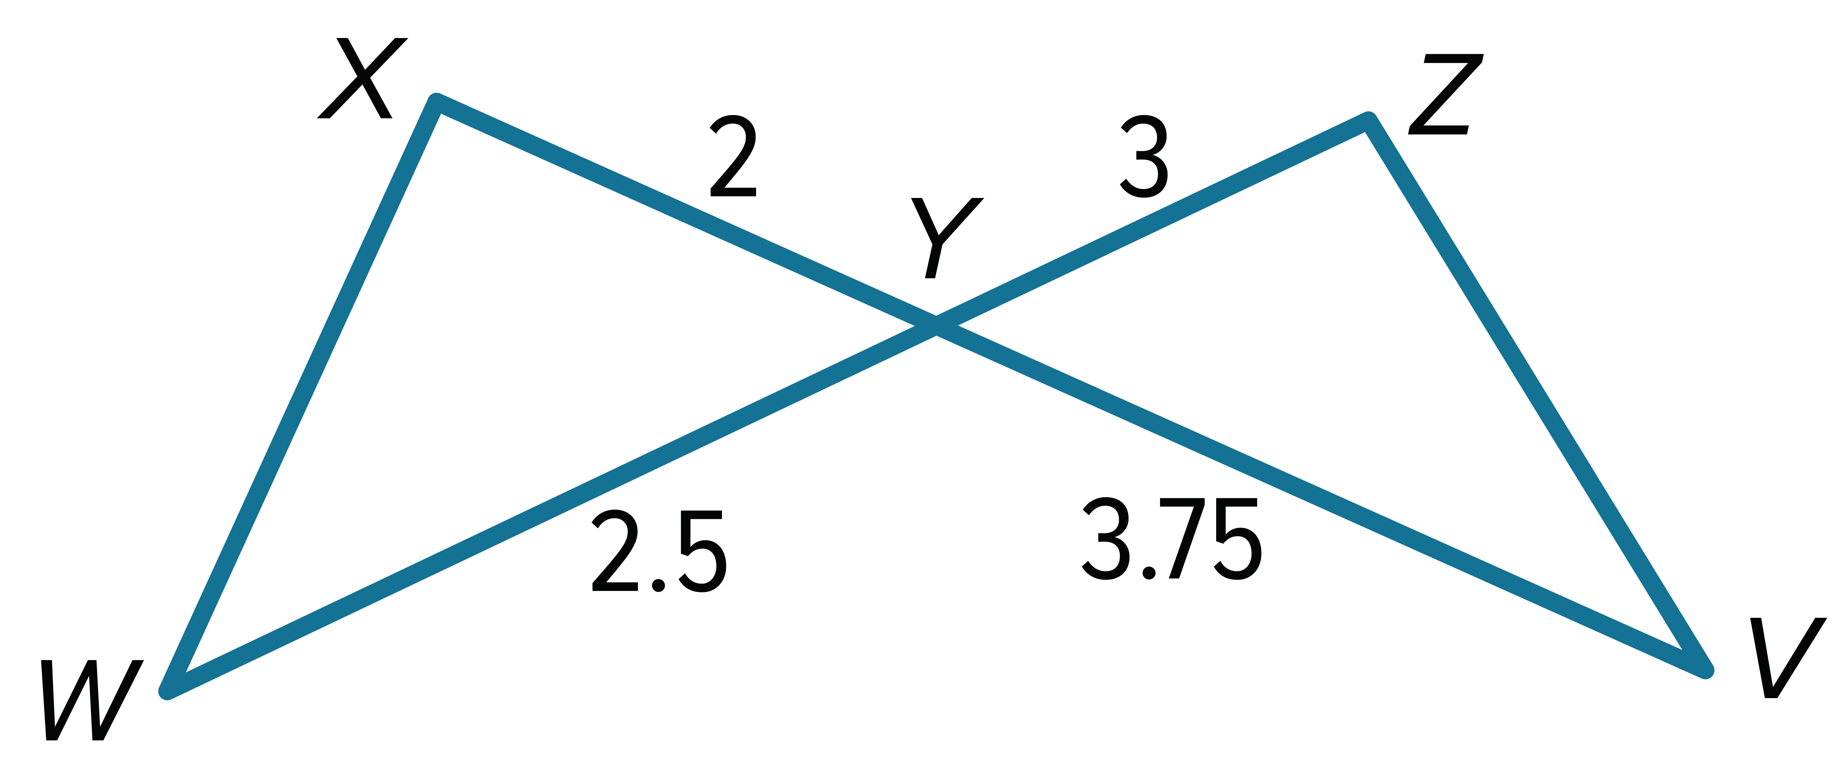
Exit Ticket
Are the triangles similar? If so, write a similarity statement, and justify your answer.
1. 2.

Slide 33
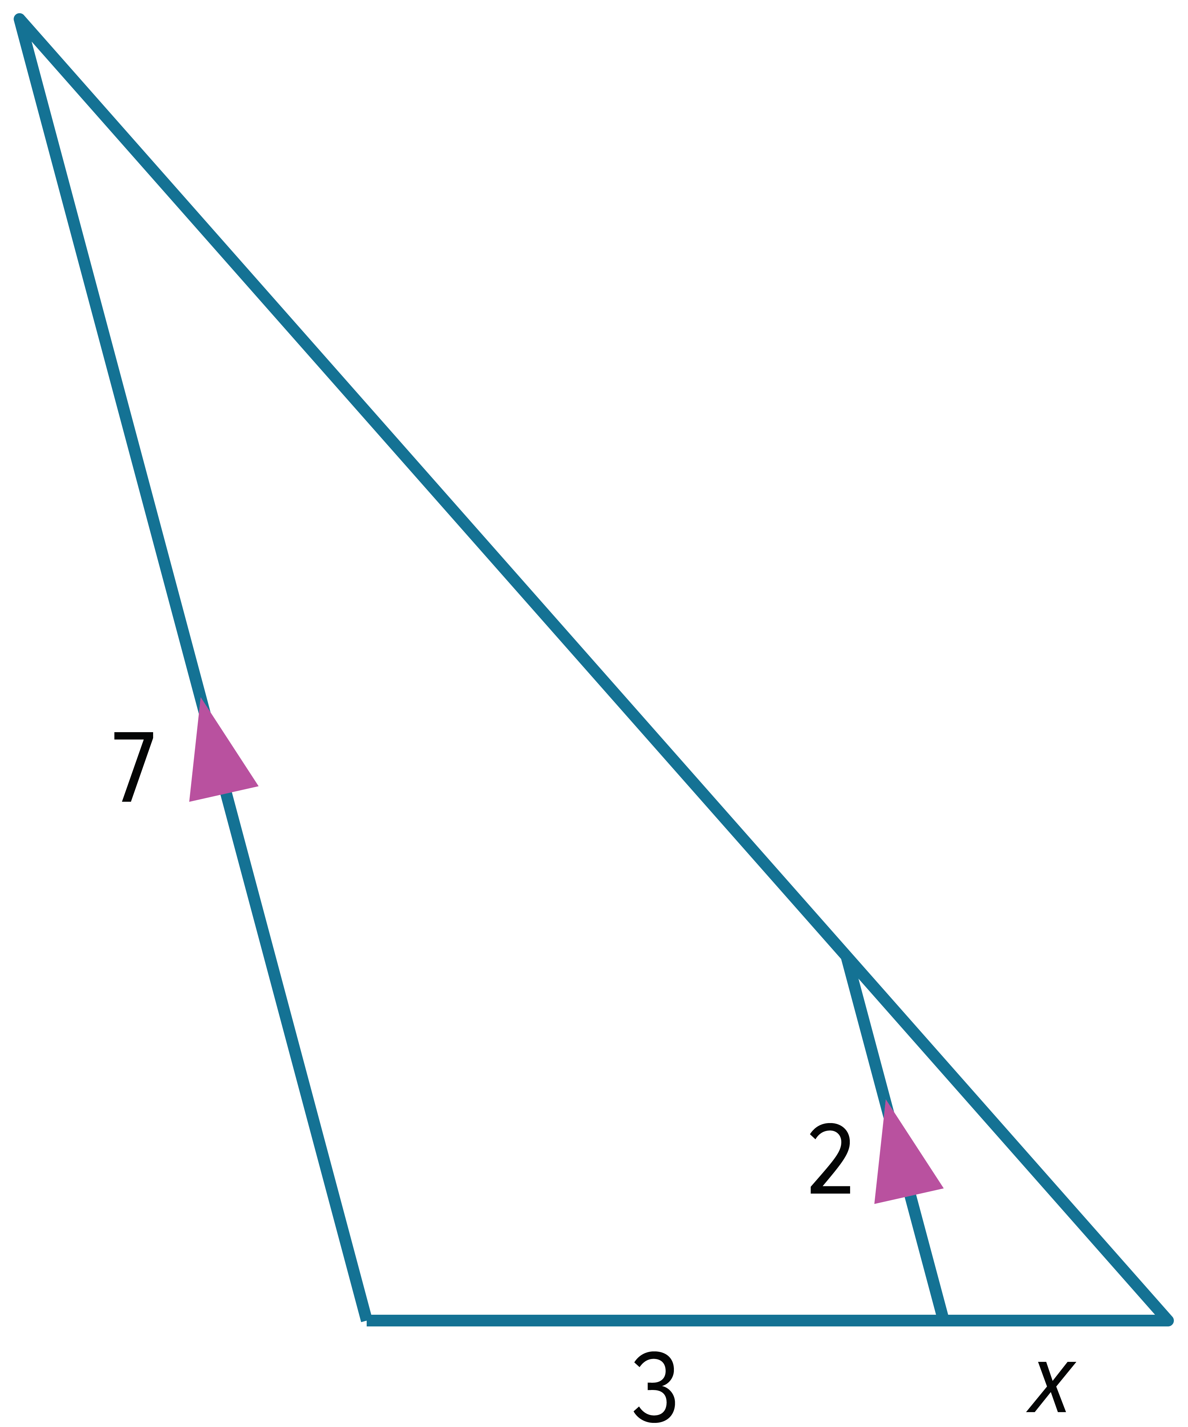
Exit Ticket
3. What is the value of x?

Slide 34
Exit Ticket
Are the triangles similar? If so, write a similarity statement, and justify your answer.
1. 2.
△JKL ∼ △NPM; SSS Similarity
△XWY ∼ △ZVY; SAS Similarity
Notes:
△JKL ∼ △NPM; SSS Similarity
△XWY ∼ △ZVY; SAS Similarity

Slide 35
Exit Ticket
3. What is the value of x? 1.2
Notes:
1.2

