Slide 1
Congruent Triangles

Slide 2
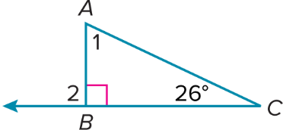
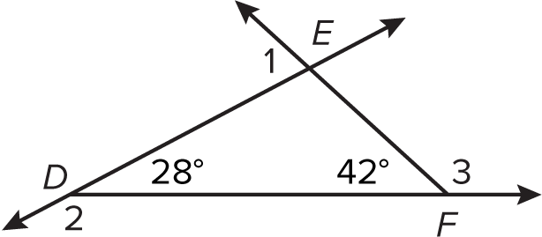
Warm Up
Solve for x. Then evaluate 2x + 30.
1. (2x + 30) + 2(x + 5) = 180
2. 7x + (4x + 20) + (2x + 30) = 180
3. Find m∠1 and m∠2.
4. Find m∠1 + m∠2 + m∠3.

Slide 3
Warm Up
Solve for x. Then evaluate 2x + 30.
1. (2x + 30) + 2(x + 5) = 180 35; 100
2. 7x + (4x + 20) + (2x + 30) = 180 10; 50
3. Find m∠1 and m∠2. 64°; 90°
4. Find m∠1 + m∠2 + m∠3. 360°
Notes:
35; 100
10; 50
64°; 90°
360°

Slide 4
Florida’s B.E.S.T. Standards for Mathematics
MA.912.GR.1.3 Prove relationships and theorems about triangles. Solve mathematical and real-world problems involving postulates, relationships and theorems of triangles.
MA.912.GR.1.6 Solve mathematical and real-world problems involving congruence or similarity in two-dimensional figures.
MA.912.GR.2.6 Apply rigid transformations to map one figure onto another to justify that the two figures are congruent.

Slide 5
Florida’s Mathematical Thinking and Reasoning Standards
MA.K12.MTR.4.1
Engage in discussions that reflect on the mathematical thinking of self and others.

Slide 6
Lesson Objectives
Content Objective
Students will use congruence criteria and the Third Angles Theorem to solve problems.
Language Objectives
Students explain congruence between triangles based on their corresponding parts using same, equal, corresponding, and congruent.
To optimize output, students participate in MLR7: Compare and Connect.

Slide 7
Learn
Congruent Triangles
The principle of superposition states that two figures are congruent if and only if there is a rigid transformation or series of rigid transformations that maps one figure exactly onto the other. Recall that congruent figures have exactly the same shape and size.
In two congruent polygons, all the parts of one polygon are congruent to the corresponding parts, or matching parts, of the other polygon. These corresponding parts include corresponding angles and corresponding sides.

Slide 8
Learn
Interior Angles of Triangles
Key Concept: Congruent Triangles
Two triangles are congruent if and only if their corresponding parts are congruent.
For triangles, we say Corresponding parts of congruent triangles are congruent, or CPCTC.

Slide 9
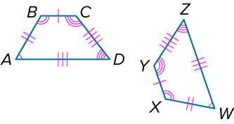
Example 1
Identify Corresponding Congruent Parts
Show that the polygons are congruent by identifying all the congruent corresponding parts. Then write a congruence statement.

Slide 10
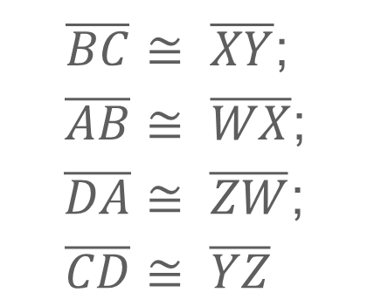
Example 1
Identify Corresponding Congruent Parts
Angles:
∠A | ≅ ∠W;
∠B | ≅ ∠X;
∠C | ≅ ∠Y;
∠D | ≅ ∠Z
Sides:
$$\overline{BC}≅$$ | $\overline{XY}$;
$$\overline{AB}≅$$ | $\overline{WX}$;
$$\overline{DA}≅$$ | $\overline{ZW}$;
$$\overline{CD}≅$$ | $$\overline{YZ}$$
All corresponding parts of the two polygons are congruent. Therefore, polygon ABCD ≅ polygon WXYZ.

Slide 11
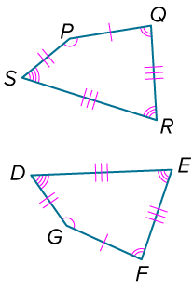
Example 1
Identify Corresponding Congruent Parts
Check
Show that the polygons are congruent by identifying all the congruent corresponding parts. Then write a congruence statement.

Slide 12
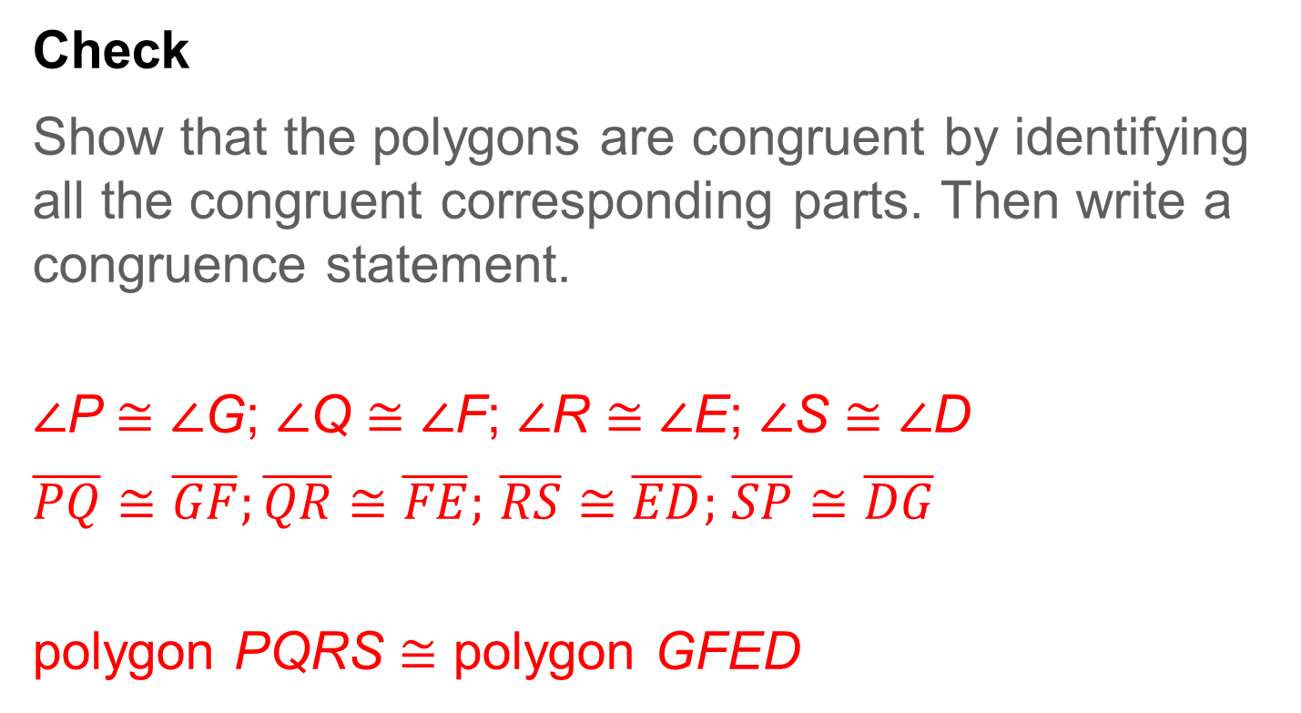
Example 1
Identify Corresponding Congruent Parts
Check
Show that the polygons are congruent by identifying all the congruent corresponding parts. Then write a congruence statement.
∠P ≅ ∠G; ∠Q ≅ ∠F; ∠R ≅ ∠E; ∠S ≅ ∠D
$\overline{PQ}≅\overline{GF};\overline{QR}≅\overline{FE};$ $\overline{RS}≅\overline{ED};$ $\overline{SP}≅\overline{DG}$
polygon PQRS ≅ polygon GFED
Notes:
∠P ≅ ∠G; ∠Q ≅ ∠F; ∠R ≅ ∠E; ∠S ≅ ∠D
$\overline{PQ}≅\overline{GF};\overline{QR}≅\overline{FE};$ $\overline{RS}≅\overline{ED};$ $\overline{SP}≅\overline{DG}$
polygon PQRS ≅ polygon GFED

Slide 13
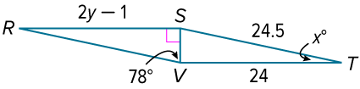
Example 2
Use Corresponding Parts of Congruent Triangles
In the diagram, △RSV ≅ △TVS. Find the values of x and y.
Part A Find the value of x.
Part B Find the value of y.

Slide 14
Example 2
Use Corresponding Parts of Congruent Triangles
Part A Find the value of x.
The value of x is 12.
∠T | ≅ ∠R | CPCTC
m∠T | = m∠R | Definition of congruence
 | = 180° − 90° − 78° | Triangle Angle-Sum Theorem
 | = 12° | Solve.

Slide 15
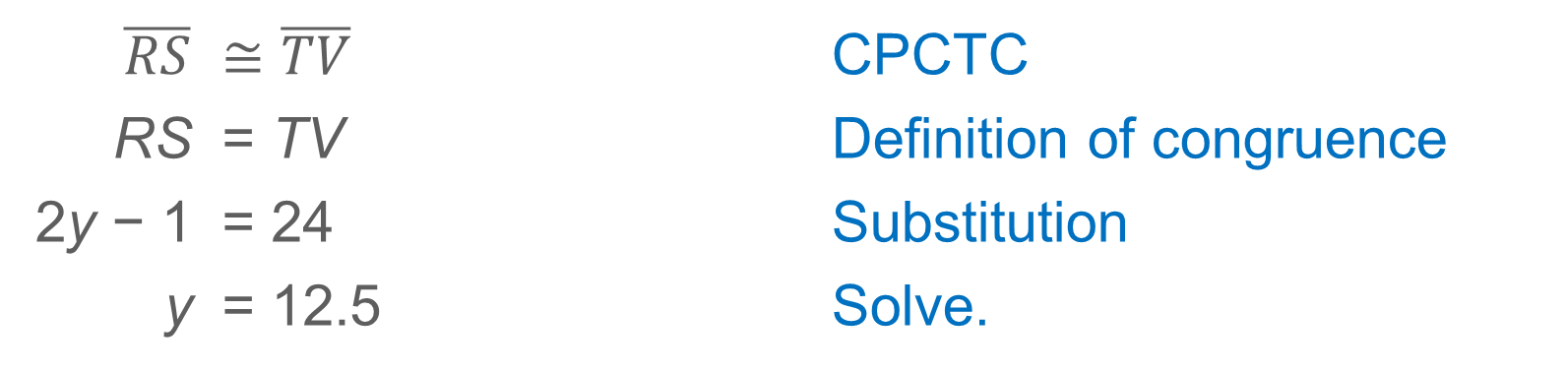
Example 2
Use Corresponding Parts of Congruent Triangles
Part B Find the value of y.
The value of y is 12.5.
$$\overline{RS}$$ | $$≅\overline{TV}$$ | CPCTC
RS | = TV | Definition of congruence
2y − 1 | = 24 | Substitution
y | = 12.5 | Solve.

Slide 16
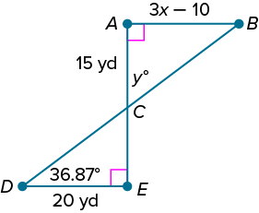
Example 2
Use Corresponding Parts of Congruent Triangles
Check
In the diagram, △ABC ≅ △EDC. Find the values of x and y.

Slide 17
Example 2
Use Corresponding Parts of Congruent Triangles
Check
In the diagram, △ABC ≅ △EDC. Find the values of x and y.
x = 10; y = 53.13
Notes:
x = 10; y = 53.13

Slide 18
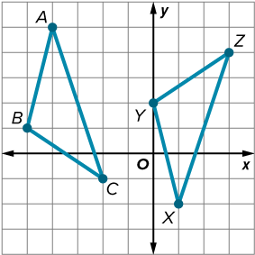
Example 3
Justify Congruence Using Rigid Transformations
Is △ABC ≅ △XYZ? Justify your answer using rigid transformations.

Slide 19
Example 3
Justify Congruence Using Rigid Transformations
Identify the rigid transformations that could map △XYZ onto △ABC.
If X and A are corresponding vertices, we need to reorient △XYZ so that X is the topmost vertex of the triangle. Reflect △XYZ in the x-axis.
X(1, −2) | → | X′(1, 2)
Y(0, 2) | → | Y′(0, −2)
Z(3, 4) | → | Z′(3, −4)

Slide 20
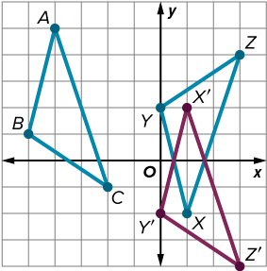
Example 3
Justify Congruence Using Rigid Transformations
Each vertex of △X′Y′Z′ can be mapped onto △ABC with a translation along the vector ⟨−5, 3⟩. We know that rigid transformations preserve side lengths and angle measures. Therefore, after the reflection and translation the corresponding sides and corresponding angles of △ABC and the image of △XYZ coincide. Therefore, △ABC ≅ △XYZ.

Slide 21
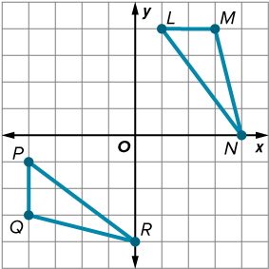
Example 3
Justify Congruence Using Rigid Transformations
Check
Is △LMN ≅ △PQR? Justify your answer using rigid transformations.
A. △LMN ≇ △PQR; you cannot map △LMN onto △PQR using a series of rigid transformations.
B. △LMN ≅ △PQR; you can map △LMN onto △PQR with a rotation 270° counterclockwise about the origin and a reflection in the
y-axis.
C. △LMN ≅ △PQR; you can map △LMN onto △PQR with a rotation 180° about the origin and a reflection in the line y = −2.
D. △LMN ≅ △PQR; you can map △LMN onto △PQR with a translation along the vector ⟨−5, −5⟩ and a reflection in the line y = x.

Slide 22
Example 3
Justify Congruence Using Rigid Transformations
Check
Is △LMN ≅ △PQR? Justify your answer using rigid transformations. B
A. △LMN ≇ △PQR; you cannot map △LMN onto △PQR using a series of rigid transformations.
B. △LMN ≅ △PQR; you can map △LMN onto △PQR with a rotation 270° counterclockwise about the origin and a reflection in the
y-axis.
C. △LMN ≅ △PQR; you can map △LMN onto △PQR with a rotation 180° about the origin and a reflection in the line y = −2.
D. △LMN ≅ △PQR; you can map △LMN onto △PQR with a translation along the vector ⟨−5, −5⟩ and a reflection in the line y = x.
Notes:
B

Slide 23
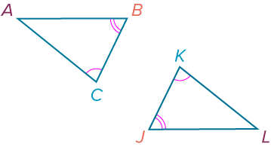
Learn
Third Angles Theorem and Triangle Congruence
Theorem 5.3: Third Angles Theorem
Words | If two angles of one triangle are congruent to two angles of a second triangle, then the third angles of the triangles are congruent.
Example | If ∠C ≅ ∠K and ∠B ≅ ∠J, then ∠A ≅ ∠L.

Slide 24
Learn
Third Angles Theorem and Triangle Congruence
Theorem 5.4: Properties of Triangle Congruence
Reflexive Property of Triangle Congruence
△ABC ≅ △ABC
Symmetric Property of Triangle Congruence
If △ABC ≅ △EFG, then △EFG ≅ △ABC.
Transitive Property of Triangle Congruence
If △ABC ≅ △EFG and △EFG ≅ △JKL, then △ABC ≅ △JKL.

Slide 25
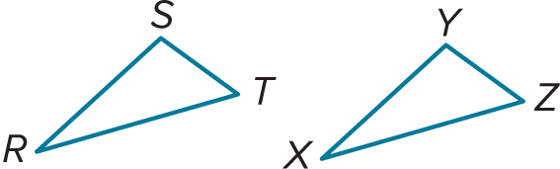
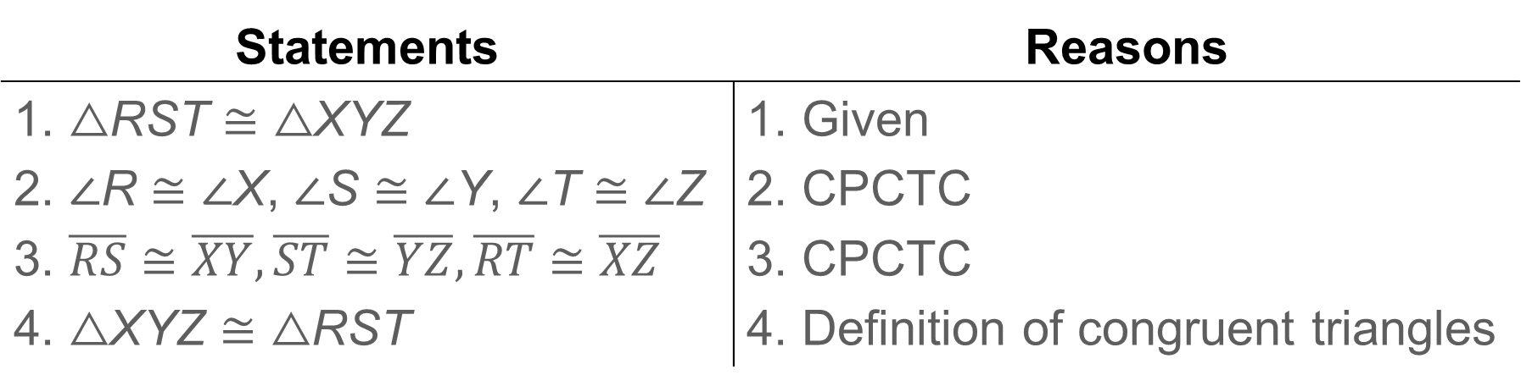
Learn
Third Angles Theorem and Triangle Congruence
A proof of the Symmetric Property of Triangle Congruence is below.
Given: △RST ≅ △XYZ
Prove: △XYZ ≅ △RST
Statements | Reasons
1. △RST ≅ △XYZ 2. ∠R ≅ ∠X, ∠S ≅ ∠Y, ∠T ≅ ∠Z 3. $\overline{RS}≅\overline{XY},\overline{ST}≅\overline{YZ},\overline{RT}≅\overline{XZ}$ 4. △XYZ ≅ △RST | 1. Given 2. CPCTC 3. CPCTC 4. Definition of congruent triangles

Slide 26
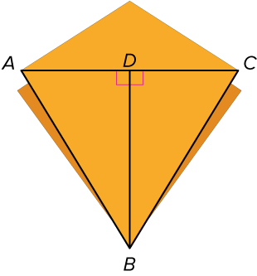
Example 4
Use the Third Angles Theorem
ORIGAMI Aika is folding origami dragons for a party she is hosting. If ∠ABD ≅ ∠CBD and m∠BAD = 58°, find m∠CBD.

Slide 27
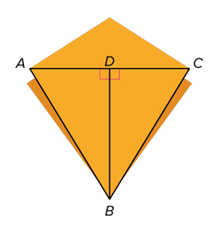
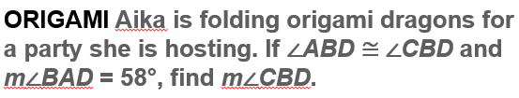
What Do You Know? | How Do You Know It?
∠ABD ≅ ∠CBD, m∠BAD = 58° | Given
∠BDC ≅ ∠BDA | All rt. ∠s are ≅.
∠BCD ≅ ∠BAD | Third Angles Theorem
m∠BCD = m∠BAD | Def. of congruence
m∠CBD + m∠BCD = 90° | The acute ∠s of a rt. △ are compl.

Slide 28
Example 4
Use the Third Angles Theorem
m∠BCD | = 58° | Substitute.
m∠CBD + 58° | = 90° | Substitute.
m∠CBD | = 32° | Solve.
The measure of ∠CBD is 32°.

Slide 29
Example 4
Use the Third Angles Theorem
Talk About It!
How could you find the m∠CBD in a different way? Which method do you think is more efficient?

Slide 30
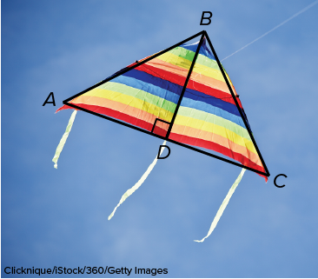
Example 4
Use the Third Angles Theorem
Check
KITES In the kite shown, ∠BAD ≅ ∠BCD and m∠BCD = 45°. Find m∠ABD.

Slide 31
Example 4
Use the Third Angles Theorem
Check
KITES In the kite shown, ∠BAD ≅ ∠BCD and m∠BCD = 45°. Find m∠ABD.
m∠ABD = 45°
Notes:
m∠ABD = 45°

Slide 32
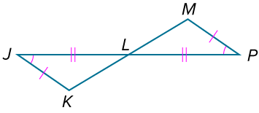
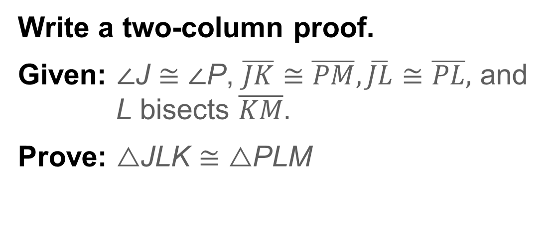
Example 5
Prove that Two Triangles Are Congruent
Write a two-column proof.
Given: ∠J ≅ ∠P, $\overline{JK}≅\overline{PM},\overline{JL}≅\overline{PL},$ and L bisects $\overline{KM}.$
Prove: △JLK ≅ △PLM

Slide 33
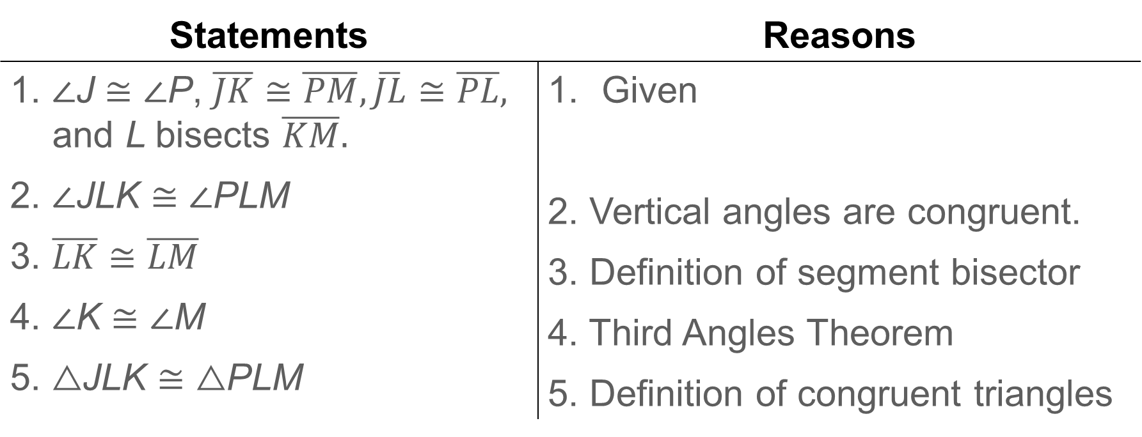
Example 5
Prove that Two Triangles Are Congruent
Statements | Reasons
1. ∠J ≅ ∠P, $\overline{JK}≅\overline{PM},\overline{JL}≅\overline{PL},$ and L bisects $\overline{KM}.$ 2. ∠JLK ≅ ∠PLM 3. $\overline{LK}≅\overline{LM}$ 4. ∠K ≅ ∠M 5. △JLK ≅ △PLM | Given 2. Vertical angles are congruent. 3. Definition of segment bisector 4. Third Angles Theorem 5. Definition of congruent triangles

Slide 34
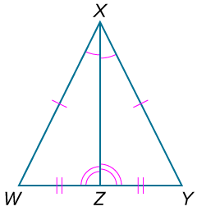
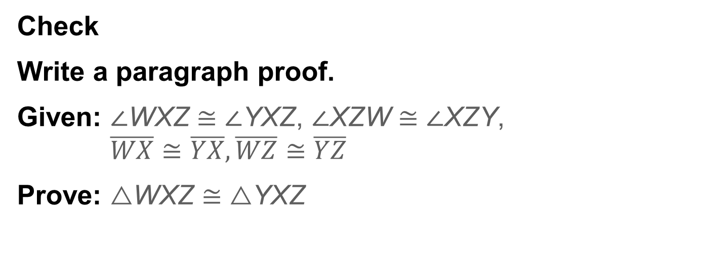
Example 5
Prove that Two Triangles Are Congruent
Check
Write a paragraph proof.
Given: ∠WXZ ≅ ∠YXZ, ∠XZW ≅ ∠XZY,
$\overline{WX}≅\overline{YX},\overline{WZ}≅\overline{YZ}$
Prove: △WXZ ≅ △YXZ

Slide 35
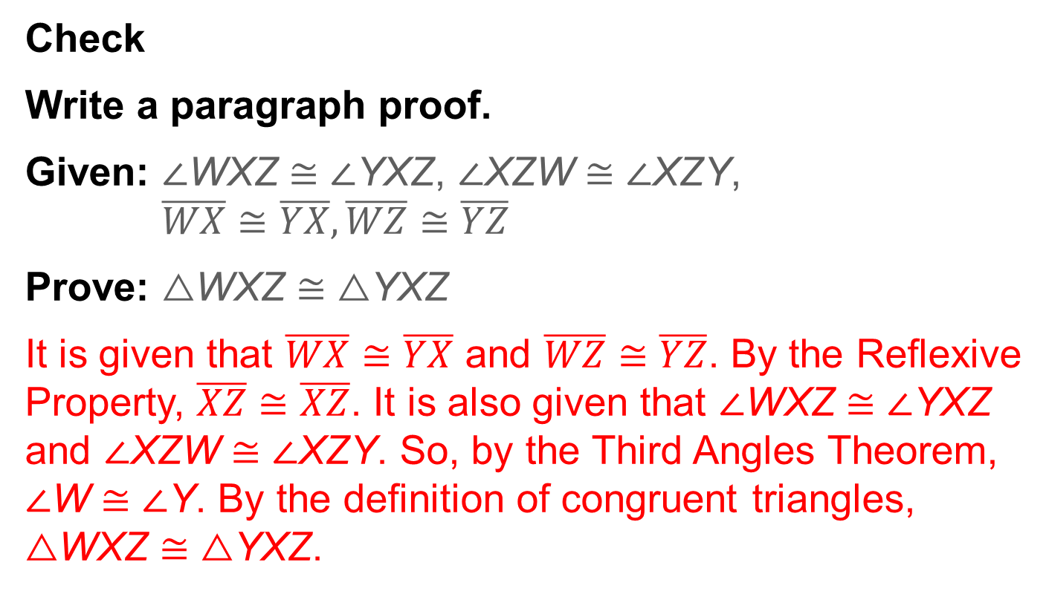
Example 5
Prove that Two Triangles Are Congruent
Check
Write a paragraph proof.
Given: ∠WXZ ≅ ∠YXZ, ∠XZW ≅ ∠XZY,
$\overline{WX}≅\overline{YX},\overline{WZ}≅\overline{YZ}$
Prove: △WXZ ≅ △YXZ
It is given that $\overline{WX}≅\overline{YX}$ and $\overline{WZ}≅\overline{YZ}$. By the Reflexive Property, $\overline{XZ}≅\overline{XZ}$. It is also given that ∠WXZ ≅ ∠YXZ and ∠XZW ≅ ∠XZY. So, by the Third Angles Theorem, ∠W ≅ ∠Y. By the definition of congruent triangles, △WXZ ≅ △YXZ.
Notes:
It is given that $\overline{WX}≅\overline{YX}$ and $\overline{WZ}≅\overline{YZ}$. By the Reflexive Property, $\overline{XZ}≅\overline{XZ}$. It is also given that ∠WXZ ≅ ∠YXZ and ∠XZW ≅ ∠XZY. So, by the Third Angles Theorem, ∠W ≅ ∠Y. By the definition of congruent triangles, △WXZ ≅ △YXZ.

Slide 36
Pause and Reflect
Did you struggle with anything in this lesson? If so, how did you deal with it?

Slide 37
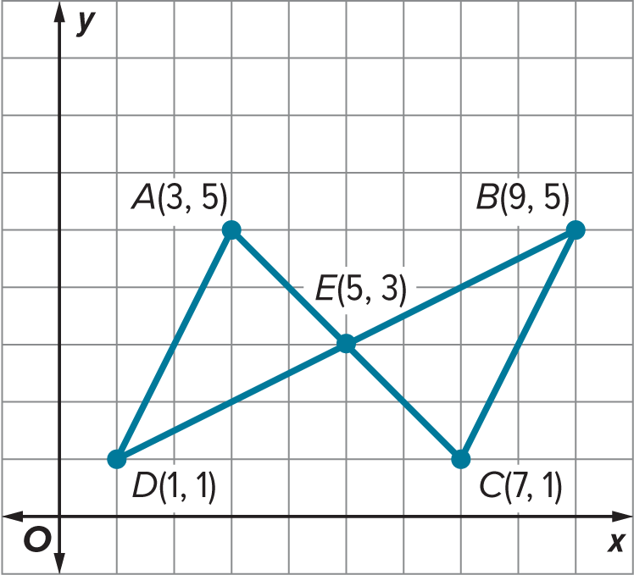
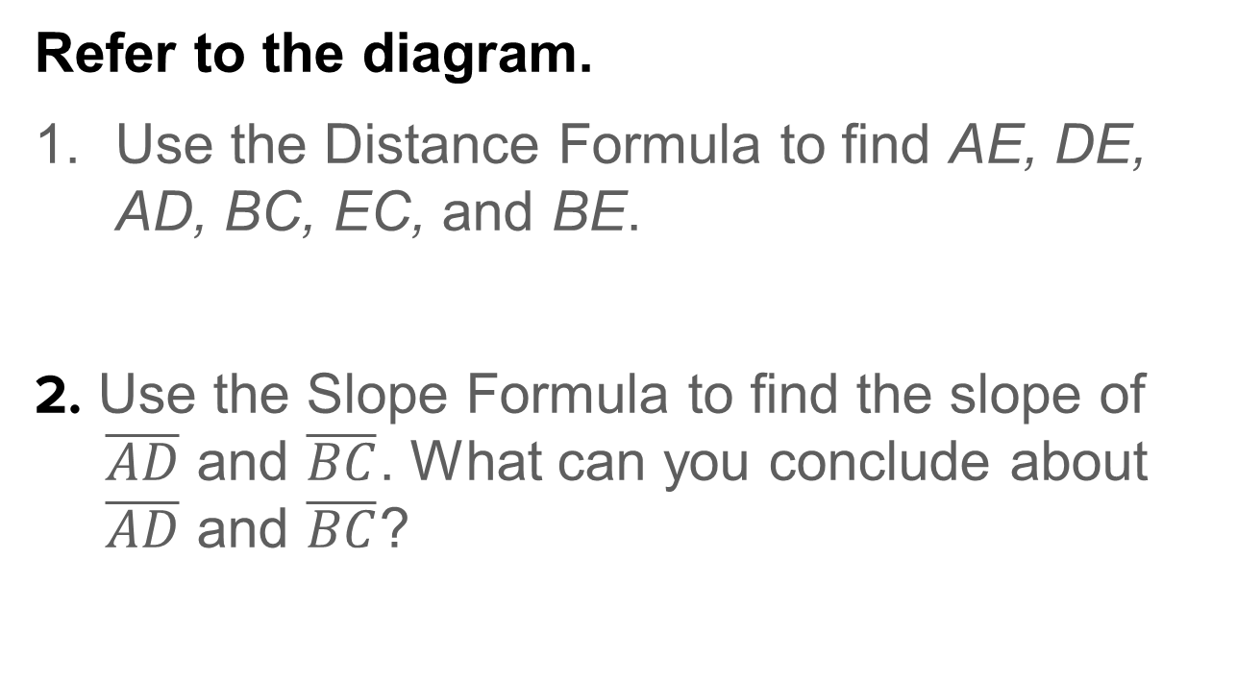
Exit Ticket
Refer to the diagram.
Use the Distance Formula to find AE, DE, AD, BC, EC, and BE.
2. Use the Slope Formula to find the slope of $\overline{AD}$ and $\overline{BC}$. What can you conclude about $\overline{AD}$ and $\overline{BC}$?

Slide 38
Exit Ticket
Refer to the diagram.
3. What can you conclude about ∠D and ∠B, ∠A and ∠C, and ∠AED and ∠CEB? Justify your answer.
4. Show that △ADE ≅ △CBE.
5. What transformation(s) could you use to show that △ADE ≅ △CBE?

Slide 39
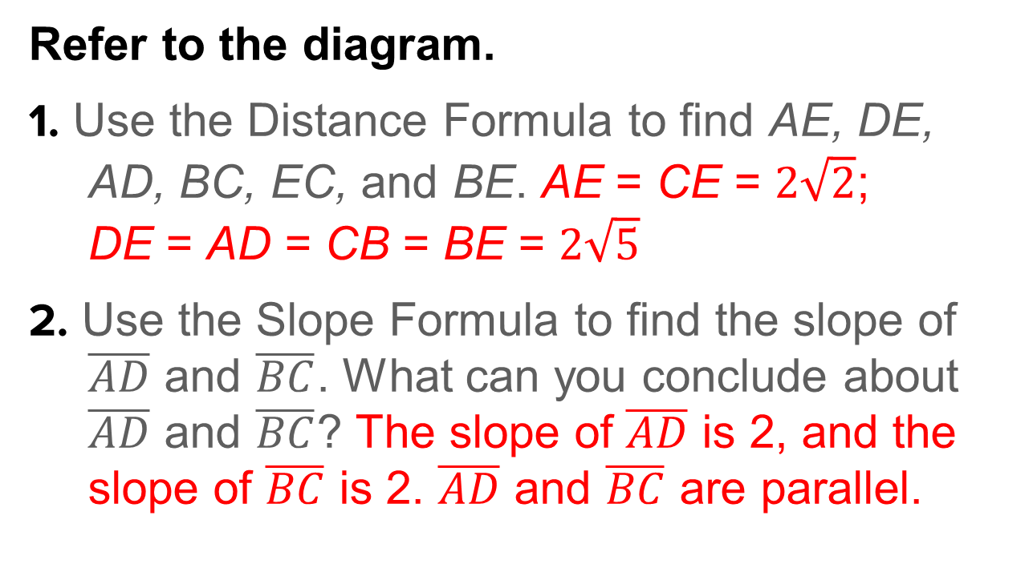
Exit Ticket
Refer to the diagram.
1. Use the Distance Formula to find AE, DE, AD, BC, EC, and BE. AE = CE = $2\sqrt{2}$;
DE = AD = CB = BE = $2\sqrt{5}$
2. Use the Slope Formula to find the slope of $\overline{AD}$ and $\overline{BC}$. What can you conclude about $\overline{AD}$ and $\overline{BC}$? The slope of $\overline{AD}$ is 2, and the slope of $\overline{BC}$ is 2. $\overline{AD}$ and $\overline{BC}$ are parallel.
Notes:
AE = CE = $2\sqrt{2}$; DE = AD = CB = BE = $2\sqrt{5}$
The slope of $\overline{AD}$ is 2, and the slope of $\overline{BC}$ is 2. $\overline{AD}$ and $\overline{BC}$ are parallel.

Slide 40
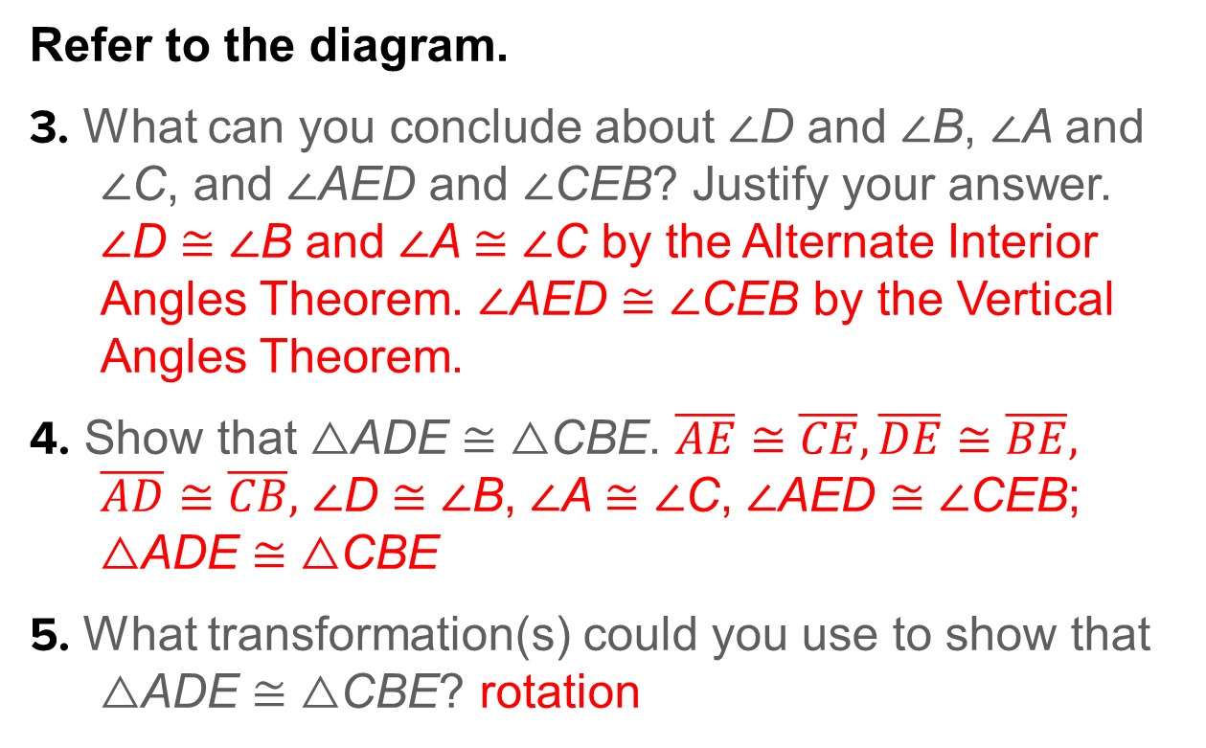
Exit Ticket
Refer to the diagram.
3. What can you conclude about ∠D and ∠B, ∠A and ∠C, and ∠AED and ∠CEB? Justify your answer. ∠D ≅ ∠B and ∠A ≅ ∠C by the Alternate Interior Angles Theorem. ∠AED ≅ ∠CEB by the Vertical Angles Theorem.
4. Show that △ADE ≅ △CBE. $\overline{AE}≅\overline{CE},\overline{DE}≅\overline{BE},$ $\overline{AD}≅\overline{CB},$ ∠D ≅ ∠B, ∠A ≅ ∠C, ∠AED ≅ ∠CEB; △ADE ≅ △CBE
5. What transformation(s) could you use to show that △ADE ≅ △CBE? rotation
Notes:
∠D ≅ ∠B and ∠A ≅ ∠C by the Alternate Interior Angles Theorem. ∠AED ≅ ∠CEB by the Vertical Angles Theorem.
$\overline{AE}≅\overline{CE},\overline{DE}≅\overline{BE},$ $\overline{AD}≅\overline{CB},$ ∠D ≅ ∠B, ∠A ≅ ∠C, ∠AED ≅ ∠CEB; △ADE ≅ △CBE
rotation

