Slide 1
Angles of Triangles

Slide 2
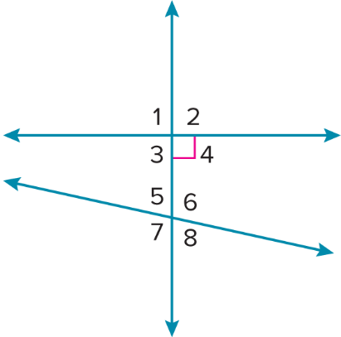
Warm Up
In the figure, which angles or pair of angles fit the indicated description?
1. an obtuse angle
2. an acute angle
3. a right angle
4. a pair of alternate interior angles
5. a pair of supplementary angles adjacent to one another

Slide 3
Warm Up
In the figure, which angles or pair of angles fit the indicated description?
1. an obtuse angle ∠6, ∠7
2. an acute angle ∠5, ∠8
3. a right angle ∠1, ∠2, ∠3, ∠4
4. a pair of alternate interior angles ∠3, ∠6; ∠5, ∠4
5. a pair of supplementary angles adjacent to one another ∠1, ∠2; ∠1, ∠3; ∠2, ∠4; ∠3, ∠4; ∠5, ∠6; ∠5, ∠7; ∠6, ∠8; ∠7, ∠8
Notes:
∠6, ∠7
∠5, ∠8
∠1, ∠2, ∠3, ∠4
∠3, ∠6; ∠5, ∠4
∠1, ∠2; ∠1, ∠3; ∠2, ∠4; ∠3, ∠4; ∠5, ∠6; ∠5, ∠7; ∠6, ∠8; ∠7, ∠8

Slide 4
Florida’s B.E.S.T. Standards for Mathematics
MA.912.GR.1.3 Prove relationships and theorems about triangles. Solve mathematical and real-world problems involving postulates, relationships and theorems of triangles.

Slide 5
Florida’s Mathematical Thinking and Reasoning Standards
MA.K12.MTR.3.1
Complete tasks with mathematical fluency.
MA.K12.MTR.6.1
Assess the reasonableness of solutions.

Slide 6
Lesson Objectives
Content Objective
Students will prove and apply the Triangle Angle-Sum Theorem, Exterior Angle Theorem, and Triangle Angle-Sum Theorem Corollaries.
Language Objectives
Students use less than and greater than to explain the differences between triangles and their angle relationships.
To cultivate conversation, students participate in MLR8: Discussion Supports.

Slide 7
Learn
Interior Angles of Triangles
An interior angle of a triangle is the angle at a vertex of a triangle. Because a triangle has three vertices, it also has three interior angles. The Triangle Angle-Sum Theorem describes the relationships among the interior angle measures of any triangle.
The relationship described by the Triangle Angle-Sum Theorem can be shown using a pictorial proof. A pictorial proof is a type of informal proof that uses a visual demonstration to prove a relationship.

Slide 8
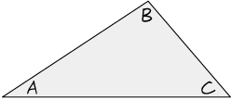



Learn
Interior Angles of Triangles
Theorem 5.1: Triangle Angle-Sum Theorem
The sum of the measures of the interior angles of a triangle is 180°.
Given: △ABC
Prove: m∠A + m∠B + m∠C = 180°
Proof:
Step 1
Step 2
Step 3
Step 4

Slide 9
Learn
Interior Angles of Triangles
Recall that triangles can be classified by their side lengths and angle measures. Three classifications based on side lengths are scalene, isosceles, and equilateral. Three classifications based on angle measures are acute, obtuse, and right.

Slide 10
Learn
Interior Angles of Triangles
Talk About It!
Discuss the reasoning behind the pictorial proof of the Triangle Angle-Sum Theorem. How do the figures demonstrate that the sum of the measures of the interior angles of a triangle is 180°? How could a pictorial proof help you develop a two-column or paragraph proof?

Slide 11
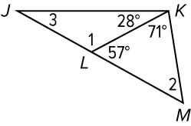
Apply Example 1
Use the Triangle Angle-Sum Theorem
Find the measure of each numbered angle.

Slide 12
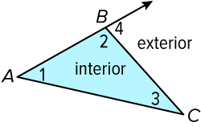
Learn
Exterior Angles of Triangles
exterior angles | An exterior angle of a triangle is an angle formed by one side of the triangle and the extension of an adjacent side. A triangle has three exterior angles. ∠4 is an exterior angle of △ABC.
remote interior angles | Each exterior angle of a triangle has two remote interior angles that are not adjacent to the exterior angle. ∠1 and ∠3 are the remote interior angles for ∠4.

Slide 13
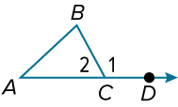
Learn
Exterior Angles of Triangles
Theorem 5.2: Exterior Angle Theorem
The measure of an exterior angle of a triangle is equal to the sum of the measures of the two remote interior angles.
Given: △ABC
Prove: m∠A + m∠B = m∠1
(continued on the next slide)

Slide 14
Learn
Exterior Angles of Triangles
Proof:
Statements | Reasons
1. △ABC 2. ∠2 and ∠1 form a linear pair. 3. ∠2 and ∠1 are supplementary. 4. m∠2 + m∠1 = 180° 5. m∠A + m∠B + m∠2 = 180° 6. m∠A + m∠B + m∠2 = m∠2 + m∠1 7. m∠A + m∠B = m∠1 | 1. Given 2. Definition of linear pair 3. If 2 ∠s form a linear pair, they are supplementary. 4. Definition of supplementary 5. Triangle Angle-Sum Theorem 6. Substitution 7. Subtraction Property of =

Slide 15
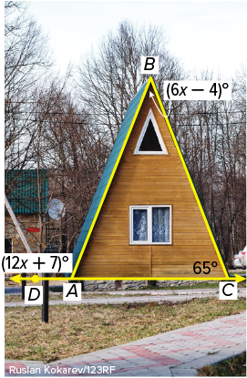
Example 2
Use the Exterior Angle Theorem
ARCHITECTURE Find the measure of ∠DAB in the front face of the building.

Slide 16
Example 2
Use the Exterior Angle Theorem
m∠DAB | = m∠ABC + m∠BCA | Exterior Angle Theorem
(12x + 7)° | = (6x − 4)° + 65° | Substitution
x | = 9 | Solve.
m∠DAB | = [12(9) + 7]° or 115°

Slide 17
Example 2
Use the Exterior Angle Theorem
Think About It!
What theorems and definitions can you use to check your answer for reasonableness?

Slide 18
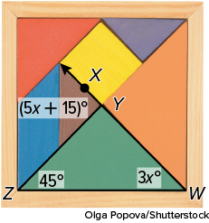
Example 2
Use the Exterior Angle Theorem
Check
PUZZLES Find the measure of ∠XYZ.

Slide 19
Example 2
Use the Exterior Angle Theorem
Check
PUZZLES Find the measure of ∠XYZ.
90°
Notes:
90°

Slide 20
Learn
Triangle Angle-Sum Corollaries
A corollary is a theorem with a proof that follows as a direct result of another theorem. As with a theorem, a corollary can be used as a reason in a proof. The corollaries below follow directly from the Triangle Angle-Sum Theorem.
Corollary 5.1
The acute angles of a right triangle are complementary.
Corollary 5.2
There can be at most one right or obtuse angle in a triangle.

Slide 21
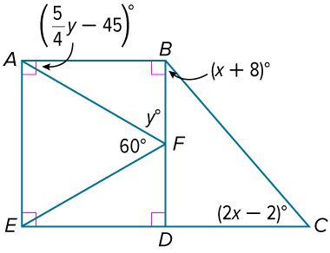
Example 3
Find Angle Measures in Right Triangles
Find each measure.
a. m∠BCD
b. m∠BAF

Slide 22
Example 3
Find Angle Measures in Right Triangles
a. m∠BCD
Because ∠BDC and ∠EDF form a linear pair and m∠EDF = 90°, m∠BDC = 90° by the Supplement Theorem. Therefore, m∠BCD + m∠DBC = 90° because the acute angles of a right triangle are complementary.

Slide 23
Example 3
Find Angle Measures in Right Triangles
m∠BCD + m∠DBC | = 90° | Corollary 5.1
(x + 8)° + (2x − 2)° | = 90° | Substitution
x | = 28 | Solve.
m∠BCD = [2(28) − 2]° or 54°

Slide 24
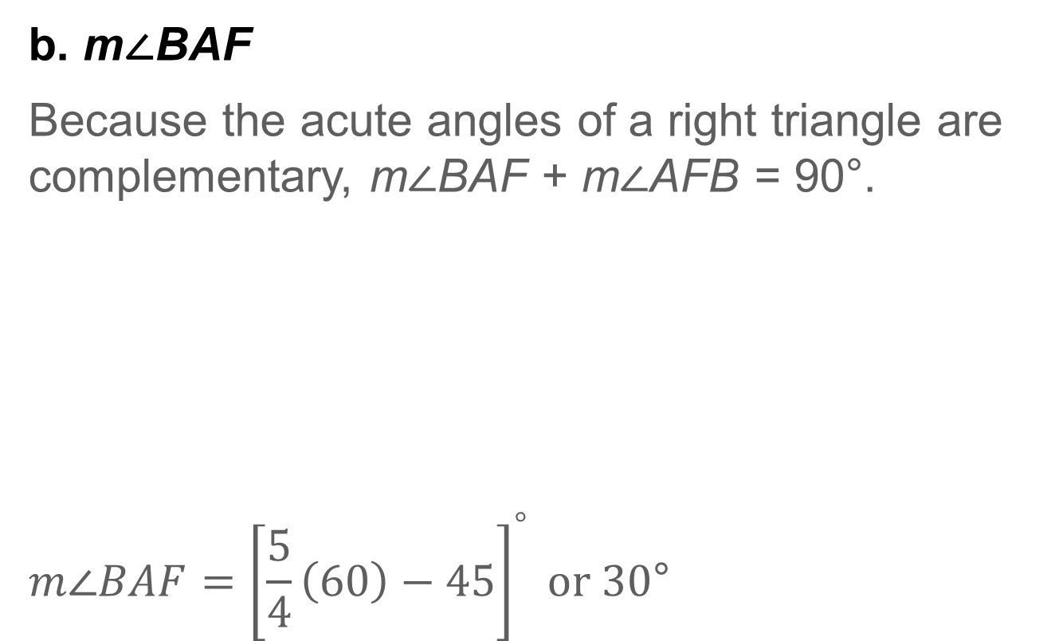
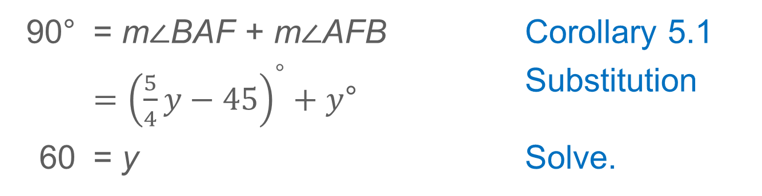
Example 3
Find Angle Measures in Right Triangles
b. m∠BAF
Because the acute angles of a right triangle are complementary, m∠BAF + m∠AFB = 90°.
$$m∠BAF={\left[\frac{5}{4}\left(60\right)−45\right]}^{°} or 30\text{°}$$
90° | = m∠BAF + m∠AFB | Corollary 5.1
 | $={\left(\frac{5}{4}y−45\right)}^{°}+y$° | Substitution
60 | = y | Solve.

Slide 25
Example 3
Find Angle Measures in Right Triangles
Talk About It!
How could you prove that m∠FED = 30°? What proof method would you choose? Explain your reasoning.

Slide 26
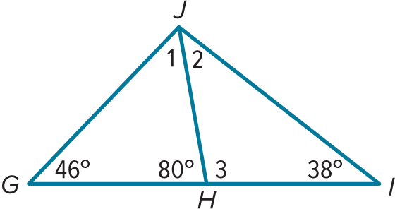
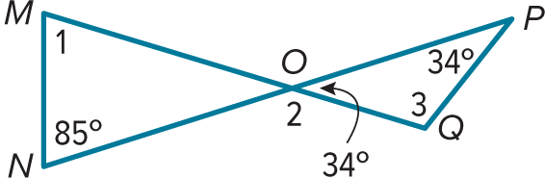
Exit Ticket
Find m∠1, m∠2, and m∠3.
1.
2.

Slide 27
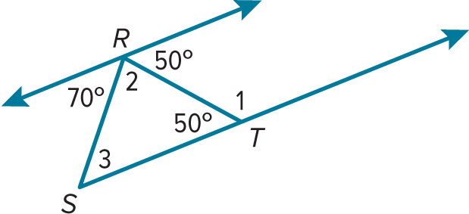
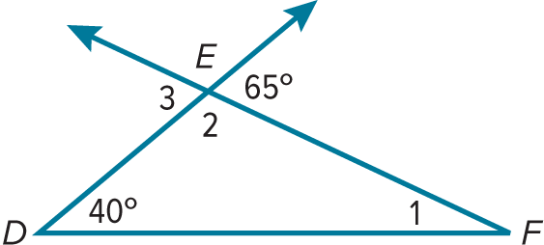
Exit Ticket
Find m∠1, m∠2, and m∠3.
3.
4.

Slide 28
Exit Ticket
Find m∠1, m∠2, and m∠3.
1. 54°, 42°, 100°
2. 61°, 146°, 112°
Notes:
1. 54°, 42°, 100°
2. 61°, 146°, 112°

Slide 29
Exit Ticket
Find m∠1, m∠2, and m∠3.
3. 130°, 60°, 70°
4. 25°, 115°, 65°
Notes:
3. 130°, 60°, 70°
4. 25°, 115°, 65°

