Slide 1
Section 2-1
Angles and Congruence

Slide 2

Warm Up

Slide 3
Florida’s B.E.S.T. Standards for Mathematics
MA.912.GR.1.6
Solve mathematical and real-world problems involving congruence or similarity in two-dimensional figures.
MA.912.GR.5.1
Construct a copy of a segment or an angle.
MA.912.GR.5.2
Construct the bisector of a segment or an angle, including the perpendicular bisector of a line segment.

Slide 4
Florida’s Mathematical Thinking and Reasoning Standards
MA.K12.MTR.3.1
Complete tasks with mathematical fluency.
MA.K12.MTR.4.1
Engage in discussions that reflect on the mathematical thinking of self and others.

Slide 5
Lesson Objectives
Content Objective
Students identify and use angles, angle parts, and special angle pairs.
Language Objectives
Students talk about angles and congruence using because and if.
To maximize linguistic and cognitive meta-awareness, students participate in MLR8: Discussion Supports.

Slide 6

Learn
Angles
Lines and portions of lines intersect to form angles.
A ray is the part of a line consisting of a point on the line, called the endpoint of the ray, together with all of the collinear points on one side of the endpoint. | Rays are named by stating the endpoint first and then another point on the ray.

Slide 7
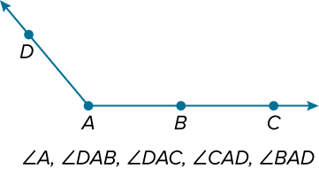
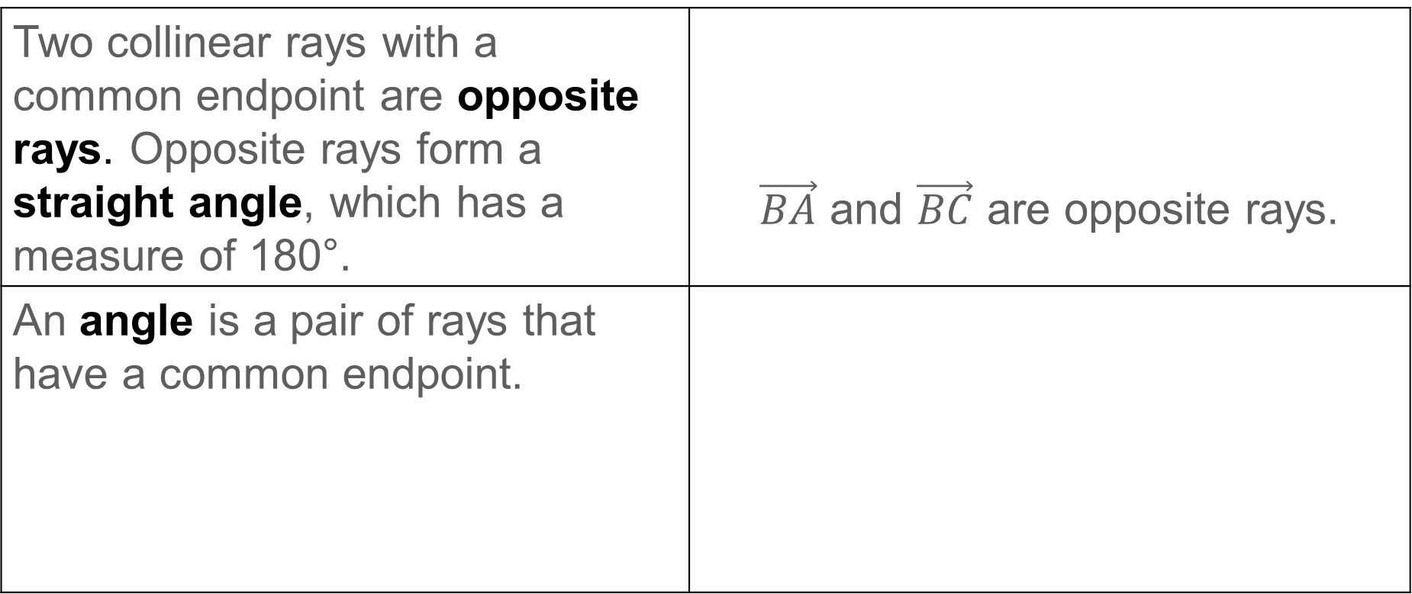
Learn
Angles
Two collinear rays with a common endpoint are opposite rays. Opposite rays form a straight angle, which has a measure of 180°. | $\vec{BA}$ and $\vec{BC}$ are opposite rays.
An angle is a pair of rays that have a common endpoint.

Slide 8
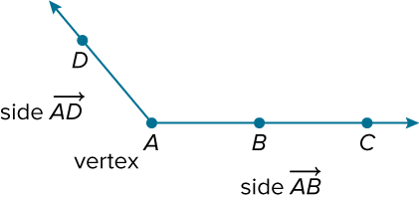
Learn
Angles
The rays are called sides of the angle. The common endpoint is the vertex.

Slide 9
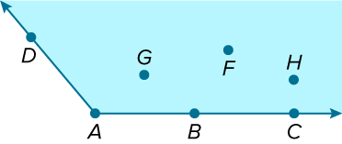
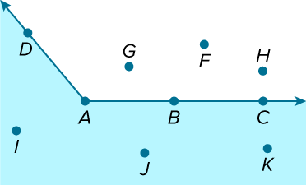
Learn
Angles
An angle divides a plane into three distinct parts.
Points D, A, B, and C lie on the angle. Points G, F, and H lie in the interior of the angle.
Points I, J, and K lie in the exterior of the angle.

Slide 10
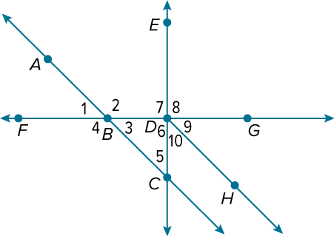
Example 1
Identify Angles
Use the figure to identify the angles or parts of angles that satisfy each given condition.
a. Name all the angles that have D as a vertex.
b. Name the sides of ∠2.
c. Name a point in the interior of ∠FDE.
d. Name all of the points in the exterior of ∠FDE.

Slide 11
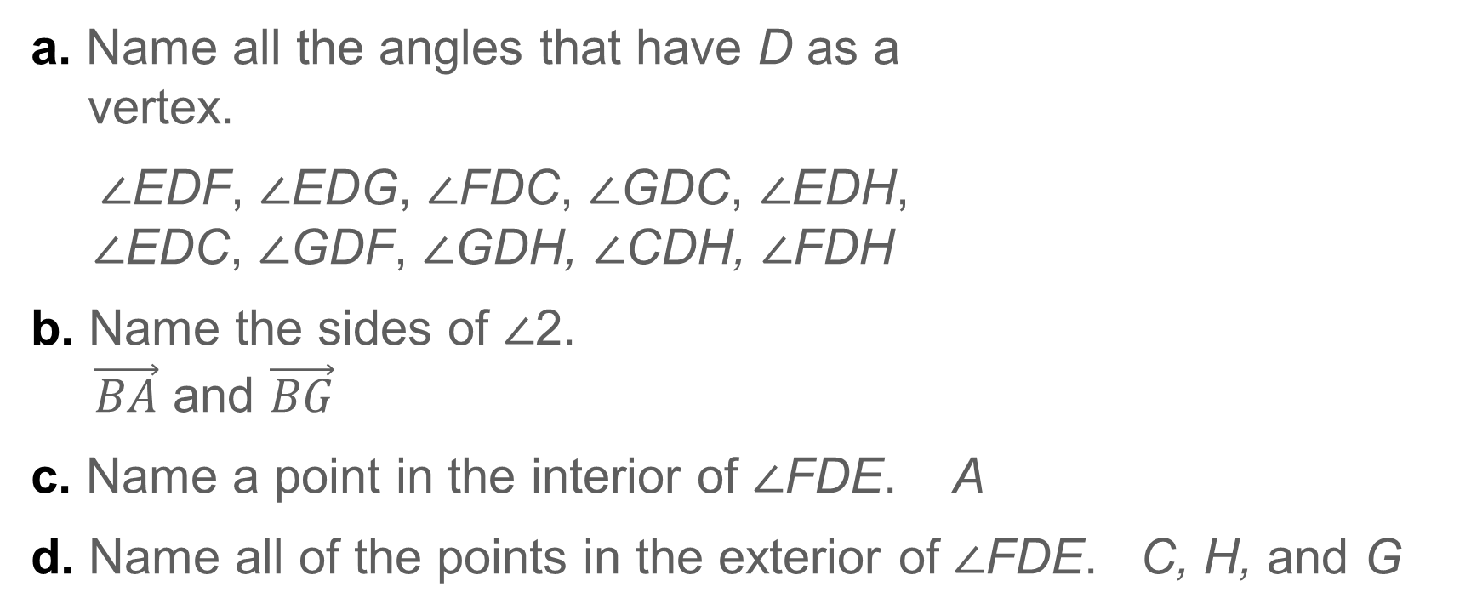
Example 1
Identify Angles
a. Name all the angles that have D as a
vertex.
∠EDF, ∠EDG, ∠FDC, ∠GDC, ∠EDH,
∠EDC, ∠GDF, ∠GDH, ∠CDH, ∠FDH
b. Name the sides of ∠2.
$\vec{BA}$ and $\vec{BG}$
c. Name a point in the interior of ∠FDE. A
d. Name all of the points in the exterior of ∠FDE. C, H, and G

Slide 12
Example 1
Identify Angles
Think About It!
Can a point be in the interior of one angle and the exterior of another angle? If so, use the diagram in Example 1 to justify your reasoning.

Slide 13
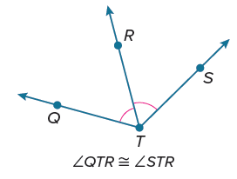
Learn
Congruent Angles
The measure of an angle is the measure in degrees of the space between the sides of the angle. Angles that have the same measure are congruent angles. Congruent angles are indicated on the figure by a matching number of arcs.

Slide 14
Learn
Congruent Angles
You can use various tools to copy an angle. To use string, start by loosely tying the end of the string around a pencil to ensure the length of the portion of the string being used doesn't change each time. Use a thumbtack to fix the other end of the string to a point.

Slide 15
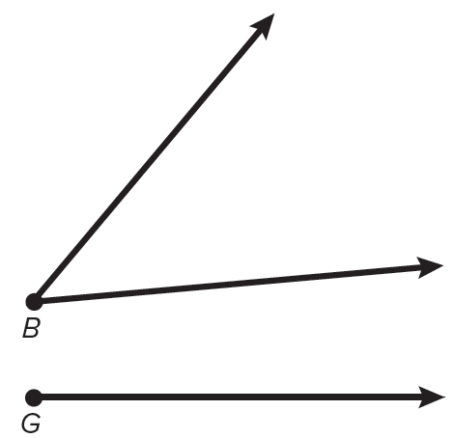
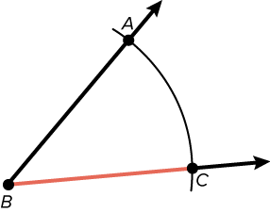
Learn
Congruent Angles
Construction: Copy an Angle
STEP 1 You are given ∠B. Use a straightedge to draw a ray on your paper. Label its endpoint G.
STEP 2 Place the thumbtack at the vertex of ∠B and draw a large arc that intersects both sides of ∠B. Label the points of intersection A and C.

Slide 16
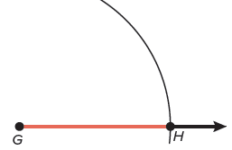
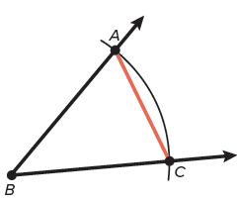
Learn
Congruent Angles
Construction: Copy an Angle
STEP 3 Without changing the length of the string, place the thumbtack on G and draw an arc that starts above the ray and intersects the ray. Label the point of intersection H.
STEP 4 Place the thumbtack on C and adjust your string so that the pencil tip is on A.

Slide 17
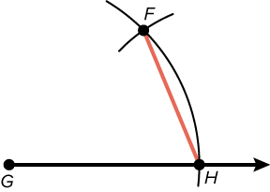
Learn
Congruent Angles
Construction: Copy an Angle
STEP 5 Without changing the length of the string, place the thumbtack on H and draw an arc to intersect the larger arc you drew in Step 3. Label the point of intersection F.

Slide 18
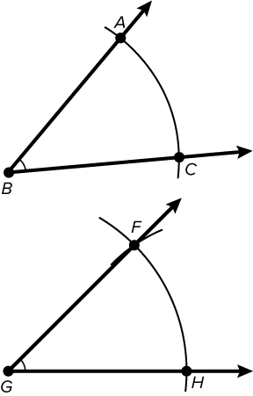
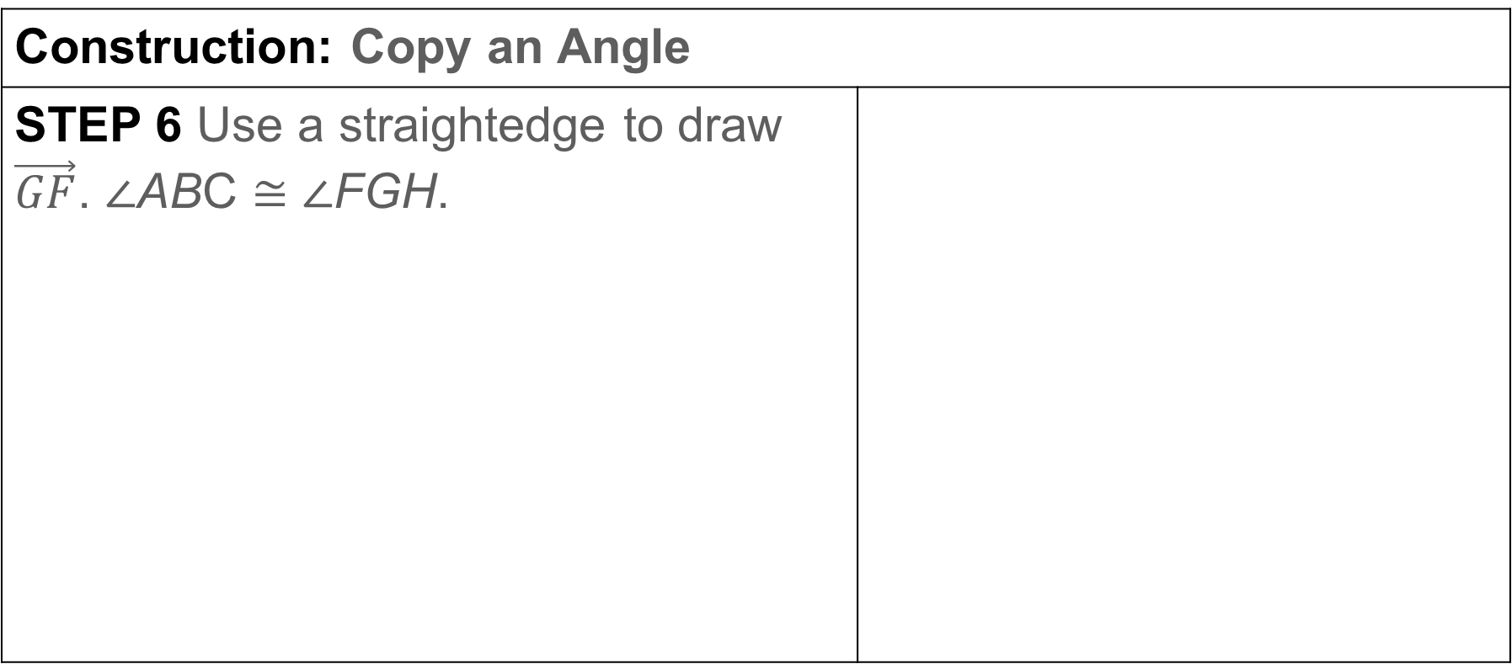
Learn
Congruent Angles
Construction: Copy an Angle
STEP 6 Use a straightedge to draw $\vec{GF}$. ∠ABC ≅ ∠FGH.

Slide 19
Learn
Congruent Angles
A ray or segment that divides an angle into two congruent angles is an angle bisector. You can create the angle bisector of any angle without knowing the measure of the angle.

Slide 20
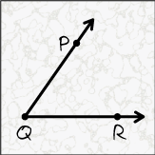
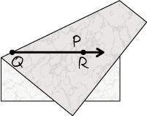
Learn
Congruent Angles
Construction: Bisect an Angle
STEP 1 Draw ∠PQR on a sheet of tracing paper.
STEP 2 Fold the paper until the two rays of the angle overlap. Then crease the paper. Unfold the paper.

Slide 21
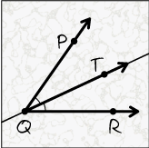
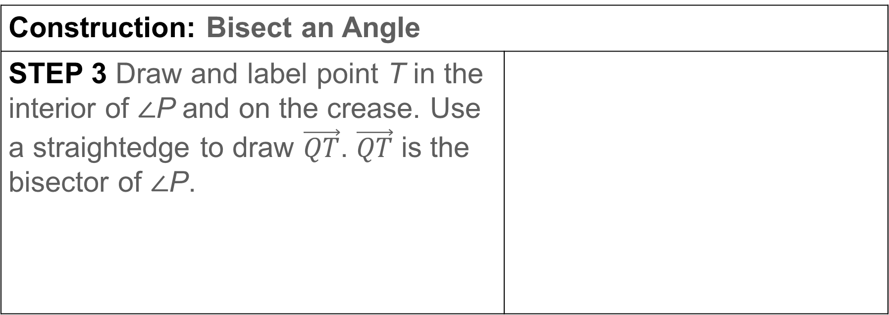
Learn
Congruent Angles
Construction: Bisect an Angle
STEP 3 Draw and label point T in the interior of ∠P and on the crease. Use a straightedge to draw $\vec{QT}$. $\vec{QT}$ is the bisector of ∠P.

Slide 22
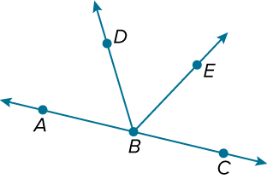

Example 2
Congruent Angles and Angle Bisectors
In the figure, $\vec{BA}$ and $\vec{BC}$ are opposite rays and $\vec{BD}$ bisects ∠ABE. If m∠ABD = (4x + 14)° and m∠DBE = (8x − 32)°, find m∠DBE.

Slide 23
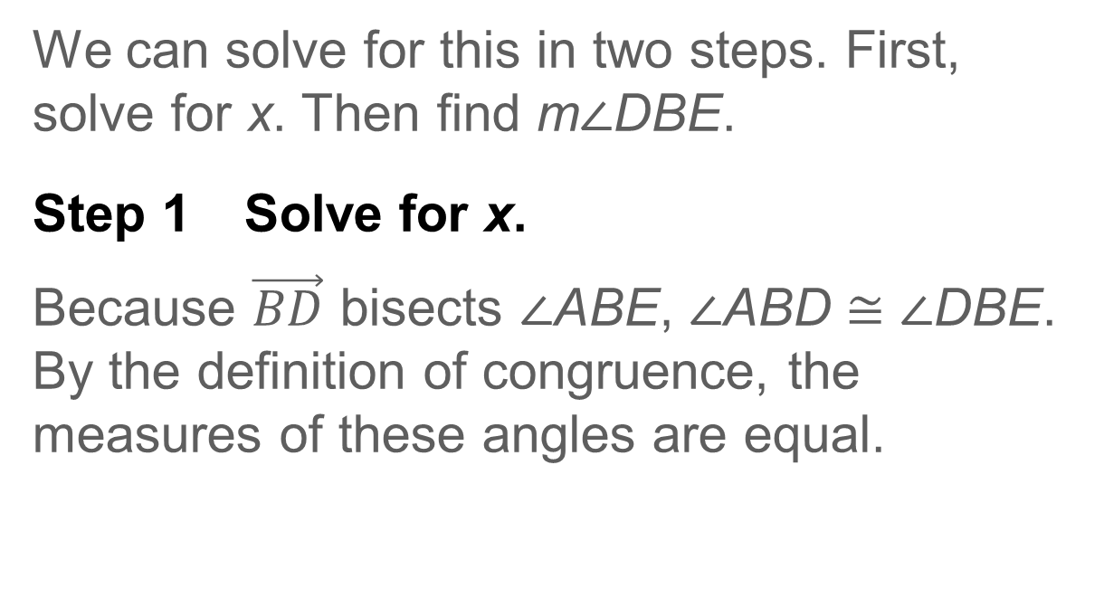
Example 2
Congruent Angles and Angle Bisectors
We can solve for this in two steps. First, solve for x. Then find m∠DBE.
Step 1 Solve for x.
Because $\vec{BD}$ bisects ∠ABE, ∠ABD ≅ ∠DBE. By the definition of congruence, the measures of these angles are equal.

Slide 24
Example 2
Congruent Angles and Angle Bisectors
m∠ABD = m∠DBE | Definition of congruent angles
(4x + 14)° = (8x − 32)° | Substitution
14° = 4x° − 32° | Subtract 4x° from each side.
46° = 4x° | Add 32° to each side.
11.5 = x | Divide each side by 4°.

Slide 25
Example 2
Congruent Angles and Angle Bisectors
Step 2 Find the angle measure.
Because we are asked to find m∠DBE, we substitute 11.5 for x in the expression.
m∠DBE = (8x − 32)° | Given
= [8(11.5) − 32]° | Substitute.
= 92°− 32° or 60° | Simplify.
m∠DBE = 60°

Slide 26
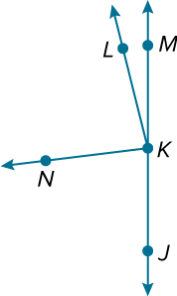
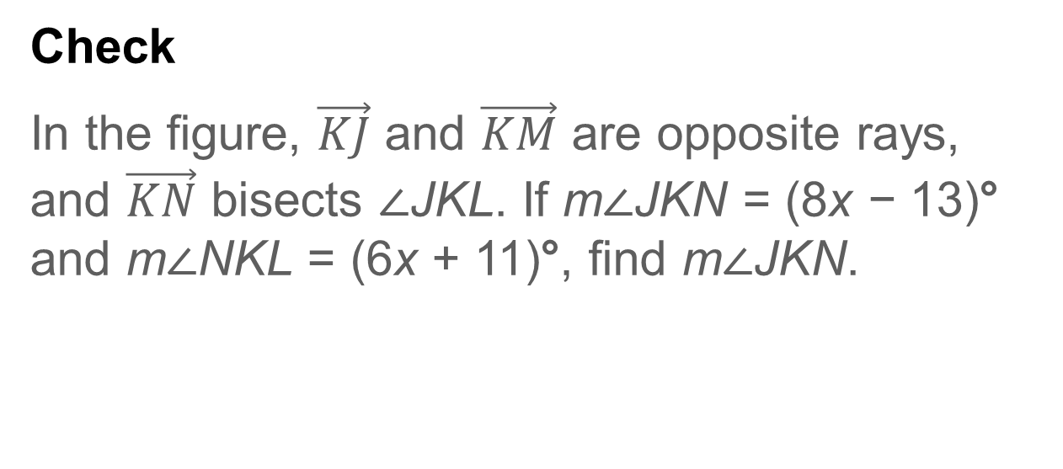
Example 2
Congruent Angles and Angle Bisectors
Check
In the figure, $\vec{KJ}$ and $\vec{KM}$ are opposite rays, and $\vec{KN}$ bisects ∠JKL. If m∠JKN = (8x − 13)° and m∠NKL = (6x + 11)°, find m∠JKN.

Slide 27
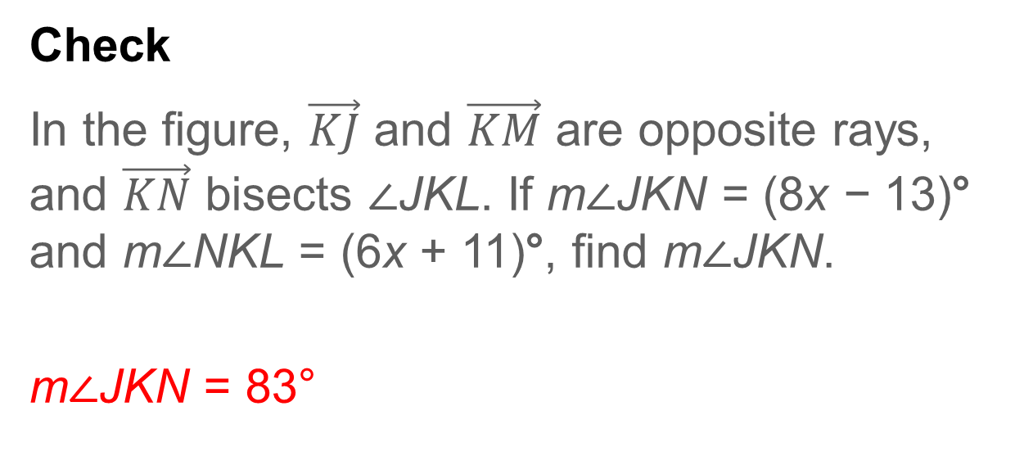
Example 2
Congruent Angles and Angle Bisectors
Check
In the figure, $\vec{KJ}$ and $\vec{KM}$ are opposite rays, and $\vec{KN}$ bisects ∠JKL. If m∠JKN = (8x − 13)° and m∠NKL = (6x + 11)°, find m∠JKN.
m∠JKN = 83°
Notes:
m∠JKN = 83°

Slide 28
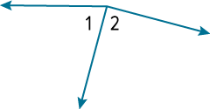
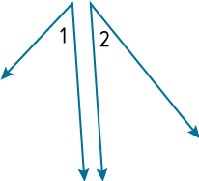
Learn
Special Angle Pairs
Special Angle Pairs
Special Angle Pair Definition | Examples | Nonexamples
Adjacent angles are two angles that lie in the same plane, have a common vertex and a common side, but have no common interior points. | ∠1 and ∠2 are adjacent angles.

Slide 29

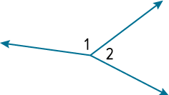
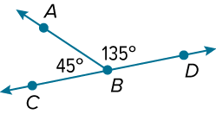
Learn
Special Angle Pairs
Special Angle Pairs
Special Angle Pair Definition | Examples | Nonexamples
A linear pair is a pair of adjacent angles with noncommon sides that are opposite rays. | ∠1 and ∠2 are a linear pair.
The sum of the angle measures is 180°.

Slide 30
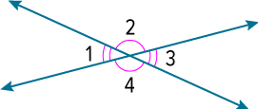
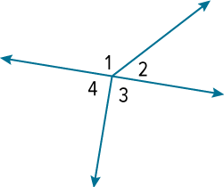
Learn
Special Angle Pairs
Special Angle Pairs
Special Angle Pair Definition | Examples | Nonexamples
Vertical angles are the two nonadjacent angles formed by two intersecting lines. Vertical angles are congruent. | ∠1 and ∠3 are vertical angles. ∠2 and ∠4 are vertical angles.

Slide 31
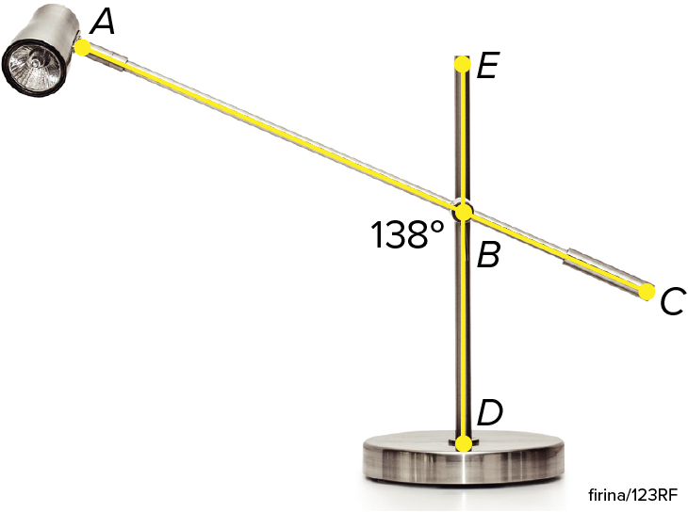
Example 3
Vertical Angles and Angle Pairs
HOME DECOR The office lamp is made using two intersecting metal bars.
a. How many pairs of adjacent angles do you see
in the figure? List two pairs.
b. Identify two pairs of vertical angles in the figure.
c. How many linear pairs do you see in the figure?
List each pair.
d. Find m∠EBC.
e. Find m∠ABE.

Slide 32
Example 3
Vertical Angles and Angle Pairs
a. How many pairs of adjacent angles do
you see in the figure? List two pairs.
4; ∠DBA and ∠ABE, ∠ABE and ∠EBC
b. Identify two pairs of vertical angles in the figure.
∠DBA and ∠EBC, ∠ABE and ∠CBD
c. How many linear pairs do you see in the
figure? List each pair.
4; ∠DBA and ∠ABE, ∠ABE and ∠EBC, ∠EBC and ∠CBD, ∠CBD and ∠DBA

Slide 33
Example 3
Vertical Angles and Angle Pairs
d. Find m∠EBC.
Because ∠ABD and ∠EBC are formed by intersecting line segments, they are vertical angles. Because vertical angles are congruent, m∠EBC is the same as m∠ABD, 138°.
e. Find m∠ABE.
Because ∠ABE and ∠ABD form a linear pair, their measures add to 180°. Thus, m∠ABE = 180° − m∠ABD = 180° − 138° = 42°.

Slide 34
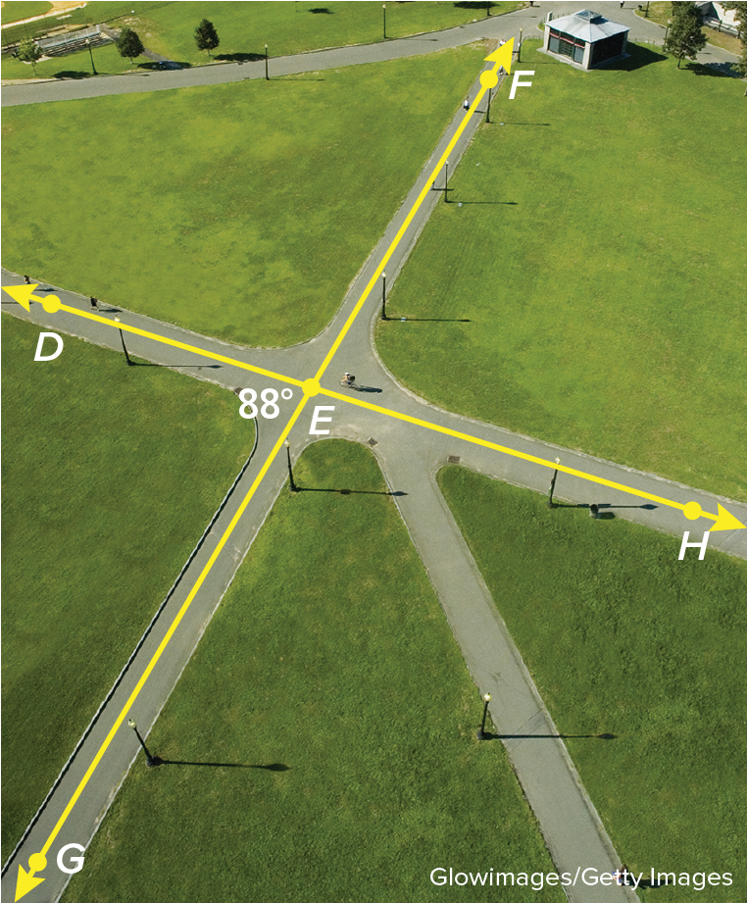
Example 4
Vertical Angles and Angle Pairs
Check
PARK A city planner is designing a park. He wants to place two pathways that intersect near the center of the park. If m∠GED = 88°, identify the true statement(s).
A. m∠DEF = 92°
B. m∠DEG = 92°
C. m∠FEH = 88°
D. m∠DEH = 92°
E. m∠GEH = 88°

Slide 35
Example 3
Vertical Angles and Angle Pairs
Check
PARK A city planner is designing a park. He wants to place two pathways that intersect near the center of the park. If m∠GED = 88°, identify the true statement(s). A, C
A. m∠DEF = 92°
B. m∠DEG = 92°
C. m∠FEH = 88°
D. m∠DEH = 92°
E. m∠GEH = 88°
Notes:
A, C

Slide 36
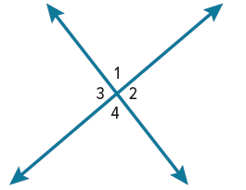
Exit Ticket
Use the figure.
1. ∠1 and what other angle(s) are vertical angles?
2. ∠2 and what other angle(s) are vertical angles?
3. ∠4 is adjacent to what other angle(s)?
4. ∠1 and what other angle(s) form a linear pair?
5. If m∠2 = 114°, then what are m∠1, m∠3, and m∠4?

Slide 37
Exit Ticket
Use the figure.
1. ∠1 and what other angle(s) are vertical angles?
2. ∠2 and what other angle(s) are vertical angles?
3. ∠4 is adjacent to what other angle(s)?
4. ∠1 and what other angle(s) form a linear pair?
5. If m∠2 = 114°, then what are m∠1, m∠3, and m∠4?
∠4
∠3
∠2 and ∠3
∠2 and ∠3
m∠1 = 66°, m∠3 = 114°, m∠4 = 66°
Notes:
∠4
∠3
∠2 and ∠3
∠2 and ∠3
m∠1 = 66°, m∠3 = 114°, m∠4 = 66°

