Slide 1
Section 3-4
Writing Proofs

Slide 2
Warm Up
Is the argument valid or invalid?
1. If an animal is a golden retriever, then it is a dog. Mac is a dog. Therefore, Mac is a golden retriever.
2. If the temperature is below 32°F, then water will freeze. The temperature is 23°F. Therefore, water will freeze.
3. All students must study. Emma studies. Therefore, Emma is a student.

Slide 3
Warm Up
4. If a figure is a quadrilateral, then the figure has four sides. A pentagon does not have four sides. Therefore, a pentagon is not a quadrilateral.
5. All trees have leaves. An oak is a tree. Therefore, an oak has leaves.

Slide 4
Warm Up
Is the argument valid or invalid?
1. If an animal is a golden retriever, then it is a dog. Mac is a dog. Therefore, Mac is a golden retriever. invalid
2. If the temperature is below 32°F, then water will freeze. The temperature is 23°F. Therefore, water will freeze. valid
3. All students must study. Emma studies. Therefore, Emma is a student. invalid
Notes:
invalid
valid
invalid

Slide 5
Warm Up
4. If a figure is a quadrilateral, then the figure has four sides. A pentagon does not have four sides. Therefore, a pentagon is not a quadrilateral. valid
5. All trees have leaves. An oak is a tree. Therefore, an oak has leaves. valid
Notes:
valid
valid

Slide 6
Florida’s B.E.S.T. Standards for Mathematics
MA.912.GR.1.1
Prove relationships and theorems about lines and angles. Solve mathematical and real-world problems involving postulates, relationships and theorems of lines and angles.

Slide 7
Florida’s Mathematical Thinking and Reasoning Standards
MA.K12.MTR.1.1
Actively participate in effortful learning both individually and collectively.
MA.K12.MTR.4.1
Engage in discussions that reflect on the mathematical thinking of self and others.

Slide 8
Lesson Objectives
Content Objective
Students analyze and construct viable arguments.
Language Objective
Students explain how to analyze and construct viable arguments using so.
To optimize output, students participate in MLR1: Stronger and Clearer Each Time.

Slide 9

Learn
Postulates About Points, Lines, and Planes
Recall that a postulate or axiom is a statement accepted as true without proof. The postulates listed below about points, lines, and planes cannot be proven, but they can be used as reasons in proofs.
Postulates: Points, Lines, and Planes
3.1 | Through any two points, there is exactly one line. Example Line 𝓃 is the only line through points P and R.

Slide 10

Learn
Distance Between a Point and a Line
Postulates: Points, Lines, and Planes
3.2 | Through any three noncollinear points, there is exactly one plane. Example Plane 𝒦 is the only plane through noncollinear points A, B, and C.
3.3 | A line contains at least two points. Example Line 𝓃 contains points P and R.

Slide 11

Learn
Distance Between a Point and a Line
3.4 | A plane contains at least three noncollinear points. Example Plane 𝒦 contains noncollinear points A, B, and C.
3.5 | If two points lie in a plane, then the entire line containing those points lies in that plane. Example Points A and B lie in plane 𝒦, and line 𝓂 contains points A and B, so line 𝓂 is in plane 𝒦.

Slide 12
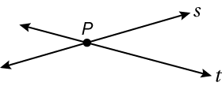
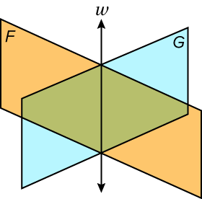
Learn
Distance Between a Point and a Line
3.6 | If two lines intersect, then their intersection is exactly one point. Example Lines 𝓈 and 𝓉 intersect at point P.
3.7 | If two planes intersect, then their intersection is a line. Example Planes ℱ and 𝒢 intersect in line 𝓌.

Slide 13
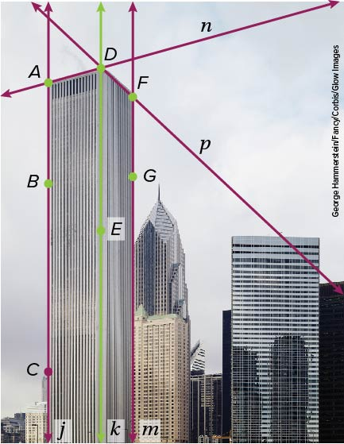
Example 1
Identify Postulates
ARCHITECTURE Explain how the photo illustrates that each statement is true. Then state the postulate that can be used to show that the statement is true.
a. Lines 𝓃 and 𝓅 intersect at point D.
b. Points A, B, and D determine a plane.
c. The plane that contains A, D, and E intersects the plane that contains F, G, and E in line 𝓀.

Slide 14
Example 1
Identify Postulates
a. Lines 𝓃 and 𝓅 intersect at point D.
The top edges of the building are represented by lines 𝓃 and 𝓅. The lines intersect at the corner point, D. Postulate
3.6 states that if two lines intersect, then their intersection is exactly one point.

Slide 15
Example 1
Identify Postulates
b. Points A, B, and D determine a plane.
Points A, B, and D are three noncollinear points on the front face of the building. By Postulate 3.2, through any three noncollinear points, there is exactly one plane.

Slide 16
Example 1
Identify Postulates
c. The plane that contains A, D, and E intersects the plane that contains F, G, and E in line 𝓀.
The front face of the building can be represented by the plane that contains A, D, and E. The side face of the building can be represented by the plane that contains F, G, and E. These planes intersect at the corner of the building represented by line 𝓀. Postulate 3.7 states that if two planes intersect, then their intersection is a line.

Slide 17
Example 2
Use Postulates
Determine whether each statement is sometimes, always, or never true. Justify your argument.
a. The intersection of three planes is a line.
b. Line 𝓇 contains only point P.
c. Through points H and K, there is exactly one line.

Slide 18
Example 2
Use Postulates
a. The intersection of three planes is a line.
Sometimes; if three planes intersect, then their intersection could be a line or a point.
b. Line 𝓇 contains only point P.
Never; Postulate 3.3 states that a line contains at least two points.
c. Through points H and K, there is exactly one line.
Always; Postulate 3.1 states that through any two points, there is exactly one line.

Slide 19
Example 2
Use Postulates
Think About It!
Martin claims that this is a true statement. Through any three points, there is exactly one plane. Do you agree? Explain.

Slide 20
Example 2
Use Postulates
Check
Determine whether the statement is sometimes, always, or never true. Justify your argument.
Two intersecting lines determine a plane.

Slide 21
Example 2
Use Postulates
Check
Determine whether the statement is sometimes, always, or never true. Justify your argument.
Two intersecting lines determine a plane. Always; sample answer: Between any two intersecting lines there are always at least three noncollinear points, and Postulate 2.2 states that through any three noncollinear points there is exactly one plane.
Notes:
Always; sample answer: Between any two intersecting lines there are always at least three noncollinear points, and Postulate 2.2 states that through any three noncollinear points there is exactly one plane.

Slide 22
Learn
Two-Column Proofs
Recall that Euclidean geometry is based on logical reasoning. A proof is a logical argument in which each statement is supported by a statement that is accepted as true. These supporting statements can include undefined terms, definitions, postulates, and theorems. A two-column proof is a proof that contains statements and reasons that are organized in a two-column format. You can develop a deductive argument to prove a statement by building a logical chain of statements and reasons.

Slide 23
Learn
Two-Column Proofs
Key Concept: How to Write a Proof
Step 1 | List the given information. Draw a diagram if needed.
Step 2 | Create a deductive argument that links the given information to the statement that you are proving.
Step 3 | Justify each statement with a reason. Reasons include definitions, postulates, theorems, and algebraic properties.
Step 4 | State what it is that you have proven.

Slide 24
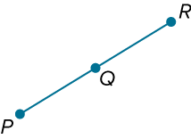
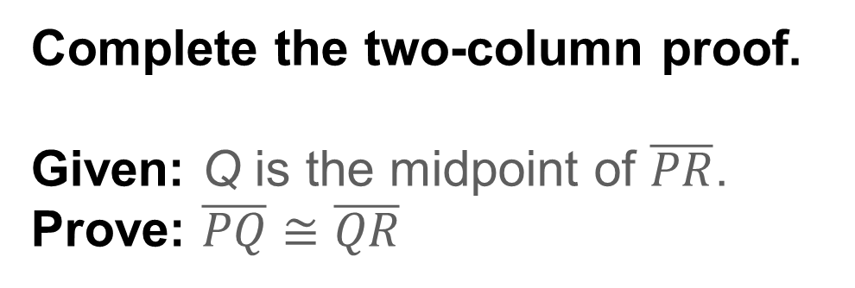
Example 3
Two-Column Proof
Complete the two-column proof.
Given: Q is the midpoint of $\overline{PR}$.
Prove: $\overline{PQ}$ ≅ $\overline{QR}$

Slide 25
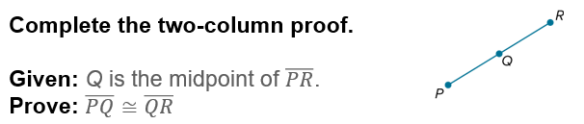
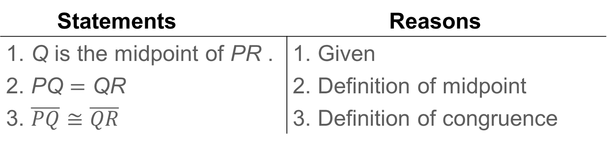
Example 3
Two-Column Proof
Statements | Reasons
1. Q is the midpoint of PR . | 1. Given
2. PQ = QR | 2. Definition of midpoint
3. $\overline{PQ}$ ≅ $\overline{QR}$ | 3. Definition of congruence
Once a conjecture has been proven true, it can be used as a reason in other proofs. The conjecture proven above is known as the Midpoint Theorem.

Slide 26

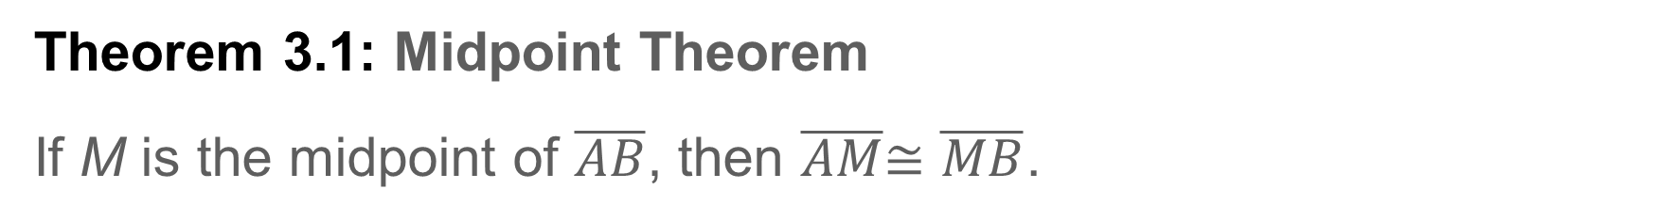
Example 3
Two-Column Proof
Theorem 3.1: Midpoint Theorem
If M is the midpoint of $\overline{AB}$, then $\overline{AM}$≅ $\overline{MB}$.

Slide 27
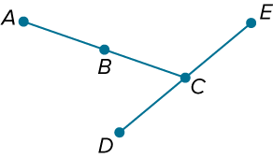
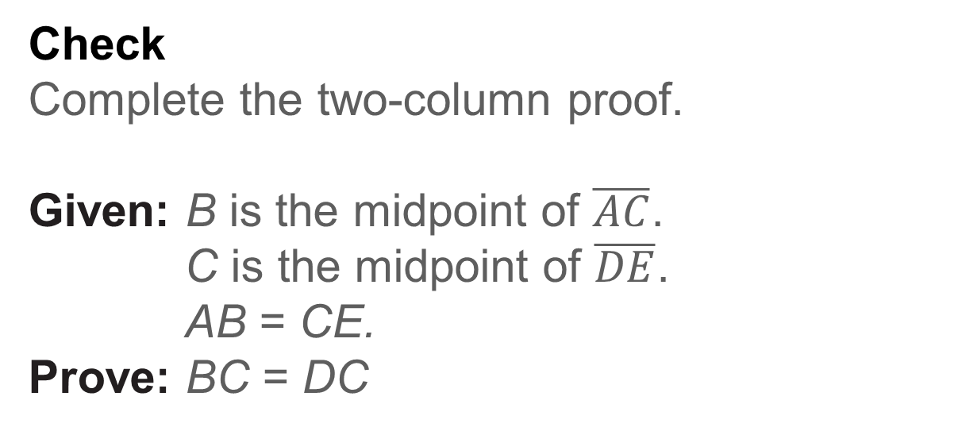
Example 3
Two-Column Proof
Check
Complete the two-column proof.
Given: B is the midpoint of $\overline{AC}$.
C is the midpoint of $\overline{DE}$.
AB = CE.
Prove: BC = DC

Slide 28
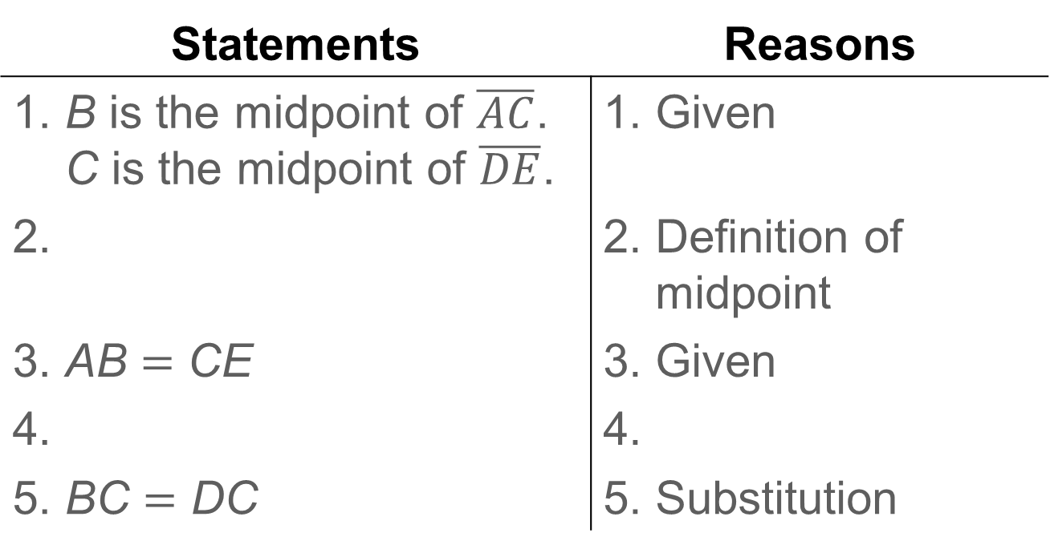
Example 3
Two-Column Proof
Statements | Reasons
1. B is the midpoint of $\overline{AC}$. C is the midpoint of $\overline{DE}$. | 1. Given
2. | 2. Definition of midpoint
3. AB = CE | 3. Given
4. | 4.
5. BC = DC | 5. Substitution

Slide 29
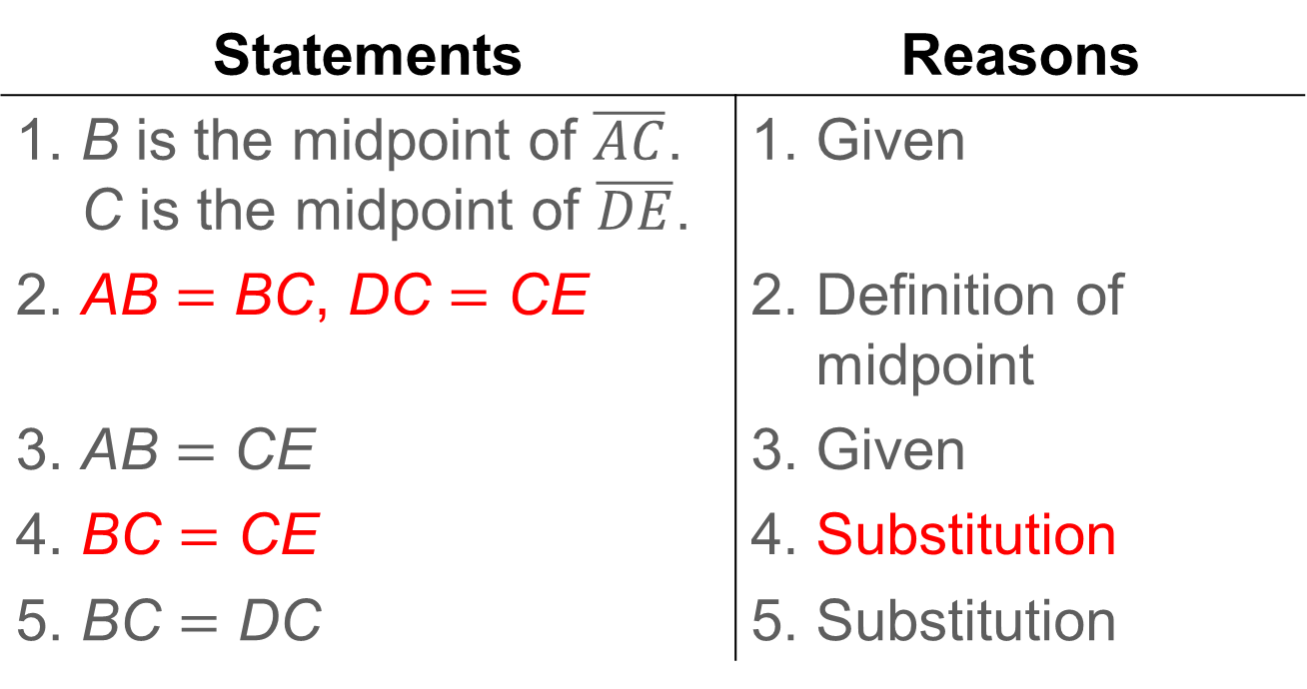
Example 3
Two-Column Proof
Statements | Reasons
1. B is the midpoint of $\overline{AC}$. C is the midpoint of $\overline{DE}$. | 1. Given
2. AB = BC, DC = CE | 2. Definition of midpoint
3. AB = CE | 3. Given
4. BC = CE | 4. Substitution
5. BC = DC | 5. Substitution
Notes:
AB = BC, DC = CE
BE = CE
Substitution

Slide 30
Learn
Flow Proofs
A flow proof, or flow chart proof, uses boxes and arrows to show the logical progression of an argument. The statement is in the box, and the reason is below it. Arrows indicate the order of the steps.

Slide 31
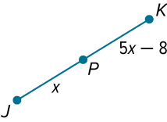
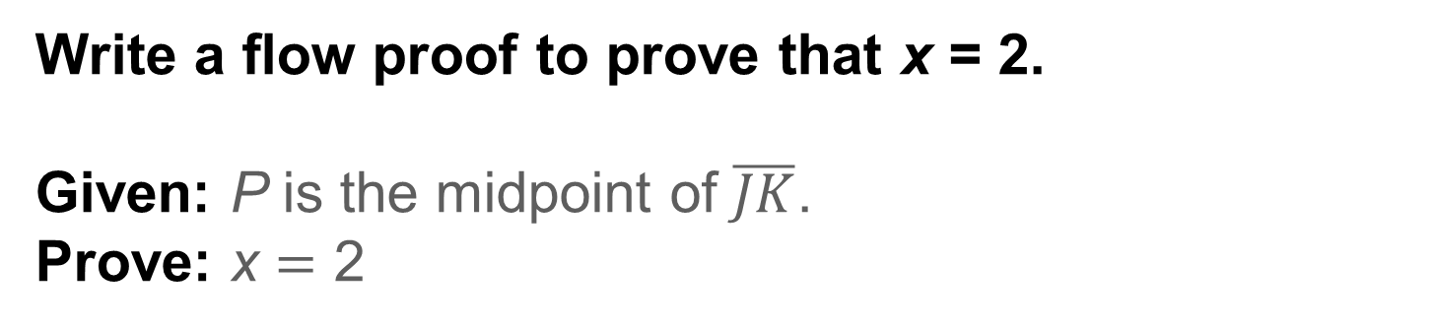
Example 4
Flow Proofs
Write a flow proof to prove that x = 2.
Given: P is the midpoint of $\overline{JK}$.
Prove: x = 2

Slide 32
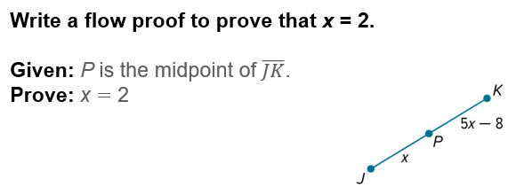
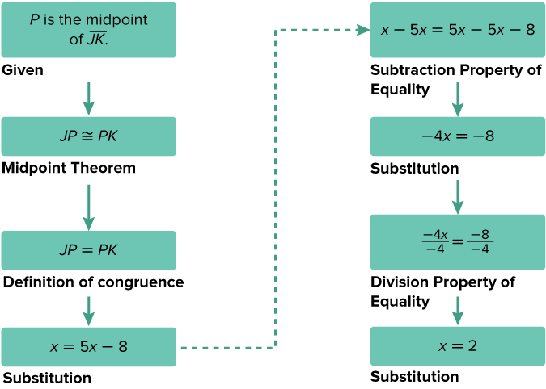
Example 4
Flow Proofs
Proof:

Slide 33
Example 4
Flow Proofs
Talk About It!
Can you eliminate a step from the proof? Explain.

Slide 34

Example 4
Flow Proofs
Check
Write each statement and reason in the correct box to complete the flow proof.
Given: FG = HK
Prove: x = 7

Slide 35
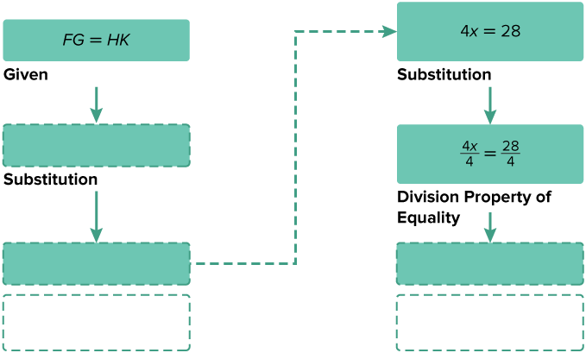
Example 4
Flow Proofs
Proof:

Slide 36
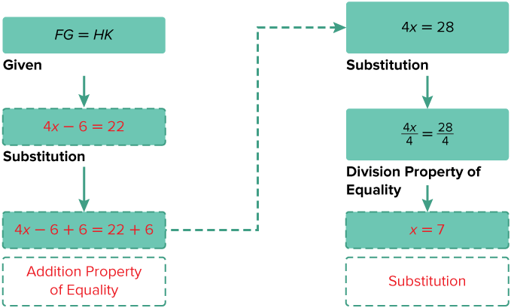
Example 4
Flow Proofs
Proof:

Slide 37
Learn
Paragraph Proofs
Another way to prove a conjecture is to write a paragraph that explains why the conjecture for a given situation is true. This is called a paragraph proof. A paragraph proof includes the undefined terms, theorems, definitions, or postulates that support each statement.

Slide 38
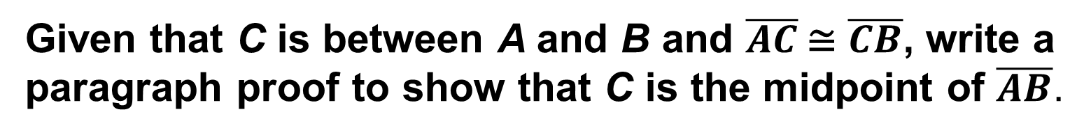
Example 5
Paragraph Proof
Given that C is between A and B and $\overline{AC}$ ≅ $\overline{CB}$, write a paragraph proof to show that C is the midpoint of $\overline{AB}$.

Slide 39

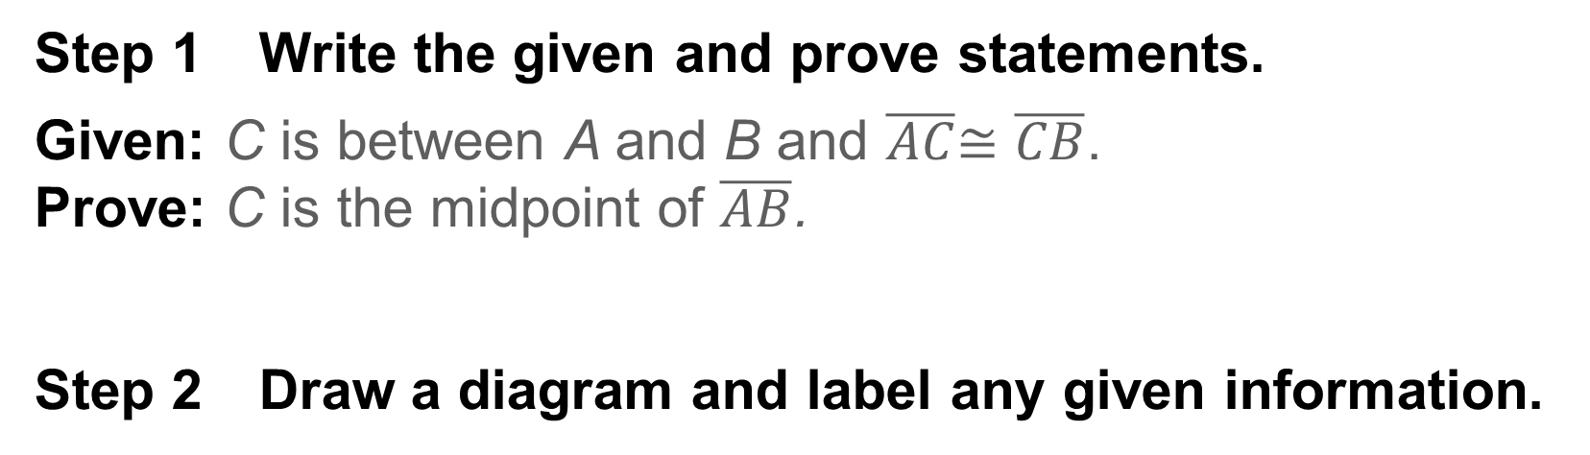
Example 5
Paragraph Proof
Step 1 Write the given and prove statements.
Given: C is between A and B and $\overline{AC}$≅ $\overline{CB}$.
Prove: C is the midpoint of $\overline{AB}$.
Step 2 Draw a diagram and label any given information.

Slide 40
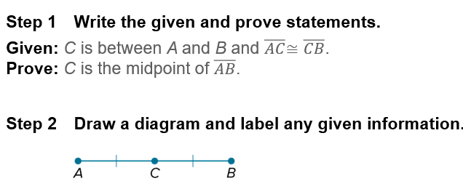
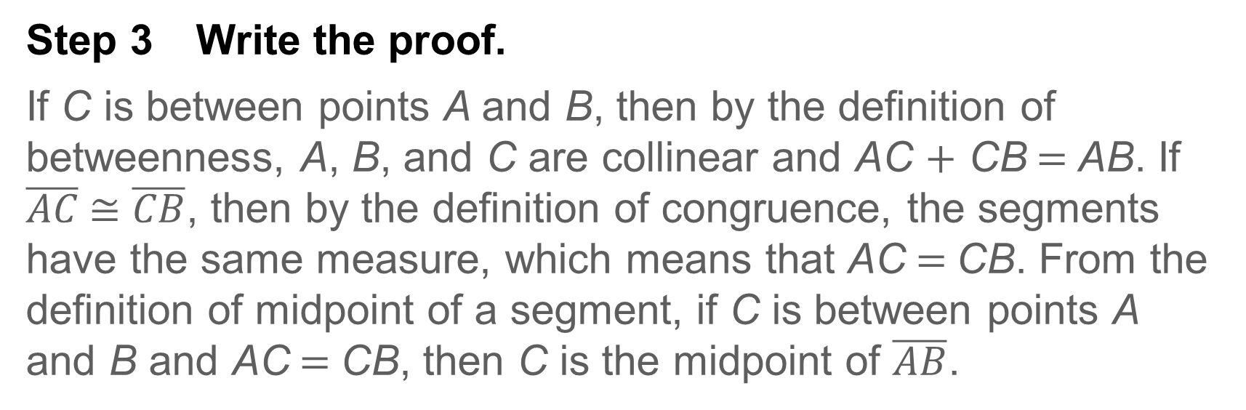
Example 5
Paragraph Proof
Step 3 Write the proof.
If C is between points A and B, then by the definition of betweenness, A, B, and C are collinear and AC + CB = AB. If $\overline{AC}$ ≅ $\overline{CB}$, then by the definition of congruence, the segments have the same measure, which means that AC = CB. From the definition of midpoint of a segment, if C is between points A and B and AC = CB, then C is the midpoint of $\overline{AB}$.

Slide 41
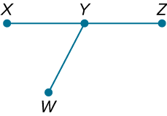
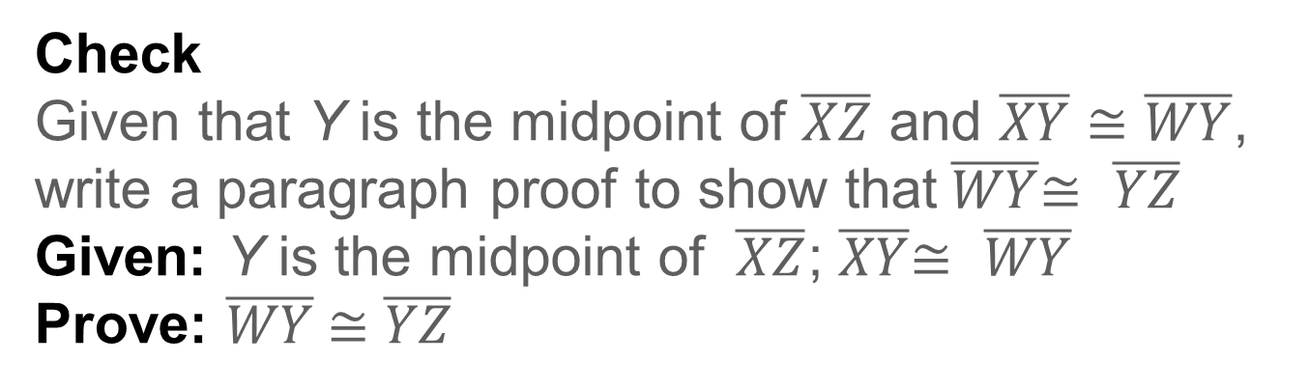
Example 5
Paragraph Proof
Check
Given that Y is the midpoint of $\overline{XZ}$ and $\overline{XY}$ ≅ $\overline{WY}$, write a paragraph proof to show that $\overline{WY}$≅ $\overline{YZ}$
Given: Y is the midpoint of $\overline{XZ}$; $\overline{XY}$≅ $\overline{WY}$
Prove: $\overline{WY}$ ≅ $\overline{YZ}$

Slide 42
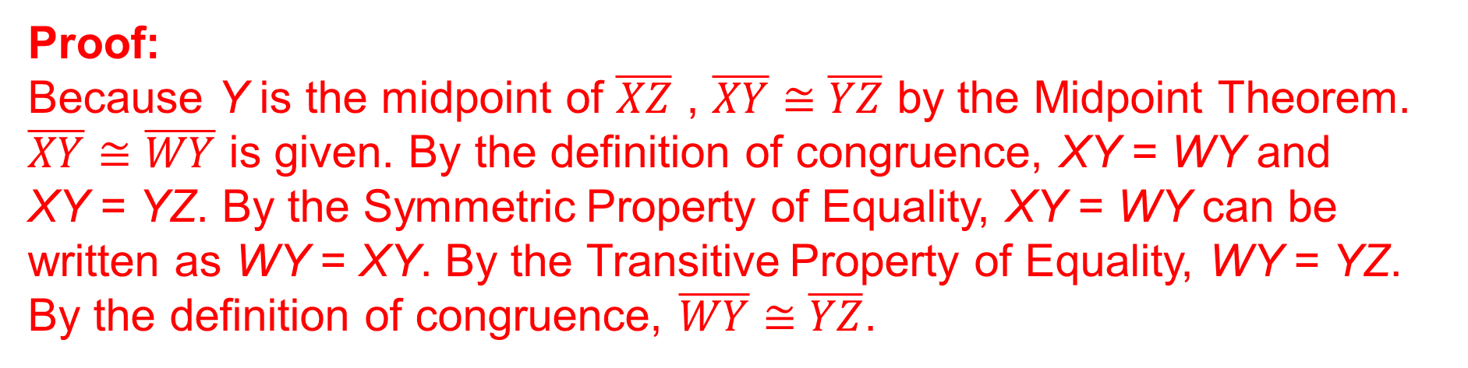
Example 5
Paragraph Proof
Check
Given that Y is the midpoint of $\overline{XZ}$ and $\overline{XY}$ ≅ $\overline{WY}$, write a paragraph proof to show that $\overline{WY}$≅ $\overline{YZ}$
Given: Y is the midpoint of $\overline{XZ}$; $\overline{XY}$≅ $\overline{WY}$
Prove: $\overline{WY}$ ≅ $\overline{YZ}$
Proof:
Because Y is the midpoint of $\overline{XZ}$ , $\overline{XY}$ ≅ $\overline{YZ}$ by the Midpoint Theorem. $\overline{XY}$ ≅ $\overline{WY}$ is given. By the definition of congruence, XY = WY and XY = YZ. By the Symmetric Property of Equality, XY = WY can be written as WY = XY. By the Transitive Property of Equality, WY = YZ. By the definition of congruence, $\overline{WY}$ ≅ $\overline{YZ}$.
Notes:
Proof:
Because Y is the midpoint of $\overline{XZ}$ , $\overline{XY}$ ≅ $\overline{YZ}$ by the Midpoint Theorem. $\overline{XY}$ ≅ $\overline{WY}$ is given. By the definition of congruence, XY = WY and XY = YZ. By the Symmetric Property of Equality, XY = WY can be written as WY = XY. By the Transitive Property of Equality, WY = YZ. By the definition of congruence, $\overline{WY}$ ≅ $\overline{YZ}$.

Slide 43
Exit Ticket
1. What can you use to justify a statement in a proof?
2. What are the parts of a proof?
3. Why can algebraic properties be used in geometric proofs?

Slide 44
Exit Ticket
4. Why are the steps of a two-column proof numbered?
5. How are the types of proofs similar and different?

Slide 45
Exit Ticket
1. What can you use to justify a statement in a proof? given statements, definitions, postulates, previously proven theorems, previously proven statements within the proof
2. What are the parts of a proof? given and prove statements, figure, statements, reasons
3. Why can algebraic properties be used in geometric proofs? Sample answer: Segment and angle measures are real numbers.
Notes:
given statements, definitions, postulates, previously proven theorems, previously proven statements within the proof
given and prove statements, figure, statements, reasons
Sample answer: Segment and angle measures are real numbers.

Slide 46
Exit Ticket
4. Why are the steps of a two-column proof numbered? Sample answer: The numbers help you refer to each statement and reason and show you which reason is associated with each statement.
5. How are the types of proofs similar and different? Sample answer: Each type of proof uses statements and reasons to form logical arguments. In two-column proofs, the statements and reasons are listed in two columns. In flow proofs, the statements and reasons are arranged in a flowchart. In paragraph proofs, the statements and reasons are written in a paragraph.
Notes:
Sample answer: The numbers help you refer to each statement and reason and show you which reason is associated with each statement.
Sample answer: Each type of proof uses statements and reasons to form logical arguments. In two-column proofs, the statements and reasons are listed in two columns. In flow proofs, the statements and reasons are arranged in a flowchart. In paragraph proofs, the statements and reasons are written in a paragraph.

