Slide 1
Deductive Reasoning

Slide 2
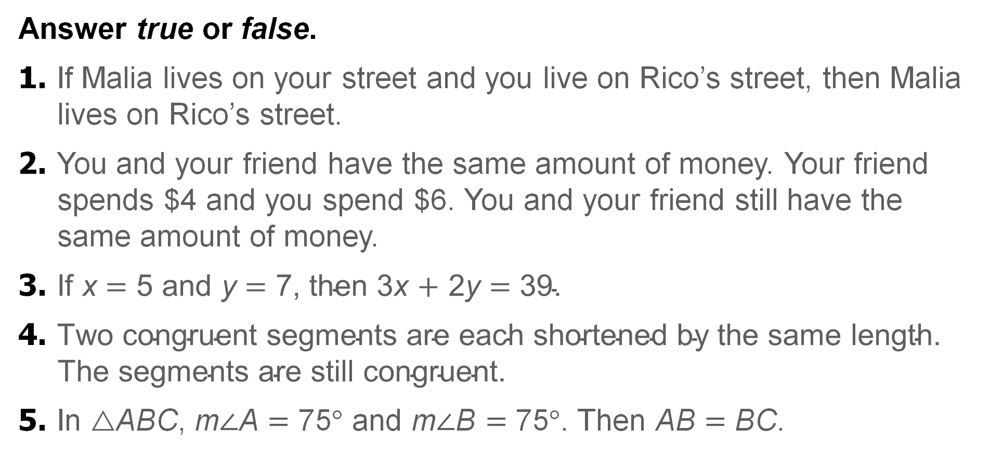
Warm Up
Answer true or false.
1. If Malia lives on your street and you live on Rico’s street, then Malia lives on Rico’s street.
2. You and your friend have the same amount of money. Your friend spends $4 and you spend $6. You and your friend still have the same amount of money.
3. $\text{If} \text{x} \text{=}\text{ 5 }\text{and} \text{y} \text{=}\text{ 7, }\text{then}\text{ 3}\text{x} \text{+}\text{ 2}\text{y} \text{=}\text{ 39.}$
4. $\text{Two} \text{congruent} \text{segments} \text{are} \text{each} \text{shortened} \text{by} \text{the} \text{same} \text{length}\text{. }\text{The} \text{segments} \text{are} \text{still} \text{congruent}\text{.}$
5. In △ABC, m∠A = 75° and m∠B = 75°. Then AB = BC.
Notes:
true
false
false
true
false

Slide 3
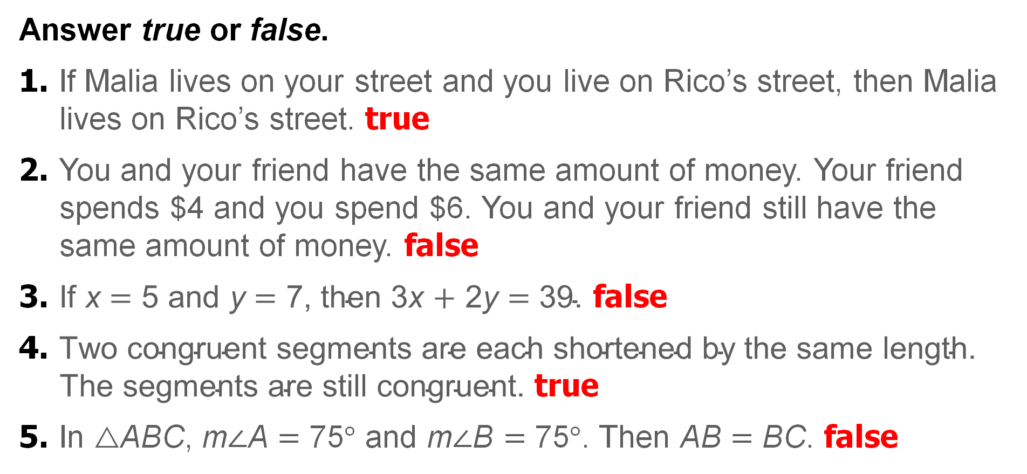
Warm Up
Answer true or false.
1. If Malia lives on your street and you live on Rico’s street, then Malia lives on Rico’s street. true
2. You and your friend have the same amount of money. Your friend spends $4 and you spend $6. You and your friend still have the same amount of money. false
3. $\text{If} \text{x} \text{=}\text{ 5 }\text{and} \text{y} \text{=}\text{ 7, }\text{then}\text{ 3}\text{x} \text{+}\text{ 2}\text{y} \text{=}\text{ 39.}$ false
4. $\text{Two} \text{congruent} \text{segments} \text{are} \text{each} \text{shortened} \text{by} \text{the} \text{same} \text{length}\text{. }\text{The} \text{segments} \text{are} \text{still} \text{congruent}\text{.}$ true
5. In △ABC, m∠A = 75° and m∠B = 75°. Then AB = BC. false
Notes:
true
false
false
true
false

Slide 4
Florida’s B.E.S.T. Standards for
Mathematics
MA.912.LT.4.10
Judge the validity of arguments and give counterexamples to disprove statements.

Slide 5
Florida’s Mathematical Thinking and Reasoning Standards
MA.K12.MTR.1.1
Actively participate in effortful learning both individually and collectively.
MA.K12.MTR.5.1
Use patterns and structure to help understand and connect mathematical concepts.

Slide 6
Lesson Objectives
Content Objective
Students apply the Laws of Detachment and Syllogism.
Language Objectives
Students talk about applying the Laws of Detachment and Syllogism in deductive reasoning using while and whereas.
To maximize linguistic and cognitive meta-awareness, students participate in MLR3: Critique, Correct, and Clarify.

Slide 7
Learn
The Law of Detachment
Unlike inductive reasoning, which uses a specific pattern of examples or observations to make a general conclusion, deductive reasoning uses general facts, rules, definitions, or properties to reach specific valid conclusions from given statements. An argument is valid if it is impossible for all the premises, or supporting statements, of the argument to be true and for its conclusion to be false. One law related to deductive reasoning is the Law of Detachment.

Slide 8
Learn
The Law of Detachment
Key Concept: Law of Detachment
Words | If p → q is a true statement and p is true, then q is true.
Example | Given: If a car is out of gas, then it will not start. Sarah’s car is out of gas. Valid Conclusion: Sarah’s car will not start.

Slide 9
Example 1
Inductive and Deductive Reasoning
Determine whether each conclusion is based on inductive or deductive reasoning.
a. If a student is late returning a library book, then he or she will be charged a $2 late fee. Chang returned a library book late, so he concludes that he will be charged a $2 late fee.
b. Every time Tamika has worn her favorite jersey to a football game, her school’s team has won the game. Tamika is wearing her favorite jersey to the football game tonight, so she concludes that her school’s team will win the game.

Slide 10
Example 1
Inductive and Deductive Reasoning
a. If a student is late returning a library book, then he or she will be charged a $2 late fee. Chang returned a library book late, so he concludes that he will be charged a $2 late fee.
Chang is basing his conclusion on the library’s policies, so he is using deductive reasoning.

Slide 11
Example 1
Inductive and Deductive Reasoning
b. Every time Tamika has worn her favorite jersey to a football game, her school’s team has won the game. Tamika is wearing her favorite jersey to the football game tonight, so she concludes that her school’s team will win the game.
Tamika is basing her conclusion on a specific pattern of observations, so she is using inductive reasoning.

Slide 12
Example 1
Inductive and Deductive Reasoning
Check
Determine whether each conclusion is based on inductive or deductive reasoning.
Newton’s first law of motion states that an object at rest will remain at rest unless acted on by an unbalanced force. Elisa watches a soccer ball roll across the field. She concludes that an unbalanced force has acted upon the soccer ball.
Mrs. Jackson notices that her family’s data usage is increasing by approximately 2500 megabytes of data every month. So, she concludes that her family’s data usage next month will be 2500 megabytes greater than this month’s data usage.

Slide 13
Example 1
Inductive and Deductive Reasoning
Check
Determine whether each conclusion is based on inductive or deductive reasoning.
Newton’s first law of motion states that an object at rest will remain at rest unless acted on by an unbalanced force. Elisa watches a soccer ball roll across the field. She concludes that an unbalanced force has acted upon the soccer ball. deductive
Mrs. Jackson notices that her family’s data usage is increasing by approximately 2500 megabytes of data every month. So, she concludes that her family’s data usage next month will be 2500 megabytes greater than this month’s data usage. inductive
Notes:
deductive
inductive

Slide 14
Example 2
The Law of Detachment
Determine whether each conclusion is valid based on the given information. Write valid or invalid. Explain your reasoning.
a. Given: To go on the field trip, a student must turn in a
permission slip. Mariana turned in her permission slip.
Conclusion: Mariana can go on the field trip.
b. Given: If a figure is a square, then it is a polygon.
Figure A is a polygon.
Conclusion: Figure A is a square.
Notes:
Yes; 31.3 feet

Slide 15
Example 2
The Law of Detachment
a. Given: To go on the field trip, a student must turn in a
permission slip. Mariana turned in her permission slip.
Conclusion: Mariana can go on the field trip.
Step 1 Identify the hypothesis and conclusion.
Because a student must turn in a permission slip to go on the field trip, the phrase a student must turn in a permission slip is the hypothesis of the conditional statement.
p: A student turns in a permission slip.
q: The student can go on the field trip.

Slide 16
Example 2
The Law of Detachment
Step 2 Analyze the conclusion.
The given statement Mariana turned in her permission slip satisfies the hypothesis, so p is true. By the Law of Detachment, Mariana can go on the field trip, which matches q, is a true or valid conclusion.

Slide 17
Example 2
The Law of Detachment
b. Given: If a figure is a square, then it is a polygon.
Figure A is a polygon.
Conclusion: Figure A is a square.
Step 1 Identify the hypothesis and conclusion.
p: A figure is a square.
q: It is a polygon.

Slide 18
Example 2
The Law of Detachment
Step 2 Analyze the conclusion.
The given statement Figure A is a polygon satisfies the conclusion q of a true conditional. However, knowing that a conditional statement and its conclusion are true does not make the hypothesis true. Figure A could be a triangle. The conclusion
is invalid.

Slide 19
Example 2
The Law of Detachment
Check
Determine whether the conclusion is valid based on the given information. Select the correct answer and justification.
Given: If three points are noncollinear, then they determine a plane.
Points A, B, and C lie in plane 𝒢.
Conclusion: Points A, B, and C are noncollinear.
A. Valid; points A, B, and C determine plane 𝒢. Therefore, they are noncollinear.
B. Valid; because points A, B, and C are noncollinear, they determine plane 𝒢.
C. Invalid; points A, B, and C determine plane 𝒢. Therefore, they are
noncollinear.
D. Invalid; points A, B, and C can be collinear and lie in plane 𝒢.
Notes:
D

Slide 20
Example 2
The Law of Detachment
Check
Determine whether the conclusion is valid based on the given information. Select the correct answer and justification.
Given: If three points are noncollinear, then they determine a plane.
Points A, B, and C lie in plane 𝒢.
Conclusion: Points A, B, and C are noncollinear. D
A. Valid; points A, B, and C determine plane 𝒢. Therefore, they are noncollinear.
B. Valid; because points A, B, and C are noncollinear, they determine plane 𝒢.
C. Invalid; points A, B, and C determine plane 𝒢. Therefore, they are
noncollinear.
D. Invalid; points A, B, and C can be collinear and lie in plane 𝒢.
Notes:
D

Slide 21
Example 2
The Law of Detachment
Given: If Dakota goes to the video game store, then he will buy a new game.
Dakota went to the video game store this afternoon.
Conclusion: Dakota bought a new game.
A. Invalid; because the statement Dakota bought a new game does not satisfy
the hypothesis of the conditional statement, the conclusion is not true.
B. Valid; because the statement Dakota went to the video game store this
afternoon satisfies the conclusion of the conditional statement, the hypothesis
of the conditional is true.
C. Valid; because the statement Dakota went to the video game store this
afternoon satisfies the hypothesis of the conditional statement, the conclusion
is true.
D. Invalid; because the statement Dakota went to the video game store this afternoon satisfies only the hypothesis, the conclusion is not true.
Notes:
Yes; 31.3 feet

Slide 22
Example 2
The Law of Detachment
Given: If Dakota goes to the video game store, then he will buy a new game.
Dakota went to the video game store this afternoon.
Conclusion: Dakota bought a new game. C
A. Invalid; because the statement Dakota bought a new game does not satisfy
the hypothesis of the conditional statement, the conclusion is not true.
B. Valid; because the statement Dakota went to the video game store this
afternoon satisfies the conclusion of the conditional statement, the hypothesis
of the conditional is true.
C. Valid; because the statement Dakota went to the video game store this
afternoon satisfies the hypothesis of the conditional statement, the conclusion
is true.
D. Invalid; because the statement Dakota went to the video game store this afternoon satisfies only the hypothesis, the conclusion is not true.
Notes:
C

Slide 23
Learn
The Law of Syllogism
One law that is related to deductive reasoning is the Law of Syllogism. This law allows you to draw conclusions from two true conditional statements when the conclusion of one statement is the hypothesis of the other.
Key Concept: Law of Syllogism
Words | If p → q and q → r are true statements, then p → r is a true statement.
Example | Given: If you get a job, then you will earn money. If you earn money, then you will buy a car. Valid Conclusion: If you get a job, then you will buy a car.

Slide 24
Learn
The Law of Syllogism
Talk About It!
Do you think that the order of the given statements is important when applying the Law of Syllogism? Justify your argument.

Slide 25
Example 3
The Law of Syllogism
SLEEP Scientists have found that the quality and amount of sleep greatly impact learning and memory. Lack of sleep causes students to have trouble focusing and receiving new information. Sleep deprivation also makes it difficult to retrieve previously learned information. Draw a valid conclusion from the given statements, if possible.
Given: If you are tired, then you will not do well on your test.
If you do not get enough sleep, then you will be tired.

Slide 26
Example 3
The Law of Syllogism
Step 1 Identify the hypothesis and conclusion that are the same.
Determine whether the conclusion of one statement is the hypothesis of the other statement.
Given: If you are tired, then you will not do well on your test.
If you do not get enough sleep, then you will be tired.

Slide 27
Example 3
The Law of Syllogism
Reorder the given statements so the conclusion of the first statement is the hypothesis of the second statement. This will allow you to make a valid conclusion using the Law of Syllogism.
Given: | If you do not get enough sleep, | p: You do not get enough sleep.
 | then you will be tired. | q: You will be tired.
 | If you are tired, then you will not do well on your test. | r: You will not do well on your test.

Slide 28
Example 3
The Law of Syllogism
Step 2 Represent the statements with symbols.
Let p, q, and r represent the parts of the given conditional statements. Analyze the logic of the given conditional statements using symbols.
Statement 1: p → q
Statement 2: q → r
Because both statements are true and the conclusion of the first statement is the hypothesis of the second statement, p → r by the Law of Syllogism. A valid conclusion is If you do not get enough sleep, then you will not do well on your test.

Slide 29
Example 3
The Law of Syllogism
Think About It!
Can the Law of Syllogism be applied if the two given statements have the same conclusion? Justify your argument.

Slide 30
Example 3
The Law of Syllogism
Check
GRAND CANYON The Grand Canyon covers an area of 1900 square miles and contains 277 miles of the Colorado River. Since the Grand Canyon became a national park in 1919, over 193 million people have visited.
Draw a valid conclusion from the given statements, if possible.
Given: If Ebony takes a vacation, then she will go to the Grand
Canyon. If Ebony goes to the Grand Canyon, then she will
hike to the Colorado River.

Slide 31
Example 3
The Law of Syllogism
Check
GRAND CANYON The Grand Canyon covers an area of 1900 square miles and contains 277 miles of the Colorado River. Since the Grand Canyon became a national park in 1919, over 193 million people have visited.
Draw a valid conclusion from the given statements, if possible.
Given: If Ebony takes a vacation, then she will go to the Grand
Canyon. If Ebony goes to the Grand Canyon, then she will
hike to the Colorado River.
If Ebony takes a vacation, then she will hike to the Colorado River.
Notes:
If Ebony takes a vacation, then she will hike to the Colorado River.

Slide 32
Exit Ticket
Draw a valid conclusion from the given statements, if possible.
1. If it rains, then flowers will grow. It rains.
2. If there are two points on a grid, then a line can be drawn through them. Two points are graphed on a grid.
3. If Cody is not on time, then he will be fired. If Cody is fired, then Ashanti will get his job.
4. My parents are happy when I get good grades. I get to go to the party if my parents are happy.

Slide 33
Exit Ticket
Draw a valid conclusion from the given statements, if possible.
1. If it rains, then flowers will grow. It rains. Flowers will grow.
2. If there are two points on a grid, then a line can be drawn through them. Two points are graphed on a grid. A line can be drawn through the two points.
3. If Cody is not on time, then he will be fired. If Cody is fired, then Ashanti will get his job. If Cody is not on time, then Ashanti will get his job.
4. My parents are happy when I get good grades. I get to go to the party if my parents are happy. If I get good grades, then I get to go to the party.
Notes:
Flowers will grow.
A line can be drawn through the two points.
If Cody is not on time, then Ashanti will get his job.
If I get good grades, then I get to go to the party.

