Slide 1
6-7 Inequalities in Two Triangles

Slide 2
Warm Up
The lengths of two sides of a triangle are given. Find the range of lengths for the third side.
1. 3 mm, 5 mm
2. 7 ft, 10 ft
3. 1.2 in., 4.6 in.
4. 2.5 cm, 8 cm
5. 2.5 mi, 2.5 mi

Slide 3
Warm Up
The lengths of two sides of a triangle are given. Find the range of lengths for the third side.
1. 3 mm, 5 mm 2 mm < x < 8 mm
2. 7 ft, 10 ft 3 ft < x < 17 ft
3. 1.2 in., 4.6 in. 3.4 in. < x < 5.8 in.
4. 2.5 cm, 8 cm 5.5 cm < x < 10.5 cm
5. 2.5 mi, 2.5 mi 0 mi < x < 5 mi
Notes:
2 mm < x < 8 mm
3 ft < x < 17 ft
3.4 in. < x < 5.8 in.
5.5 cm < x < 10.5 cm
0 mi < x < 5 mi

Slide 4
Florida’s B.E.S.T. Standards for Mathematics
MA.912.GR.1.3 Prove relationships and theorems about triangles. Solve mathematical and real-world problems involving postulates, relationships and theorems of triangles.

Slide 5
Florida’s Mathematical Thinking and Reasoning Standards
MA.K12.MTR.2.1
Demonstrate understanding by representing problems in multiple ways.
MA.K12.MTR.6.1
Assess the reasonableness of solutions.

Slide 6
Lesson Objectives
Content Objective
Students solve problems using the Hinge Theorem and its converse.
Language Objectives
Students explain how to solve problems involving the Hinge Theorem using longer and shorter.
To support sense-making, students participate in MLR6: Three Reads.

Slide 7
Learn
Hinge Theorem
Theorem 6.12: Hinge Theorem
If two sides of a triangle are congruent to two sides of another triangle, and the included angle of the first is larger than the included angle of the second triangle, then the third side of the first triangle is longer than the third side of the second triangle.

Slide 8
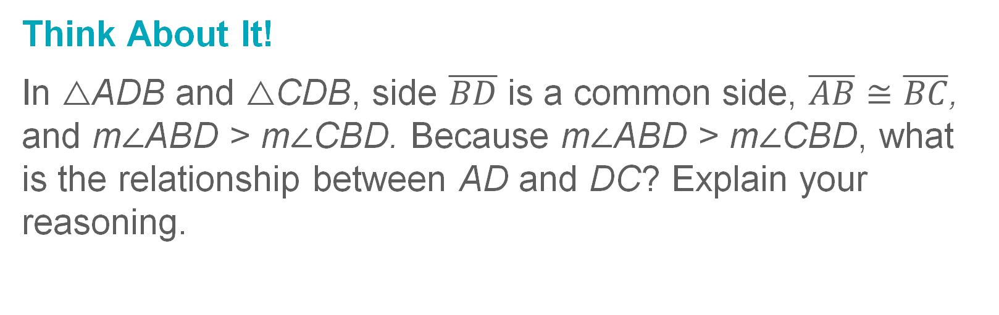
Learn
Hinge Theorem
Think About It!
In △ADB and △CDB, side $\overline{BD}$ is a common side, $\overline{AB}≅\overline{BC}$, and m∠ABD > m∠CBD. Because m∠ABD > m∠CBD, what is the relationship between AD and DC? Explain your reasoning.

Slide 9
Example 1
Use the Hinge Theorem
BOATING Two families set sail on their boats from the same dock. The Nguyens sail 3.5 nautical miles north, turn 85° east of north, and then sail 2 nautical miles. The Griffins sail 3.5 nautical miles south, turn 95° east of south, and then sail 2 nautical miles. At this point, which boat is farther from the dock? Explain your reasoning.

Slide 10
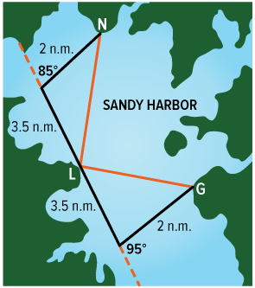
Example 1
Use the Hinge Theorem
Step 1 Draw a diagram of the situation.
The course of each boat and the straight-line distance from each stopping point back to the boat dock form two triangles.

Slide 11
Example 1
Use the Hinge Theorem
Step 2 Determine the interior angle measures.
Use linear pairs to find the measures of the included angles. The measure of the included angle for the Nguyens is 180° – 85° or 95°. The measure of the included angle for the Griffins is 180° – 95° or 85°.

Slide 12
Example 1
Use the Hinge Theorem
Step 3 Compare the distance each boat is from the boat launch.
Use the Hinge Theorem to compare the distances.
Because 95 > 85, NL > GL by the Hinge Theorem. So, the Nguyens are farther from the boat launch.

Slide 13
Example 1
Use the Hinge Theorem
Check
DRONES Esperanza and Landon each fly a drone from the same place in a park and at the same altitude. Esperanza flies her drone 440 feet east, then turns it 122° south of east and flies 300 more feet. Landon flies his drone 440 feet east, then turns it 140° north of east and flies 300 more feet. Whose drone is closer to its original position?

Slide 14
Example 1
Use the Hinge Theorem
Check
DRONES Esperanza and Landon each fly a drone from the same place in a park and at the same altitude. Esperanza flies her drone 440 feet east, then turns it 122° south of east and flies 300 more feet. Landon flies his drone 440 feet east, then turns it 140° north of east and flies 300 more feet. Whose drone is closer to its original position? Landon’s drone
Notes:
Landon’s drone

Slide 15
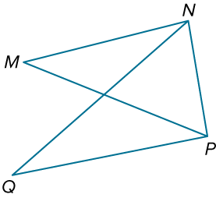
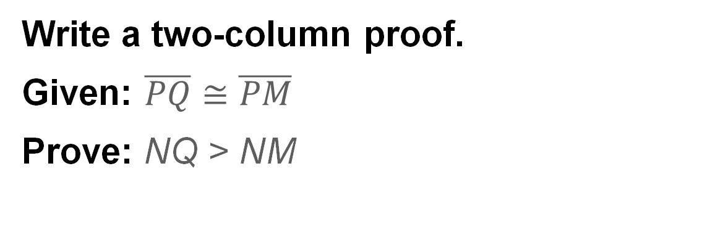
Example 2
Prove Triangle Relationships by Using the Hinge Theorem
Write a two-column proof.
Given: $\overline{PQ}≅\overline{PM}$
Prove: NQ > NM

Slide 16
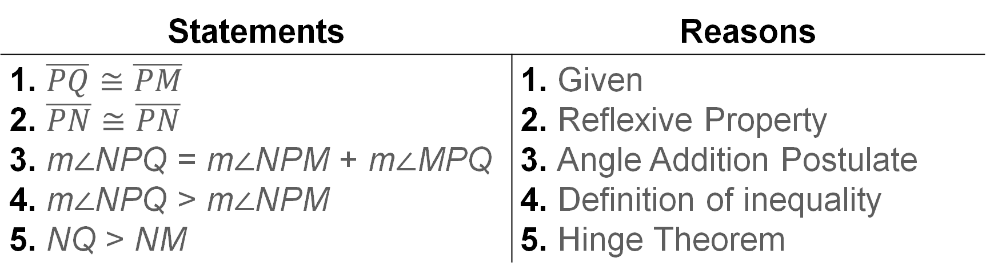
Example 2
Prove Triangle Relationships by Using the Hinge Theorem
Proof:
Statements | Reasons
1. $\overline{PQ}≅\overline{PM}$ 2. $\overline{PN}≅\overline{PN}$ 3. m∠NPQ = m∠NPM + m∠MPQ 4. m∠NPQ > m∠NPM 5. NQ > NM | 1. Given 2. Reflexive Property 3. Angle Addition Postulate 4. Definition of inequality 5. Hinge Theorem

Slide 17
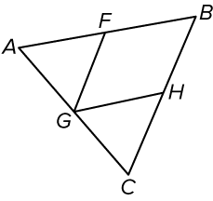
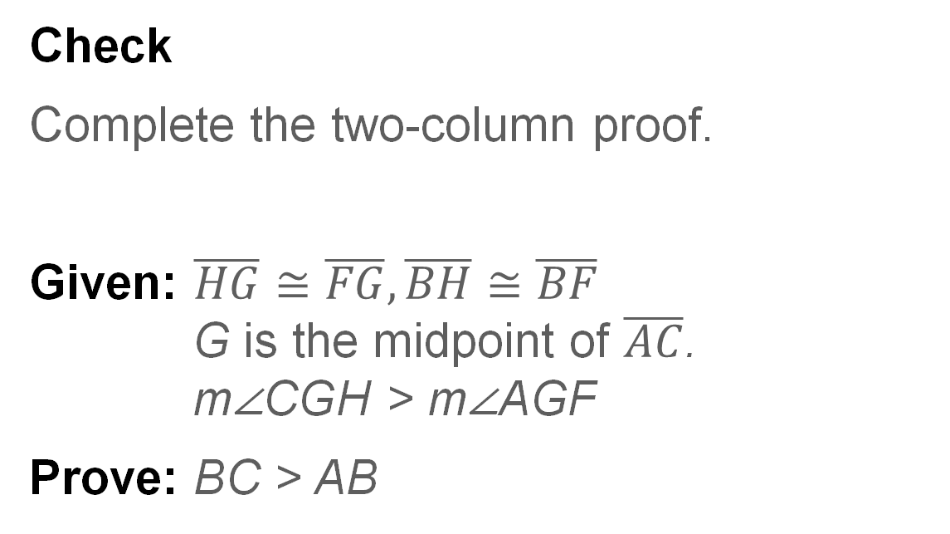
Example 2
Prove Triangle Relationships by Using the Hinge Theorem
Check
Complete the two-column proof.
Given: $\overline{HG}≅\overline{FG},\overline{BH}≅\overline{BF}$
G is the midpoint of $\overline{AC}$.
m∠CGH > m∠AGF
Prove: BC > AB

Slide 18
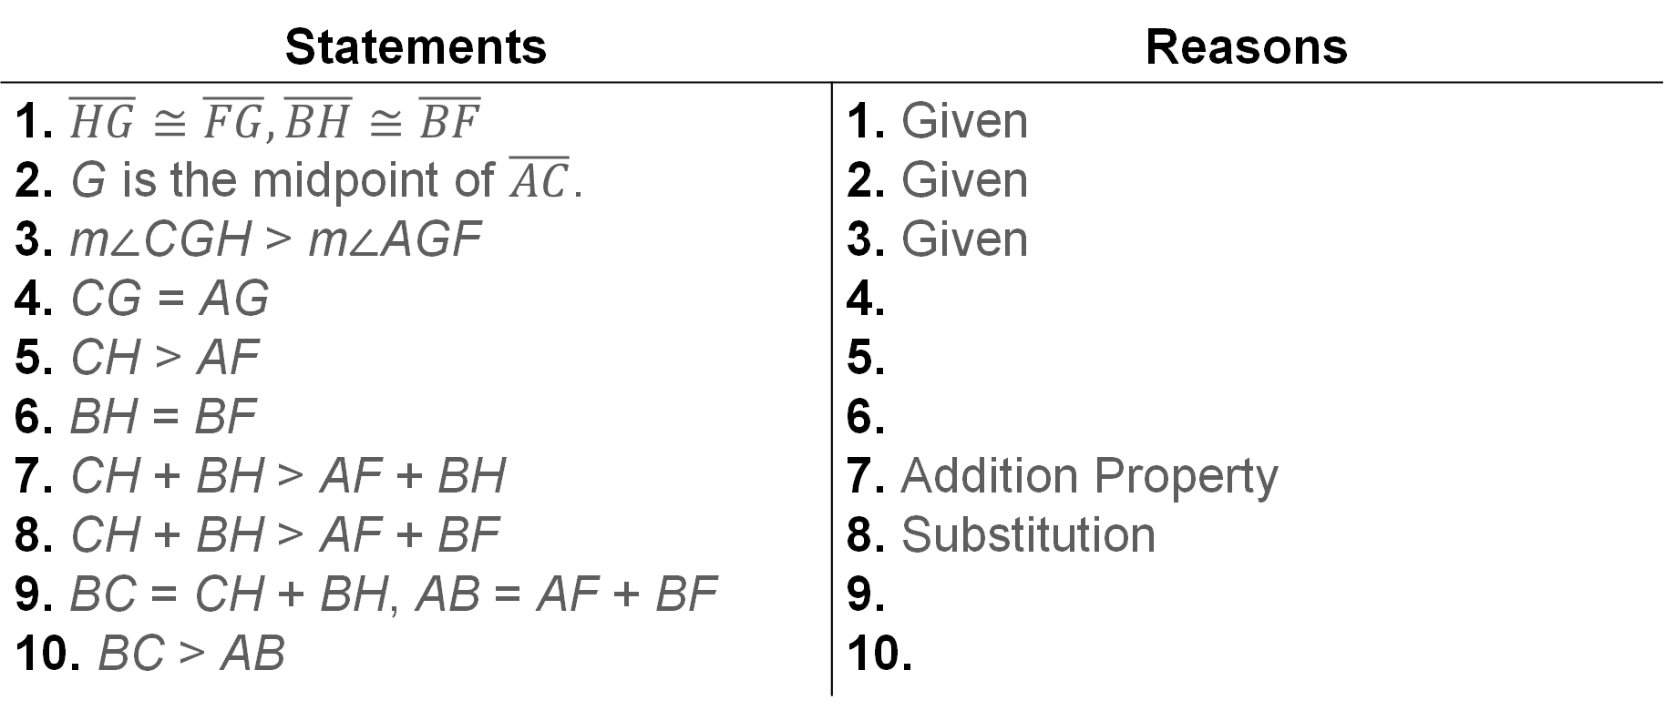
Example 2
Prove Triangle Relationships by Using the Hinge Theorem
Statements | Reasons
1. $\overline{HG}≅\overline{FG},\overline{BH}≅\overline{BF}$ 2. G is the midpoint of $\overline{AC}$. 3. m∠CGH > m∠AGF 4. CG = AG 5. CH > AF 6. BH = BF 7. CH + BH > AF + BH 8. CH + BH > AF + BF 9. BC = CH + BH, AB = AF + BF 10. BC > AB | 1. Given 2. Given 3. Given 4. 5. 6. 7. Addition Property 8. Substitution 9. 10.

Slide 19
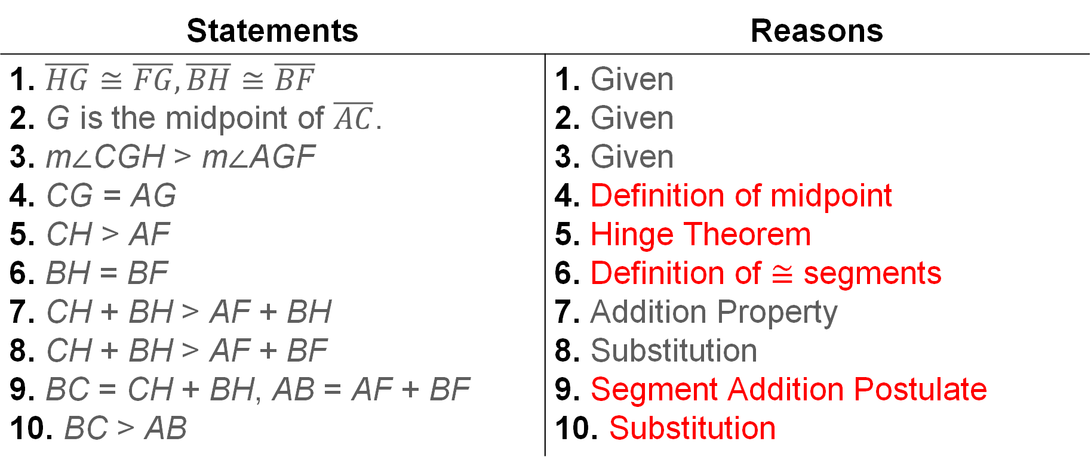
Example 2
Prove Triangle Relationships by Using the Hinge Theorem
Statements | Reasons
1. $\overline{HG}≅\overline{FG},\overline{BH}≅\overline{BF}$ 2. G is the midpoint of $\overline{AC}$. 3. m∠CGH > m∠AGF 4. CG = AG 5. CH > AF 6. BH = BF 7. CH + BH > AF + BH 8. CH + BH > AF + BF 9. BC = CH + BH, AB = AF + BF 10. BC > AB | 1. Given 2. Given 3. Given 4. Definition of midpoint 5. Hinge Theorem 6. Definition of ≅ segments 7. Addition Property 8. Substitution 9. Segment Addition Postulate 10. Substitution
Notes:
Reasons
4. Definition of midpoint
5. Hinge Theorem
6. Definition of ≅ segments
9. Segment Addition Postulate
10. Substitution

Slide 20
Learn
Converse of the Hinge Theorem
Theorem 6.13: Converse of the Hinge Theorem
If two sides of a triangle are congruent to two sides of another triangle and the third side of the first triangle is longer than the third side of the second triangle, then the included angle measure of the first triangle is greater than the included angle measure of the second triangle.

Slide 21
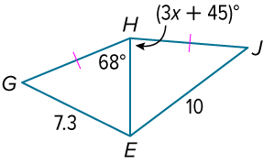
Example 3
Apply Algebra to Relationships in Triangles
Find the range of possible values for x.

Slide 22
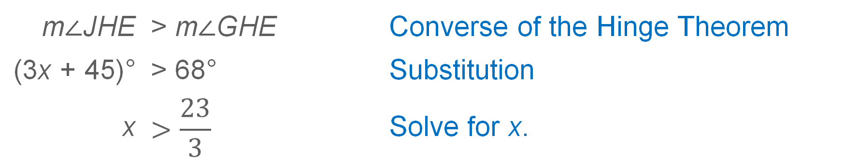
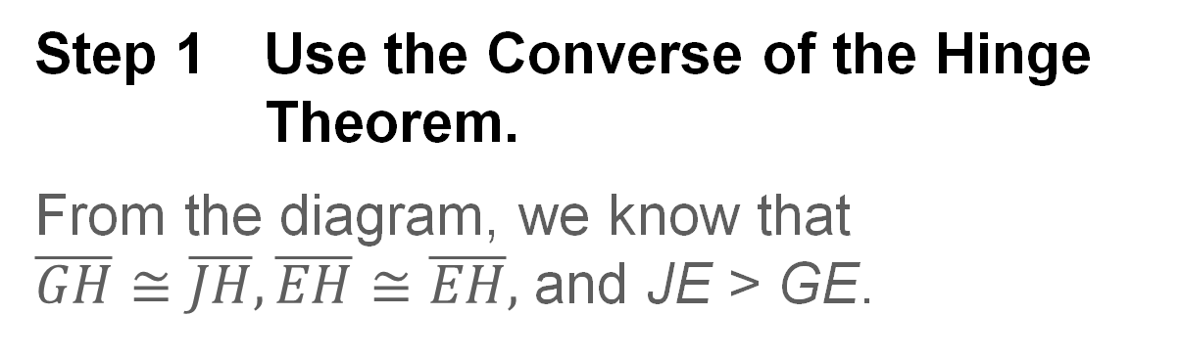
Example 3
Apply Algebra to Relationships in Triangles
Step 1 Use the Converse of the Hinge Theorem.
From the diagram, we know that
$\overline{GH}≅\overline{JH},\overline{EH}≅\overline{EH},$ and JE > GE.
m∠JHE | > m∠GHE | Converse of the Hinge Theorem
(3x + 45)° | > 68° | Substitution
x | $$>\frac{23}{3}$$ | Solve for x.

Slide 23
Example 3
Apply Algebra to Relationships in Triangles
Step 2 Use your knowledge of the interior angles of a triangle.
Use the fact that the measure of any angle in a triangle is less than 180° to write a second inequality.
m∠JHE | < 180°
(3x + 45)° | < 180° | Substitution
x | < 45 | Solve for x.

Slide 24
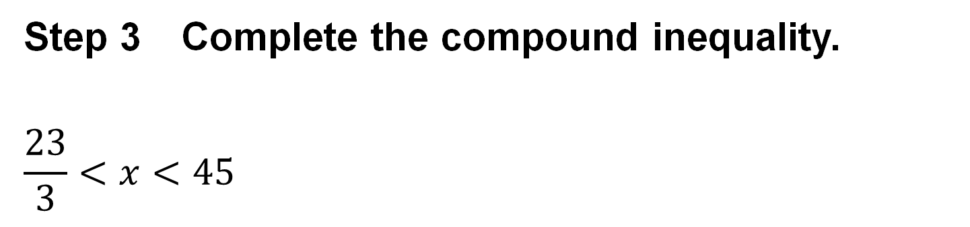
Example 3
Apply Algebra to Relationships in Triangles
Step 3 Complete the compound inequality.
$$\frac{23}{3}<x<45$$

Slide 25
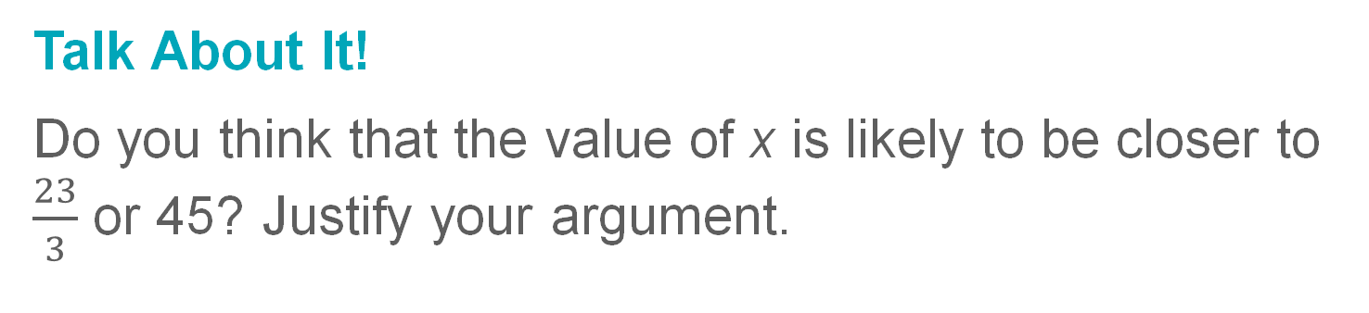
Example 3
Apply Algebra to Relationships in Triangles
Talk About It!
Do you think that the value of x is likely to be closer to $\frac{23}{3}$ or 45? Justify your argument.

Slide 26
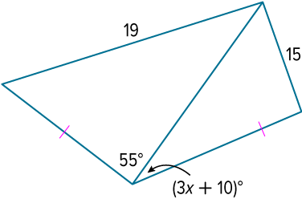
Example 3
Apply Algebra to Relationships in Triangles
Check
Find the range of possible values for x.

Slide 27
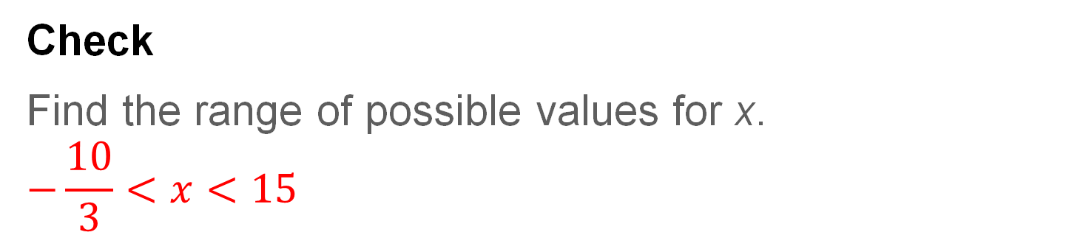
Example 3
Apply Algebra to Relationships in Triangles
Check
Find the range of possible values for x.
$$−\frac{10}{3}<x<15$$
Notes:
$$−\frac{10}{3}<x<15$$

Slide 28
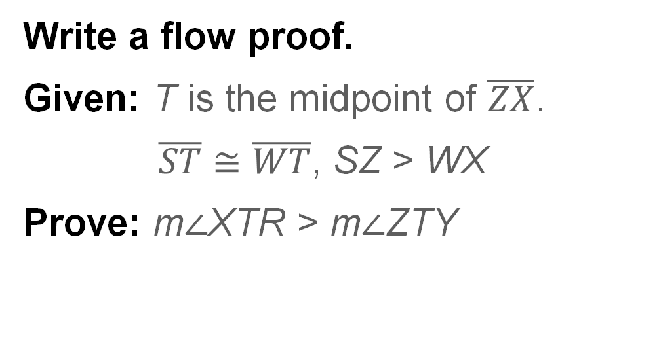
Example 4
Prove Relationships by Using the Converse of the Hinge Theorem
Write a flow proof.
Given: T is the midpoint of $\overline{ZX}$.
$\overline{ST}≅\overline{WT}$, SZ > WX
Prove: m∠XTR > m∠ZTY

Slide 29
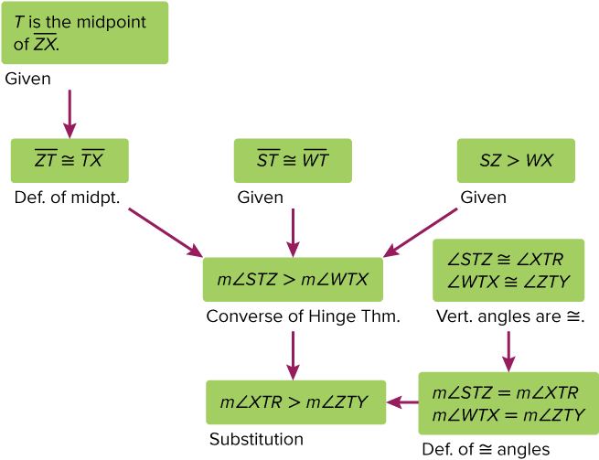
Example 4
Prove Relationships by Using the Converse of the Hinge Theorem
Proof:

Slide 30
Pause and Reflect
Which type of proof do you prefer to write? Why?

Slide 31
Exit Ticket
Suppose △JKN and △LMN satisfy the converse of the Hinge Theorem.
1. Compare m∠JKN to m∠MNL.
2. Find the range of possible values for x.

Slide 32
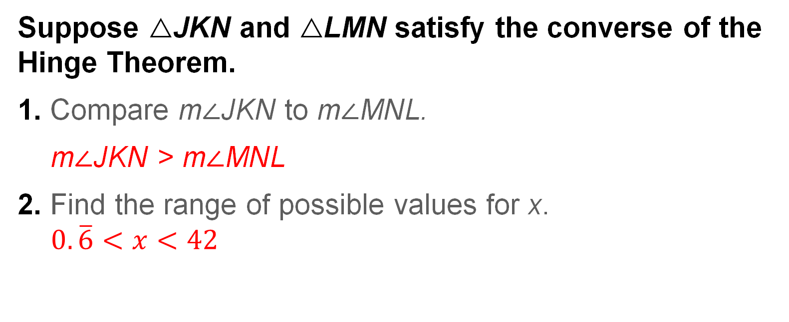
Exit Ticket
Suppose △JKN and △LMN satisfy the converse of the Hinge Theorem.
1. Compare m∠JKN to m∠MNL.
m∠JKN > m∠MNL
2. Find the range of possible values for x.
$$0.\overline{6}<x<42$$
Notes:
m∠JKN > m∠MNL
$$0.\overline{6}<x<42$$

