Slide 1
Inequalities in One Triangle

Slide 2
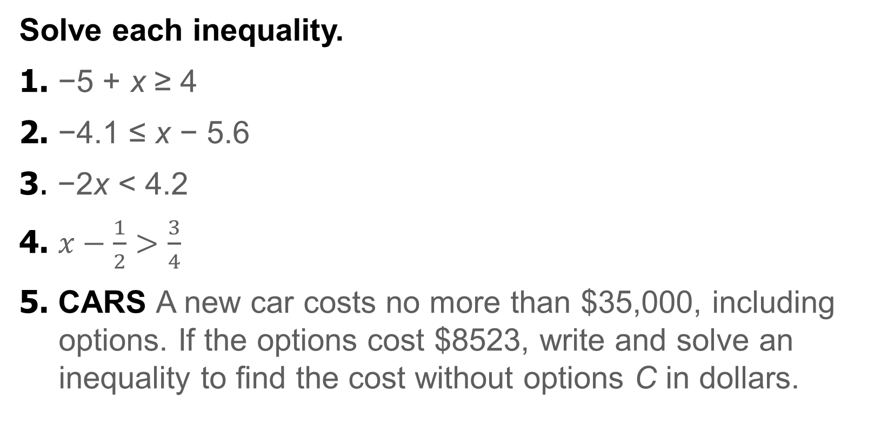
Warm Up
Solve each inequality.
1. −5 + x ≥ 4
2. −4.1 ≤ x − 5.6
3. −2x < 4.2
4. $x−\frac{1}{2}>\frac{3}{4}$
5. CARS A new car costs no more than $35,000, including options. If the options cost $8523, write and solve an inequality to find the cost without options C in dollars.

Slide 3
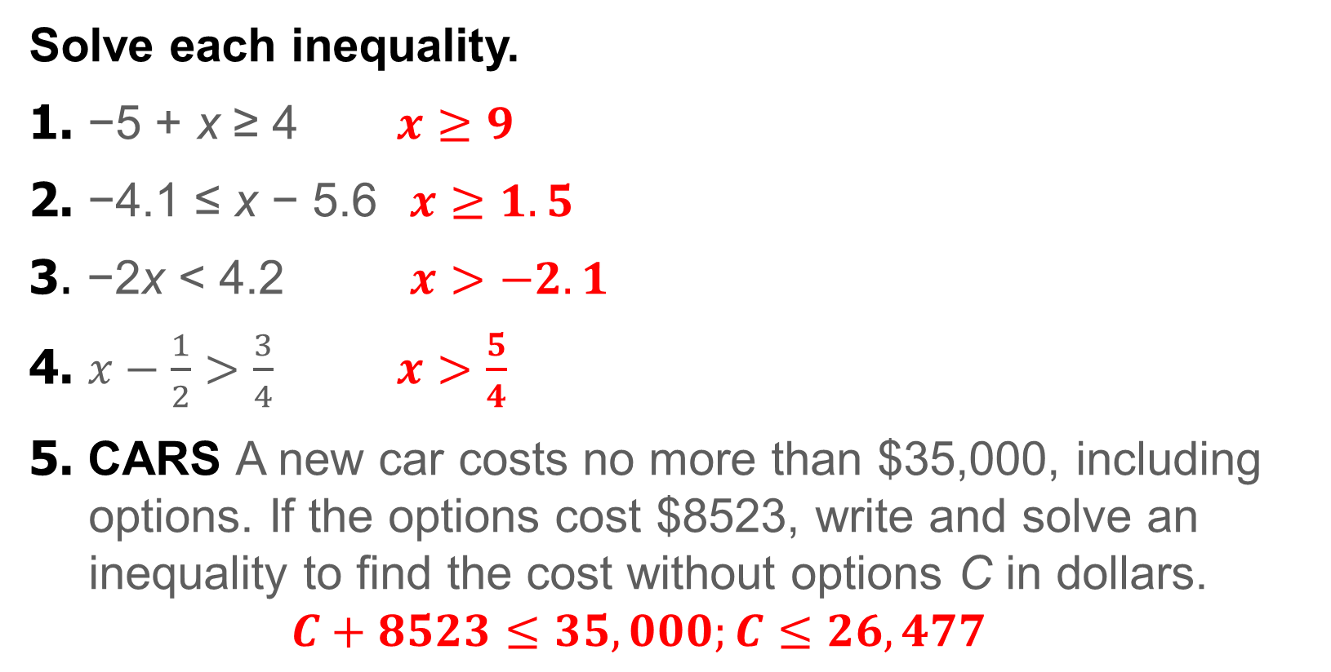
Warm Up
Solve each inequality.
1. −5 + x ≥ 4 $x≥9$
2. −4.1 ≤ x − 5.6 $x≥1.5$
3. −2x < 4.2 $x>−2.1$
4. $x−\frac{1}{2}>\frac{3}{4}$ $x>\frac{5}{4}$
5. CARS A new car costs no more than $35,000, including options. If the options cost $8523, write and solve an inequality to find the cost without options C in dollars.
$$C+8523≤35,000;C≤26,477$$
Notes:
$$x≥9$$
$$x≥1.5$$
$$x>−2.1$$
$$x>\frac{5}{4}$$
$$C+8523≤35,000;C≤26,477$$

Slide 4
Florida’s B.E.S.T. Standards for Mathematics
MA.912.GR.1.3 Prove relationships and theorems about triangles. Solve mathematical and real-world problems involving postulates, relationships and theorems of triangles.

Slide 5
Florida’s Mathematical Thinking and Reasoning Standards
MA.K12.MTR.4.1
Engage in discussions that reflect on the mathematical thinking of self and others.
MA.K12.MTR.7.1
Apply mathematics to real-world contexts.

Slide 6
Lesson Objectives
Content Objective
Students solve problems using inequalities in the angles and sides of a triangle.
Language Objectives
Students use greater than and less than to talk about solving problems involving using inequalities in the angles and sides of a triangle.
To maximize linguistic and cognitive meta-awareness, students participate in MLR5: Co-Craft Questions and Problems.

Slide 7
Learn
Angle Inequalities in One Triangle
Key Concept: Properties of Inequality
Comparison Property of Inequality
Words | The value of a must be less than, greater than, or equal to the value of b.
Symbols | For all real numbers a and b, the following is true: a < b, a > b, or a = b.

Slide 8
Learn
Angle Inequalities in One Triangle
Transitive Property of Inequality
Words | If a is less than b and b is less than c, then a is less than c. If a is greater than b and b is greater than c, then a is greater than c.
Symbols | For all real numbers a, b, and c, the following are true. If a < b and b < c, then a < c. If a > b and b > c, then a > c.

Slide 9
Learn
Angle Inequalities in One Triangle
Addition Property of Inequality
Words | If the same number is added to each side of a true inequality, then the resulting inequality is also true.
Symbols | For all real numbers a, b, and c, the following are true. If a > b, then a + c > b + c. If a < b, then a + c < b + c.

Slide 10
Learn
Angle Inequalities in One Triangle
Subtraction Property of Inequality
Words | If the same number is subtracted from each side of a true inequality, then the resulting inequality is also true.
Symbols | For all real numbers a, b, and c, the following are true. If a > b, then a − c > b − c. If a < b, then a − c < b − c.

Slide 11
Learn
Angle Inequalities in One Triangle
The definition of inequality and the properties of inequalities can be applied to the measures of angles and segments, because these are real numbers.
Theorem 6.8: Exterior Angle Inequality Theorem
The measure of an exterior angle of a triangle is greater than the measure of either of its corresponding remote interior angles.
Remember, each exterior angle of a triangle has two remote interior angles that are not adjacent to the exterior angle.

Slide 12
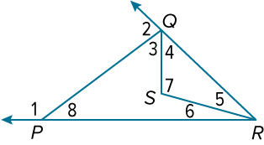
Example 1
Use the Exterior Angle Inequality Theorem
List the angles that satisfy the stated condition. Justify your reasoning using the Exterior Angle Inequality Theorem.
a. measures < m∠1
b. measures > m∠8

Slide 13
Example 1
Use the Exterior Angle Inequality Theorem
a. measures < m∠1
∠1 is an exterior angle of △PQR, with ∠PQR and ∠PRQ as corresponding remote interior angles. By the Exterior Angle Inequality Theorem, m∠1 > m∠PQR and m∠1 > m∠PRQ. Because m∠PQR = m∠3 + m∠4 and m∠PRQ = m∠5 + m∠6, m∠1 > m∠3 + m∠4 and m∠1 > m∠5 + m∠6 by substitution. So, the angles with measures less than m∠1 are ∠3, ∠4, ∠5, ∠6, ∠PQR, and ∠PRQ.

Slide 14
Example 1
Use the Exterior Angle Inequality Theorem
b. measures > m∠8
∠2 is an exterior angle of △PQR. So, by the Exterior Angle Inequality Theorem, m∠2 > m∠8.

Slide 15
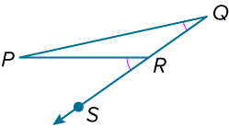
Example 1
Use the Exterior Angle Inequality Theorem
Think About It!
Why must the markings be incorrect in the given diagram? Justify your argument.

Slide 16
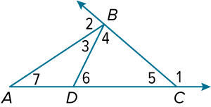
Example 1
Use the Exterior Angle Inequality Theorem
Check
List the angles that satisfy the stated condition. Justify your reasoning using the Exterior Angle Inequality Theorem.
a. measures < m∠1
b. measures > m∠7

Slide 17
Example 1
Use the Exterior Angle Inequality Theorem
Check
List the angles that satisfy the stated condition. Justify your reasoning using the Exterior Angle Inequality Theorem.
a. measures < m∠1
m∠1 > m∠CBA, m∠1 > m∠CBD, m∠1 > m∠CDB, and m∠1 > m∠CAB by the Exterior Angle Inequality Theorem. So, the angles with measures less than m∠1 are ∠3, ∠4, ∠6, ∠7, and ∠CBA.
Notes:
m∠1 > m∠CBA, m∠1 > m∠CBD, m∠1 > m∠CDB, and m∠1 > m∠CAB by the Exterior Angle Inequality Theorem. So, the angles with measures less than m∠1 are ∠3, ∠4, ∠6, ∠7, and ∠CBA.

Slide 18
Example 1
Use the Exterior Angle Inequality Theorem
Check
List the angles that satisfy the stated condition. Justify your reasoning using the Exterior Angle Inequality Theorem.
b. measures > m∠7
∠1 and ∠2 are exterior angles of △ABC, and ∠7 is a remote interior angle for ∠1 and ∠2. Similarly, ∠6 is an exterior angle of △ABD, and ∠7 is a remote interior angle for ∠6. So, the angles with measures greater than m∠7 are ∠1, ∠2, and ∠6.
Notes:
∠1 and ∠2 are exterior angles of △ABC, and ∠7 is a remote interior angle for ∠1 and ∠2. Similarly, ∠6 is an exterior angle of △ABD, and ∠7 is a remote interior angle for ∠6. So, the angles with measures greater than m∠7 are ∠1, ∠2, and ∠6.

Slide 19
Learn
Angle-Side Inequalities in One Triangle
We know that if two sides of a triangle are congruent, or the triangle is isosceles, then the angles opposite those sides are congruent.
Angle-Side Relationships in Triangles
Theorem 6.9
If one side of a triangle is longer than another side, then the angle opposite the longer side has a greater measure than the angle opposite the shorter side.

Slide 20
Learn
Angle-Side Inequalities in One Triangle
Theorem 6.10
If one angle of a triangle has a greater measure than another angle, then the side opposite the angle with the greater measure is longer than the side opposite the angle with the lesser measure.

Slide 21
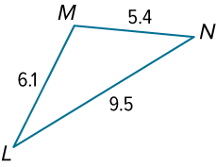
Example 2
Order Triangle Angle Measures
List the angles of △LMN in order from smallest to largest.

Slide 22
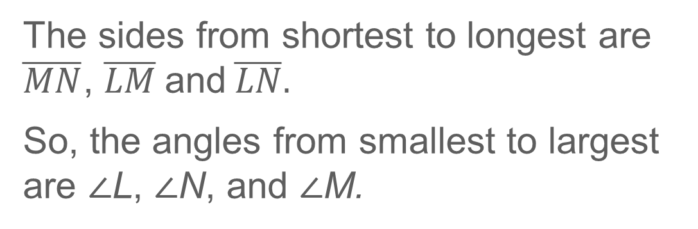
Example 2
Order Triangle Angle Measures
The sides from shortest to longest are $\overline{MN}$, $\overline{LM}$and$\overline{LN}.$
So, the angles from smallest to largest are ∠L, ∠N, and ∠M.

Slide 23
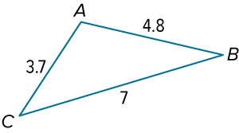
Example 2
Order Triangle Angle Measures
Check
List the angles of △ABC in order from smallest to largest.

Slide 24
Example 2
Order Triangle Angle Measures
Check
List the angles of △ABC in order from smallest to largest.
The angles from smallest to largest are ∠B, ∠C, and ∠A.
Notes:
The angles from smallest to largest are ∠B, ∠C, and ∠A.

Slide 25
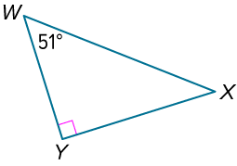
Example 3
Order Triangle Side Lengths
List the sides of △WXY in order from shortest to longest.

Slide 26
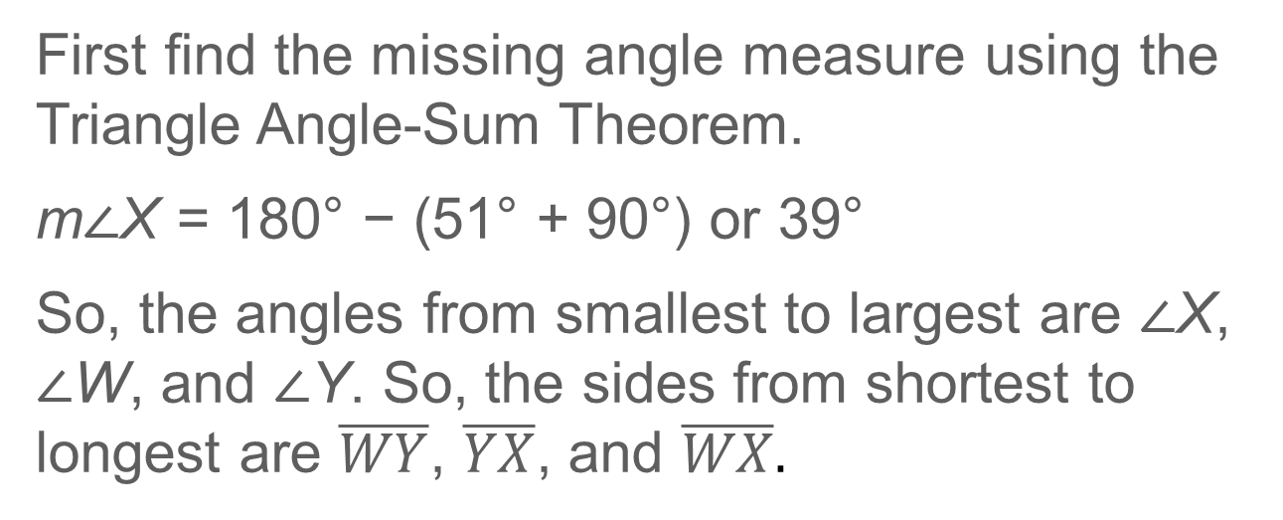
Example 3
Order Triangle Side Lengths
First find the missing angle measure using the Triangle Angle-Sum Theorem.
m∠X = 180° − (51° + 90°) or 39°
So, the angles from smallest to largest are ∠X, ∠W, and ∠Y. So, the sides from shortest to longest are $\overline{WY}$, $\overline{YX}$, and $\overline{WX}.$

Slide 27
Example 3
Order Triangle Side Lengths
Talk About It!
Why is the hypotenuse always the longest side of a triangle?

Slide 28
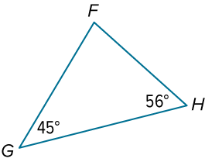
Example 3
Order Triangle Side Lengths
Check
List the sides of △FGH in order from shortest to longest.

Slide 29
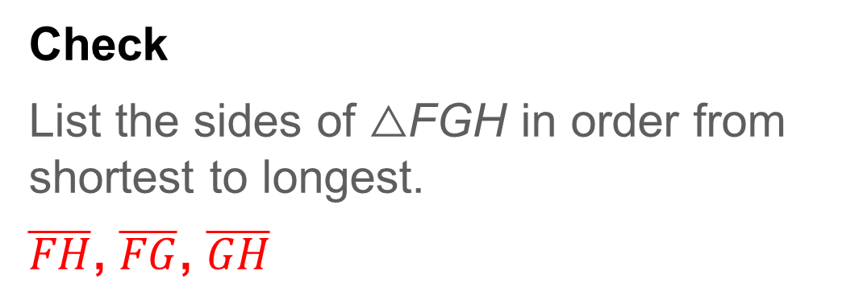
Example 3
Order Triangle Side Lengths
Check
List the sides of △FGH in order from shortest to longest.
$\overline{FH}$, $\overline{FG}$, $\overline{GH}$
Notes:
$\overline{FH}$, $\overline{FG}$, $\overline{GH}$

Slide 30
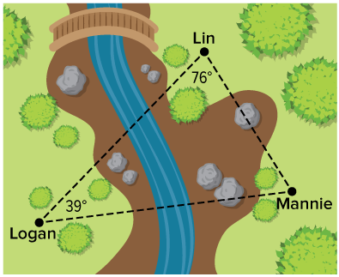
Example 4
Use Angle-Side Relationships
PAINTBALL During a game of paintball, opposing teams try to eliminate players on the opposite team. Mannie and Lin are on the same team and want to eliminate Logan from the game. If Mannie, Lin, and Logan are located at the positions shown on the diagram, who is closer to Logan? Explain your reasoning.

Slide 31
Example 4
Use Angle-Side Relationships
By the Triangle Angle-Sum Theorem, the measure of the angle across from the segment between Logan and Lin is 65°. Because 65 < 76, according to Theorem 6.10, Lin is closer to Logan.

Slide 32
Example 4
Use Angle-Side Relationships
Think About It!
What assumption did you make while solving this problem?

Slide 33
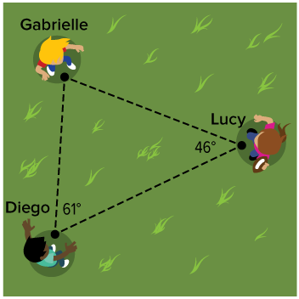
Example 4
Use Angle-Side Relationships
Check
SPORTS Gabrielle, Diego, and Lucy are passing a football. Lucy wants to practice throwing the ball long distances. Which player should she throw the ball to next if she wants to pass the football the farthest distance?

Slide 34
Example 4
Use Angle-Side Relationships
Check
SPORTS Gabrielle, Diego, and Lucy are passing a football. Lucy wants to practice throwing the ball long distances. Which player should she throw the ball to next if she wants to pass the football the farthest distance?
Diego
Notes:
Diego

Slide 35
Exit Ticket
Given the side lengths, list the angles of each triangle in order from smallest to largest.
1. △UVW: UV = 4, VW = 7, WU = 9
2. △RST: RS = 7.6, ST = 5.9, TR = 4.3
Given the angle measures, list the sides of each triangle in order from smallest to largest.
3. △FGH: m∠F = 36°, m∠H = 104°
4. △LMN: m∠L = 90°, m∠N = 50°

Slide 36
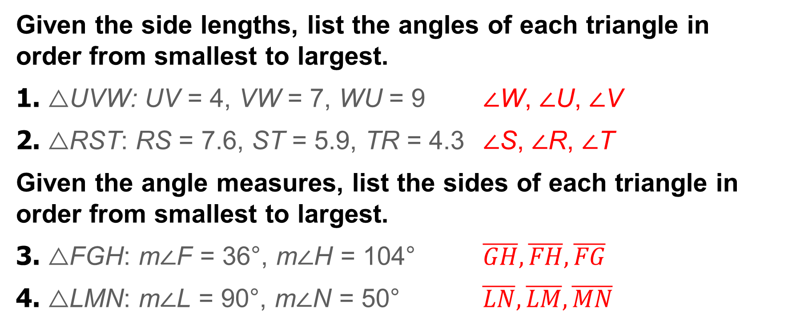
Exit Ticket
Given the side lengths, list the angles of each triangle in order from smallest to largest.
1. △UVW: UV = 4, VW = 7, WU = 9 ∠W, ∠U, ∠V
2. △RST: RS = 7.6, ST = 5.9, TR = 4.3 ∠S, ∠R, ∠T
Given the angle measures, list the sides of each triangle in order from smallest to largest.
3. △FGH: m∠F = 36°, m∠H = 104° $\overline{GH},\overline{FH},\overline{FG}$
4. △LMN: m∠L = 90°, m∠N = 50° $\overline{LN},\overline{LM},\overline{MN}$
Notes:
∠W, ∠U, ∠V
∠S, ∠R, ∠T
$$\overline{GH},\overline{FH},\overline{FG}$$
$$\overline{LN},\overline{LM},\overline{MN}$$

