Slide 1
Section 3-10
Perpendiculars and Distance

Slide 2
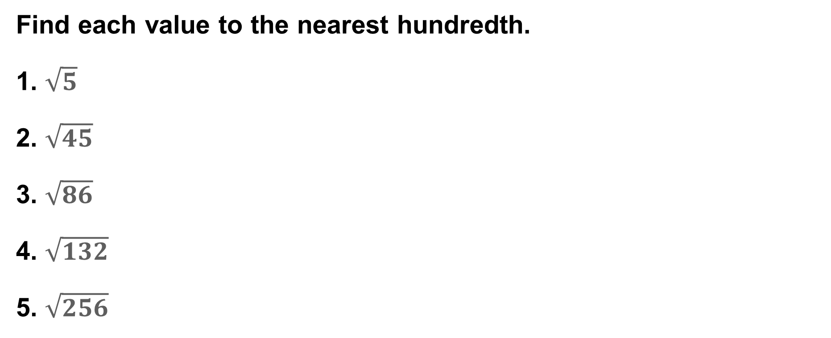
Warm Up
Find each value to the nearest hundredth.
1. $\sqrt{5}$
2. $\sqrt{45}$
3. $\sqrt{86}$
4. $\sqrt{132}$
5. $\sqrt{256}$

Slide 3
Warm Up
Find each value to the nearest hundredth.
1. $\sqrt{5}$
2. $\sqrt{45}$
3. $\sqrt{86}$
4. $\sqrt{132}$
5. $\sqrt{256}$
2.24
6.71
9.27
11.49
16
Notes:
2.24
6.71
9.27
11.49
16

Slide 4
Florida’s B.E.S.T. Standards for Mathematics
MA.912.GR.1.1
Prove relationships and theorems about lines and angles. Solve mathematical and real-world problems involving postulates, relationships and theorems of lines and angles.
MA.912.GR.3.3
Use coordinate geometry to solve mathematical and real-world geometric problems involving lines, circles, triangles and quadrilaterals.

Slide 5
Florida’s Mathematical Thinking and Reasoning Standards
MA.K12.MTR.3.1
Complete tasks with mathematical fluency.
MA.K12.MTR.7.1
Apply mathematics to real-world contexts.

Slide 6
Lesson Objectives
Content Objective
Students use perpendicular lines to find distance.
Language Objectives
Students use have to, must, and need to to explain how to find distance using perpendicular lines.
To support sense-making, students participate in MLR6: Three Reads.

Slide 7
Learn
Distance Between a Point and a Line
There is an infinite number of lines that intersect a line and pass through a given point not on the line. However, when determining the distance between the line and the point, you must find the shortest distance between the two. This distance is the length of the segment that is perpendicular to the line through the point.
Key Concept : Distance Between a Point and a Line
The distance between a line and a point not on the line is the length of the segment perpendicular to the line from the point.

Slide 8
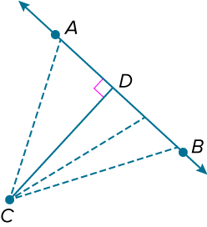
Learn
Distance Between a Point and a Line
Given AB and point C not on the line, there are an infinite number of lines that pass through the point and intersect the line. The shortest distance between the point and the line is the length of the segment that is perpendicular to the line through the point. So, the distance between C and AB is CD.

Slide 9
Learn
Distance Between a Point and a Line
Think About It!
If line 𝓂 and point P are on the coordinate plane and P is not on line 𝓂, how do you find the distance between P and line 𝓂?

Slide 10
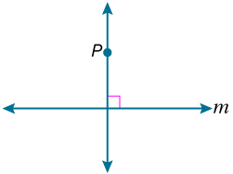
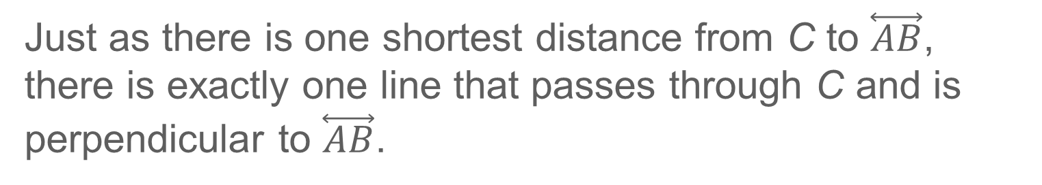
Learn
Distance Between a Point and a Line
Just as there is one shortest distance from C to $\overset{⃡}{AB}$, there is exactly one line that passes through C and is perpendicular to $\overset{⃡}{AB}$.
Postulate 3.14: Perpendicular Postulate
If given a line and a point not on the line, then there exists exactly one line through the point that is perpendicular to the given line.

Slide 11
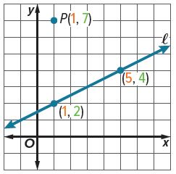
Example 1
Distance from a Point to a Line on the Coordinate Plane
Line ℓ contains points (1, 2) and (5, 4). Find the distance between line 𝓁 and the point P(1, 7).

Slide 12
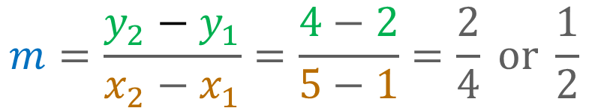
Example 1
Distance from a Point to a Line on the Coordinate Plane
Step 1 Find the equation of line 𝓁.
Begin by finding the slope of the line through points (1, 2) and (5, 4).
$$m=\frac{y_{2}−y_{1}}{x_{2}−x_{1}}=\frac{4−2}{5−1}=\frac{2}{4} or \frac{1}{2}$$

Slide 13

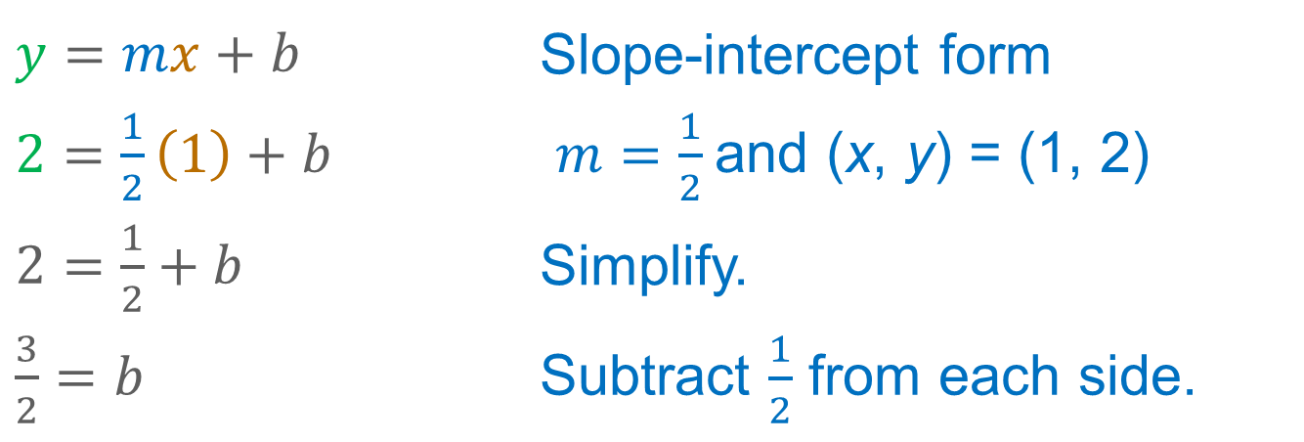
Example 1
Distance from a Point to a Line on the Coordinate Plane
Then write the equation of the line using the point (1, 2).
$y=mx+b$ | Slope-intercept form
$2=\frac{1}{2}\left(1\right)+b$ | $m=\frac{1}{2}$and (x, y) = (1, 2)
$2=\frac{1}{2}+b$ | Simplify.
$\frac{3}{2}=b$ | Subtract $\frac{1}{2}$ from each side.
The equation of line 𝓁 is $y=\frac{1}{2}x+\frac{3}{2}.$

Slide 14
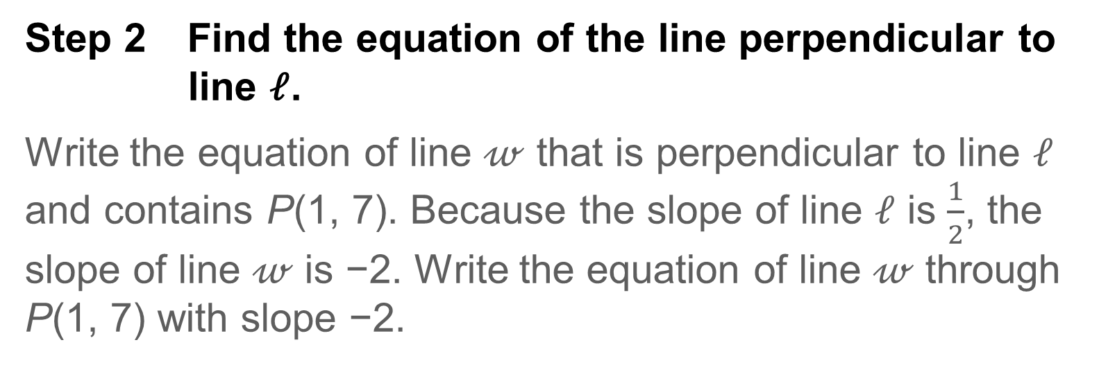
Example 1
Distance from a Point to a Line on the Coordinate Plane
Step 2 Find the equation of the line perpendicular to line 𝓁.
Write the equation of line 𝓌 that is perpendicular to line 𝓁 and contains P(1, 7). Because the slope of line 𝓁 is $\frac{1}{2}$, the slope of line 𝓌 is −2. Write the equation of line 𝓌 through P(1, 7) with slope −2.

Slide 15
Example 1
Distance from a Point to a Line on the Coordinate Plane
y = mx + b | Slope-intercept form
7 = −2(1) + b | m = −2, (x, y) = (1, 7)
7 = −2 + b | Simplify.
9 = b | Add 2 to each side.
The equation of the line is y = −2x + 9.

Slide 16
Example 1
Distance from a Point to a Line on the Coordinate Plane
Step 3 Solve the system of equations.
Find the point of intersection of lines 𝓁 and 𝓌.
Solve the system of equations to determine the point of intersection.

Slide 17
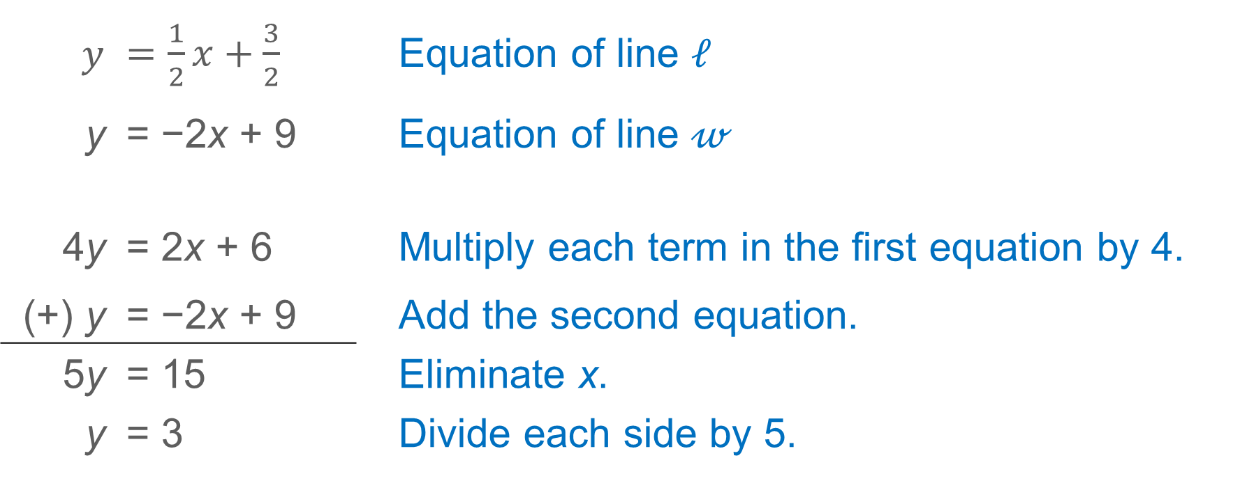
Example 1
Distance from a Point to a Line on the Coordinate Plane
$y$ | $=\frac{1}{2}x+\frac{3}{2}$ |  | Equation of line 𝓁
y | = −2x + 9 |  | Equation of line 𝓌
4y | = 2x + 6 |  | Multiply each term in the first equation by 4.
(+) y | = −2x + 9 |  | Add the second equation.
5y | = 15 |  | Eliminate x.
y | = 3 |  | Divide each side by 5.

Slide 18
Example 1
Distance from a Point to a Line on the Coordinate Plane
Solve for x.
y = −2x + 9 | Equation of line 𝓌
3 = −2x + 9 | Substitute 3 for y.
−6 = −2x | Subtract 9 from each side.
3 = x | Divide each side by −2.
The point of intersection is (3, 3). Let this be point Q.

Slide 19
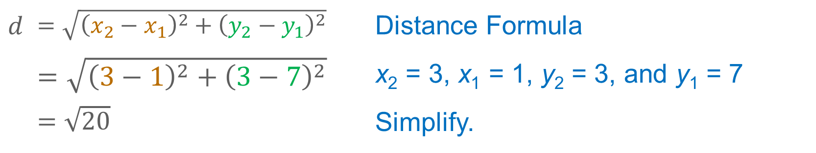
Example 1
Distance from a Point to a Line on the Coordinate Plane
Step 4 Calculate the distance between P and Q.
Use the Distance Formula to determine the distance between P(1, 7) and Q(3, 3).
$d$ | $=\sqrt{{\left(x_{2}−x_{1}\right)}^{2}+{\left(y_{2}−y_{1}\right)}^{2}}$ | Distance Formula
 | $=\sqrt{{\left(3−1\right)}^{2}+{\left(3−7\right)}^{2}}$ | x₂ = 3, x₁ = 1, y₂ = 3, and y₁ = 7
 | $=\sqrt{20}$ | Simplify.
The distance between point P and line 𝓁 is $\sqrt{20}$ or about 4.47 units.

Slide 20
Example 1
Distance from a Point to a Line on the Coordinate Plane
Talk About It!
Why do you use the perpendicular distance to find the distance between a line and a point not on the line?

Slide 21
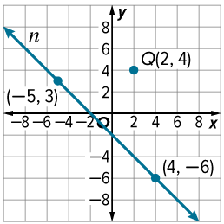
Example 1
Distance from a Point to a Line on the Coordinate Plane
Check
Line 𝓃 contains points (−5, 3) and (4, −6). Find the distance between line 𝓃 and point Q(2, 4). Round to the nearest tenth, if necessary.

Slide 22
Example 1
Distance from a Point to a Line on the Coordinate Plane
Check
Line 𝓃 contains points (−5, 3) and (4, −6). Find the distance between line 𝓃 and point Q(2, 4). Round to the nearest tenth, if necessary.
5.7 units
Notes:
5.7 units

Slide 23
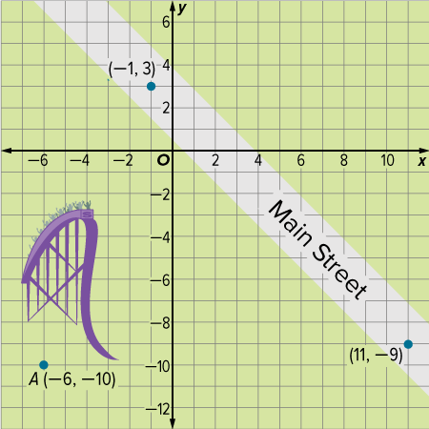
Apply Example 2
Solve a Design Problem by Using Distance
AMUSEMENT PARK The developers of an amusement park want to build a new attraction. According to park regulations, the entrance to each attraction must be at least 10 yards from the center of Main Street. In the design plans, the entrance to the new attraction is located at A(−6, −10), and Main Street contains the points (−1, 3) and (11, −9). If each unit represents 1 yard, will the new attraction comply with park regulations? Explain.

Slide 24
Apply Example 2
Solve a Design Problem by Using Distance
Talk About It!
Ask a partner to provide feedback on your work. Are there ways in which you can improve your model or process?

Slide 25
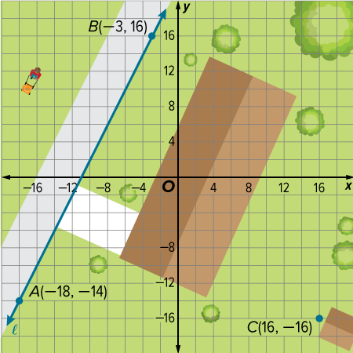
Apply Example 2
Solve a Design Problem by Using Distance
Check
ZONING Javier wants to build a shed on his property. According to zoning laws, the shed must be at least 20 feet from his property line. Javier knows that points A and B fall on his property line. If Javier plans to build the shed behind his house at point C, will he satisfy the zoning laws? If yes, how far away will the shed be from Javier’s property line? Each unit on the coordinate plane represents 1 foot.
A. no B. yes; 31.3 ft C. yes; 34.1 ft D. yes; 37.2 ft

Slide 26
Apply Example 2
Solve a Design Problem by Using Distance
Check
ZONING Javier wants to build a shed on his property. According to zoning laws, the shed must be at least 20 feet from his property line. Javier knows that points A and B fall on his property line. If Javier plans to build the shed behind his house at point C, will he satisfy the zoning laws? If yes, how far away will the shed be from Javier’s property line? Each unit on the coordinate plane represents 1 foot. B
A. no B. yes; 31.3 ft C. yes; 34.1 ft D. yes; 37.2 ft
Notes:
B

Slide 27
Learn
Distance Between Parallel Lines
By definition, parallel lines do not intersect. An alternate definition states that two lines in a plane are parallel if they are always equidistant. Two lines are equidistant from each other if the distance between the two lines, measured along a perp.

Slide 28
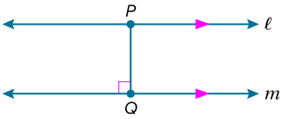
Learn
Distance Between Parallel Lines
Key Concept: Distance Between Parallel Lines
The distance between two parallel lines is the perpendicular distance between one of the lines and any point on the other line.

Slide 29
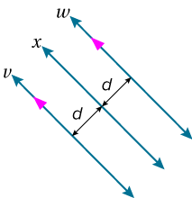
Learn
Distance Between Parallel Lines
Theorem 3.24: Two Lines Equidistant from a Third
In a plane, if two lines are each equidistant from a third line, then the two lines are parallel to each other.
Example If line 𝓌 and line 𝓋 are equidistant from line 𝓍, then line 𝓌 and line 𝓋 are parallel.

Slide 30
Learn
Distance Between Parallel Lines
Think About It!
How would you find the distance between two parallel planes?

Slide 31
Example 3
Distance Between Parallel Lines
Find the distance between the parallel lines 𝓇 and 𝓉 with equations y = −3x − 5 and y = −3x + 6, respectively.

Slide 32
Example 3
Distance Between Parallel Lines
You need to solve a system of equations to find the endpoints of a segment perpendicular to lines 𝓇 and 𝓉. We know that the slope of lines 𝓇 and 𝓉 is −3. Let line 𝓆 be perpendicular to lines 𝓇 and 𝓉.

Slide 33
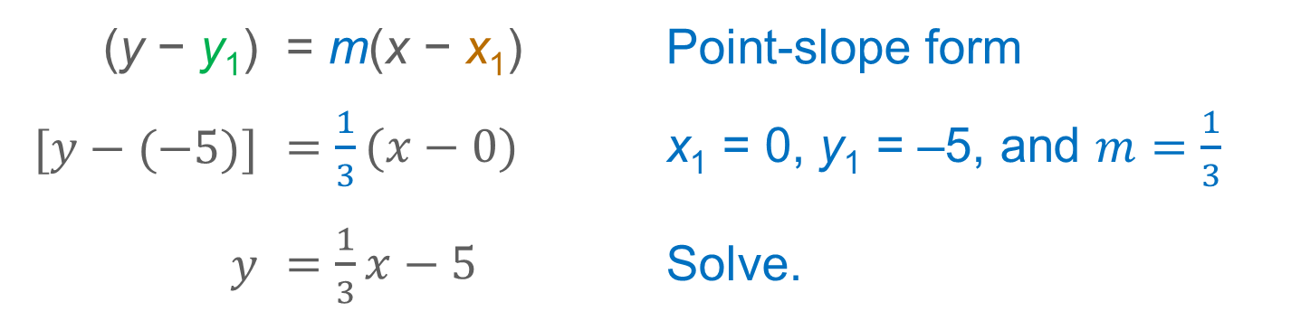
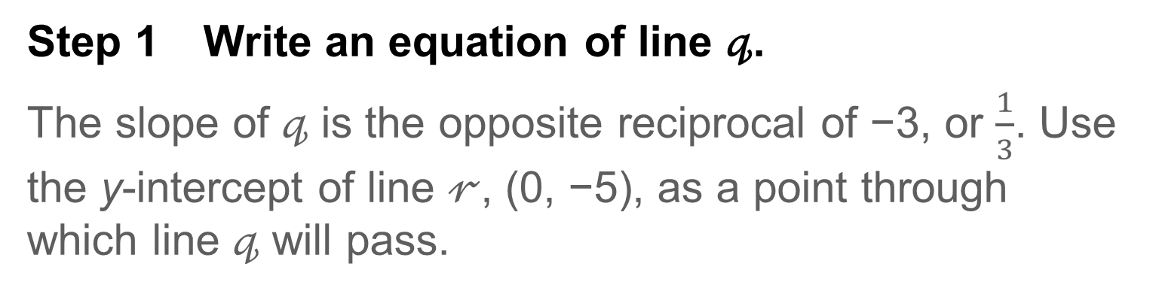
Example 3
Distance Between Parallel Lines
Step 1 Write an equation of line 𝓆.
The slope of 𝓆 is the opposite reciprocal of −3, or $\frac{1}{3}$. Use the y-intercept of line 𝓇, (0, −5), as a point through which line 𝓆 will pass.
(y − y₁) | = m(x − x₁) | Point-slope form
$[y−(−5)]$ | $=\frac{1}{3}(x−0)$ | x₁ = 0, y₁ = –5, and $m=\frac{1}{3}$
$$y$$ | $=\frac{1}{3}x−5$ | Solve.

Slide 34
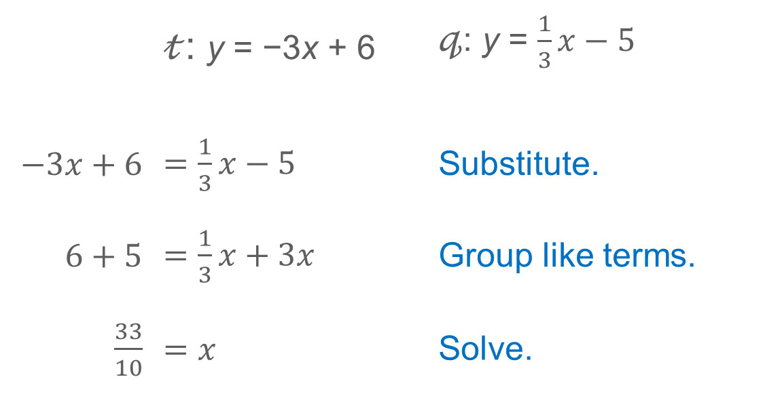
Example 3
Distance Between Parallel Lines
Step 2 Solve the system of equations.
Determine the point of intersection of lines 𝓉 and 𝓆.
 | 𝓉: y = −3x + 6 | 𝓆: y = $\frac{1}{3}x−5$
$−3x+6$ | $=\frac{1}{3}x−5$ | Substitute.
$6+5$ | $=\frac{1}{3}x+3x$ | Group like terms.
$\frac{33}{10}$ | $=x$ | Solve.

Slide 35
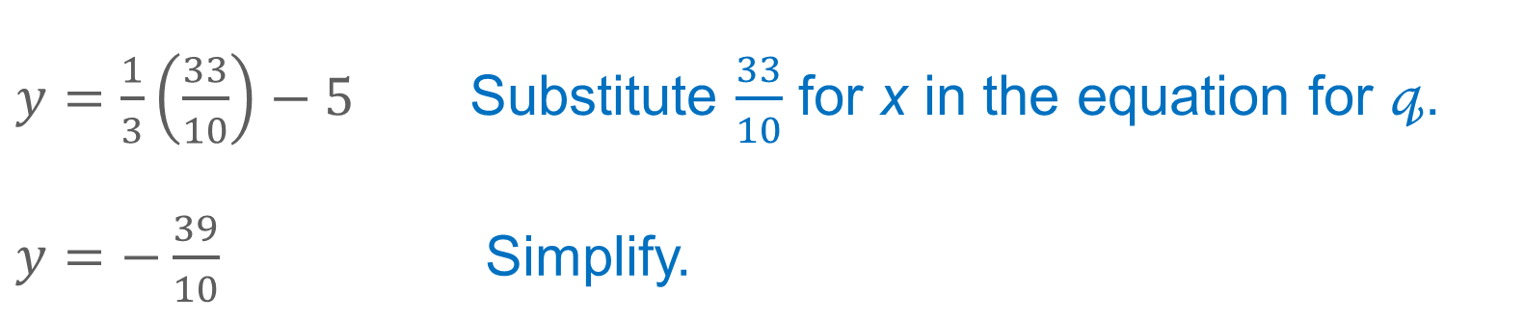
Example 3
Distance Between Parallel Lines
Solve for y when $x=\frac{33}{10}.$
$y=\frac{1}{3}\left(\frac{33}{10}\right)−5$ | Substitute $\frac{33}{10}$ for x in the equation for 𝓆.
$y=−\frac{39}{10}$ | Simplify.
The point of intersection is $\left(\frac{33}{10},−\frac{39}{10} \right)$ or (3.3, –3.9).

Slide 36
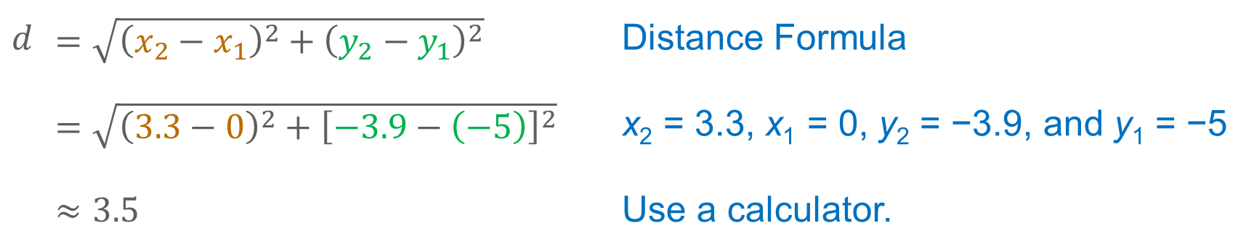
Example 3
Distance Between Parallel Lines
Step 3 Calculate the distance between lines 𝓇 and 𝓉.
Use the Distance Formula to determine the distance between (0, −5) and (3.3, −3.9).
$$d$$ | $=\sqrt{{\left(x_{2}−x_{1}\right)}^{2}+{\left(y_{2}−y_{1}\right)}^{2}}$ | Distance Formula
 | $=\sqrt{{\left(3.3−0\right)}^{2}+{\left[−3.9−\left(−5\right)\right]}^{2}}$ | x₂ = 3.3, x₁ = 0, y₂ = −3.9, and y₁ = −5
 | $≈3.5$ | Use a calculator.
The distance between the lines is about 3.5 units.

Slide 37
Example 3
Distance Between Parallel Lines
Talk About It!
Compare and contrast the processes for finding the distance between a point and a line and for finding the distance between parallel lines.

Slide 38
Example 3
Distance Between Parallel Lines
Check
Find the distance between parallel lines 𝒶 and 𝒷 with equations x + 3y = 6 and x + 3y = −14, respectively. Round to the nearest hundredth, if necessary.

Slide 39
Example 3
Distance Between Parallel Lines
Check
Find the distance between parallel lines 𝒶 and 𝒷 with equations x + 3y = 6 and x + 3y = −14, respectively. Round to the nearest hundredth, if necessary.
6.32 units
Notes:
6.32 units

Slide 40
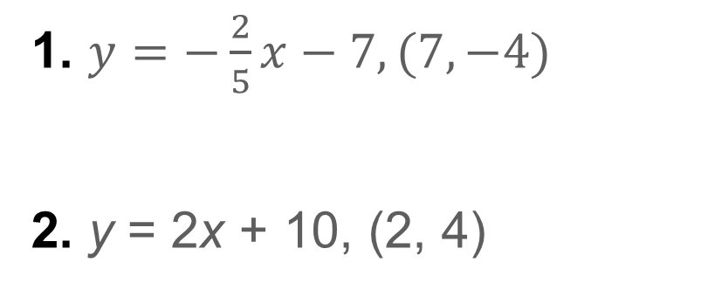
Exit Ticket
Find the distance between the given line and point. Round each answer to the nearest hundredth if necessary.
1. $y=−\frac{2}{5}x−7, (7, −4)$
2. y = 2x + 10, (2, 4)

Slide 41
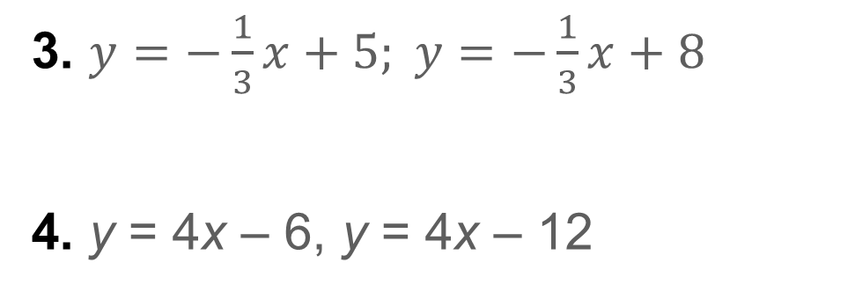
Exit Ticket
Find the distance between the given parallel lines. Round each answer to the nearest hundredth, if necessary.
3. $y=−\frac{1}{3}x+5; y=−\frac{1}{3}x+8$
4. y = 4x – 6, y = 4x – 12

Slide 42
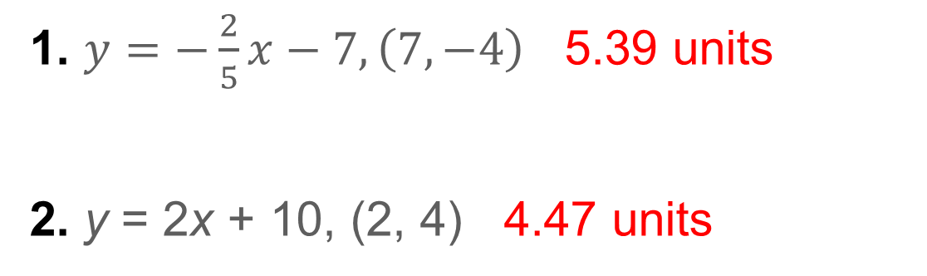
Exit Ticket
Find the distance between the given line and point. Round each answer to the nearest hundredth if necessary.
1. $y=−\frac{2}{5}x−7, \left(7, −4\right)$ 5.39 units
2. y = 2x + 10, (2, 4) 4.47 units
Notes:
5.39 units
4.47 units

Slide 43
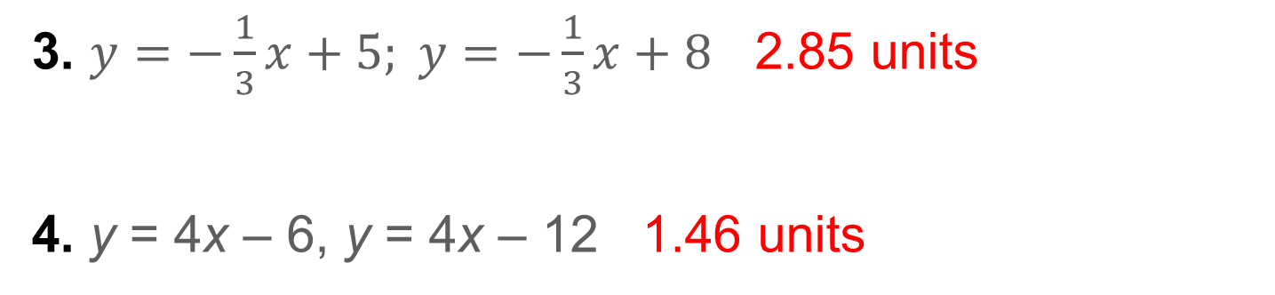
Exit Ticket
Find the distance between the given parallel lines. Round each answer to the nearest hundredth, if necessary.
3. $y=−\frac{1}{3}x+5; y=−\frac{1}{3}x+8$ 2.85 units
4. y = 4x – 6, y = 4x – 12 1.46 units
Notes:
2.85 units
1.46 units

