Slide 1
Section 3-8
Slope and Equations of Lines

Slide 2
Warm Up

Slide 3
Warm Up Exercise
Line m, o, and p are parallel to each other and cut by a transversal t. Find the value of x and y:
m
o
p
5y - 4
t
3y
2x + 13

Slide 4
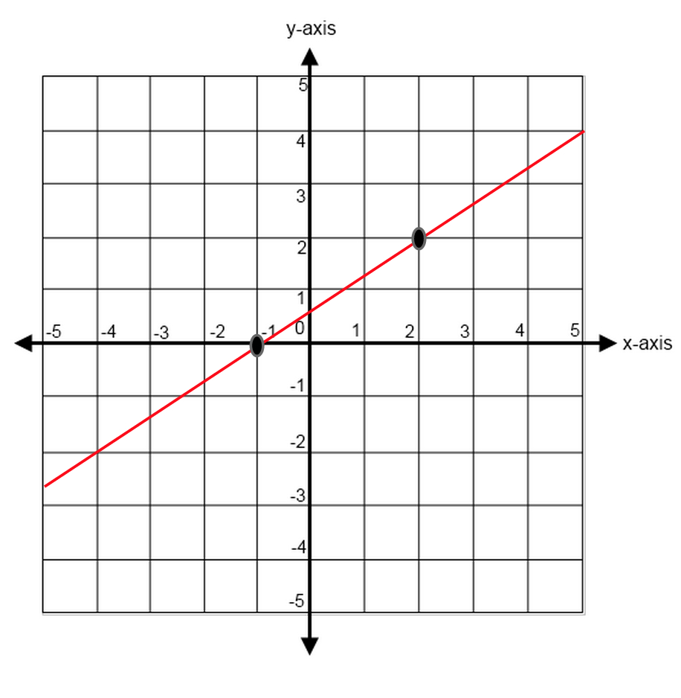
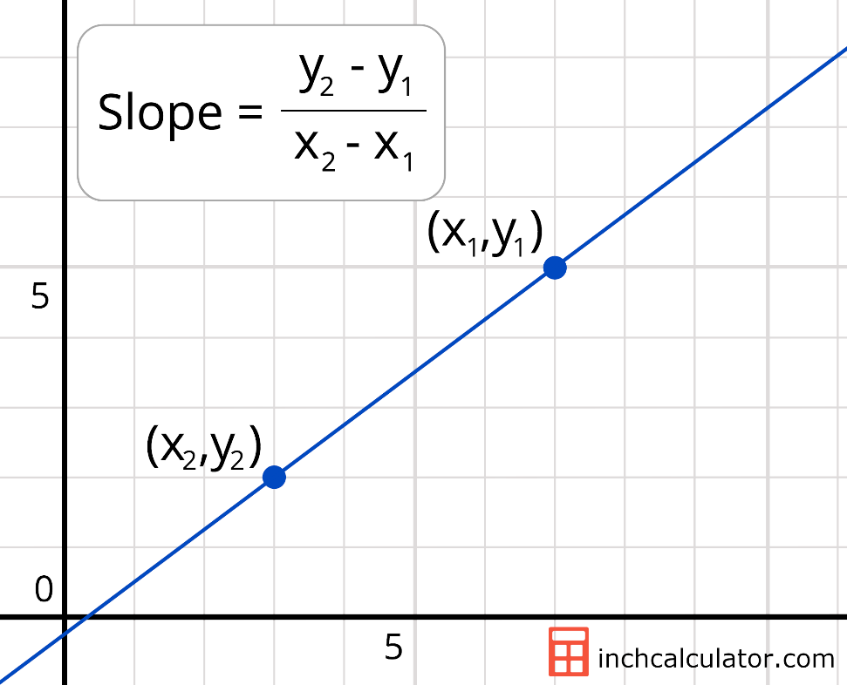
Warm Up
Finding the slope from a graph

Slide 5
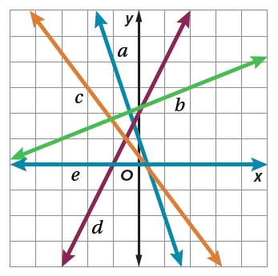


Warm Up
Find the slope of each line.
1. 𝒶
2. 𝒷
3. 𝒸
4. 𝒹
5. ℯ
−3
$\frac{2}{5}$
$−\frac{4}{3}$
2
0
Notes:
–3
$\frac{2}{5}$
$−\frac{4}{3}$
2
0

Slide 6
Florida’s B.E.S.T. Standards for Mathematics
MA.912.GR.3.3
Use coordinate geometry to solve mathematical and real-world geometric problems involving lines, circles, triangles and quadrilaterals.

Slide 7
Florida’s Mathematical Thinking and Reasoning Standards
MA.K12.MTR.1.1
Actively participate in effortful learning both individually and collectively.
MA.K12.MTR.4.1
Engage in discussions that reflect on the mathematical thinking of self and others.

Slide 8
Lesson Objectives
Content Objective
Students classify lines as parallel, perpendicular, or neither by using the slope criteria.
Language Objectives
• Students use positive and negative to explain how to classify lines as parallel, perpendicular, or neither by using the slope criteria.
• To maximize linguistic and cognitive meta-awareness, students participate in MLR5: Co-Craft Questions and Problems.

Slide 9
Learn
Slope Criteria for Parallel and Perpendicular Lines
Slope is the ratio of the change in the y-coordinate (rise) to the corresponding change in the x-coordinate (run) as you move from one point to another along a line. The slope criteria outlines a method for proving the relationship between lines based on a comparison of the slopes of the lines. You can use the slopes of two lines to determine whether the lines are parallel, perpendicular, or neither.

Slide 10
Learn
Slope Criteria for Parallel and Perpendicular Lines
Postulate 3.13: Slope Criteria for Parallel and Perpendicular Lines
Slopes of Parallel Lines Two distinct nonvertical lines have the same slope if and only if they are parallel. All vertical lines are parallel.
Slopes of Perpendicular Lines Two nonvertical lines are perpendicular if and only if the product of their slopes is −1. Vertical and horizontal lines are perpendicular.

Slide 11

Example 1
Determine Line Relationships When Given Points
Determine whether $\overset{⃡}{AB}$ and $\overset{⃡}{CD}$ are parallel, perpendicular, or neither for A(3, 6), B(−9, 2), C(5, 4), and D(2, 3). Graph each line to verify your answer.

Slide 12
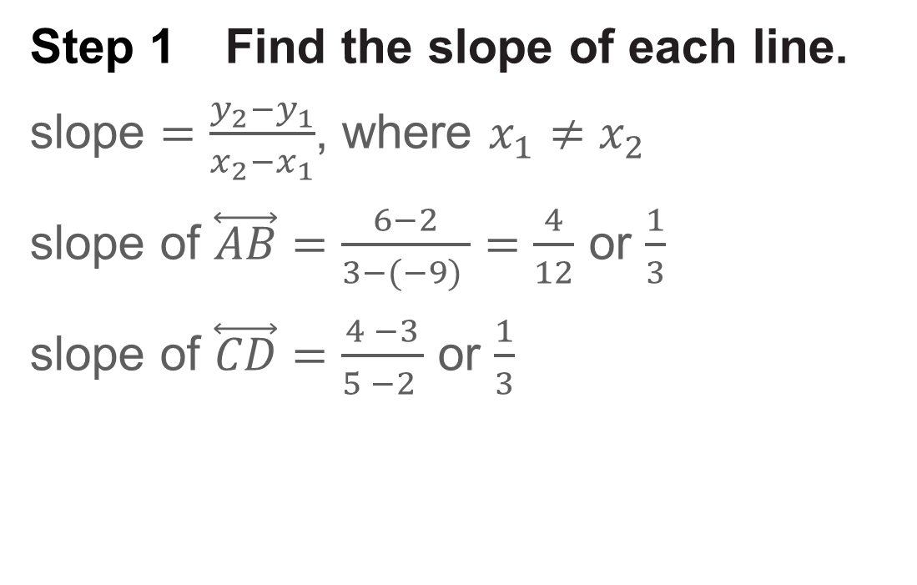
Example 1
Determine Line Relationships When Given Points
Step 1 Find the slope of each line.
slope $=\frac{y_{2}−y_{1}}{x_{2}−x_{1}}$, where $x_{1}≠x_{2}$
slope of $\overset{⃡}{AB}$ $=\frac{6−2}{3−(−9) }=\frac{4}{12}$ or $\frac{1}{3}$
slope of $\overset{⃡}{CD}$ $=\frac{4 −3}{5 −2 }$ or $\frac{1}{3}$

Slide 13
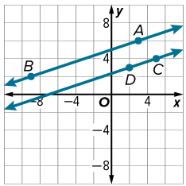
Example 1
Determine Line Relationships When Given Points
Step 2 Determine the relationship.
The two lines have the same slope, so they are parallel.

Slide 14
Example 1
Determine Line Relationships When Given Points
Talk About It!
Your classmate argues that you could have graphed the points and determined whether the lines were parallel, perpendicular, or neither just by looking at the graph. What question can you ask to help them correct the error?

Slide 15
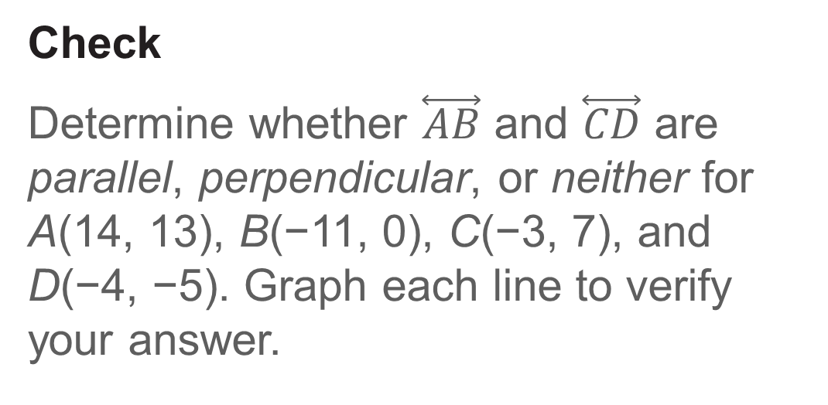
Example 1
Determine Line Relationships When Given Points
Check
Determine whether $\overset{⃡}{AB}$ and $\overset{⃡}{CD}$ are parallel, perpendicular, or neither for A(14, 13), B(−11, 0), C(−3, 7), and D(−4, −5). Graph each line to verify your answer.

Slide 16
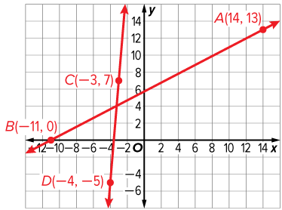
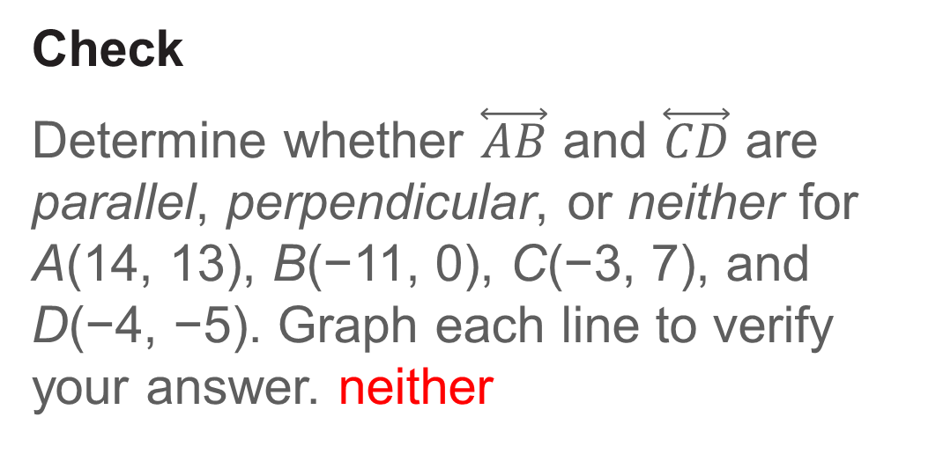
Example 1
Determine Line Relationships When Given Points
Check
Determine whether $\overset{⃡}{AB}$ and $\overset{⃡}{CD}$ are parallel, perpendicular, or neither for A(14, 13), B(−11, 0), C(−3, 7), and D(−4, −5). Graph each line to verify your answer. neither
Notes:
neither

Slide 17
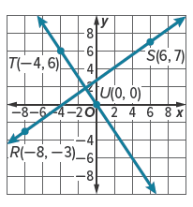

Example 2
Determine Line Relationships When Given Graphs
Determine whether each pair of lines is parallel, perpendicular, or neither.
a. $\overset{⃡}{RS}$ and $\overset{⃡}{TU}$
b. $\overset{⃡}{EF}$ and $\overset{⃡}{DG}$

Slide 18
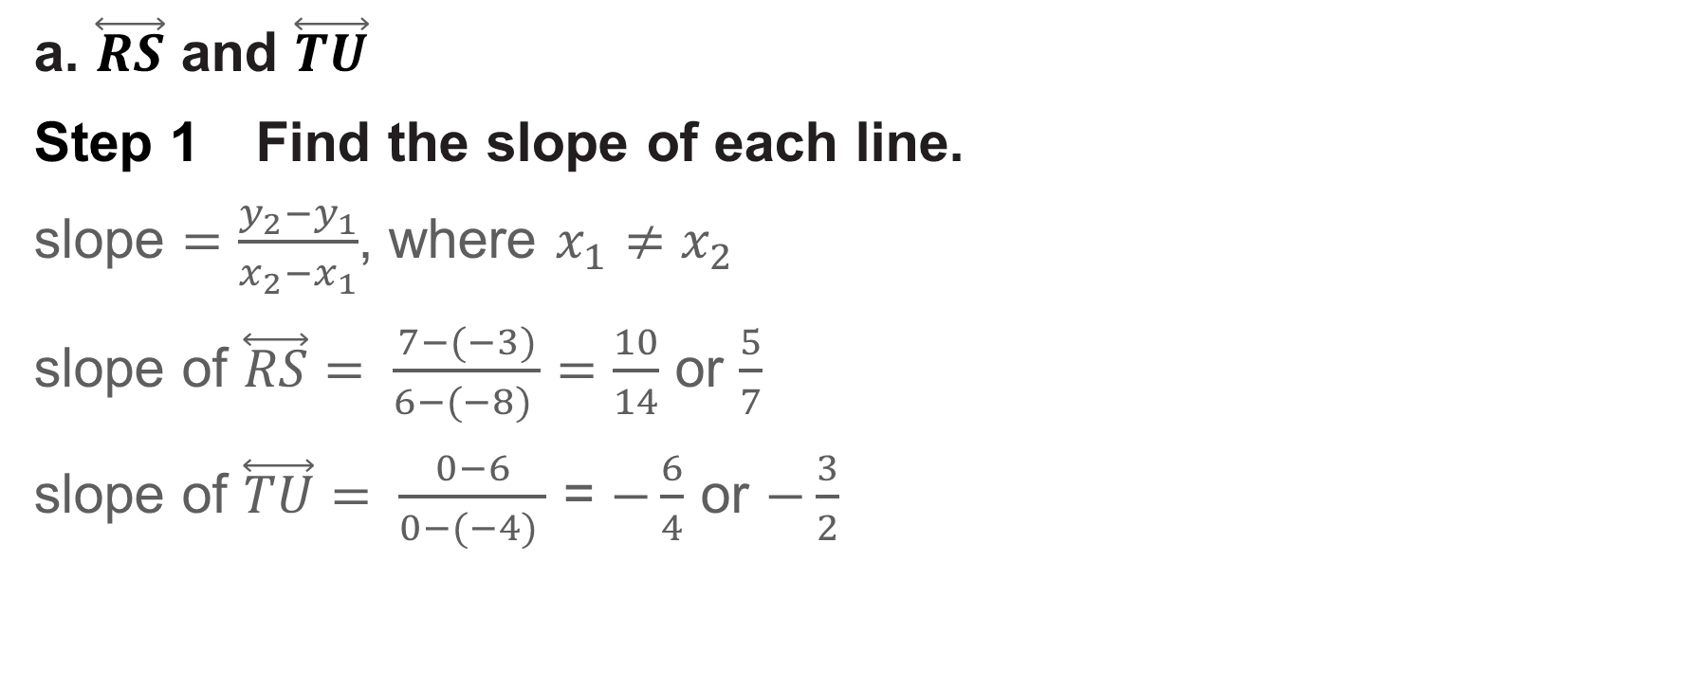
Example 2
Determine Line Relationships When Given Graphs
a. $\overset{⃡}{RS}$ and $\overset{⃡}{TU}$
Step 1 Find the slope of each line.
slope $=\frac{y_{2}−y_{1}}{x_{2}−x_{1}}$, where $x_{1}≠x_{2}$
slope of $\overset{⃡}{RS}$ $= \frac{7−(−3)}{6−(−8) }=\frac{10}{14}$ or $\frac{5}{7}$
slope of $\overset{⃡}{TU}$ $= \frac{0−6}{0−(−4) }$ = $−\frac{6}{4}$ or $−\frac{3}{2}$

Slide 19
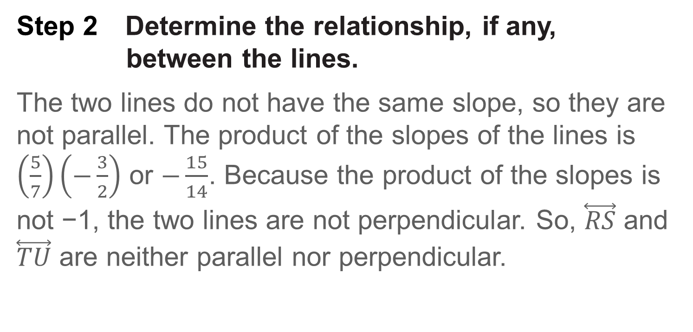
Example 2
Determine Line Relationships When Given Graphs
Step 2 Determine the relationship, if any, between the lines.
The two lines do not have the same slope, so they are not parallel. The product of the slopes of the lines is $\left(\frac{5}{7}\right)\left(−\frac{3}{2}\right)$ or $−\frac{15}{14}$. Because the product of the slopes is not −1, the two lines are not perpendicular. So, $\overset{⃡}{RS}$ and $\overset{⃡}{TU}$ are neither parallel nor perpendicular.

Slide 20
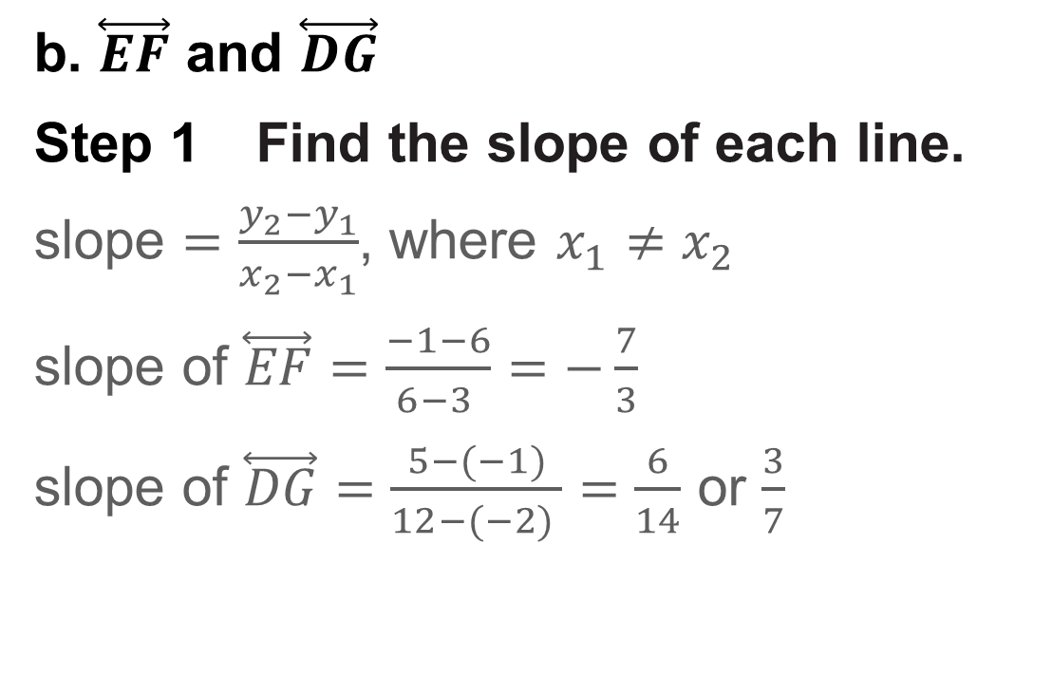
Example 2
Determine Line Relationships When Given Graphs
b. $\overset{⃡}{EF}$ and $\overset{⃡}{DG}$
Step 1 Find the slope of each line.
slope $=\frac{y_{2}−y_{1}}{x_{2}−x_{1}}$, where $x_{1}≠x_{2}$
slope of $\overset{⃡}{EF}$ $=\frac{−1−6}{6−3 }=−\frac{7}{3}$
slope of $\overset{⃡}{DG}$ $=\frac{5−(−1)}{12−(−2) }=\frac{6}{14}$ or $\frac{3}{7}$

Slide 21
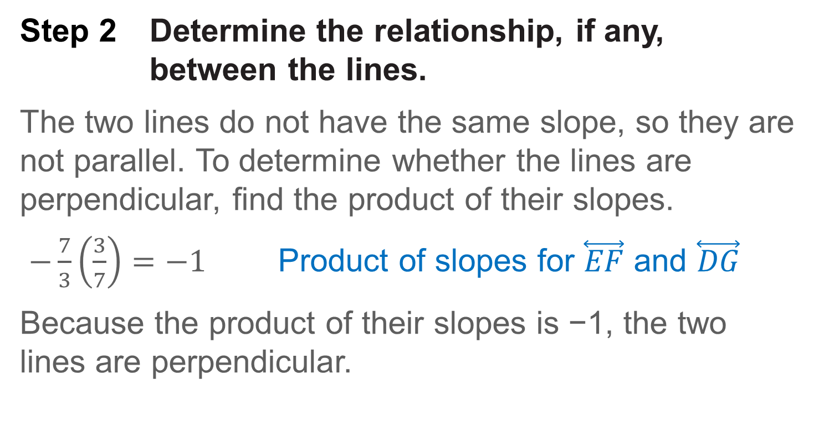
Example 2
Determine Line Relationships When Given Graphs
Step 2 Determine the relationship, if any, between the lines.
The two lines do not have the same slope, so they are not parallel. To determine whether the lines are perpendicular, find the product of their slopes.
$−\frac{7}{3}\left(\frac{3}{7}\right)=−1$ Product of slopes for $\overset{⃡}{EF}$ and $\overset{⃡}{DG}$
Because the product of their slopes is −1, the two lines are perpendicular.

Slide 22
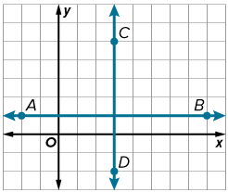
Example 2
Determine Line Relationships When Given Graphs
Check
Determine whether the pair of lines is parallel, perpendicular, or neither.

Slide 23
Example 2
Determine Line Relationships When Given Graphs
Check
Determine whether the pair of lines is parallel, perpendicular, or neither.
perpendicular
Notes:
perpendicular

Slide 24
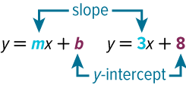
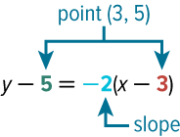
Learn
Equations of Lines
An equation of a nonvertical line can be written in different but equivalent forms.
Key Concept: Nonvertical Line Equations
The slope-intercept form of a linear equation is y = mx + b, where m is the slope of the line and b is the y-intercept.
The point-slope form of a linear equation is y − y₁ = m(x – x₁), where (x₁, y₁) is any point on the line and m is the slope of the line.

Slide 25
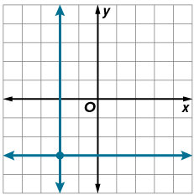
Learn
Equations of Lines
The equations of horizontal and vertical lines involve only one variable.
Key Concept: Horizontal and Vertical Line Equations
The equation of a horizontal line is y = b, where b is the y-intercept of the line.
The equation of a vertical line is x = a, where a is the x-intercept of the line.
When given the equations of two lines, you can compare the equations to determine the relationship between the lines.

Slide 26
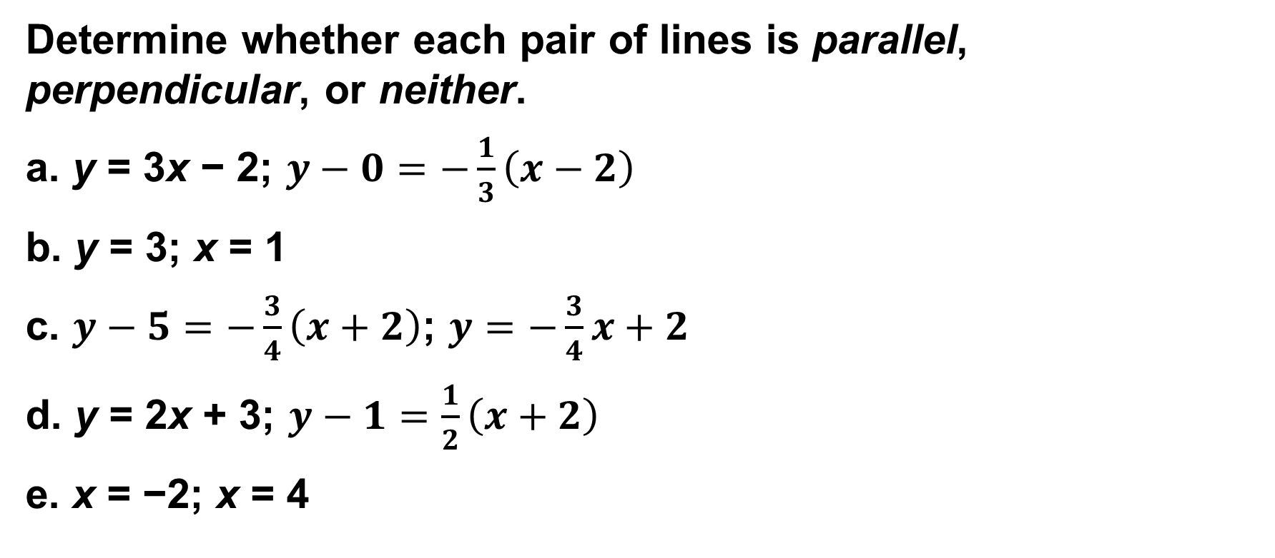
Example 3
Determine Line Relationships When Given Equations
Determine whether each pair of lines is parallel, perpendicular, or neither.
a. y = 3x − 2; $y−0=−\frac{1}{3}\left(x−2\right)$
b. y = 3; x = 1
c. $y−5=−\frac{3}{4}\left(x+2\right)$; $y=−\frac{3}{4}x+2$
d. y = 2x + 3; $y−1=\frac{1}{2}\left(x+2\right)$
e. x = −2; x = 4
Notes:
perpendicular

Slide 27
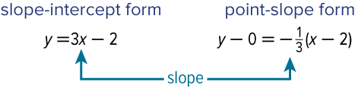
Example 3
Determine Line Relationships When Given Equations
a. y = 3x − 2; $y−0=−\frac{1}{3}\left(x−2\right)$
Notes:
perpendicular

Slide 28
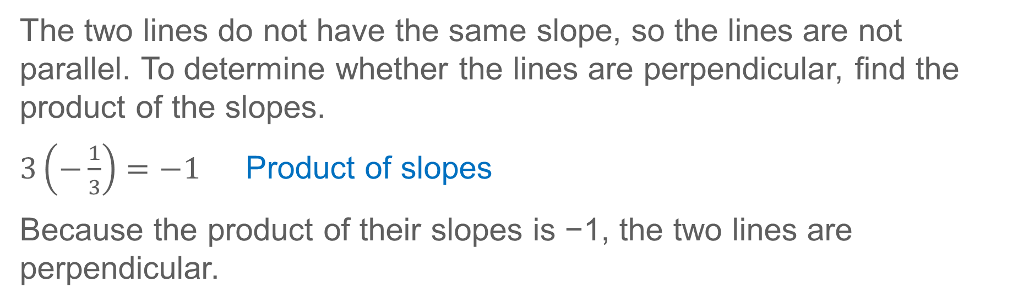
Example 3
Determine Line Relationships When Given Equations
The two lines do not have the same slope, so the lines are not parallel. To determine whether the lines are perpendicular, find the product of the slopes.
$3\left(−\frac{1}{3}\right)=−1$ Product of slopes
Because the product of their slopes is −1, the two lines are perpendicular.
Notes:
perpendicular

Slide 29
Example 3
Determine Line Relationships When Given Equations
b. y = 3; x = 1
The line y = 3 is a horizontal line. The line x = 1 is a vertical line.
Vertical and horizontal lines are always perpendicular.
Notes:
perpendicular

Slide 30

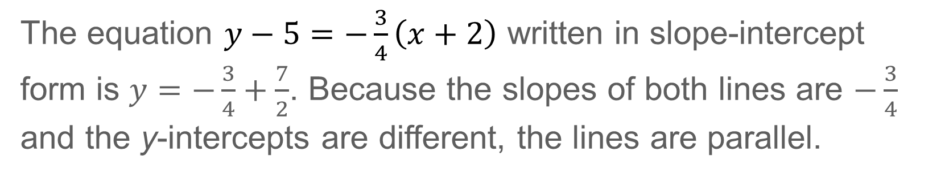
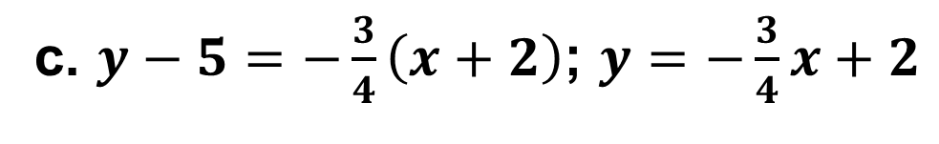
Example 3
Determine Line Relationships When Given Equations
c. $y−5=−\frac{3}{4}\left(x+2\right)$; $y=−\frac{3}{4}x+2$
The equation $y−5=−\frac{3}{4}\left(x+2\right)$ written in slope-intercept form is $y=−\frac{3}{4}+\frac{7}{2}$. Because the slopes of both lines are $−\frac{3}{4}$ and the y-intercepts are different, the lines are parallel.
Notes:
perpendicular

Slide 31

Example 3
Determine Line Relationships When Given Equations
d. y = 2x + 3; $y−1=\frac{1}{2}\left(x+2\right)$
Notes:
perpendicular

Slide 32
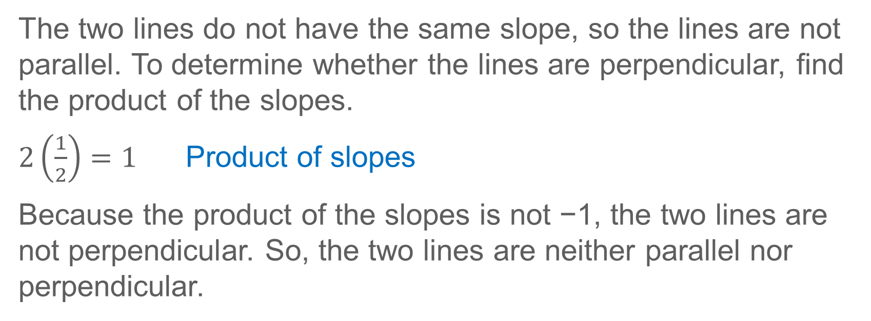
Example 3
Determine Line Relationships When Given Equations
The two lines do not have the same slope, so the lines are not parallel. To determine whether the lines are perpendicular, find the product of the slopes.
$2\left(\frac{1}{2}\right)=1$ Product of slopes
Because the product of the slopes is not −1, the two lines are not perpendicular. So, the two lines are neither parallel nor perpendicular.
Notes:
perpendicular

Slide 33
Example 3
Determine Line Relationships When Given Equations
e. x = −2; x = 4
Both lines are vertical with undefined slope. Vertical lines are always parallel.
Notes:
perpendicular

Slide 34
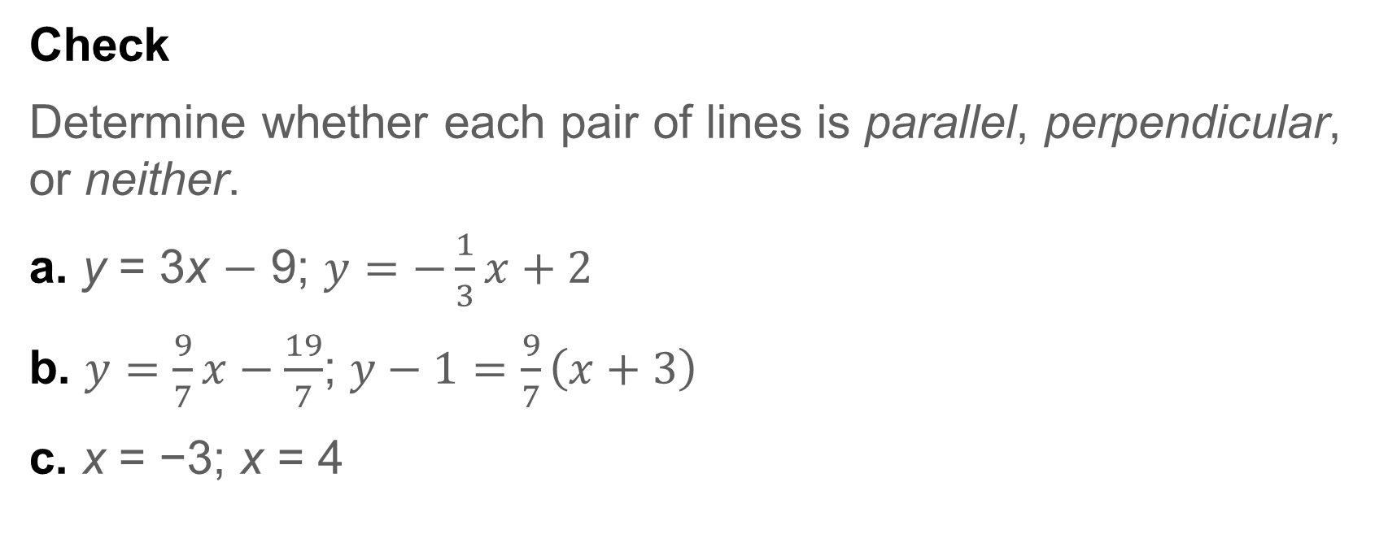
Example 3
Determine Line Relationships When Given Equations
Check
Determine whether each pair of lines is parallel, perpendicular, or neither.
a. y = 3x $−$ 9; $y=−\frac{1}{3}x+2$
b. $y=\frac{9}{7}x−\frac{19}{7}$; $y−1=\frac{9}{7}\left(x+3\right)$
c. x = −3; x = 4
Notes:
perpendicular

Slide 35
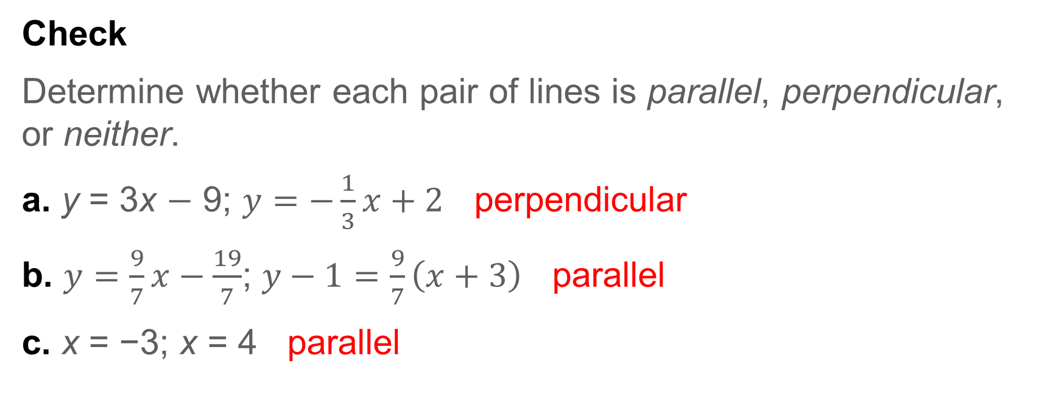
Example 3
Determine Line Relationships When Given Equations
Check
Determine whether each pair of lines is parallel, perpendicular, or neither.
a. y = 3x $−$ 9; $y=−\frac{1}{3}x+2$ perpendicular
b. $y=\frac{9}{7}x−\frac{19}{7}$; $y−1=\frac{9}{7}\left(x+3\right)$ parallel
c. x = −3; x = 4 parallel
Notes:
perpendicular
parallel
parallel

Slide 36
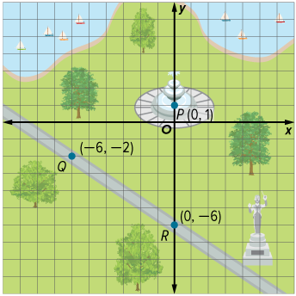
Example 4
Use Slope to Graph a Line
DESIGN Valentina is designing a park using grid paper. She wants to build a sidewalk that connects with the fountain at P(0, 1) and is perpendicular to the existing sidewalk that passes through points Q(−6, −2) and R(0, −6). Graph the line that represents the new sidewalk.

Slide 37
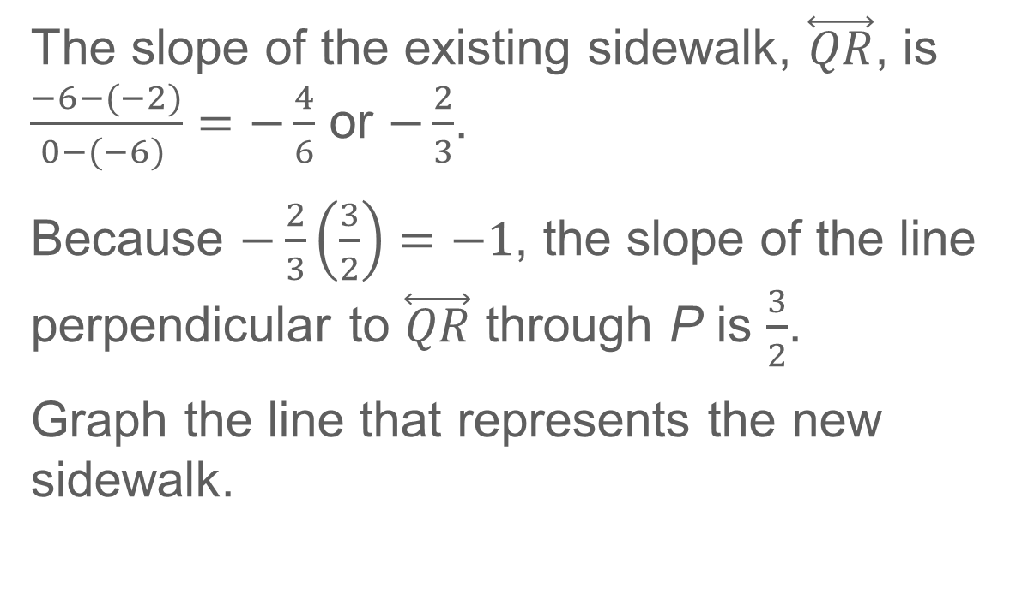
Example 4
Use Slope to Graph a Line
The slope of the existing sidewalk, $\overset{⃡}{QR}$, is $\frac{−6−(−2)}{0−(−6) }=−\frac{4}{6}$ or $−\frac{2}{3}$.
Because $−\frac{2}{3}\left(\frac{3}{2}\right)=−1$, the slope of the line perpendicular to $\overset{⃡}{QR}$ through P is $\frac{3}{2}$.
Graph the line that represents the new sidewalk.

Slide 38
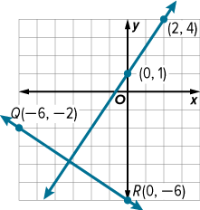
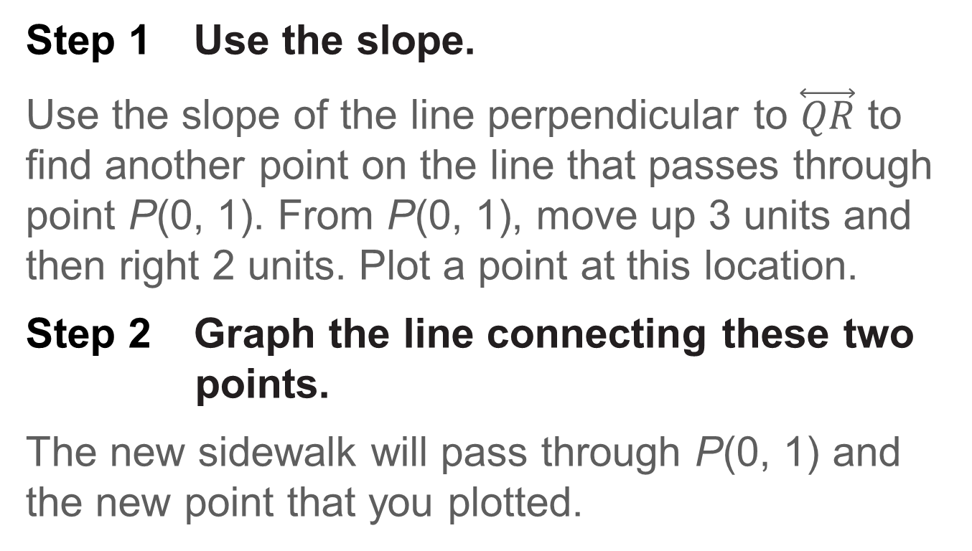
Example 4
Use Slope to Graph a Line
Step 1 Use the slope.
Use the slope of the line perpendicular to $\overset{⃡}{QR}$ to find another point on the line that passes through point P(0, 1). From P(0, 1), move up 3 units and then right 2 units. Plot a point at this location.
Step 2 Graph the line connecting these two points.
The new sidewalk will pass through P(0, 1) and the new point that you plotted.

Slide 39
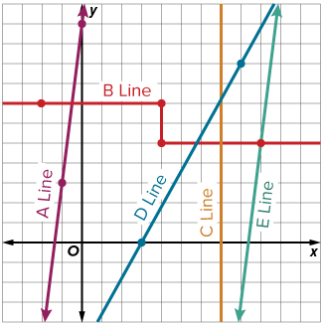
Example 4
Use Slope to Graph a Line
Check
MAPS Isabella is creating a map of her town’s metro lines. She knows that the A Line and the E Line are parallel. On her map, the equation that represents the A Line is y = 8x + 11 and the E Line passes through (9, 5). Write the equation in slope-intercept form that represents the E Line.

Slide 40
Example 4
Use Slope to Graph a Line
Check
MAPS Isabella is creating a map of her town’s metro lines. She knows that the A Line and the E Line are parallel. On her map, the equation that represents the A Line is y = 8x + 11 and the E Line passes through (9, 5). Write the equation in slope-intercept form that represents the E Line.
y = 8x − 67
Notes:
y = 8x − 67

Slide 41

Example 5
Write Equations of Parallel and Perpendicular Lines
Write an equation in slope-intercept form for the line parallel to $y=−\frac{3}{4}x+3$ containing (−3, 6).

Slide 42
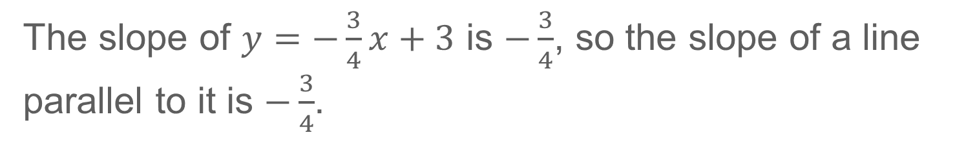
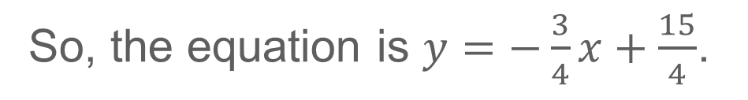
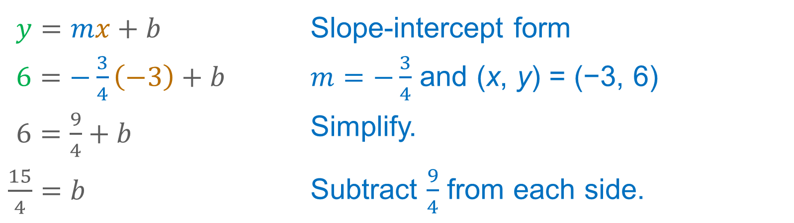
Example 5
Write Equations of Parallel and Perpendicular Lines
The slope of $y=−\frac{3}{4}x+3$ is $−\frac{3}{4}$, so the slope of a line parallel to it is $−\frac{3}{4}$.
$y=mx+b$ | Slope-intercept form
$6=−\frac{3}{4}\left(−3\right)+b$ | $m=−\frac{3}{4}$ and (x, y) = (−3, 6)
$6=\frac{9}{4}+b$ | Simplify.
$\frac{15}{4}=b$ | Subtract $\frac{9}{4}$ from each side.
So, the equation is $y=−\frac{3}{4}x+\frac{15}{4}$.

Slide 43
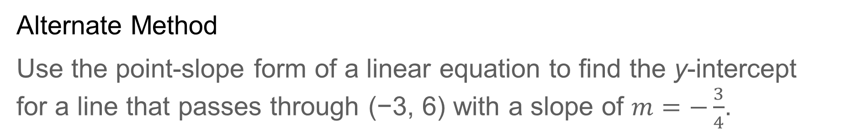
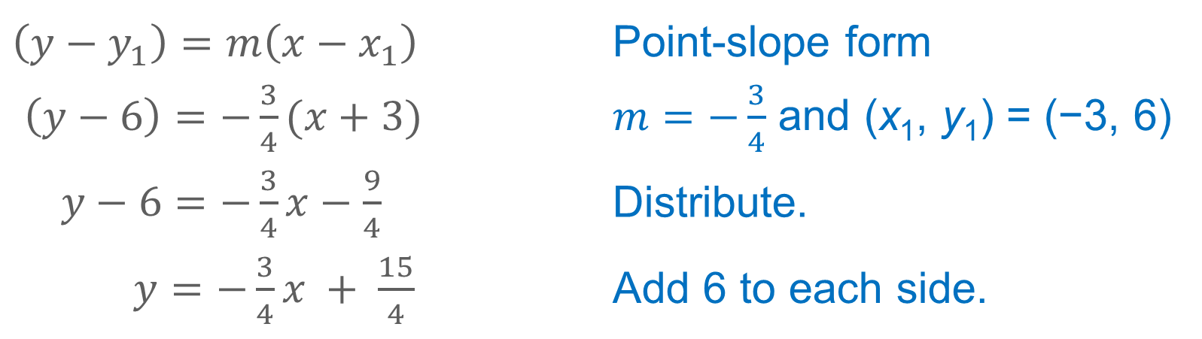
Example 5
Write Equations of Parallel and Perpendicular Lines
Alternate Method
Use the point-slope form of a linear equation to find the y-intercept for a line that passes through (−3, 6) with a slope of $m=−\frac{3}{4}$.
$\left(y−y_{1}\right)=m\left(x−x_{1}\right)$ | Point-slope form
$\left(y−6\right)=−\frac{3}{4}(x+3)$ | $m=−\frac{3}{4}$ and (x₁, y₁) = (−3, 6)
$y−6=−\frac{3}{4}x−\frac{9}{4}$ | Distribute.
$y=−\frac{3}{4}x + \frac{15}{4}$ | Add 6 to each side.

Slide 44
Example 5
Alternate Method
Talk About It!
Compare and contrast the methods. Which method do you think is more efficient?

Slide 45

Example 5
Write Equations of Parallel and Perpendicular Lines
Check
Write an equation in slope-intercept form for the line parallel to $y=\frac{1}{2}x+\frac{5}{2}$ containing $\left(\frac{3}{2}, 1\right)$.

Slide 46
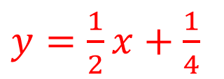
Example 5
Write Equations of Parallel and Perpendicular Lines
Check
Write an equation in slope-intercept form for the line parallel to $y=\frac{1}{2}x+\frac{5}{2}$ containing $\left(\frac{3}{2}, 1\right)$.
$y=\frac{1}{2}x+\frac{1}{4}$
Notes:
$$y=\frac{1}{2}x+\frac{1}{4}$$

Slide 47
Exit Ticket
Write the equation of the line parallel to the given line and containing the given point.
1. y = 3x + 2, (1, 2)
2. x + 2y = 6, (4, 3)
Write the equation of the line perpendicular to the given line and containing the given point.
3. −3x + 4y = 16, (3, 2)
4. 4x − y = 9, (8, −6)

Slide 48
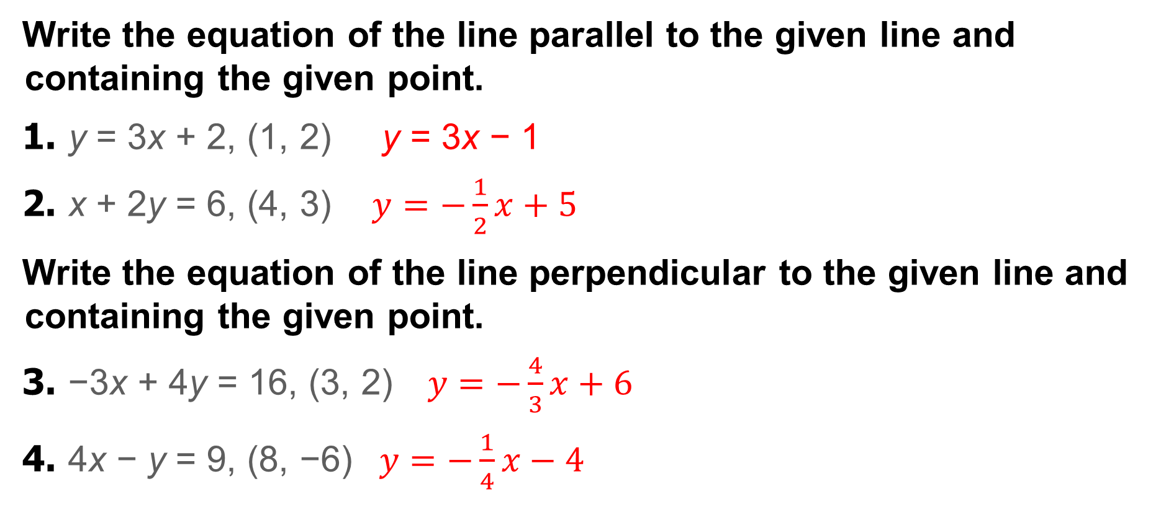
Exit Ticket
Write the equation of the line parallel to the given line and containing the given point.
1. y = 3x + 2, (1, 2) y = 3x − 1
2. x + 2y = 6, (4, 3) $y=−\frac{1}{2}x+5$
Write the equation of the line perpendicular to the given line and containing the given point.
3. −3x + 4y = 16, (3, 2) $y=−\frac{4}{3}x+6$
4. 4x − y = 9, (8, −6) $y=−\frac{1}{4}x−4$
Notes:
y = 3x − 1
$y=−\frac{1}{2}x+5$
$y=−\frac{4}{3}x+6$
$y=−\frac{1}{4}x−4$

