Slide 1
2-5 Three-Dimensional Figures

Slide 2
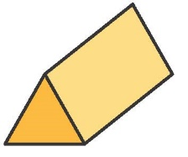
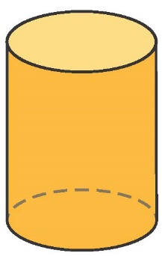
Warm Up
Identify each figure.
1. 2.

Slide 3
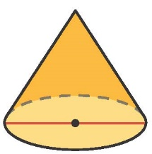
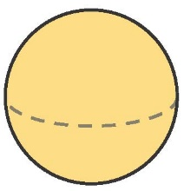
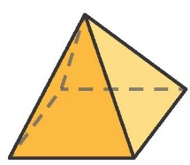
Warm Up
Identify each figure.
3. 4. 5.

Slide 4
Florida’s B.E.S.T. Standards for Mathematics
MA.912.GR.4.5
Solve mathematical and real-world problems involving the volume of three-dimensional figures limited to cylinders, pyramids, prisms, cones and spheres.
MA.912.GR.4.6
Solve mathematical and real-world problems involving the surface area of three-dimensional figures limited to cylinders, pyramids, prisms, cones and spheres.

Slide 5
Florida’s Mathematical Thinking and Reasoning Standards
MA.K12.MTR.4.1
Engage in discussions that reflect on the mathematical thinking of self and others.
MA.K12.MTR.5.1
Use patterns and structure to help understand and connect mathematical concepts.

Slide 6
Lesson Objectives
Content Objective
Students find surface area, volume, and missing measures of three-dimensional objects.
Language Objectives
Students use base, height, surface, and surface area to talk about three-dimensional figures.
To optimize output, students participate in MLR7: Compare and Connect.

Slide 7
Learn
Identifying Three-Dimensional Figures
A polyhedron is a closed three-dimensional figure made up of flat polygonal regions. A face of a polyhedron is a flat surface on the polyhedron. An edge of a polyhedron is a line segment where the faces of the polyhedron intersect. A vertex of a polyhedron is the intersection of the edges of the polyhedron. The bases of a prism or cylinder are the two parallel congruent faces of the solid. The base of a pyramid or cone is the face of the solid opposite the vertex of the solid.

Slide 8
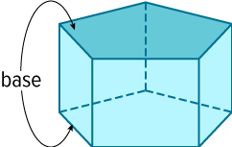
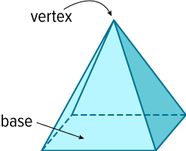
Learn
Identifying Three-Dimensional Figures
Types of Solids
A prism is a polyhedron that has two parallel congruent bases, connected by parallelogram faces.
A pyramid is a polyhedron that has a polygonal base and three or more triangular faces that meet at a common vertex. A regular pyramid has a base that is a regular polygon.

Slide 9
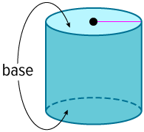
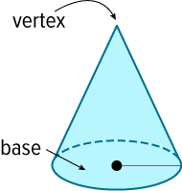
Learn
Identifying Three-Dimensional Figures
Types of Solids
A cylinder is a solid figure that has two congruent and parallel circular bases connected by a curved surface.
A cone is a solid figure that has a circular base connected by a curved surface to a single vertex.

Slide 10
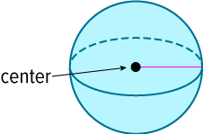
Learn
Identifying Three-Dimensional Figures
Types of Solids
A sphere is a set of all points in space equidistant from a given point called the center of the sphere. A sphere has no faces, edges, or vertices.

Slide 11
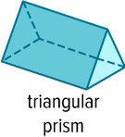


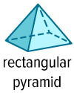

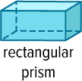
Learn
Identifying Three-Dimensional Figures
Polyhedra, or polyhedrons, are named by the shapes of their bases.
Types of Solids

Slide 12
Learn
Identifying Three-Dimensional Figures
A polyhedron is a regular polyhedron if all of its faces are regular congruent polygons and all of the edges are congruent. There are exactly five types of regular polyhedra, called Platonic solids because Plato used them extensively.

Slide 13



Learn
Identifying Three-Dimensional Figures
Platonic Solids
Tetrahedron | Hexahedron or Cube | Octahedron
4 equilateral triangular faces | 6 square faces | 8 equilateral triangular faces

Slide 14


Learn
Identifying Three-Dimensional Figures
Platonic Solids
Dodecahedron | Icosahedron
12 regular pentagonal faces | 20 equilateral triangular faces

Slide 15
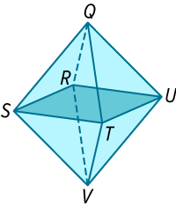
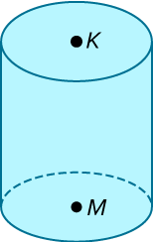
Example 1
Identify Properties of Three-Dimensional Figures
Determine whether each solid is a polyhedron. Then identify the solid. If it is a polyhedron, name the bases, faces, edges, and vertices.

Slide 16
Example 1
Identify Properties of Three-Dimensional Figures
The solid is formed by polygonal faces, so it is a polyhedron. There is no base, but the solid has 8 equilateral triangular faces, so it is an octahedron.

Slide 17
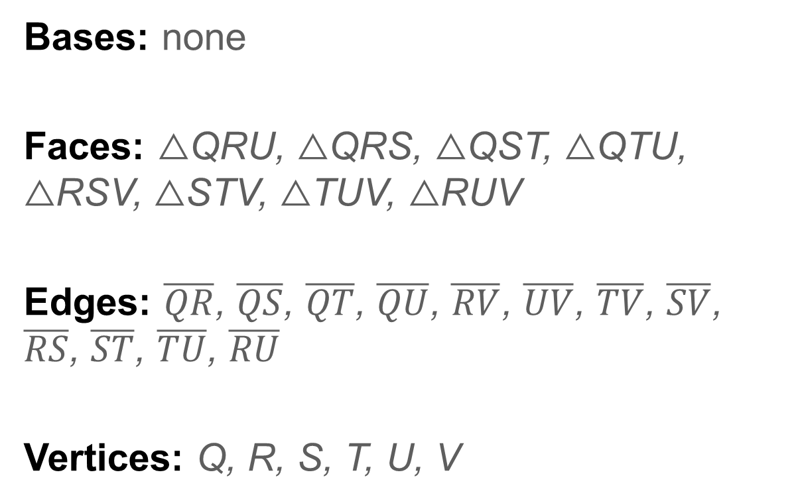
Example 1
Identify Properties of Three-Dimensional Figures
Bases: none
Faces: △QRU, △QRS, △QST, △QTU, △RSV, △STV, △TUV, △RUV
Edges: $\overline{QR}$, $\overline{QS}$, $\overline{QT}$, $\overline{QU}$, $\overline{RV}$, $\overline{UV}$, $\overline{TV}$, $\overline{SV}$, $\overline{RS}$, $\overline{ST}$, $\overline{TU}$, $\overline{RU}$
Vertices: Q, R, S, T, U, V

Slide 18
Example 1
Identify Properties of Three-Dimensional Figures
The solid has a curved surface, so it is not a polyhedron. It has two congruent and parallel circular bases, so it is a cylinder.

Slide 19
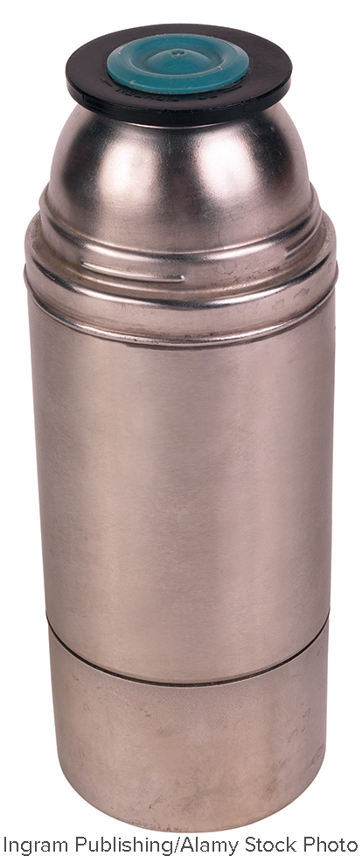
Example 2
Model Three-Dimensional Figures
Identify the three-dimensional figure that can model the beverage container. State whether the model is a polyhedron.

Slide 20
Example 2
Model Three-Dimensional Figures
The beverage container can be modeled by a cylinder. Because the model has a curved surface it is not a polyhedron.

Slide 21
Learn
Measuring Three-Dimensional Figures
Often a geometric figure is used to model a real-world object to estimate a measurement. Surface area is the sum of the areas of all faces and side surfaces of a three-dimensional figure. Volume is the measure of the amount of space enclosed by a three-dimensional figure. The surface area of a right pyramid or right cone can be found by using the slant height of the figure. The slant height of a pyramid or cone is the length of a segment with one endpoint on the base edge of the figure and the other at the vertex.

Slide 22
Learn
Measuring Three-Dimensional Figures
To find the surface area or volume of a sphere, you must use the radius or diameter of the sphere. The radius of a sphere is a line segment from the center to a point on the sphere. The diameter of a sphere is a line segment that passes through the center of the sphere with endpoints on the sphere.

Slide 23
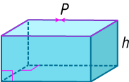
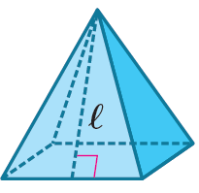

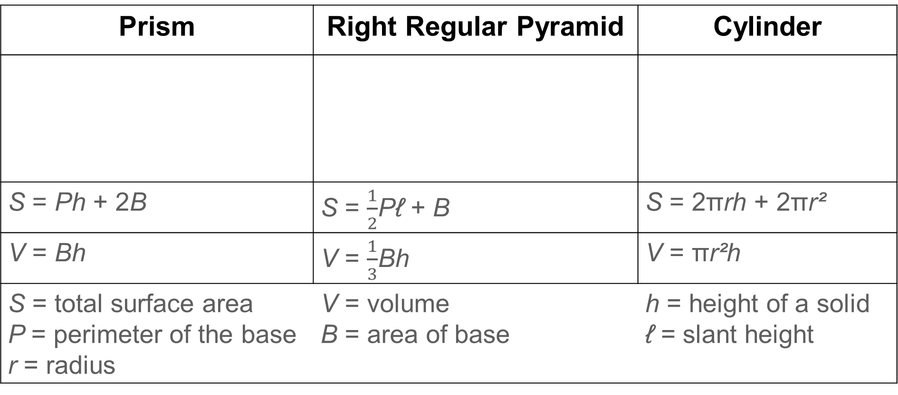
Learn
Measuring Three-Dimensional Figures
Prism | Right Regular Pyramid | Cylinder
S = Ph + 2B | S = $\frac{1}{2}$Pℓ + B | S = 2πrh + 2πr²
V = Bh | V = $\frac{1}{3}$Bh | V = πr²h
S = total surface area P = perimeter of the base r = radius | V = volume B = area of base | h = height of a solid ℓ = slant height

Slide 24

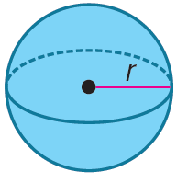
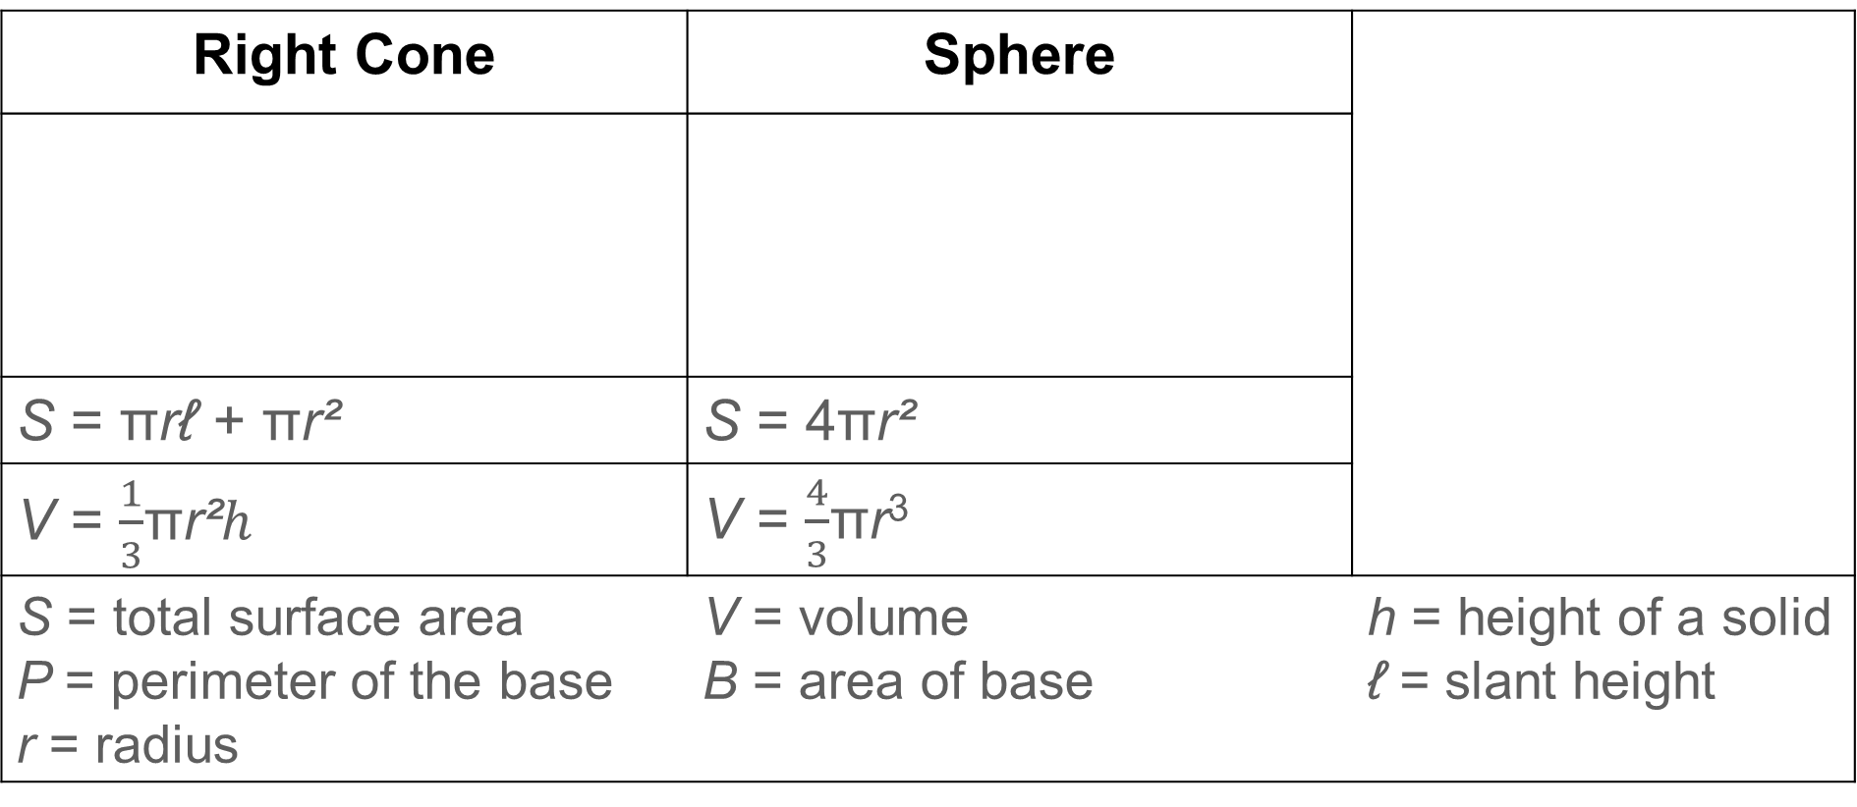
Learn
Measuring Three-Dimensional Figures
Right Cone | Sphere
S = πrℓ + πr² | S = 4πr²
V = $\frac{1}{3}$πr²ℎ | V = $\frac{4}{3}$πr³
S = total surface area P = perimeter of the base r = radius | V = volume B = area of base | h = height of a solid ℓ = slant height

Slide 25

Example 3
Find Measurements of Three-Dimensional Figures
Find the surface area and volume of the cone. Round each measure to the nearest tenth, if necessary.

Slide 26
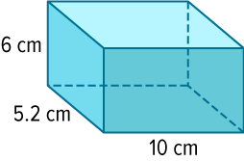
Example 3
Find Measurements of Three-Dimensional Figures
Check
Find the surface area and volume of the rectangular prism. Round each measure to the nearest tenth, if necessary.

Slide 27
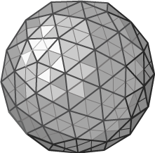
Example 4
Calculate Measurements by Using
Three-Dimensional Models
NEW YEAR’S EVE The New Year’s Eve ball is a geodesic sphere that is 12 feet in diameter. It weighs 11,875 pounds, is lit by 32,256 LED lights, and is covered with 2688 crystal triangles.
Part A How many lights are contained on the ball’s surface within an area of 4 square feet?
Part B Tony is repairing a section of the ball that has a volume of 8 cubic feet. How much does the section weigh?

Slide 28
Example 4
Calculate Measurements by Using
Three-Dimensional Models
Part A How many lights are contained on the ball’s surface within an area of 4 square feet?
Step 1 Find the surface area of the ball.
Because the diameter is 12 feet, the radius of the sphere is 6 feet.
S = 4πr² | Surface area of a sphere
= 4π(6)² | r = 6
= 144π or about 452.4 | Use a calculator.
The surface area of the ball is about 452.4 square feet.

Slide 29
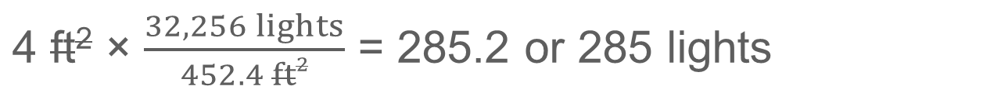
Example 4
Calculate Measurements by Using
Three-Dimensional Models
Step 2 Determine the number of lights within an area of 4 square feet.
4 ft² × $\frac{32,256 lights}{452.4 ft2}$ = 285.2 or 285 lights
There are about 285 lights within an area of 4 square feet.

Slide 30
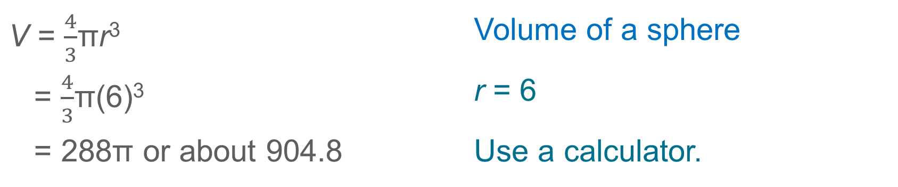
Example 4
Calculate Measurements by Using
Three-Dimensional Models
Part B Tony is repairing a section of the ball that has a volume of 8 cubic feet. How much does the section weigh?
Step 1 Find the volume of the ball.
V = $\frac{4}{3}$πr³ | Volume of a sphere
= $\frac{4}{3}$π(6)³ | r = 6
= 288π or about 904.8 | Use a calculator.

Slide 31

Example 4
Calculate Measurements by Using
Three-Dimensional Models
Step 2 Determine the weight of the section.
8 ft³ × $\frac{11, 875 lb}{904.8 ft3}$ = 105.0
The section of the ball weighs about 105.0 pounds.

Slide 32
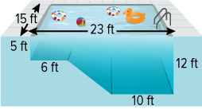
Example 4
Calculate Measurements by Using
Three-Dimensional Models
Check
POOLS Mateo’s family is building a new inground pool. A cross section of the pool is shown.

Slide 33
Example 4
Calculate Measurements by Using
Three-Dimensional Models
Part A What is the volume of the pool to the nearest tenth?
Part B Mateo’s family needs to install a protective liner to cover the walls and flat base of the deep end of the pool. How much liner is required to cover the deep end of the pool in square feet?
A. 570 ft² B. 750 ft² C. 900 ft² D. 1800 ft²

Slide 34
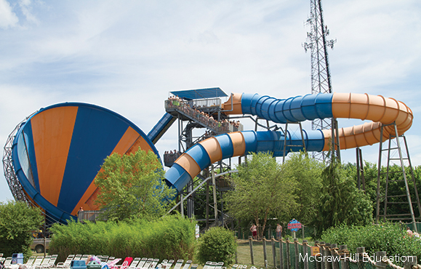
Apply Example 5
Solve for Unknown Values
WATER PARK Destiny visits a water park where a new cyclone water ride has opened. On the new ride, a tunnel flows into a large funnel. The slant height of the funnel is 29 meters, and the surface area of the funnel is 910 square meters. When the funnel is at its widest, what is the diameter? Round your answer to the nearest tenth.

Slide 35
Exit Ticket
1. Which two types of three-dimensional figures have circular bases?
2. Which two types of three-dimensional figures have only one base?
3. Which three-dimensional figure has five faces, one of which is a rectangular base and the others are triangles?

Slide 36
Exit Ticket
4. Which three-dimensional figure has two triangular faces and three rectangular faces?
5. Which three-dimensional figure has six square faces?

