Slide 1
Trigonometry 9-3B

Slide 2
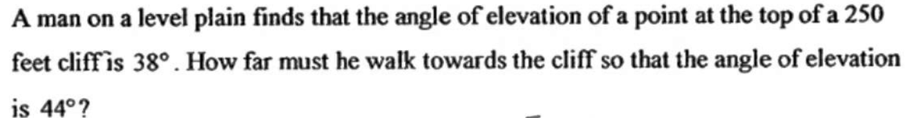
Warm Up

Slide 3
Florida’s B.E.S.T. Standards for Mathematics
MA.912.T.1.1
Define trigonometric ratios for acute angles in right triangles.
MA.912.T.1.2
Solve mathematical and real-world problems involving right triangles using trigonometric ratios and the Pythagorean Theorem.

Slide 4
Florida’s Mathematical Thinking and Reasoning Standards
MA.K12.MTR.2.1
Demonstrate understanding by representing problems in multiple ways.
MA.K12.MTR.4.1
Engage in discussions that reflect on the mathematical thinking of self and others.
MA.K12.MTR.5.1
Use patterns and structure to help understand and connect mathematical concepts.

Slide 5
Lesson Objectives
Content Objective
Students will solve problems using the trigonometric ratios and inverse trigonometric ratios for acute angles.
Language Objectives
Students talk about solving problems using the trigonometric ratios and inverse trigonometric ratios for acute angles with distance, length, and angle
To support sense-making, students participate in MLR2: Collect and Display.

Slide 6
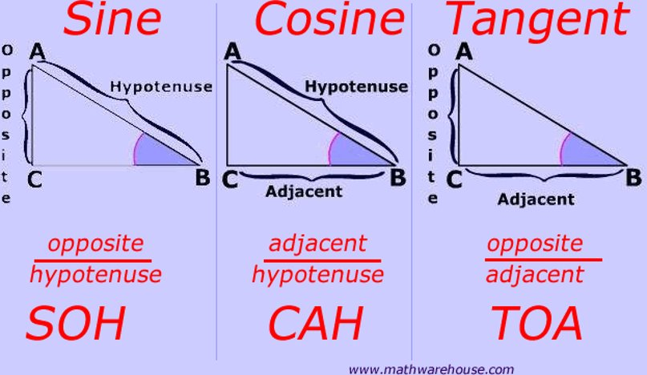
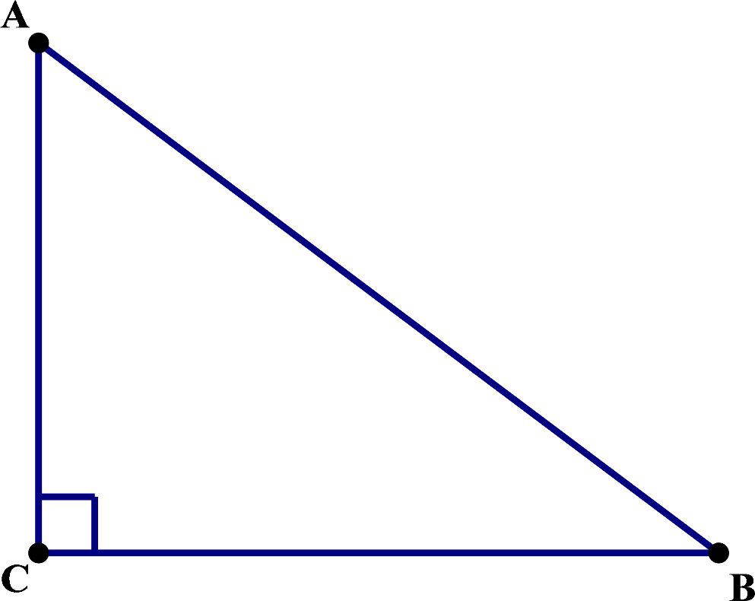

Slide 7
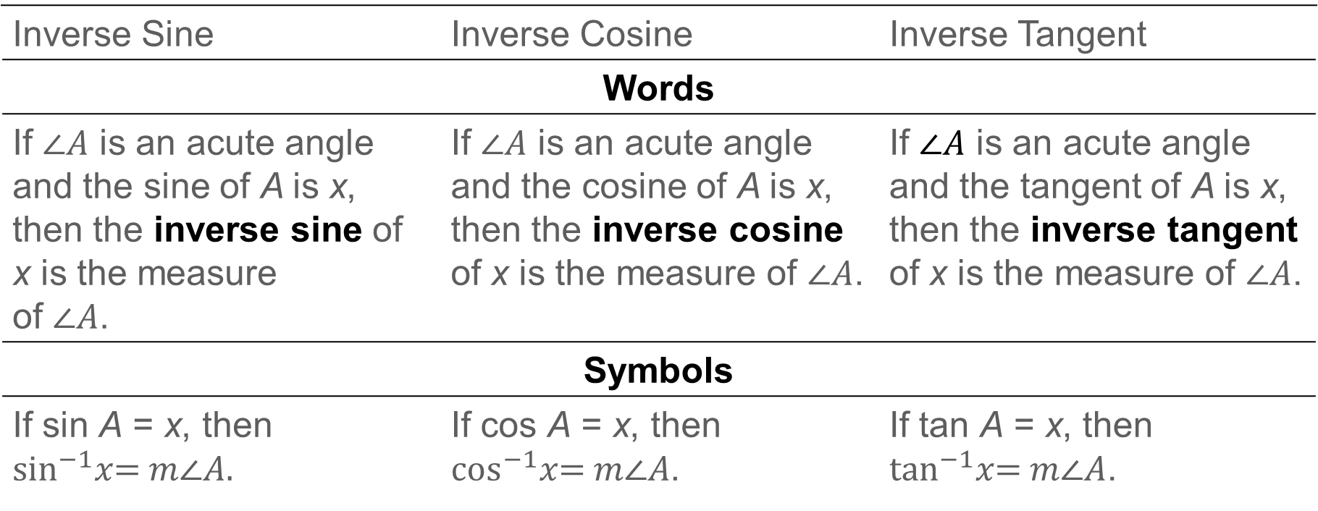
Learn
Inverse Trigonometric Ratios
Key Concept: Inverse Trigonometric Ratios
Inverse Sine | Inverse Cosine | Inverse Tangent
 | Words
If $\text{∠}A$ is an acute angle and the sine of A is x, then the inverse sine of x is the measure of $\text{∠}A$. | If $\text{∠}A$ is an acute angle and the cosine of A is x, then the inverse cosine of x is the measure of $\text{∠}A$. | If $\text{∠}A$ is an acute angle and the tangent of A is x, then the inverse tangent of x is the measure of $\text{∠}A$.
 | Symbols
If sin A = x, then $$\sin^{−1}x\text{=} m\text{∠}A.$$ | If cos A = x, then $\cos^{−1}x\text{=} m\text{∠}A$. | If tan A = x, then $\tan^{−1}x\text{=} m\text{∠}A$.

Slide 8
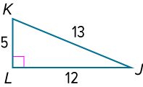
Example 1
Find Trigonometric Ratios
Find m< J and m< K.

Slide 9
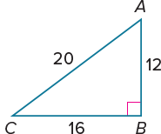
Example 2
Find Trigonometric Ratios
Check
Find the measurement of < A and < C.

Slide 10

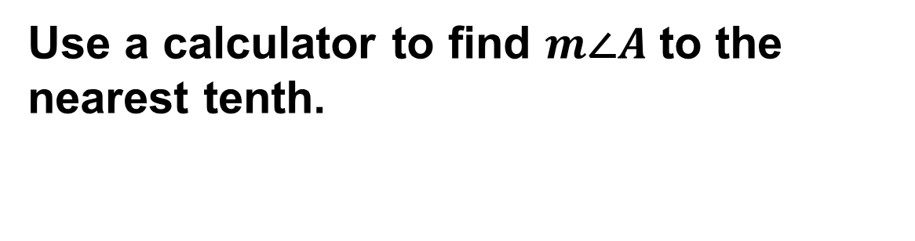
Example 3
Find Angle Measures by Using Inverse Trigonometric Ratios
Use a calculator to find $m\text{∠}A$ to the nearest tenth.

Slide 11
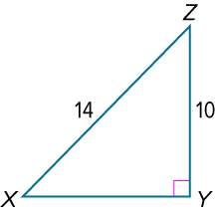
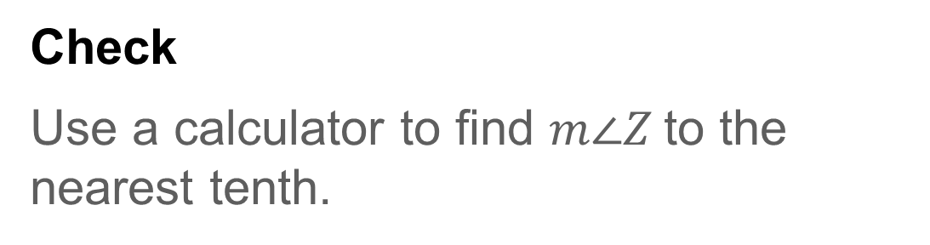
Example 4
Find Angle Measures by Using Inverse Trigonometric Ratios
Check
Use a calculator to find $m\text{∠}Z$to the nearest tenth.

Slide 12
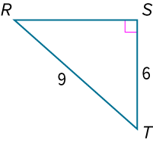
Example 5
Solve a Right Triangle
Solve the right triangle. Round side and angle measures to the nearest tenth.

Slide 13
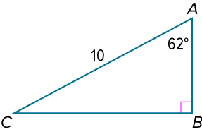
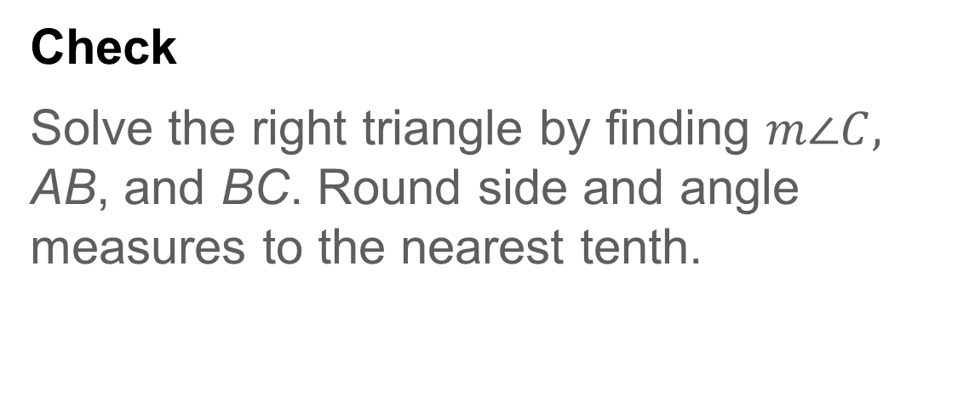
Example 6
Solve a Right Triangle
Check
Solve the right triangle by finding $m\text{∠}C,$ AB, and BC. Round side and angle measures to the nearest tenth.

Slide 14
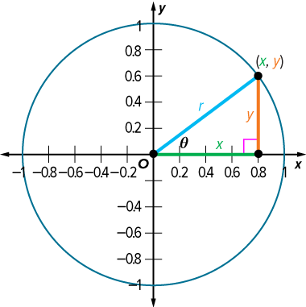
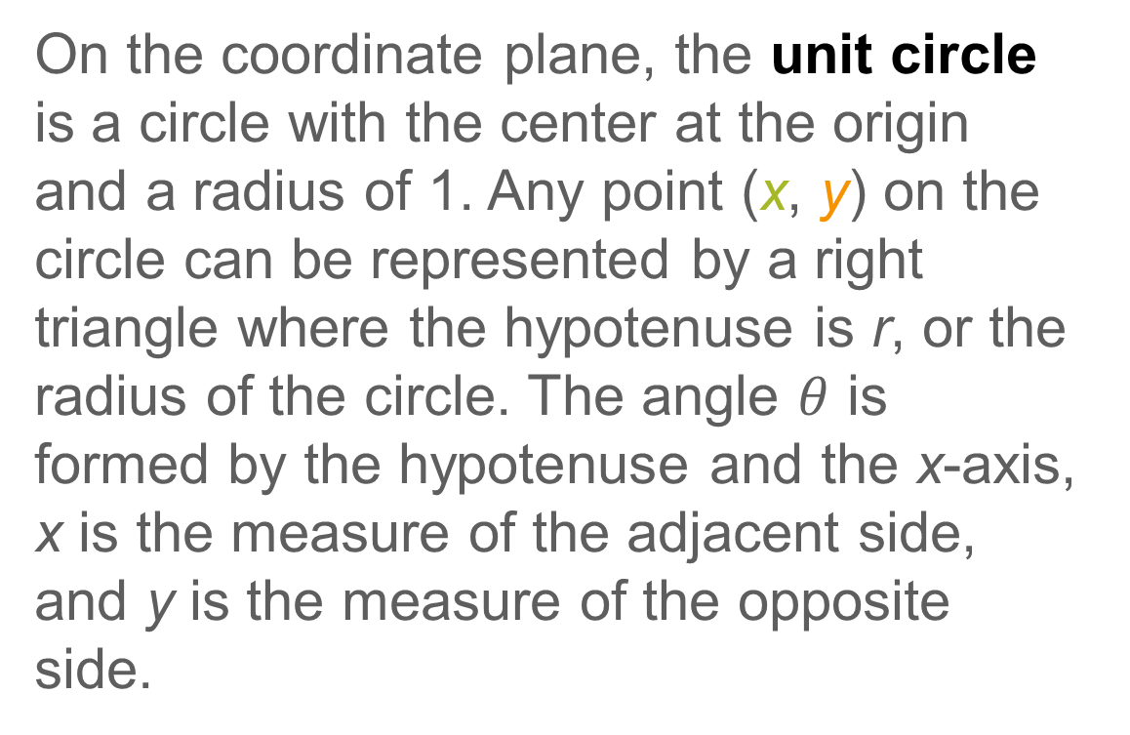
Learn
Trigonometric Ratios on the Coordinate Plane
On the coordinate plane, the unit circle is a circle with the center at the origin and a radius of 1. Any point (x, y) on the circle can be represented by a right triangle where the hypotenuse is r, or the radius of the circle. The angle $θ$ is formed by the hypotenuse and the x-axis, x is the measure of the adjacent side, and y is the measure of the opposite side.

Slide 15
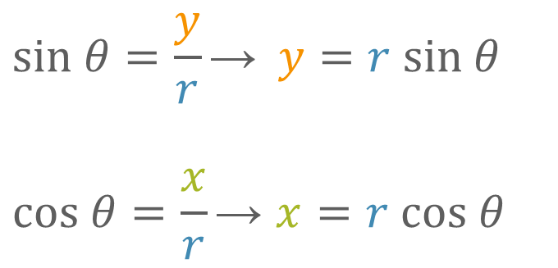

Learn
Trigonometric Ratios on the Coordinate Plane
The trigonometric ratios can then be rewritten.
$$sin θ=\frac{y}{r}\text{→} y=r sin θ$$
$$cos θ=\frac{x}{r}\text{→} x=r cos θ$$
Because r = 1, the trigonometric ratios simplify to $y=sin θ$ and $x= cos θ\text{.}$

Slide 16

Example 7
Use Trigonometric Ratios on the Coordinate Plane
A point on the unit circle has coordinates (−0.5, −0.866). Find $θ$.

Slide 17
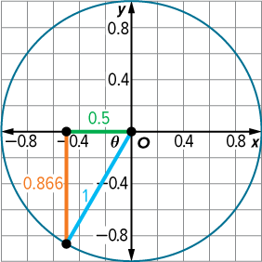
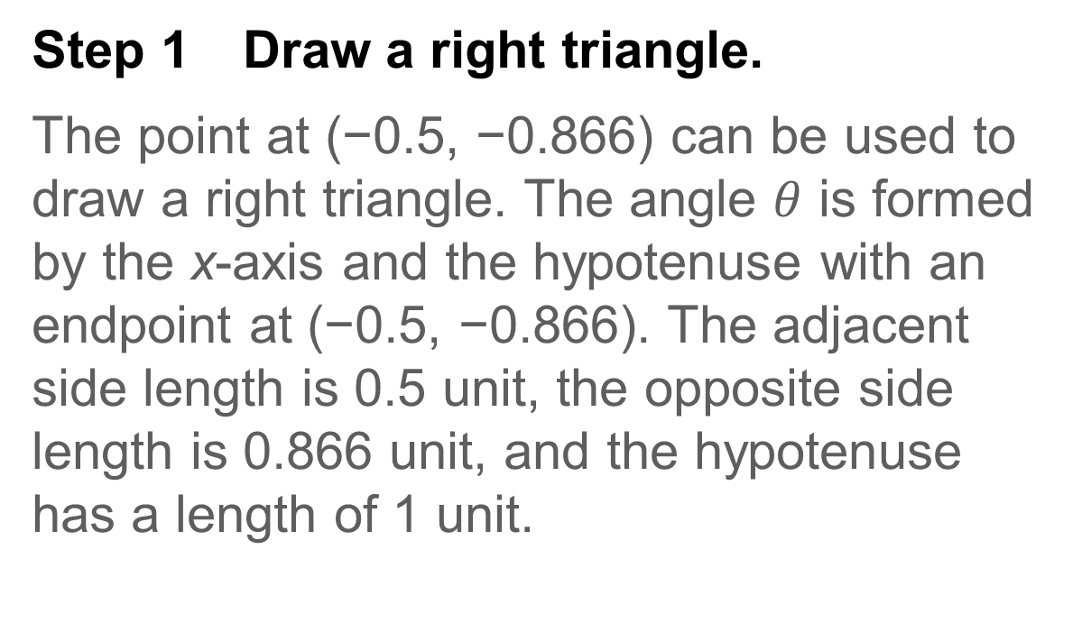
Example 6
Use Trigonometric Ratios on the Coordinate Plane
Step 1 Draw a right triangle.
The point at (−0.5, −0.866) can be used to draw a right triangle. The angle $θ$ is formed by the x-axis and the hypotenuse with an endpoint at (−0.5, −0.866). The adjacent side length is 0.5 unit, the opposite side length is 0.866 unit, and the hypotenuse has a length of 1 unit.

Slide 18
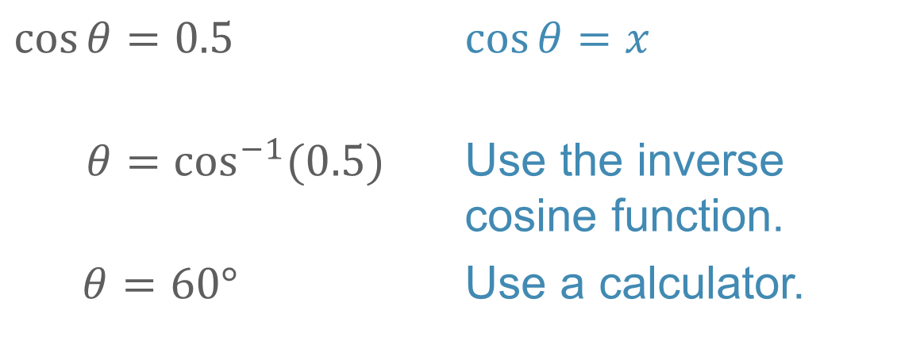
Example 6
Use Trigonometric Ratios on the Coordinate Plane
Step 2 Find θ.
$$\cos{θ}=0.5$$ | $$\cos{θ}=x$$
$$θ=\cos^{−1}{(0.5)}$$ | Use the inverse cosine function.
$$θ=60°$$ | Use a calculator.

Slide 19
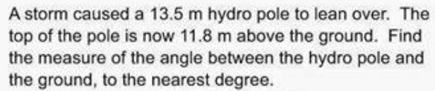
Exit Ticket

