Slide 1
2-3 Two-Dimensional Figures

Slide 2
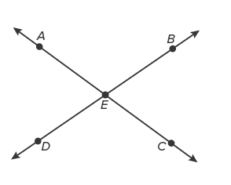
Warm Up
Complete each exercise.
1. What angles are supplementary to ∠AEB?
2. Name a pair of vertical angles.
3. If the measure of ∠AED is 70°, then what is the measure of ∠CEB?
4. What is the measure of ∠CED if the measure of ∠AED is 70°?
5. If two angles are supplementary, are they sometimes, always, or never congruent?

Slide 3
Florida’s B.E.S.T. Standards for Mathematics
MA.912.GR.3.4
Use coordinate geometry to solve mathematical and real-world problems on the coordinate plane involving perimeter or area of polygons.
MA.912.GR.4.4
Solve mathematical and real-world problems involving the area of two-dimensional figures.

Slide 4
Florida’s Mathematical Thinking and Reasoning Standards
MA.K12.MTR.6.1
Assess the reasonableness of solutions.
MA.K12.MTR.7.1
Apply mathematics to real-world contexts.

Slide 5
Lesson Objectives
Content Objective
Students model and find measures of two-dimensional objects.
Language Objectives
Students use can and could to talk about two-dimensional figures.
To optimize output, students participate in MLR5: Co-Craft Questions and Problems.

Slide 6
Learn pg.81
Perimeter, Circumference, and Area
A polygon is a closed plane figure with at least three straight sides.
The perimeter of a polygon is the sum of the lengths of the sides of the polygon. Some shapes have special formulas for perimeter, but all are derived from the basic definition of perimeter.
The circumference of a circle is the distance around the circle.
Area is the number of square units needed to cover a surface.

Slide 7
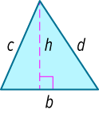
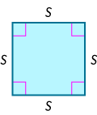
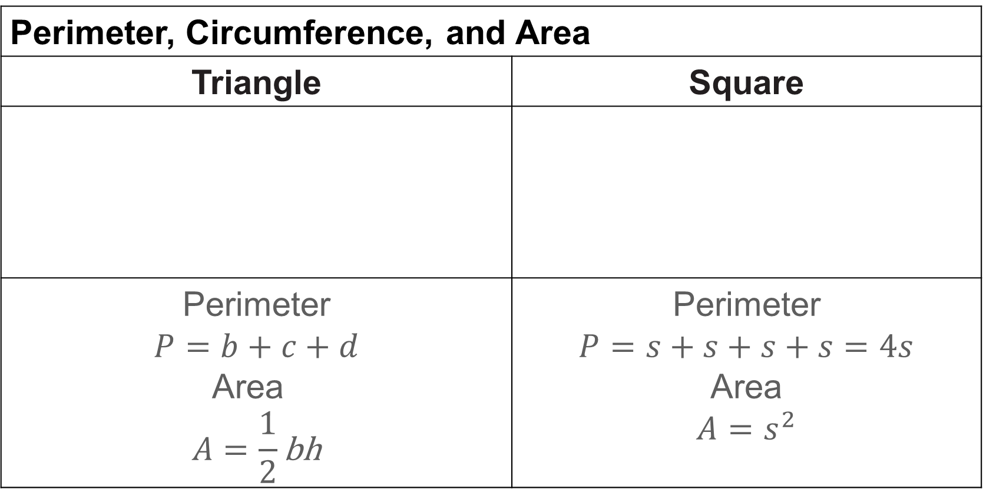
Learn pg. 81
Perimeter, Circumference, and Area
Perimeter, Circumference, and Area
Triangle | Square
Perimeter $$P=b+c+d$$ Area $$A=\frac{1}{2}\text{bh}$$ | Perimeter $$P=s+s+s+s=4s$$ Area $$A=s^{2}$$

Slide 8
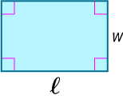
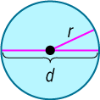
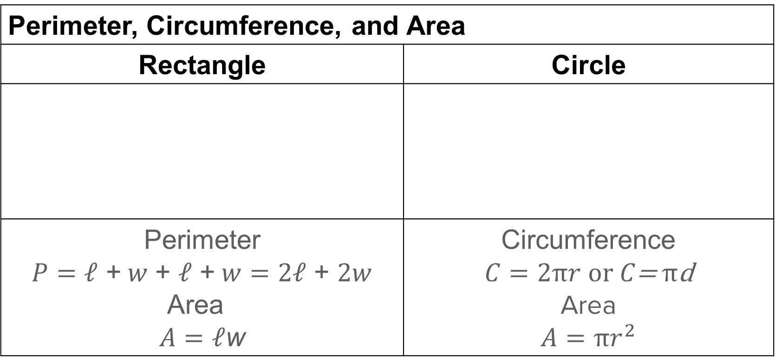
Learn pg. 81
Perimeter, Circumference, and Area
Perimeter, Circumference, and Area
Rectangle | Circle
Perimeter $$P=\text{𝓁}\text{ +} w\text{ + }\text{𝓁}\text{ +} w=\text{2}\text{𝓁}\text{ + }2w$$ Area $$A=\text{𝓁}\text{w}$$ | Circumference $$C=2πr or C\text{= }π\text{d}$$ Area $$A=πr^{2}$$

Slide 9
Learn pg. 81
Perimeter, Circumference, and Area
You can use the Distance Formula to find the perimeter and area of a polygon graphed on a coordinate plane. You can also use the Distance Formula to calculate the radius of a circle and then use the appropriate equations for circumference and area.
An equilateral polygon has all sides congruent. An equiangular polygon has all angles congruent. A regular polygon is a convex polygon that is both equilateral and equiangular.

Slide 10
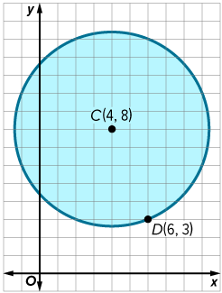
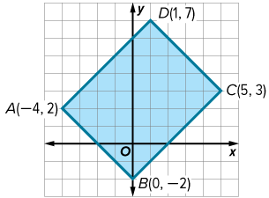
Example 1 pg. 83
Find Perimeter, Circumference, and Area
Find the perimeter or circumference and area of each figure.
Rectangle ABCD
Circle C

Slide 11
Learn pg. 84
Modeling with Two-Dimensional Figures
A geometric model is a geometric figure that represents a real-world object. A good model shows all the important characteristics of the object it represents, although some of the detail may be lost.
Drafters use two-dimensional geometric models to create technical drawings that communicate an object’s function or construction. Scientists may use two-dimensional models to record an object’s general shape or mechanics in a field notebook. You can use two-dimensional models to estimate the perimeter, circumference, and area of objects.

Slide 12
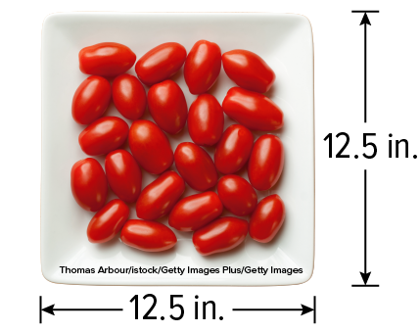
Example 2 pg. 84
Modeling with Two-Dimensional Figures
TABLEWARE Use an appropriate two-dimensional model and the dimensions provided in the image to calculate the perimeter and area of the serving platter.

Slide 13
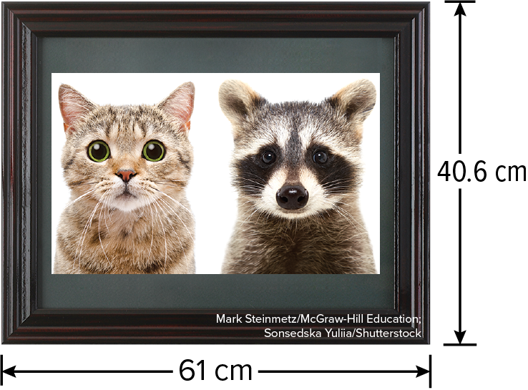
Example 2 pg. 84
Modeling with Two-Dimensional Figures
Check
FRAMES Use an appropriate two-dimensional model and the dimensions provided in the image to calculate the perimeter and area of the framed art.
What two-dimensional figure can be used to model the art?

Slide 14
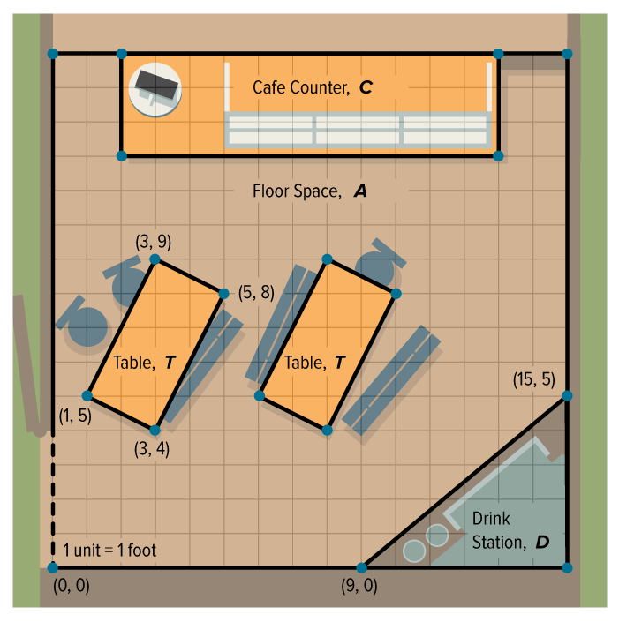
Example 3 pg. 85
Using a Two-Dimensional Model
BUSINESS Isaiah owns a small café.
Part A A new fire code states that there must be 15 square feet of free space for every customer in the café. How many people can be in the café?
Part B Isaiah wants to hang garland around the tables and the drink station. How much garland does Isaiah need?

Slide 15
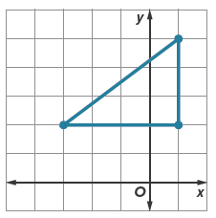
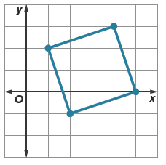
Exit Ticket
Find the exact perimeter or circumference and area of each figure.
1.
2.

Slide 16
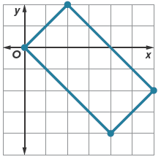
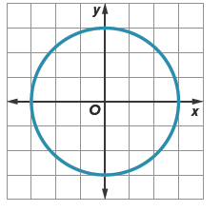
Exit Ticket
Find the exact perimeter or circumference and area of each figure.
3.
4.

