Slide 1
6-1 Perpendicular Bisectors

Slide 2
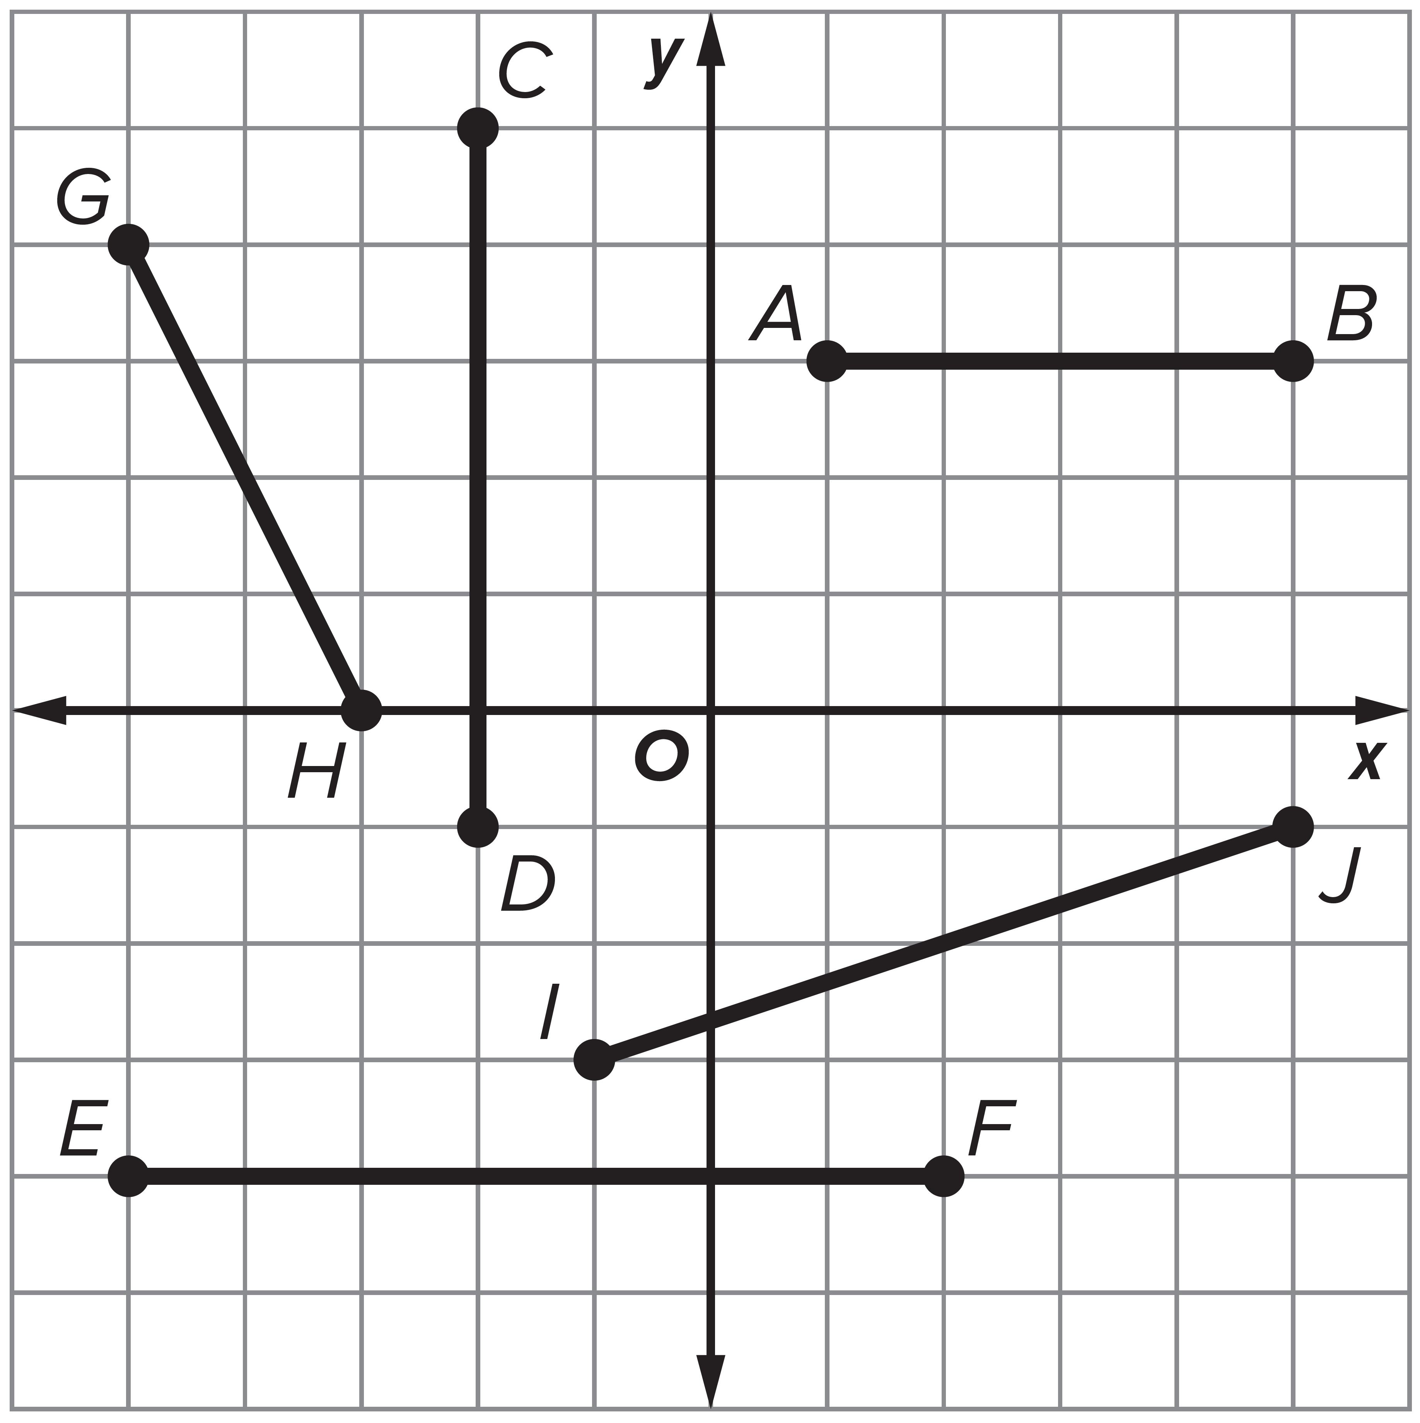
Warm Up
Visually determine the point that lies midway between each pair of points.
1. A and B
2. C and D
3. E and F
4. G and H
5. I and J

Slide 3
Warm Up
Visually determine the point that lies midway between each pair of points.
1. A and B (3, 3)
2. C and D (−2, 2)
3. E and F (−1.5, −4)
4. G and H (−4, 2)
5. I and J (2, −2)
Notes:
(3, 3)
(−2, 2)
(−1.5, −4)
(−4, 2)
(2, −2)

Slide 4
Florida’s B.E.S.T. Standards for Mathematics
MA.912.GR.1.1 Prove relationships and theorems about lines and angles. Solve mathematical and real-world problems involving postulates, relationships and theorems of lines and angles.
MA.912.GR.3.3 Use coordinate geometry to solve mathematical and real-world geometric problems involving lines, circles, triangles and quadrilaterals.
MA.912.GR.5.2 Construct the bisector of a segment or an angle, including the perpendicular bisector of a line segment.

Slide 5
Florida’s Mathematical Thinking and Reasoning Standards
MA.K12.MTR.3.1
Complete tasks with mathematical fluency.
MA.K12.MTR.4.1
Engage in discussions that reflect on the mathematical thinking of self and others.
MA.K12.MTR.6.1
Assess the reasonableness of solutions.

Slide 6
Lesson Objectives
Content Objective
Students solve problems using perpendicular bisectors in triangles.
Language Objectives
Students talk about solving problems involving perpendicular bisectors and the circumcenter of a triangle using will and would.
To support sense-making, students participate in MLR2: Collect and Display.

Slide 7
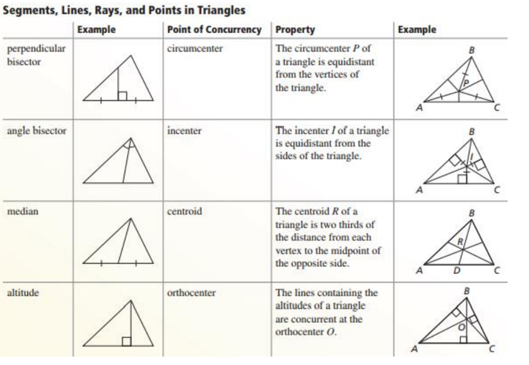

Slide 8
Learn
Perpendicular Bisectors of Segments
A perpendicular bisector is a line, segment, or ray that passes through the midpoint of a segment and is perpendicular to that segment.
You can use various tools to construct the perpendicular bisector of a segment. To use string, start by wrapping the end of the string around a pencil. Use a thumbtack to fix the string to a point.

Slide 9
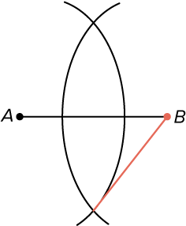
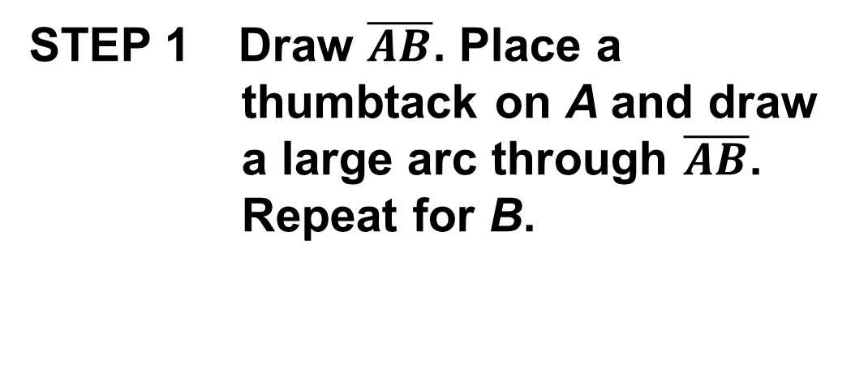
Learn
Perpendicular Bisectors of Segments
Construction: Perpendicular Bisector of a Segment
STEP 1 Draw $\overline{AB}$. Place a thumbtack on A and draw a large arc through $\overline{AB}$. Repeat for B.

Slide 10
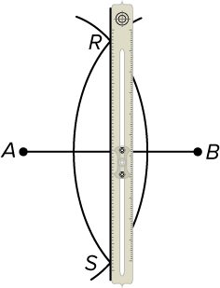
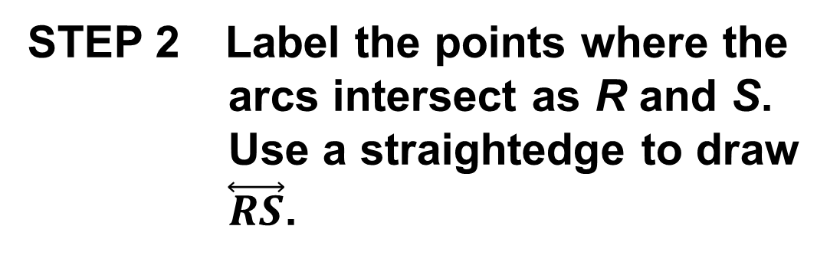
Learn
Perpendicular Bisectors of Segments
STEP 2 Label the points where the arcs intersect as R and S. Use a straightedge to draw $\overset{⃡}{RS}$.

Slide 11
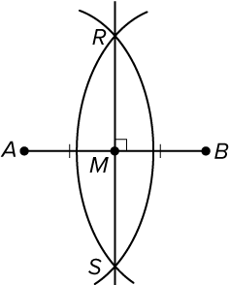
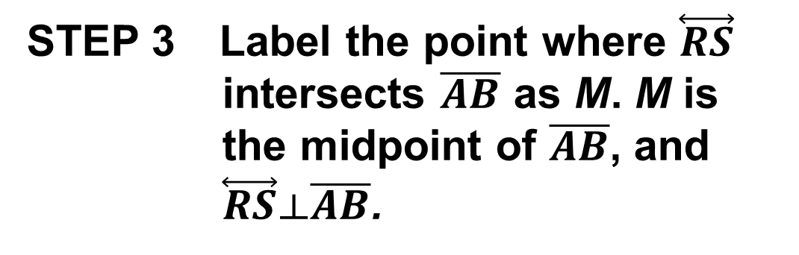
Learn
Perpendicular Bisectors of Segments
STEP 3 Label the point where $\overset{⃡}{RS}$ intersects $\overline{AB}$ as M. M is the midpoint of $\overline{AB}$, and $\overset{⃡}{RS}⟂\overline{AB}$.

Slide 12
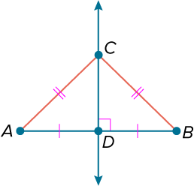
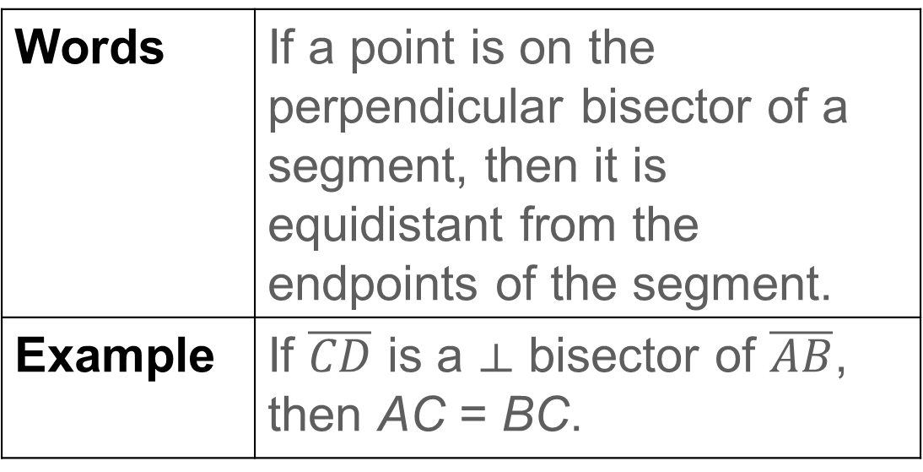
Learn
Perpendicular Bisectors of Segments
Theorem 6.1: Perpendicular Bisector Theorem
Words | If a point is on the perpendicular bisector of a segment, then it is equidistant from the endpoints of the segment.
Example | If $\overline{CD}$ is a ⟂ bisector of $\overline{AB}$, then AC = BC.

Slide 13
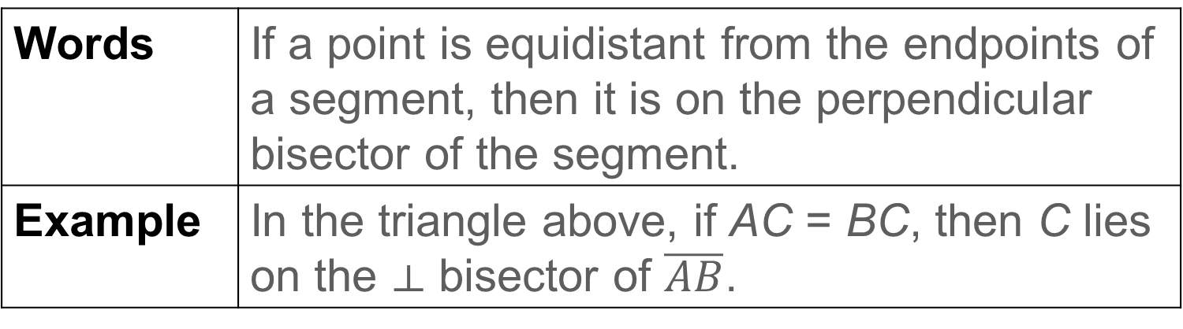
Learn
Perpendicular Bisectors of Segments
Theorem 6.2: Converse of the Perpendicular Bisector Theorem
Words | If a point is equidistant from the endpoints of a segment, then it is on the perpendicular bisector of the segment.
Example | In the triangle above, if AC = BC, then C lies on the ⟂ bisector of $\overline{AB}$.

Slide 14
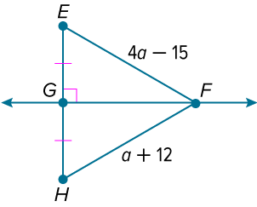
Example 1
Use the Perpendicular Bisector Theorem
Find EF.

Slide 15
Example 1
Use the Perpendicular Bisector Theorem
$\overset{⃡}{FG}$ is the perpendicular bisector of $\overline{EH}$.
EF | = HF | Perpendicular Bisector Theorem
4a − 15 | = a + 12 | Substitution
a | = 9 | Solve.
So, EF = 4(9) − 15 or 21.

Slide 16
Example 1
Use the Perpendicular Bisector Theorem
Think About It!
Is your answer reasonable? Explain.

Slide 17
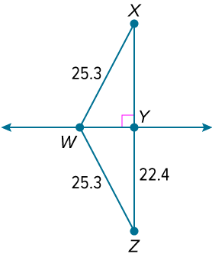
Example 2
Use the Converse of the Perpendicular Bisector Theorem
Find XY.

Slide 18
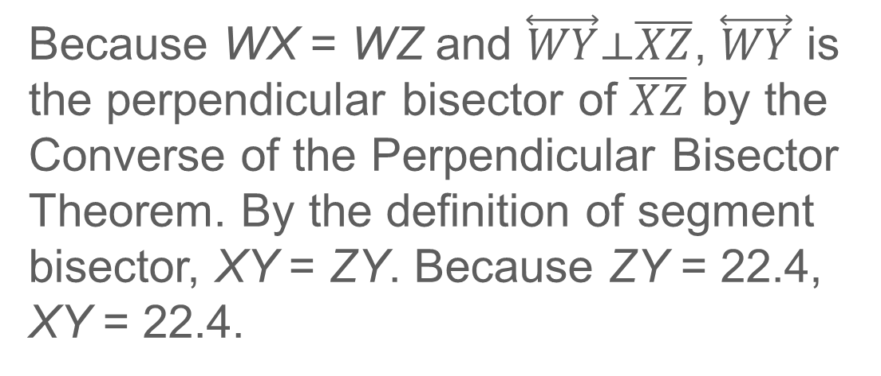
Example 2
Use the Converse of the Perpendicular Bisector Theorem
Because WX = WZ and $\overset{⃡}{WY}⟂\overline{XZ}$, $\overset{⃡}{WY}$ is the perpendicular bisector of $\overline{XZ}$ by the Converse of the Perpendicular Bisector Theorem. By the definition of segment bisector, XY = ZY. Because ZY = 22.4, XY = 22.4.

Slide 19
Learn
Perpendicular Bisectors of Triangles
When three or more lines intersect at a common point, the lines are called concurrent lines. The point of intersection of concurrent lines is called the point of concurrency.
A triangle has three sides, so it also has three perpendicular bisectors. These bisectors are concurrent lines. The point of concurrency of the perpendicular bisectors of the sides of a triangle is called the circumcenter of the triangle.

Slide 20
Learn
Perpendicular Bisectors of Triangles
Theorem 6.3: Circumcenter Theorem
The perpendicular bisectors of a triangle intersect at a point called the circumcenter that is equidistant from the vertices of the triangle.

Slide 21
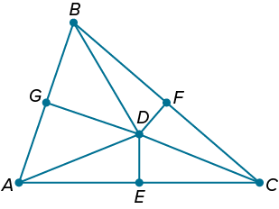
Example 3
Use the Circumcenter Theorem
Find BF if D is the circumcenter of △ABC, AC = 9, DE = 1.83, and DF = 1.53.

Slide 22
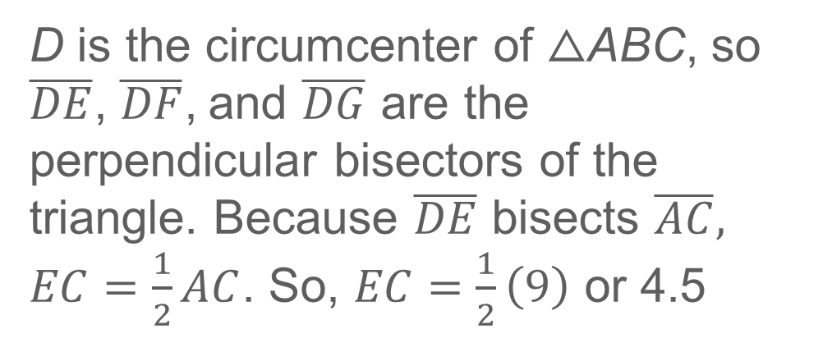
Example 3
Use the Circumcenter Theorem
D is the circumcenter of △ABC, so $\overline{DE}$, $\overline{DF}$, and $\overline{DG}$ are the perpendicular bisectors of the triangle. Because $\overline{DE}$ bisects $\overline{AC},$ $EC=\frac{1}{2}AC$. So, $EC=\frac{1}{2}\left(9\right)$ or 4.5

Slide 23
Example 3
Use the Circumcenter Theorem
Use the Pythagorean Theorem to find DC.
Because length cannot be negative, use the positive square root, 4.86.
c² | = a² + b² | Pythagorean Theorem
DC² | = 1.83² + 4.5² | Substitution
DC² | = 3.35 + 20.25 | Simplify.
DC² | = 23.60 | Add.
DC | ≈ ±4.86 | Take the square root of each side.

Slide 24
Example 3
Use the Circumcenter Theorem
By the Circumcenter Theorem, DC = DB. So, DB ≈ 4.86. Because DB ≈ 4.86 and DF = 1.53, we can use the Pythagorean Theorem to find BF.
a² + b² | = c² | Pythagorean Theorem
1.53² + BF² | = 4.86² | Substitution
2.34 + BF² | = 23.62 | Simplify.
BF² | = 21.28 | Subtract.
BF | = ±4.61 | Take the square root of each side.
The length of the segment must be positive, so BF ≈ 4.61.

Slide 25
Example 3
Use the Circumcenter Theorem
Talk About It!
Determine whether the statement is sometimes, always, or never true. Justify your argument.
The perpendicular bisectors of a triangle intersect at a point that is equidistant from the sides of the triangle.

Slide 26
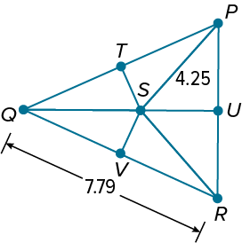
Example 3
Use the Circumcenter Theorem
Check
Find SV if S is the circumcenter of △QPR, QR = 7.79, and PS = 4.25. If necessary, round your answer to the nearest tenth.

Slide 27
Example 3
Use the Circumcenter Theorem
Check
Find SV if S is the circumcenter of △QPR, QR = 7.79, and PS = 4.25. If necessary, round your answer to the nearest tenth.
SV = 1.7
Notes:
SV = 1.7

Slide 28
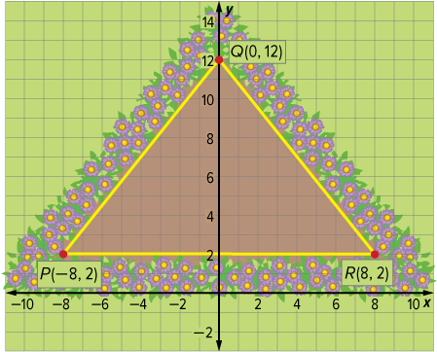
Example 4
Use Perpendicular Bisectors in Design Problems
GARDEN FOUNTAINS Alonzo wants to install a fountain in his triangular garden. Where should Alonzo place the fountain so it is equidistant from the vertices of the garden?

Slide 29
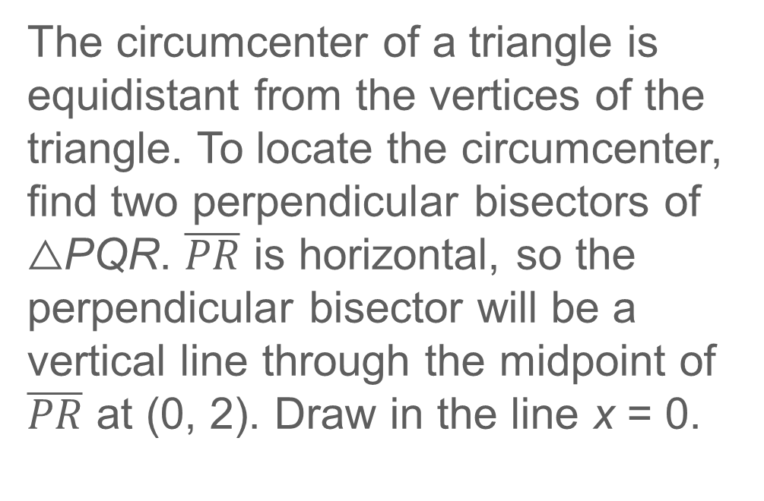
Example 4
Use Perpendicular Bisectors in Design Problems
The circumcenter of a triangle is equidistant from the vertices of the triangle. To locate the circumcenter, find two perpendicular bisectors of △PQR. $\overline{PR}$ is horizontal, so the perpendicular bisector will be a vertical line through the midpoint of $\overline{PR}$ at (0, 2). Draw in the line x = 0.

Slide 30
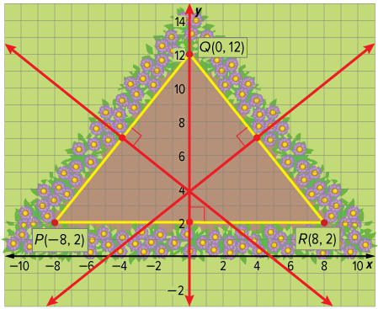
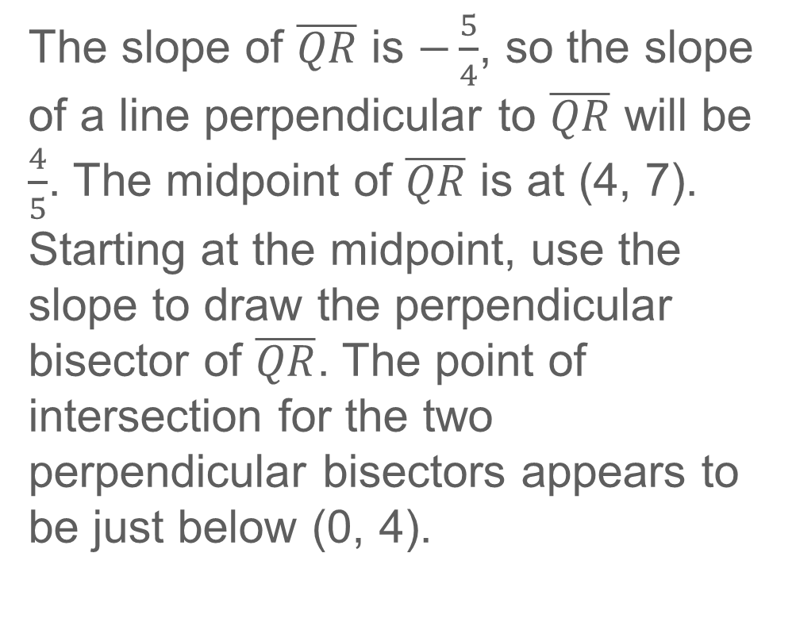
Example 4
Use Perpendicular Bisectors in Design Problems
The slope of $\overline{QR}$ is $−\frac{5}{4}$, so the slope of a line perpendicular to $\overline{QR}$ will be $\frac{4}{5}$. The midpoint of $\overline{QR}$ is at (4, 7). Starting at the midpoint, use the slope to draw the perpendicular bisector of $\overline{QR}$. The point of intersection for the two perpendicular bisectors appears to be just below (0, 4).

Slide 31
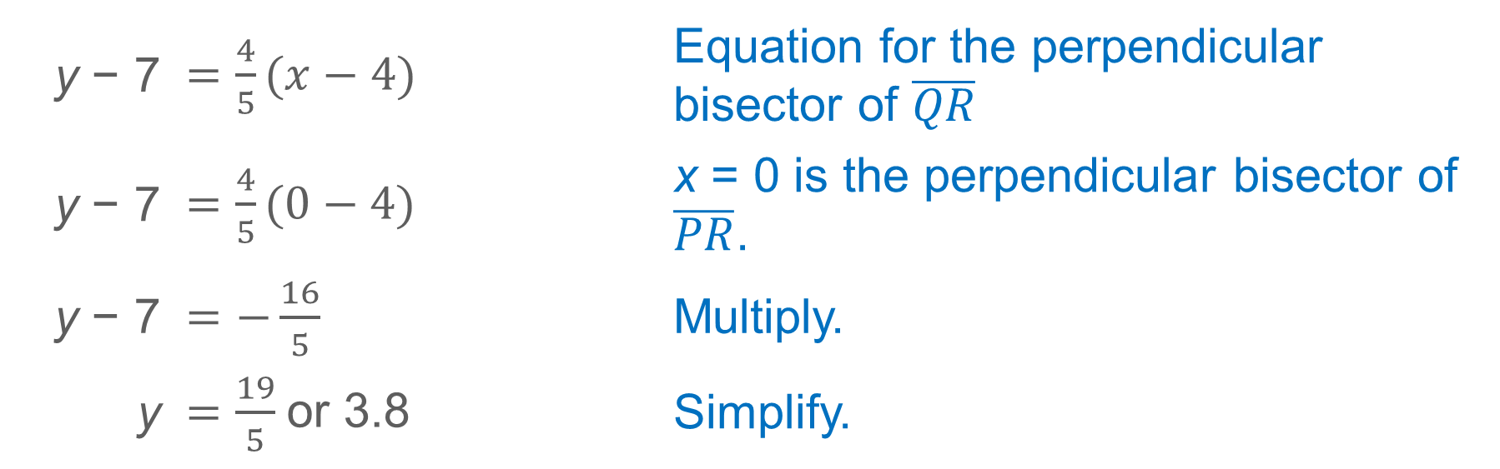
Example 4
Use Perpendicular Bisectors in Design Problems
Calculate the point of intersection using the equations of the two perpendicular bisectors.
y − 7 | $=\frac{4}{5}(x−4)$ | Equation for the perpendicular bisector of $\overline{QR}$
y − 7 | $=\frac{4}{5}(0−4)$ | x = 0 is the perpendicular bisector of $\overline{PR}$.
y − 7 | $=−\frac{16}{5}$ | Multiply.
y | $=\frac{19}{5}$or 3.8 | Simplify.

Slide 32
Example 4
Use Perpendicular Bisectors in Design Problems
This is close to my estimate of
(0, 4), so it is reasonable for the circumcenter, and Alonzo’s fountain, to be located at (0, 3.8).

Slide 33
Example 4
Use Perpendicular Bisectors in Design Problems
Talk About It!
Ask a classmate for feedback about your work. What could you do to improve the efficiency of your model or process?

Slide 34
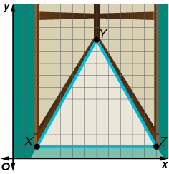
Example 4
Use Perpendicular Bisectors in Design Problems
Check
HOME IMPROVEMENT Lana wants to install a skylight in her bedroom. The section of roof where she plans to install the skylight has an incline and is triangular. The vertices of the roof are at X(2, 1), Y(7, 10), and Z(12, 1). Estimate where the center of the skylight should be located so that it is equidistant from the vertices of the roof. Then calculate the coordinates to the nearest tenth.

Slide 35
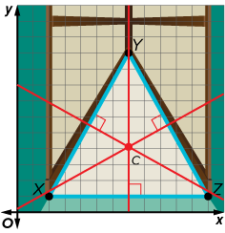
Example 4
Use Perpendicular Bisectors in Design Problems
Check
HOME IMPROVEMENT Lana wants to install a skylight in her bedroom. The section of roof where she plans to install the skylight has an incline and is triangular. The vertices of the roof are at X(2, 1), Y(7, 10), and Z(12, 1). Estimate where the center of the skylight should be located so that it is equidistant from the vertices of the roof. Then calculate the coordinates to the nearest tenth.
estimated: (7, 4)
calculated: (7, 4.1)
Notes:
estimated: (7, 4)
calculated: (7, 4.1)

Slide 36

Exit Ticket
Suppose you want to write the equation of the perpendicular bisector of $\overline{AC}$ in slope-intercept form.
1. What steps would you follow?

Slide 37
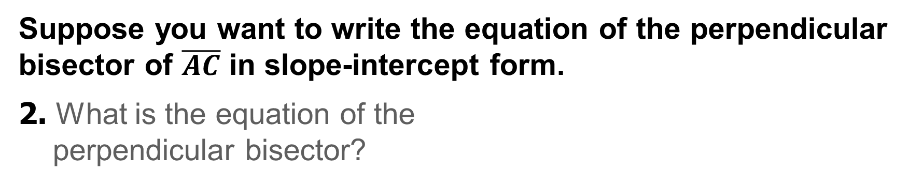
Exit Ticket
Suppose you want to write the equation of the perpendicular bisector of $\overline{AC}$ in slope-intercept form.
2. What is the equation of the
perpendicular bisector?

Slide 38
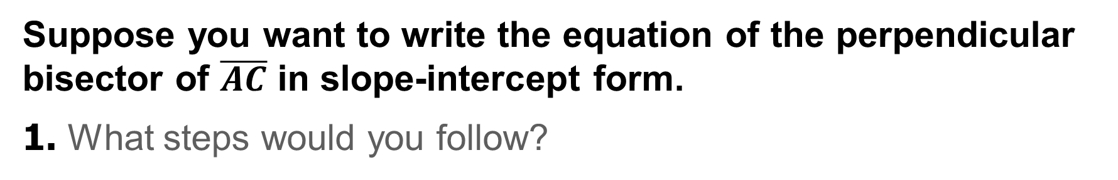
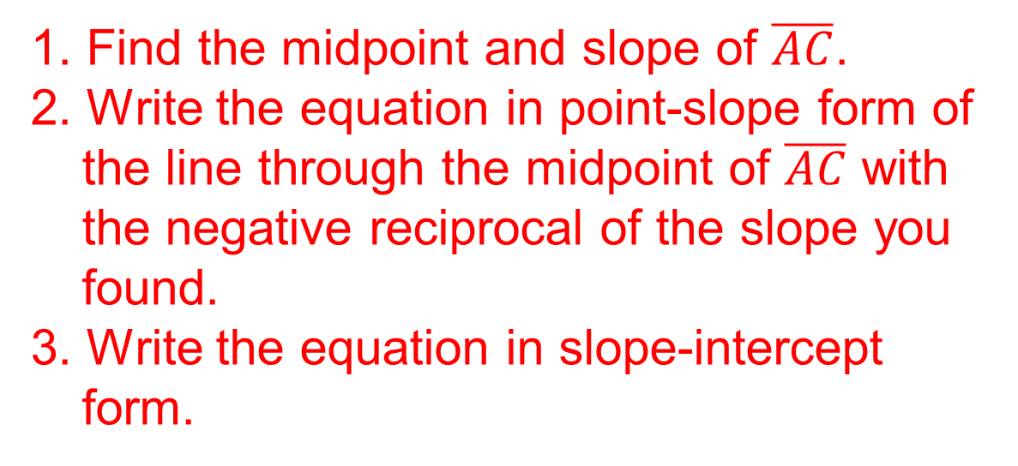
Exit Ticket
Suppose you want to write the equation of the perpendicular bisector of $\overline{AC}$ in slope-intercept form.
1. What steps would you follow?
1. Find the midpoint and slope of $\overline{AC}$.
2. Write the equation in point-slope form of the line through the midpoint of $\overline{AC}$ with the negative reciprocal of the slope you found.
3. Write the equation in slope-intercept form.
Notes:
1. Find the midpoint and slope of $\overline{AC}$.
2. Write the equation in point-slope form of the line through the midpoint of $\overline{AC}$ with the negative reciprocal of the slope you found.
3. Write the equation in slope-intercept form.

Slide 39
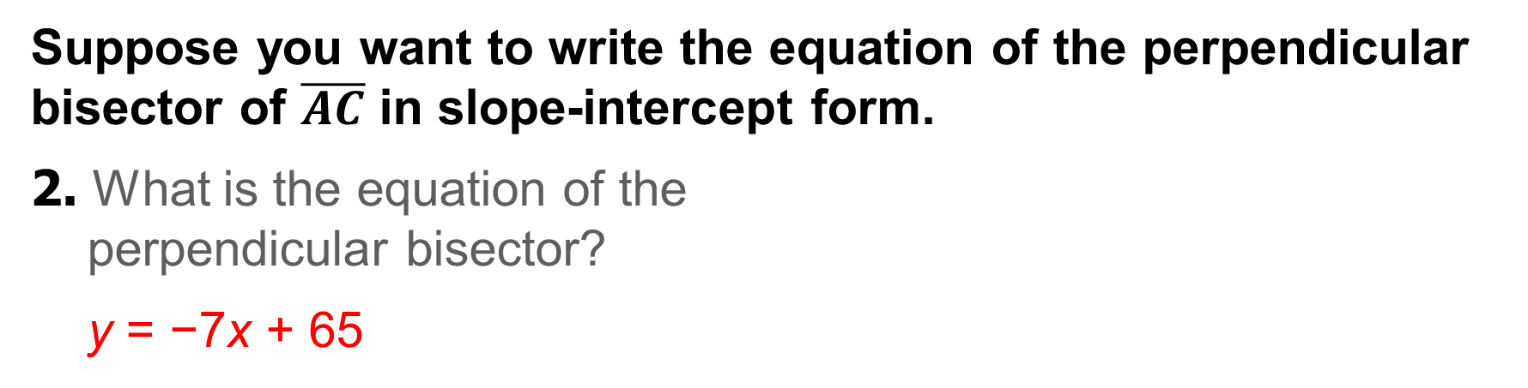
Exit Ticket
Suppose you want to write the equation of the perpendicular bisector of $\overline{AC}$ in slope-intercept form.
2. What is the equation of the
perpendicular bisector?
y = −7x + 65
Notes:
y = −7x + 65

