Slide 1
Section 4-1 Reflections

Slide 2
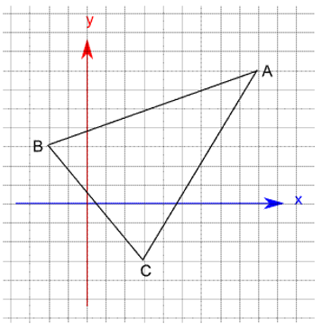
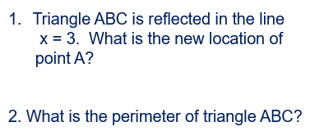
Warm Up

Slide 3
Florida’s B.E.S.T. Standards for Mathematics
MA.912.GR.2.1 Given a preimage and image, describe the transformation and represent the transformation algebraically using coordinates.
MA.912.GR.2.3 Identify a sequence of transformations that will map a given figure onto itself or onto another congruent or similar figure.

Slide 4
Florida’s Mathematical Thinking and Reasoning Standards
MA.K12.MTR.2.1
Demonstrate understanding by representing problems in multiple ways.

Slide 5
Lesson Objectives
Content Objective
Students will use rigid transformations to reflect figures on the coordinate plane and describe the effects of the reflections.
Language Objectives
Students use the same and the opposite to describe reflections from rigid transformations.
To cultivate conversation, students participate in MLR8: Discussion Supports.

Slide 6
Learn
Reflections
You’ve learned that when a figure is reflected in a line, each point on the preimage and its corresponding point on the image are the same distance from the line of reflection.

Slide 7
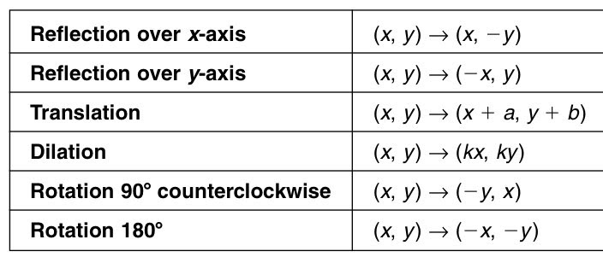
Rules for Transformations

Slide 8
Learn
Reflections
Key Concept: Reflection
Reflection in a Vertical Line
When a figure is reflected in a vertical line that is not the y-axis, the y-coordinates of the image remain the same as the preimage.
Reflection in a Horizontal Line
When a figure is reflected in a horizontal line that is not the x-axis, the x-coordinates of the image remain the same as the preimage.

Slide 9
Learn
Reflections
Key Concept: Reflection
Reflection in y = x
To reflect a point in the line y = x interchange the x- and y-coordinates;
(x, y) → (y, x).

Slide 10
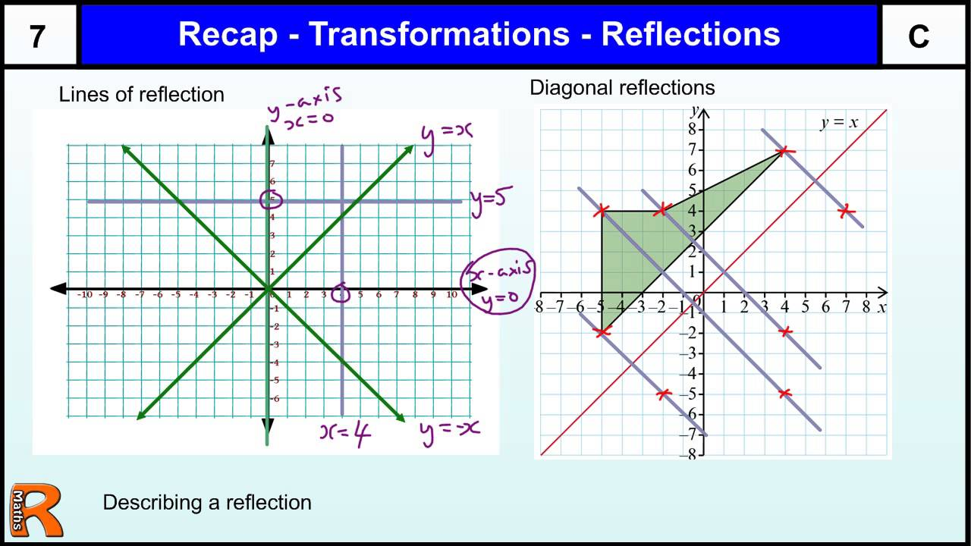

Slide 11
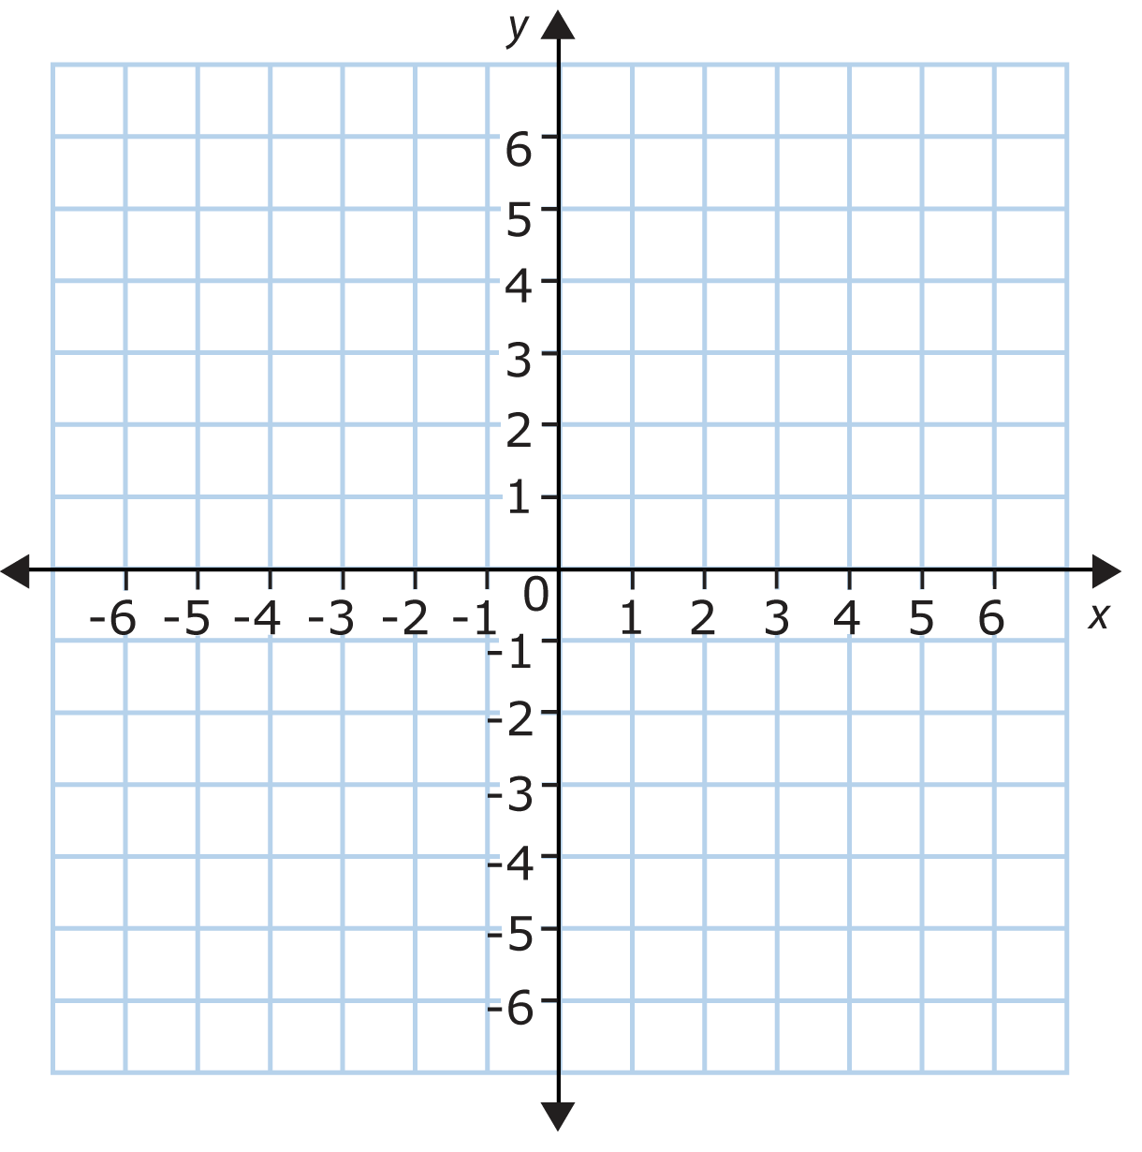
Y = x
Y = - x

Slide 12
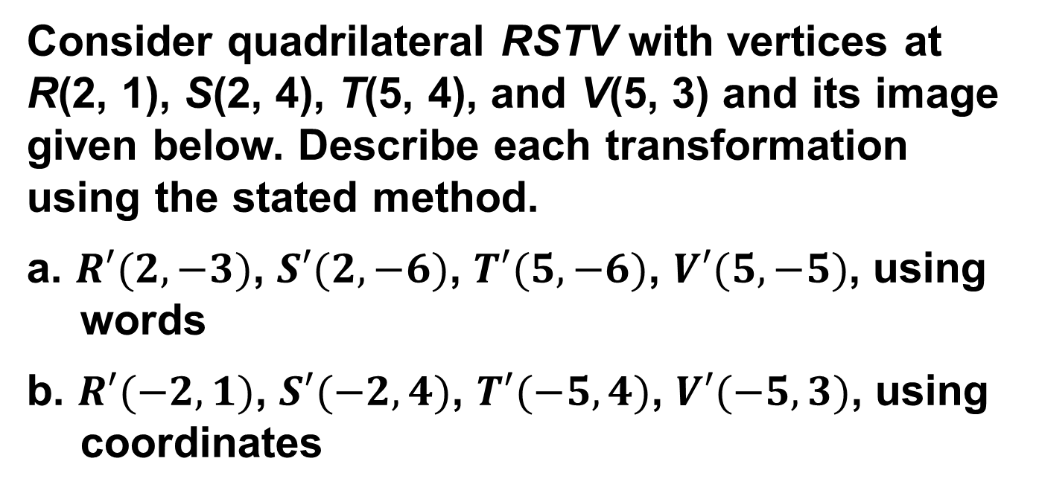
Example 1
Reflection in a Horizontal or Vertical Line
Consider quadrilateral RSTV with vertices at R(2, 1), S(2, 4), T(5, 4), and V(5, 3) and its image given below. Describe each transformation using the stated method.
a. $R′(2, −3)$, $S′(2, −6)$, $T′(5, −6)$, $V′(5, −5)$, using words
b. $R′(−2, 1)$, $S′(−2, 4)$, $T′(−5, 4)$, $V′(−5, 3)$, using coordinates

Slide 13
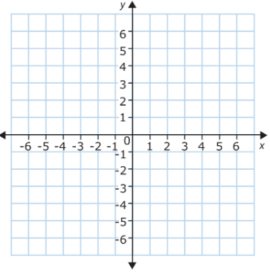
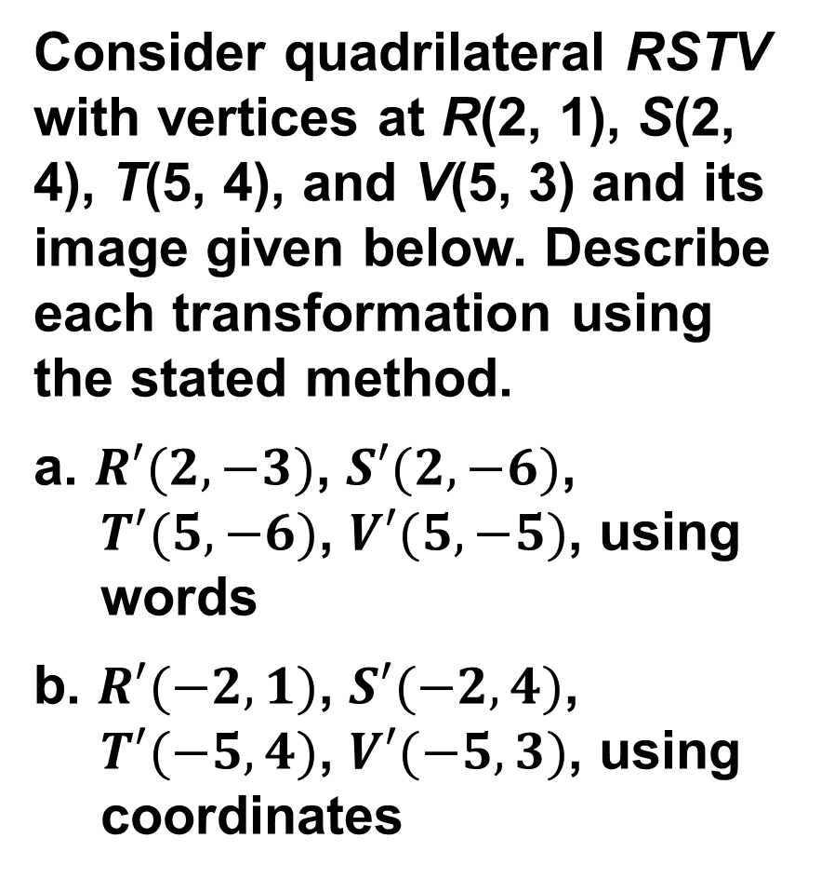
Consider quadrilateral RSTV with vertices at R(2, 1), S(2, 4), T(5, 4), and V(5, 3) and its image given below. Describe each transformation using the stated method.
a. $R′(2, −3)$, $S′(2, −6)$, $T′(5, −6)$, $V′(5, −5)$, using words
b. $R′(−2, 1)$, $S′(−2, 4)$, $T′(−5, 4)$, $V′(−5, 3)$, using coordinates

Slide 14
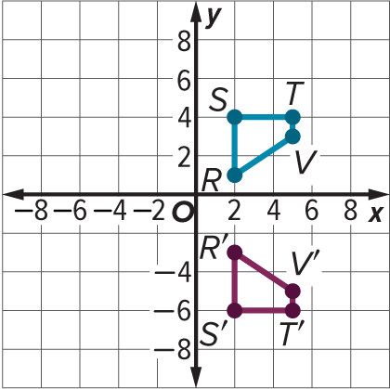
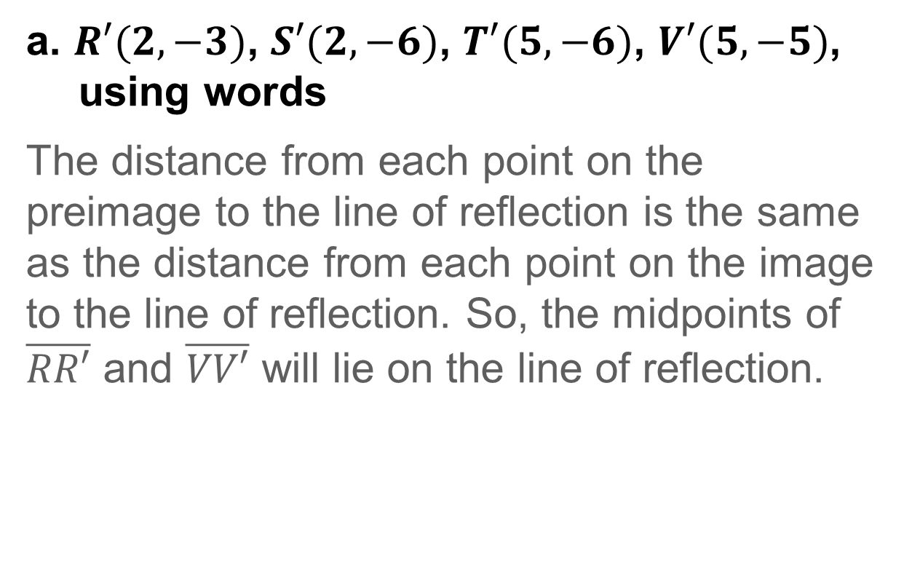
Example 1
Reflection in a Horizontal or Vertical Line
a. $R′(2, −3)$, $S′(2, −6)$, $T′(5, −6)$, $V′(5, −5)$, using words
The distance from each point on the preimage to the line of reflection is the same as the distance from each point on the image to the line of reflection. So, the midpoints of $\overline{RR′}$ and $\overline{VV′}$ will lie on the line of reflection.

Slide 15
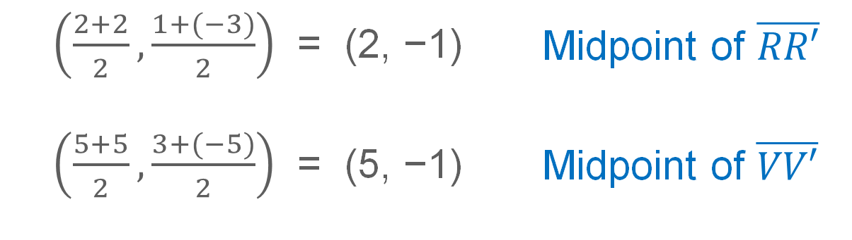
Example 1
Reflection in a Horizontal or Vertical Line
$\left(\frac{2+2}{2},\frac{1+(−3)}{2}\right)$ | = | (2, −1) | Midpoint of $\overline{RR′}$
$\left(\frac{5+5}{2},\frac{3+(−5)}{2}\right)$ | = | (5, −1) | Midpoint of $\overline{VV′}$
The y-coordinates of the midpoints are the same, so this transformation is a reflection in the line y = −1.

Slide 16
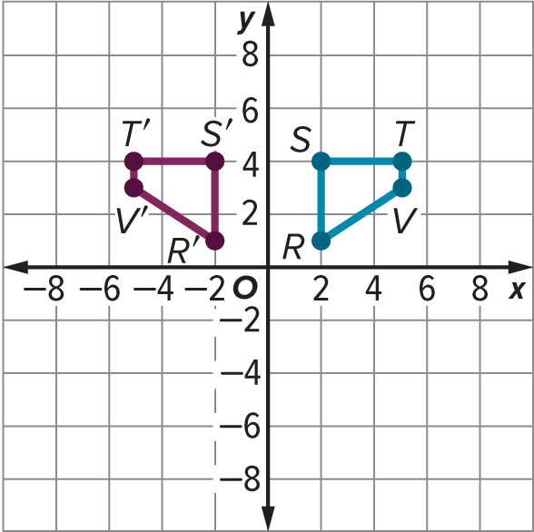
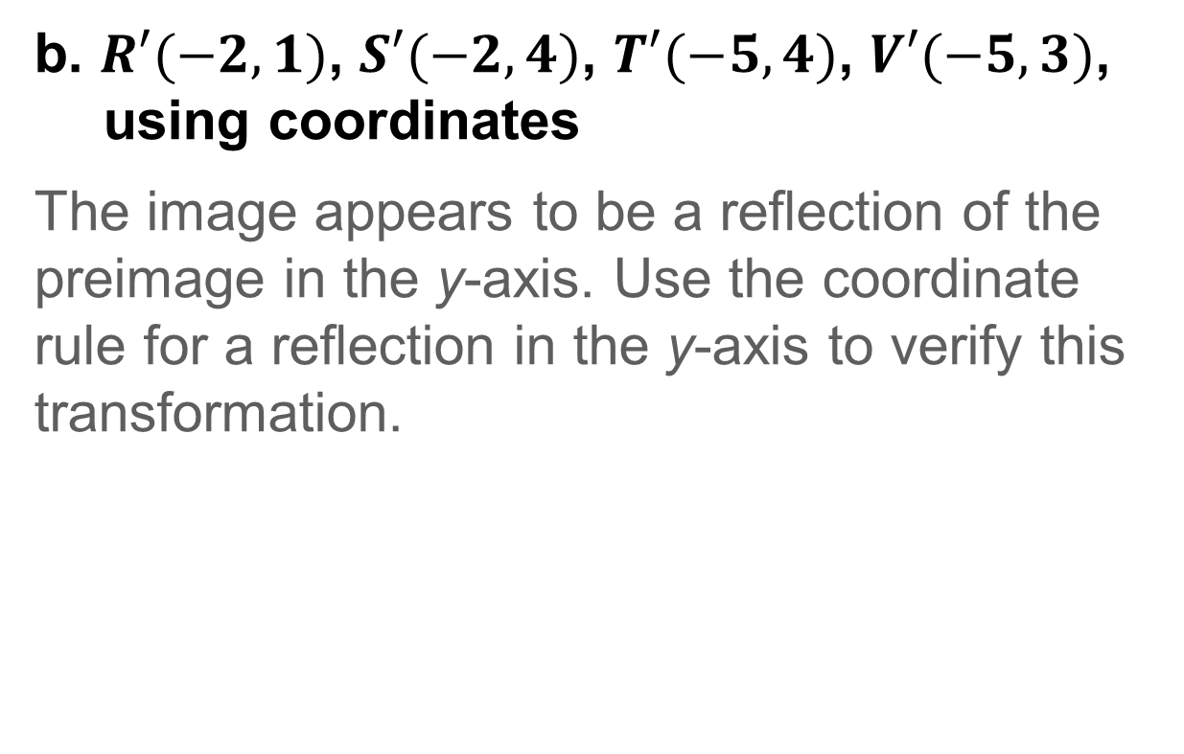
Example 1
Reflection in a Horizontal or Vertical Line
b. $R′(−2, 1)$, $S′(−2, 4)$, $T′(−5, 4)$, $V′(−5, 3)$, using coordinates
The image appears to be a reflection of the preimage in the y-axis. Use the coordinate rule for a reflection in the y-axis to verify this transformation.

Slide 17
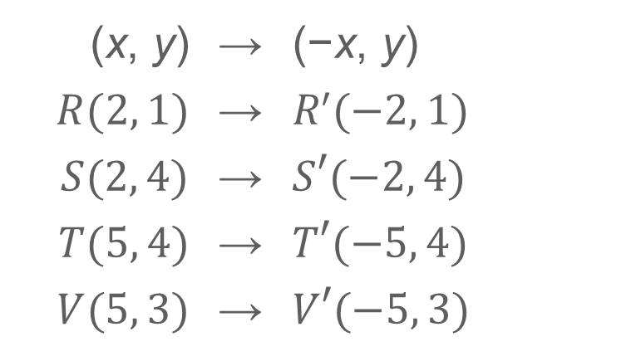
Example 1
Reflection in a Horizontal or Vertical Line
(x, y) | → | (−x, y)
$R(2, 1)$ | → | $R′(−2, 1)$
$S(2, 4)$ | → | $S′(−2, 4)$
$T(5, 4)$ | → | $T′(−5, 4)$
$V(5, 3)$ | → | $V′(−5, 3)$
Because the transformation of the preimage using the coordinate rule for a reflection in the y-axis corresponds to the image on the coordinate plane, the transformation shown is a reflection in the y-axis, (x, y) → (−x, y)

Slide 18
Example 1
Reflection in a Horizontal or Vertical Line
Talk About It!
What appears to be the same about the two figures after a reflection? What appears to be different?

Slide 19
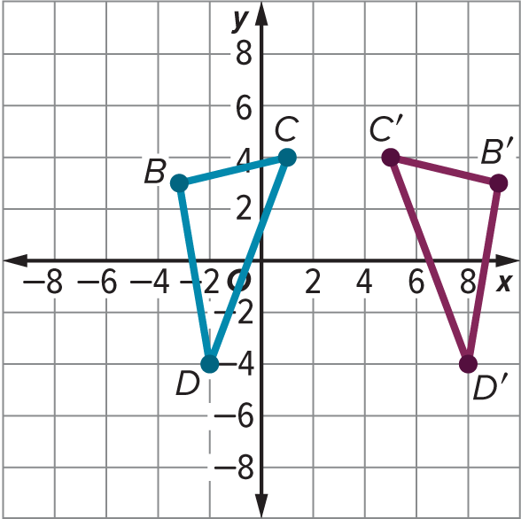

Example 1
Reflection in a Horizontal or Vertical Line
Check
Triangle BCD has coordinates B(−3, 3), C(1, 4), and D(−2, −4), and its image has coordinates $B′(9, 3)$, $C′(5, 4)$, and $D′(8, −4)$. Describe the reflection.

Slide 20
Example 1
Reflection in a Horizontal or Vertical Line
Check
Triangle BCD has coordinates B(−3, 3), C(1, 4), and D(−2, −4), and its image has coordinates B′(9, 3), C'(5, 4), and D′(8, −4).
reflection in the line x = 3
Notes:
reflection in the line x = 3

Slide 21
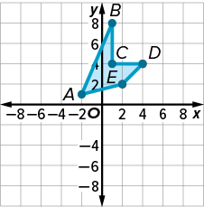
Example 2
Reflection in the Line y = x
DESIGN Winona is designing a logo for her blog header. She graphs a figure on the coordinate plane and wants to reflect it in the line y = x to complete the basic shape for her logo design. What are the coordinates of the vertices of the image after the reflection?

Slide 22
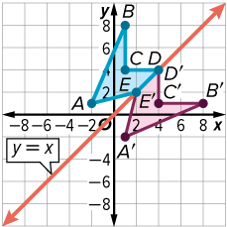
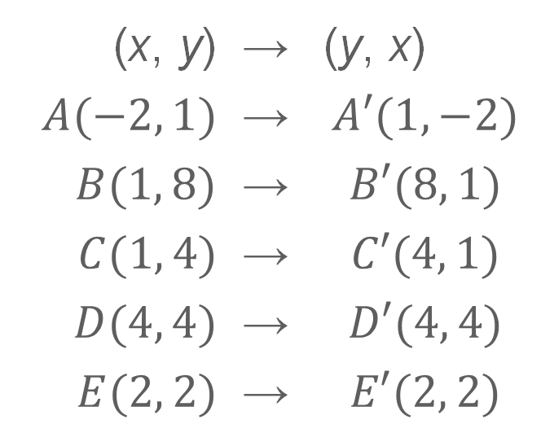
Example 2
Reflection in the Line y = x
(x, y) | → | (y, x)
$A(−2, 1)$ | → | $$A′(1, −2)$$
$B(1, 8)$ | → | $$B′(8, 1)$$
$C(1, 4)$ | → | $$C′(4, 1)$$
$D(4, 4)$ | → | $$D′(4, 4)$$
$E(2, 2)$ | → | $$E′(2, 2)$$

Slide 23
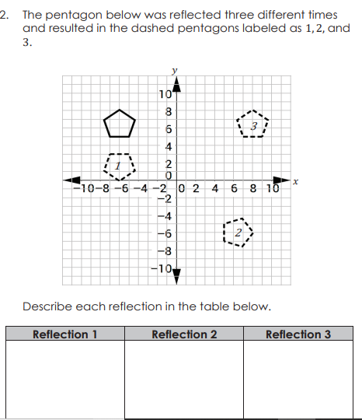

Slide 24
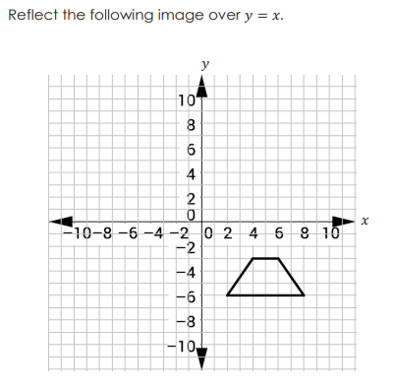

Slide 25
Exit Ticket
Quadrilateral ABCD has coordinates A(0, 2), B(3, 4), C(4, 2), and D(3, 0). Determine the coordinates of the vertices of A'B'C'D' after reflections in:
1. the y-axis
2. the line y = 1
3. the line y = x

Slide 26
Exit Ticket
Quadrilateral ABCD has coordinates A(0, 2), B(3, 4), C(4, 2), and D(3, 0). Determine the coordinates of the vertices of A'B'C'D' after reflections in:
1. the y-axis A'(0, 2), B'(−3, 4), C'(−4, 2), D'(-3, 0)
2. the line y = 1 A'(0, 0), B'(3, −2), C'(4, 0), D'(3, 2)
3. the line y = x A'(2, 0), B'(4, 3), C'(2, 4), D'(0, 3)
Notes:
A'(0, 2), B'(−3, 4), C'(−4, 2), D'(-3, 0)
A'(0, 0), B'(3, −2), C'(4, 0), D'(3, 2)
A'(2, 0), B'(4, 3), C'(2, 4), D'(0, 3)

