Slide 1
Locating Points Using Weighted Averages

Slide 2
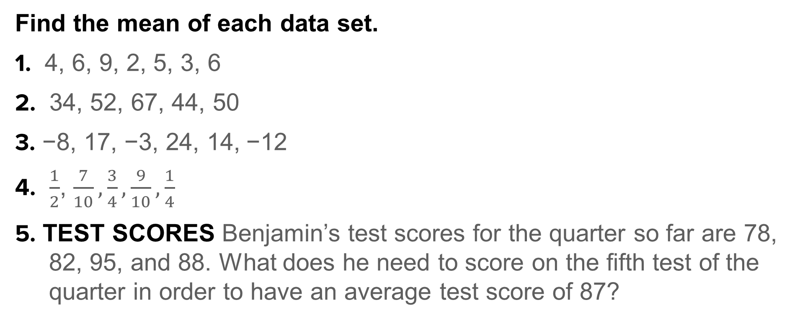
Warm Up
Find the mean of each data set.
1. 4, 6, 9, 2, 5, 3, 6
2. 34, 52, 67, 44, 50
3. −8, 17, −3, 24, 14, −12
4. $\frac{1}{2}$, $\frac{7}{10},\frac{3}{4},\frac{9}{10},\frac{1}{4}$
5. TEST SCORES Benjamin’s test scores for the quarter so far are 78,
82, 95, and 88. What does he need to score on the fifth test of the
quarter in order to have an average test score of 87?

Slide 3
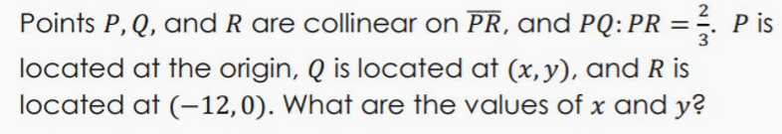
Warm Up

Slide 4
Florida’s B.E.S.T. Standards for Mathematics
MA.912.GR.3.1
Determine the weighted average of two or more points on a line.
MA.912.GR.3.3
Use coordinate geometry to solve mathematical and real-world geometric problems involving lines, circles, triangles and quadrilaterals.

Slide 5
Florida’s Mathematical Thinking and Reasoning Standards
MA.K12.MTR.3.1
Complete tasks with mathematical fluency.

Slide 6
Lesson Objectives
Content Objective
Students will locate points on a number line and a coordinate plane by using weighted averages.
Language Objectives
Students use therefore to explain how to locate points on a number line and a coordinate plane using weighted averages.
To optimize output, students participate in MLR3: Three Reads.

Slide 7
Learn
Locating a Weighted Average on a Number Line
A weighted average is the average of a set of values such that the values hold different levels of importance. The level of importance for each value is represented by a weight that is a constant greater than or equal to 1. In geometry, if points have different levels of importance, then you can use weighted values to locate the point that represents their average.

Slide 8
Learn
Locating a Weighted Average on a Number Line
The midpoint of a segment partitions the segment into a ratio of 1:1, meaning that the endpoints are weighted equally. So, when you are calculating the coordinates of the midpoint, you are also finding the average of the coordinates of the endpoints.

Slide 9

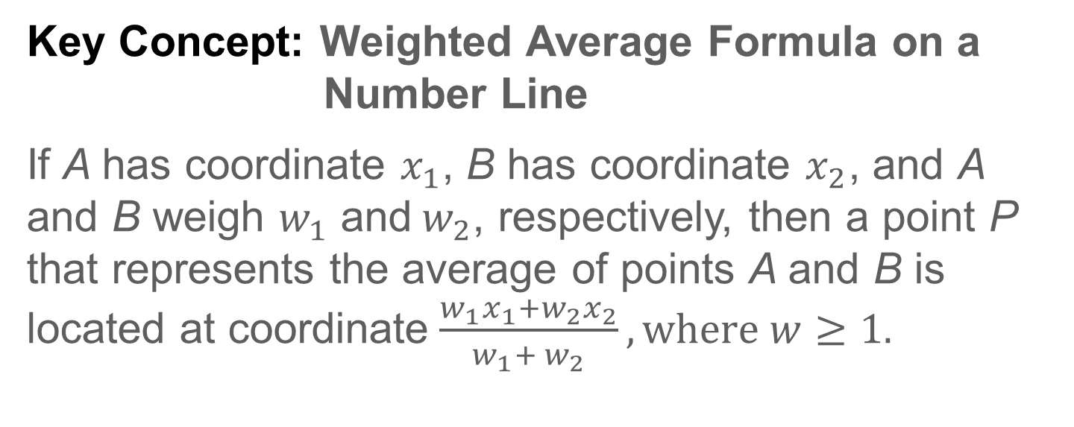
Learn
Locating a Weighted Average on a Number Line
Key Concept: Weighted Average Formula on a Number Line
If A has coordinate $x_{1}$, B has coordinate $x_{2}$, and A and B weigh $w_{1}$ and${ w}_{2}$, respectively, then a point P that represents the average of points A and B is located at coordinate $\frac{w_{1}x_{1}+w_{2}x_{2}}{w_{1}{+ w}_{2}}, where$ $w≥1.$

Slide 10
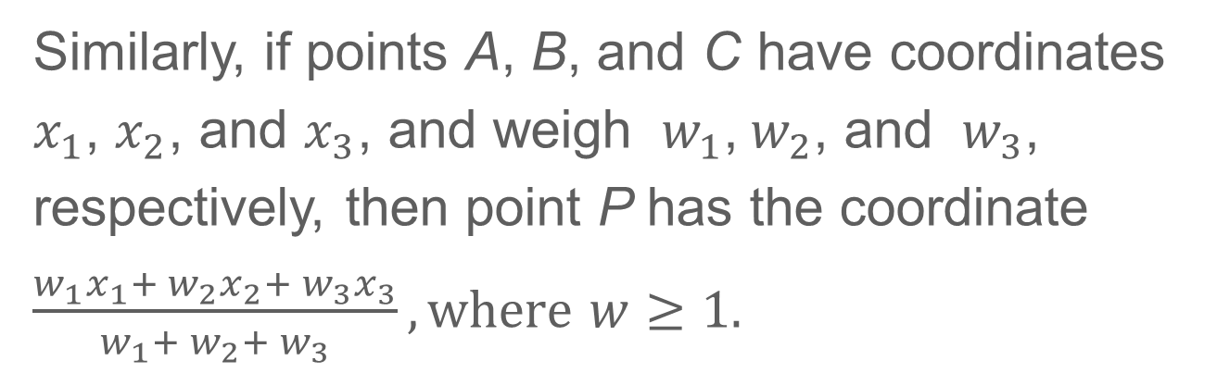
Learn
Locating a Weighted Average on a Number Line
Similarly, if points A, B, and C have coordinates $x_{1}$, $x_{2}$, and $x_{3}$, and weigh ${ w}_{1}$,${ w}_{2}$, and ${ w}_{3}$, respectively, then point P has the coordinate $\frac{w_{1}x_{1}+ w_{2}x_{2}+ w_{3}x_{3}}{w_{1}{+ w}_{2}{+ w}_{3}}, where$ $w≥1.$

Slide 11


Example 1
Find a Weighted Average on a Number Line
Find the coordinate of P that represents the weighted average for each set of points with the given conditions.
a. Point C weighs twice as much as point D.
b. Point G weighs three times as much as point F, and point H weighs twice as much as point F.

Slide 12
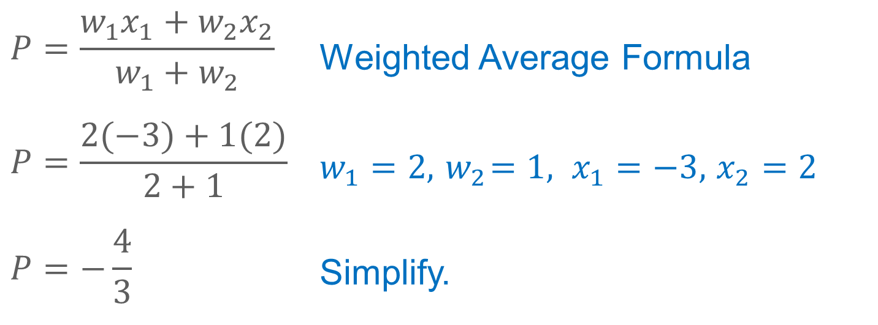
Example 1
Find a Weighted Average on a Number Line
a. Point C weighs twice as much as point D.
$$P=\frac{w_{1}x_{1}+w_{2}x_{2}}{w_{1}{+ w}_{2}}$$ | Weighted Average Formula
$$P=\frac{2(−3)+1(2)}{2+1}$$ | $w_{1}=2,{ w}_{2}=1, x_{1}=−3,$ $x_{2}=2$
$$P=−\frac{4}{3}$$ | Simplify.

Slide 13
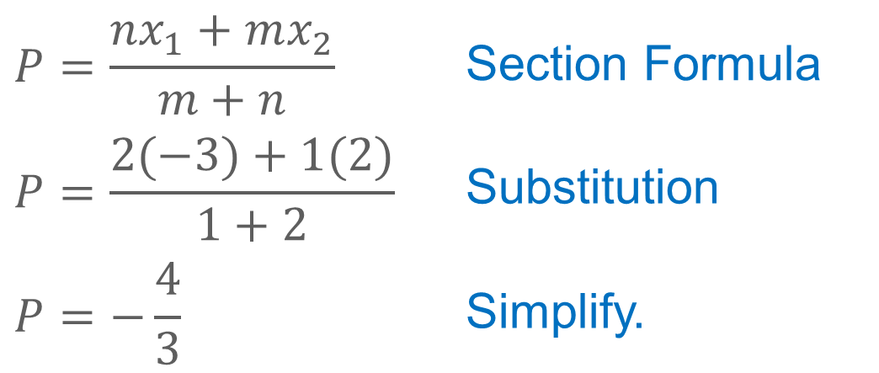
Example 1
Find a Weighted Average on a Number Line
ALTERNATE METHOD Use the Section
Formula to check your answer.
Because point C weighs twice as much as point D, P is pulled towards C so that PD = 2CP and the ratio of CP to PD is 1:2.
$$P=\frac{nx_{1}+mx_{2}}{m+n}$$ | Section Formula
$$P=\frac{2(−3)+1(2)}{1+2}$$ | Substitution
$$P=−\frac{4}{3}$$ | Simplify.

Slide 14
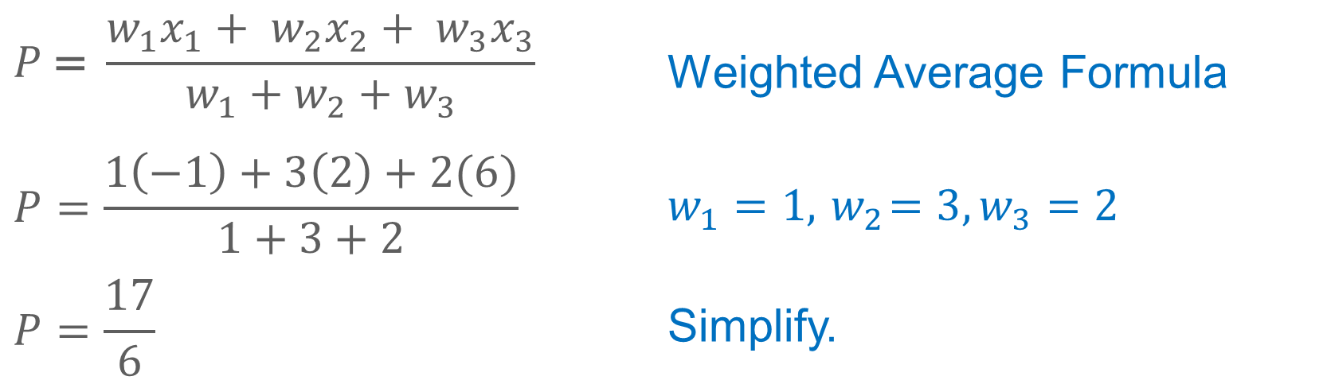
Example 1
Find a Weighted Average on a Number Line
b. Point G weighs three times as much as point F, and point H weighs twice as much as point F.
$$P\text{ =} \frac{w_{1}x_{1}+ w_{2}x_{2}+ w_{3}x_{3}}{w_{1}{+ w}_{2}{+ w}_{3}}$$ | Weighted Average Formula
$$P=\frac{1\left(−1\right)+3\left(2\right)+2(6)}{1+3+2}$$ | $$w_{1}=1,{ w}_{2}=3,w_{3}=2$$
$$P=\frac{17}{6}$$ | Simplify.

Slide 15

Example 1
Find a Weighted Average on a Number Line
Check
Find the coordinate of P that represents the weighted average for each set of points based on the given conditions.
a. Point A has a weight of 2, and point B has a weight of 3.
b. Point B weighs twice as much as point A, and point C weighs
four times as much as point A.

Slide 16
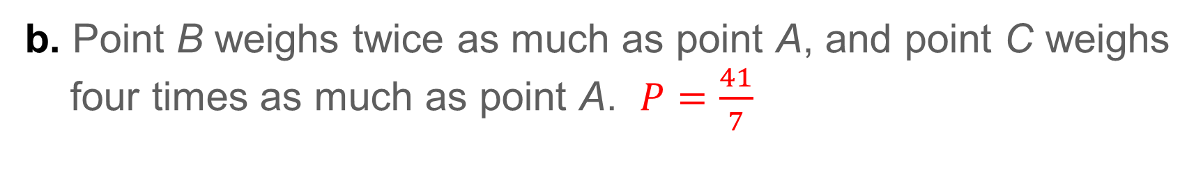
Example 1
Find a Weighted Average on a Number Line
Check
Find the coordinate of P that represents the weighted average for each set of points based on the given conditions.
a. Point A has a weight of 2, and point B has a weight of 3. $P=\frac{6}{5}$
b. Point B weighs twice as much as point A, and point C weighs
four times as much as point A. $P=\frac{41}{7}$
Notes:
$P=\frac{6}{5}$
$P=\frac{41}{7}$

Slide 17
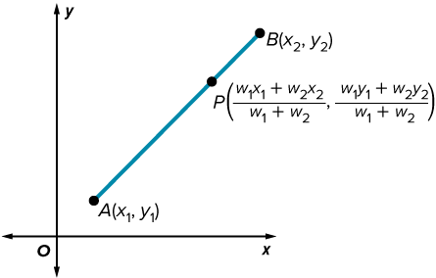
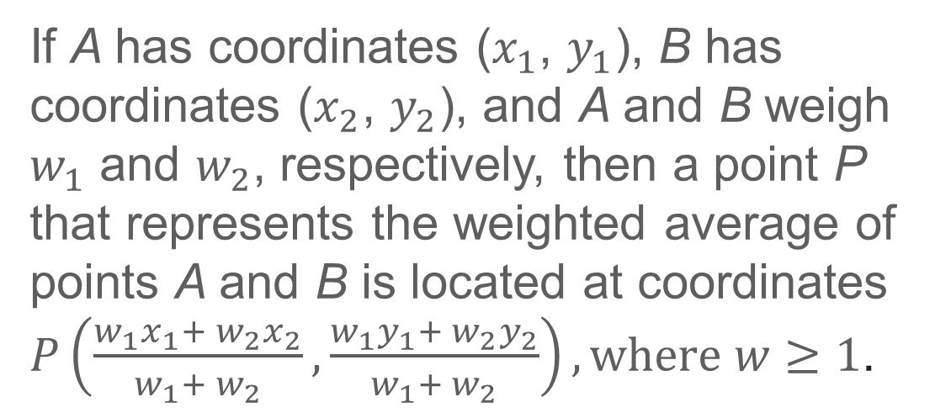
Learn
Locating a Weighted Average on the Coordinate Plane
Key Concept: Weighted Average Formula on the Coordinate Plane
KEY CONCEPT • Weighted Average Formula on the Coordinate Plane
If A has coordinates ($x_{1}$, $y_{1}$), B has coordinates ($x_{2}$, $y_{2}$), and A and B weigh $w_{1}$ and $w_{2}$, respectively, then a point P that represents the weighted average of points A and B is located at coordinates $P\left(\frac{w_{1}x_{1}+ w_{2}x_{2}}{w_{1}{+ w}_{2}},\frac{w_{1}y_{1}+ w_{2}y_{2}}{w_{1}{+ w}_{2}}\right), where w≥1$.

Slide 18
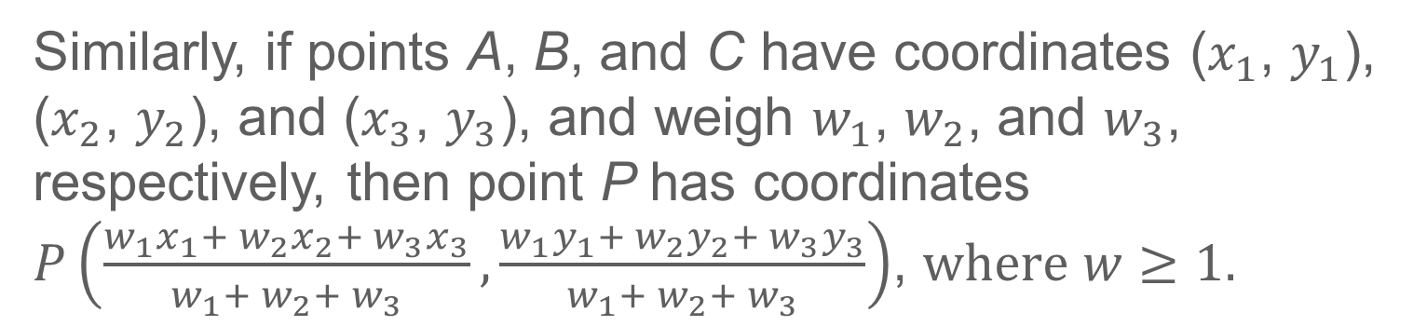
Learn
Locating a Weighted Average on the Coordinate Plane
Similarly, if points A, B, and C have coordinates ($x_{1}$, $y_{1}$), ($x_{2}$, $y_{2}$), and ($x_{3}$, $y_{3}$), and weigh $w_{1}$, $w_{2}$, and $w_{3}$, respectively, then point P has coordinates $P\left(\frac{w_{1}x_{1}+ w_{2}x_{2}+ w_{3}x_{3}}{w_{1}{+ w}_{2}{+ w}_{3}},\frac{w_{1}y_{1}+ w_{2}y_{2}+ w_{3}y_{3}}{w_{1}{+ w}_{2}{+ w}_{3}}\right)$, $where w≥1.$

Slide 19
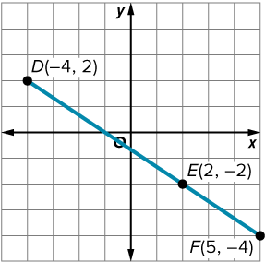
Example 2
Find a Weighted Average on the Coordinate Plane
Find the coordinates of P that represent the weighted average of each set of points based on the given conditions.
a. Point D weighs twice as much as point E.
b. Point E weighs twice as much as point F, and point D weighs three times as much as point F.

Slide 20
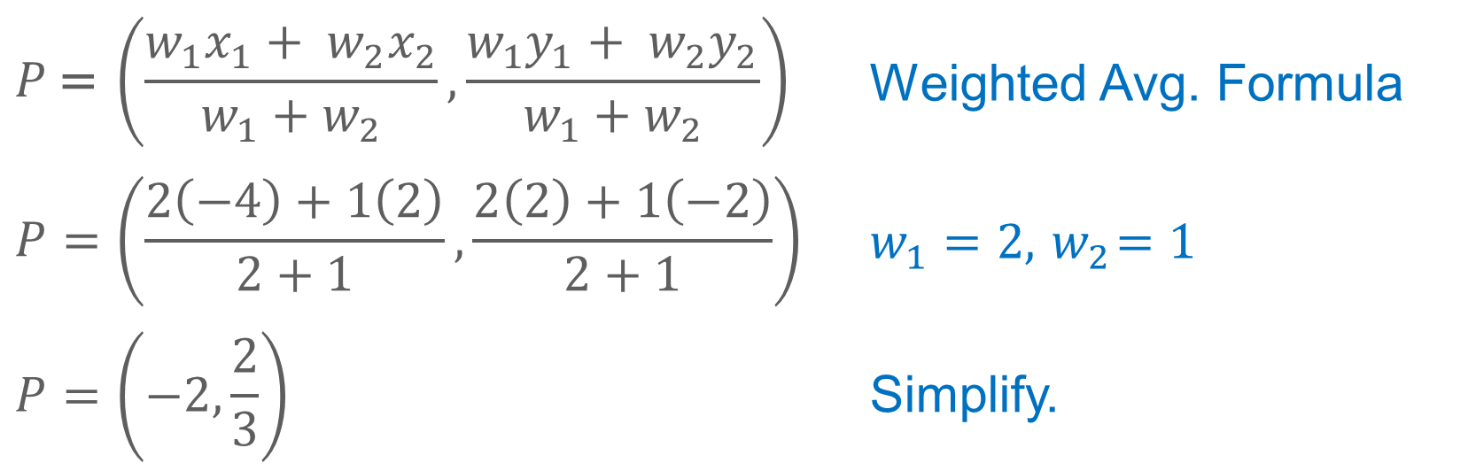
Example 2
Find a Weighted Average on the Coordinate Plane
a. Point D weighs twice as much as point E.
$$P\text{ = }\left(\frac{w_{1}x_{1}+ w_{2}x_{2}}{w_{1}{+ w}_{2}},\frac{w_{1}y_{1}+ w_{2}y_{2}}{w_{1}{+ w}_{2}}\right)$$ | Weighted Avg. Formula
$$P=\left(\frac{2\left(−4\right)+1\left(2\right)}{2+1},\frac{2\left(2\right)+1\left(−2\right)}{2+1}\right)$$ | $$w_{1}=2,{ w}_{2}=1$$
$$P=\left(−2, \frac{2}{3}\right)$$ | Simplify.
The weighted average of points D and E is located at $P\left(−2, \frac{2}{3}\right)$.

Slide 21
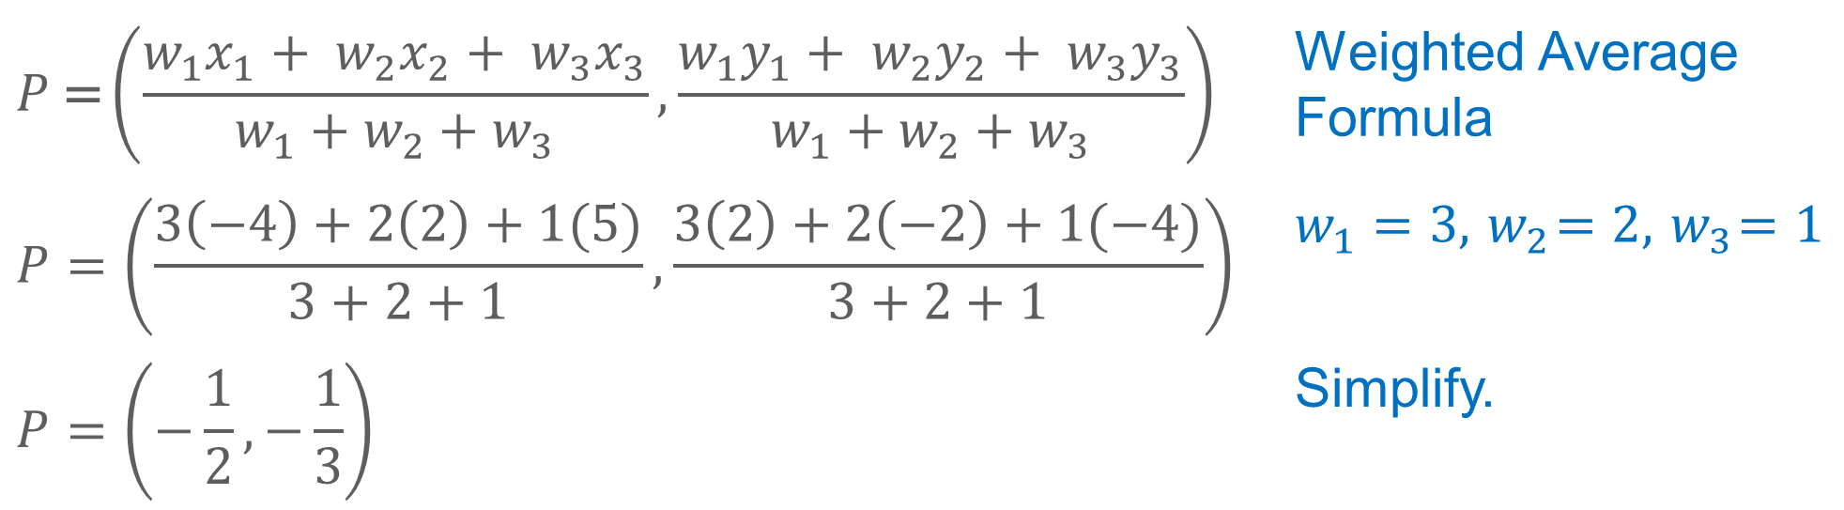
Example 2
Find a Weighted Average on the Coordinate Plane
b. Point E weighs twice as much as point F, and point D weighs three times as much as point F.
$$P\text{ =}\left(\frac{w_{1}x_{1}+ w_{2}x_{2}+ w_{3}x_{3}}{w_{1}{+ w}_{2}{+ w}_{3}},\frac{w_{1}y_{1}+ w_{2}y_{2}+ w_{3}y_{3}}{w_{1}{+ w}_{2}{+ w}_{3}}\right)$$ | Weighted Average Formula
$$P=\left(\frac{3\left(−4\right)+2\left(2\right)+1(5)}{3+2+1},\frac{3\left(2\right)+2\left(−2\right)+1(−4)}{3+2+1}\right)$$ | $$w_{1}=3,{ w}_{2}=2, { w}_{3}=1$$
$$P=\left(−\frac{1}{2},−\frac{1}{3}\right)$$ | Simplify.
The weighted average of points D, E, and F is located at $P\left(−\frac{1}{2},−\frac{1}{3}\right)$.

Slide 22
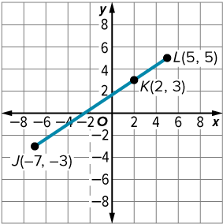
Example 2
Find a Weighted Average on the Coordinate Plane
Check
Find the coordinates of P that represent the weighted average for each set of points based on the given conditions.
a. Point J has a weight of 2, and point K has a
weight of 3.
b. Point J weighs twice as much as point K, and point L weighs five times as much as point K.

Slide 23
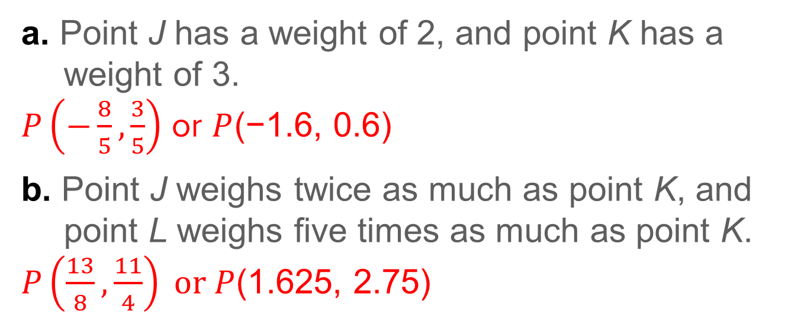
Example 2
Find a Weighted Average on the Coordinate Plane
Check
Find the coordinates of P that represent the weighted average for each set of points based on the given conditions.
a. Point J has a weight of 2, and point K has a
weight of 3.
$P\left(−\frac{8}{5},\frac{3}{5}\right)$ or $P$(−1.6, 0.6)
b. Point J weighs twice as much as point K, and point L weighs five times as much as point K.
$P\left(\frac{13}{8},\frac{11}{4}\right) or P$(1.625, 2.75)
Notes:
$P\left(−\frac{8}{5},\frac{3}{5}\right)$ or $P$(−1.6, 0.6)
$P\left(\frac{13}{8},\frac{11}{4}\right) or P$(1.625, 2.75)

Slide 24
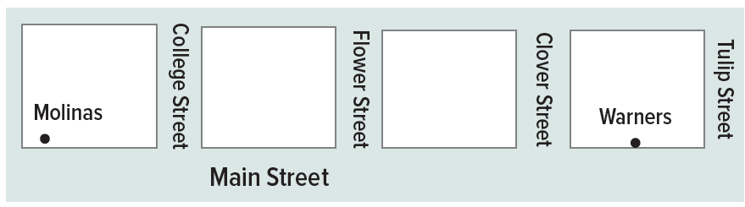
Example 3
Use Weighted Averages
PLANNING A school district is planning the location of a new bus stop on Main Street based on the number of children in each household who ride the bus. The district wants to use the location that represents the weighted average of the riders as the location for the new stop. The Molinas live at 6 Main Street, and the Warners live at 64 Main Street.

Slide 25
Example 3
Use Weighted Averages
Part A The Molinas have 2 bus riders, and the Warners have 5 bus riders. Where should the bus stop be located?
Part B Next year the Warners will only have 3 bus riders. Where should the bus stop be relocated?
Part C Describe the change in the location of the bus stop. Does this make sense? Explain.

Slide 26
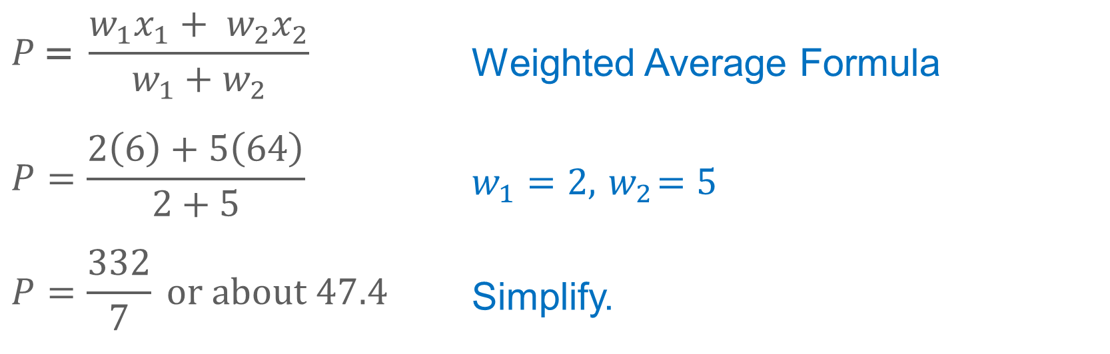
Example 3
Use Weighted Averages
Part A The Molinas have 2 bus riders, and the Warners have 5 bus riders. Where should the bus stop be located?
$$P\text{ =} \frac{w_{1}x_{1}+ w_{2}x_{2}}{w_{1}{+ w}_{2}}$$ | Weighted Average Formula
$$P=\frac{2\left(6\right)+5\left(64\right)}{2+5}$$ | $$w_{1}=2,{ w}_{2}=5$$
$$P=\frac{332}{7} or about 47.4$$ | Simplify.
The bus stop should be between 47 and 48 Main Street.

Slide 27
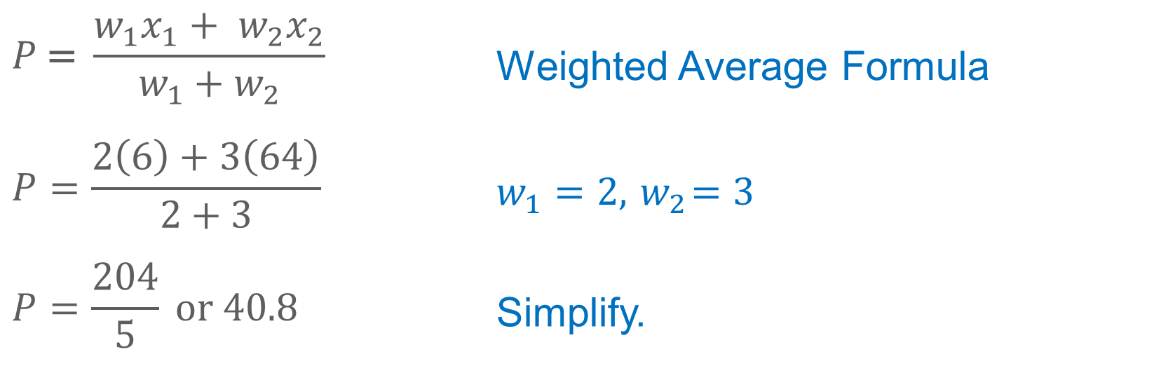
Example 3
Use Weighted Averages
Part B Next year the Warners will only have 3 bus riders. Where should the bus stop be relocated?
$$P\text{ =} \frac{w_{1}x_{1}+ w_{2}x_{2}}{w_{1}{+ w}_{2}}$$ | Weighted Average Formula
$$P=\frac{2\left(6\right)+3\left(64\right)}{2+3}$$ | $$w_{1}=2,{ w}_{2}=3$$
$$P=\frac{204}{5} or 40.8$$ | Simplify.
The bus stop should be between 40 and 41 Main Street.

Slide 28
Example 3
Use Weighted Averages
Check
MAIL A new business district is placing a mail drop box at the location that represents the weighted average of the mail usage at the businesses on the same street. A small business is located at 83 Burnside Avenue, a five-story office building is located at 165 Burnside Avenue, and a shared office space is at 105 Burnside Avenue.

Slide 29
Example 3
Use Weighted Averages
Part A If the small business has twice as much mail as the shared office space, and the five-story office has seven times as much mail as the shared office space, where should the mail drop box be located?
Part B The planning department discovered a mistake in the data. The small business has four times as much mail as the shared office space. Where should the mail drop box be located?
Part C How did the location of the mail drop box change with the new information? Does this make sense? Explain.

Slide 30
Example 3
Use Weighted Averages
Part A If the small business has twice as much mail as the shared office space, and the five-story office has seven times as much mail as the shared office space, where should the mail drop box be located?
P = 142.6; The mail drop box should be located between 142 and 143 Burnside Avenue.
Notes:
P = 142.6; The mail drop box should be located between 142 and 143 Burnside Avenue.

Slide 31
Example 3
Use Weighted Averages
Part B The planning department discovered a mistake in the data. The small business has four times as much mail as the shared office space. Where should the mail drop box be located?
P ≈ 132.67; The mail drop box should be located between 132 and 133 Burnside Avenue.
Notes:
P ≈ 132.67; The mail drop box should be located between 132 and 133 Burnside Avenue.

Slide 32
Example 3
Use Weighted Averages
Part C How did the location of the mail drop box change with the new information? Does this make sense? Explain.
The location of the mail drop box is closer to the midpoint because the small business has more mail than what was originally recorded. It makes sense that the mail drop box will still be between the five-story office building and the shared office space because the five-story building has more mail than the other two businesses.
Notes:
The location of the mail drop box is closer to the midpoint because the small business has more mail than what was originally recorded. It makes sense that the mail drop box will still be between the five-story office building and the shared office space because the five-story building has more mail than the other two businesses.

Slide 33
Pause and Reflect
Did you struggle with anything in this lesson? If so, how did you deal with it?

Slide 34

Exit Ticket
P is the weighted average of A and B on the number line. Find the coordinate of P under the given conditions.
1. A has a weight of 6 and B has a weight of 3.
2. The weight of A is one third the weight of B.
3. The weight of B is 0 and the weight of A is greater than 0.

Slide 35
Exit Ticket
P is the weighted average of C(2, −5) and D(4, 6) on the coordinate plane. Find the coordinates of P under the given conditions.
4. Point C has a weight of 1 and point D has a weight of 2.
5. Point D weighs three times as much as point C.

Slide 36
Exit Ticket
P is the weighted average of A and B on the number line. Find the coordinate of P under the given conditions.
1. A has a weight of 6 and B has a weight of 3. −2
2. The weight of A is one third the weight of B. 0.5
3. The weight of B is 0 and the weight of A is greater than 0. −4
Notes:
−2
0.5
−4

Slide 37
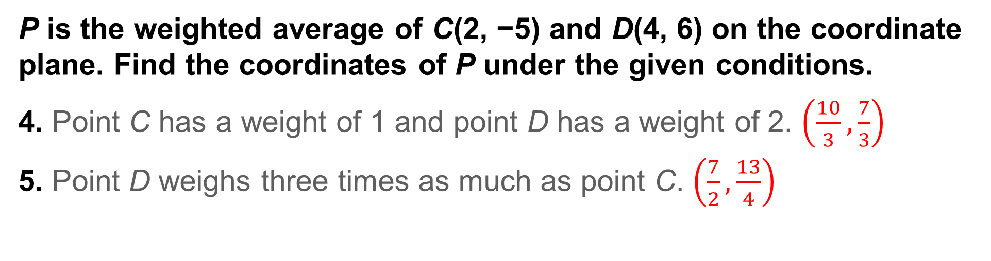
Exit Ticket
P is the weighted average of C(2, −5) and D(4, 6) on the coordinate plane. Find the coordinates of P under the given conditions.
4. Point C has a weight of 1 and point D has a weight of 2. $\left(\frac{10}{3},\frac{7}{3}\right)$
5. Point D weighs three times as much as point C. $\left(\frac{7}{2},\frac{13}{4}\right)$
Notes:
$$\left(\frac{10}{3},\frac{7}{3}\right)$$
$$\left(\frac{7}{2},\frac{13}{4}\right)$$

