Slide 1
Areas of Circles and Sectors

Slide 2
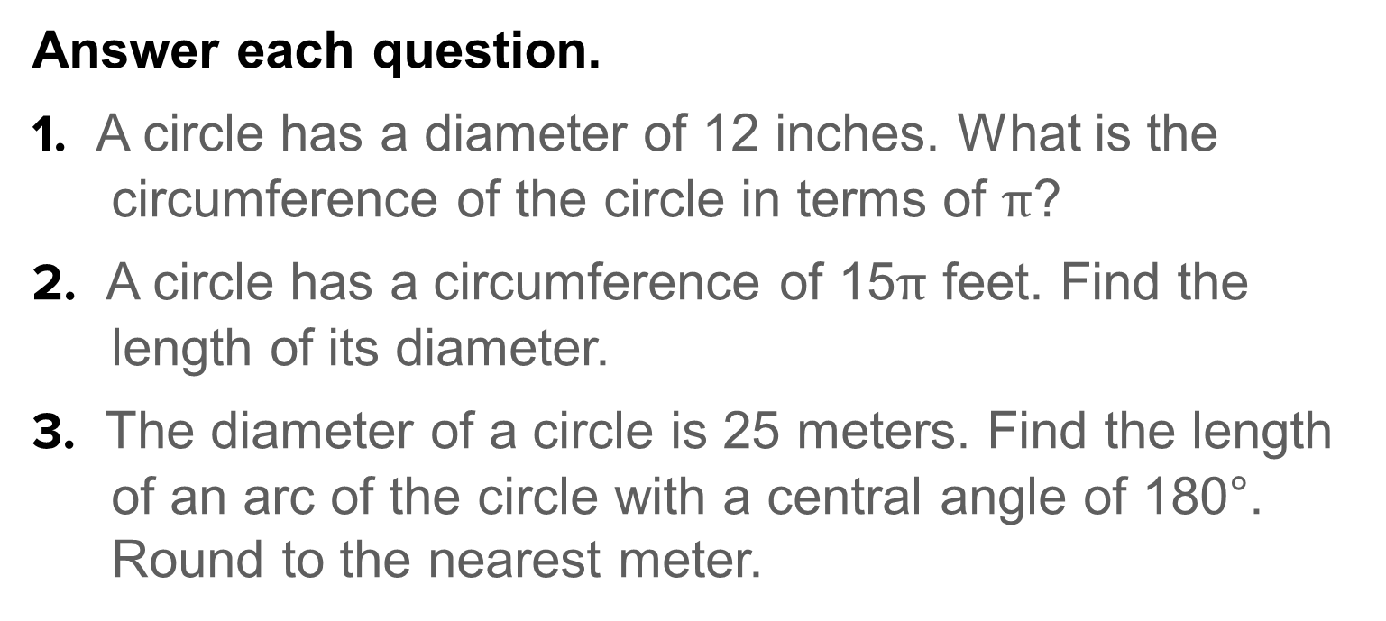
Warm Up
Answer each question.
1. A circle has a diameter of 12 inches. What is the circumference of the circle in terms of $π$?
2. A circle has a circumference of 15$π$ feet. Find the length of its diameter.
3. The diameter of a circle is 25 meters. Find the length of an arc of the circle with a central angle of 180°. Round to the nearest meter.

Slide 3
Warm Up
4. A circle has a circumference of 312 centimeters. What is the length of an arc of this circle if the arc has a measure of 90°?
5. An arc of a circle has a length of 10 feet and a measure of 45°. What is the circumference of the circle?

Slide 4


Warm Up
Answer each question.
1. A circle has a diameter of 12 inches. What is the circumference of the circle in terms of $π$?
2. A circle has a circumference of 15$π$ feet. Find the length of its diameter.
3. The diameter of a circle is 25 meters. Find the length of an arc of the circle with a central angle of 180°. Round to the nearest meter.
12$π$ in.
15 ft
39 m
Notes:
12π in.
15 ft
39 m

Slide 5
Warm Up
4. A circle has a circumference of 312 centimeters. What is the length of an arc of this circle if the arc has a measure of 90°?
5. An arc of a circle has a length of 10 feet and a measure of 45°. What is the circumference of the circle?
78 cm
80 ft
Notes:
78 m
80 ft

Slide 6
Florida’s B.E.S.T. Standards for Mathematics
MA.912.GR.4.4
Solve mathematical and real-world problems involving the area of two-dimensional figures.
MA.912.GR.6.4
Solve mathematical and real-world problems involving the arc length and area of a sector in a given circle.

Slide 7
Florida’s Mathematical Thinking and Reasoning Standards
MA.K12.MTR.3.1
Complete tasks with mathematical fluency.

Slide 8
Lesson Objectives
Content Objective
Students find areas of circles and sectors.
Language Objectives
Students use so and because to explain how to find areas of circles and sectors.
To optimize output, students participate in MLR1: Stronger and Clearer Each Time.

Slide 9
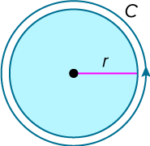
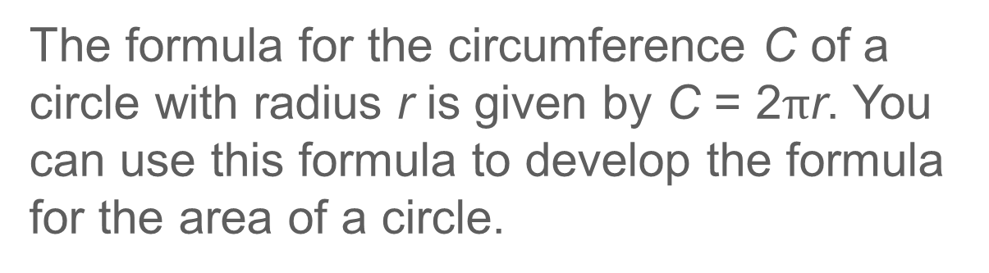
Learn
Areas of Circles
The formula for the circumference C of a circle with radius r is given by C = 2$π$r. You can use this formula to develop the formula for the area of a circle.

Slide 10
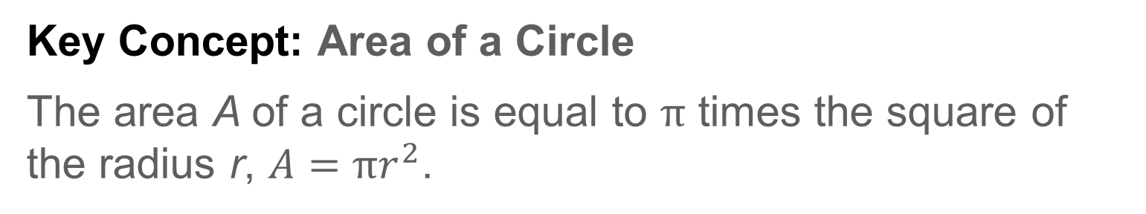
Learn
Areas of Circles
Key Concept: Area of a Circle
The area A of a circle is equal to $π$ times the square of the radius r, $A=πr^{2}$.

Slide 11
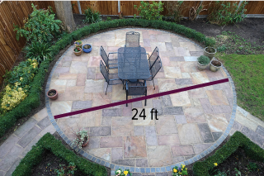
Example 1
Area of a Circle
PATIO Keon is building a circular patio in his backyard.
Part A What is the area of the patio to the nearest square foot?
Part B Keon can purchase paving stones for $135 per square yard. About how much will he spend on paving stones for his patio?

Slide 12
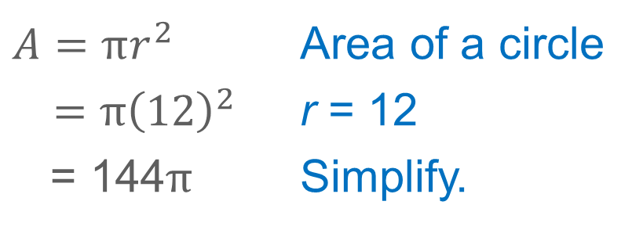
Example 1
Area of a Circle
Part A What is the area of the patio to the nearest square foot?
The diameter of the circle is 24 feet, so the radius is 12 feet.
$$A=πr^{2}$$ | Area of a circle
$$=π{\left(12\right)}^{2}$$ | r = 12
= 144$π$ | Simplify.
So, the area is 144$π$ or about 452 square feet.

Slide 13
Example 1
Area of a Circle
Part B Keon can purchase paving stones for $135 per square yard. About how much will he spend on paving stones for his patio?
Convert from square feet to square yards to find how much he will spend.

Slide 14
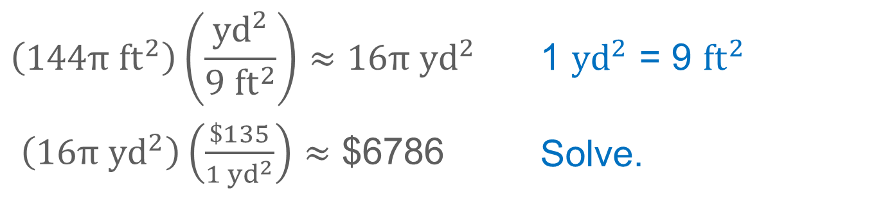
Example 1
Area of a Circle
$$\left(144π {ft}^{2}\right)\left(\frac{{yd}^{2}}{{9 ft}^{2}}\right)≈16π {yd}^{2}$$ | 1 ${yd}^{2}$ = 9 ${ft}^{2}$
$\left(16π {yd}^{2}\right)\left(\frac{\$135}{{1 yd}^{2}}\right)≈$ $6786 | Solve.
So, Keon could expect to spend about $6786 on paving stones.

Slide 15
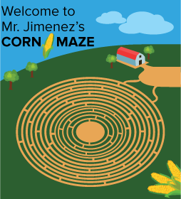
Example 1
Area of a Circle
Check
CORN MAZE Mr. Jimenez wants to create a corn maze in his field for a local festival. At the center of the maze, there is a circle with a diameter of 150 meters.

Slide 16
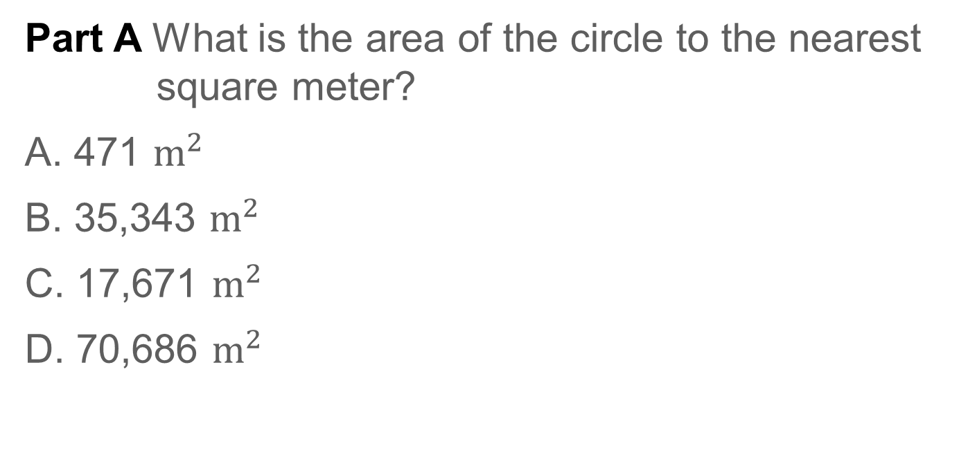
Example 1
Area of a Circle
Part A What is the area of the circle to the nearest square meter?
A. 471 $m^{2}$
B. 35,343 $m^{2}$
C. 17,671 $m^{2}$
D. 70,686 $m^{2}$

Slide 17
Example 1
Area of a Circle
Part B In a square kilometer of corn fields, there are about 100,000 plants. About how many plants will Mr. Jimenez have to trample to create the center of the maze?

Slide 18
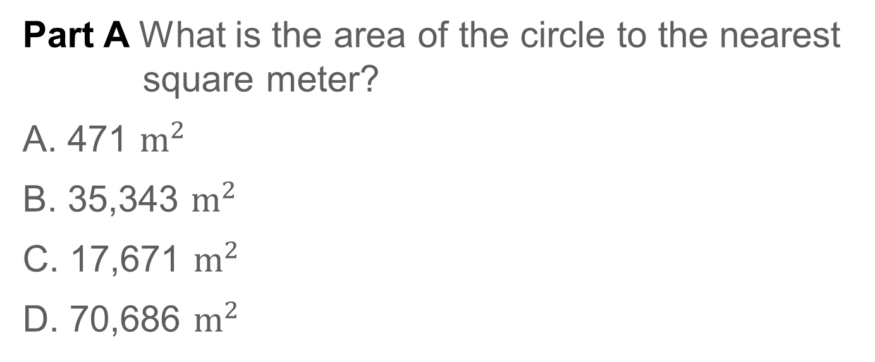
Example 1
Area of a Circle
Part A What is the area of the circle to the nearest square meter?
A. 471 $m^{2}$
B. 35,343 $m^{2}$
C. 17,671 $m^{2}$
D. 70,686 $m^{2}$
C
Notes:
C

Slide 19
Example 1
Area of a Circle
Part B In a square kilometer of corn fields, there are about 100,000 plants. About how many plants will Mr. Jimenez have to trample to create the center of the maze?
1767 plants
Notes:
1767 plants

Slide 20
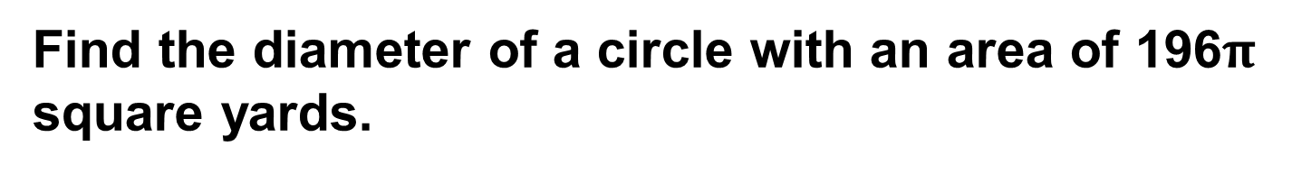
Example 2
Use the Area of a Circle to Find a Missing Measure
Find the diameter of a circle with an area of 196$π$ square yards.

Slide 21
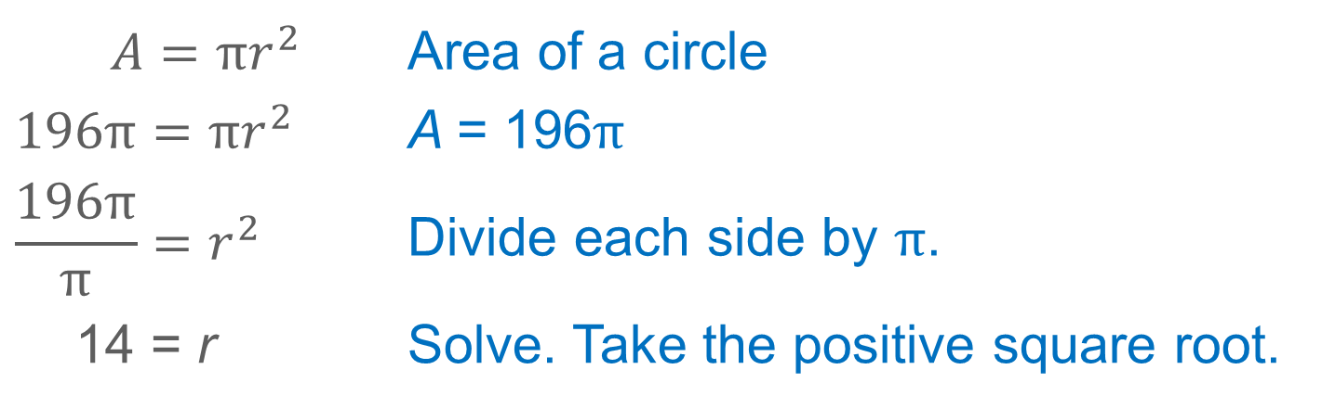
Example 2
Use the Area of a Circle to Find a Missing Measure
$A=πr^{2}$ | Area of a circle
$$196π=πr^{2}$$ | A = 196$π$
$$\frac{196π}{π}=r^{2}$$ | Divide each side by $π$.
14 = r | Solve. Take the positive square root.
The radius is half the diameter, so the diameter of the circle is 28 yards.

Slide 22
Example 2
Use the Area of a Circle to Find a Missing Measure
Check
Find the diameter of a circle with an area of 915 square feet. Round to the nearest tenth, if necessary.

Slide 23
Example 2
Use the Area of a Circle to Find a Missing Measure
Check
Find the diameter of a circle with an area of 915 square feet. Round to the nearest tenth, if necessary.
34.1 ft
Notes:
34.1 ft

Slide 24
Learn
Areas of Sectors
A sector is a region of a circle bounded by a central angle and its intercepted arc. The formula for the area of a sector is similar to the formula for arc length.

Slide 25
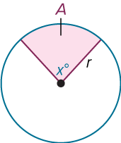
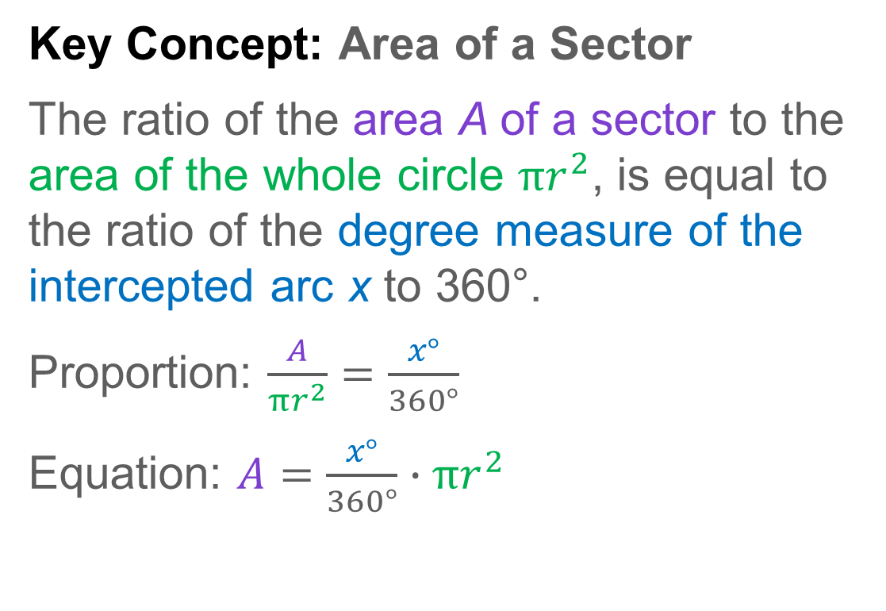
Learn
Areas of Sectors
Key Concept: Area of a Sector
The ratio of the area A of a sector to the area of the whole circle $πr^{2}$, is equal to the ratio of the degree measure of the intercepted arc x to 360°.
Proportion: $\frac{A}{πr^{2}}=\frac{x°}{360°}$
Equation: $A=\frac{x°}{360°}∙πr^{2}$

Slide 26
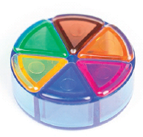
Example 3
Area of a Sector
GAMES Malaya is playing a game where she must track her progress using sectors of a circle and a circular game piece. The game piece has a diameter of 3.5 centimeters and is divided into 6 congruent sectors. What is the area of one sector to the nearest hundredth?

Slide 27
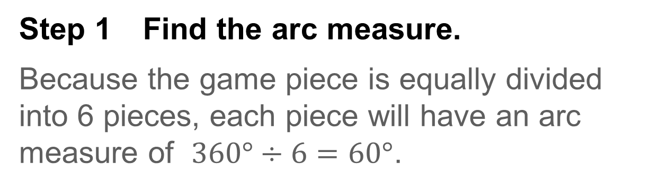
Example 3
Area of a Sector
Step 1 Find the arc measure.
Because the game piece is equally divided into 6 pieces, each piece will have an arc measure of $360°÷6=60°$.

Slide 28
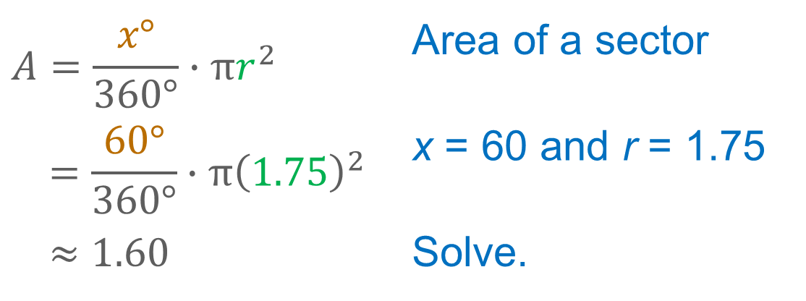
Example 3
Area of a Sector
Step 2 Find the area.
$$A=\frac{x°}{360°}∙πr^{2}$$ | Area of a sector
$$=\frac{60°}{360°}∙π{\left(1.75\right)}^{2}$$ | x = 60 and r = 1.75
$$≈1.60$$ | Solve.
So, the area of one sector of this game piece is about 1.60 square centimeters.

Slide 29
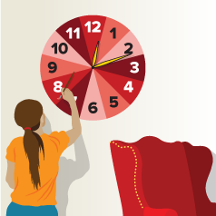
Example 3
Area of a Sector
Check
ART Jorrie is crafting a wall clock using paint and a set of battery-operated clock hands. The clock will have a diameter of 3 feet. What is the area of each sector to the nearest hundredth?

Slide 30
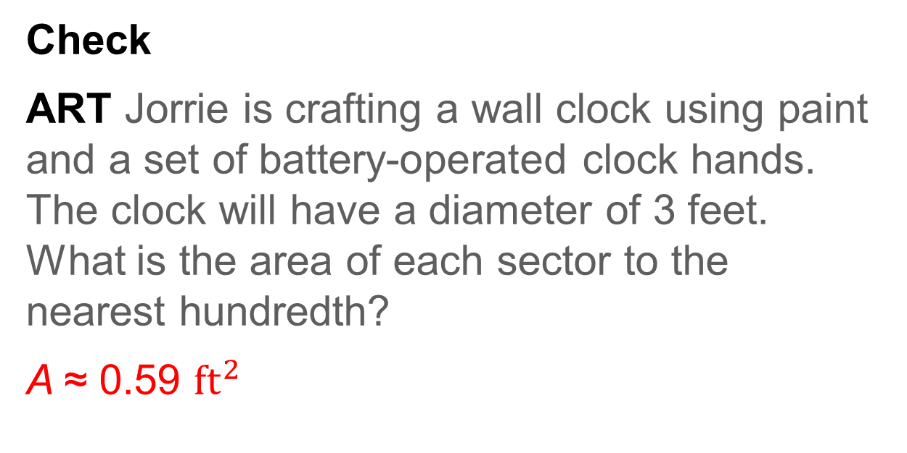
Example 3
Area of a Sector
Check
ART Jorrie is crafting a wall clock using paint and a set of battery-operated clock hands. The clock will have a diameter of 3 feet. What is the area of each sector to the nearest hundredth?
A ≈ 0.59 ${ft}^{2}$
Notes:
A ≈ 0.59 ft²

Slide 31
Example 4
Use the Area of a Sector to Find the Area of a Circle
One sector of a circle has an area of 42 square feet and an arc measure of 45°. Find the area of the circle to the nearest square foot.

Slide 32
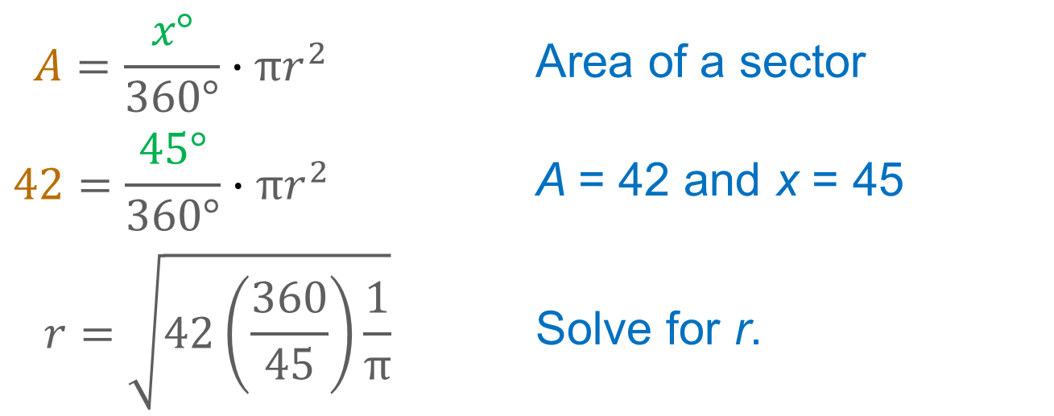
Example 4
Use the Area of a Sector to Find the Area of a Circle
Step 1 Find the radius.
Use the area of the sector to find the radius of the circle.
$$A=\frac{x°}{360°}∙πr^{2}$$ | Area of a sector
$$42=\frac{45°}{360°}∙πr^{2}$$ | A = 42 and x = 45
$$r=\sqrt{42\left(\frac{360}{45}\right)\frac{1}{π}}$$ | Solve for r.

Slide 33
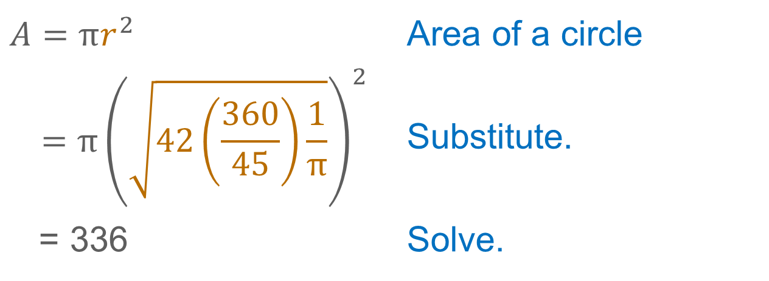
Example 4
Use the Area of a Sector to Find the Area of a Circle
Step 2 Find the area.
Use the radius to calculate the area of the circle.
$$A=πr^{2}$$ | Area of a circle
$$=π{\left(\sqrt{42\left(\frac{360}{45}\right)\frac{1}{π}}\right)}^{2}$$ | Substitute.
= 336 | Solve.
The area of the circle is 336 square feet.

Slide 34
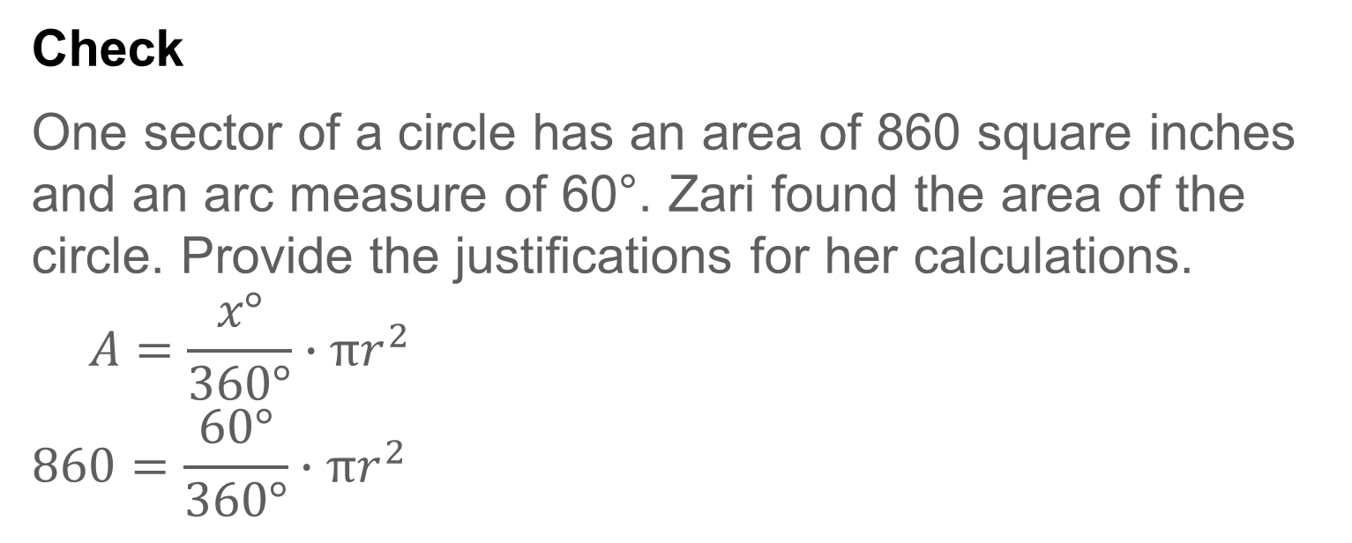
Example 4
Use the Area of a Sector to Find the Area of a Circle
Check
One sector of a circle has an area of 860 square inches and an arc measure of 60°. Zari found the area of the circle. Provide the justifications for her calculations.
$$A=\frac{x°}{360°}∙πr^{2}$$
$$860=\frac{60°}{360°}∙πr^{2}$$

Slide 35

Example 4
Use the Area of a Sector to Find the Area of a Circle
$$r=\sqrt{860\left(\frac{360}{60}\right)\frac{1}{π}}$$
$$A=πr^{2}$$
$=π{\left(\sqrt{860\left(\frac{360}{60}\right)\frac{1}{π}}\right)}^{2}$
$$=5160 {in}^{2}$$

Slide 36
Example 4
Use the Area of a Sector to Find the Area of a Circle
Check
One sector of a circle has an area of 860 square inches and an arc measure of 60°. Zari found the area of the circle. Provide the justifications for her calculations.
$$A=\frac{x°}{360°}∙πr^{2}$$
$$860=\frac{60°}{360°}∙πr^{2}$$
Area of a sector
A = 860 and x = 60
Notes:
Area of a sector
A = 860 and x = 60

Slide 37

Example 4
Use the Area of a Sector to Find the Area of a Circle
$$r=\sqrt{860\left(\frac{360}{60}\right)\frac{1}{π}}$$
$$A=πr^{2}$$
$=π{\left(\sqrt{860\left(\frac{360}{60}\right)\frac{1}{π}}\right)}^{2}$
$$=5160 {in}^{2}$$
Solve for r.
Area of a circle
Substitute.
Solve.
Notes:
Solve for r.
Area of a circle
Substitute.
Solve.

Slide 38
Example 4
Use the Area of a Sector to Find the Area of a Circle
Talk About It!
Ask a partner to provide feedback on your work. Are there other ways to find the area of the circle?

Slide 39
Pause and Reflect
Did you struggle with anything in this lesson? If so, how did you deal with it?

Slide 40
Exit Ticket
Answer each question. Round to the nearest tenth, if necessary.
1. Circle O has a radius of 16 inches. Sector AOB of this circle has a central angle of 45°. What is the area of sector AOB?
2. A semicircular sector of circle P has an area of 225 square feet. What is the area of circle P?

Slide 41
Exit Ticket
3. Circle T has a diameter of 28 meters. Sector STP of this circle has a central angle of 90°. What is the area of sector STP?
4. Sector SWP of circle W has a central angle of 270° and an area of 60 square centimeters. What is the area of circle W?

Slide 42
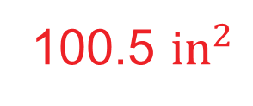
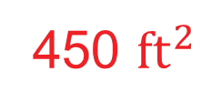
Exit Ticket
Answer each question. Round to the nearest tenth, if necessary.
1. Circle O has a radius of 16 inches. Sector AOB of this circle has a central angle of 45°. What is the area of sector AOB?
2. A semicircular sector of circle P has an area of 225 square feet. What is the area of circle P?
100.5 ${in}^{2}$
450 ${ft}^{2}$
Notes:
100.5 ${in}^{2}$
450 ${ft}^{2}$

Slide 43
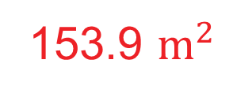
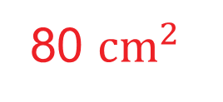
Exit Ticket
3. Circle T has a diameter of 28 meters. Sector STP of this circle has a central angle of 90°. What is the area of sector STP?
4. Sector SWP of circle W has a central angle of 270° and an area of 60 square centimeters. What is the area of circle W?
153.9 $m^{2}$
80 ${cm}^{2}$
Notes:
153.9 $m^{2}$
80 ${cm}^{2}$

