Slide 1
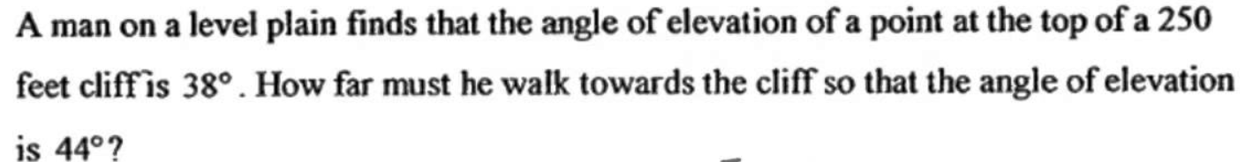
Applying Trigonometry

Slide 2
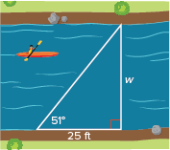
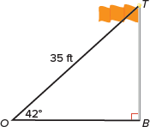
Warm Up
Solve. Round answers to the nearest tenth.
1. Find the height of the flagpole, TB.
2. Find the width of the river, w.

Slide 3
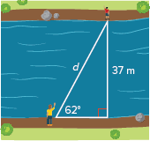
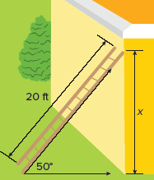
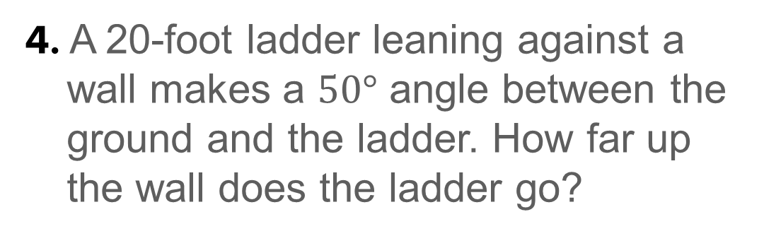
Warm Up
Solve. Round answers to the nearest tenth.
3. What is the distance between the two people on opposite sides of the river?
4. A 20-foot ladder leaning against a wall makes a $50°$ angle between the ground and the ladder. How far up the wall does the ladder go?

Slide 4
Warm Up
Solve. Round answers to the nearest tenth.
1. Find the height of the flagpole, TB. 23.4 ft
2. Find the width of the river, w. 30.9 ft
Notes:
23.4 ft
30.9 ft

Slide 5
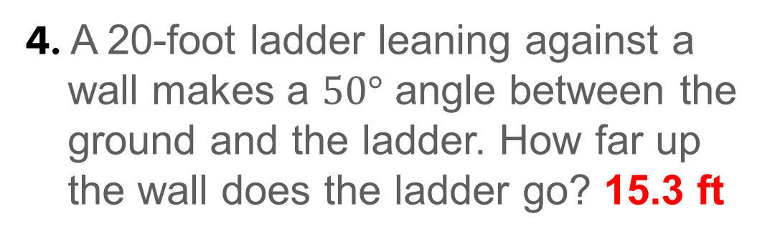
Warm Up
Solve. Round answers to the nearest tenth.
3. What is the distance between the two people on opposite sides of the river? 41.9 m
4. A 20-foot ladder leaning against a wall makes a $50°$ angle between the ground and the ladder. How far up the wall does the ladder go? 15.3 ft
Notes:
41.9 m
15.3 ft

Slide 6
Florida’s B.E.S.T. Standards for Mathematics
MA.912.T.1.2
Solve mathematical and real-world problems involving right triangles using trigonometric ratios and the Pythagorean Theorem.

Slide 7
Florida’s Mathematical Thinking and Reasoning Standards
MA.K12.MTR.4.1
Engage in discussions that reflect on the mathematical thinking of self and others.
MA.K12.MTR.7.1
Apply mathematics to real-world contexts.

Slide 8
Lesson Objectives
Content Objective
Students will solve real-world problems using the trigonometric ratios and their inverses. Students will find the area of triangles using a formula based on the sine function.
Language Objectives
Students explain how to apply trigonometry to real-world situations using about.
To optimize output, students participate in MLR3: Three Reads.

Slide 9
Learn
Angles of Elevation and Depression
Often the only way to measure an object is through the use of indirect measurement, which involves using similar figures and proportions to measure an object. In these cases, you measure the object by measuring something else. Indirect measurements use special types of angles. An angle of elevation is the angle formed by a horizontal line and an observer’s line of sight to an object above the horizontal line. An angle of depression is the angle formed by a horizontal line and an observer’s line of sight to an object below the horizontal line.

Slide 10
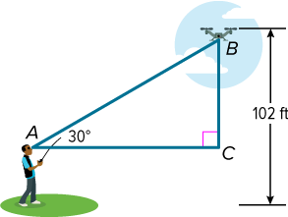
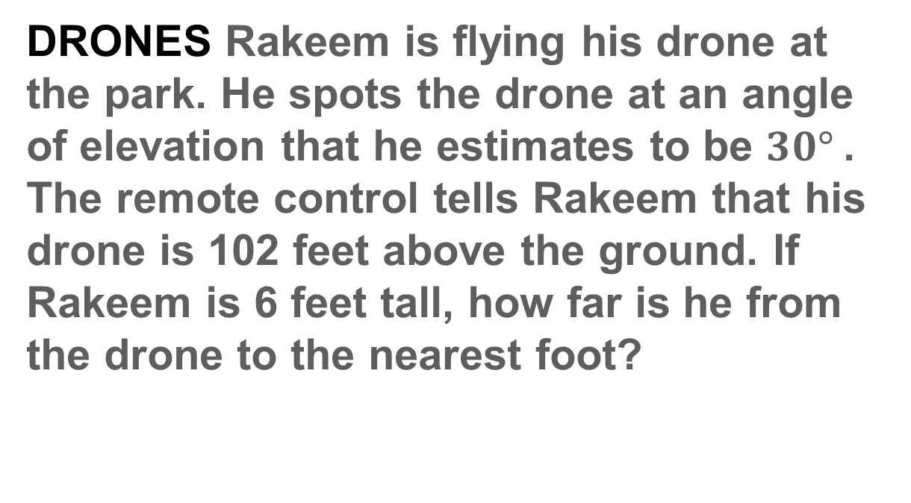
Example 1
Angle of Elevation
DRONES Rakeem is flying his drone at the park. He spots the drone at an angle of elevation that he estimates to be $30°$. The remote control tells Rakeem that his drone is 102 feet above the ground. If Rakeem is 6 feet tall, how far is he from the drone to the nearest foot?

Slide 11
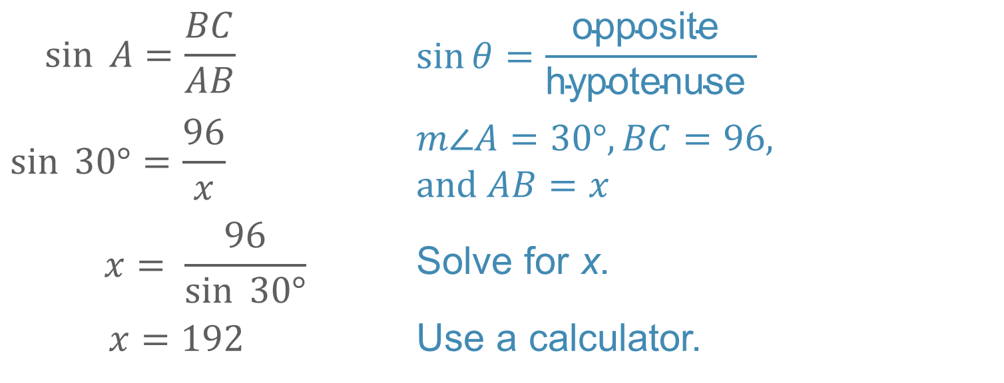
Example 1
Angle of Elevation
Because Rakeem is 6 feet tall, BC = 102 − 6 or 96 feet. Let x represent the distance from Rakeem to the drone.
$$\sin{ A}=\frac{BC}{AB}$$ | $$\sin{θ}=\frac{\text{opposite} }{\text{hypotenuse} }$$
$$\sin{ 30°}=\frac{96}{x}$$ | $$m\text{∠}A=30°, BC=96, \\ and AB=x$$
$$x= \frac{96}{\sin{ 30°}}$$ | Solve for x.
$$x=192$$ | Use a calculator.
Rakeem is 192 feet from his drone.

Slide 12
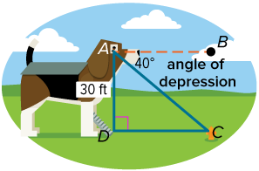
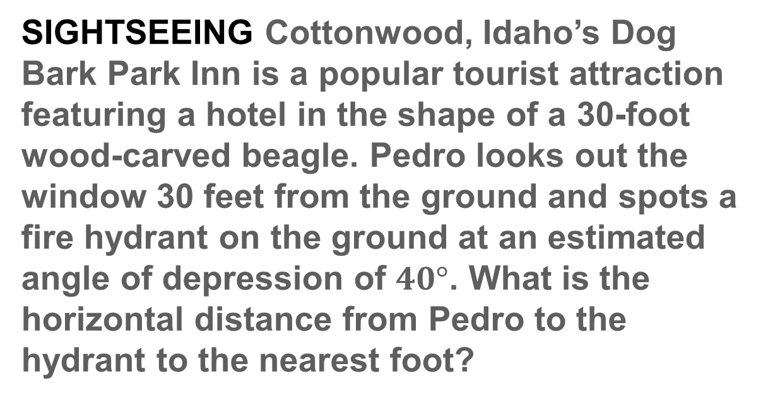
Example 2
Angle of Depression
SIGHTSEEING Cottonwood, Idaho’s Dog Bark Park Inn is a popular tourist attraction featuring a hotel in the shape of a 30-foot wood-carved beagle. Pedro looks out the window 30 feet from the ground and spots a fire hydrant on the ground at an estimated angle of depression of $40°$. What is the horizontal distance from Pedro to the hydrant to the nearest foot?

Slide 13
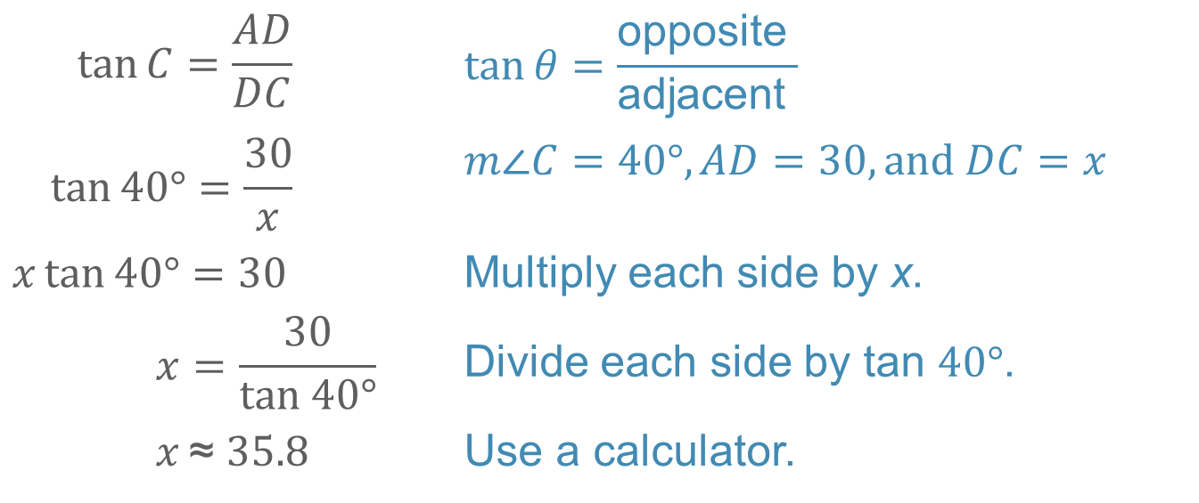
Example 2
Angle of Depression
Let x represent the horizontal distance from the base of the hotel to the hydrant.
$$\tan{C=\frac{AD}{DC}}$$ | $$\tan{θ=\frac{\text{opposite} }{\text{adjacent} }}$$
$$\tan{40°=\frac{30}{x}}$$ | $$m\text{∠}C=40°, AD=30, and DC=x$$
$$x\tan{40°=30}$$ | Multiply each side by x.
$$x=\frac{30}{tan 40°}$$ | Divide each side by tan $40°$.
$$x \text{≈ }35.8$$ | Use a calculator.
The horizontal distance from Pedro to the hydrant is about 36 feet.

Slide 14
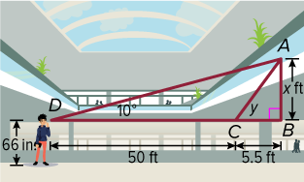
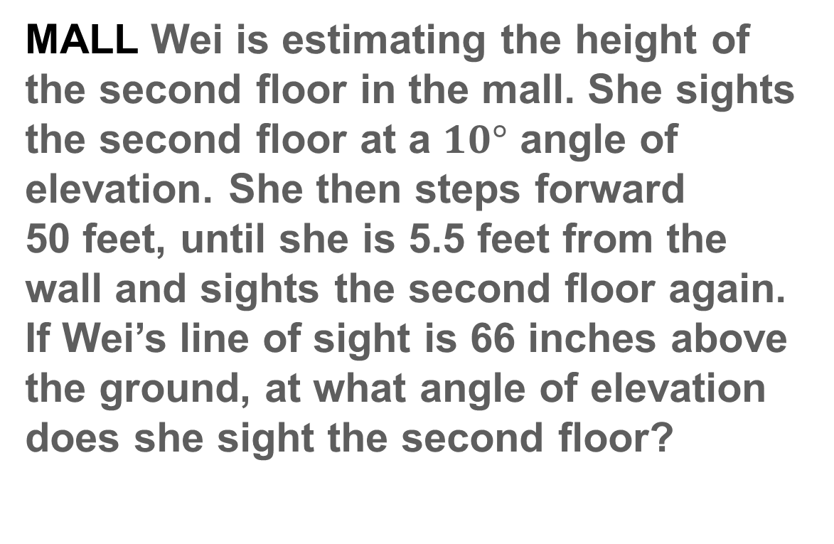
Example 3A
Use Two Angles of Elevation or Depression
MALL Wei is estimating the height of the second floor in the mall. She sights the second floor at a $10°$ angle of elevation. She then steps forward 50 feet, until she is 5.5 feet from the wall and sights the second floor again. If Wei’s line of sight is 66 inches above the ground, at what angle of elevation does she sight the second floor?

Slide 15
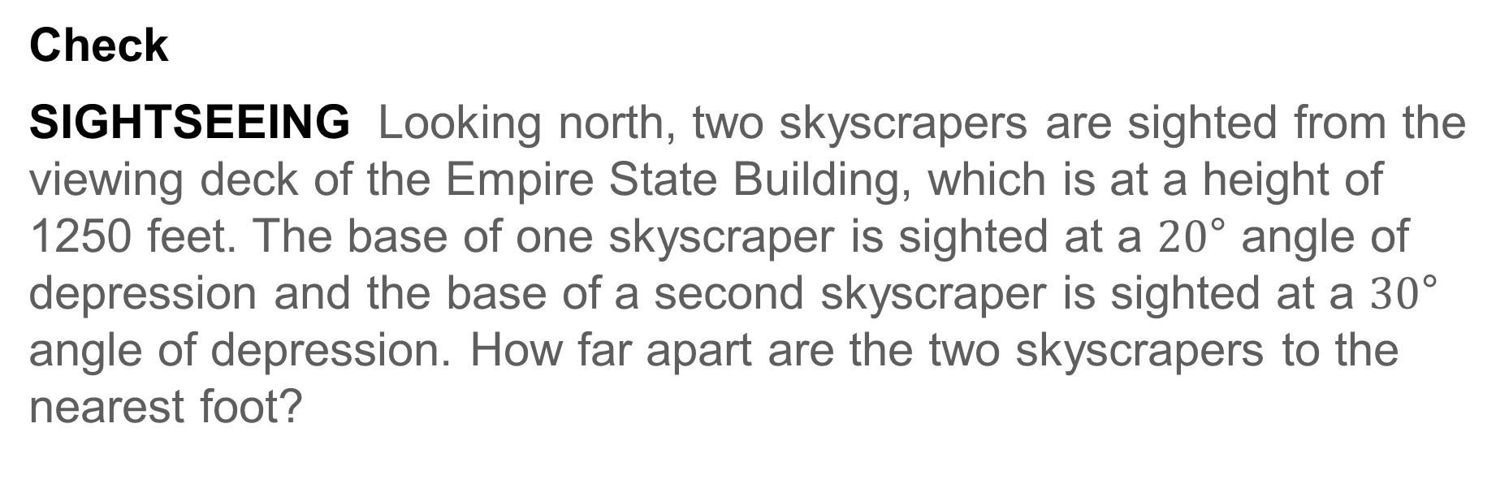
Example 3B
Use Two Angles of Elevation or Depression
Check
SIGHTSEEING Looking north, two skyscrapers are sighted from the viewing deck of the Empire State Building, which is at a height of 1250 feet. The base of one skyscraper is sighted at a $20\text{°}$ angle of depression and the base of a second skyscraper is sighted at a $30\text{°}$ angle of depression. How far apart are the two skyscrapers to the nearest foot?

Slide 16
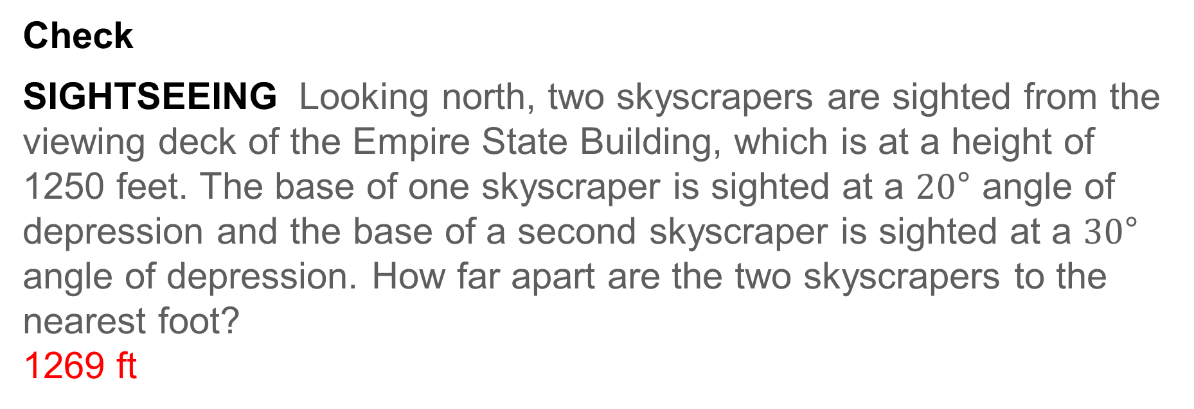
Example 3
Use Two Angles of Elevation or Depression
Check
SIGHTSEEING Looking north, two skyscrapers are sighted from the viewing deck of the Empire State Building, which is at a height of 1250 feet. The base of one skyscraper is sighted at a $20\text{°}$ angle of depression and the base of a second skyscraper is sighted at a $30\text{°}$ angle of depression. How far apart are the two skyscrapers to the nearest foot?
1269 ft
Notes:
1269 ft

Slide 17

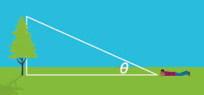
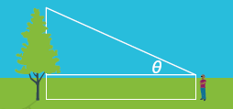
Exit Ticket
Suppose you want to measure the height of a tree. Describe the method of indirect measurement being used in each picture.
1. 2. 3.

Slide 18
Exit Ticket
Suppose you want to measure the height of a tree. Describe the method of indirect measurement being used in each picture.
1. 2. 3.
similar triangles and proportions with shadows
angle of elevation and trigonometric ratio (on the ground)
angle of elevation and trigonometric ratio (standing)
Notes:
similar triangles and proportions with shadows
angle of elevation and trigonometric ratio (on the ground)
angle of elevation and trigonometric ratio (standing)

