Slide 1

monday

Slide 2
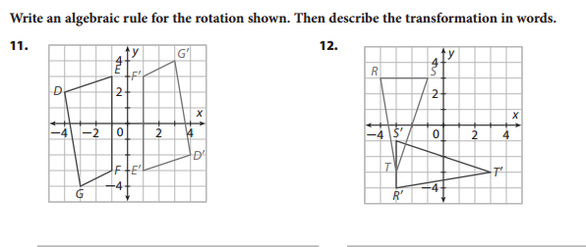
tuesday

Slide 3
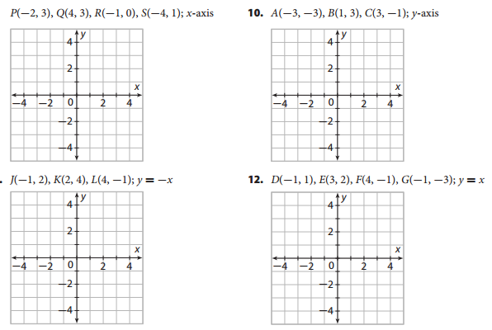
wednesday

Slide 4

thursday
Write the rule of the these transformations:

Slide 5
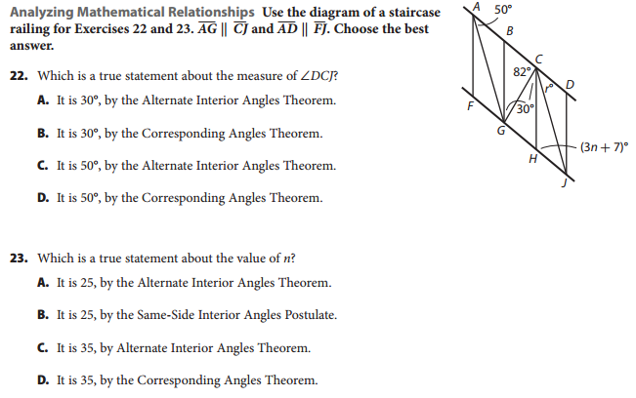
Friday

