Slide 1
Density

Slide 2
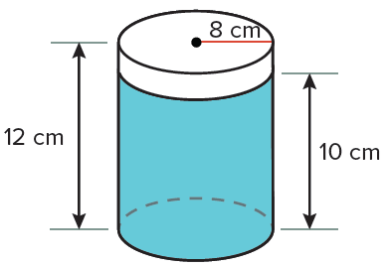
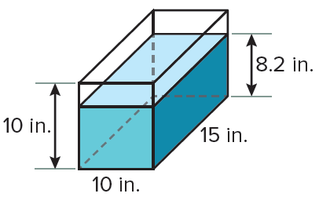
Warm Up
The amount of powder left in each container is shown. Find the volume of each container. Then find the volume of the powder left in the container. Round to the nearest tenth if necessary.
1.
2.

Slide 3
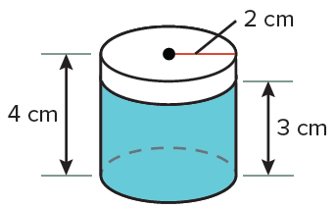
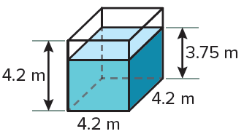
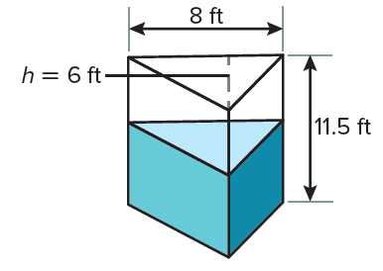
Warm Up
3.
4.
5. The volume of powder poured out of the triangular prism is 120 cubic feet. What is the volume of the powder left inside the prism?

Slide 4
Warm Up
The amount of powder left in each container is shown. Find the volume of each container. Then find the volume of the powder left in the container. Round to the nearest tenth if necessary.
1.
2.
2412.7 cm³; 2010.6 cm³
1500 in³; 1230 in³
Notes:
2412.7 cm³; 2010.6 cm³
1500 in³; 1230 in³

Slide 5
Warm Up
3.
4.
74.1 m³; 66.2 m³
50.3 cm³; 37.7 cm³
5. The volume of powder poured out of the triangular prism is 120 cubic feet. What is the volume of the powder left inside the prism?
156 ft³
Notes:
74.1 m³; 66.2 m³
50.3 cm³; 37.7 cm³
156 ft³

Slide 6
Florida’s B.E.S.T. Standards for Mathematics
MA.912.GR.4.4
Solve mathematical and real-world problems involving
the area of two-dimensional figures.
MA.912.GR.4.5
Solve mathematical and real-world problems involving
the volume of three-dimensional figures limited to cylinders, pyramids, prisms, cones and spheres.

Slide 7
Florida’s Mathematical Thinking and Reasoning Standards
MA.K12.MTR.1.1
Actively participate in effortful learning both individually and collectively.
MA.K12.MTR.6.1
Assess the reasonableness of solutions.
MA.K12.MTR.7.1
Apply mathematics to real-world contexts.

Slide 8
Lesson Objectives
Content Objective
Students solve real-world problems involving
density by using area and volume.
Language Objectives
Students explain how to compute density in real-world problems using means.
To support sense-making, students participate in MLR6: Three Reads.

Slide 9
Learn
Density Based on Area
Density is a measure of the quantity of some physical property per unit of length, area, or volume. One example of density is population density, which is the measurement of population per unit of area. Population density is calculated for states, major cities, or other areas, based on data collected from the U.S. Census.

Slide 10
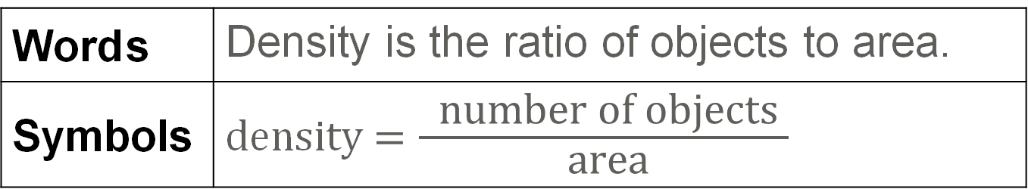
Learn
Density Based on Area
Density Based on Area
Word s | Density is the ratio of objects to area.
Symbols | density $=\frac{ \text{number} \text{of} \text{objects} }{ \text{area} }$

Slide 11
Example 1
Find the Density of an Area
POPULATION The World Bank reports that the population of Greenland in 2015 was 56,114. If the total land area is about 836,000 square miles, what is the population density of Greenland?

Slide 12
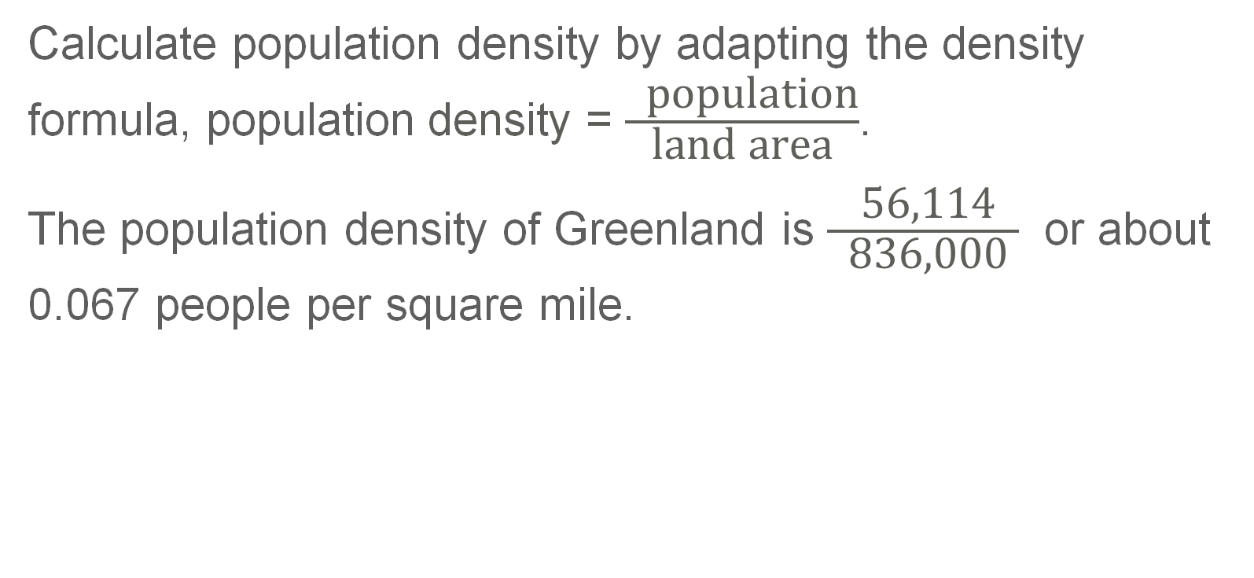
Example 1
Find the Density of an Area
Calculate population density by adapting the density formula, population density = $\frac{ \text{population}}{\text{land} \text{area}}$.
The population density of Greenland is $\frac{ \text{56,114} }{ \text{836,000} }$ or about 0.067 people per square mile.

Slide 13
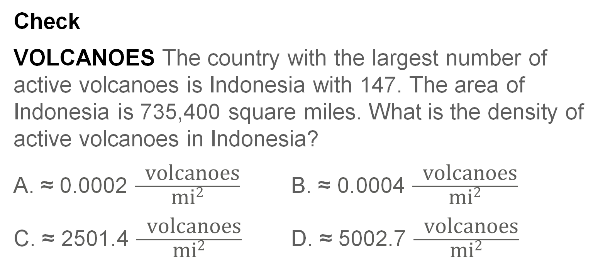
Example 1
Find the Density of an Area
Check
VOLCANOES The country with the largest number of active volcanoes is Indonesia with 147. The area of Indonesia is 735,400 square miles. What is the density of active volcanoes in Indonesia?
A. ≈ 0.0002 $\frac{ \text{volcanoes}}{\text{mi}\text{2}}$ B. ≈ 0.0004 $\frac{ \text{volcanoes}}{\text{mi}\text{2}}$
C. ≈ 2501.4 $\frac{ \text{volcanoes}}{\text{mi}\text{2}}$ D. ≈ 5002.7 $\frac{ \text{volcanoes}}{\text{mi}\text{2}}$

Slide 14
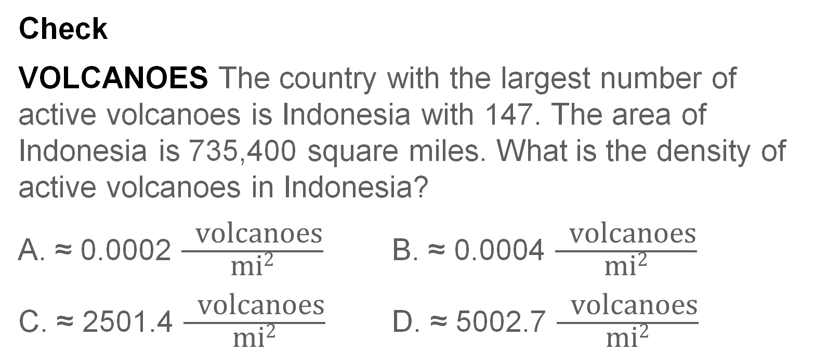
Example 1
Find the Density of an Area
Check
VOLCANOES The country with the largest number of active volcanoes is Indonesia with 147. The area of Indonesia is 735,400 square miles. What is the density of active volcanoes in Indonesia?
A. ≈ 0.0002 $\frac{ \text{volcanoes}}{\text{mi}\text{2}}$ B. ≈ 0.0004 $\frac{ \text{volcanoes}}{\text{mi}\text{2}}$
C. ≈ 2501.4 $\frac{ \text{volcanoes}}{\text{mi}\text{2}}$ D. ≈ 5002.7 $\frac{ \text{volcanoes}}{\text{mi}\text{2}}$
A
Notes:
A

Slide 15
Example 2
Use the Density of an Area
GREENHOUSE GASES Masha has a farm with 220 milking cows that produce 286 pounds per acre for a total of 1,412,840 pounds of milk. Due to recent regulations, Masha must pay a fee if she has more than 30 cows per square mile on her farm. Determine whether Masha will have to pay the fee. (Hint: There are 640 acres in 1 square mile.)

Slide 16
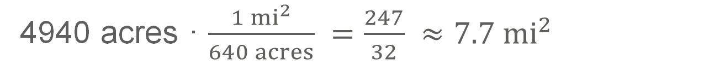
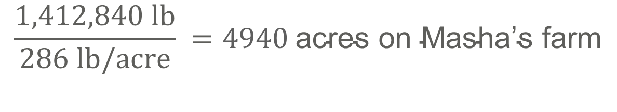
Example 2
Use the Density of an Area
Step 1 Find the area of the farm.
$$\frac{1,412,840 lb}{286 lb/acre} =4940 \text{acres} \text{on} \text{Masha}\text{’}\text{s} \text{farm}$$
Step 2 Convert to square miles.
Use a conversion factor.
4940 acres · $\frac{1 {mi}^{2}}{640 acres} =\frac{247}{32} ≈7.7 {mi}^{2}$
There are about 7.7 square miles on Masha’s farm.

Slide 17
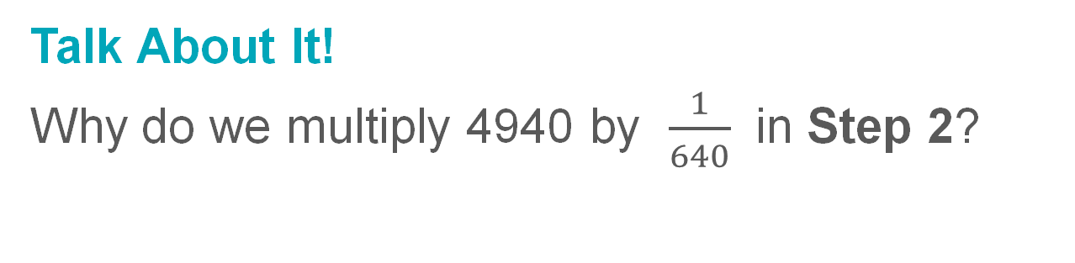
Example 2
Use the Density of an Area
Talk About It!
Why do we multiply 4940 by $\frac{1}{640}$ in Step 2?

Slide 18
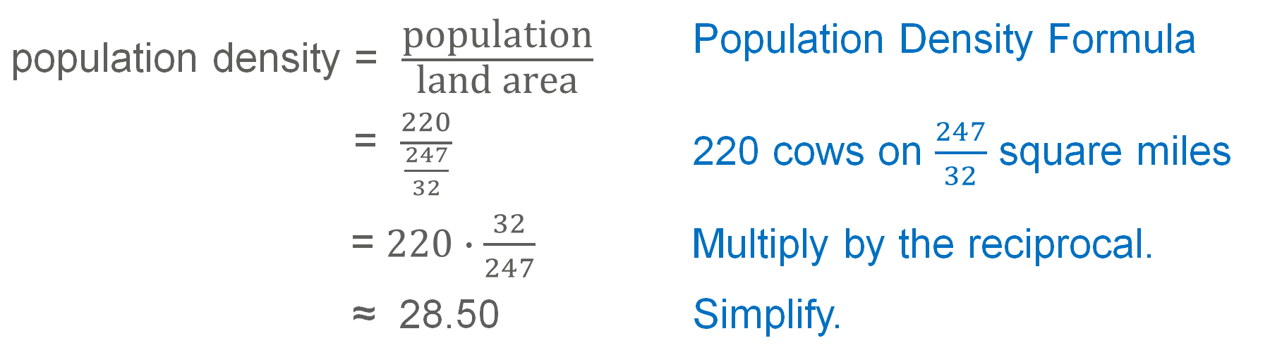
Example 2
Use the Density of an Area
Step 3 Find the density of cows per acre.
Calculate population density by adapting the density formula.
population density = $\frac{\text{population}}{\text{land} \text{area}}$ | Population Density Formula
= $\frac{220}{\frac{247}{32}}$ | 220 cows on $\frac{247}{32}$ square miles
= $220∙\frac{32}{247}$ | Multiply by the reciprocal.
≈ 28.50 | Simplify.
Because 28.50 is fewer than 30, Masha will not have to pay the fee.

Slide 19
Example 2
Use the Density of an Area
Check
DUCK POND For a school carnival game, Adalynn is planning to fill a pool with water and float a layer of numbered rubber ducks on top. She knows that it takes 25 rubber ducks to fill 1 square foot of area. The pool used for the carnival has an area of about 7 square feet. How many rubber ducks should she buy to fill the pool?

Slide 20
Example 2
Use the Density of an Area
Check
DUCK POND For a school carnival game, Adalynn is planning to fill a pool with water and float a layer of numbered rubber ducks on top. She knows that it takes 25 rubber ducks to fill 1 square foot of area. The pool used for the carnival has an area of about 7 square feet. How many rubber ducks should she buy to fill the pool?
Adalynn should buy 175 rubber ducks.
Notes:
Adalynn should buy 175 rubber ducks.

Slide 21
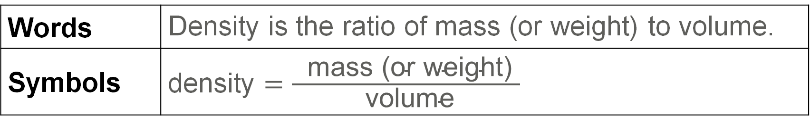
Learn
Density Based on Volume
Density is the measure of the quantity of some physical property per unit of length, area, or volume. If two objects have the same volume but different masses, the object with the greater mass will be denser.
Density Based on Volume
Words | Density is the ratio of mass (or weight) to volume.
Symbols | density $=\frac{ \text{mass}\text{ (}\text{or} \text{weight}\text{) }}{ \text{volume} }$

Slide 22
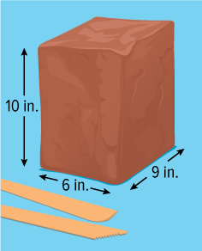
Example 3
Find the Density of a Solid
ART Antonio opens a new brick of clay
that weighs 25 pounds.
a. What is the density of the brick of clay?
b. Antonio uses the same clay to make a foundational cube for a sculpture. If the cube weighs 1.3 pounds, what are the dimensions of the cube?

Slide 23
Example 3
Find the Density of a Solid
a. What is the density of the brick of clay?
First find the volume of the clay, which can be approximated by using the formula for the volume of a rectangular prism.
V = 𝓁wh | Volume of a rectangular prism
= 6(9)(10) | 𝓁 = 6, w = 9, and h = 10
≈ 540 in³ | Simplify.

Slide 24
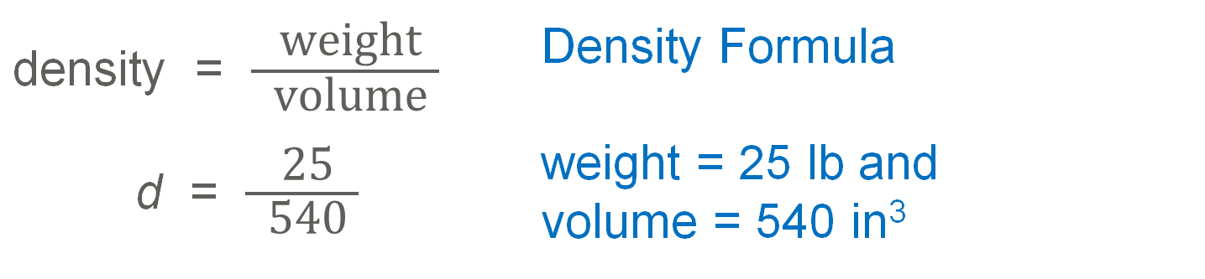
Example 3
Find the Density of a Solid
Next, use the density formula to calculate the density.
density = $\frac{ \text{weight} }{ \text{volume} }$ | Density Formula
d = $\frac{\text{ 25 }}{\text{ 540 }}$ | weight = 25 lb and volume = 540 in³
The density of the clay is about 0.046 pounds per cubic inch.

Slide 25
Example 3
Find the Density of a Solid
b. Antonio uses the same clay to make a foundational cube for a sculpture. If the cube weighs 1.3 pounds, what are the dimensions of the cube?
Use the density formula to find the volume of the clay Antonio is using given the weight and the density of the clay.

Slide 26
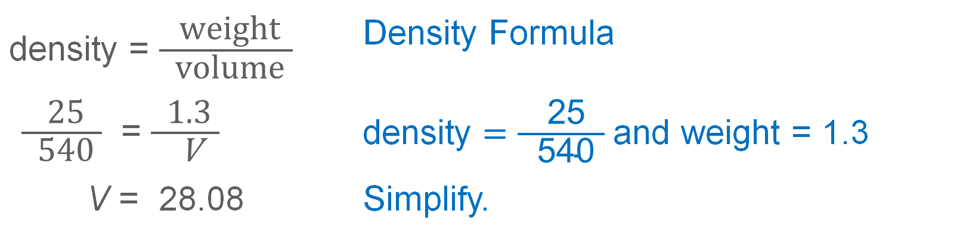
Example 3
Find the Density of a Solid
density = $\frac{ \text{weight} }{ \text{volume} }$ | Density Formula
$\frac{\text{ 25 }}{\text{ 540 }}$ = $\frac{\text{ 1.3 }}{ \text{V} }$ | density $=\frac{\text{ 25 }}{\text{ 540 }}$and weight = 1.3
V = 28.08 | Simplify.
Because the foundation is a cube, each edge s must be the same length. Therefore, s³ = 28.08 and s ≈ 3.04.
Each side of Antonio’s cube will be about 3.04 inches long.

Slide 27
Example 3
Find the Density of a Solid
Think About It!
If Antonio decides to change the size of the cube so that its weight is greater than 1.3 pounds, how will this change affect the density? Explain.

Slide 28
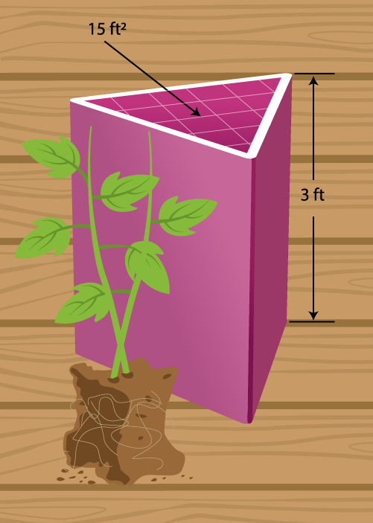
Example 3
Find the Density of a Solid
Check
GARDENING When Kimani filled her planter with soil, the weight of the planter increased by 90 pounds.
What is the density of the soil?
Kimani uses the same soil to fill another planter, and the weight increased by 154 pounds. What is the volume of the other planter?

Slide 29
Example 3
Find the Density of a Solid
Check
GARDENING When Kimani filled her planter with soil, the weight of the planter increased by 90 pounds.
What is the density of the soil? 2 pounds per cubic foot
Kimani uses the same soil to fill another planter, and the weight increased by 154 pounds. What is the volume of the other planter? 77 ft³
Notes:
2 pounds per cubic foot
77 ft³

Slide 30
Pause and Reflect
Did you struggle with anything in this lesson?
If so, how did you deal with it?

Slide 31
Exit Ticket
Answer each question.
1. As of 2014, the city of Tokyo, Japan, had 37,833,000 residents. These people share a space with an area of 845 square miles. To the nearest person, what is the approximate density of Tokyo?
2. Jana makes a cheese ball for a party she is attending. The cheese ball weighs about 32 ounces and has a radius of about 3 inches. You can estimate the volume of the cheese ball using the formula for the volume of a sphere. What is the density of the cheese ball rounded to the nearest hundredth?

Slide 32
Exit Ticket
Answer each question.
1. As of 2014, the city of Tokyo, Japan, had 37,833,000 residents. These people share a space with an area of 845 square miles. To the nearest person, what is the approximate density of Tokyo?
2. Jana makes a cheese ball for a party she is attending. The cheese ball weighs about 32 ounces and has a radius of about 3 inches. You can estimate the volume of the cheese ball using the formula for the volume of a sphere. What is the density of the cheese ball rounded to the nearest hundredth?
44,773 people per square mile
0.28 ounce per cubic inch
Notes:
44,773 people per square mile
0.28 ounce per cubic inch

