Slide 1
Rectangles

Slide 2
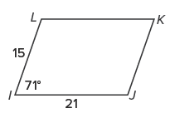
Warm Up
Find the unknown measures for the parallelogram.
1. JK
2. m∠J
3. m∠L
4. KL
5. m∠K

Slide 3
Warm Up
Find the unknown measures for the parallelogram.
1. JK 15
2. m∠J 109°
3. m∠L 109°
4. KL 21
5. m∠K 71°
Notes:
15
109°
109°
21
71°

Slide 4
Florida’s B.E.S.T. Standards for Mathematics
MA.912.GR.1.4
Prove relationships and theorems about parallelograms. Solve mathematical and real-world problems involving postulates, relationships and theorems of parallelograms.
MA.912.GR.3.2
Given a mathematical context, use coordinate geometry to classify or justify definitions, properties and theorems involving circles, triangles or quadrilaterals.
MA.912.GR.3.3
Use coordinate geometry to solve mathematical and real-world geometric problems involving lines, circles, triangles and quadrilaterals.

Slide 5
Florida’s Mathematical Thinking and Reasoning Standards
MA.K12.MTR.2.1
Demonstrate understanding by representing problems in multiple ways.

Slide 6
Lesson Objectives
Content Objective
Students use the properties of rectangles to determine whether a parallelogram is a rectangle and to write proofs.
Language Objectives
Students talk about using the properties of rectangles to determine whether a parallelogram is a rectangle and to write proofs using sentences starting with Because….
To support sense-making, students participate in MLR2: Collect and Display.

Slide 7
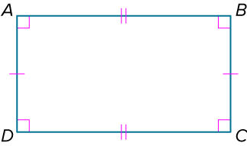
Learn
Properties of Rectangles
A rectangle is a parallelogram with four right angles. To name a rectangle, use the symbol ▭. From the definition, you know that a rectangle has the following properties:
All four angles are right angles.
Opposite sides are parallel and congruent.
Opposite angles are congruent.
Consecutive angles are supplementary.
Diagonals bisect each other.

Slide 8
Learn
Properties of Rectangles
In addition, the diagonals of a rectangle are congruent.
Theorem 7.13: Diagonals of a Rectangle
If a parallelogram is a rectangle, then its diagonals are congruent.

Slide 9
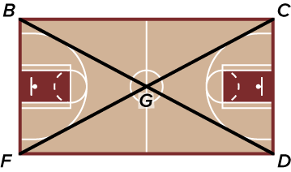
Example 1
Use Properties of Rectangles
PRACTICE A basketball team is running a drill along the diagonals of the court. Given ▭BCDF, if FC = 106.5 feet, find DG.

Slide 10
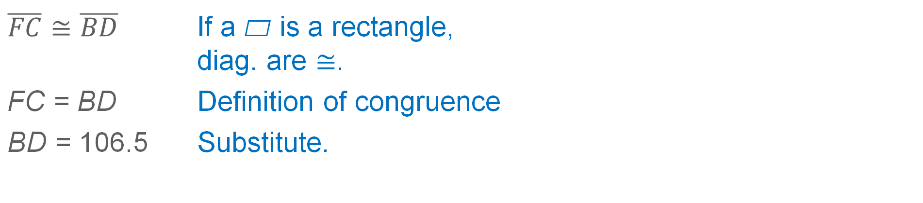
Example 1
Use Properties of Rectangles
$\overline{FC}≅\overline{BD}$ | If a ▱ is a rectangle, diag. are $≅$.
FC = BD | Definition of congruence
BD = 106.5 | Substitute.

Slide 11
Example 1
Use Properties of Rectangles
Think About It!
What does point G represent in the context of the problem?

Slide 12
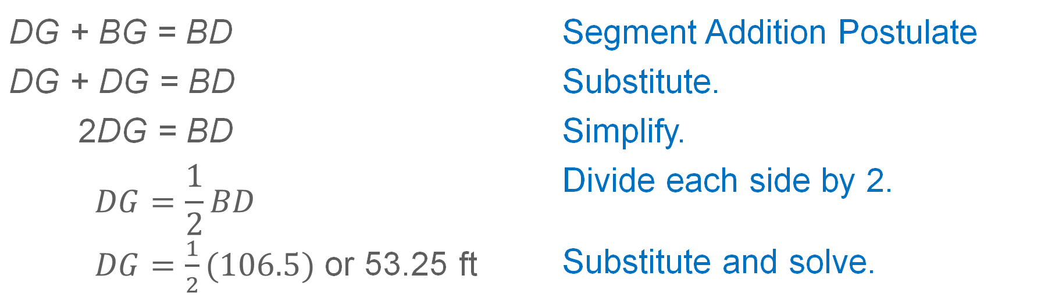
Example 1
Use Properties of Rectangles
Because BCDF is a rectangle, it is a parallelogram. The diagonals of a parallelogram bisect each other, so DG = BG.
DG + BG = BD | Segment Addition Postulate
DG + DG = BD | Substitute.
2DG = BD | Simplify.
$$DG=\frac{1}{2}BD$$ $DG=\frac{1}{2}(106.5)$ or 53.25 ft | Divide each side by 2. Substitute and solve.

Slide 13
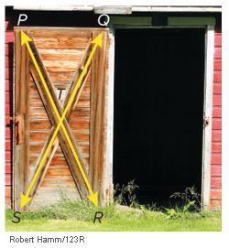
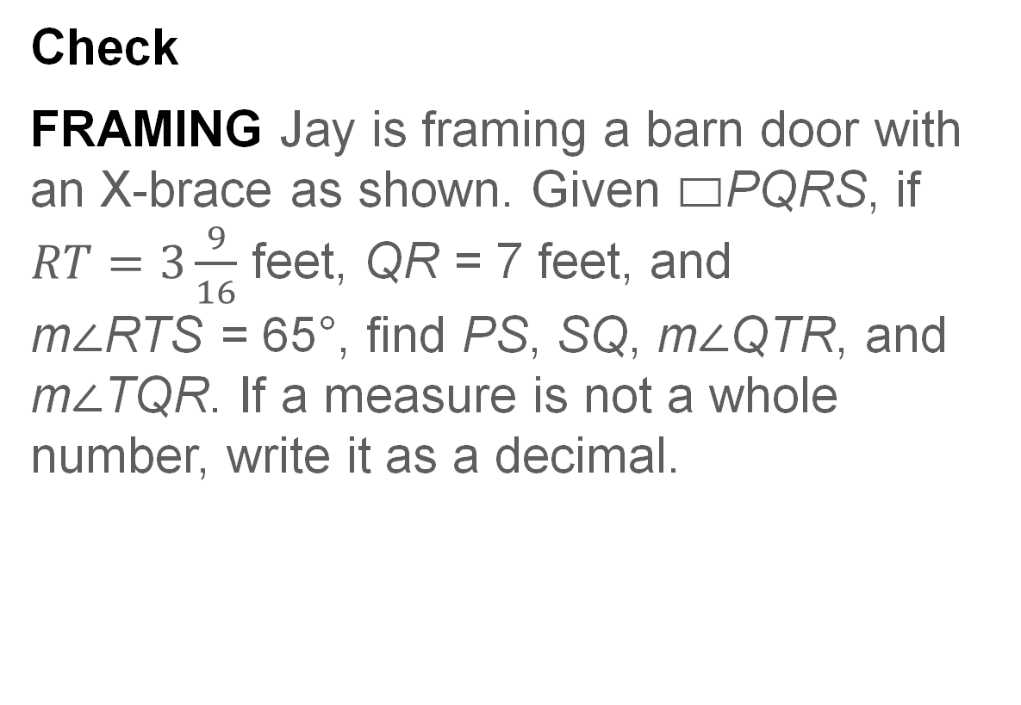
Example 1
Use Properties of Rectangles
Check
FRAMING Jay is framing a barn door with an X-brace as shown. Given ▭PQRS, if $RT=3\frac{9}{16}$ feet, QR = 7 feet, and
m∠RTS = 65°, find PS, SQ, m∠QTR, and m∠TQR. If a measure is not a whole number, write it as a decimal.

Slide 14
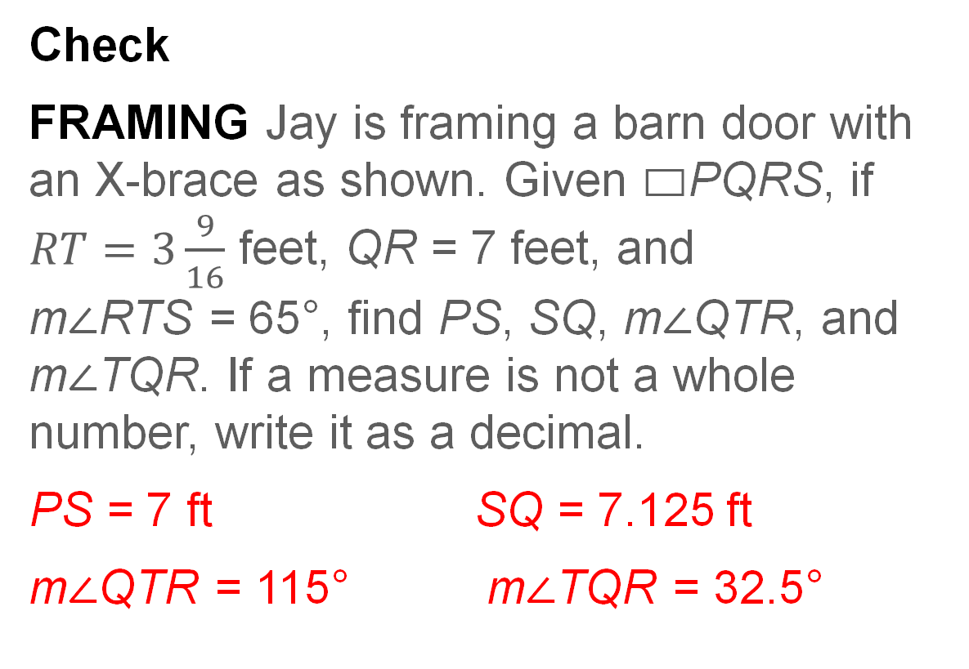
Example 1
Use Properties of Rectangles
Check
FRAMING Jay is framing a barn door with an X-brace as shown. Given ▭PQRS, if $RT=3\frac{9}{16}$ feet, QR = 7 feet, and
m∠RTS = 65°, find PS, SQ, m∠QTR, and m∠TQR. If a measure is not a whole number, write it as a decimal.
PS = 7 ft SQ = 7.125 ft
m∠QTR = 115° m∠TQR = 32.5°
Notes:
PS = 7 ft
SQ = 7.125 ft
m∠QTR = 115°
m∠TQR = 32.5°

Slide 15
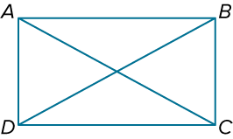
Example 2
Use Properties of Rectangles and Algebra
Quadrilateral ABCD is a rectangle.
If m∠BAC = (3x + 3)° and
m∠ACB = (5x − 1)°, find the value of x.

Slide 16
Example 2
Use Properties of Rectangles and Algebra
Because ABCD is a rectangle, it has four right angles. So, m∠DCB = 90°. Because a rectangle is a parallelogram, opposite sides are parallel. Alternate interior angles of parallel lines are congruent, so ∠ACD ≅ ∠BAC.
m∠ACD + m∠ACB = 90° | Angle Addition Postulate
m∠BAC + m∠ACB = 90° | Substitution
(3x + 3)° + (5x − 1)° = 90° | Substitution
x = 11 | Solve.

Slide 17
Example 2
Use Properties of Rectangles and Algebra
Think About It!
There are four congruent right triangles formed by the diagonals of a rectangle. How many pairs of congruent triangles are there in all?

Slide 18
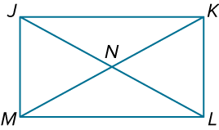
Example 2
Use Properties of Rectangles and Algebra
Check
Quadrilateral JKLM is a rectangle.
Part A
If MN = 3x + 1 and JL = 2x + 9, find MK. Round to the nearest tenth if necessary.
Part B
If m∠JNK = (5x + 2)° and m∠JNM = (3x − 6)°, find m∠JNK and m∠JNM.

Slide 19
Example 2
Use Properties of Rectangles and Algebra
Check
Quadrilateral JKLM is a rectangle.
Part A
If MN = 3x + 1 and JL = 2x + 9, find MK. Round to the nearest tenth if necessary.
MK = 12.5
Part B
If m∠JNK = (5x + 2)° and m∠JNM = (3x − 6)°, find m∠JNK and m∠JNM.
m∠JNK = 117°, m∠JNM = 63°
Notes:
MK = 12.5
m∠JNK = 117°, m∠JNM = 63°

Slide 20
Learn
Proving that Parallelograms are Rectangles
You have learned that if a parallelogram is a rectangle, then the diagonals of the parallelogram are congruent. The converse is also true.
Theorem 7.14: Diagonals of a Rectangle
If the diagonals of a parallelogram are congruent, then the parallelogram is a rectangle.

Slide 21
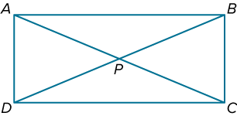
Example 3
Prove Rectangular Relationships
If AB = 50 feet, BC = 20 feet,
CD = 50 feet, AD = 20 feet,
AC = 54 feet, and BD = 54 feet, prove that quadrilateral ABCD is a rectangle.

Slide 22
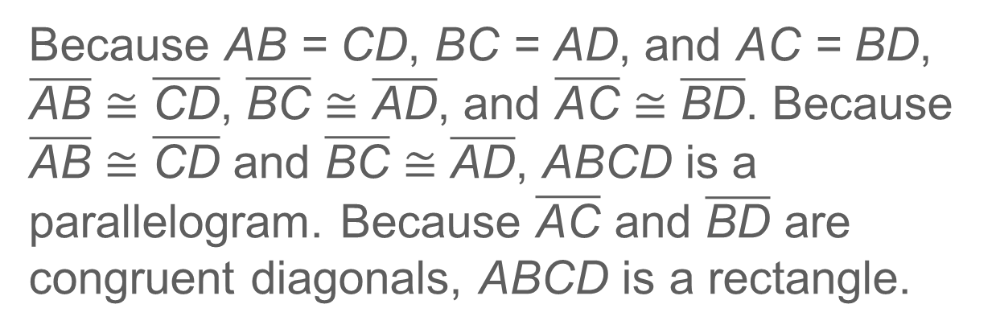
Example 3
Prove Rectangular Relationships
Because AB = CD, BC = AD, and AC = BD, $\overline{\text{AB}}$≅ $\overline{\text{CD}}$, $\overline{\text{BC}}$≅ $\overline{\text{A}\text{D}}$, and $\overline{\text{A}\text{C}}$≅ $\overline{\text{B}\text{D}}$. Because $\overline{\text{AB}}$≅ $\overline{\text{CD}}$ and $\overline{\text{BC}}$≅ $\overline{\text{AD}}$, ABCD is a parallelogram. Because $\overline{\text{A}\text{C}}$ and $\overline{\text{BD}}$ are congruent diagonals, ABCD is a rectangle.

Slide 23
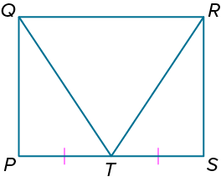
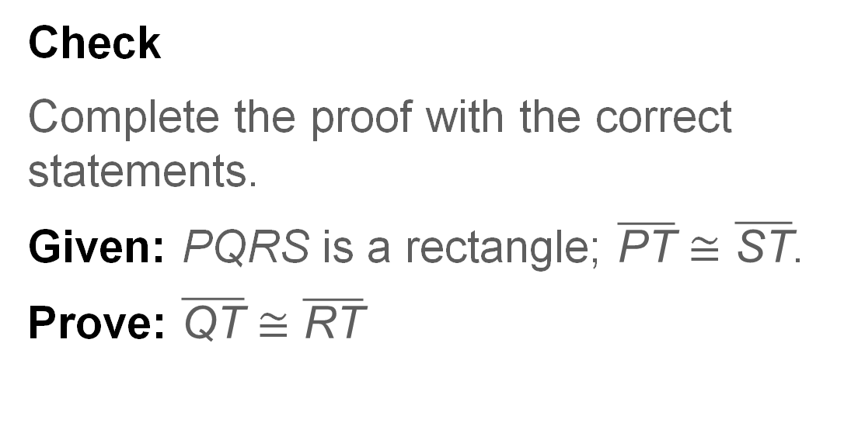
Example 3
Prove Rectangular Relationships
Check
Complete the proof with the correct statements.
Given: PQRS is a rectangle; $\overline{\text{PT}}$≅ $\overline{\text{ST}}$.
Prove: $\overline{\text{QT}}$≅ $\overline{\text{RT}}$

Slide 24
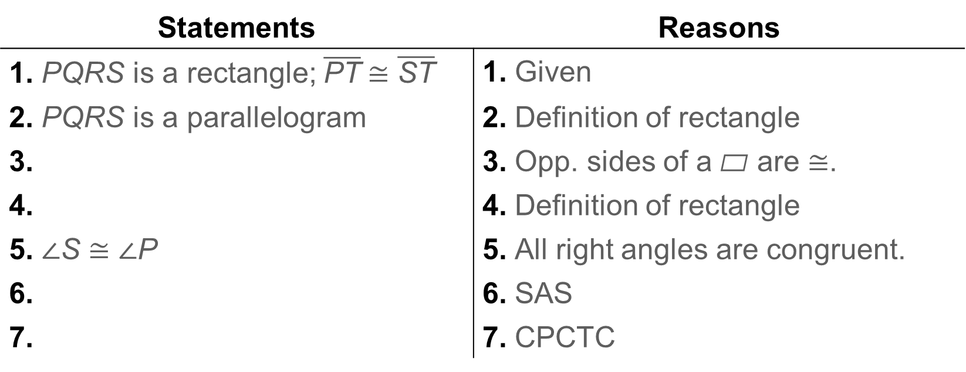
Example 3
Prove Rectangular Relationships
Proof:
Statements | Reasons
1. PQRS is a rectangle; $\overline{\text{PT}}$≅ $\overline{\text{ST}}$ | 1. Given
2. PQRS is a parallelogram | 2. Definition of rectangle
3. | 3. Opp. sides of a ▱ are ≅.
4. | 4. Definition of rectangle
5. ∠S ≅ ∠P | 5. All right angles are congruent.
6. | 6. SAS
7. | 7. CPCTC

Slide 25
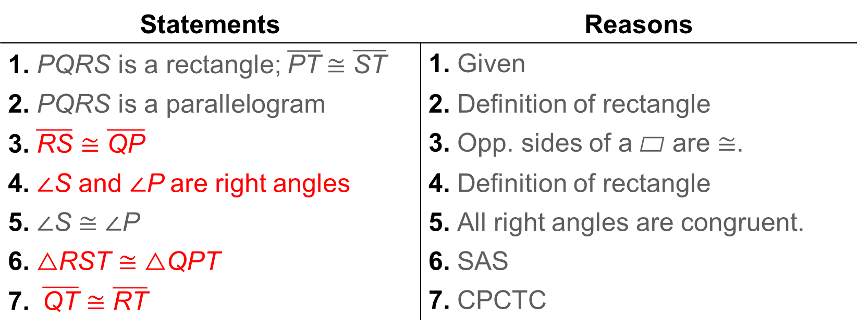
Example 3
Prove Rectangular Relationships
Proof:
Statements | Reasons
1. PQRS is a rectangle; $\overline{\text{PT}}$≅ $\overline{\text{ST}}$ | 1. Given
2. PQRS is a parallelogram | 2. Definition of rectangle
3. $\overline{\text{RS}}≅\overline{\text{QP}}$ | 3. Opp. sides of a ▱ are ≅.
4. ∠S and ∠P are right angles | 4. Definition of rectangle
5. ∠S ≅ ∠P | 5. All right angles are congruent.
6. △RST ≅ △QPT | 6. SAS
7. $\overline{\text{QT}}≅\overline{\text{RT}}$ | 7. CPCTC
Notes:
3. $\overline{\text{RS}}$ ≅ $\overline{\text{QP}}$
4. ∠S and ∠P are right angles.
6. △RST ≅ △QPT
7. $\overline{\text{QT}}$ ≅ $\overline{\text{RT}}$

Slide 26
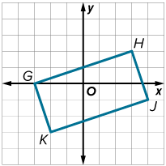
Example 4
Identify Rectangles on the Coordinate Plane
Quadrilateral GHJK has vertices G(−3, 0), H(3, 2), J(4, −1), and K(−2, −3). Determine whether GHJK is a rectangle by using the Distance Formula.

Slide 27
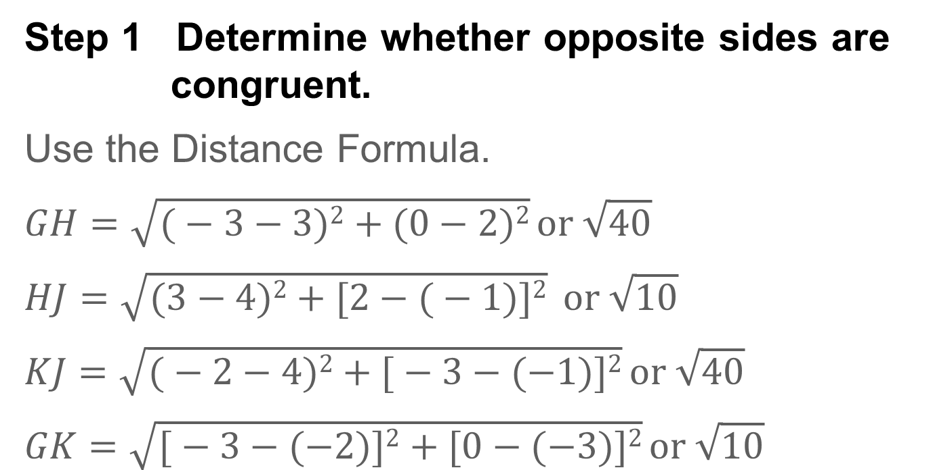
Example 4
Identify Rectangles on the Coordinate Plane
Step 1 Determine whether opposite sides are congruent.
Use the Distance Formula.
$$GH=\sqrt{\text{(}−\text{3}−\text{3)}\text{2}+\text{(0}−\text{2)}\text{2}} or \sqrt{\text{40}}$$
$$HJ=\sqrt{\text{(3}−\text{4}\text{)}\text{2}+\text{[2}−\text{(}−\text{1}\text{)}\text{]}\text{2}} or \sqrt{\text{10}}$$
$$KJ=\sqrt{\text{(}−\text{2}−\text{4}\text{)}\text{2}+\text{[}−\text{3}−(−\text{1}\text{)}\text{]}\text{2}} or \sqrt{\text{40}}$$
$$GK=\sqrt{\text{[}−\text{3}−(−\text{2}\text{)}\text{]}\text{2}+\text{[}\text{0}−(−\text{3}\text{)]}\text{2}} or \sqrt{\text{10}}$$

Slide 28
Example 4
Identify Rectangles on the Coordinate Plane
Because opposite sides of the quadrilateral have the same measure, they are congruent. So, quadrilateral GHJK is a parallelogram.

Slide 29
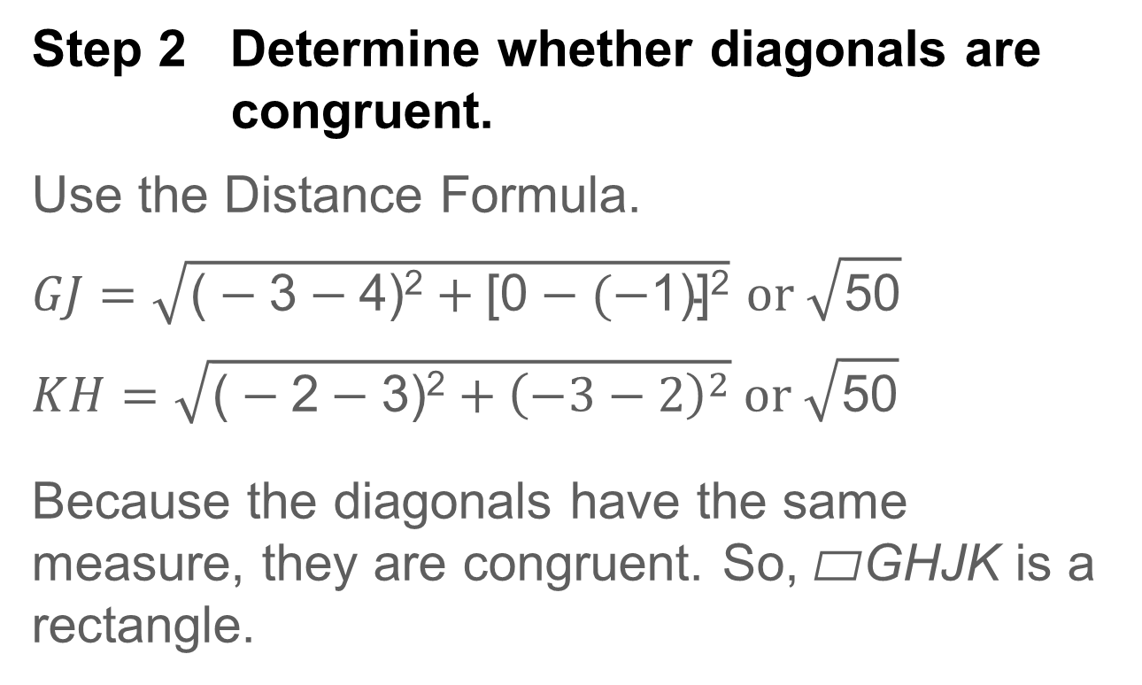
Example 4
Identify Rectangles on the Coordinate Plane
Step 2 Determine whether diagonals are congruent.
Use the Distance Formula.
$$GJ=\sqrt{\text{(}−\text{3}−\text{4}\text{)}\text{2}+\text{[0}−(−\text{1}\text{)}\text{]}\text{2}} or \sqrt{\text{50}}$$
$$KH=\sqrt{\text{(}−\text{2}−\text{3}\text{)}\text{2}+{\left(−3−2\right)}^{2}} or \sqrt{\text{50}}$$
Because the diagonals have the same measure, they are congruent. So, ▱GHJK is a rectangle.

Slide 30
Example 4
Identify Rectangles on the Coordinate Plane
Talk About It!
Is there another way to show that GHJK is a rectangle? If yes, explain.

Slide 31
Example 4
Identify Rectangles on the Coordinate Plane
Check
A quadrilateral has vertices A(2, 6), B(3, 7), and C(6, 4). Which of the following points would make ABCD a rectangle?
A. D(5, 3)
B. D(5, 2)
C. D(4, 3)
D. D(6, 3)

Slide 32
Example 4
Identify Rectangles on the Coordinate Plane
Check
A quadrilateral has vertices A(2, 6), B(3, 7), and C(6, 4). Which of the following points would make ABCD a rectangle? A
A. D(5, 3)
B. D(5, 2)
C. D(4, 3)
D. D(6, 3)
Notes:
A

Slide 33
Pause and Reflect
Did you struggle with anything in this lesson? If so, how did you deal with it?

Slide 34
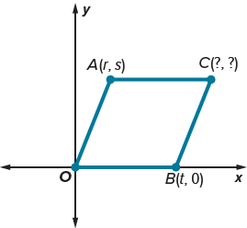
Exit Ticket
Without introducing any new variables, write the coordinates to place each figure on the coordinate plane. Justify your answers.
1. parallelogram

Slide 35
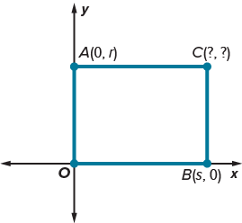
Exit Ticket
Without introducing any new variables, write the coordinates to place each figure on the coordinate plane. Justify your answers.
2. rectangle

Slide 36
Exit Ticket
Without introducing any new variables, write the coordinates to place each figure on the coordinate plane. Justify your answers.
1. parallelogram
(r + t, s); The x-coordinate of C would be the sum of the x-coordinates of A and B, and the y-coordinate of C would be the same as the y-coordinate of B.
Notes:
(r $+$ t, s); The x-coordinate of C would be the sum of the x-coordinates of A and B, and the y-coordinate of C would be the same as the y-coordinate of B.

Slide 37
Exit Ticket
Without introducing any new variables, write the coordinates to place each figure on the coordinate plane. Justify your answers.
2. rectangle
(s, r); The x-coordinate of C would be the same as the x-coordinate of B, and the
y-coordinate of C would be the same as the y-coordinate of A.
Notes:
(s, r); The x-coordinate of C would be the same as the x-coordinate of B, and the y-coordinate of C would be the same as the y-coordinate of A.

