Slide 1
Tangents and Secants

Slide 2
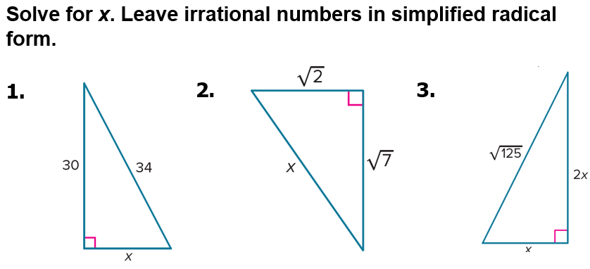
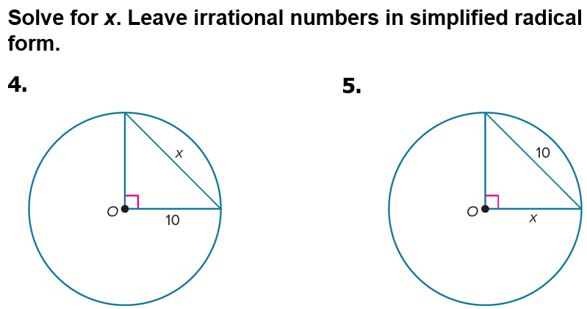
Warm Up

Slide 3
Florida’s B.E.S.T. Standards for Mathematics
MA.912.GR.6.1
Solve mathematical and real-world problems involving the length of a secant, tangent, segment or chord in a given circle.
MA.912.GR.6.2
Solve mathematical and real-world problems involving the measures of arcs and related angles.

Slide 4
Florida’s Mathematical Thinking and Reasoning Standards
MA.K12.MTR.4.1
Engage in discussions that reflect on the mathematical thinking of self and others.
MA.K12.MTR.6.1
Assess the reasonableness of solutions.

Slide 5
Lesson Objectives
Content Objective
Students solve problems using relationships between circles, tangents, and secants.
Language Objectives
Students talk about tangents and secants using represent.
To maximize linguistic and cognitive meta-awareness, students participate in MLR2: Collect and Display.

Slide 6
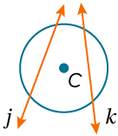
Learn
Tangents, Secants, and Angle Measures
A secant is any line or ray that intersects a circle in exactly two points. Lines j and k are secants of ⊙C.
When two secants intersect inside a circle, the angles formed are related to the arcs they intercept.

Slide 7
Learn
Tangents, Secants, and Angle Measures
Theorems
10.14 | If two secants or chords intersect in the interior of a circle, then the measure of each angle formed is one half the sum of the measures of the arcs intercepted by the angle and its vertical angle.
10.15 | If a secant and a tangent intersect at the point of tangency, then the measure of each angle formed is one half the measure of its intercepted arc.

Slide 8
Learn
Tangents, Secants, and Angle Measures
Theorems
10.16 | If two secants, a secant and a tangent, or two tangents intersect in the exterior of a circle, then the measure of the angle formed is one half the difference of the measures of the intercepted arcs.

Slide 9
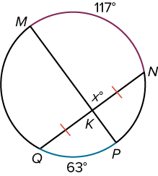
Example 1
Intersecting Chords or Secants
Find the value of x.

Slide 10
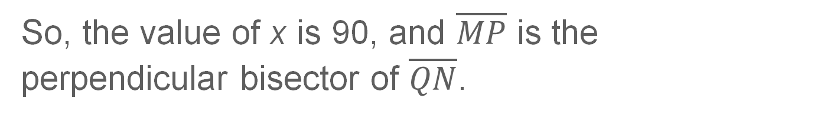
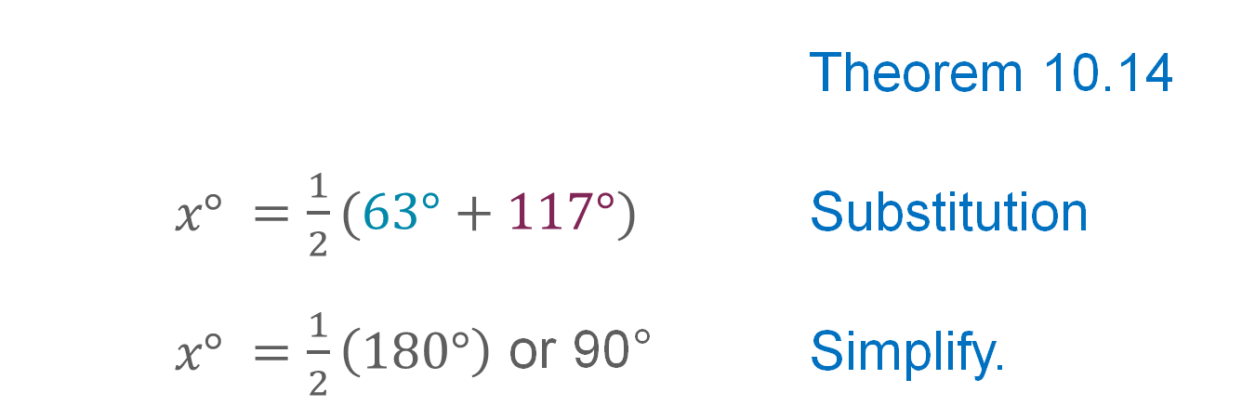
Example 1
Intersecting Chords or Secants
 |  | Theorem 10.14
$x°$ | $=\frac{1}{2}(63°+117°)$ | Substitution
$x°$ | $=\frac{1}{2}\left(180°\right)$ or 90° | Simplify.
So, the value of x is 90, and $\overline{MP}$ is the perpendicular bisector of $\overline{QN}$.

Slide 11
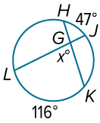
Example 1
Intersecting Chords or Secants
Check
Find the value of x.

Slide 12
Example 1
Intersecting Chords or Secants
Check
Find the value of x.
x = 81.5
Notes:
x = 81.5

Slide 13
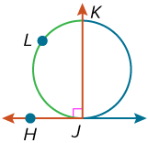
Example 2
Secants and Tangents Intersecting on a Circle
Find

Slide 14
Example 2
Secants and Tangents Intersecting on a Circle
 | Theorem 10.15
 | Substitution
 | Solve.

Slide 15
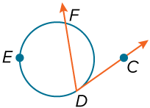
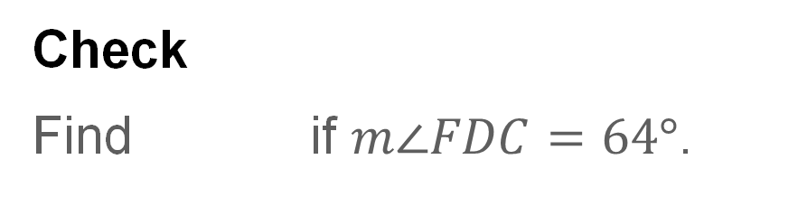
Example 2
Secants and Tangents Intersecting on a Circle
Check
Find if $m\text{∠}FDC=64°$.

Slide 16
Example 2
Secants and Tangents Intersecting on a Circle
Check
Find if $m\text{∠}FDC=64°$.
Notes:
$m\hat{DEF}=232°$

Slide 17
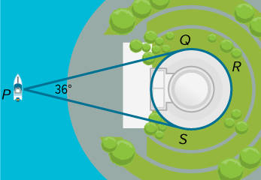
Example 3
Tangents and Secants Intersecting Outside a Circle
MEMORIALS A photographer is taking a photo of the Thomas Jefferson Memorial in Washington, D.C., from a boat in the Tidal Basin. The photographer’s lines of sight are tangent to the memorial at points Q and S. If the camera’s viewing angle measures 36°, what portion of the memorial will be visible in the photo?

Slide 18
Example 3
Tangents and Secants Intersecting Outside a Circle
Because the Thomas Jefferson Memorial can be modeled by a circle, the arc measure of the memorial is 360°. So, the portion of the memorial that will be visible in the photo is equal to

Slide 19
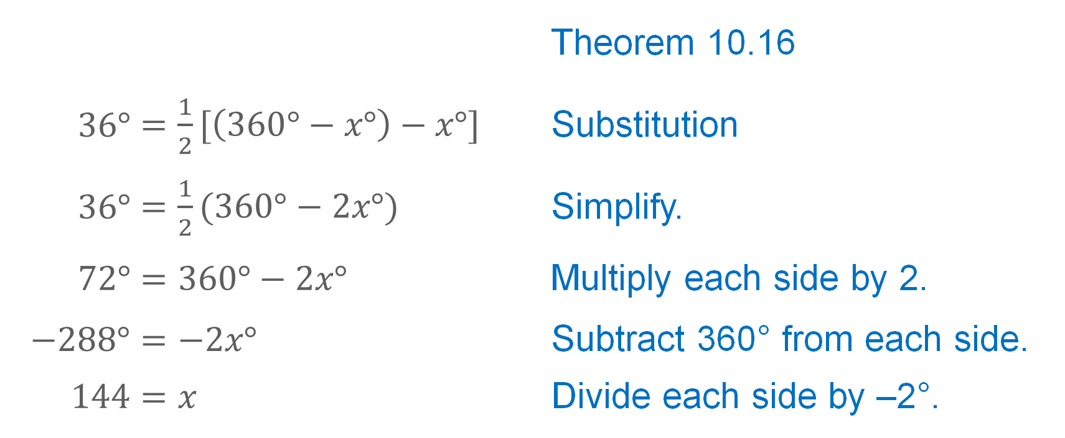
Example 3
Tangents and Secants Intersecting Outside a Circle
Let So,
 |  | Theorem 10.16
$36°$ | $=\frac{1}{2}[\left(360°−x°\right)−x°]$ | Substitution
$36°$ | $=\frac{1}{2}(360°−2x°)$ | Simplify.
$72°$ | $$=360°−2x°$$ | Multiply each side by 2.
$−288°$ | $$=−2x°$$ | Subtract 360° from each side.
$144$ | $$=x$$ | Divide each side by –2°.

Slide 20
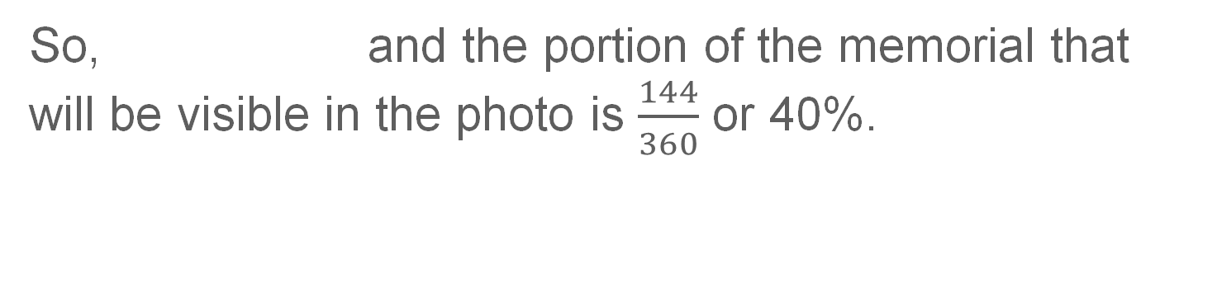
Example 3
Tangents and Secants Intersecting Outside a Circle
So, and the portion of the memorial that will be visible in the photo is $\frac{144}{360}$ or 40%.

Slide 21
Example 3
Tangents and Secants Intersecting Outside a Circle
Talk About It!
What is the difference between a tangent and a secant?

Slide 22
Learn
Tangents, Secants, and Segment Lengths
Special relationships also exist for the segment lengths of two chords when the chords intersect inside a circle, or when secants and tangents intersect outside of a circle.
When two chords intersect inside a circle, each chord is divided into segments, called chord segments. A secant segment is a segment of a secant line that has exactly one endpoint on the circle. An external secant segment is a secant segment that lies in the exterior of the circle. A tangent segment is the segment of a tangent with one endpoint on the circle.

Slide 23
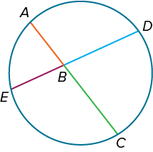
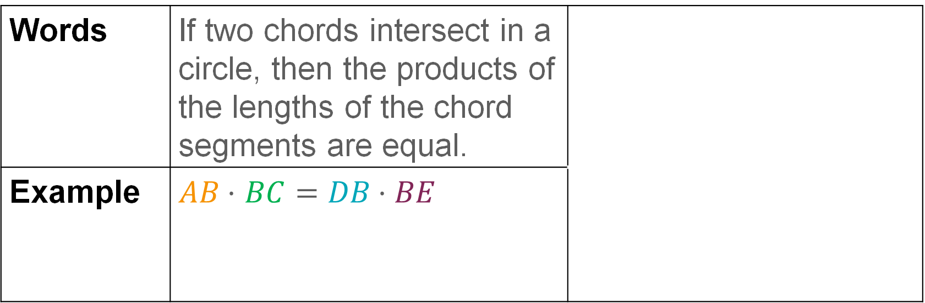
Learn
Tangents, Secants, and Segment Lengths
Theorem 10.17 Segments of Chords Theorem
Words | If two chords intersect in a circle, then the products of the lengths of the chord segments are equal.
Example | $AB \text{⋅}$ $BC=DB \text{⋅} BE$

Slide 24
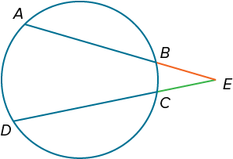
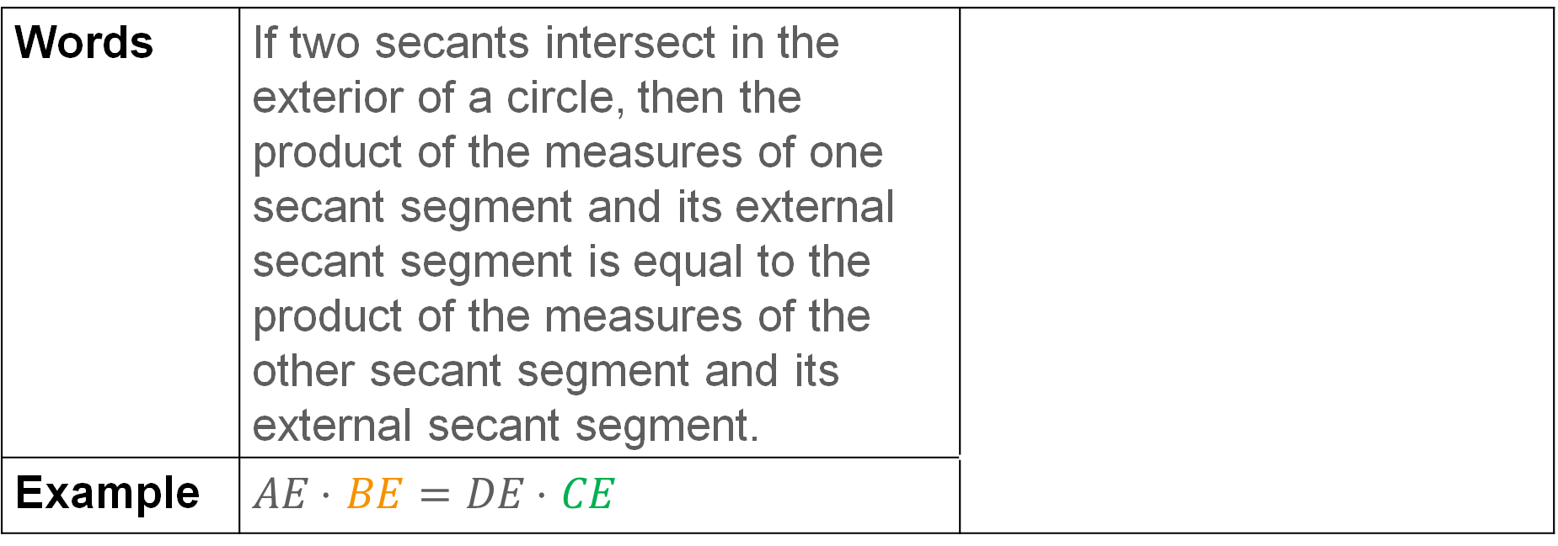
Learn
Tangents, Secants, and Segment Lengths
Theorem 10.18 Secant Segments Theorem
Words | If two secants intersect in the exterior of a circle, then the product of the measures of one secant segment and its external secant segment is equal to the product of the measures of the other secant segment and its external secant segment.
Example | $AE \text{⋅}$ $BE=DE \text{⋅ }CE$

Slide 25
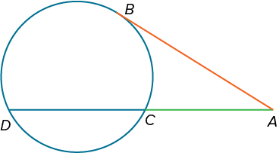
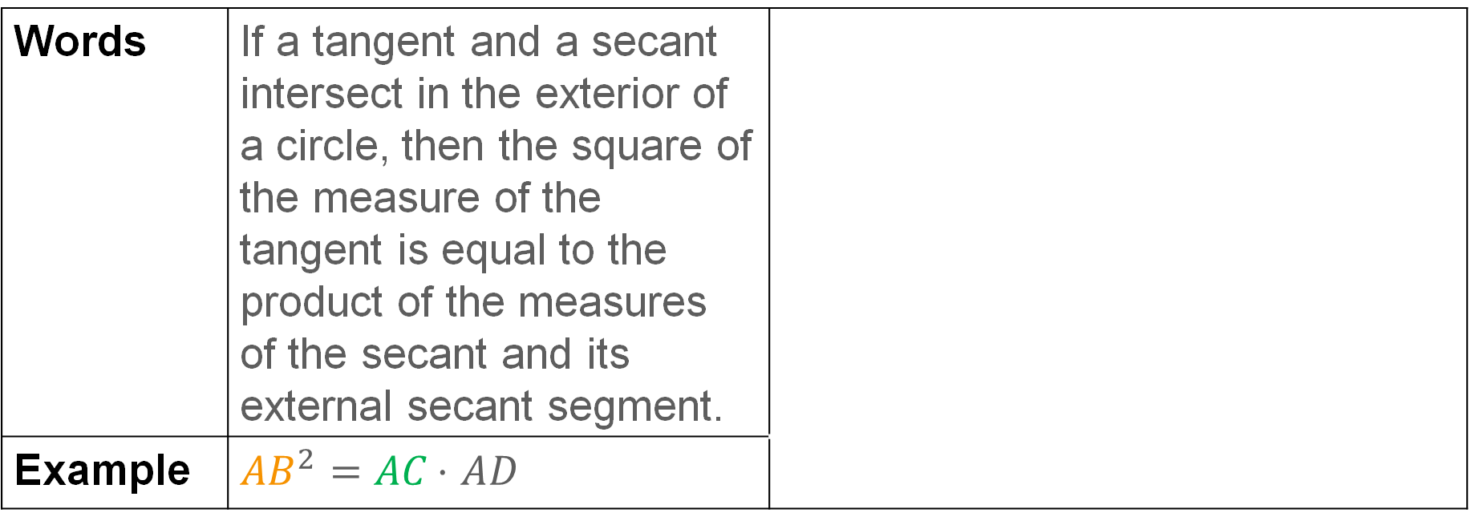
Learn
Tangents, Secants, and Segment Lengths
Theorem 10.19
Words | If a tangent and a secant intersect in the exterior of a circle, then the square of the measure of the tangent is equal to the product of the measures of the secant and its external secant segment.
Example | ${AB}^{2}=AC \text{⋅ }AD$

Slide 26
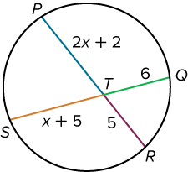
Example 4
Use the Intersection of Two Chords
Find PT.

Slide 27
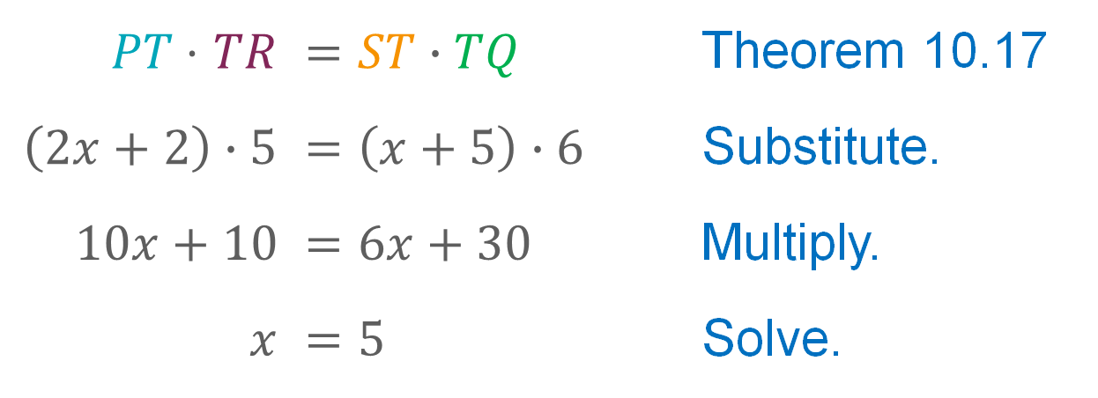
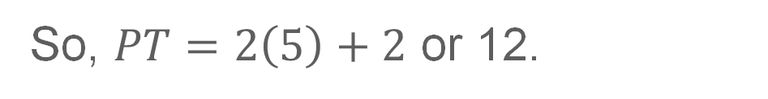
Example 4
Use the Intersection of Two Chords
$PT \text{⋅ }TR$ | $$=ST∙TQ$$ | Theorem 10.17
$\left(2x+2\right)∙5$ | $$=\left(x+5\right)∙6$$ | Substitute.
$10x+10$ | $$=6x+30$$ | Multiply.
$x$ | $$=5$$ | Solve.
So, $PT=2\left(5\right)+2$ or 12.

Slide 28
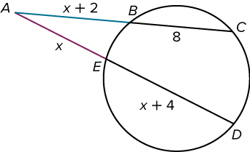
Example 5
Use the Intersection of Two Secants
Find AB.

Slide 29
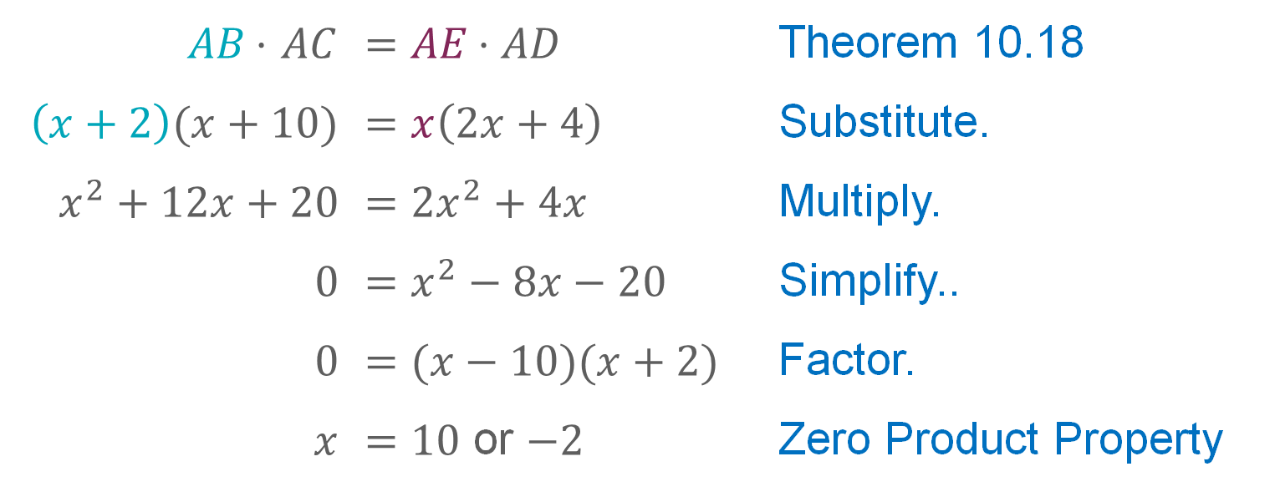
Example 5
Use the Intersection of Two Secants
$AB \text{⋅ }AC$ | $$=AE \text{⋅} AD$$ | Theorem 10.18
$\left(x+2\right)(x+10)$ | $$=x\left(2x+4\right)$$ | Substitute.
$x^{2}+12x+20$ | $$={2x}^{2}+4x$$ | Multiply.
$0$ | $$=x^{2}−8x−20$$ | Simplify..
$0$ | $$=(x−10)(x+2)$$ | Factor.
$x$ | $=10$ or $−2$ | Zero Product Property
The length of a segment must be positive, so AB = 10 + 2 or 12.

Slide 30
Example 5
Use the Intersection of Two Secants
Talk About It!
Why is only one solution for x used?

Slide 31
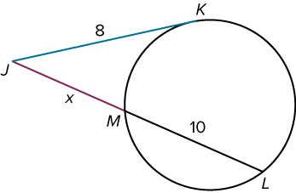
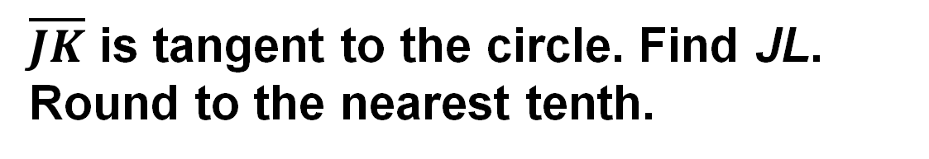
Example 6
Use the Intersection of a Secant and a Tangent
$\overline{JK}$ is tangent to the circle. Find JL. Round to the nearest tenth.

Slide 32
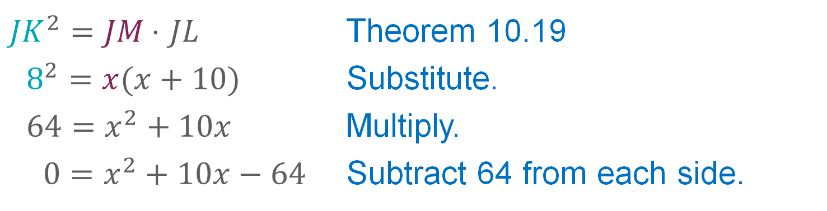
Example 6
Use the Intersection of a Secant and a Tangent
${JK}^{2}=JM \text{⋅ }JL$ | Theorem 10.19
$8^{2}=x(x+10)$ | Substitute.
$64=x^{2}+10x$ | Multiply.
$0=x^{2}+10x−64$ | Subtract 64 from each side.

Slide 33
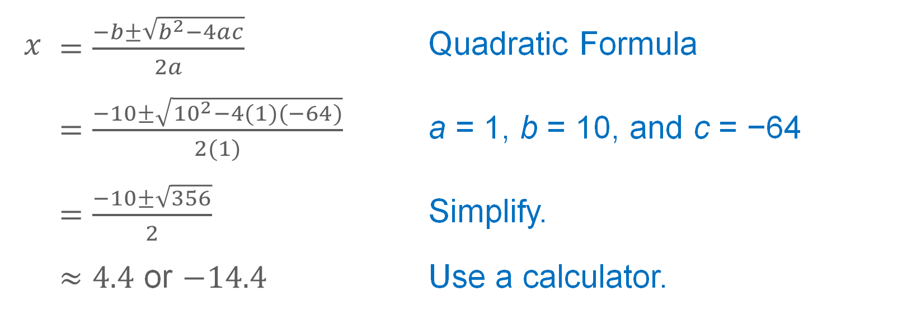
Example 6
Use the Intersection of a Secant and a Tangent
The expression is not factorable, so use the Quadratic Formula to solve for x.
$x$ | $=\frac{−b±\sqrt{b^{2}−4ac}}{2a}$ | Quadratic Formula
 | $=\frac{−10±\sqrt{{10}^{2}−4(1)(−64)}}{2(1)}$ | a = 1, b = 10, and c = −64
 | $=\frac{−10±\sqrt{356}}{2}$ | Simplify.
 | $≈4.4$ or $−14.4$ | Use a calculator.
Because lengths cannot be negative, x ≈ 4.4 and JL ≈ 10 + 4.4 or 14.4.

Slide 34
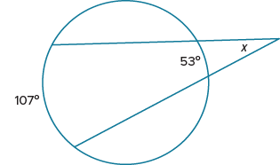
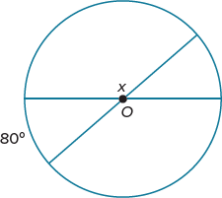
Exit Ticket
Find the value of x.
1.
2.

Slide 35
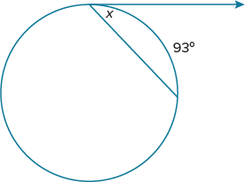
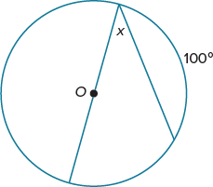
Exit Ticket
Find the value of x.
3.
4.

Slide 36
Exit Ticket
Find the value of x.
1. 27°
2. 100°
Notes:
$$27°$$
$$100°$$

Slide 37
Exit Ticket
Find the value of x.
3. 46.5°
4. 40°
Notes:
$$46.5°$$
$$40°$$

