Slide 1
Volumes of Cylinders, Cones, and Spheres

Slide 2
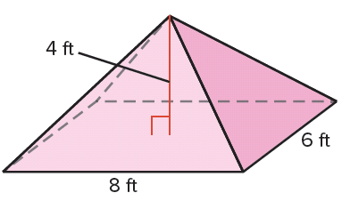
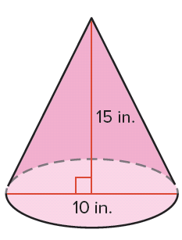
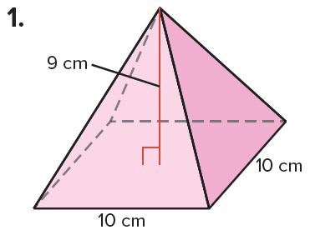
Warm Up
Find the volume of each figure. Round to the nearest whole number.
1. 2. 3.

Slide 3
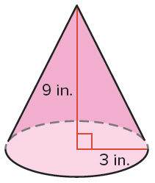
Warm Up
4.
5. GARDENING Julian planted his garden in 4 rectangular raised planting beds, 6 feet long by 3 feet wide by 1 foot high. If soil is sold in cubic yards, how many should he order to fill all of the beds? Round to the next cubic yard.

Slide 4
Warm Up
Find the volume of each figure. Round to the nearest whole number.
1. 2. 3.
360 cm³
64 ft³
393 in³
Notes:
360 cm³
64 ft³
393 in³

Slide 5
Warm Up
4.
5. GARDENING Julian planted his garden in 4 rectangular raised planting beds, 6 feet long by 3 feet wide by 1 foot high. If soil is sold in cubic yards, how many should he order to fill all of the beds? Round to the next cubic yard.
85 in³
3 yd³
Notes:
85 in³
3 yd³

Slide 6
Florida’s B.E.S.T. Standards for Mathematics
MA.912.GR.4.5
Solve mathematical and real-world problems involving
the volume of three-dimensional figures limited to cylinders, pyramids, prisms, cones and spheres.

Slide 7
Florida’s Mathematical Thinking and Reasoning Standards
MA.K12.MTR.4.1
Engage in discussions that reflect on the mathematical thinking of self and others.
MA.K12.MTR.5.1
Use patterns and structure to help understand and connect mathematical concepts.
MA.K12.MTR.7.1
Apply mathematics to real-world contexts.

Slide 8
Lesson Objectives
Content Objective
Students find volumes of cylinders, cones, and
spheres by using the formulas they derive.
Language Objectives
Students use will to explain how to find volumes of cylinders, cones, and spheres.
To optimize output, students participate in MLR1: Stronger and Clearer Each Time.

Slide 9
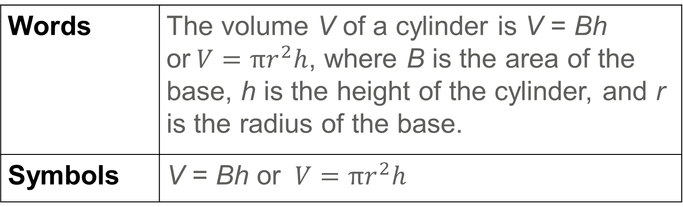
Learn
Volumes of Cylinders
Like a prism, the volume of a cylinder can be thought of as consisting of layers. For a cylinder, these layers are congruent circular discs.
Key Concept: Volume of a Cylinder
Words | The volume V of a cylinder is V = Bh or$V=πr^{2}h$, where B is the area of the base, h is the height of the cylinder, and r is the radius of the base.
Symbols | V = Bh or $V=πr^{2}h$

Slide 10
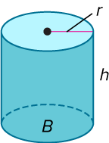
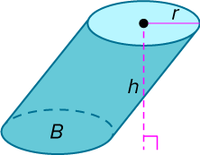
Learn
Volumes of Cylinders
You can use Cavalieri’s Principle to find volumes of oblique cylinders. Notice that at every level of a right or oblique cylinder, a cross section parallel to the base is a figure that is congruent to the base. The area of each of these cross sections is the same. According to Cavalieri’s Principle, if the areas of the bases and measures of the heights of two cylinders are equal, then the cylinders have the same volume. Thus, the formula for the volume of an oblique cylinder is the same as the formula for a right cylinder.

Slide 11
Learn
Volumes of Cylinders
Talk About It!
What real-world situation shows how Cavalieri’s Principle
applies to right and oblique cylinders? Explain.

Slide 12
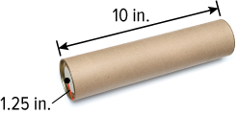
Example 1
Approximate the Volume of a Cylinder
POSTAL SERVICE Andrew wants to mail his brother a collection of antique marbles. He needs to calculate the volume of the mail tube before he buys it to ensure that it will hold all of the marbles. Find the volume of the mail tube to the nearest tenth.

Slide 13
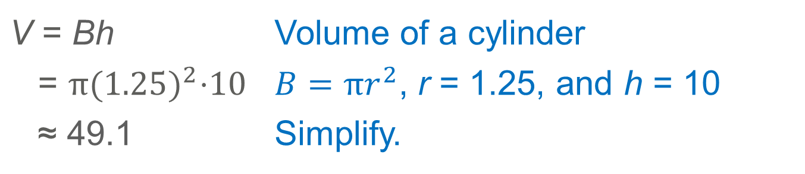
Example 1
Approximate the Volume of a Cylinder
V = Bh | Volume of a cylinder
= $π{(1.25)}^{2}$⋅10 | $B=πr^{2}$, r = 1.25, and h = 10
≈ 49.1 | Simplify.
The volume of the mail tube is about 49.1 cubic inches.

Slide 14
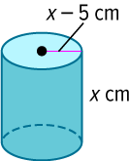
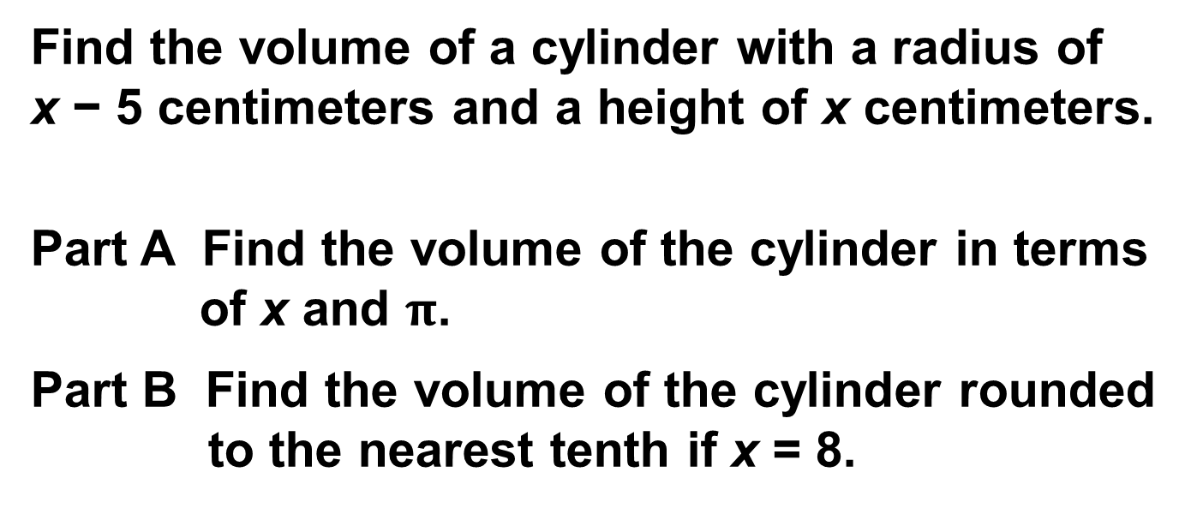
Example 2
Volume of a Cylinder
Find the volume of a cylinder with a radius of
x − 5 centimeters and a height of x centimeters.
Part A Find the volume of the cylinder in terms of x and $π$.
Part B Find the volume of the cylinder rounded to the nearest tenth if x = 8.

Slide 15
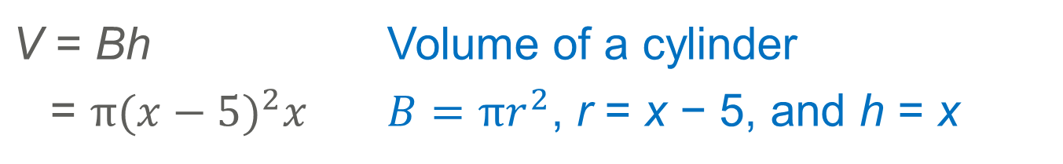

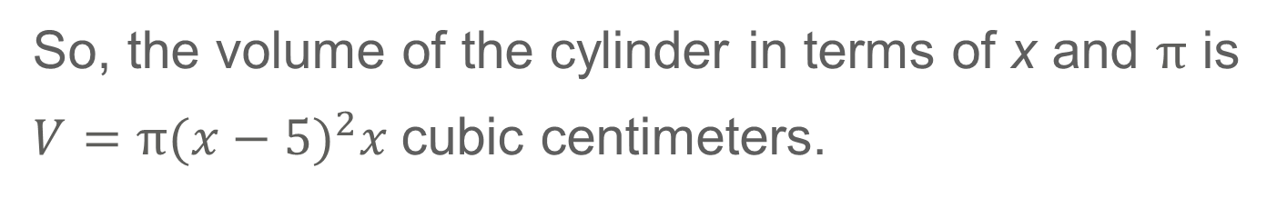
Example 2
Volume of a Cylinder
Part A Find the volume of the cylinder in terms of x and $π$.
V = Bh | Volume of a cylinder
= $π{(x−5)}^{2}x$ | $B=πr^{2}$, r = x − 5, and h = x
So, the volume of the cylinder in terms of x and $π$ is
$V=π{(x−5)}^{2}x$cubic centimeters.

Slide 16
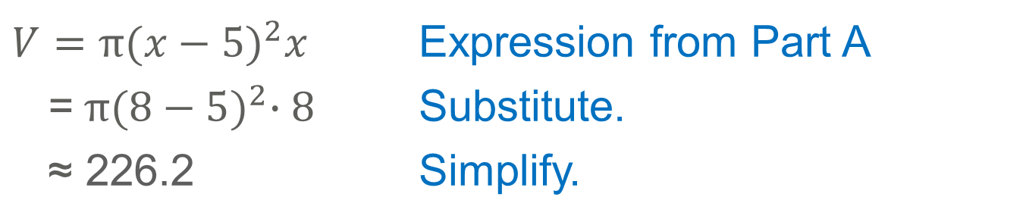
Example 2
Volume of a Cylinder
Part B Find the volume of the cylinder rounded to the nearest tenth if x = 8.
Substitute the value of x into the expression you found in Part A.
$$V=π{(x−5)}^{2}x$$ | Expression from Part A
=$π{(8−5)}^{2}∙8$ | Substitute.
≈ 226.2 | Simplify.
The volume of the cylinder is about 226.2 cubic centimeters.

Slide 17
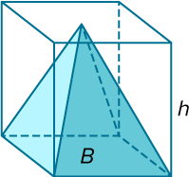
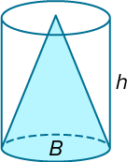
Learn
Volumes of Cones
The pyramid and prism shown have the same base area B and height h as the cylinder and cone. You can use Cavalieri’s Principle and similar triangles to show that the volume of the cone is equal to the volume of the pyramid.

Slide 18
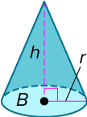
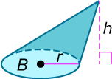
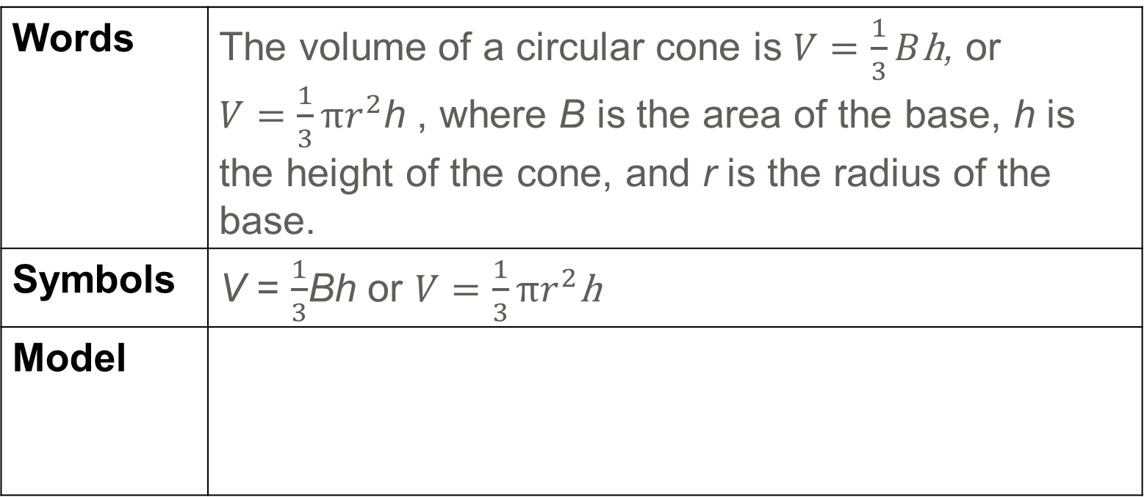
Learn
Volumes of Cones
Key Concept: Volume of a Cone
Words | The volume of a circular cone is $V=\frac{1}{3}B$h, or $V=\frac{1}{3}πr^{2}$h , where B is the area of the base, h is the height of the cone, and r is the radius of the base.
Symbols | V = $\frac{1}{3}$Bh or $V=\frac{1}{3}πr^{2}$h
Model

Slide 19
Learn
Volumes of Cones
Think About It!
Determine whether the following statement is sometimes, always, or never true. Justify your reasoning. The volume of a cone with radius r and height h equals the volume of a prism with height h.

Slide 20
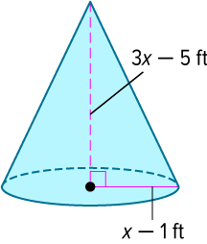
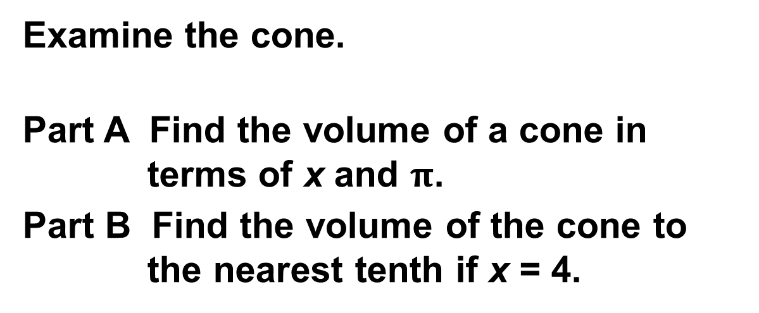
Example 3
Volume of a Cone
Examine the cone.
Part A Find the volume of a cone in terms of x and $π$.
Part B Find the volume of the cone to the nearest tenth if x = 4.

Slide 21
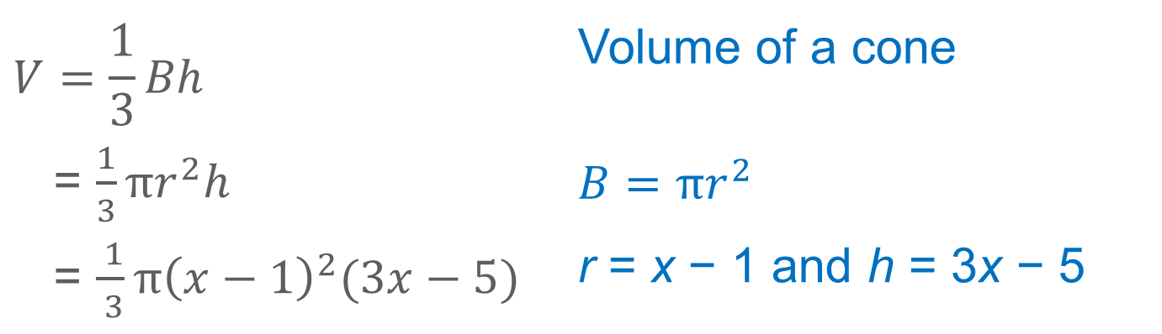

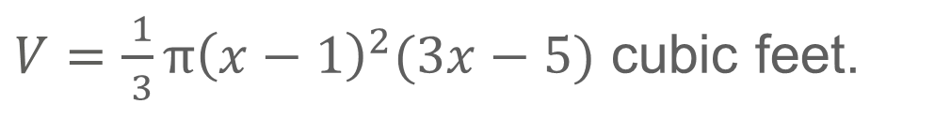
Example 3
Volume of a Cone
Part A Find the volume of a cone in terms of x and $π$.
$$V=\frac{1}{3}Bh$$ | Volume of a cone
= $\frac{1}{3}πr^{2}h$ | $$B=πr^{2}$$
= $\frac{ 1}{ 3}π{\left(x−1\right)}^{2}(3x−5)$ | r = x − 1 and h = 3x − 5
So, the volume of the cone in terms of x and $π$ is
$V=\frac{ 1}{ 3}π{\left(x−1\right)}^{2}(3x−5)$ cubic feet.

Slide 22
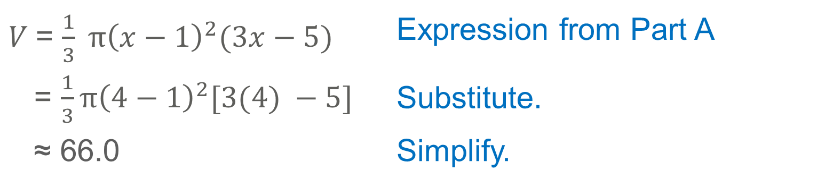
Example 3
Volume of a Cone
Part B Find the volume of the cone to the nearest tenth if x = 4.
Substitute the value of x into the expression you found in Part A.
$V$= $\frac{1}{3} π{\left(x−1\right)}^{2}(3x−5)$ | Expression from Part A
= $\frac{1}{3}π{\left(4−1\right)}^{2}[3(4) −5]$ | Substitute.
≈ 66.0 | Simplify.
The volume of the cone is about 66.0 cubic feet.

Slide 23
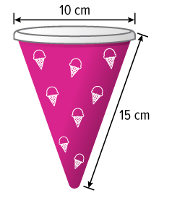
Example 4
Approximate the Volume of a Cone
TREATS Alyssa serves ice cream in paper cones with plastic lids. What is the volume of the paper cone?

Slide 24
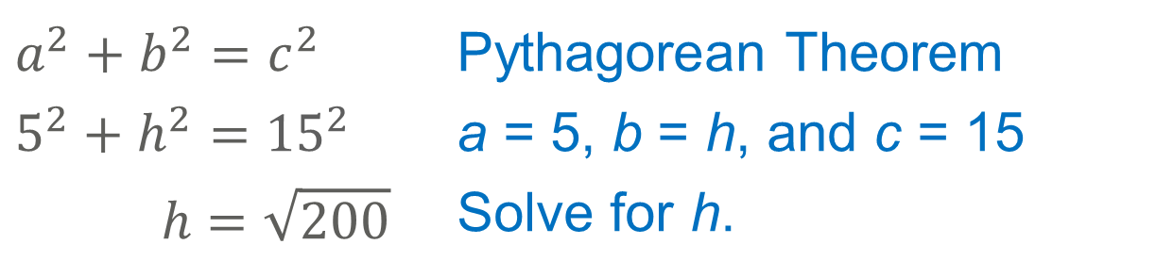
Example 4
Approximate the Volume of a Cone
Step 1 Find the height of the paper cone.
$$a^{2}+b^{2}=c^{2}$$ | Pythagorean Theorem
$$5^{2}+h^{2}={15}^{2}$$ | a = 5, b = h, and c = 15
$$h=\sqrt{200}$$ | Solve for h.

Slide 25
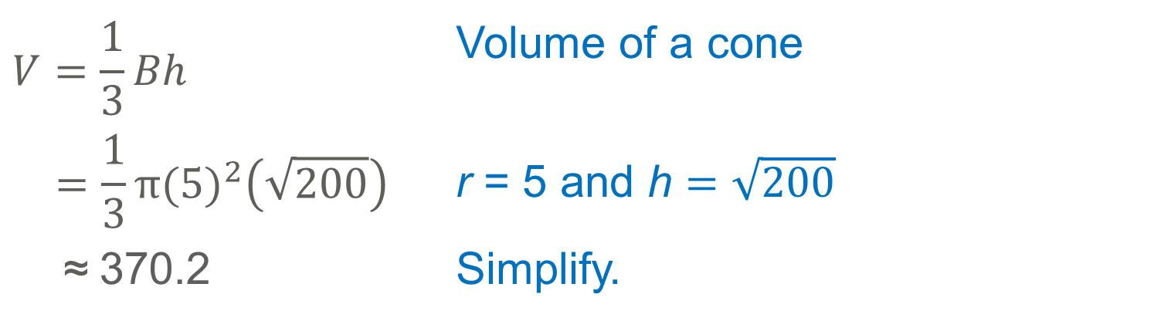
Example 4
Approximate the Volume of a Cone
Step 2 Find the volume of the paper cone to the nearest tenth.
$$V=\frac{1}{3}Bh$$ | Volume of a cone
$$=\frac{1}{3}π{(5)}^{2}\left(\sqrt{200}\right)$$ | r = 5 and h $=\sqrt{200}$
≈ 370.2 | Simplify.
The volume of the paper cone is about 370.2 cubic centimeters.

Slide 26
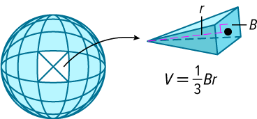
Learn
Volumes of Spheres
Suppose a sphere with radius r contains infinitely many pyramids with vertices at the center of the sphere. Each pyramid has height r. The sum of the volumes of all the pyramids equals the volume of the sphere.

Slide 27
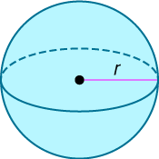
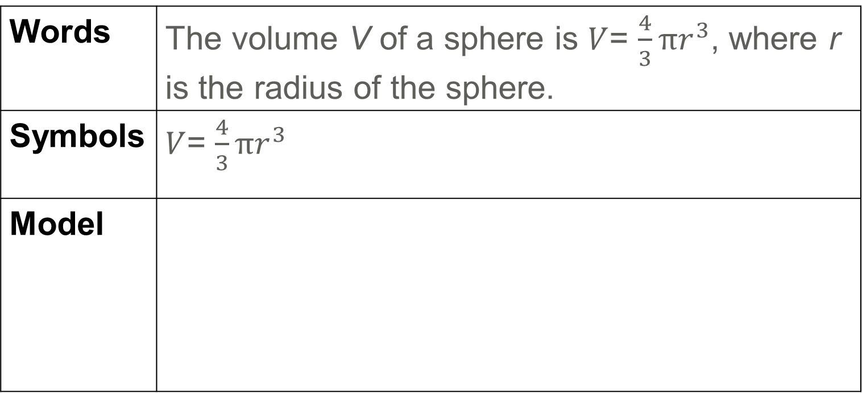
Learn
Volumes of Spheres
Key Concept: Volume of a Sphere
Words | The volume V of a sphere is $V$= $\frac{4}{3}πr^{3}$, where r is the radius of the sphere.
Symbols | $V$= $\frac{4}{3}πr^{3}$
Model

Slide 28

Example 5
Approximate the Volume of a Sphere
CANDY A chocolate company wants to create bite-sized individually wrapped solid chocolate spheres. If the diameter of the sphere is
1.5 inches, find the volume of chocolate used to make the spheres to the nearest hundredth.

Slide 29
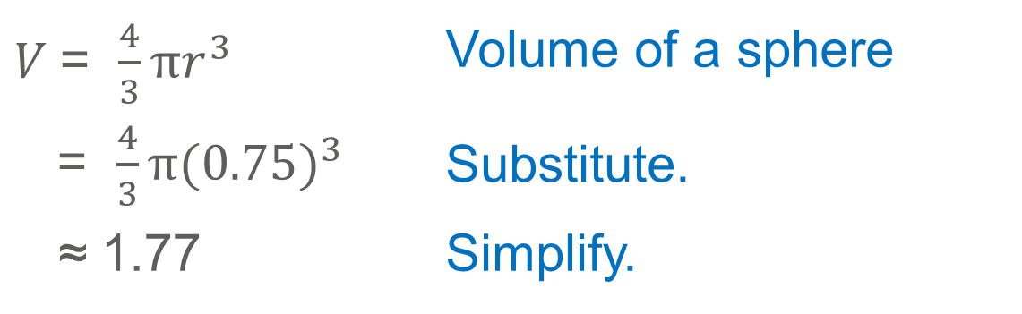
Example 5
Approximate the Volume of a Sphere
$V$= $\frac{4}{3}πr^{3}$ | Volume of a sphere
= $\frac{4}{3}π{(0.75)}^{3}$ | Substitute.
≈ 1.77 | Simplify.
The volume of chocolate used is about 1.77 cubic inches.

Slide 30
Example 5
Approximate the Volume of a Sphere
Think About It!
The chocolate company needs to start sending bags of these new chocolates to stores. The company plans to have 30 chocolates in each bag and 200 bags in each shipping box. If the boxes being used are shaped like cubes, what will be the minimum side length needed for the boxes to meet the company’s requirements?

Slide 31
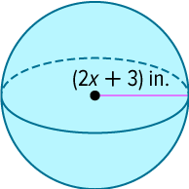
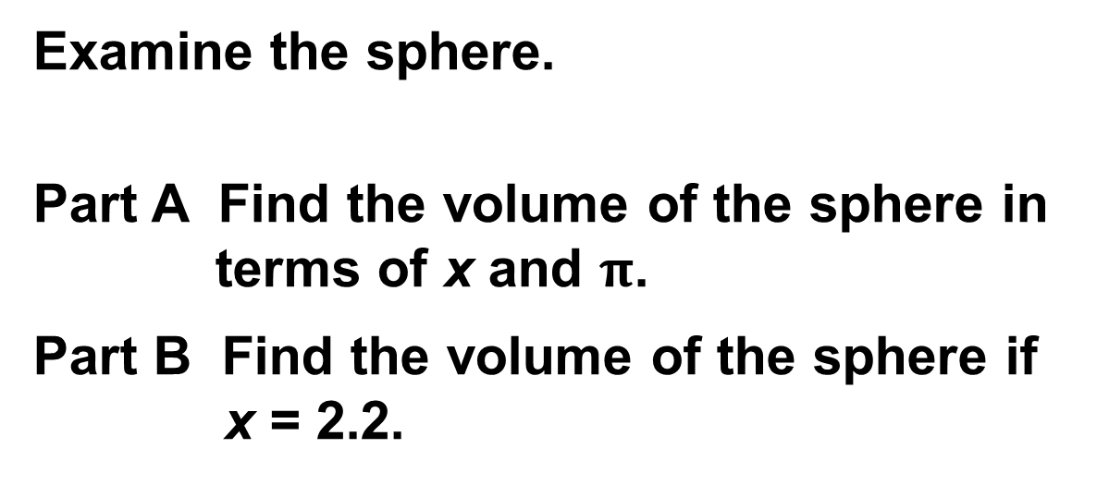
Example 6
Volume of a Sphere
Examine the sphere.
Part A Find the volume of the sphere in terms of x and $π$.
Part B Find the volume of the sphere if x = 2.2.

Slide 32
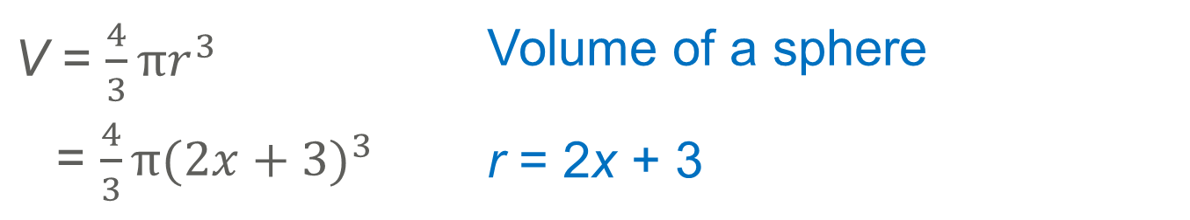

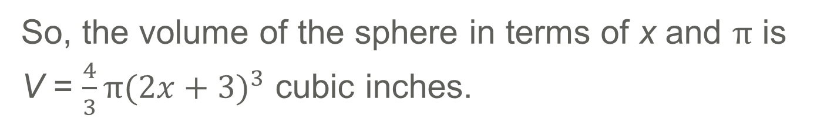
Example 6
Volume of a Sphere
Part A Find the volume of the sphere in terms of x and $π$.
V = $\frac{4}{3}πr^{3}$ | Volume of a sphere
= $\frac{4}{3}π{(2x+3)}^{3}$ | r = 2x + 3
So, the volume of the sphere in terms of x and $π$ is
V = $\frac{4}{3}π{(2x+3)}^{3}$ cubic inches.

Slide 33
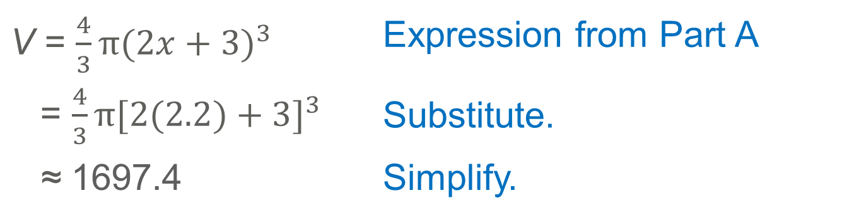
Example 6
Volume of a Sphere
Part B Find the volume of the sphere if x = 2.2.
Substitute the value of x into the expression you found in Part A.
V = $\frac{4}{3}π{(2x+3)}^{3}$ | Expression from Part A
= $\frac{4}{3}π{[2(2.2)+3]}^{3}$ | Substitute.
≈ 1697.4 | Simplify.
The volume of the sphere is about 1697.4 cubic inches.

Slide 34
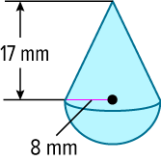
Example 7
Volume of a Composite Solid
Find the volume of the composite solid.

Slide 35
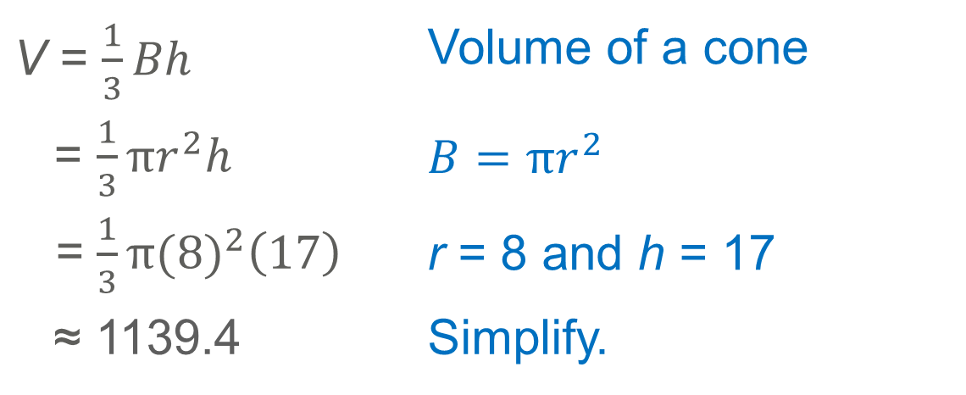
Example 7
Volume of a Composite Solid
The composite solid is a combination of a cone and a hemisphere.
Step 1 Find the volume of the cone to the nearest tenth.
V = $\frac{1}{3}Bh$ | Volume of a cone
= $\frac{1}{3}πr^{2}h$ | $$B=πr^{2}$$
= $\frac{1}{3}π{(8)}^{2}\left(17\right)$ | r = 8 and h = 17
≈ 1139.4 | Simplify.
The volume of the cone is about 1139.4 mm³.

Slide 36
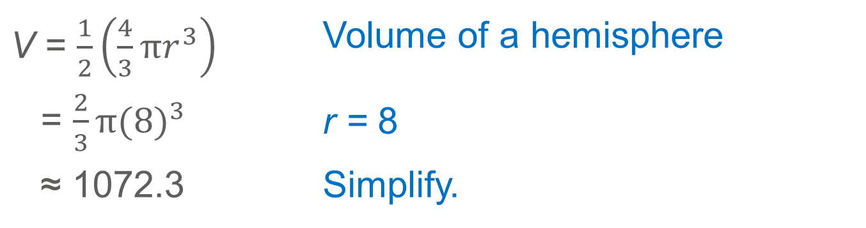
Example 7
Volume of a Composite Solid
Step 2 Find the volume of the hemisphere to the nearest tenth.
V = $\frac{1}{2}\left(\frac{4}{3}πr^{3}\right)$ | Volume of a hemisphere
= $\frac{2}{3}π{(8)}^{3}$ | r = 8
≈ 1072.3 | Simplify.
The volume of the hemisphere is about 1072.3 mm³ .

Slide 37
Example 7
Volume of a Composite Solid
Step 3 Find the volume of the composite solid.
The volume of the composite solid is the sum of the volumes of the cone and the hemisphere.
V ≈ 2211.7 mm³

Slide 38
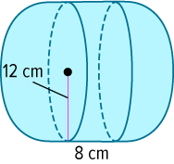
Example 7
Volume of a Composite Solid
Check
Find the volume of the composite solid to the nearest tenth.

Slide 39
Example 7
Volume of a Composite Solid
Check
Find the volume of the composite solid to the nearest tenth.
V ≈ 10,857.3 cm³
Notes:
V ≈ 10,857.3 cm³

Slide 40
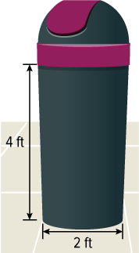
Apply Example 8
Approximate the Volume of a
Composite Solid
HOME DÉCOR Mia purchased a trash container for her study area. Find the volume of the trash container rounded to the nearest tenth.

Slide 41
Apply Example 8
Approximate the Volume of a Composite Solid
Talk About It!
Share your method with a partner. How does your method compare to theirs?

Slide 42
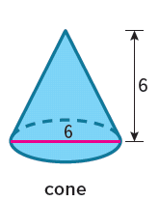
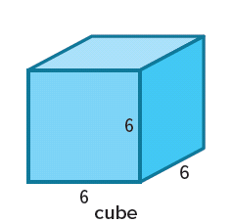
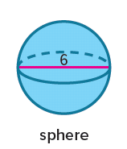
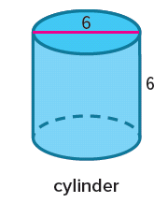
Exit Ticket
Consider these four figures.
1. Without doing any calculations, write the names of the shapes in order from greatest surface area to least surface area.
2. Without doing any calculations, write the names of the shapes in order from greatest volume to least volume.

Slide 43
Exit Ticket
Consider these four figures.
1. Without doing any calculations, write the names of the shapes in order from greatest surface area to least surface area.
2. Without doing any calculations, write the names of the shapes in order from greatest volume to least volume.
cube, cylinder, sphere, cone
cube, cylinder, sphere, cone
Notes:
cube, cylinder, sphere, cone
cube, cylinder, sphere, cone

