Slide 1
Module 1-2
Pg. 15
Line Segments

Slide 2
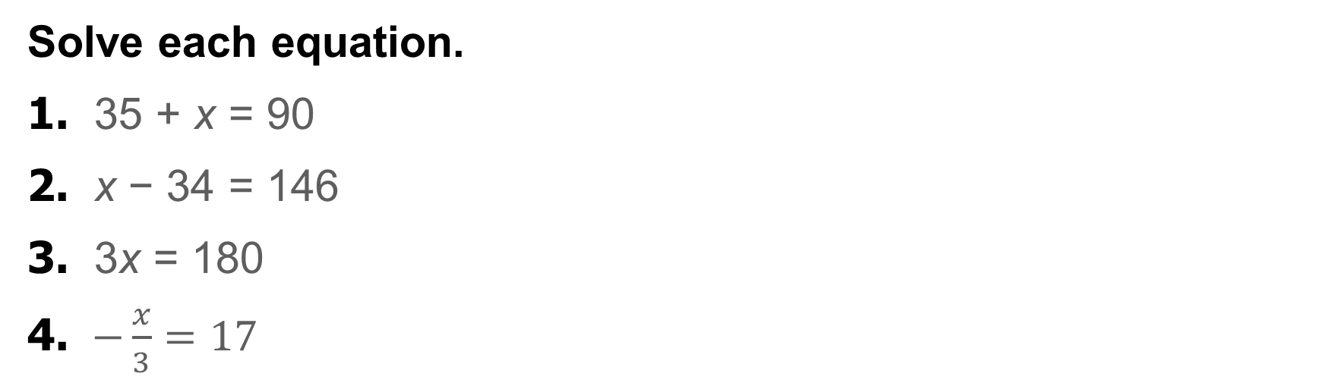
Warm Up
Solve each equation.
1. 35 + x = 90
2. x − 34 = 146
3. 3x = 180
4. $−\frac{x}{3}=17$
5. GEOGRAPHY Russia, the largest country in the world in terms of area, occupies 6,592,800 square miles. The difference in area between Russia and Canada is 2,740,991 square miles. Write and solve an equation to find the area of Canada.

Slide 3
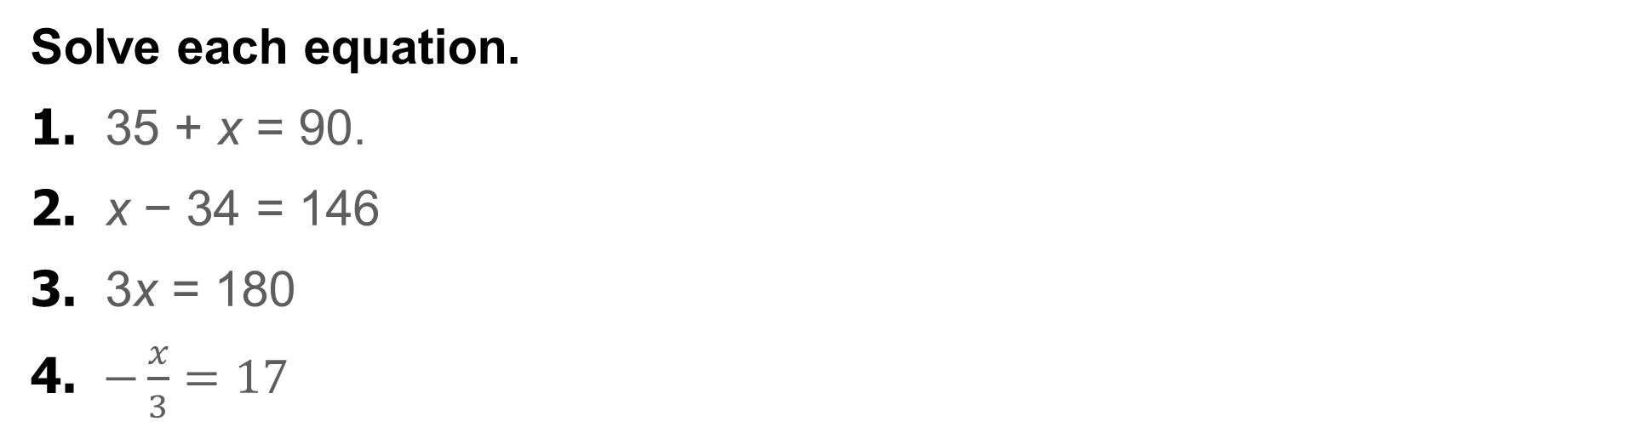
Warm Up
Solve each equation.
1. 35 + x = 90.
2. x − 34 = 146
3. 3x = 180
4. $−\frac{x}{3}=17$
55
180
60
−51
5. GEOGRAPHY Russia, the largest country in the world in terms of area, occupies 6,592,800 square miles. The difference in area between Russia and Canada is 2,740,991 square miles. Write and solve an equation to find the area of Canada.
c + 2,740,991 = 6,592,800; 3,851,809 mi²
Notes:
55
180
60
-51

Slide 4
Florida’s B.E.S.T. Standards for Mathematics
MA.912.GR.5.1
Construct a copy of a segment or an angle.

Slide 5
Florida’s Mathematical Thinking and Reasoning Standards
MA.K12.MTR.3.1
Complete tasks with mathematical fluency.
MA.K12.MTR.5.1
Use patterns and structure to help understand and connect mathematical concepts.
MA.K12.MTR.6.1
Assess the reasonableness of solutions.

Slide 6
Lesson Objectives
Content Objective
Students will calculate measures of line segments.
Language Objectives
Students use negative and positive to talk about calculating measures of line segments.
To optimize output, students participate in MLR1: Stronger and Clearer Each Time.

Slide 7
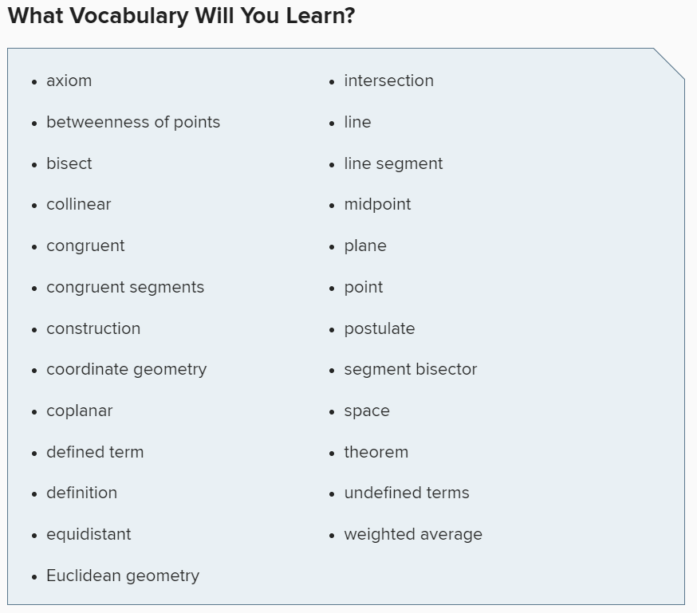





















Slide 8







Slide 9



Learn
Betweenness of Points pg. 15
A line segment is a measurable part of a line that consists of two points, called endpoints, and all of the points between them. The two endpoints are used to name the segment.
For any two real numbers a and b, there is a real number n between a and b such that a < n < b. This relationship also applies to points on a line and is called betweenness of points.

Slide 10

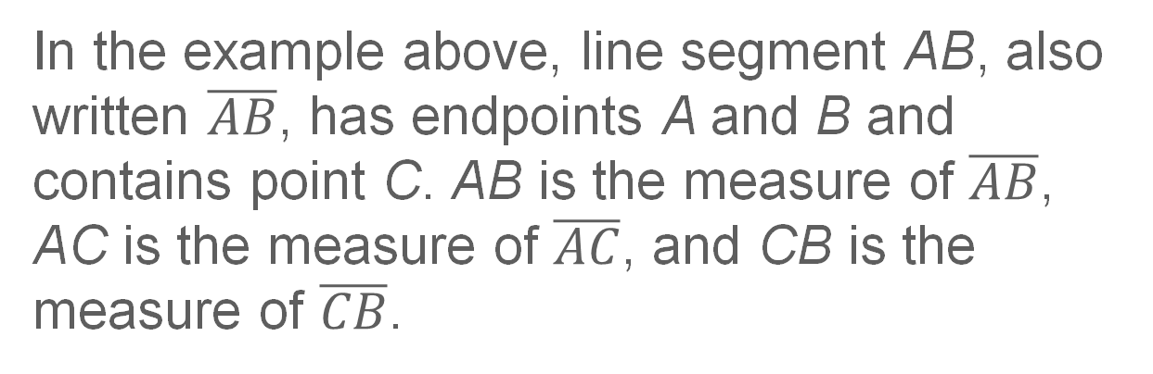
Learn pg. 15
Betweenness of Points
Key Concept: Betweenness of Points
Point C is between A and B
if and only if A, B, and C are
collinear and AC + CB = AB.
In the example above, line segment AB, also written $\overline{AB}$, has endpoints A and B and contains point C. AB is the measure of $\overline{AB}$, AC is the measure of $\overline{AC}$, and CB is the measure of $\overline{CB}$.

Slide 11
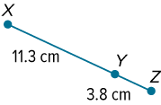

Example 1 –WE DO! Pg. 15 SI
Find Measurements by Adding
Find the measure of $\overline{XZ}$.

Slide 12
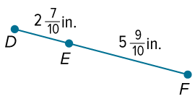

Example 1 – WE DO! Pg. 15
Find Measurements by Adding
Check
Find the measure of $\overline{DF}$.

Slide 13
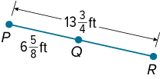

Example 2 – YOU DO! Pg. 16 SI
Find Measurements by Subtracting
Find the measure of $\overline{QR}$.

Slide 14


Example 2 – You Do pg. 16
Find Measurements by Subtracting
Check
Find the measure of $\overline{PQ}$. Round your answer to the nearest tenth, if necessary.

Slide 15
Example 3 – WE DO! Pg. 16
Write and Solve Equations to Find Measurements
Find the value of x and BC if B is between A and C, AC = 4x − 12, AB = x, and BC = 2x + 3.

Slide 16
Apply Example 4 pg. 17
Use Betweenness of Points
SPACE NEEDLE Darrell is visiting the Space Needle in Seattle, Washington. He knows that the total height of the Space Needle is 605 feet. The distance from the ground to the observation deck is 10 feet more than six times the distance from the observation deck to the top of the Space Needle. Help Darrell find the distance from the ground to the observation deck.

Slide 17


Learn – pg. 17
Line Segment Congruence
If two geometric figures have exactly the same shape and size, then they are congruent. Two segments that have the same measure are congruent segments.

Slide 18





Learn – pg 18
Line Segment Congruence
Key Concept: Congruent Segments
≅ is read is congruent to. Tick marks on the figure also indicate congruence. Use a consecutive number of tick marks for each new pair of congruent segments in a figure.

Slide 19

Learn – pg. 18
Line Segment Congruence
It may be useful to sketch, draw, and construct figures. Sketches are created without the use of any tools. Drawings are created using measuring tools such as a ruler and protractor. Constructions are created without the benefit of measuring tools. You can use a compass and straightedge, string, a reflective device, paper folding, or dynamic geometry software to create constructions.

Slide 20
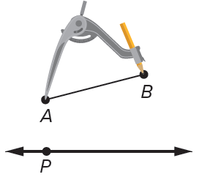
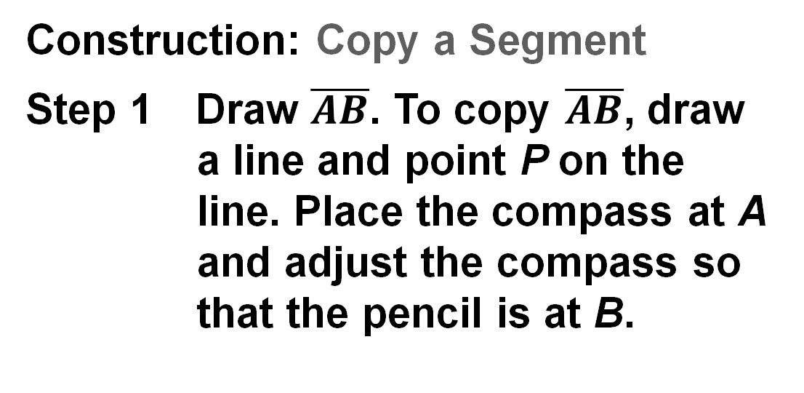
Learn – pg. 18
Line Segment Congruence
You can construct a segment that is congruent to a given segment.
Construction: Copy a Segment
Step 1 Draw $\overline{AB}$. To copy $\overline{AB}$, draw a line and point P on the line. Place the compass at A and adjust the compass so that the pencil is at B.

Slide 21
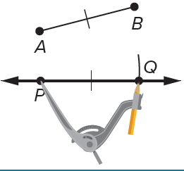
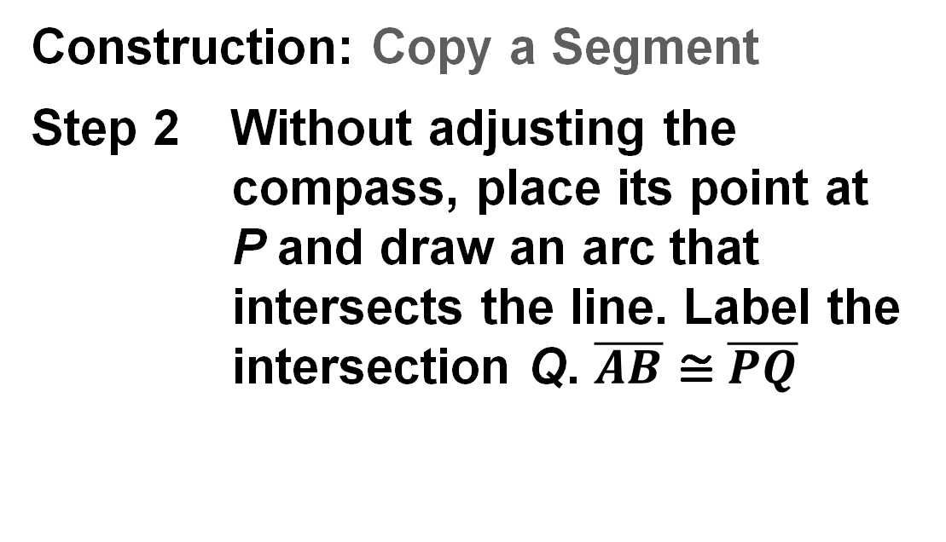
Learn pg. 18
Line Segment Congruence
Construction: Copy a Segment
Step 2 Without adjusting the compass, place its point at P and draw an arc that intersects the line. Label the intersection Q. $\overline{AB}$ ≅ $\overline{PQ}$

Slide 22

Example 5 – WE DO! Pg. 18
Write and Solve Equations by Using Congruence
Find the value of x.

Slide 23


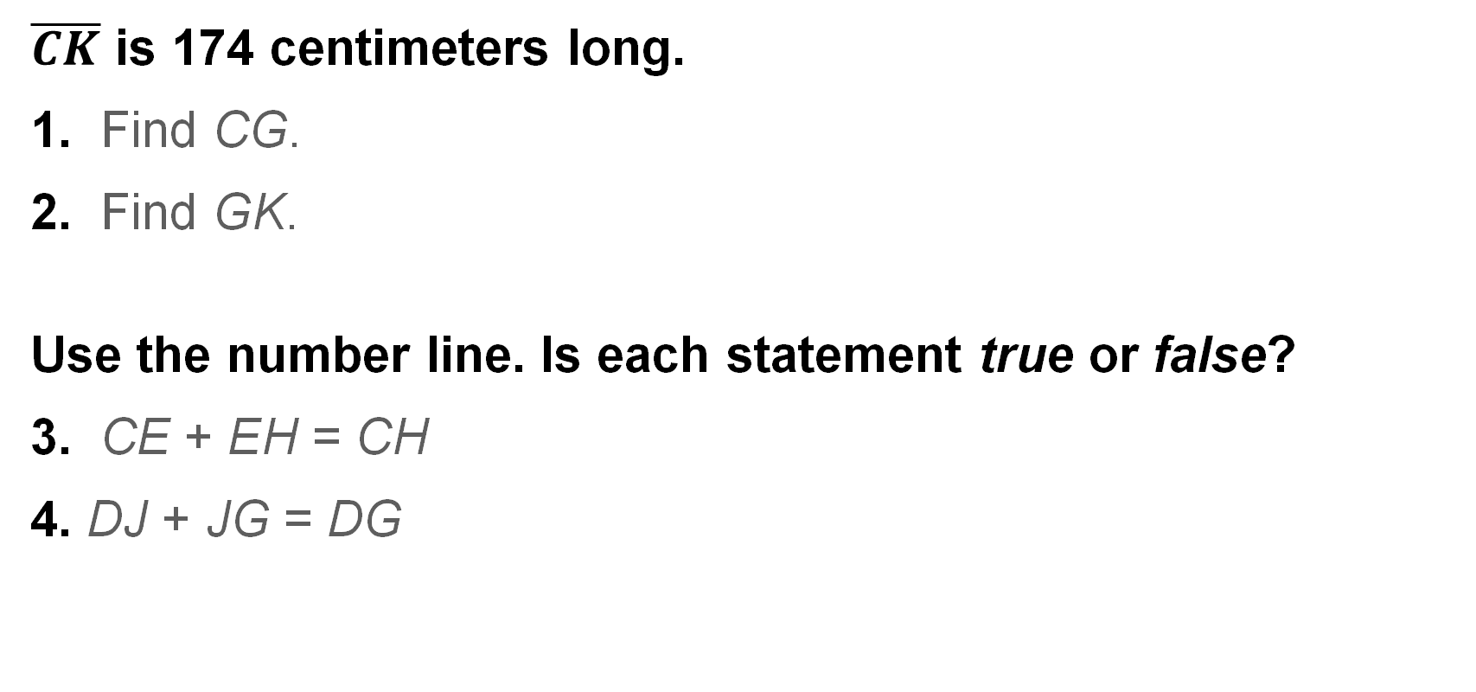
Warm Up
$\overline{CK}$ is 174 centimeters long.
1. Find CG.
2. Find GK.
Use the number line. Is each statement true or false?
3. CE + EH = CH
4. DJ + JG = DG

