Slide 1
Rhombi and Squares

Slide 2
Warm Up
Determine whether each pair of lines is parallel, perpendicular, or neither.
1. the line containing X(8, −3) and Y(−4, −6)
the line containing R(1, 13) and S(−3, −3)
2. the line containing A(2, −1) and B(3, −4)
the line containing C(1, 6) and D(3, 0)
3. y = 2x + 1
2y = −x − 1

Slide 3
Warm Up
Determine whether each pair of lines is parallel, perpendicular, or neither.
4. 4x − y = 2
8x − 2y = −6
5. Plot and connect the vertices X(−2, 1), Y(−1, −1), and Z(3, 1)
on your own paper. Is XYZ a right triangle?

Slide 4
Warm Up
Determine whether each pair of lines is parallel, perpendicular, or neither.
1. the line containing X(8, −3) and Y(−4, −6)
the line containing R(1, 13) and S(−3, −3) neither
2. the line containing A(2, −1) and B(3, −4)
the line containing C(1, 6) and D(3, 0) parallel
3. y = 2x + 1
2y = −x − 1 perpendicular
Notes:
neither
parallel
perpendicular

Slide 5
Warm Up
Determine whether each pair of lines is parallel, perpendicular, or neither.
4. 4x − y = 2
8x − 2y = −6 parallel
5. Plot and connect the vertices X(−2, 1), Y(−1, −1), and Z(3, 1)
on your own paper. Is XYZ a right triangle? yes
Notes:
parallel
yes

Slide 6
Florida’s B.E.S.T. Standards for Mathematics
MA.912.GR.1.4
Prove relationships and theorems about parallelograms. Solve mathematical and real-world problems involving postulates, relationships and theorems of parallelograms.
MA.912.GR. 3.2
Given a mathematical context, use coordinate geometry to classify or justify definitions, properties and theorems involving circles, triangles or quadrilaterals.
MA.912.GR.3.3
Use coordinate geometry to solve mathematical and real-world geometric problems involving lines, circles, triangles and quadrilaterals.

Slide 7
Florida’s Mathematical Thinking and Reasoning Standards
MA.K12.MTR.4.1
Engage in discussions that reflect on the mathematical thinking of self and others.
MA.K12.MTR.5.1
Use patterns and structure to help understand and connect mathematical concepts.

Slide 8
Lesson Objectives
Content Objective
Students apply and prove the properties of rhombi and squares.
Language Objectives
Students explain how to apply and prove the properties of rhombi and squares using sentences starting with Because and So.
To optimize output, students participate in MLR3: Critique, Correct, and Clarify.

Slide 9
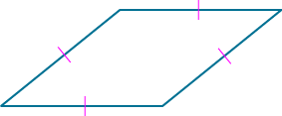
Learn
Properties of Rhombi and Squares
A rhombus is a parallelogram with all four sides congruent. All of the properties of a parallelogram hold true for a rhombus, in addition to the following two theorems.
Theorems: Diagonals of a Rhombus
Theorem 7.15
If a parallelogram is a rhombus, then its diagonals are perpendicular.
Theorem 7.16
If a parallelogram is a rhombus, then each diagonal bisects a pair of opposite angles.

Slide 10
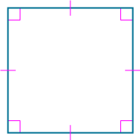
Learn
Properties of Rhombi and Squares
A square is a parallelogram with all four sides and all four angles congruent. All of the properties of parallelograms, rectangles, and rhombi apply to squares. For example, the diagonals of a square bisect each other (parallelogram), are congruent (rectangle), and are perpendicular (rhombus).

Slide 11
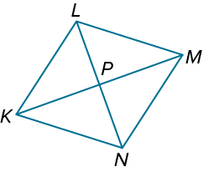
Example 1
Use the Definition of a Rhombus
If LM = 2x − 9 and KN = x + 15 in rhombus KLMN, find the value of x.

Slide 12
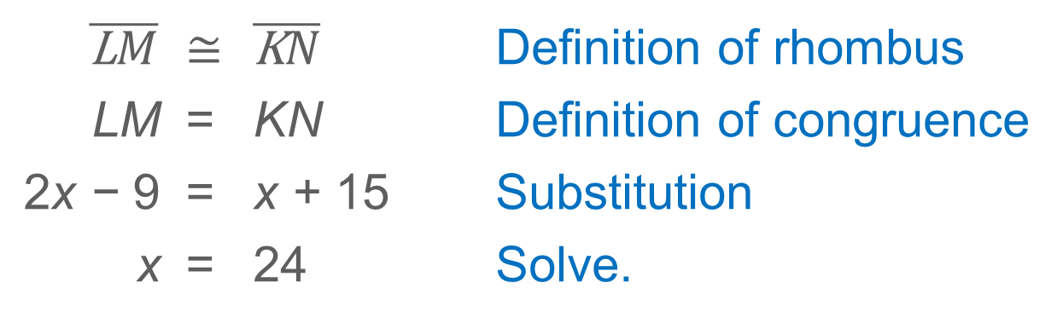
Example 1
Use the Definition of a Rhombus
$$\overline{\text{L}M}$$ | ≅ | $$\overline{\text{K}N}$$ | Definition of rhombus
LM | = | KN | Definition of congruence
2x − 9 | = | x + 15 | Substitution
x | = | 24 | Solve.

Slide 13
Example 1
Use the Definition of a Rhombus
Think About It!
How are the definition of a rhombus and the definition of congruence used to justify the first and second steps?

Slide 14
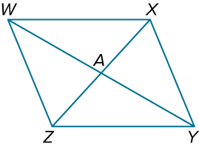
Example 1
Use the Definition of a Rhombus
Check
Quadrilateral WXYZ is a rhombus.
If AZ = 14, ZY = 22, and m∠WYZ = 35°, find XZ, m∠XYZ, and m∠WXZ.

Slide 15
Example 1
Use the Definition of a Rhombus
Check
Quadrilateral WXYZ is a rhombus.
If AZ = 14, ZY = 22, and m∠WYZ = 35°, find XZ, m∠XYZ, and m∠WXZ.
XZ = 28
m∠XYZ = 70°
m∠WXZ = 55°
Notes:
XZ = 28
m∠XYZ = 70°
m∠WXZ = 55°

Slide 16
Example 2
Use the Diagonals of a Rhombus
The diagonals of rhombus KLMN intersect at P. If m∠LMN = 75°, find m∠KNP.

Slide 17
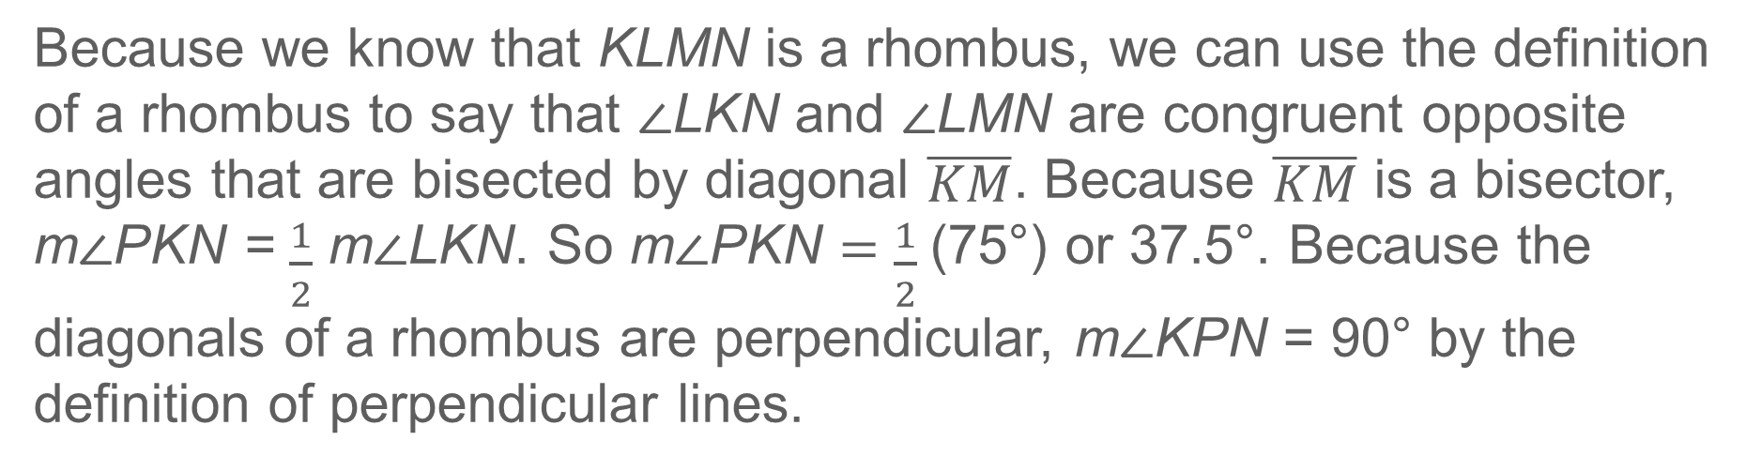
Example 2
Use the Diagonals of a Rhombus
Because we know that KLMN is a rhombus, we can use the definition of a rhombus to say that ∠LKN and ∠LMN are congruent opposite angles that are bisected by diagonal $\overline{KM}$. Because $\overline{KM}$ is a bisector, m∠PKN = $\frac{1}{2}$ m∠LKN. So m∠PKN = $\frac{1}{2}$(75°) or 37.5°. Because the diagonals of a rhombus are perpendicular, m∠KPN = 90° by the definition of perpendicular lines.
m∠PKN + m∠KPN + m∠KNP | = 180° | Triangle Angle-Sum Theorem
37.5° + 90° + m∠KNP | = 180° | Substitution
m∠KNP | = 52.5° | Solve.

Slide 18
Example 2
Use the Diagonals of a Rhombus
Talk About It!
Compare all of the properties of the following quadrilaterals: parallelograms, rectangles, rhombi, and squares.

Slide 19
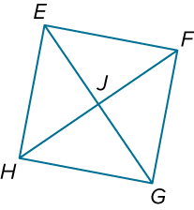
Example 3
Use the Definition of a Square
EFGH is a square. If FJ = 19, find FH.

Slide 20
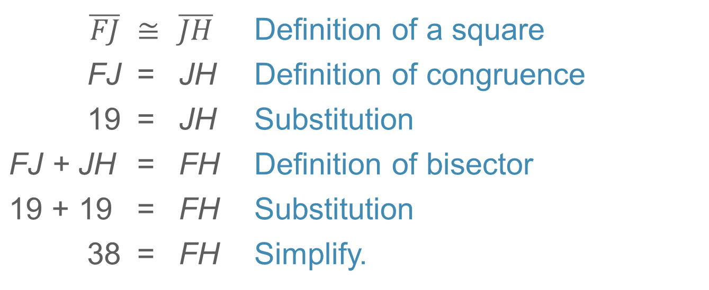
Example 3
Use the Definition of a Square
Because EFGH is square, it is both a parallelogram and a rectangle. Therefore, we know that its diagonals bisect each other and are congruent.
$$\overline{FJ}$$ | ≅ | $$\overline{JH}$$ | Definition of a square
FJ | = | JH | Definition of congruence
19 | = | JH | Substitution
FJ + JH | = | FH | Definition of bisector
19 + 19 | = | FH | Substitution
38 | = | FH | Simplify.

Slide 21
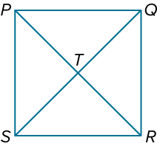
Example 3
Use the Definition of a Square
Check
In rhombus PQRS, PQ = 4x + 3, QR = 41, and m∠PQT = (2x + 4y)°. What must the value of y be for rhombus PQRS to be a square?
A. 6.5 B. 9.5 C. 45 D. 90

Slide 22
Example 3
Use the Definition of a Square
Check
In rhombus PQRS, PQ = 4x + 3, QR = 41, and m∠PQT = (2x + 4y)°. What must the value of y be for rhombus PQRS to be a square?
A. 6.5 B. 9.5 C. 45 D. 90
A
Notes:
A

Slide 23
Learn
Tests for Rhombi and Squares
If a parallelogram meets certain conditions, you can conclude that it is a rhombus or a square.
Theorems: Conditions for Rhombi and Squares
Theorem 7.17
If the diagonals of a parallelogram are perpendicular, then the parallelogram is a rhombus.
Theorem 7.18
If one diagonal of a parallelogram bisects a pair of opposite angles, then the parallelogram is a rhombus.

Slide 24
Learn
Tests for Rhombi and Squares
Theorem 7.19
If two consecutive sides of a parallelogram are congruent, then the parallelogram is a rhombus.
Theorem 7.20
If a quadrilateral is both a rectangle and a rhombus, then it is a square.

Slide 25
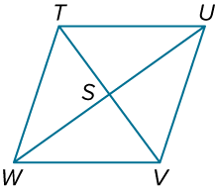
Example 4
Use Conditions for Rhombi and Squares
Write a paragraph proof.
Given: TUVW is a parallelogram.
△TSW ≅ △TSU
Prove: TUVW is a rhombus.

Slide 26
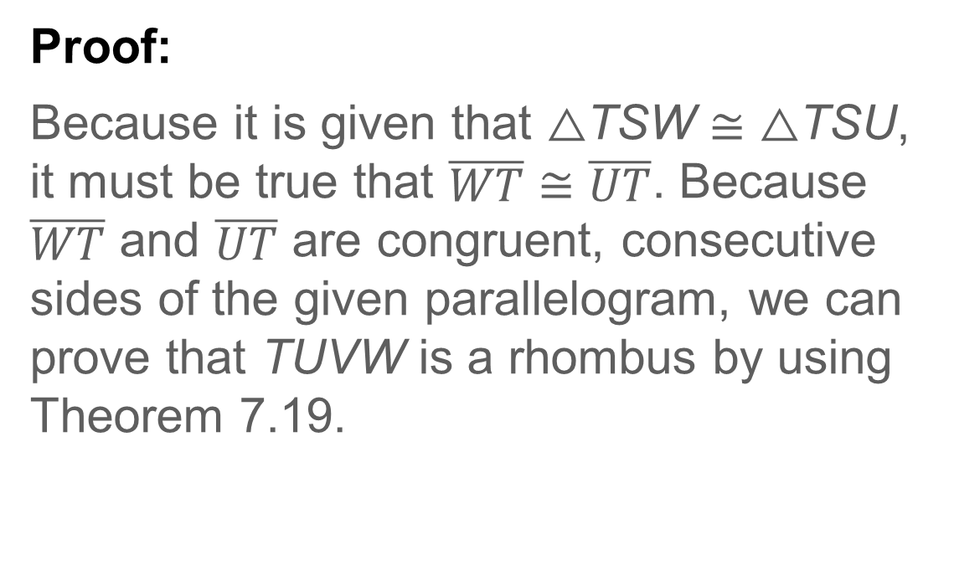
Example 4
Use Conditions for Rhombi and Squares
Proof:
Because it is given that △TSW ≅ △TSU, it must be true that $\overline{WT}$ ≅ $\overline{UT}$. Because $\overline{WT}$ and $\overline{UT}$ are congruent, consecutive sides of the given parallelogram, we can prove that TUVW is a rhombus by using Theorem 7.19.

Slide 27
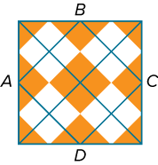
Example 5
Use Properties of a Rhombus
GARMENT DESIGN Ananya is designing a sweater using an argyle pattern. All four sides of quadrilateral ABCD are 2 inches long. How can Ananya be sure that the argyle pattern is a square?

Slide 28
Example 5
Use Properties of a Rhombus
A square has all of the properties of a parallelogram, a rhombus, and a rectangle. To prove that quadrilateral ABCD is a square, prove that it is a parallelogram, a rhombus, and a rectangle.

Slide 29
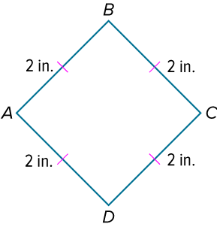
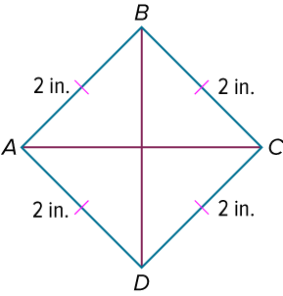
Example 5
Use Properties of a Rhombus
Because both pairs of opposite sides are congruent, ABCD is a parallelogram.
Because consecutive sides of ▱ABCD are congruent, it is a rhombus.
If the diagonals of a parallelogram are congruent, then the parallelogram is a rectangle. So, if Ananya measures the length of each diagonal and finds that they are equal, then ABCD is a square.

Slide 30
Example 5
Use Properties of a Rhombus
Think About It!
How could Ananya show that the pattern is a square in a different way? Which method is more efficient?

Slide 31
Example 6
Classify Parallelograms by Using Coordinate Geometry
Determine whether ▱ABCD with vertices A(−3, 2), B(−2, 6), C(2, 7), and D(1, 3) is a rhombus, a rectangle, a square, or none. List all that apply. Explain.

Slide 32
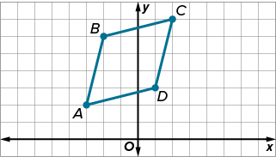
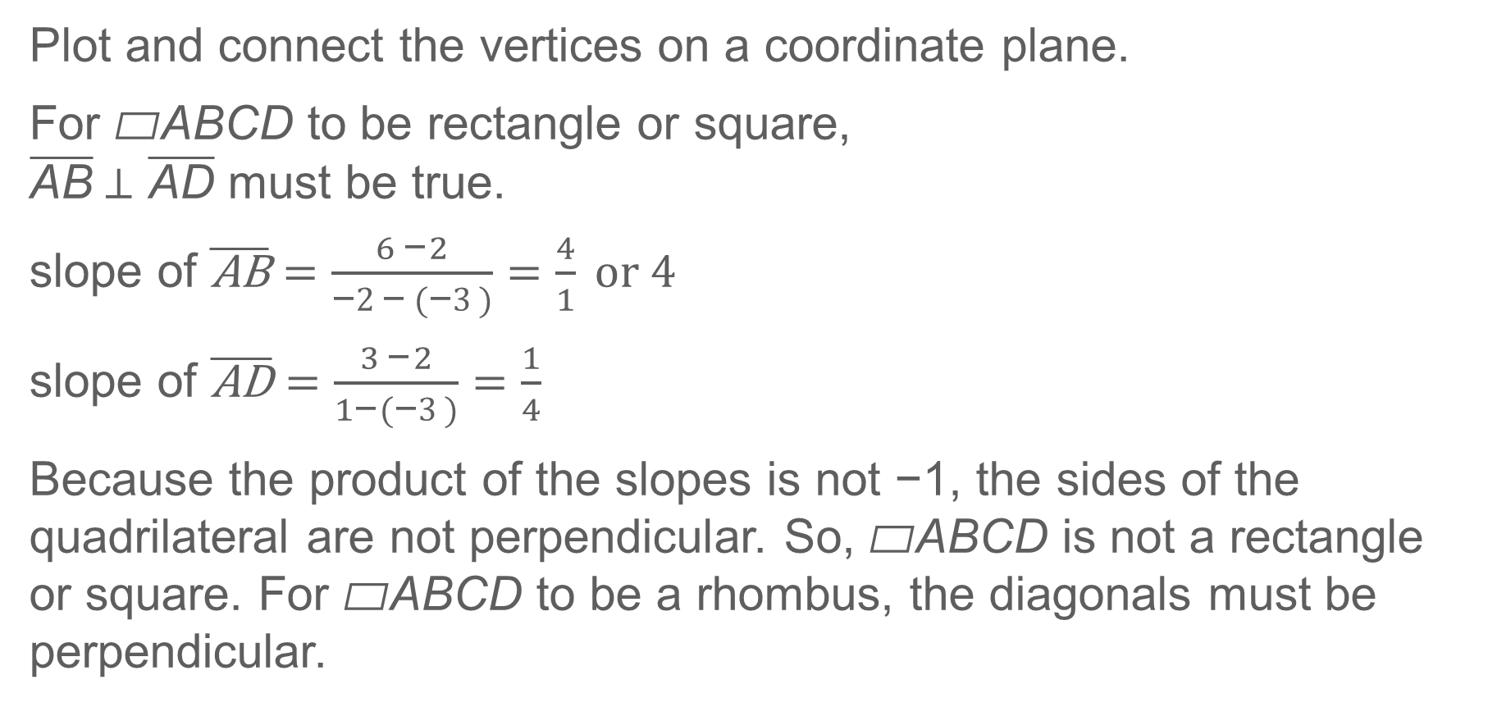
Example 6
Classify Parallelograms by Using Coordinate Geometry
Plot and connect the vertices on a coordinate plane.
For ▱ABCD to be rectangle or square,
$\overline{\text{AB}}$⊥ $\overline{\text{AD}}$ must be true.
slope of $\overline{\text{AB}}=\frac{6 \text{–} 2}{\text{–}2\text{–} (\text{–}3)}=\frac{4}{1} or 4$
slope of $\overline{\text{A}\text{D}}=\frac{3\text{ –} 2}{1\text{–} (\text{–}3)}=\frac{1}{4}$
Because the product of the slopes is not −1, the sides of the quadrilateral are not perpendicular. So, ▱ABCD is not a rectangle or square. For ▱ABCD to be a rhombus, the diagonals must be perpendicular.

Slide 33
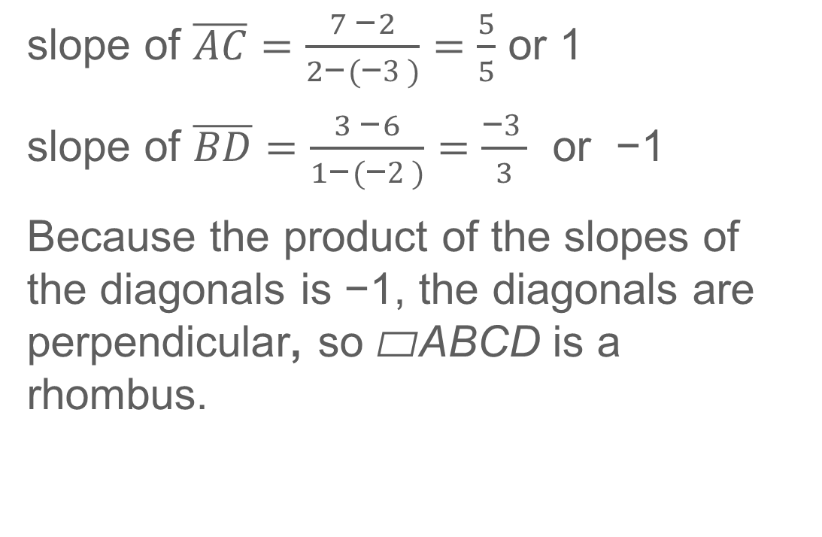
Example 6
Classify Parallelograms by Using Coordinate Geometry
slope of $\overline{AC}=\frac{7 \text{–} 2}{2\text{–} (\text{–}3)}=\frac{5}{5}$ or 1
slope of $\overline{BD}=\frac{3 \text{–} 6}{1\text{–} (\text{–}2)}=\frac{\text{–}3}{3}$ or −1
Because the product of the slopes of the diagonals is −1, the diagonals are perpendicular, so ▱ABCD is a rhombus.

Slide 34
Example 6
Classify Parallelograms by Using Coordinate Geometry
Think About It!
What other way could you use to determine whether a quadrilateral is a rhombus?

Slide 35
Exit Ticket
Which statements are true, and which are false?
1. All parallelograms are quadrilaterals.
2. No rhombus is a parallelogram.
3. All squares are rhombi.
4. Some rectangles are squares.
5. Some rhombi are rectangles.

Slide 36
Exit Ticket
Which statements are true, and which are false?
1. All parallelograms are quadrilaterals. true
2. No rhombus is a parallelogram. false
3. All squares are rhombi. true
4. Some rectangles are squares. true
5. Some rhombi are rectangles. true
Notes:
true
false
true
true
true

