Slide 1
Medians and Altitudes of Triangles

Slide 2
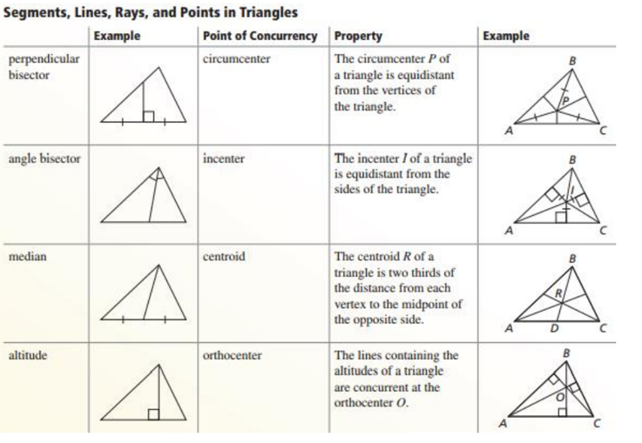
Medians and Altitudes of Triangles

Slide 3
Warm Up
Use the picture to name all angle pairs and the relationships between the angles.
1. corresponding angles
2. alternate interior angles
3. alternate exterior angles
4. same side interior angles

Slide 4
Warm Up
Use the picture to name all angle pairs and the relationships between the angles.
1. corresponding angles
∠1, ∠5; ∠2, ∠6; ∠3, ∠7; ∠4, ∠8; ≅
2. alternate interior angles
∠3, ∠5; ∠4, ∠6; ≅
3. alternate exterior angles
∠2, ∠8; ∠1, ∠7; ≅
4. same side interior angles
∠3, ∠6; ∠4, ∠5; supplementary
Notes:
∠1, ∠5; ∠2, ∠6; ∠3, ∠7; ∠4, ∠8; ≅
∠3, ∠5; ∠4, ∠6; ≅
∠2, ∠8; ∠1, ∠7; ≅
∠3, ∠6; ∠4, ∠5; supplementary

Slide 5
Florida’s B.E.S.T. Standards for Mathematics
MA.912.GR.1.3 Prove relationships and theorems about triangles. Solve mathematical and real-world problems involving postulates, relationships and theorems of triangles.
MA.912.GR.3.3 Use coordinate geometry to solve mathematical and real-world geometric problems involving lines, circles, triangles and quadrilaterals.

Slide 6
Florida’s Mathematical Thinking and Reasoning Standards
MA.K12.MTR.1.1
Actively participate in effortful learning both individually and collectively.
MA.K12.MTR.4.1
Engage in discussions that reflect on the mathematical thinking of self and others.
MA.K12.MTR.5.1
Use patterns and structure to help understand and connect mathematical concepts.

Slide 7
Lesson Objectives
Content Objective
Students solve problems using medians and altitudes in triangles.
Language Objectives
Students explain how to solve problems involving medians and altitudes in triangles using interior and exterior.
To cultivate conversation, students participate in MLR8: Discussion Supports.

Slide 8
Learn
Medians of Triangles
In a triangle, a median is a line segment with endpoints that are a vertex of the triangle and the midpoint of the side opposite the vertex.
Every triangle has three medians that are concurrent. The point of concurrency of the medians of a triangle is called the centroid, and it is always inside the triangle.

Slide 9
Learn
Medians of Triangles
Theorem 6.7: Centroid Theorem
The medians of a triangle intersect at a point called the centroid that is two-thirds of the distance from each vertex to the midpoint of the opposite side.
All polygons have a balancing point or center of gravity. This is the point at which the weight of a region is evenly dispersed and all sides of the region are balanced. The centroid is the center of gravity for a triangular region.

Slide 10
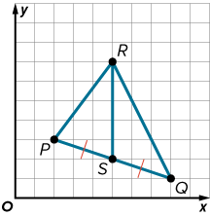
Learn
Medians of Triangles
Think About It!
How could you find the coordinates of the centroid of △PQR?

Slide 11
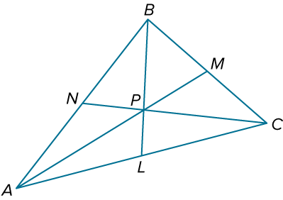
Example 1
Use the Centroid Theorem
In △ABC, P is the centroid and BL = 6. Find BP and PL.

Slide 12
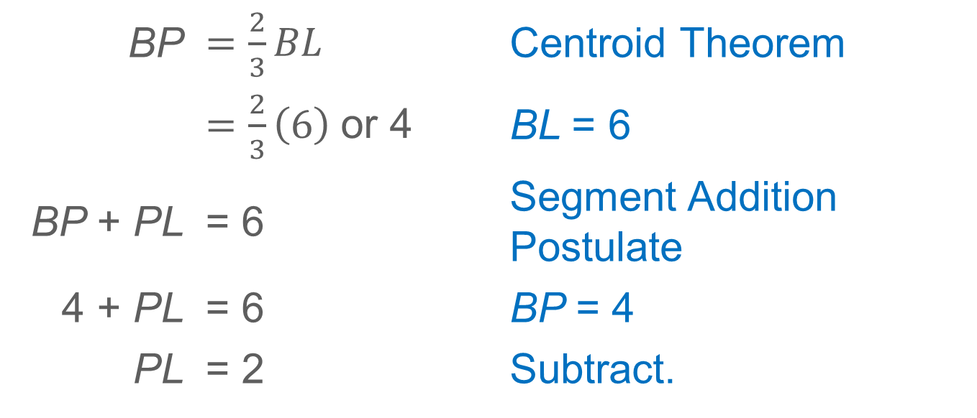
Example 1
Use the Centroid Theorem
BP | $=\frac{2}{3}BL$ | Centroid Theorem
 | $=\frac{2}{3}\left(6\right)$or 4 | BL = 6
BP + PL | = 6 | Segment Addition Postulate
4 + PL | = 6 | BP = 4
PL | = 2 | Subtract.

Slide 13
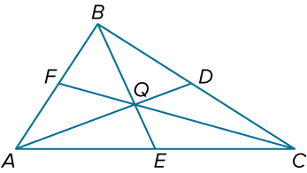
Example 1
Use the Centroid Theorem
Check
In △ABC, Q is the centroid and BE = 9. Find BQ and QE.

Slide 14
Example 1
Use the Centroid Theorem
Check
In △ABC, Q is the centroid and BE = 9. Find BQ and QE.
BQ = 6 and QE = 3
Notes:
BQ = 6 and QE = 3

Slide 15
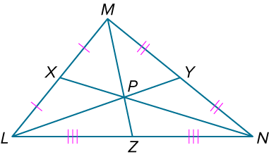
Example 2
Apply the Centroid Theorem
In △LMN, PY = 7. Find LP.

Slide 16
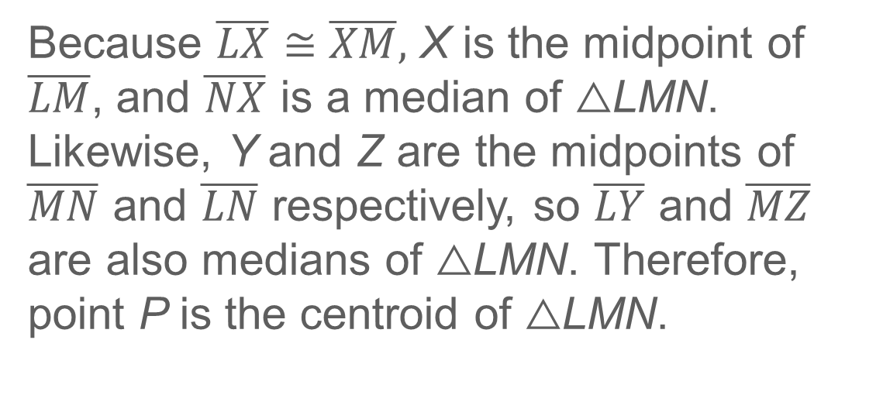
Example 2
Apply the Centroid Theorem
Because $\overline{LX}≅\overline{XM},$ X is the midpoint of $\overline{LM}$, and $\overline{NX}$ is a median of △LMN. Likewise, Y and Z are the midpoints of $\overline{MN}$ and $\overline{LN}$ respectively, so $\overline{LY}$ and $\overline{MZ}$ are also medians of △LMN. Therefore, point P is the centroid of △LMN.

Slide 17
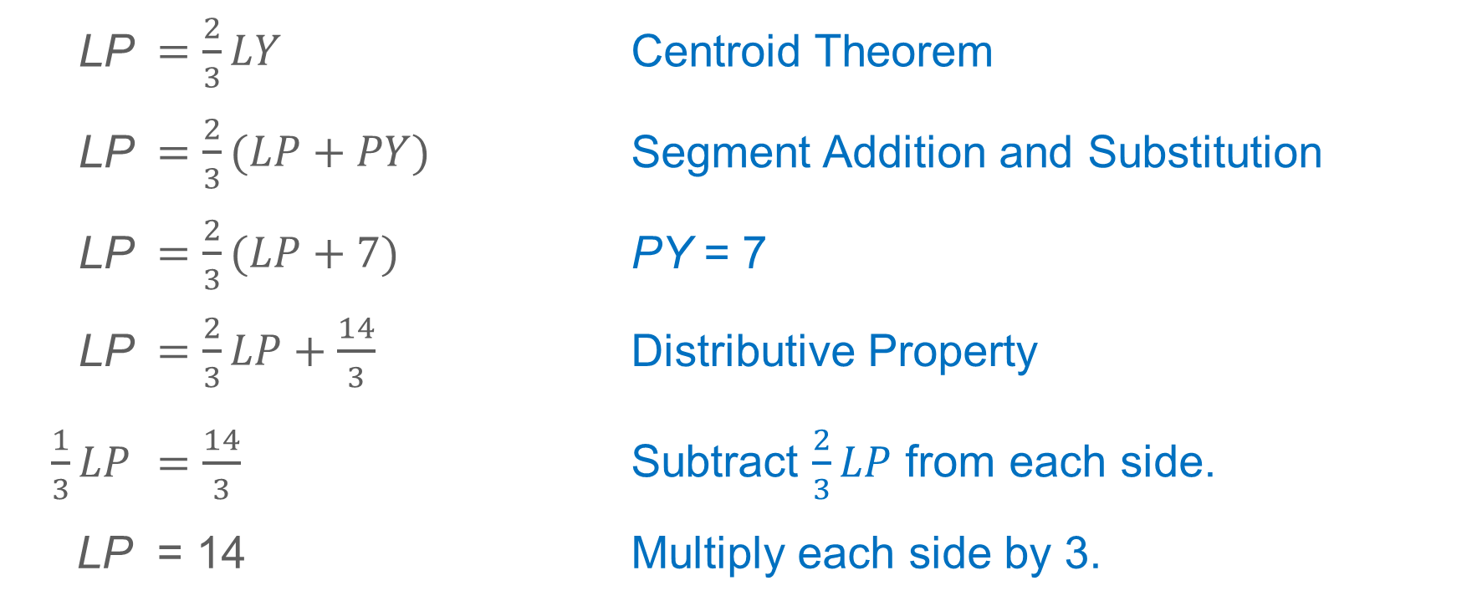
Example 2
Apply the Centroid Theorem
LP | $=\frac{2}{3}LY$ | Centroid Theorem
LP | $=\frac{2}{3}(LP+PY)$ | Segment Addition and Substitution
LP | $=\frac{2}{3}(LP+7)$ | PY = 7
LP | $=\frac{2}{3}LP+\frac{14}{3}$ | Distributive Property
$\frac{1}{3}LP$ | $=\frac{14}{3}$ | Subtract $\frac{2}{3}LP$ from each side.
LP | = 14 | Multiply each side by 3.

Slide 18
Example 2
Apply the Centroid Theorem
Talk About It!
How can you find LP without solving an equation? Justify your argument. Which method do you think is more efficient?

Slide 19
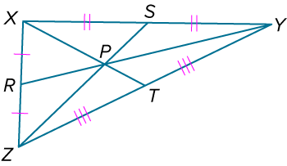
Example 2
Apply the Centroid Theorem
Check
In △XYZ, SP = 3.5. Find PZ.

Slide 20
Example 2
Apply the Centroid Theorem
Check
In △XYZ, SP = 3.5. Find PZ.
PZ = 7
Notes:
PZ = 7

Slide 21
Apply Example 3
Find a Centroid on the Coordinate Plane
CHIMES Lashaya needs to hang a wind chime with a single piece of cord. The pipes of the wind chime are attached to a triangular platform. When the platform is placed on a coordinate plane, the vertices of the triangle are located at (1, 1), (11, 5), and (7, 10). What are the coordinates of the point where the cord should be attached to the platform so the wind chime stays balanced?

Slide 22
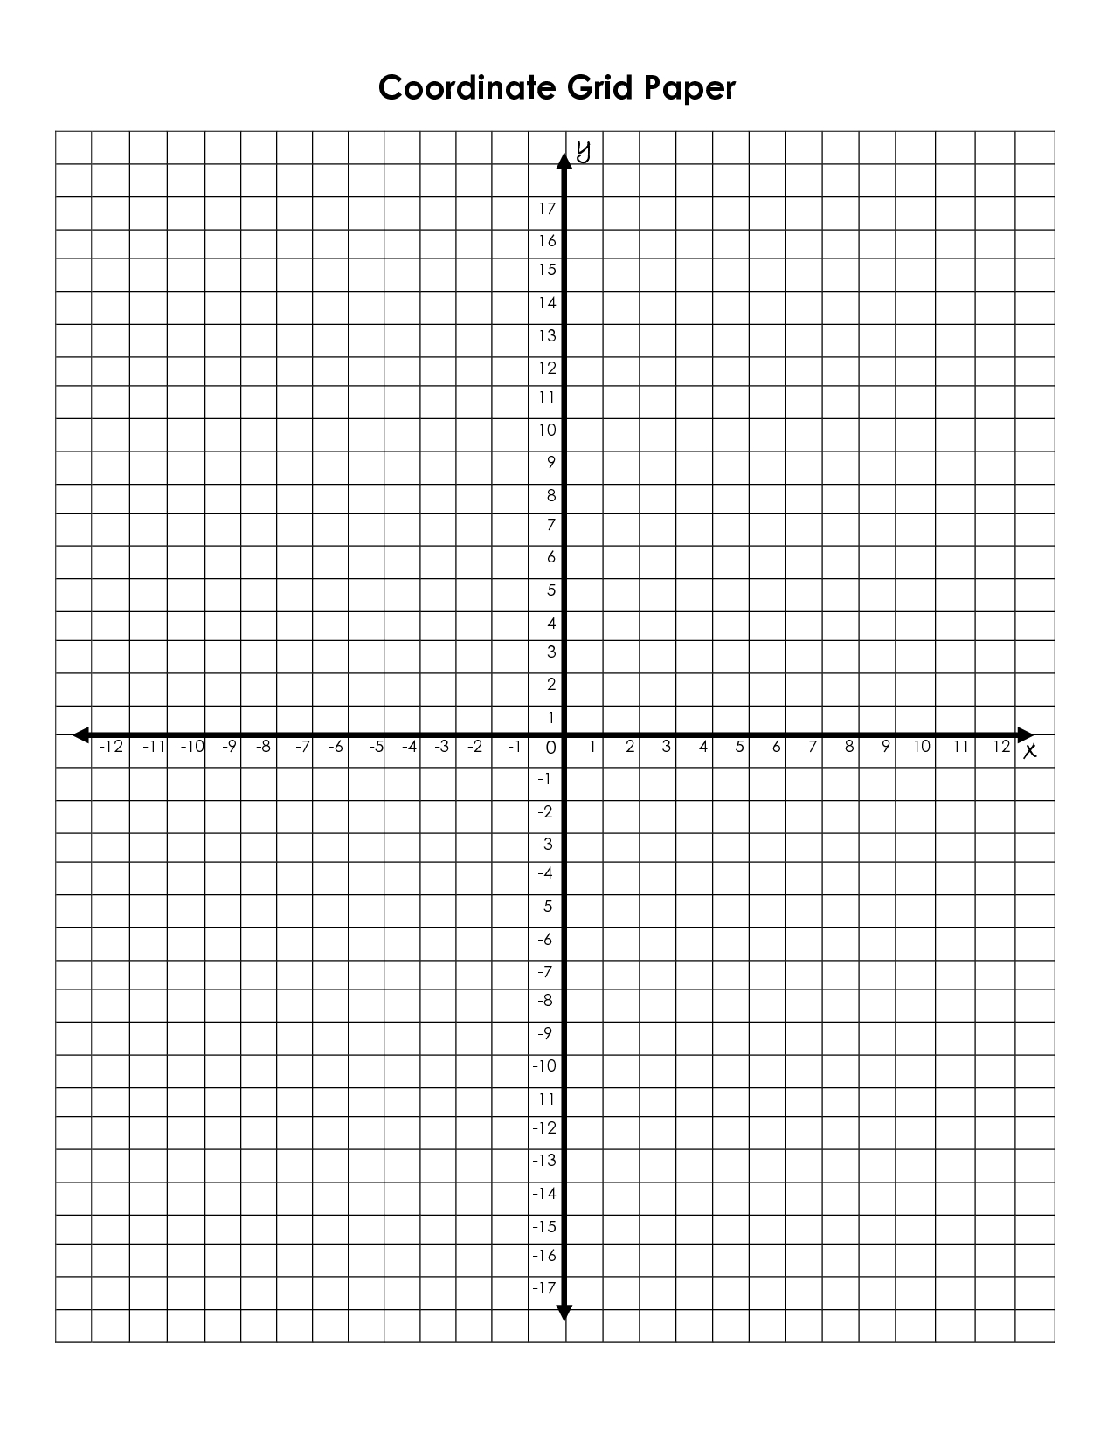


Slide 23
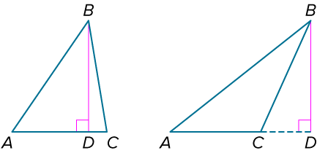
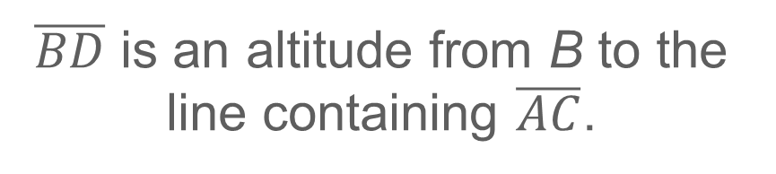
Learn
Altitudes of Triangles
An altitude of a triangle is a segment from a vertex of the triangle to the line containing the opposite side and perpendicular to that side. An altitude can lie in the interior, in the exterior, or on the side of the triangle.
$\overline{BD}$ is an altitude from B to the line containing $\overline{AC}$.

Slide 24
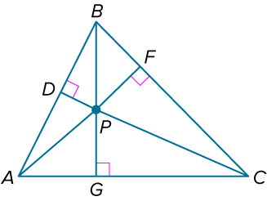
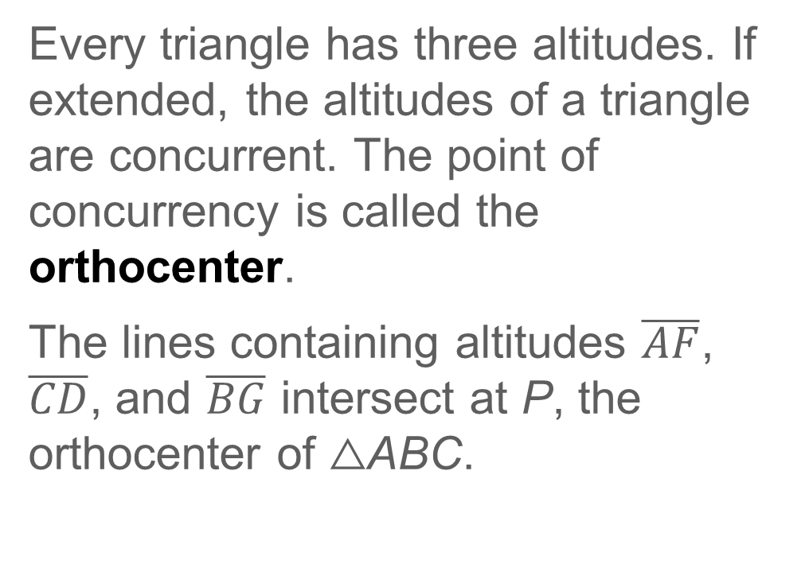
Learn
Altitudes of Triangles
Every triangle has three altitudes. If extended, the altitudes of a triangle are concurrent. The point of concurrency is called the orthocenter.
The lines containing altitudes $\overline{AF}$, $\overline{CD}$, and $\overline{BG}$ intersect at P, the orthocenter of △ABC.

Slide 25
Example 4
Find an Orthocenter on the Coordinate Plane
The vertices of △ABC are A(4, 0), B(−2, 4), and C(0, 6). Find the coordinates of the orthocenter of △ABC.

Slide 26
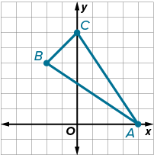
Example 4
Find an Orthocenter on the Coordinate Plane
Step 1 Graph △ABC.
To find the orthocenter of △ABC, find the point where two of the three altitudes intersect.

Slide 27
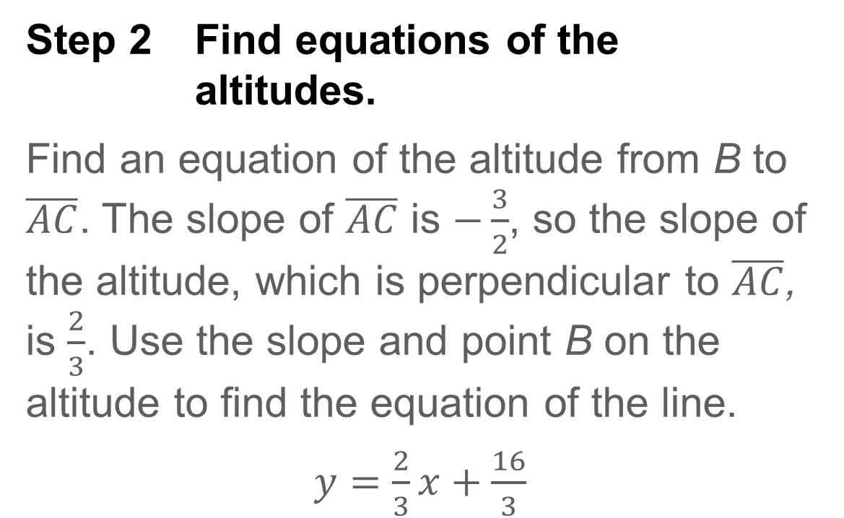
Example 4
Find an Orthocenter on the Coordinate Plane
Step 2 Find equations of the altitudes.
Find an equation of the altitude from B to $\overline{AC}$. The slope of $\overline{AC}$ is $−\frac{3}{2}$, so the slope of the altitude, which is perpendicular to $\overline{AC}$, is $\frac{2}{3}$. Use the slope and point B on the altitude to find the equation of the line.
$y=\frac{2}{3}x+\frac{16}{3}$

Slide 28
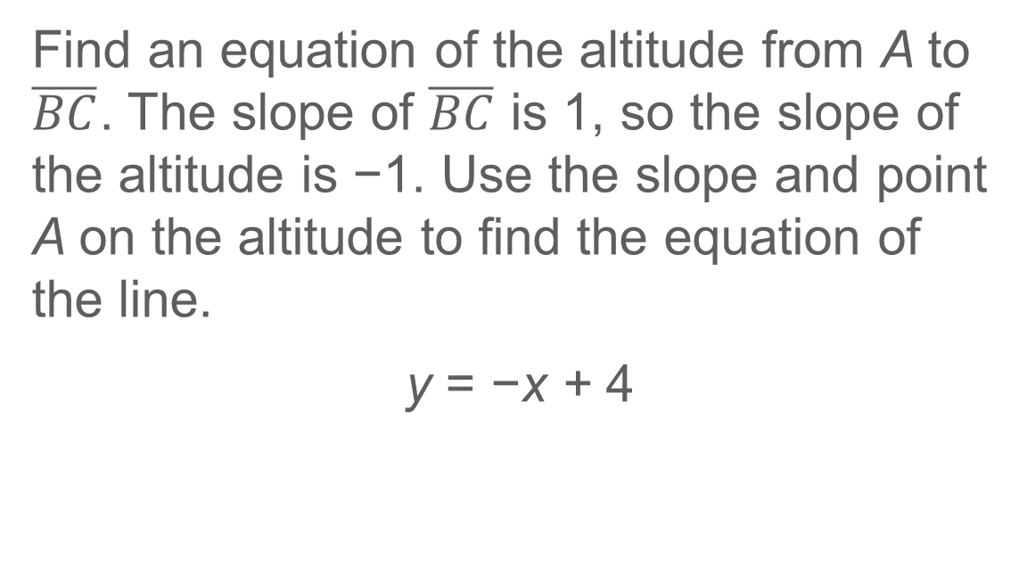
Example 4
Find an Orthocenter on the Coordinate Plane
Find an equation of the altitude from A to $\overline{BC}$. The slope of $\overline{BC}$ is 1, so the slope of the altitude is −1. Use the slope and point A on the altitude to find the equation of the line.
y = −x + 4

Slide 29
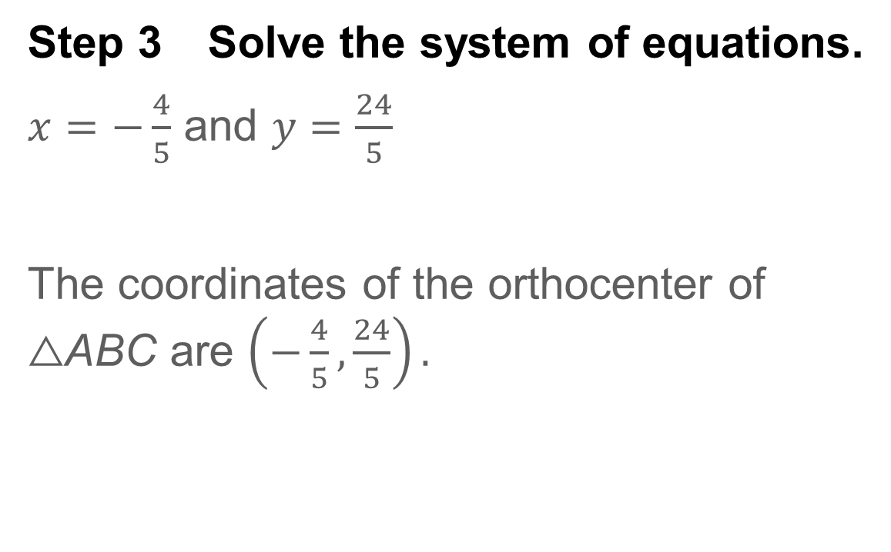
Example 4
Find an Orthocenter on the Coordinate Plane
Step 3 Solve the system of equations.
$x=−\frac{4}{5}$ and $y=\frac{24}{5}$
The coordinates of the orthocenter of △ABC are $\left(−\frac{4}{5}, \frac{24}{5}\right).$

Slide 30
Example 4
Find an Orthocenter on the Coordinate Plane
Check
The vertices of △FGH are F(−2, 4), G(4, 4), and H(1, −2). What are the coordinates of the orthocenter of △FGH? If necessary, round your answer to the nearest tenth.

Slide 31
Example 4
Find an Orthocenter on the Coordinate Plane
Check
The vertices of △FGH are F(−2, 4), G(4, 4), and H(1, −2). What are the coordinates of the orthocenter of △FGH? If necessary, round your answer to the nearest tenth. (1, 2.5)
Notes:
(1, 2.5)

Slide 32
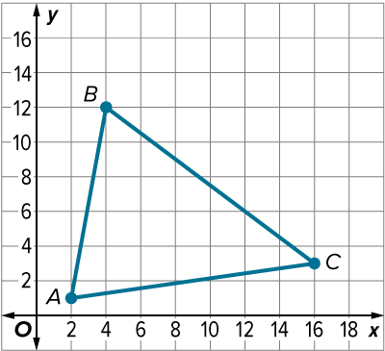
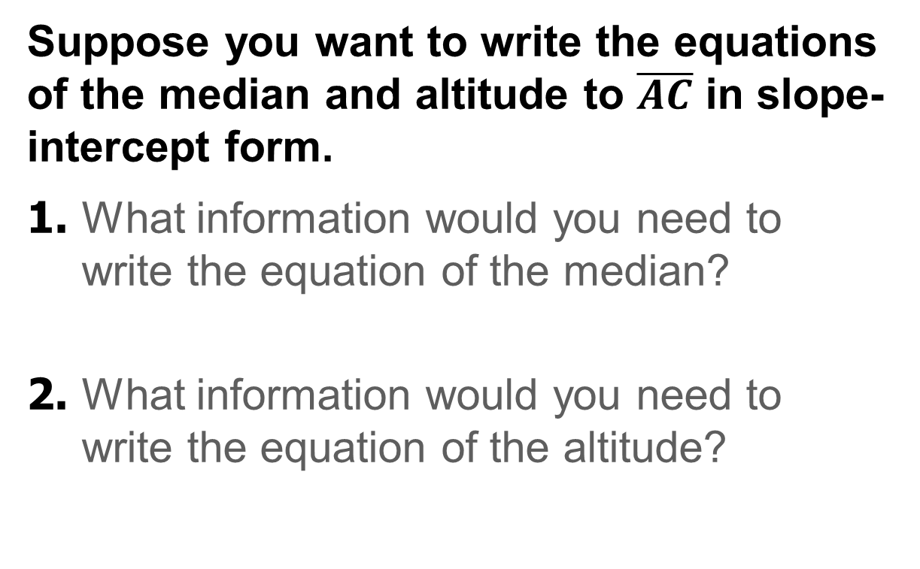
Exit Ticket
Suppose you want to write the equations of the median and altitude to $\overline{AC}$ in slope-intercept form.
1. What information would you need to write the equation of the median?
2. What information would you need to write the equation of the altitude?

Slide 33
Exit Ticket
3. Complete the table to show where the points of concurrency lie in each type of triangle.
4. For which type of triangle are the circumcenter, incenter, centroid, and orthocenter the same point?
Triangle | Circumcenter | Incenter | Centroid | Orthocenter
acute | interior | interior
obtuse | exterior | interior
right | on | interior

Slide 34
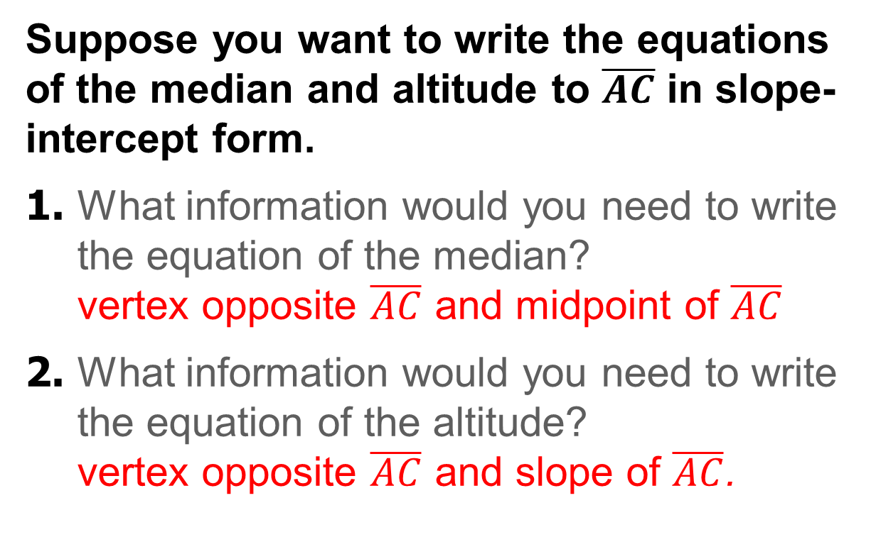
Exit Ticket
Suppose you want to write the equations of the median and altitude to $\overline{AC}$ in slope-intercept form.
1. What information would you need to write the equation of the median?
vertex opposite $\overline{AC}$ and midpoint of $\overline{AC}$
2. What information would you need to write the equation of the altitude?
vertex opposite $\overline{AC}$ and slope of $\overline{AC}$.
Notes:
vertex opposite $\overline{AC}$ and midpoint of $\overline{AC}$
vertex opposite $\overline{AC}$ and slope of $\overline{AC}$.

Slide 35
Exit Ticket
3. Complete the table to show where the points of concurrency lie in each type of triangle.
4. For which type of triangle are the circumcenter, incenter, centroid, and orthocenter the same point? equilateral
Triangle | Circumcenter | Incenter | Centroid | Orthocenter
acute | interior | interior | interior | inside
obtuse | exterior | interior | interior | outside
right | on | interior | interior | vertex of the right angle
Notes:
interior; inside
interior; outside
interior; vertex of the right angle
equilateral

