Slide 1
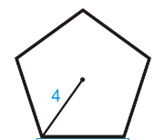
Areas of Regular Polygons

Slide 2
Warm up exercise
Find the area of the regular polygon

Slide 3
Warm Up
Find the measure of an interior angle of each regular polygon.
1. square
2. equilateral triangle
3. pentagon
4. octagon

Slide 4
Warm Up
5. BEEKEEPING Beekeeping involves raising honeybees for their honey. Honeybees construct combs consisting of cells in the shape of a regular hexagon. What is the measure of an interior angle of a honeybee comb cell?

Slide 5
Warm Up
Find the measure of an interior angle of each regular polygon.
1. square
2. equilateral triangle
3. pentagon
4. octagon
90°
60°
108°
135°
Notes:
90°
60°
108°
135°

Slide 6
Warm Up
5. BEEKEEPING Beekeeping involves raising honeybees for their honey. Honeybees construct combs consisting of cells in the shape of a regular hexagon. What is the measure of an interior angle of a honeybee comb cell?
120°
Notes:
120°

Slide 7
Florida’s B.E.S.T. Standards for Mathematics
MA.912.GR.4.4
Solve mathematical and real-world problems involving the area of two-dimensional figures.

Slide 8
Florida’s Mathematical Thinking and Reasoning Standards
MA.K12.MTR.1.1
Actively participate in effortful learning both individually and collectively.

Slide 9
Lesson Objectives
Content Objective
Students find areas of regular polygons.
Language Objectives
Students use regular and irregular to explain how to find areas of regular polygons.
To support sense-making, students participate in MLR2: Collect and Display.

Slide 10
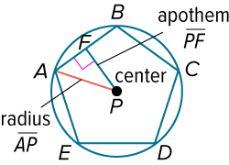
Learn
Areas of Regular Polygons
In the figure, a regular pentagon is inscribed in ⊙P, and ⊙P is circumscribed about the pentagon. The center of a regular polygon is the center of the circle circumscribed about the polygon. The radius of a regular polygon is the radius of the circle circumscribed about the polygon. The apothem of a regular polygon is a perpendicular segment between the center of the polygon and a side of the polygon.

Slide 11
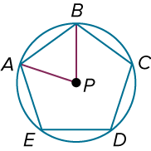
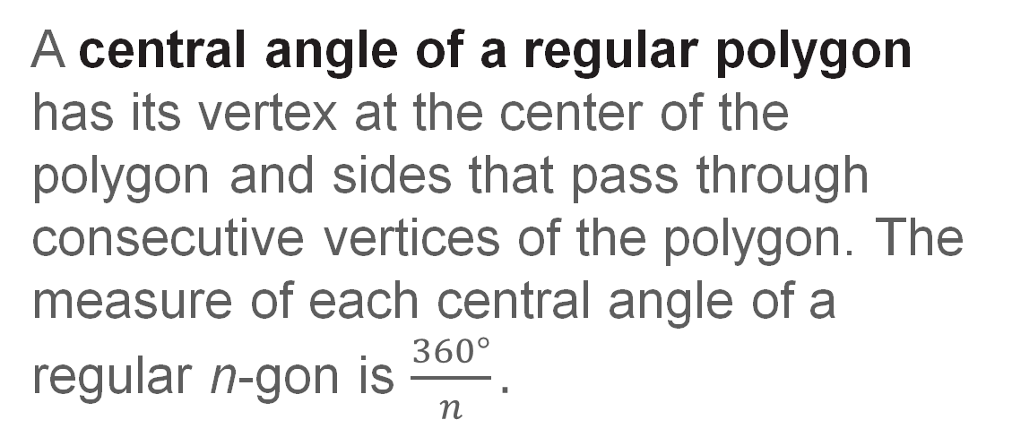
Learn
Areas of Regular Polygons
A central angle of a regular polygon has its vertex at the center of the polygon and sides that pass through consecutive vertices of the polygon. The measure of each central angle of a regular n-gon is $\frac{360°}{n}.$

Slide 12
Learn
Areas of Regular Polygons
You can find the area of any regular n-gon by dividing the polygon into congruent isosceles triangles. This strategy is sometimes called decomposing the polygon into triangles. To find the total area of the regular polygon, calculate the area of one triangle and multiply that area by the total number of triangles.

Slide 13
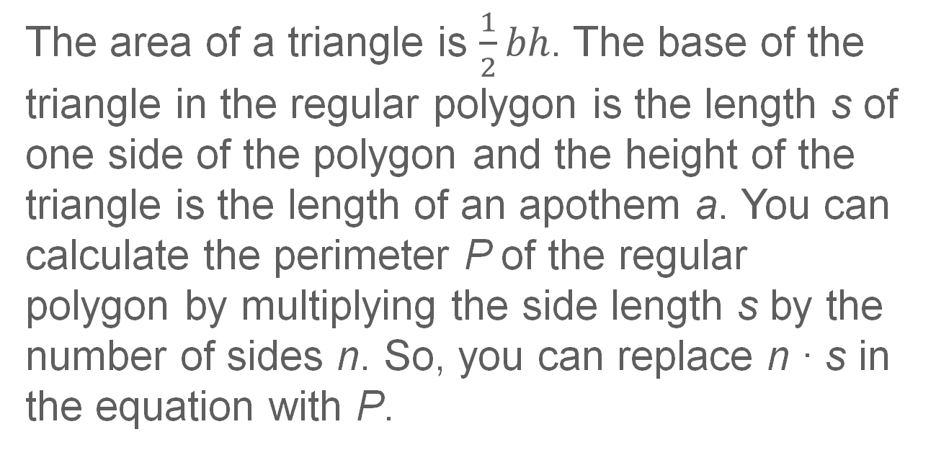
Learn
Areas of Regular Polygons
The area of a triangle is $\frac{1}{2}bh$. The base of the triangle in the regular polygon is the length s of one side of the polygon and the height of the triangle is the length of an apothem a. You can calculate the perimeter P of the regular polygon by multiplying the side length s by the number of sides n. So, you can replace n ∙ s in the equation with P.

Slide 14
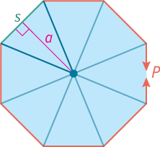
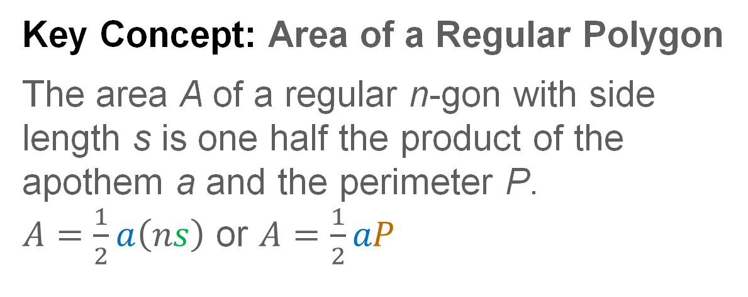
Learn
Areas of Regular Polygons
Key Concept: Area of a Regular Polygon
The area A of a regular n-gon with side length s is one half the product of the apothem a and the perimeter P.
$A=\frac{1}{2}a\left(ns\right)$ or $A=\frac{1}{2}aP$

Slide 15
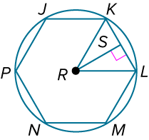
Example 1
Identify Segments and Angles in Regular Polygons
In the figure, regular hexagon JKLMNP is inscribed in ⊙R. Identify the center, a radius, an apothem, and a central angle of the polygon. Then find the measure of a central angle.

Slide 16
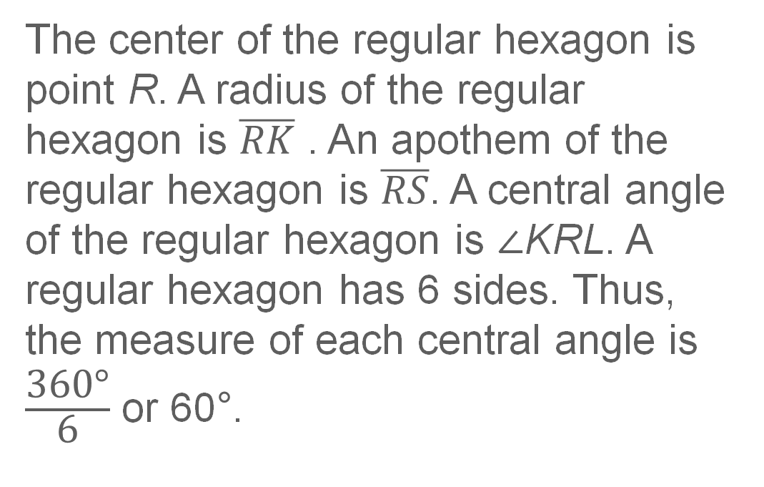
Example 1
Identify Segments and Angles in Regular Polygons
The center of the regular hexagon is point R. A radius of the regular hexagon is $\overline{RK}$ . An apothem of the regular hexagon is $\overline{RS}$. A central angle of the regular hexagon is ∠KRL. A regular hexagon has 6 sides. Thus, the measure of each central angle is $\frac{\text{360°}}{\text{6}}$ or 60$\text{°}$.

Slide 17
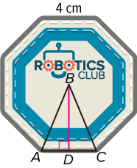
Example 2
Area of a Regular Polygon
PATCHES Lindsay created a patch for the robotics club at her school. The patch is a regular octagon with a side length of
4 centimeters. Find the area covered by the patch. Round to the nearest tenth.

Slide 18

Example 2
Area of a Regular Polygon
Step 1 Find the measure of a central angle.
A regular octagon has 8 congruent central angles, so m∠ABC = $\frac{\text{360°}}{\text{8}}$ or 45°.

Slide 19
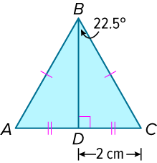
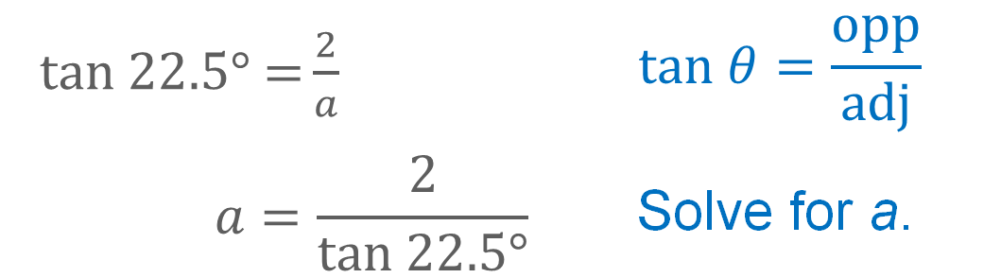
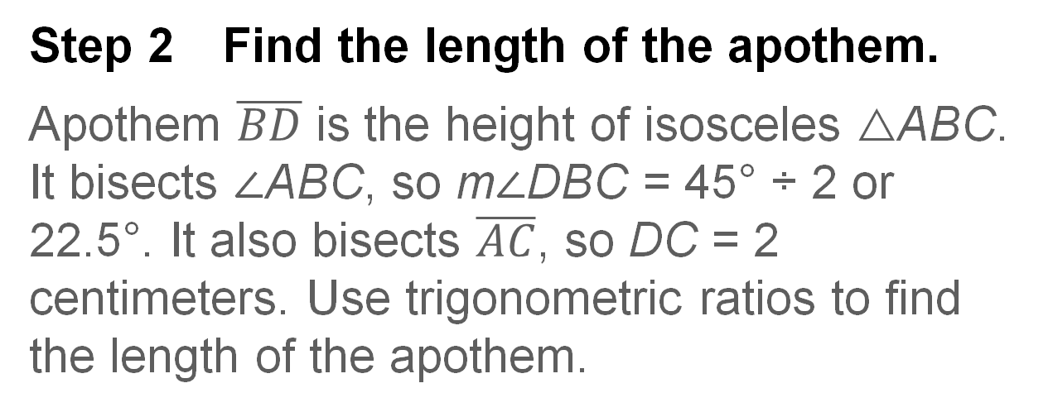
Example 2
Area of a Regular Polygon
Step 2 Find the length of the apothem.
Apothem $\overline{BD}$ is the height of isosceles △ABC. It bisects ∠ABC, so m∠DBC = 45° ÷ 2 or 22.5°. It also bisects $\overline{AC}$, so DC = 2 centimeters. Use trigonometric ratios to find the length of the apothem.
$tan 22.5°\text{ =}\frac{2}{a}$ | $$tan θ=\frac{opp}{adj}$$
$$a=\frac{2}{tan 22.5°}$$ | Solve for a.

Slide 20
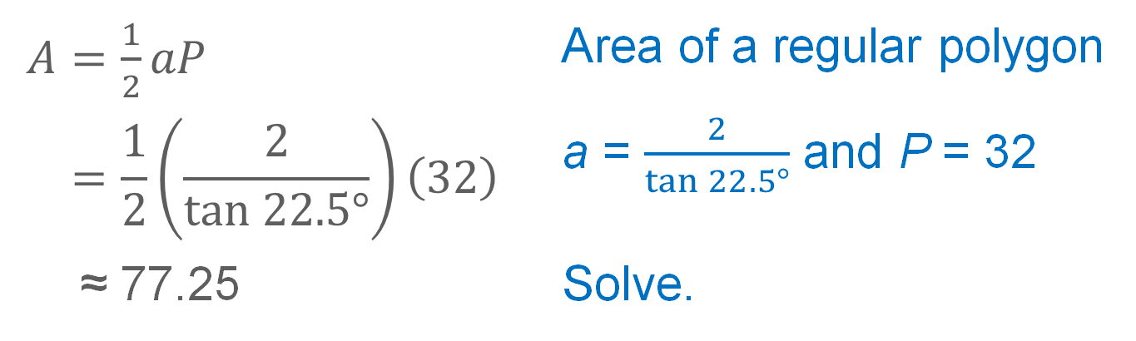
Example 2
Area of a Regular Polygon
Step 3 Use the formula for the area of a regular polygon.
$A=\frac{1}{2}aP$ | Area of a regular polygon
$$=\frac{1}{2}\left(\frac{2}{tan 22.5°}\right)\left(32\right)$$ | a = $\frac{2}{tan 22.5°}$ and P = 32
≈ 77.25 | Solve.
The patch covers an area of about 77.25 square centimeters.

Slide 21
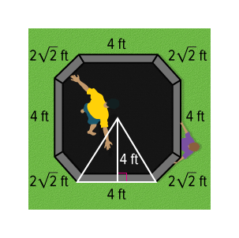
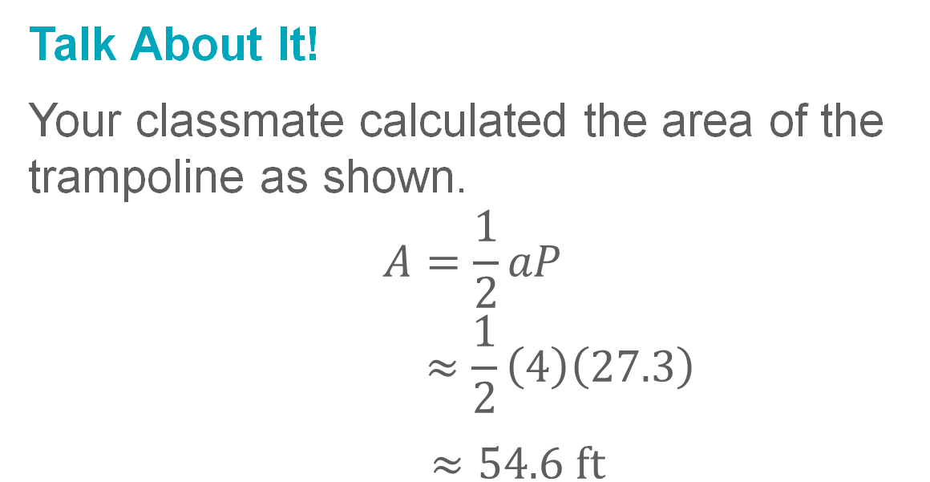
Example 2
Area of a Regular Polygon
Talk About It!
Your classmate calculated the area of the trampoline as shown.
$$A=\frac{1}{2}aP$$
$$≈\frac{1}{2}\left(4\right)\left(27.3\right)$$
$≈54.6 ft$
Describe the error. What feedback can you provide to help them correct the error?

Slide 22
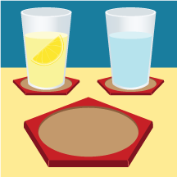
Example 2
Area of a Regular Polygon
Check
CERAMICS Imani is crafting coasters for a local craft fair. Each side measures 4 inches. Find the area of each coaster. Round your answer to the nearest tenth, if necessary.

Slide 23
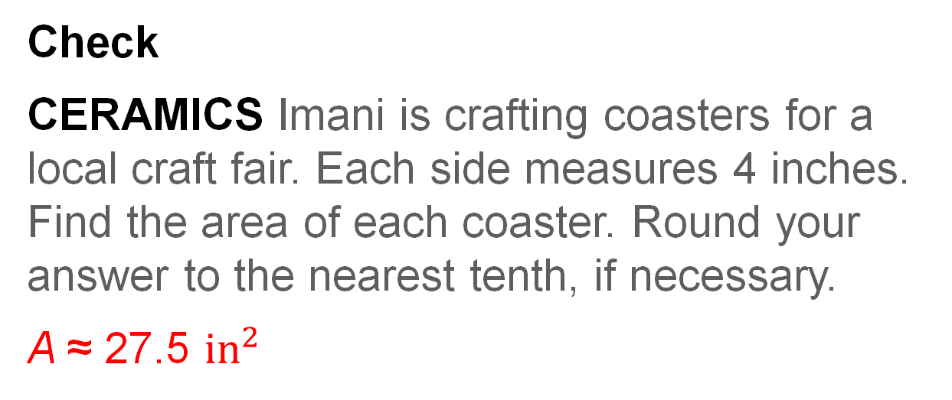
Example 2
Area of a Regular Polygon
Check
CERAMICS Imani is crafting coasters for a local craft fair. Each side measures 4 inches. Find the area of each coaster. Round your answer to the nearest tenth, if necessary.
A ≈ 27.5 ${in}^{2}$
Notes:
A ≈ 27.5 in²

Slide 24

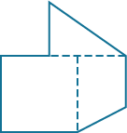
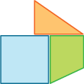

Learn
Areas of Composite Figures
A composite figure is a figure that can be separated into regions that are basic figures, such as triangles, rectangles, trapezoids, and circles. To find the area of a composite figure, find the area of each basic figure and then use the Area Addition Postulate.

Slide 25
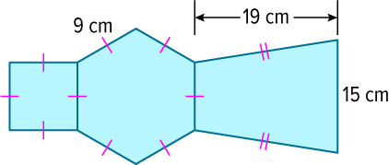
Example 3
Find the Area of a Composite Figure by Adding
Find the area of the composite figure.

Slide 26
Example 3
Find the Area of a Composite Figure by Adding
Step 1 Separate the composite figure.
The figure shown is composed of a square, regular hexagon, and trapezoid.
So, area of figure = area of square +
area of hexagon + area of trapezoid.

Slide 27
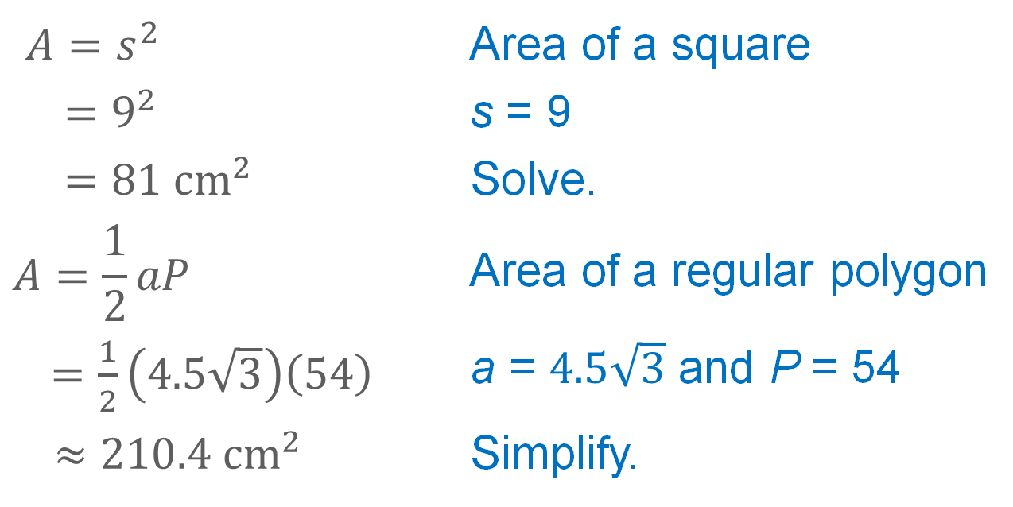
Example 3
Find the Area of a Composite Figure by Adding
Step 2 Calculate the area of each basic figure.
$A=s^{2}$ | Area of a square
$$=9^{2}$$ | s = 9
$=81 {cm}^{2}$ | Solve.
$$A=\frac{1}{2}aP$$ | Area of a regular polygon
$=\frac{1}{2}\left(4.5\sqrt{3}\right)\left(54\right)$ | a = $4.5\sqrt{3}$ and P = 54
$$≈210.4 {cm}^{2}$$ | Simplify.

Slide 28
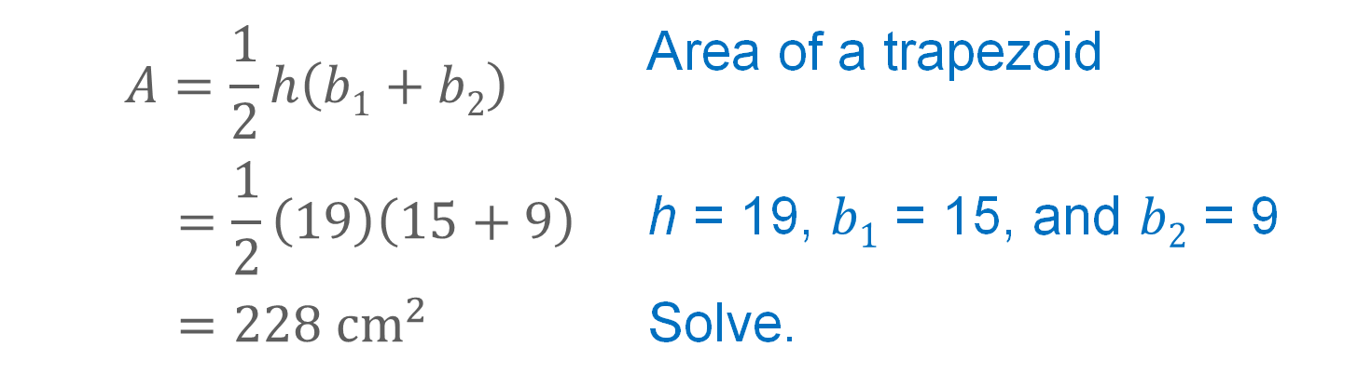
Example 3
Find the Area of a Composite Figure by Adding
$$A=\frac{1}{2}h\left(b1+b2\right)$$ | Area of a trapezoid
$$=\frac{1}{2}\left(19\right)\left(15+9\right)$$ | h = 19, $b1$ = 15, and $b2$ = 9
$=228 {cm}^{2}$ | Solve.

Slide 29
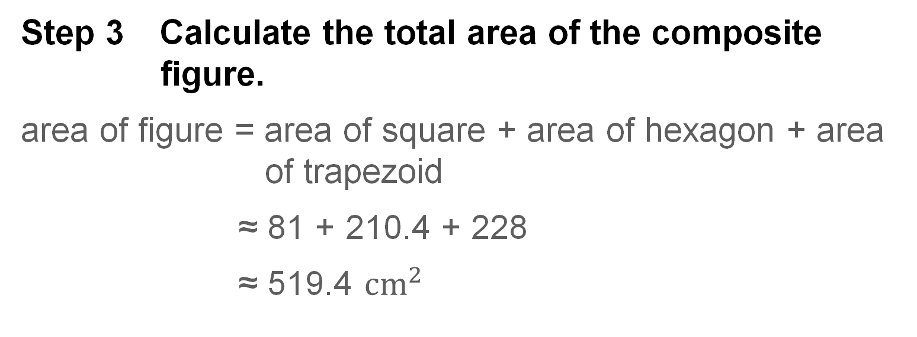
Example 3
Find the Area of a Composite Figure by Adding
Step 3 Calculate the total area of the composite figure.
area of figure = area of square + area of hexagon + area of trapezoid
≈ 81 + 210.4 + 228
≈ 519.4 ${cm}^{2}$

Slide 30
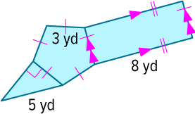
Example 3
Find the Area of a Composite Figure by Adding
Check
Find the area of the composite figure. Round to the nearest tenth, if necessary.

Slide 31
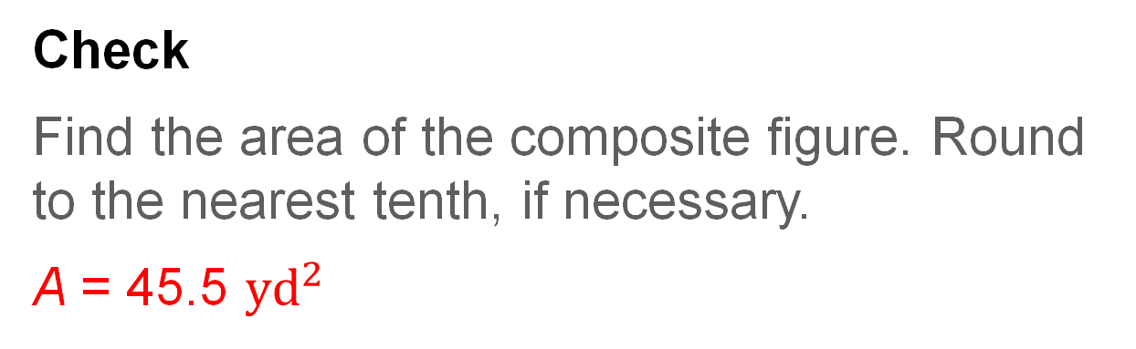
Example 3
Find the Area of a Composite Figure by Adding
Check
Find the area of the composite figure. Round to the nearest tenth, if necessary.
A = 45.5 ${yd}^{2}$
Notes:
A = 45.5 yd²

Slide 32
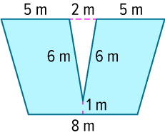
Example 4
Find the Area of a Composite Figure by Subtracting
Find the area of the composite figure. Round to the nearest tenth, if necessary.

Slide 33
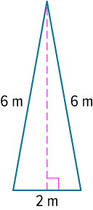
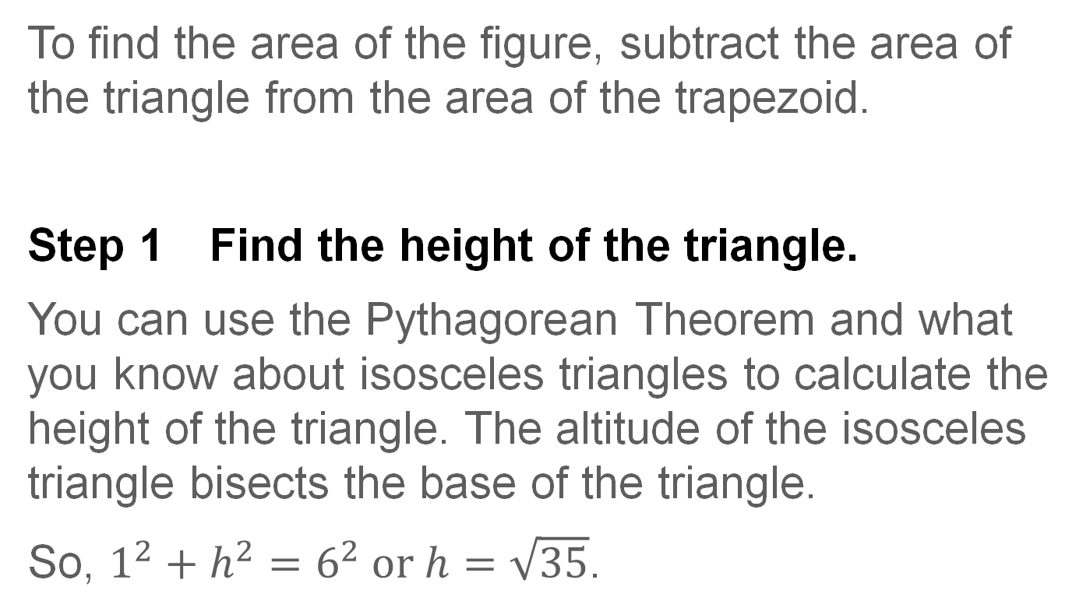
Example 4
Find the Area of a Composite Figure by Subtracting
To find the area of the figure, subtract the area of the triangle from the area of the trapezoid.
Step 1 Find the height of the triangle.
You can use the Pythagorean Theorem and what you know about isosceles triangles to calculate the height of the triangle. The altitude of the isosceles triangle bisects the base of the triangle.
So, $1^{2}+h^{2}=6^{2} or h=\sqrt{35}$.

Slide 34
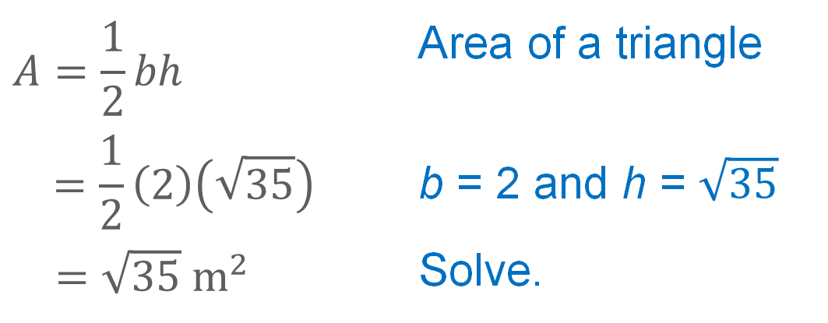
Example 4
Find the Area of a Composite Figure by Subtracting
Step 2 Find the area of the triangle.
$$A=\frac{1}{2}bh$$ | Area of a triangle
$$=\frac{1}{2}\left(2\right)\left(\sqrt{35}\right)$$ | b = 2 and h = $\sqrt{35}$
$=\sqrt{35} m^{2}$ | Solve.

Slide 35
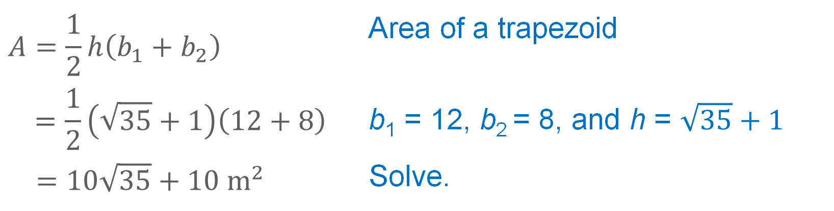
Example 4
Find the Area of a Composite Figure by Subtracting
Step 3 Find the area of the trapezoid.
$$A=\frac{1}{2}h\left(b_{1}+b_{2}\right)$$ | Area of a trapezoid
$$=\frac{1}{2}\left(\sqrt{35}+1\right)\left(12+8\right)$$ | b₁ = 12, b₂ = 8, and h = $\sqrt{35}+1$
$=10\sqrt{35}+10 m^{2}$ | Solve.

Slide 36
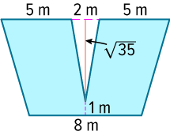
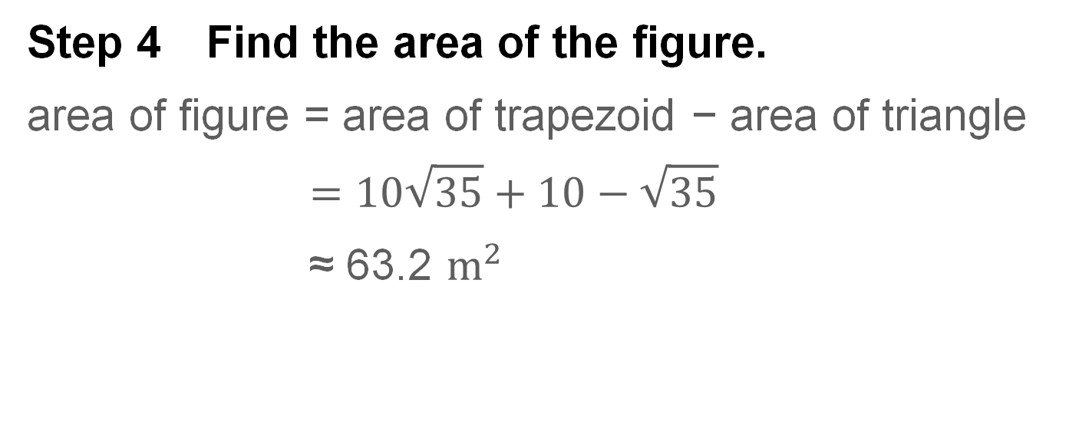
Example 4
Find the Area of a Composite Figure by Subtracting
Step 4 Find the area of the figure.
area of figure = area of trapezoid − area of triangle
$$=10\sqrt{35}+10−\sqrt{35}$$
≈ 63.2 $m^{2}$

Slide 37
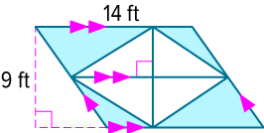
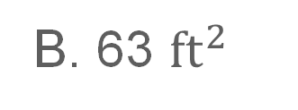
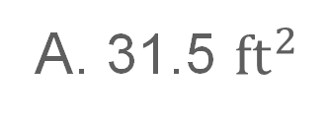
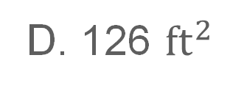
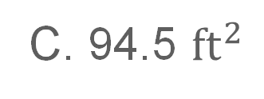
Example 4
Find the Area of a Composite Figure by Subtracting
Check
Select the area of the composite figure.
A. 31.5 ${ft}^{2}$
B. 63 ${ft}^{2}$
C. 94.5 ${ft}^{2}$
D. 126 ${ft}^{2}$

Slide 38
Example 4
Find the Area of a Composite Figure by Subtracting
Check
Select the area of the composite figure.
A. 31.5 ${ft}^{2}$
B. 63 ${ft}^{2}$
C. 94.5 ${ft}^{2}$
D. 126 ${ft}^{2}$
B
Notes:
B

Slide 39
Exit Ticket
Find the area of each regular polygon to the nearest tenth.
1. octagon, side length 7 inches
2. nonagon, perimeter 27 centimeters
3. heptagon, apothem 13 feet
4. triangle, side length 5 meters

Slide 40
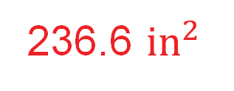
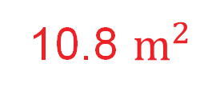
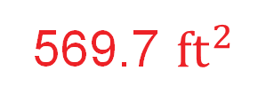
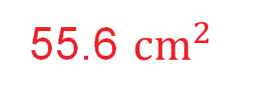
Exit Ticket
Find the area of each regular polygon to the nearest tenth.
1. octagon, side length 7 inches
2. nonagon, perimeter 27 centimeters
3. heptagon, apothem 13 feet
4. triangle, side length 5 meters
236.6 ${in}^{2}$
55.6 ${cm}^{2}$
569.7 ${ft}^{2}$
10.8 $m^{2}$
Notes:
236.6 ${in}^{2}$
55.6 ${cm}^{2}$
569.7 ${ft}^{2}$
10.8 $m^{2}$

