Slide 1
Section 3-2
Statements, Conditionals, and Biconditionals

Slide 2
Warm Up
Answer true or false.
1. If an object is red, then it is not blue.
2. If an object is not red, then it is not blue.
3. If an object is not blue, then it is not red.
4. If an object is blue, then it is not red.
5. Rewrite this statement as a true if-then statement. An even number is divisible by 2.

Slide 3
Warm Up
Answer true or false.
1. If an object is red, then it is not blue.
2. If an object is not red, then it is not blue.
3. If an object is not blue, then it is not red.
4. If an object is blue, then it is not red.
5. Rewrite this statement as a true if-then statement. An even number is divisible by 2.
true
false
false
true
If a number is even, then it is divisible by 2.
Notes:
true
false
false
true
If a number is even, then it is divisible by 2.

Slide 4
Florida’s B.E.S.T. Standards for Mathematics
MA.912.LT.4.3
Identify and accurately interpret “if…then,” “if and only if,” “all” and “not” statements. Find the converse, inverse and contrapositive of a statement.
MA.912.LT.4.10
Judge the validity of arguments and give counterexamples to disprove statements.

Slide 5
Florida’s Mathematical Thinking and Reasoning Standards
MA.K12.MTR.2.1
Demonstrate understanding by representing problems in multiple ways.
MA.K12.MTR.4.1
Engage in discussions that reflect on the mathematical thinking of self and others.

Slide 6
Lesson Objectives
Content Objective
Students write and analyze compound statements by using logic.
Language Objectives
Students use If … , then … statements to explain how to analyze compound statements using logic.
To cultivate conversation, students participate in MLR8: Discussion Supports.

Slide 7
Learn
Using Logic
A statement is any sentence that is either true T or false F, but not both. Truth value is the truth or falsity of a statement. Statements are often represented using a letter such as p or q.
If a statement is represented by p, then not p or ∼p is the negation of the statement. The negation of a statement has the opposite meaning, as well as the opposite truth value, of the original statement.

Slide 8
Learn
Using Logic
Two or more statements joined by the word and or or form a compound statement. A compound statement using the word and is called a conjunction. A conjunction is true only when both statements that form it are true. A conjunction is written as p and q or p ∧ q.
A compound statement using the word or is called a disjunction. A disjunction is true if at least one of the statements is true. A disjunction is written as p or q or p ∨ q.

Slide 9

Example 1
Truth Values of Conjunctions
Use the statements to write each conjunction. Then find the truth values. Explain your reasoning.
p: The figure is a pentagon.
q: The figure has four congruent sides.
r: The figure has four right angles.
a. p and r
b. ∼p ∧ q

Slide 10
Example 1
Truth Values of Conjunctions
a. p and r
p and r: The figure is a pentagon, and the figure has four right angles. The statement r is true, and p is false. So, p and r is false.
b. ∼p ∧ q
∼p ∧ q: The figure is not a pentagon, and the figure has four congruent sides. Both ∼p and q are true, so ∼p ∧ q is true.

Slide 11
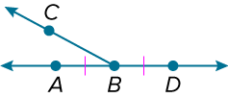
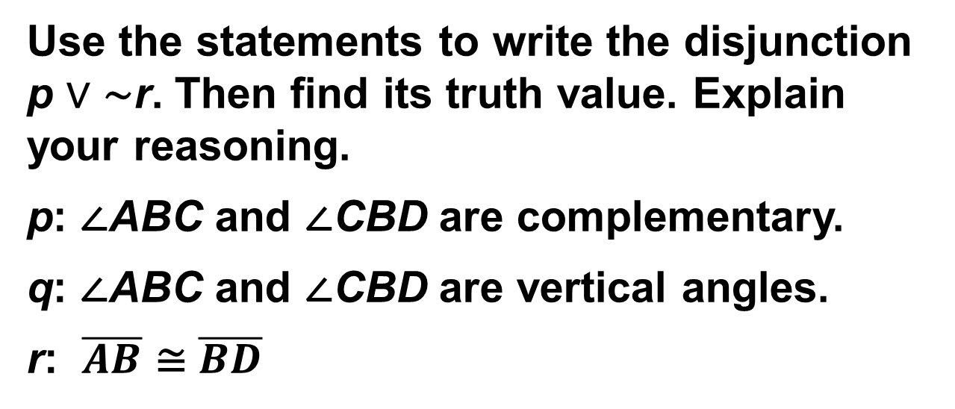
Example 2
Truth Values of Disjunctions
Use the statements to write the disjunction p ∨ ∼r. Then find its truth value. Explain your reasoning.
p: ∠ABC and ∠CBD are complementary.
q: ∠ABC and ∠CBD are vertical angles.
r: $\overline{AB}$ ≅ $\overline{BD}$

Slide 12
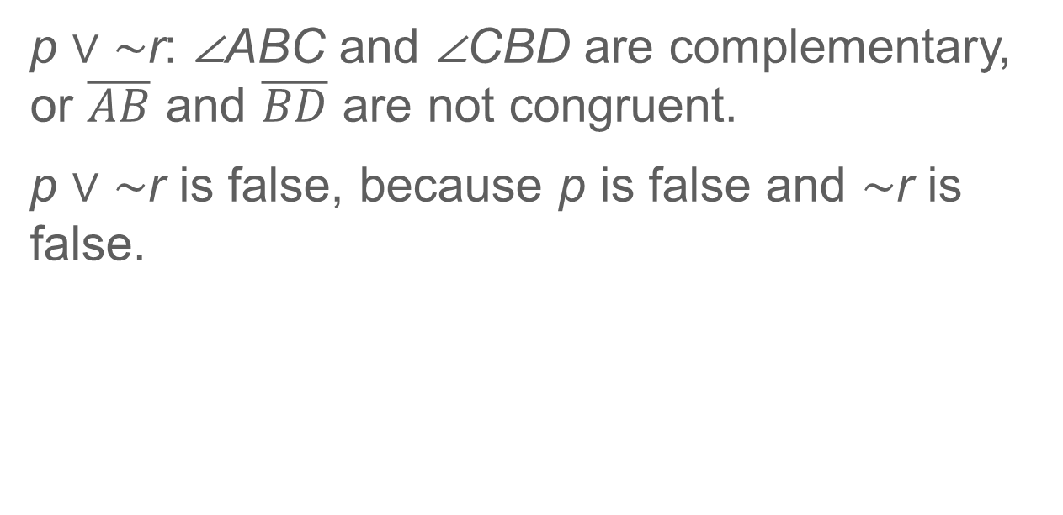
Example 2
Truth Values of Disjunctions
p ∨ ∼r: ∠ABC and ∠CBD are complementary, or $\overline{AB}$ and $\overline{BD}$ are not congruent.
p ∨ ∼r is false, because p is false and ∼r is false.

Slide 13
Learn
Conditionals
A conditional statement is a compound statement that consists of a premise, or hypothesis, and a conclusion, which is false only when its hypothesis is true and its conclusion is false.

Slide 14
Learn
Conditionals
Conditional Statements and Related Conditionals
Words | Examples
An if-then statement is a compound statement of the form “if p, then q,” where p and q are statements. Symbols: p → q; read if p, then q, or p implies q | If it rains, then the parade will be canceled.
The hypothesis of an if-then statement is the phrase immediately following the word if. Symbols: p → q; read if p, then q, or p implies q

Slide 15
Learn
Conditionals
Conditional Statements and Related Conditionals
Words | Examples
The conclusion of an if-then statement is the phrase immediately following the word then. Symbols: p → q; read if p, then q, or p implies q | If it rains, then the parade will be canceled.

Slide 16
Learn
Conditionals
Conditional Statements and Related Conditionals
Words | Examples
The converse is formed by exchanging the hypothesis and conclusion of the conditional. Symbols: q → p, read if q, then p, or q implies p | If the parade is canceled, then it has rained.

Slide 17
Learn
Conditionals
Conditional Statements and Related Conditionals
Words | Examples
The inverse is formed by negating both the hypothesis and conclusion of the conditional. Symbols: ∼p → ∼q, read if not p, then not q | If it does not rain, then the parade will not be canceled.

Slide 18
Learn
Conditionals
Conditional Statements and Related Conditionals
Words | Examples
The contrapositive is formed by negating both the hypothesis and the conclusion of the converse of the conditional. Symbols: ∼q → ∼p, read if not q, then not p | If the parade is not canceled, then it does not rain.

Slide 19
Example 3
Identify the Hypothesis and Conclusion
Identify the hypothesis and conclusion of each conditional statement.
a. If a polygon has six sides, then it is a hexagon.
b. Another performance will be scheduled if the first one is sold out.

Slide 20
Example 3
Identify the Hypothesis and Conclusion
a. If a polygon has six sides, then it is a hexagon.
Hypothesis: A polygon has six sides.
Conclusion: The polygon is a hexagon.
b. Another performance will be scheduled if the first one is
sold out.
Notice that the word if appears in the second portion of the sentence.
Hypothesis: The first performance is sold out.
Conclusion: Another performance will be scheduled.

Slide 21
Example 3
Identify the Hypothesis and Conclusion
Check
Identify the hypothesis and conclusion of each conditional statement.
a. If the forecast is rain, then I will take an umbrella.
Hypothesis:
Conclusion:
b. A number is divisible by 10 if its last digit is a 0.
Hypothesis:
Conclusion:

Slide 22
Example 3
Identify the Hypothesis and Conclusion
Check
Identify the hypothesis and conclusion of each conditional statement.
a. If the forecast is rain, then I will take an umbrella.
Hypothesis:
Conclusion:
b. A number is divisible by 10 if its last digit is a 0.
Hypothesis:
Conclusion:
The forecast is rain.
I will take an umbrella.
The last digit of a number is 0.
A number is divisible by 10.
Notes:
The forecast is rain.
I will take an umbrella.
The last digit of a number is 0.
A number is divisible by 10.

Slide 23
Example 4
Write a Conditional in If-Then Form
Identify the hypothesis and conclusion for each conditional statement. Then write the statement in if-then form.
a. Four quarters can be exchanged for a $1 bill.
b. The sum of the measures of two supplementary angles is 180°.

Slide 24
Example 4
Write a Conditional in If-Then Form
a. Four quarters can be exchanged for a $1 bill.
Hypothesis: You have four quarters.
Conclusion: You can exchange them for a $1 bill.
If-then: If you have four quarters, then you can exchange them for a $1 bill.

Slide 25
Example 4
Write a Conditional in If-Then Form
b. The sum of the measures of two supplementary angles is 180°.
Hypothesis: Two angles are supplementary.
Conclusion: The sum of their measures is 180°.
If-then: If two angles are supplementary, then the sum of their measures is 180°.

Slide 26
Example 4
Write a Conditional in If-Then Form
Talk About It!
How do you identify the hypothesis and conclusion of a conditional statement when the statement is not in if-then form?

Slide 27
Example 4
Write a Conditional in If-Then Form
Check
Identify the hypothesis and conclusion of the conditional statement A quadrilateral with two sets of parallel sides is a parallelogram. Then write the statement in if-then form.
Hypothesis:
Conclusion:
If-then:

Slide 28
Example 4
Write a Conditional in If-Then Form
Check
Identify the hypothesis and conclusion of the conditional statement A quadrilateral with two sets of parallel sides is a parallelogram. Then write the statement in if-then form.
Hypothesis:
Conclusion:
If-then:
A quadrilateral has two sets of parallel sides.
The quadrilateral is a parallelogram.
If a quadrilateral has two sets of parallel sides, then it is a parallelogram.
Notes:
A quadrilateral has two sets of parallel sides.
The quadrilateral is a parallelogram.
If a quadrilateral has two sets of parallel sides, then it is a
parallelogram.

Slide 29
Example 5
Related Conditionals
NATURE The tang is a saltwater fish that inhabits shallow coral reefs in tropical areas. Tangs are a part of the Acanthuridae family along with surgeonfish and unicornfish. All members of the Acanthuridae family are saltwater fish. Write the converse, inverse, and contrapositive of the true conditional statement Tangs are fish that live in salt water. Determine whether each related conditional is true or false. If a statement is false, then find a counterexample.

Slide 30
Example 5
Related Conditionals
Conditional: If a fish is a tang, then it lives in salt water.
Converse: If a fish lives in salt water, then it is a tang.
Counterexample: A surgeonfish lives in salt water, but it is not a tang.
Therefore, the converse is false.

Slide 31
Example 5
Related Conditionals
Inverse: If a fish is not a tang, then it does not live in salt water.
Counterexample: A surgeonfish is not a tang, but it does live in salt water. Therefore, the inverse is false.
Contrapositive: If a fish does not live in salt water, then it is not a tang.
Based on the information given, this statement is true.

Slide 32
Example 5
Related Conditionals
Think About It!
Write a conditional statement in which the converse, inverse, and contrapositive are true.

Slide 33
Example 5
Related Conditionals
Check
MUSIC Symphony orchestras contain instruments from 4 musical families: strings, woodwinds, brass, and percussion. However, string orchestras only contain string instruments. Write the converse, inverse, and contrapositive of the true conditional statement If an orchestra is a string orchestra, then it contains string instruments. Determine whether each related conditional is true or false. If the statement is false, find a counterexample.

Slide 34
Example 5
Related Conditionals
Converse: If an orchestra contains string instruments, then it is a string orchestra. False; symphony orchestras contain string instruments.
Inverse: If an orchestra is not a string orchestra, then it does not contain string instruments. False; a symphony orchestra is not a string orchestra, but it does contain string instruments.
Contrapositive: If an orchestra does not contain string instruments, then it is not a string orchestra. True.
Notes:
Converse: If an orchestra contains string instruments, then it is a string orchestra. False; symphony orchestras contain string instruments.
Inverse: If an orchestra is not a string orchestra, then it does not contain string instruments. False; a symphony orchestra is not a string orchestra, but it does contain string instruments.
Contrapositive: If an orchestra does not contain string instruments, then it is not a string orchestra. True.

Slide 35
Learn
Biconditionals
You can use logic and biconditional statements to indicate exclusivity in situations. For example, a square is a parallelogram with all four sides and all four angles congruent. You can express this as two if-then statements.
• If a parallelogram is a square, then it has all four sides and all four angles congruent.
• If a parallelogram has all four sides and all four angles congruent, then it is a square.

Slide 36
Learn
Biconditionals
Biconditional Statement
Words | A biconditional statement is the conjunction of a conditional and its converse.
Symbols | (p → q) ∧ (q → p) → (p ↔ q), read p if and only if q
So, the biconditional statement for the example above is A parallelogram is a square if and only if it has all four sides and all four angles congruent. Later, you will use biconditional statements, as well as conditional statements and their converses, to prove relationships.

Slide 37
Example 6
Write Biconditionals
Think About It!
Compare the mathematical meanings of the symbols → and ↔ in p → q and p ↔ q.

Slide 38
Example 6
Write Biconditionals
Write the conditional and converse for each statement, and determine their truth values. If false, find a counterexample. Write a biconditional statement if possible.
a. Rasha listens to music when she is in study hall.
b. If two lines are parallel, then they have the same slope and different y-intercepts.

Slide 39
Example 6
Write Biconditionals
a. Rasha listens to music when she is in study hall.
Conditional: If Rasha is in study hall, then she is listening to music.
Is the conditional statement true or false? If false, provide a counterexample. true

Slide 40
Example 6
Write Biconditionals
a. Rasha listens to music when she is in study hall.
Converse: If Rasha is listening to music, then she is in study hall.
Is the converse true or false? If false, provide a counterexample.
False; sample answer: Rasha could be listening to music in the cafeteria.
Because the converse is false, a biconditional statement cannot be written.

Slide 41
Example 6
Write Biconditionals
b. If two lines are parallel, then they have the same slope and different y-intercepts.
Conditional: If two lines are parallel, then they have the same slope and different y-intercepts.
Converse: If two lines have the same slope and different y-intercepts, then they are parallel.
The conditional and the converse are true. So, a biconditional can be written.
Biconditional: Two lines are parallel if and only if they have the same slope and different y-intercepts.

Slide 42
Example 6
Write Biconditionals
Check
Write the conditional and converse for the statement, and determine their truth values. If false, find a counterexample. Write a biconditional statement if possible.
Isosceles triangles have at least two congruent sides.

Slide 43
Example 6
Write Biconditionals
Check
Write the conditional and converse for the statement, and determine their truth values. If false, find a counterexample. Write a biconditional statement if possible.
Isosceles triangles have at least two congruent sides.

Slide 44
Example 6
Write Biconditionals
Conditional: If a triangle is isosceles, then it has at least two congruent sides.
Converse: If a triangle has at least two congruent sides, then it is isosceles.
The conditional is true, and the converse is true.
Biconditional: A triangle is isosceles if and only if it has at least two congruent sides.
Notes:
Conditional: If a triangle is isosceles, then it has at least two congruent sides.
Converse: If a triangle has at least two congruent sides, then it is isosceles.
The conditional is true, and the converse is true.
Biconditional: A triangle is isosceles if and only if it has at least two congruent sides.

Slide 45
Example 7
Determine Truth Values of Biconditionals
Write the biconditional as a conditional and its converse. Then determine whether the biconditional is true or false. If it is false, give a counterexample.
Two angles are complements if and only if their measures have a sum of 90°.

Slide 46
Example 7
Determine Truth Values of Biconditionals
Write the biconditional statement as a conditional.
If two angles are complements, then their measures have a sum of 90°.
Write the converse of your conditional statement.
If the measures of two angles have a sum of 90°, then the two angles are complements.
The conditional and the converse are true, so the biconditional is true.

Slide 47
Example 7
Determine Truth Values of Biconditionals
Think About It!
If a biconditional is true, what do you know about the conditional and converse? If a biconditional is false, what do you know about the conditional and converse?

Slide 48
Example 7
Determine Truth Values of Biconditionals
Check
Write the biconditional as a conditional and its converse. Then, determine whether the biconditional is true or false. If it is false, give a counterexample.
x > −2, if and only if x is positive.

Slide 49
Example 7
Determine Truth Values of Biconditionals
Check
Write the biconditional as a conditional and its converse. Then, determine whether the biconditional is true or false. If it is false, give a counterexample.
x > −2, if and only if x is positive.
Conditional: If x > −2, then x is positive.
Converse: If x is positive, then x > −2.
The biconditional is false, because x = −1 is a counterexample.
Notes:
Conditional: If x > −2, then x is positive.
Converse: If x is positive, then x > −2.
The biconditional is false, because x = −1 is a counterexample.

Slide 50
Exit Ticket
Identify the hypothesis and conclusion of each conditional statement.
1. If you risk nothing, then you risk everything. –Geena Davis
2. It is amazing what you can accomplish if you do not care who gets the credit. –Harry S. Truman
3. If there is no struggle, there is no progress. –Frederick Douglass

Slide 51
Exit Ticket
4. Write the converse, inverse, and contrapositive of the statement in Exercise 3.

Slide 52
Exit Ticket
Identify the hypothesis and conclusion of each conditional statement.
1. If you risk nothing, then you risk everything. –Geena Davis
Hypothesis: You risk nothing. Conclusion: You risk everything.
2. It is amazing what you can accomplish if you do not care who gets the credit. –Harry S. Truman Hypothesis: You do not care who gets the credit. Conclusion: It is amazing what you can accomplish.
3. If there is no struggle, there is no progress. –Frederick Douglass
Hypothesis: There is no struggle. Conclusion: There is no progress.
Notes:
Hypothesis: You risk nothing. Conclusion: You risk everything.
Hypothesis: You do not care who gets the credit. Conclusion: It is amazing what you can accomplish.
Hypothesis: There is no struggle. Conclusion: There is no progress.

Slide 53
Exit Ticket
4. Write the converse, inverse, and contrapositive of the statement in Exercise 3.
Converse: If there is no progress, then there is no struggle. Inverse: If there is struggle, then there is progress. Contrapositive: If there is progress, then there is struggle.
Notes:
Converse: If there is no progress, then there is no struggle. Inverse: If there is struggle, then there is progress. Contrapositive: If there is progress, then there is struggle.

