Slide 1
Volumes of Prisms and Pyramids

Slide 2
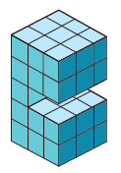
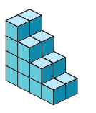
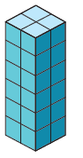
Warm Up
Determine the number of cubes that form each figure.
1. 2. 3.

Slide 3
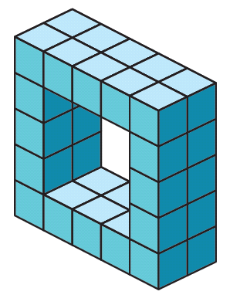
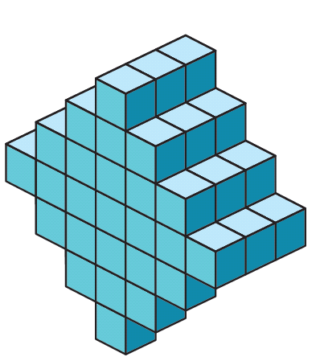
Warm Up
4. 5.

Slide 4
Warm Up
Determine the number of cubes that form each figure.
1. 2. 3.
24
39
20
Notes:
24
39
20

Slide 5
Warm Up
4. 5.
32
75
Notes:
32
75

Slide 6
Florida’s B.E.S.T. Standards for Mathematics
MA.912.GR.4.5
Solve mathematical and real-world problems involving
the volume of three-dimensional figures limited to cylinders, pyramids, prisms, cones and spheres.

Slide 7
Florida’s Mathematical Thinking and Reasoning Standards
MA.K12.MTR.4.1
Engage in discussions that reflect on the mathematical thinking of self and others.

Slide 8
Lesson Objectives
Content objective
Students find volumes of prisms and pyramids by using the formulas they derive.
Language objectives
Students explain how to find volumes of prisms and pyramids using each and any.
To cultivate conversation, students participate in MLR8: Discussion Supports.

Slide 9
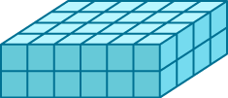
Learn
Volume of Prisms
Recall that the volume of a solid is the measure of the amount of space that the solid encloses. Volume is measured in cubic units.

Slide 10

Learn
Volume of Prisms
Key Concept: Volume of a Prism
Words | The volume V of a prism is V = Bh, where B is the area of a base and h is the height of the prism.
Symbols | V = Bh

Slide 11
Learn
Volume of Prisms
Key Concept: Cavalieri’s Principle
If two solids have the same height h and the same cross-sectional area B at every level, then they have the same volume.

Slide 12

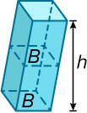
Learn
Volume of Prisms
You can use Cavalieri’s Principle to find volumes of oblique prisms. Notice that at every level of a right or oblique prism, a cross section parallel to the base is a figure that is congruent to the base. The area of each of these cross sections is the same.
According to Cavalieri’s Principle, if the areas of the bases and measures of the heights of two prisms are equal, then the prisms have the same volume. Thus, the formula for the volume of an oblique prism is the same as the formula for a right prism.

Slide 13
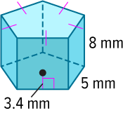
Example 1
Volume of a Prism
Find the volume of the prism.

Slide 14
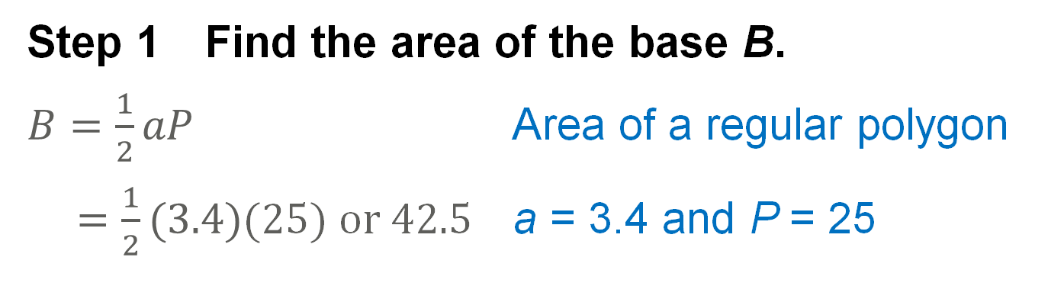
Example 1
Volume of a Prism
Step 1 Find the area of the base B.
$B=\frac{1}{2}aP$ Area of a regular polygon
= $\frac{1}{2}(3.4)$(25) or 42.5 a = 3.4 and P = 25
So, the area of the base of the prism is 42.5 square millimeters.

Slide 15
Example 1
Volume of a Prism
Step 2 Find the volume of the prism.
V = Bh Volume of a prism
= 42.5(8) or 340 B = 42.5 and h = 8
The volume of the prism is 340 cubic millimeters.

Slide 16
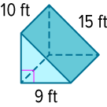
Example 1
Volume of a Prism
Check
Find the volume of the prism.

Slide 17
Example 1
Volume of a Prism
Check
Find the volume of the prism.
V = 540 ft³
Notes:
V = 540 ft³

Slide 18
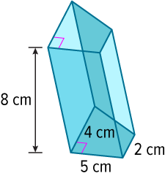
Example 2
Volume of an Oblique Prism
Find the volume of the oblique prism.
Part A Find the area of the base.
Part B Find the volume.

Slide 19
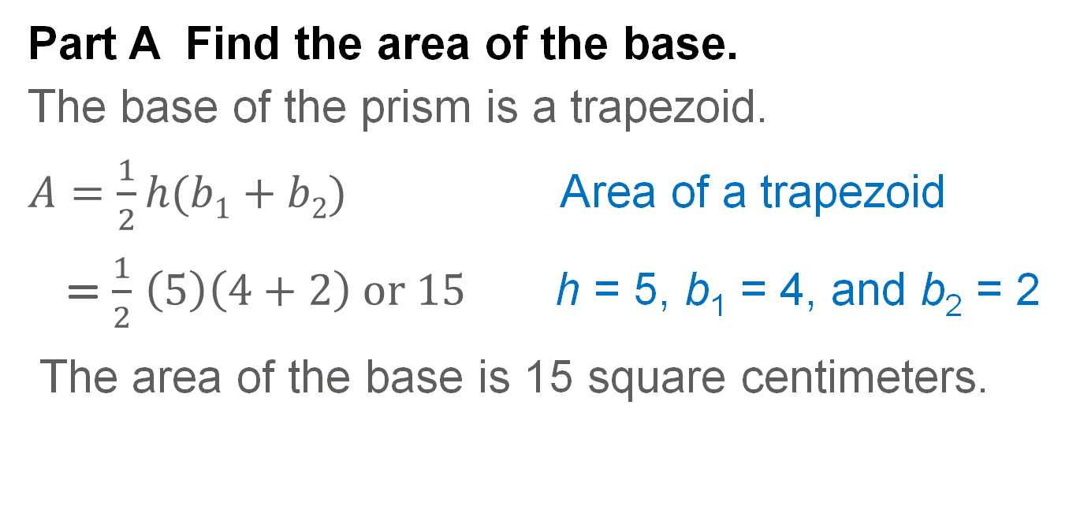
Example 2
Volume of an Oblique Prism
Part A Find the area of the base.
The base of the prism is a trapezoid.
$A=\frac{1}{2}h(b1+b2)$ Area of a trapezoid
= $\frac{1}{2}$ $\left(5\right)\left(4+2\right) or 15$ h = 5, b₁ = 4, and b₂ = 2
The area of the base is 15 square centimeters.

Slide 20
Example 2
Volume of an Oblique Prism
Part B Find the volume.
V = Bh | Volume of a prism
= (15)(8) | B = 15 and h = 8
= 120 cm³
The volume of the oblique solid is 120 cubic centimeters.

Slide 21
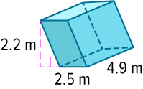
Example 2
Volume of an Oblique Prism
Check
Find the volume of the oblique rectangular prism.

Slide 22
Example 2
Volume of an Oblique Prism
Check
Find the volume of the oblique rectangular prism.
V = 26.95 m³
Notes:
V = 26.95 m³

Slide 23
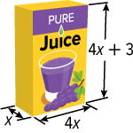
Example 3
Volume of a Prism Using Algebraic
Expressions
SNACKS Gustavo wants to calculate the volume of juice in his juice box in cubic inches.
Part A Find the volume of the juice box in terms of x.
Part B Find the volume of the juice box if x = 2.

Slide 24
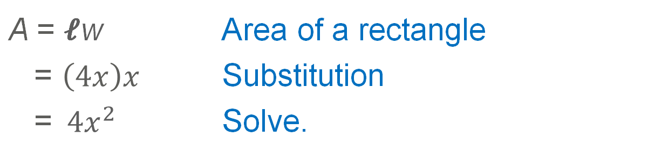
Example 3
Volume of a Prism Using Algebraic
Expressions
Part A Find the volume of the juice box in
terms of x.
Step 1 Find the area of the base.
The base of the juice box is a rectangle.
A = 𝓁w | Area of a rectangle
= $\left(4x\right)x$ | Substitution
=${ 4x}^{2}$ | Solve.

Slide 25
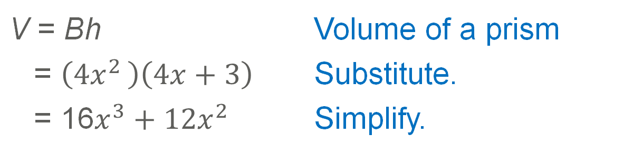
Example 3
Volume of a Prism Using Algebraic
Expressions
Step 2 Find the volume.
V = Bh | Volume of a prism
= $\left({4x}^{2 }\right)\left(4x+3\right)$ | Substitute.
= 16$x^{3}+{12x}^{2}$ | Simplify.

Slide 26
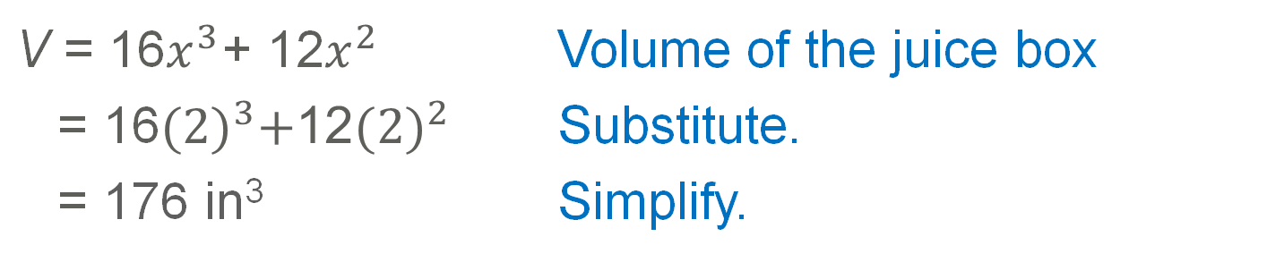
Example 3
Volume of a Prism Using Algebraic
Expressions
Part B Find the volume of the juice box if x = 2.
V = 16$x^{3}$+ 12$x^{2}$ | Volume of the juice box
= 16${(2)}^{3}+\text{1}\text{2}{(2)}^{2}$ | Substitute.
= 176 in³ | Simplify.

Slide 27


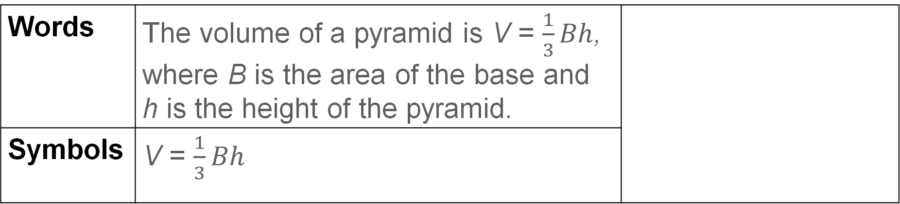
Learn
Volumes of Pyramids
Key Concept: Volume of a Pyramid
Words | The volume of a pyramid is V = $\frac{1}{3}Bh$, where B is the area of the base and h is the height of the pyramid.
Symbols | V = $\frac{1}{3}Bh$

Slide 28
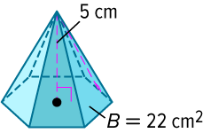
Example 4
Volume of a Pyramid
Find the volume of the pyramid.

Slide 29
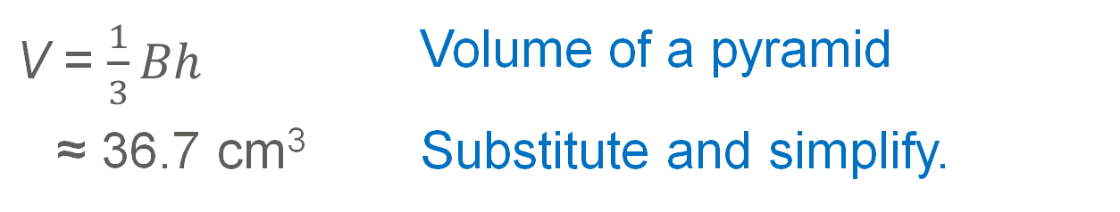
Example 4
Volume of a Pyramid
V = $\frac{1}{3}Bh$ | Volume of a pyramid
≈ 36.7 cm³ | Substitute and simplify.
The volume of the pyramid is about 36.7 cubic centimeters.

Slide 30
Example 4
Volume of a Pyramid
Talk About It!
Describe a pyramid that will have the same volume as the pyramid in Example 4. Justify your reasoning.

Slide 31
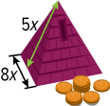
Example 5
Volume of a Pyramid Using Algebraic
Expressions
SOUVENIRS Martín bought a bank shaped like a square pyramid, and he wants to calculate its volume.
Part A Find the volume of the pyramid in terms of x.
Part B Find the volume in cubic inches if x = 4.

Slide 32
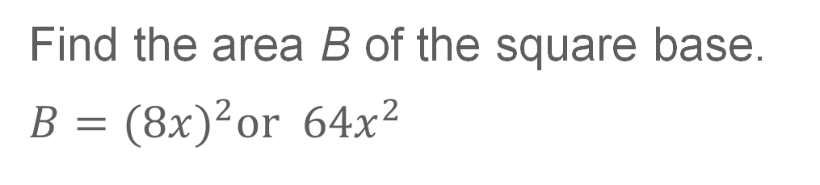
Example 5
Volume of a Pyramid Using Algebraic
Expressions
Part A Find the volume of the pyramid in terms of x.
Find the area B of the square base.
$B={(8x)}^{2}or 64x^{2}$

Slide 33
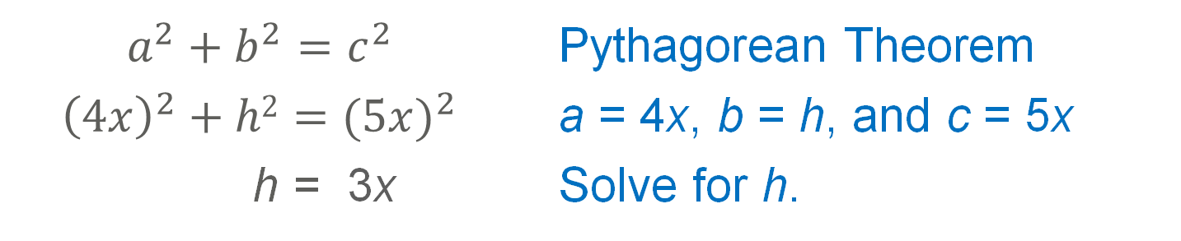
Example 5
Volume of a Pyramid Using Algebraic
Expressions
Find the height of the pyramid by using the Pythagorean Theorem.
$$a^{2}+b^{2}=c^{2}$$ | Pythagorean Theorem
$${\left(4x\right)}^{2}+h2{=(5x)}^{2}$$ | a = 4x, b = h, and c = 5x
h = 3x | Solve for h.

Slide 34
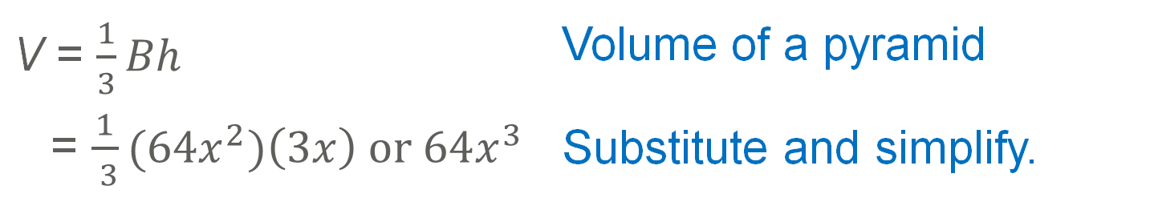
Example 5
Volume of a Pyramid Using Algebraic
Expressions
Find the volume of the pyramid in terms of x.
V = $\frac{1}{3}Bh$ | Volume of a pyramid
= $\frac{1}{ 3}{(64x}^{2})\left(3x\right) or 64x^{3}$ | Substitute and simplify.

Slide 35
Example 5
Volume of a Pyramid Using Algebraic
Expressions
Part B Find the volume in cubic inches if x = 4.
Use the formula in Part A to find the volume when x = 4.
V = 4096 in³

Slide 36
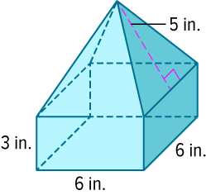
Example 6
Volume of a Composite Solid
Find the volume of the composite solid.
The composite solid is a combination of a prism and a square pyramid.
Part A Find the volume of the prism.
Part B Find the volume of the pyramid.
Part C Find the volume of the composite solid.

Slide 37
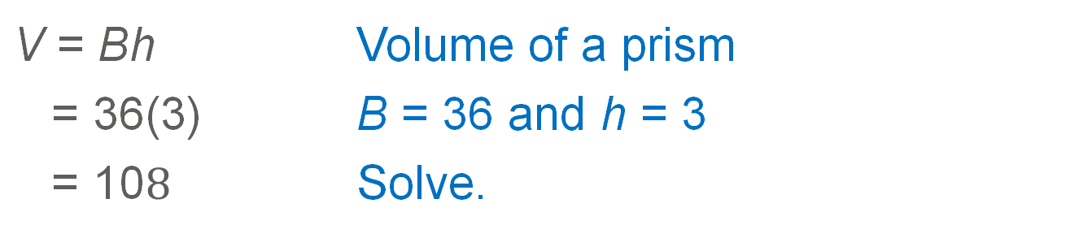
Example 6
Volume of a Composite Solid
Part A Find the volume of the prism.
V = Bh | Volume of a prism
= 36(3) | B = 36 and h = 3
= 10$8$ | Solve.
So, the volume of the prism is 108 cubic inches.

Slide 38
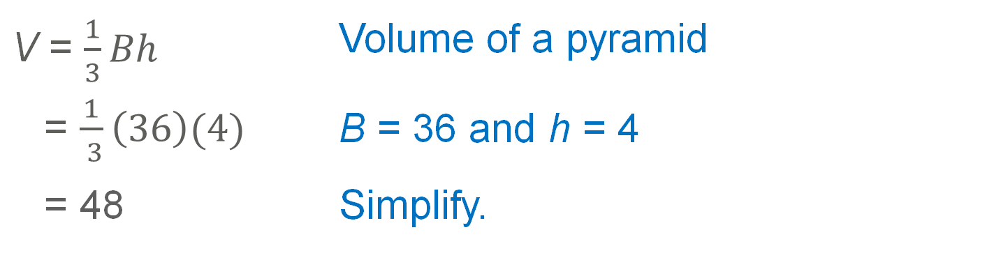
Example 6
Volume of a Composite Solid
Part B Find the volume of the pyramid.
V = $\frac{1}{3}Bh$ | Volume of a pyramid
= $\frac{1}{ 3}\left(36\right)(4)$ | B = 36 and h = 4
= 48 | Simplify.
The volume of the pyramid is 48 cubic inches.
Part C Find the volume of the composite solid.
The volume of the composite solid is 156 cubic inches.

Slide 39
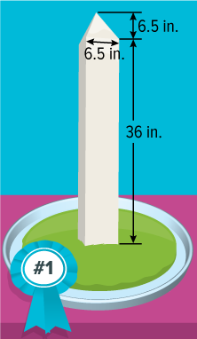
Example 7
Approximate the Volume of a
Composite Solid
CHOCOLATE For a competition, a chocolatier created a replica of the Washington Monument made entirely of white chocolate. Approximate the volume of chocolate used to create the sculpture.

Slide 40
Example 7
Approximate the Volume of a
Composite Solid
The sculpture can be approximated by a composite solid made up of a square prism and a square pyramid.
Step 1 Find the volume of the square prism.
V = Bh | Volume of a prism
= 42.25(36) | B = 42.25 and h = 36
= 1521 | Simplify.
The volume of the square prism is 1521 cubic inches.

Slide 41
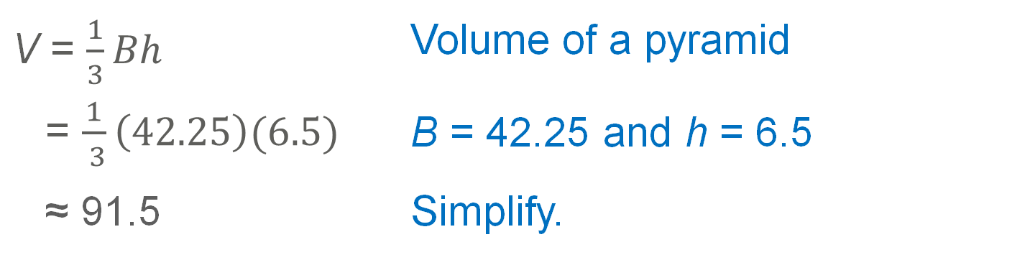
Example 7
Approximate the Volume of a
Composite Solid
Step 2 Find the volume of the square pyramid. Round to the nearest tenth, if necessary.
V = $\frac{1}{3}Bh$ | Volume of a pyramid
= $\frac{1}{ 3}\left(42.25\right)(6.5)$ | B = 42.25 and h = 6.5
≈ 91.5 | Simplify.
Step 3 Find the volume of the sculpture.
The volume of the sculpture is approximately 1612.5 cubic inches.

Slide 42
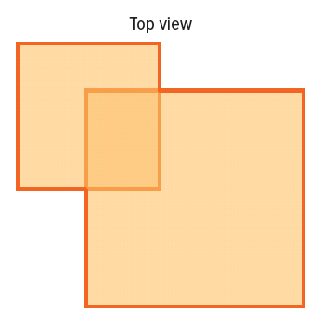
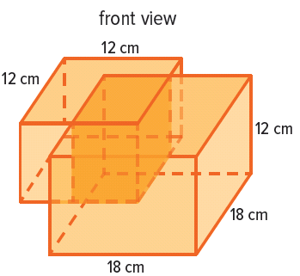
Exit Ticket
DESIGN Gemma is designing a specialized box that will contain an irregularly shaped object. The box resembles two rectangular prisms that have been merged together. Find the volume of the box if the overlapping region measures 6 centimeters by 9 centimeters.

Slide 43
Exit Ticket
DESIGN Gemma is designing a specialized box that will contain an irregularly shaped object. The box resembles two rectangular prisms that have been merged together. Find the volume of the box if the overlapping region measures 6 centimeters by 9 centimeters.
4968 cm³
Notes:
4968 cm³

