Slide 1
4-2 Translations

Slide 2
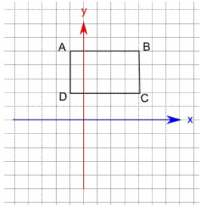
Warm Up
Rectangle ABCD is reflected in the line
y = -1 followed by a translation of
2 units left and 1 unit up. What is the
the new location of point C?
Notes:
(−x, y)
(x, −y)
(x − 1, y + 1)
(x − 4, y − 1)

Slide 3
Florida’s B.E.S.T. Standards for Mathematics
MA.912.GR.2.1 Given a preimage and image, describe the transformation and represent the transformation algebraically using coordinates.

Slide 4
Florida’s Mathematical Thinking and Reasoning Standards
MA.K12.MTR.4.1
Engage in discussions that reflect on the mathematical thinking of self and others.

Slide 5
Lesson Objectives
Content Objective
Students will use rigid transformations to translate figures on the coordinate plane and describe the effects of the translations.
Language Objectives
Students explain the effects of translations of rigid transformations using left, right, up, and down.
To optimize output, students participate in MLR1: Stronger and Clearer Each Time.

Slide 6
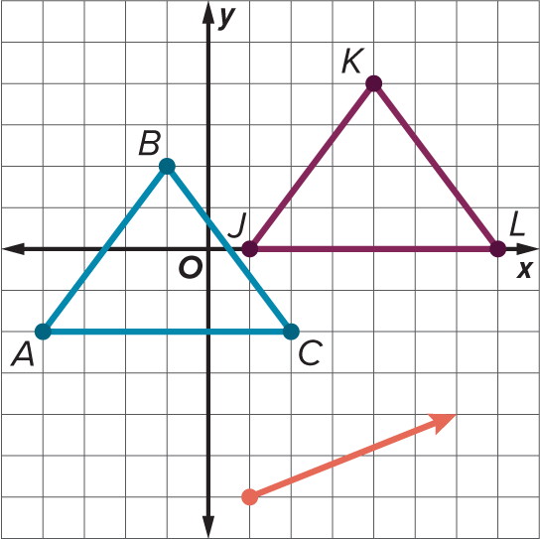
Learn
Translations
A translation is a function in which all of the points of a figure move the same distance in the same direction as described by a translation vector.
When a translation has been applied to a figure, the distance between each pair of corresponding vertices is the same, and the segments that connect each pair of corresponding vertices have the same slope and are therefore parallel.

Slide 7
Learn
Translations
Recall that a translation vector describes the magnitude and direction of the translation. The magnitude of a vector is its length from the initial point to the terminal point.

Slide 8

Translation Rule
(x,y) ----> (x + 2, y + 5) Translates a figure 2 spaces to the right on the x axis and 5 spaces up on the y axis.
(x,y) ----> (x - 4, y - 7) Translates a figure 4 spaces to the left on the x axis and 7 spaces down on the y axis.
(x,y) ----> (x, y + 1) Translates a figure 0 spaces on the x axis and 1 spaces up on the y axis.
(x,y) ----> (x + 8, y) Translates a figure 8 spaces to the right on the x axis and 0 spaces on the y axis.

Slide 9
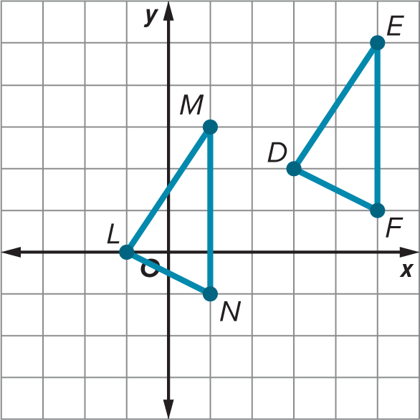
Example 1
Describe a Translation
Determine whether a translation maps △DEF onto △LMN. If so, describe the translation. If not, explain why.

Slide 10
Example 1
Describe a Translation
Draw a line segment between each pair of corresponding vertices. Each line segment starts at the initial point on △DEF and ends 4 units left and 2 units down. Thus, a translation of the form (x, y) → (x − 4, y − 2) maps △DEF onto △LMN.

Slide 11
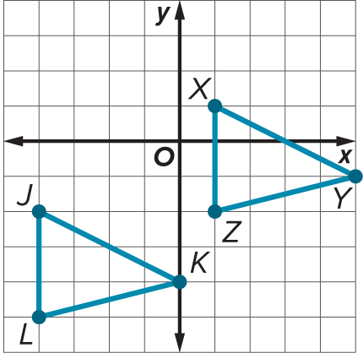
Example 1
Describe a Translation
Check
Determine whether a translation maps △JKL onto △XYZ. If so, describe the translation. If not, explain why.

Slide 12
Example 1
Describe a Translation
Check
Determine whether a translation maps △JKL onto △XYZ. If so, describe the translation. If not, explain why.
This is a translation.
(x, y) → (x + 5, y + 3)
Notes:
This is a translation.
(x, y) → (x + 5, y + 3)

Slide 13
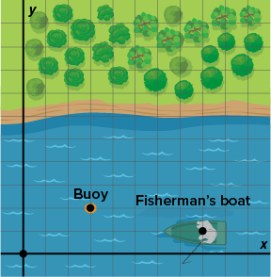
Apply Example 2
Translations on the Coordinate Plane
SCAVENGER HUNT Travis is on a scavenger hunt at the lake. He needs to swim to the nearest buoy, pick up a card, and then swim until he reaches a fisherman who will give him the next clue in exchange for the card. Describe the translation from the buoy to the fisherman’s boat using coordinates.

Slide 14
Apply Example 2
Translations on the Coordinate Plane
Talk About It!
Share your solution method with a partner. How does your method compare to theirs?

Slide 15
Exit Ticket
Quadrilateral ABCD has coordinates A(0, 2), B(3, 4), C(4, 2), and D(3, 0).
1. Determine the coordinates of the vertices of A′B′C′D′ after a translation along the vector ⟨−2, 3⟩.
2. Suppose a second translation is applied so that quadrilateral A″B″C″D″ has coordinates A″(−3, −3), B″(0, −1), C″(1, −3), and D″(0, −5). What is the translation vector?

Slide 16
Exit Ticket
Quadrilateral ABCD has coordinates A(0, 2), B(3, 4), C(4, 2), and D(3, 0).
1. Determine the coordinates of the vertices of A′B′C′D′ after a translation along the vector ⟨−2, 3⟩.
A′(−2, 5), B′(1, 7), C′(2, 5), D′(1, 3)
2. Suppose a second translation is applied so that quadrilateral A″B″C″D″ has coordinates A″(−3, −3), B″(0, −1), C″(1, −3), and D″(0, −5). What is the translation vector? ⟨−1, −8⟩
Notes:
A′(−2, 5), B′(1, 7), C′(2, 5), D′(1, 3)
⟨−1, −8⟩

