Slide 1
Dilations

Slide 2

Warm Up
Write each fraction in simplest form.
1. $\frac{15}{81}$
2. $\frac{36}{216}$
3. $\frac{95}{240}$
4. $\frac{51}{540}$
5. $\frac{189}{300}$

Slide 3
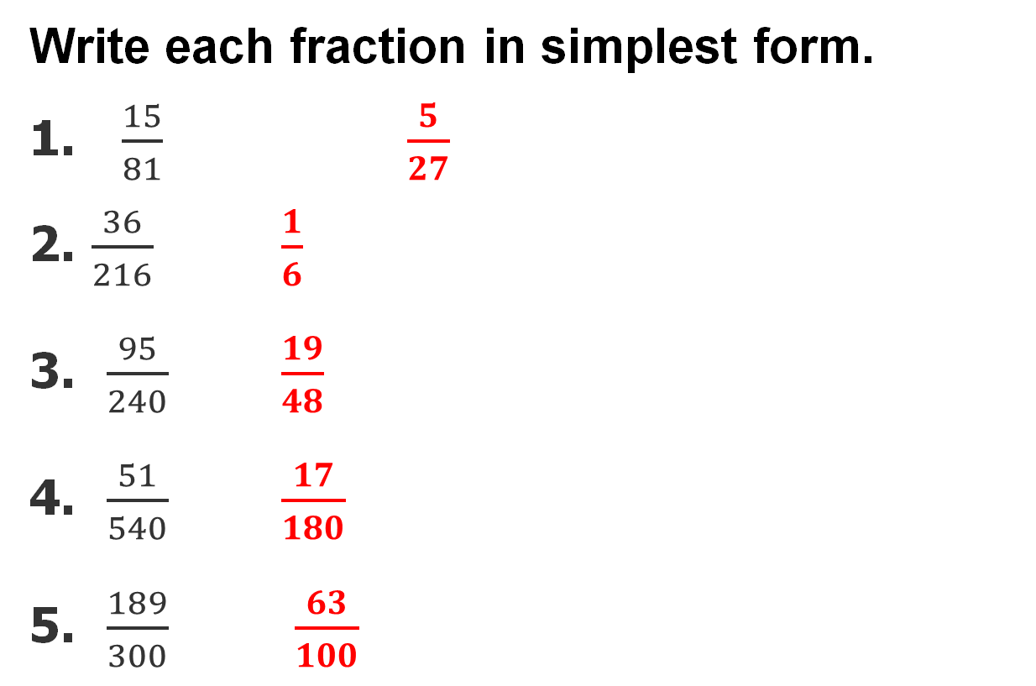
Warm Up
Write each fraction in simplest form.
1. $\frac{15}{81}$ $\frac{5}{27}$
2. $\frac{36}{216}$ $\frac{1}{6}$
3. $\frac{95}{240}$ $\frac{19}{48}$
4. $\frac{51}{540}$ $\frac{17}{180}$
5. $\frac{189}{300}$ $\frac{63}{100}$
Notes:
$\frac{5}{27}$
$\frac{1}{6}$
$\frac{19}{48}$
$\frac{17}{180}$
$\frac{63}{100}$

Slide 4
Florida’s B.E.S.T. Standards for Mathematics
MA.912.GR.2.1 Given a preimage and image, describe the transformation and represent the transformation algebraically using coordinates.
MA.912.GR.2.2 Identify transformations that do or do not preserve distance.
MA.912.GR.2.5 Given a geometric figure and a sequence of transformations, draw the transformed figure on a coordinate plane.

Slide 5
Florida’s Mathematical Thinking and Reasoning Standards
MA.K12.MTR.5.1
Use patterns and structure to help understand and connect mathematical concepts.
MA.K12.MTR.6.1
Assess the reasonableness of solutions.

Slide 6
Lesson Objectives
Content Objective
Students draw and analyze dilated figures using tools or functions.
Language Objectives
Students explain how to draw and analyze dilated figures using tools or functions with the words enlargement and reduction.
To optimize output, students participate in MLR1: Stronger and Clearer Each Time.

Slide 7
Learn
Dilations
Recall that a rigid transformation is an operation that maps an original figure, the preimage, onto a new figure called the image.
A nonrigid transformation is a transformation that changes the dimensions of a given figure. A dilation is a nonrigid transformation that enlarges or reduces a geometric figure. When a figure is enlarged or reduced, the sides of the image are proportional to the sides of the original figure.

Slide 8
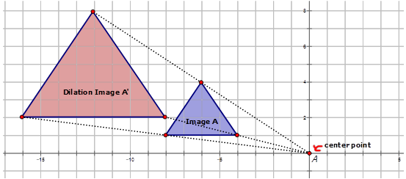
The center of dilation is the center point from which dilations are performed. The scale factor of a dilation is the ratio of a length on an image to a corresponding length on the preimage. The letter k usually represents the scale factor of a dilation.

Slide 9
Learn
Dilations
The value of k determines whether the dilation is an enlargement or a reduction. A dilation with a scale factor greater than 1 produces an enlargement, or an image that is larger than the original figure. A dilation with a scale factor between 0 and 1 produces a reduction, or an image that is smaller than the original figure.

Slide 10
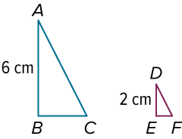
Example 1
Identify a Dilation to Find Scale Factor
Determine whether the dilation from △ABC to △DEF is an enlargement or a reduction. Then find the scale factor of the dilation.

Slide 11
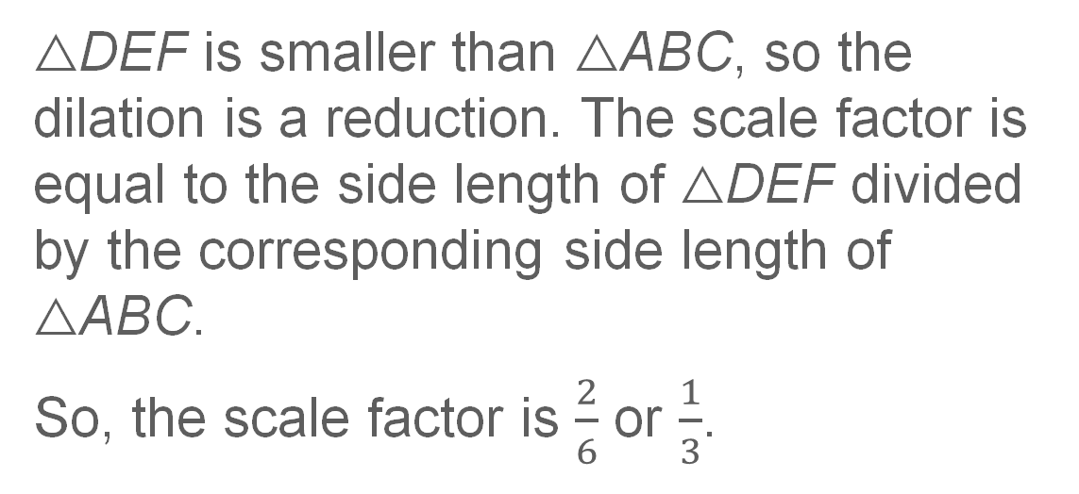
Example 1
Identify a Dilation to Find Scale Factor
△DEF is smaller than △ABC, so the dilation is a reduction. The scale factor is equal to the side length of △DEF divided by the corresponding side length of △ABC.
So, the scale factor is $\frac{2}{6}$ or $\frac{1}{3}$.

Slide 12
Example 1
Identify a Dilation to Find Scale Factor
Talk About It!
Explain why your scale factor is reasonable.

Slide 13
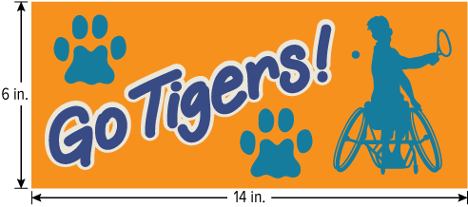
Example 2
Find and Use a Scale Factor
SCHOOL SPIRIT Jalal is printing a banner for his school’s wheelchair tennis team based on the design shown below. By what percent should Jalal enlarge his design so that the dimensions of the banner are 5 times that of the original design? What will be the dimensions of the banner?

Slide 14
Example 2
Find and Use a Scale Factor
Jalal wants to create an enlarged image of his banner design using a commercial printer. The scale factor of his enlargement is 5. Written as a percent, the scale factor is (5 × 100)% or 500%.
Now we can find the dimensions of the enlarged image using the scale factor.
width: 6 in. × 500% = 30 in.
length: 14 in. × 500% = 70 in.
The banner will be 30 inches by 70 inches.

Slide 15
Example 2
Find and Use a Scale Factor
Think About It!
Jalal’s school district has volunteered to buy 3 banners for every high school in the district. Every banner will be 30 inches by 70 inches. If there are 4 high schools in the district and it costs $8 per square foot to print a banner, what will be the total cost of the banners?

Slide 16
Learn
Dilations on the Coordinate Plane
On the coordinate plane, a dilation is a function that involves multiplying by a scale factor of k to find the coordinates of the vertices of an image.

Slide 17
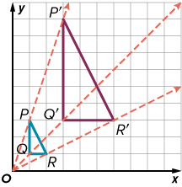
Learn
Dilations on the Coordinate Plane
Key Concept: Dilations Centered at the Origin
Words | To dilate a figure by a scale factor of k with respect to the center of dilation (0, 0), multiply the x- and y-coordinate of each vertex by k. | Example The image of △PQR dilated by k = 3 is △PʹQ′R′.
Symbols | (x, y) ⟶ (kx, ky)

Slide 18
Learn
Dilations on the Coordinate Plane
A figure will not always be dilated with respect to the origin. A center of dilation can be any point on the coordinate plane, including a point on the figure.

Slide 19
Learn
Dilations on the Coordinate Plane
Key Concept: Dilations Centered at a Point That Is Not the Origin
Words | To dilate a figure by a scale factor of k with respect to the center of dilation (a, b), translate each vertex along the vector ⟨−a, −b⟩. Then multiply the x- and y-coordinate of each vertex by k. Lastly, translate each vertex along the vector ⟨a, b⟩ .

Slide 20
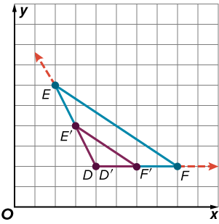
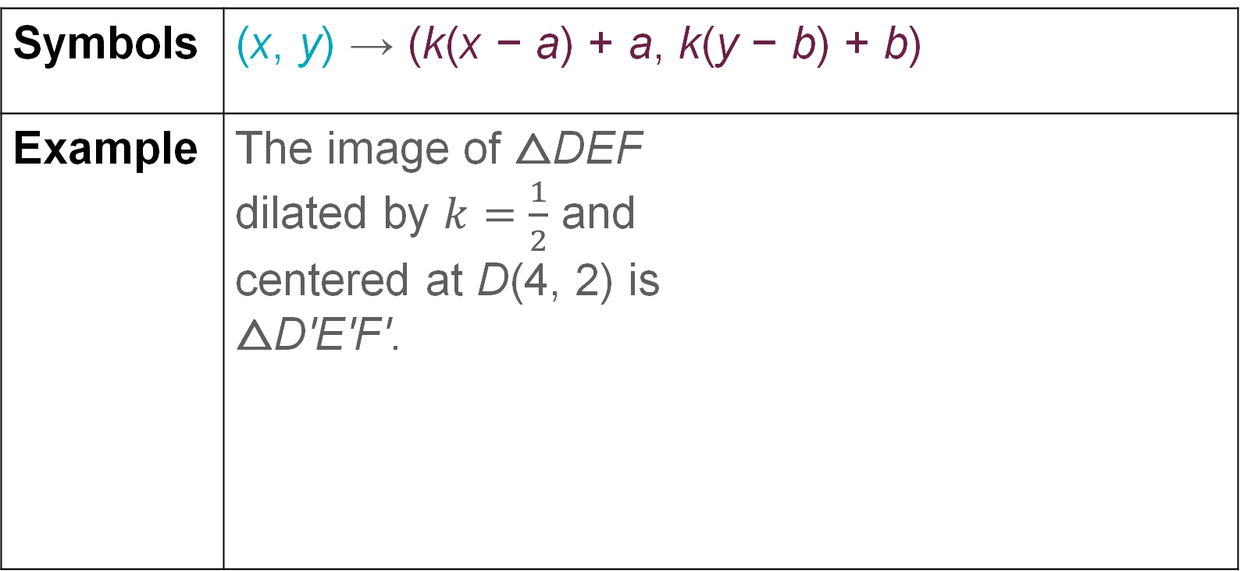
Learn
Dilations on the Coordinate Plane
Symbols | (x, y) → (k(x − a) + a, k(y − b) + b)
Example | The image of △DEF dilated by $k=\frac{1}{2}$ and centered at D(4, 2) is △D′E′F′.

Slide 21
Learn
Dilations on the Coordinate Plane
Think About It!
When the center of dilation is at (a, b), why is the figure translated along the vectors ⟨−a, −b⟩ and ⟨a, b⟩?

Slide 22
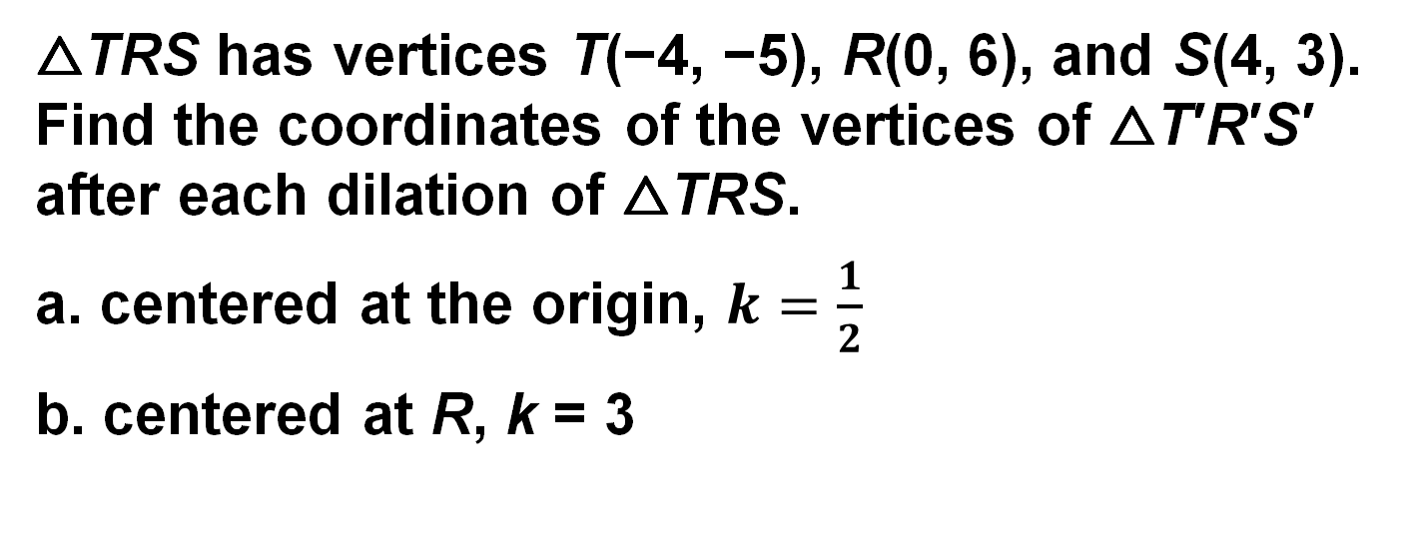
Example 3
Dilate a Figure
△TRS has vertices T(−4, −5), R(0, 6), and S(4, 3). Find the coordinates of the vertices of △T′R′S′ after each dilation of △TRS.
a. centered at the origin, $k=\frac{1}{2}$
b. centered at R, k = 3

Slide 23
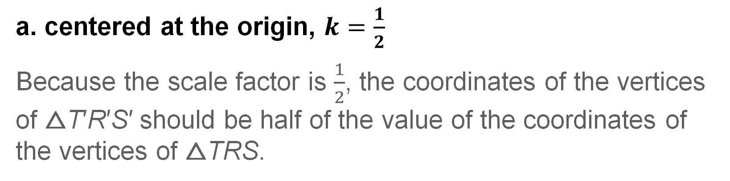
Example 3
Dilate a Figure
a. centered at the origin, $k=\frac{1}{2}$
Because the scale factor is $\frac{1}{2}$, the coordinates of the vertices of △T′R′S′ should be half of the value of the coordinates of the vertices of △TRS.

Slide 24
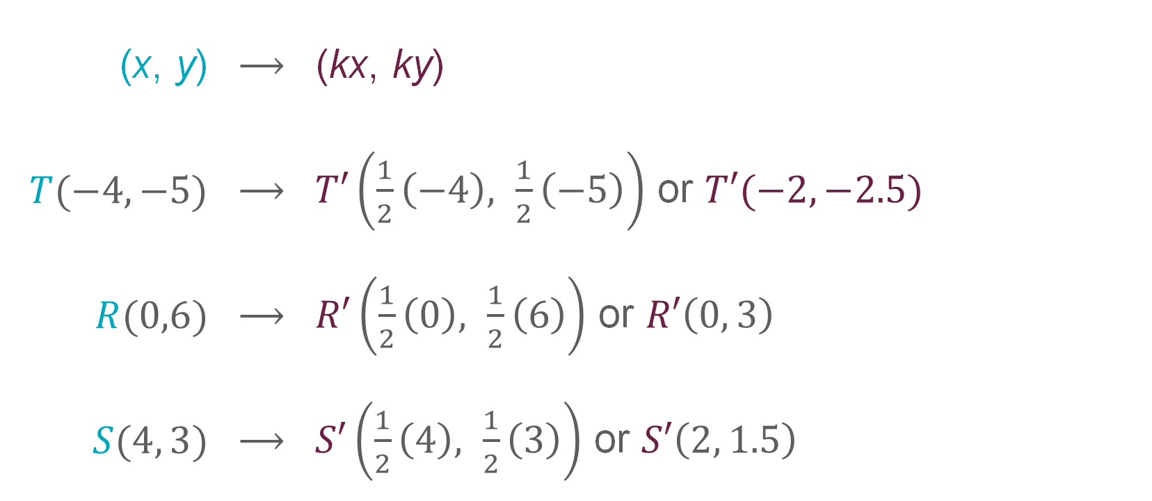
Example 3
Dilate a Figure
(x, y) | ⟶ | (kx, ky)
$T(−4,−5)$ | ⟶ | $T′\left(\frac{1}{2}\left(−4\right), \frac{1}{2}\left(−5\right)\right)$ or $T′(−2, −2.5)$
$R(0,6)$ | ⟶ | $R′\left(\frac{1}{2}\left(0\right), \frac{1}{2}\left(6\right)\right)$ or $R′\left(0, 3\right)$
$S(4, 3)$ | ⟶ | $S′\left(\frac{1}{2}\left(4\right), \frac{1}{2}\left(3\right)\right)$ or $S′\left(2, 1.5\right)$

Slide 25
Example 3
Dilate a Figure
b. centered at R, k = 3
Because the center of dilation is R(0, 6), △TRS must be translated along the vector ⟨0, −6⟩ , enlarged by a scale factor of 3, and then translated along the vector ⟨0, 6⟩.

Slide 26
Example 3
Dilate a Figure
(x, y) | ⟶ | (k(x − a) + a, k(y − b) + b)
T(−4, −5) | ⟶ | T′(3(−4 − 0) + 0, 3(−5 − 6) + 6) = (3(−4), 3(−11) + 6) or T′(−12, −27)
R(0, 6) | ⟶ | R′(3(0 − 0) + 0, 3(6 − 6) + 6) = (3(0), 3(0) + 6) or R′(0, 6)
S(4, 3) | ⟶ | S′(3(4 − 0) + 0, 3(3 − 6) + 6) = (3(4), 3(−3) + 6) or S′(12, −3)

Slide 27
Example 3
Dilate a Figure
Check
△XYZ has vertices X(3, −4), Y(6, 5), and Z(8, −2). Find the coordinates of the vertices of △X′Y′Z′ after each dilation of △XYZ.
a. centered at the origin, k = 4
b. centered at Y, k = 2

Slide 28
Example 3
Dilate a Figure
Check
△XYZ has vertices X(3, −4), Y(6, 5), and Z(8, −2). Find the coordinates of the vertices of △X′Y′Z′ after each dilation of △XYZ.
a. centered at the origin, k = 4
X′(12, −16), Y′(24, 20), Z′(32, −8)
b. centered at Y, k = 2
X′(0, −13), Y′(6, 5), Z′(10, −9)
Notes:
X′(12, −16), Y′(24, 20), Z′(32, −8)
X′(0, −13), Y′(6, 5), Z′(10, −9)

Slide 29
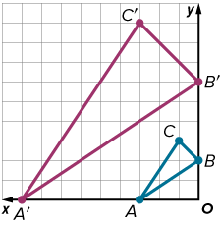
Example 4
Describe a Dilation
△A′B′C′ is the image of △ABC after a dilation. Describe the dilation. Then write a coordinate rule to represent it.

Slide 30
Example 4
Describe a Dilation
To describe the dilation, you need to find the scale factor and the coordinates of the center of dilation. Start by comparing the lengths of corresponding sides in △ABC and △A′B′C′ to find the scale factor.

Slide 31
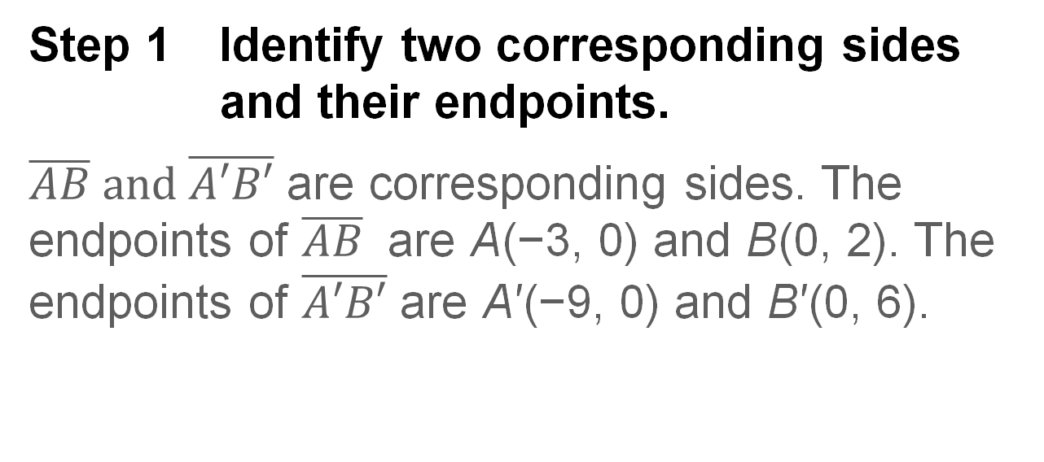
Example 4
Describe a Dilation
Step 1 Identify two corresponding sides and their endpoints.
$\overline{AB} and \overline{A′B′}$ are corresponding sides. The endpoints of $\overline{AB}$ are A(−3, 0) and B(0, 2). The endpoints of $\overline{A′B′}$ are A′(−9, 0) and B′(0, 6).

Slide 32
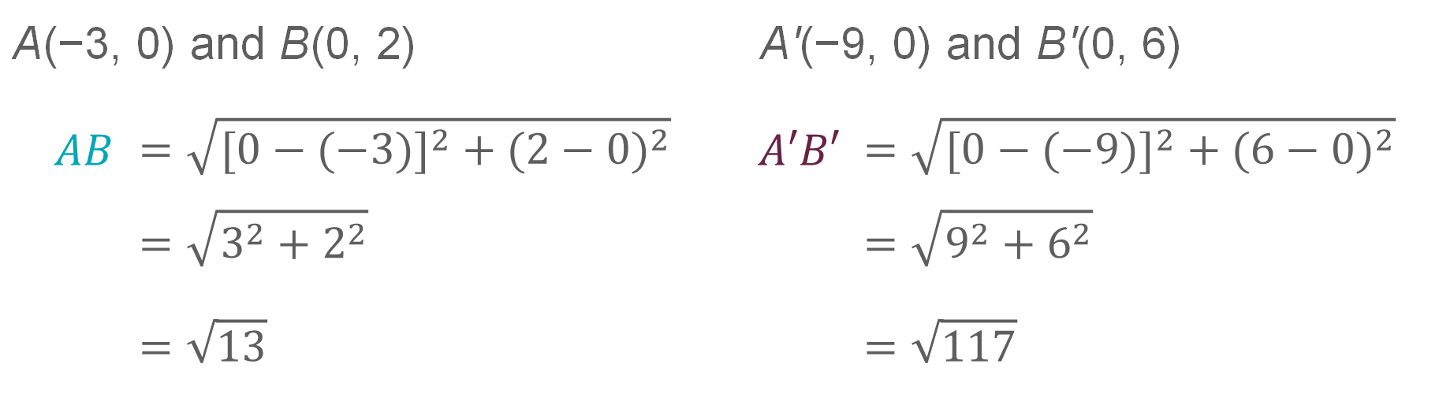
Example 4
Describe a Dilation
Step 2 Find the lengths of the corresponding sides.
Use the Distance Formula to find AB and A′B′.
A(−3, 0) and B(0, 2) |  | A'(−9, 0) and B'(0, 6)
$AB$ | $$=\sqrt{{[0−(−3)]}^{2} + {(2−0)}^{2}}$$ | $A′B′$ | $$=\sqrt{{[0−(−9)]}^{2} + {(6−0)}^{2}}$$
 | $$=\sqrt{3^{2}+2^{2}}$$ |  | $$=\sqrt{9^{2}+6^{2}}$$
 | $$=\sqrt{13}$$ |  | $$=\sqrt{117}$$

Slide 33
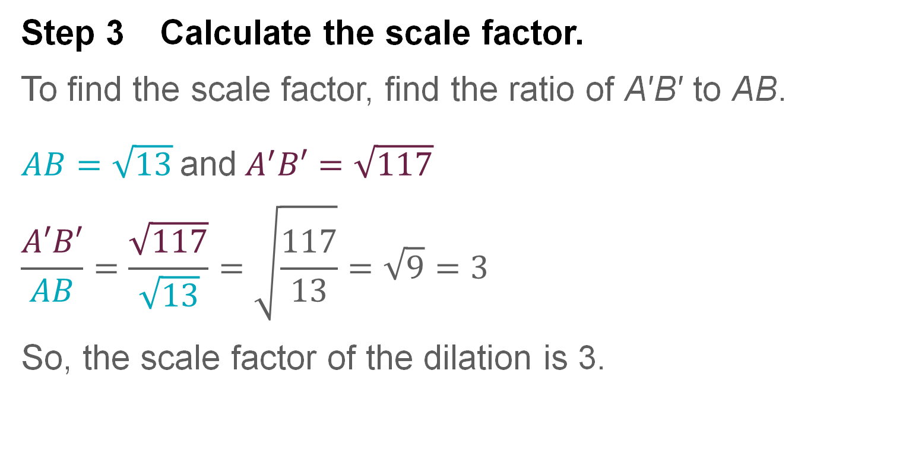
Example 4
Describe a Dilation
Step 3 Calculate the scale factor.
To find the scale factor, find the ratio of A′B′ to AB.
$AB=\sqrt{13}$and$A^{′}B′=\sqrt{117}$
$$\frac{A′B′}{AB}=\frac{\sqrt{117}}{\sqrt{13}}=\sqrt{\frac{117}{13}}=\sqrt{9}=3$$
So, the scale factor of the dilation is 3.

Slide 34
Example 4
Describe a Dilation
Step 4 Find the coordinates of the center of dilation.
To find the center of dilation at (a, b), use the scale factor k = 3 and the coordinates of the corresponding vertices A and A′ to find the values of a and b.
A(−3, 0) and A′(−9, 0)
A′ | = (k(x − a) + a, k(y − b) + b) | Dilation centered at (a, b)
(−9, 0) | = (3(−3 − a) + a, 3(0 − b) + b) | k = 3, A(−3, 0), A′(−9, 0)

Slide 35
Example 4
Describe a Dilation
Next, write two equations to solve for a and b.
−9 | = 3(−3 − a) + a | Equation for a
−9 | = −9 − 3a + a | Distributive Property
0 | = −3a + a | Add 9 to each side.
0 | = −2a | Simplify.
0 | = a | Divide each side by −2.

Slide 36
Example 4
Describe a Dilation
0 | = 3(0 − b) + b | Equation for b
0 | = 0 − 3b + b | Distributive Property
0 | = −2b | Simplify.
0 | = b | Divide each side by −2.
The center of dilation is at (0, 0).

Slide 37
Example 4
Describe a Dilation
Step 5 Describe the dilation.
The dilation of △ABC is centered at (0, 0) and has a scale factor of 3. The dilation can be represented by (x, y) → (3x, 3y).

Slide 38
Example 4
Describe a Dilation
Think About It!
Is your answer reasonable? Explain.

Slide 39
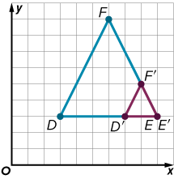
Example 4
Describe a Dilation
Check
△D′E′F′ is the image of △DEF after a dilation. Describe the dilation. Then write a coordinate rule to represent it.

Slide 40
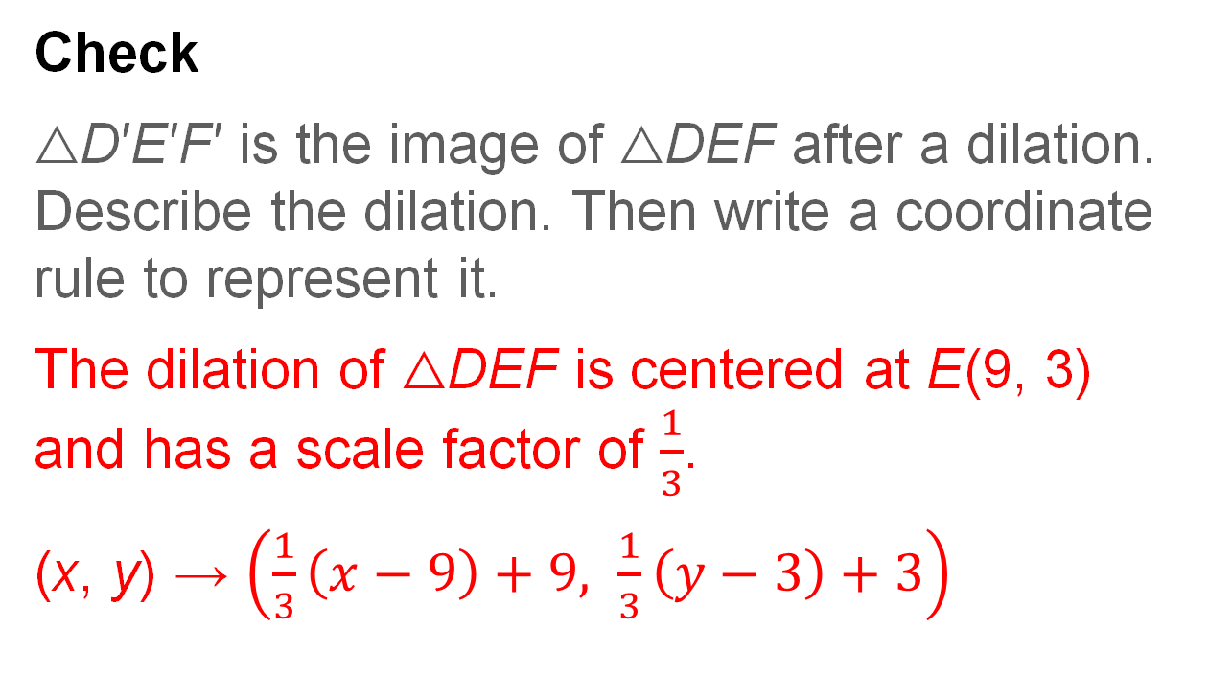
Example 4
Describe a Dilation
Check
△D′E′F′ is the image of △DEF after a dilation. Describe the dilation. Then write a coordinate rule to represent it.
The dilation of △DEF is centered at E(9, 3) and has a scale factor of $\frac{1}{3}$.
(x, y) → $\left(\frac{1}{3}\left(x−9\right)+9, \frac{1}{3}\left(y−3\right)+3\right)$
Notes:
The dilation of △DEF is centered at E(9, 3) and has a scale factor of $\frac{1}{3}$.
(x, y) → $\left(\frac{1}{3}\left(x−9\right)+9,\frac{1}{3}\left(y−3\right)+3\right)$

Slide 41
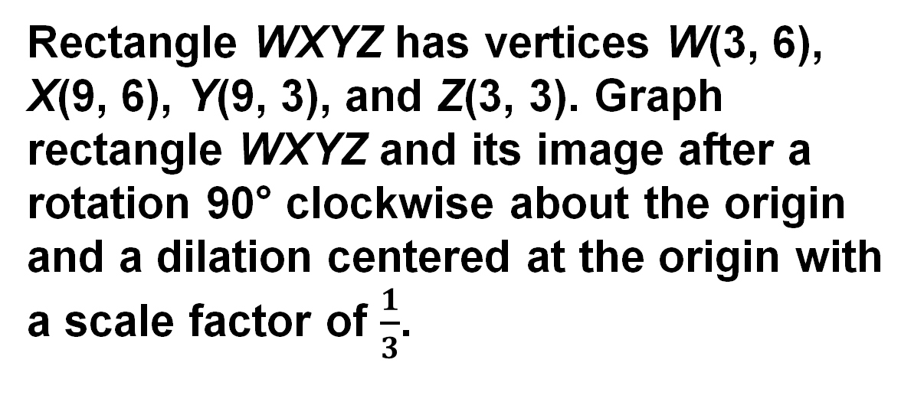
Example 5
Use a Dilation in a Composition
Rectangle WXYZ has vertices W(3, 6), X(9, 6), Y(9, 3), and Z(3, 3). Graph rectangle WXYZ and its image after a rotation 90° clockwise about the origin and a dilation centered at the origin with a scale factor of $\frac{1}{3}$.

Slide 42
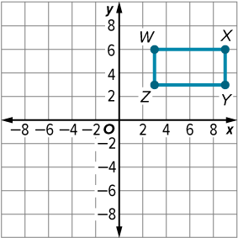
Example 5
Use a Dilation in a Composition
Step 1 Graph rectangle WXYZ.

Slide 43
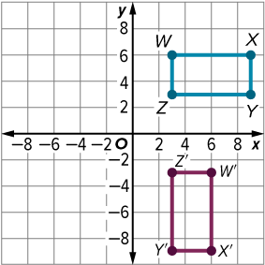
Example 5
Use a Dilation in a Composition
Step 2 Graph the image of rectangle WXYZ after a rotation 90° clockwise about the origin.
(x, y) | → | (y, −x)
W(3, 6) | → | W′(6, −3)
X(9, 6) | → | X′(6, −9)
Y(9, 3) | → | Y′(3, −9)
Z(3, 3) | → | Z′(3, −3)

Slide 44
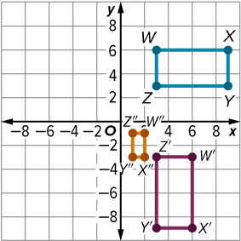
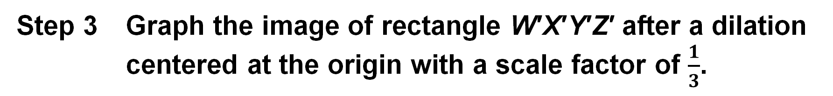
Example 5
Use a Dilation in a Composition
Step 3 Graph the image of rectangle W′X′Y′Z′ after a dilation centered at the origin with a scale factor of $\frac{1}{3}$.
(x, y) | → | (kx, ky)
W′(6, −3) | → | W″(2, −1)
X′(6, −9) | → | X″(2, −3)
Y′(3, −9) | → | Y″(1, −3)
Z′(3, −3) | → | Z″(1, −1)

Slide 45
Example 5
Use a Dilation in a Composition
Check
Triangle JKL has vertices J(−2, 1),
K(2, 0), and L(1, −4). Graph △JKL and its image after a dilation centered at K with a scale factor of 2 and a reflection in the line y = −3.

Slide 46
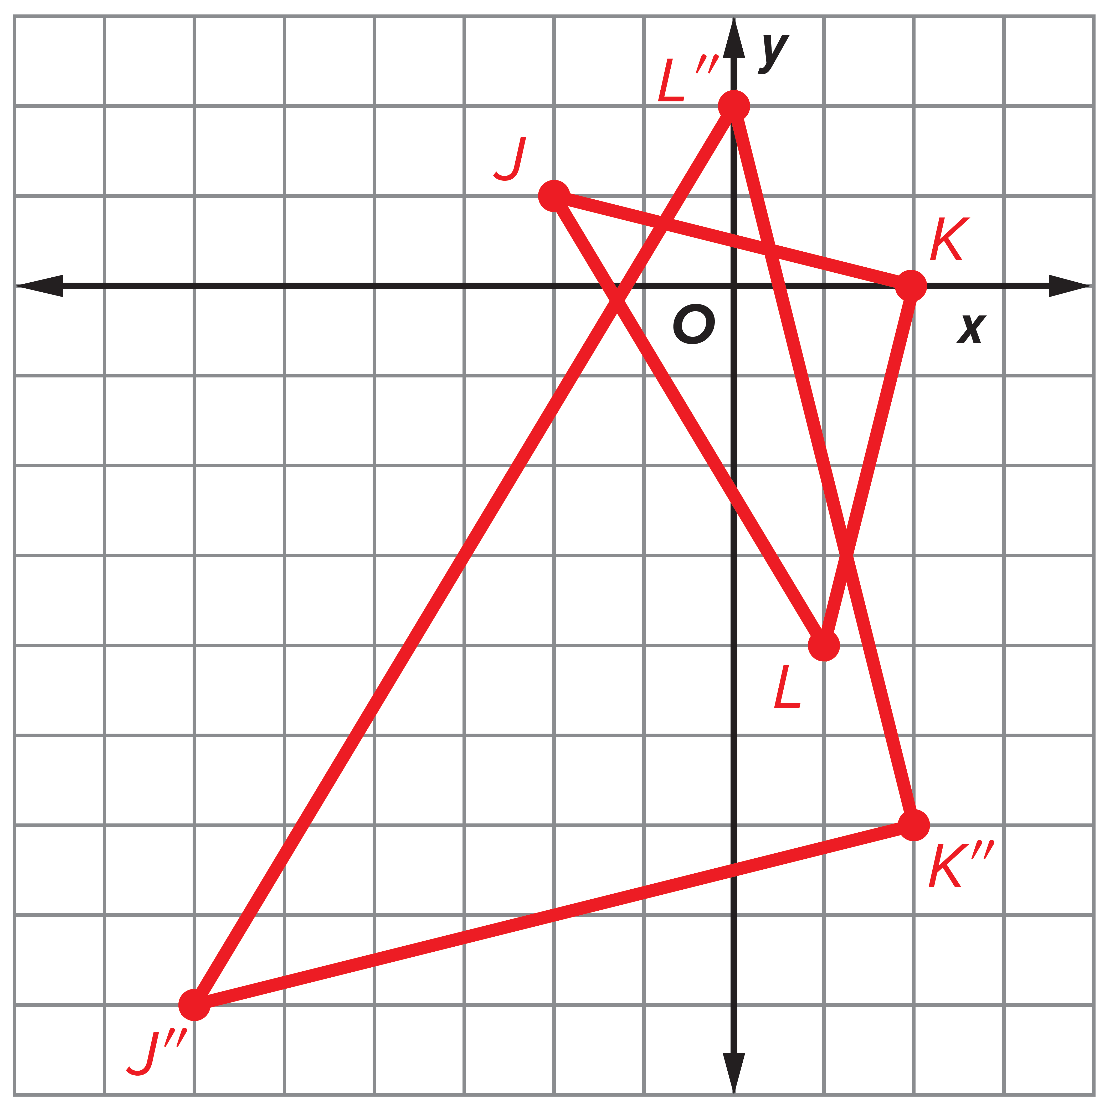
Example 5
Use a Dilation in a Composition
Check
Triangle JKL has vertices J(−2, 1),
K(2, 0), and L(1, −4). Graph △JKL and its image after a dilation centered at K with a scale factor of 2 and a reflection in the line y = −3.

Slide 47
Exit Ticket
Consider the four types of transformations: reflections, translations, rotations, and dilations.
1. How are the transformations alike and different?
2. Which transformations preserve shape and size?
3. Which transformations preserve orientation?

Slide 48
Exit Ticket
Consider the four types of transformations: reflections, translations, rotations, and dilations.
1. How are the transformations alike and different? Sample answer: All of the transformations represent a mapping of a preimage to an image. Three of the four transformations are isometries.
2. Which transformations preserve shape and size? reflections, translations, and rotations
3. Which transformations preserve orientation? translations, rotations, and dilations
Notes:
Sample answer: All of the transformations represent a mapping of a preimage to an image. Three of the four transformations are isometries.
reflections, translations, and rotations
translations, rotations, and dilations

