Slide 1
Trapezoids and Kites

Slide 2
Warm Up
Answer true or false.
1. All rectangles are parallelograms.
2. All squares are rectangles.
3. All rhombi are squares.
4. All squares are parallelograms.
5. All rhombi are parallelograms.

Slide 3
Warm Up
Answer true or false.
1. All rectangles are parallelograms. true
2. All squares are rectangles. true
3. All rhombi are squares. false
4. All squares are parallelograms. true
5. All rhombi are parallelograms. true
Notes:
true
true
false
true
true

Slide 4
Florida’s B.E.S.T. Standards for Mathematics
MA.912.GR.1.5
Prove relationships and theorems about trapezoids. Solve mathematical and real-world problems involving postulates, relationships and theorems of trapezoids.
MA.912.GR.3.2
Given a mathematical context, use coordinate geometry to classify or justify definitions, properties and theorems involving circles, triangles or quadrilaterals.
MA.912.GR.3.3
Use coordinate geometry to solve mathematical and real-world geometric problems involving lines, circles, triangles and quadrilaterals.

Slide 5
Florida’s Mathematical Thinking and Reasoning Standards
MA.K12.MTR.4.1
Engage in discussions that reflect on the mathematical thinking of self and others.
MA.K12.MTR.6.1
Assess the reasonableness of solutions.

Slide 6
Lesson Objectives
Content Objective
Students recognize and apply the properties of trapezoids and kites.
Language Objectives
• Students talk about recognizing and applying the properties of trapezoids and kites using precise mathematical vocabulary.
• To maximize linguistic and cognitive meta-awareness, students participate in MLR2: Collect and Display.

Slide 7
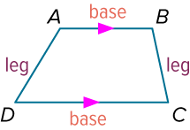
Learn
Trapezoids
A trapezoid is a quadrilateral with at least one pair of parallel sides. In a trapezoid that is not a parallelogram, the parallel sides are called the bases and the nonparallel sides are called legs.
A base angle is formed by a base and a leg. In trapezoid ABCD, ∠A and ∠B are one pair of base angles, and ∠C and ∠D are the other pair. If the legs are congruent, then a trapezoid is an isosceles trapezoid.

Slide 8
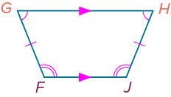
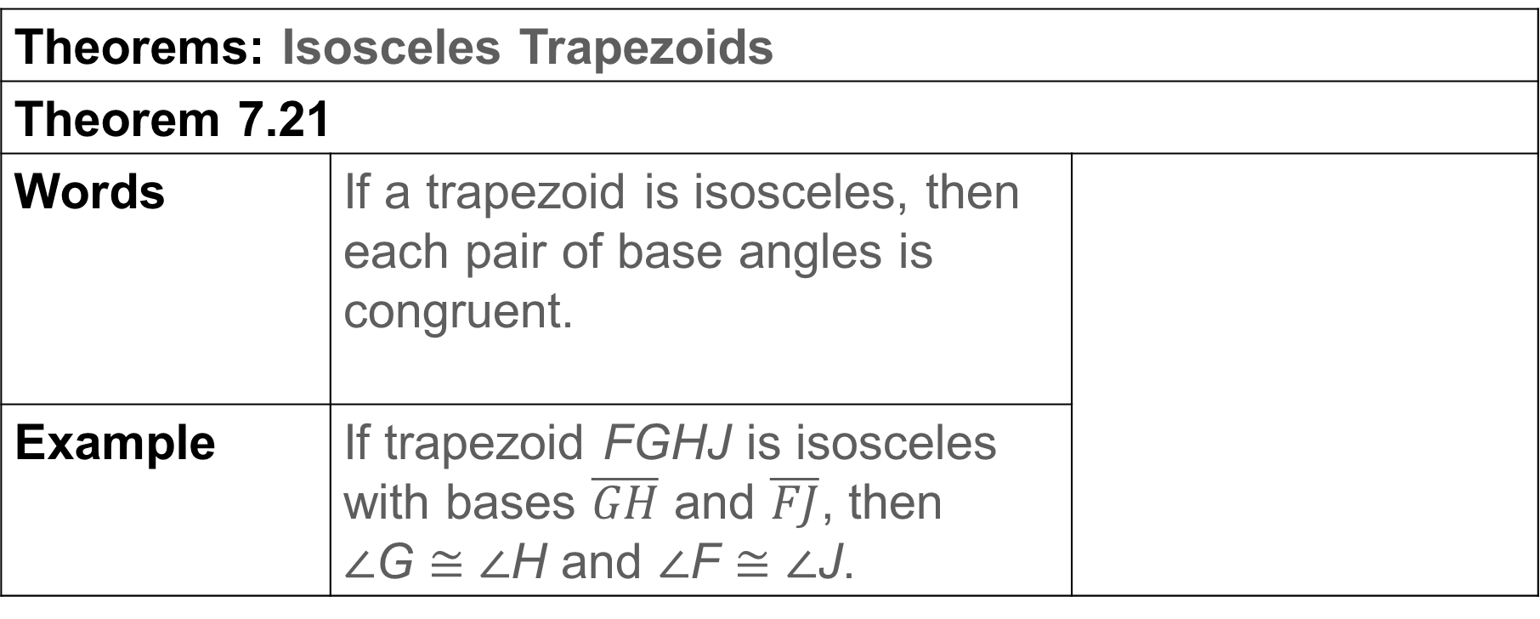
Learn
Trapezoids
Theorems: Isosceles Trapezoids
Theorem 7.21
Words | If a trapezoid is isosceles, then each pair of base angles is congruent.
Example | If trapezoid FGHJ is isosceles with bases $\overline{GH}$ and $\overline{FJ}$, then ∠G ≅ ∠H and ∠F ≅ ∠J.

Slide 9
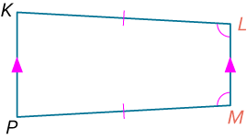
Learn
Trapezoids
Theorem 7.22
Words | If a trapezoid has one pair of congruent base angles, then it is an isosceles trapezoid.
Example | If ∠L ≅ ∠M, then trapezoid KLMP is isosceles.

Slide 10
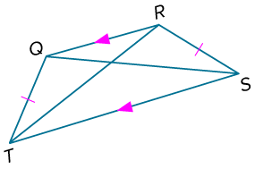
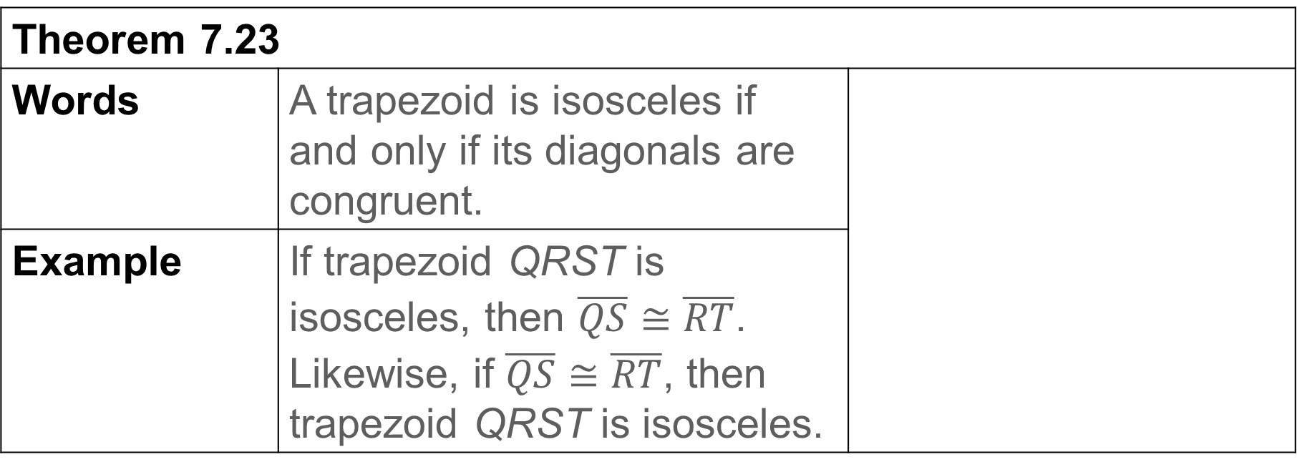
Learn
Trapezoids
Theorem 7.23
Words | A trapezoid is isosceles if and only if its diagonals are congruent.
Example | If trapezoid QRST is isosceles, then $\overline{QS}$≅ $\overline{RT}$. Likewise, if $\overline{QS}$≅ $\overline{RT}$, then trapezoid QRST is isosceles.

Slide 11

Example 1
Use Properties of Isosceles Trapezoids
MUSIC The body of the guitar shown is a trapezoidal prism. The front face of the guitar is an isosceles trapezoid.
AB = 3x − 2, CD = 3x + 9,
AD = 4x + 5, and BC = 5x − 6.
Part A Prove x = 11.
Part B Find m∠A if m∠C = 72°.
Part C Find the perimeter of the front face of the guitar in centimeters.

Slide 12
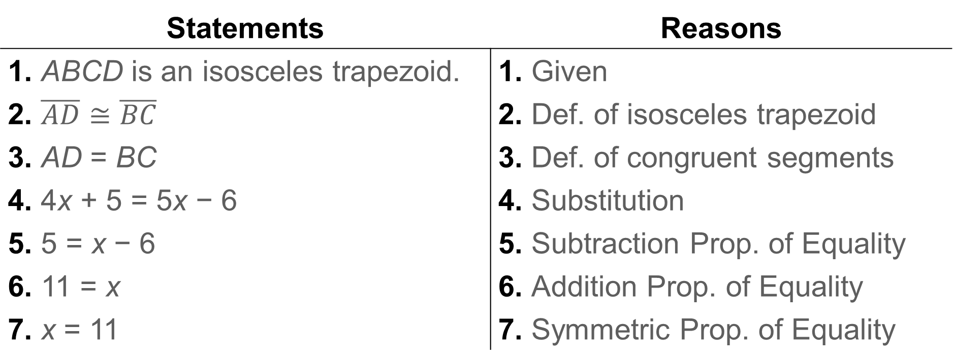
Example 1
Use Properties of Isosceles Trapezoids
Part A Prove x = 11.
Statements | Reasons
1. ABCD is an isosceles trapezoid. | 1. Given
2. $\overline{AD}$ ≅ $\overline{BC}$ | 2. Def. of isosceles trapezoid
3. AD = BC | 3. Def. of congruent segments
4. 4x + 5 = 5x − 6 | 4. Substitution
5. 5 = x − 6 | 5. Subtraction Prop. of Equality
6. 11 = x | 6. Addition Prop. of Equality
7. x = 11 | 7. Symmetric Prop. of Equality

Slide 13
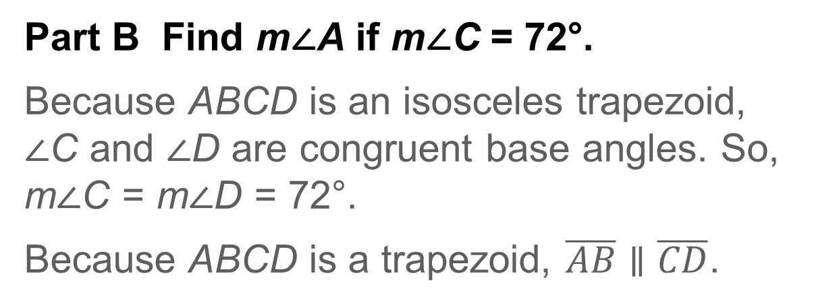
Example 1
Use Properties of Isosceles Trapezoids
Part B Find m∠A if m∠C = 72°.
Because ABCD is an isosceles trapezoid, ∠C and ∠D are congruent base angles. So, m∠C = m∠D = 72°.
Because ABCD is a trapezoid, $\overline{AB}$ ∥ $\overline{CD}$.
m∠A + m∠D = 180° | Consecutive Interior Angles Theorem
m∠A + 72° = 180° | Substitution
m∠A = 108° | Solve.

Slide 14
Example 1
Use Properties of Isosceles Trapezoids
Part C Find the perimeter of the front face of the guitar in centimeters.
P = AB + BC + CD + AD | Perimeter of trapezoid ABCD
= 3x − 2 + 5x − 6 + 3x + 9 + 4x + 5 | Substitution
= 15x + 6 | Combine like terms.
= 15(11) + 6 | x = 11
= 171 | Simplify.
So, the perimeter of the front face of the guitar is 171 centimeters.

Slide 15
Example 2
Isosceles Trapezoids and Coordinate Geometry
Quadrilateral QRST has vertices Q(−8, −4), R(0, 8), S(6, 8), and T(−6, −10). Show that QRST is a trapezoid, and determine whether QRST is an isosceles trapezoid.

Slide 16
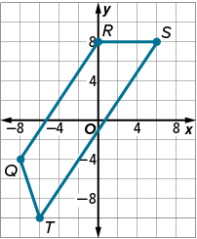
Example 2
Isosceles Trapezoids and Coordinate Geometry
Step 1 Graph quadrilateral QRST.
Graph and connect the vertices of QRST.

Slide 17
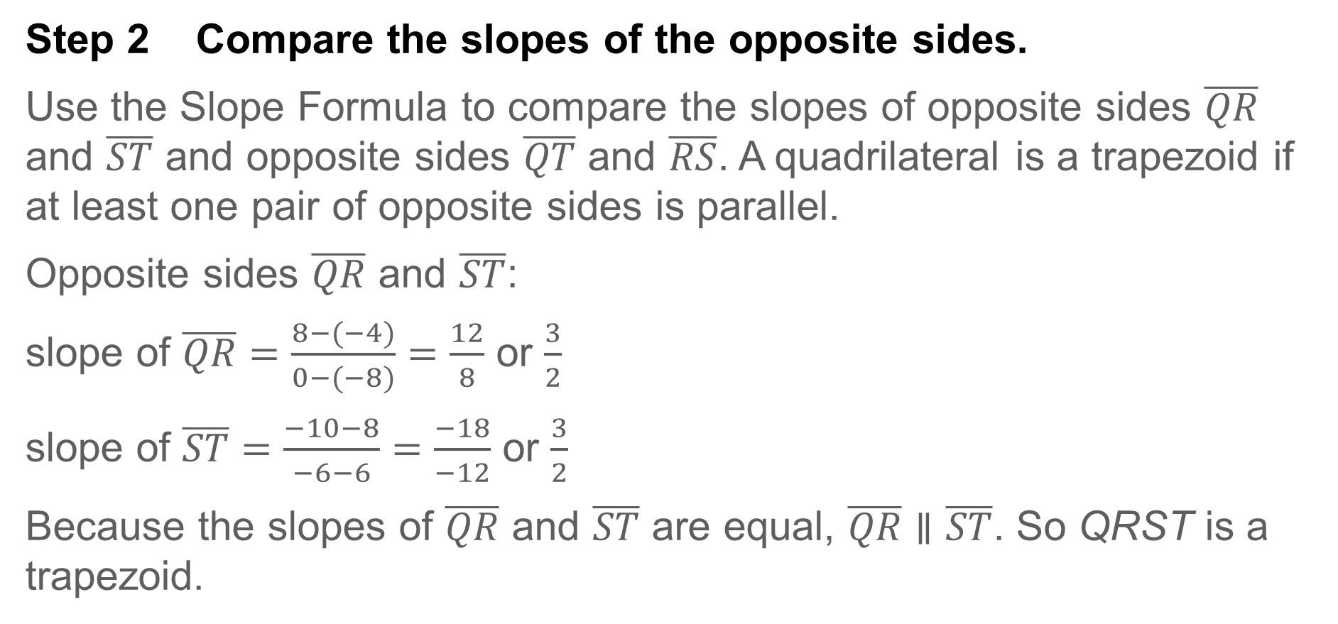
Example 2
Isosceles Trapezoids and Coordinate Geometry
Step 2 Compare the slopes of the opposite sides.
Use the Slope Formula to compare the slopes of opposite sides $\overline{QR}$ and $\overline{ST}$ and opposite sides $\overline{QT}$ and $\overline{RS}$. A quadrilateral is a trapezoid if at least one pair of opposite sides is parallel.
Opposite sides $\overline{QR}$ and $\overline{ST}$:
slope of $\overline{QR}=\frac{8−(−4)}{0−(−8)}=\frac{12}{8}$ or $\frac{3}{2}$
slope of $\overline{ST}=\frac{−10−8}{−6−6}=\frac{−18}{−12}$ or $\frac{3}{2}$
Because the slopes of $\overline{QR}$ and $\overline{ST}$ are equal, $\overline{QR}$ ∥ $\overline{ST}$. So QRST is a trapezoid.

Slide 18
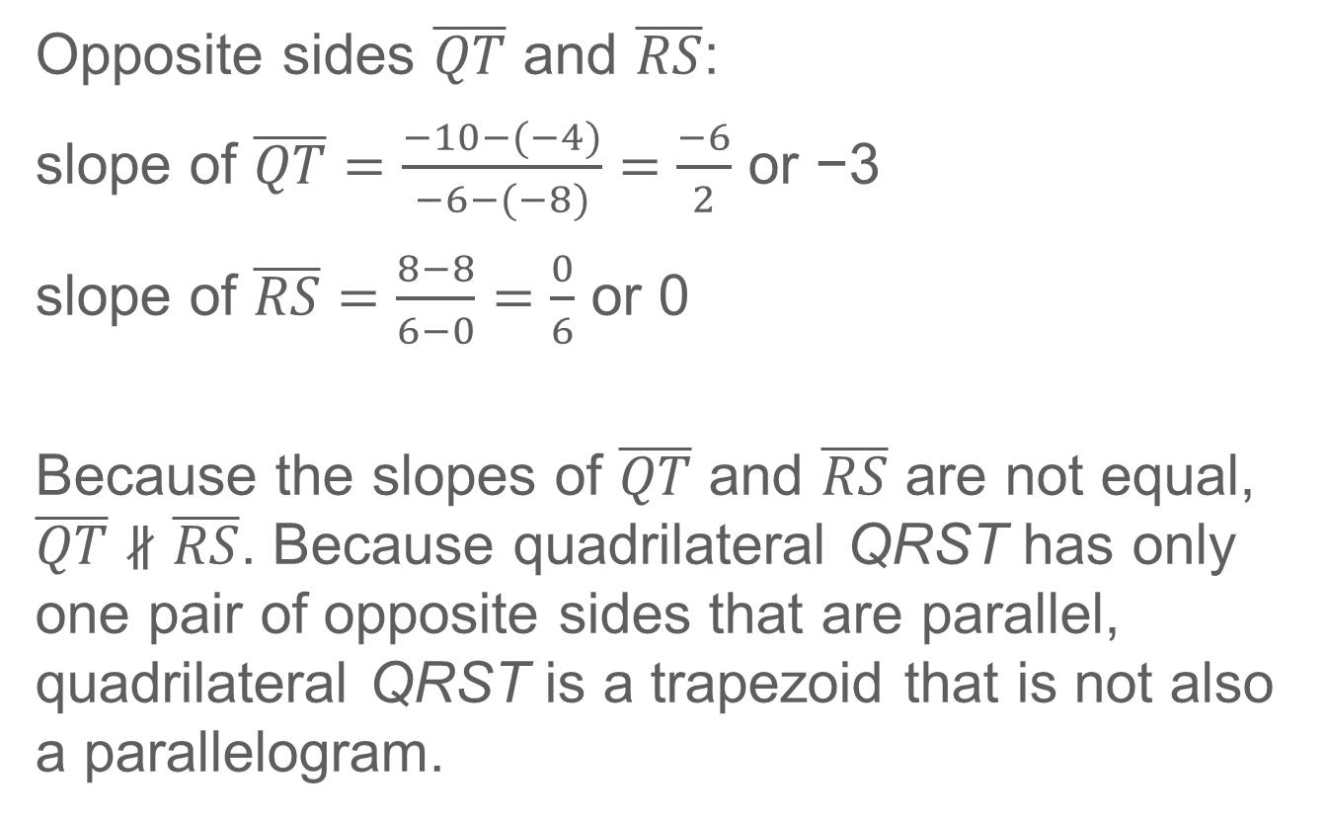
Example 2
Isosceles Trapezoids and Coordinate Geometry
Opposite sides $\overline{QT}$ and $\overline{RS}$:
slope of $\overline{QT}=\frac{−10−(−4)}{−6−(−8)}=\frac{−6}{2}$ or −3
slope of $\overline{RS}=\frac{8−8}{6−0}=\frac{0}{6}$ or 0
Because the slopes of $\overline{QT}$ and $\overline{RS}$ are not equal, $\overline{QT}$ ∦ $\overline{RS}$. Because quadrilateral QRST has only one pair of opposite sides that are parallel, quadrilateral QRST is a trapezoid that is not also a parallelogram.

Slide 19
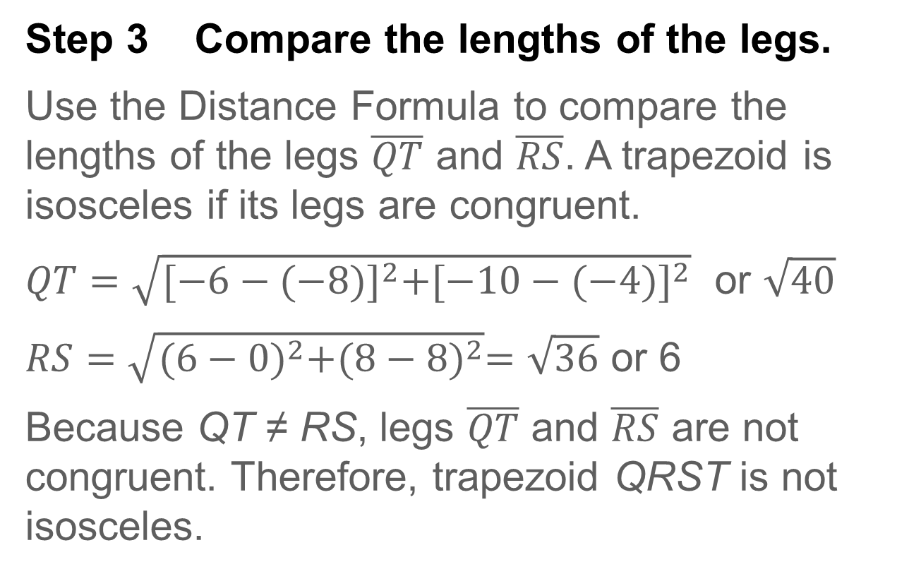
Example 2
Isosceles Trapezoids and Coordinate Geometry
Step 3 Compare the lengths of the legs.
Use the Distance Formula to compare the lengths of the legs $\overline{QT}$ and $\overline{RS}$. A trapezoid is isosceles if its legs are congruent.
$QT=\sqrt{{[−6−(−8)]}^{2}+{[−10−(−4)]}^{2}}$ or $\sqrt{40}$
$RS=\sqrt{{(6−0)}^{2}+{(8−8)}^{2}}=\sqrt{36}$ or 6
Because QT ≠ RS, legs $\overline{QT}$ and $\overline{RS}$ are not congruent. Therefore, trapezoid QRST is not isosceles.

Slide 20
Example 2
Isosceles Trapezoids and Coordinate Geometry
Think About It!
Your classmate says that you can prove trapezoid QRST is not isosceles by showing that the diagonals are not congruent. Compare and contrast your classmate's method with your method. Which method do you think is more efficient?

Slide 21
Example 2
Isosceles Trapezoids and Coordinate Geometry
Check
Quadrilateral DEFG has vertices D(−3, 2), E(−1, 6), F(3, 7), and G(−2, −3). Show that DEFG is a trapezoid, and determine whether DEFG is an isosceles trapezoid.

Slide 22
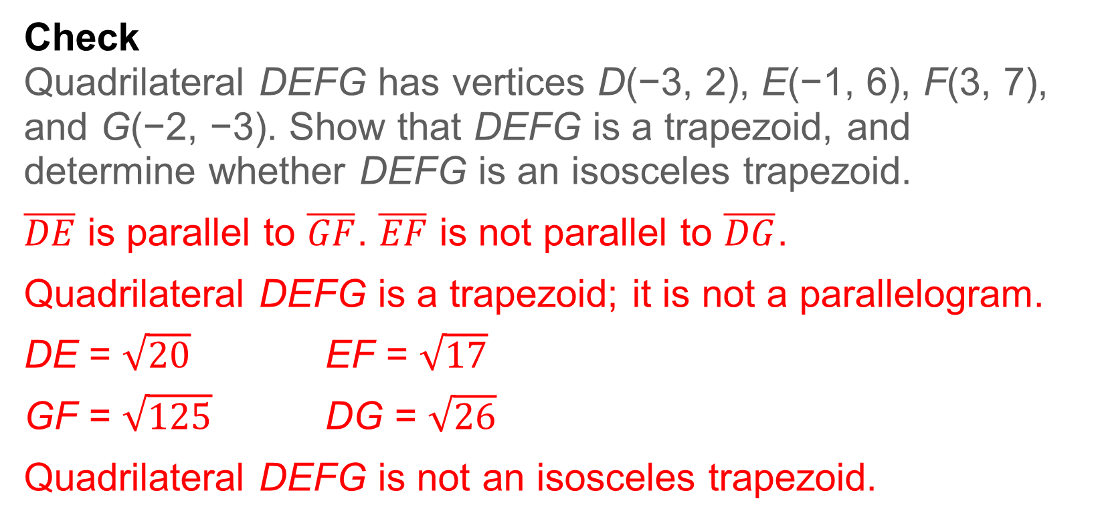
Example 2
Isosceles Trapezoids and Coordinate Geometry
Check
Quadrilateral DEFG has vertices D(−3, 2), E(−1, 6), F(3, 7), and G(−2, −3). Show that DEFG is a trapezoid, and determine whether DEFG is an isosceles trapezoid.
$\overline{DE}$ is parallel to $\overline{GF}$. $\overline{EF}$ is not parallel to $\overline{DG}$.
Quadrilateral DEFG is a trapezoid; it is not a parallelogram.
DE = $\sqrt{20}$ EF = $\sqrt{17}$
GF = $\sqrt{125}$ DG = $\sqrt{26}$
Quadrilateral DEFG is not an isosceles trapezoid.
Notes:
$\overline{DE}$ is parallel to $\overline{GF}$. $\overline{EF}$ is not parallel to $\overline{DG}$.
Quadrilateral DEFG is a trapezoid.
DE = $\sqrt{20}$ EF = $\sqrt{17}$
GF = $\sqrt{125}$ DG = $\sqrt{26}$
Quadrilateral DEFG is not an isosceles trapezoid.

Slide 23
Learn
Midsegments of Trapezoids
The midsegment of a trapezoid is the segment that connects the midpoints of the legs of the trapezoid.
Theorem 7.24: Trapezoid Midsegment Theorem
The midsegment of a trapezoid is parallel to each base and its length is one half the sum of the lengths of the bases.

Slide 24

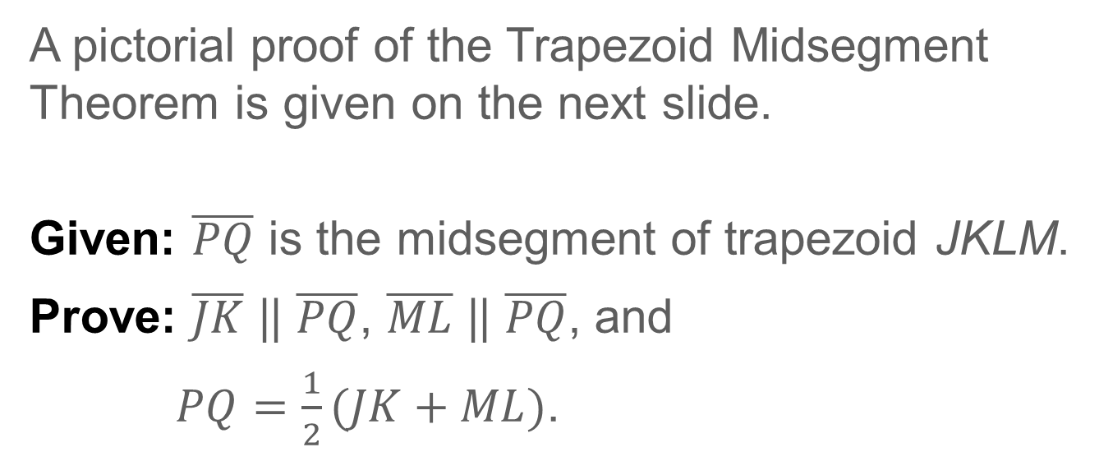
Learn
Midsegments of Trapezoids
A pictorial proof of the Trapezoid Midsegment Theorem is given on the next slide.
Given: $\overline{PQ}$ is the midsegment of trapezoid JKLM.
Prove: $\overline{JK}$ || $\overline{PQ}$, $\overline{ML}$ || $\overline{PQ}$, and
$PQ=\frac{1}{2}(JK+ML)$.

Slide 25


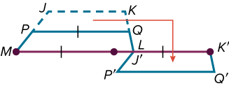
Learn
Midsegments of Trapezoids
Proof:
Step 1 Step 2 Step 3

Slide 26
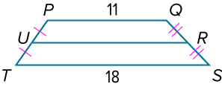

Example 3
Midsegments of Trapezoids
In the figure, $\overline{UR}$ is the midsegment of trapezoid PQST. Find UR.

Slide 27
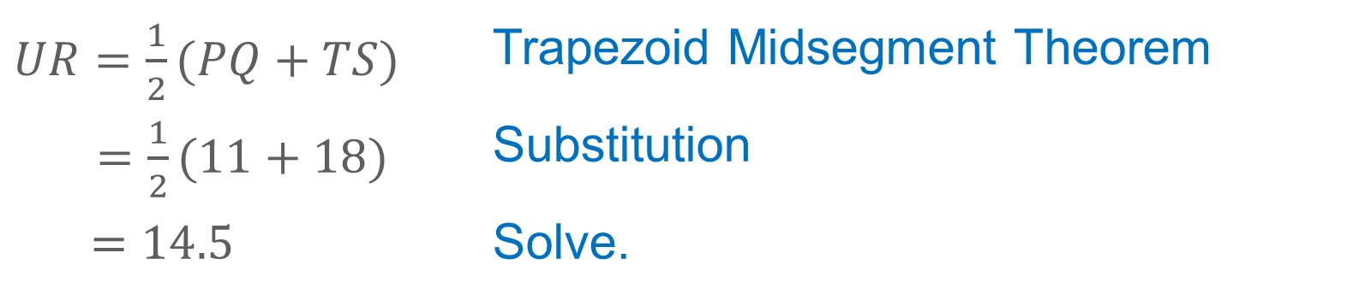
Example 3
Midsegments of Trapezoids
By the Trapezoid Midsegment Theorem, UR is equal to one half the sum of PQ and TS.
$UR=\frac{1}{2}(PQ+TS)$ | Trapezoid Midsegment Theorem
$=\frac{1}{2}(11+18)$ | Substitution
$=14.5$ | Solve.

Slide 28
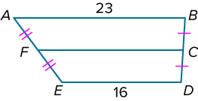
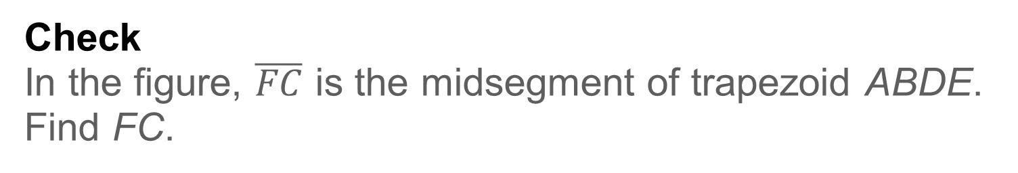
Example 3
Midsegments of Trapezoids
Check
In the figure, $\overline{FC}$ is the midsegment of trapezoid ABDE. Find FC.

Slide 29
Example 3
Midsegments of Trapezoids
Check
In the figure, $\overline{FC}$ is the midsegment of trapezoid ABDE. Find FC.
FC = 19.5
Notes:
FC = 19.5

Slide 30
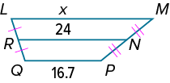
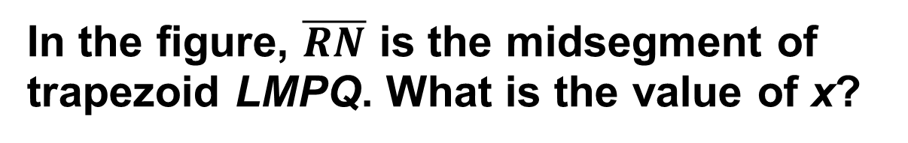
Example 4
Find Missing Values in Trapezoids
In the figure, $\overline{RN}$ is the midsegment of trapezoid LMPQ. What is the value of x?

Slide 31
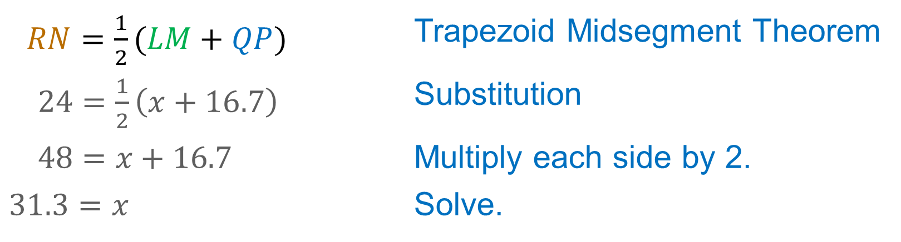
Example 4
Find Missing Values in Trapezoids
You can use the Trapezoid Midsegment Theorem to write an equation and find the value of x.
$RN=\frac{1}{2}(LM+QP)$ | Trapezoid Midsegment Theorem
$24=\frac{1}{2}\left(x+16.7\right)$ | Substitution
$48=x+16.7$ | Multiply each side by 2.
$31.3=x$ | Solve.

Slide 32
Example 4
Find Missing Values in Trapezoids
Think About It!
Is your answer reasonable? Use estimation to justify your reasoning.

Slide 33
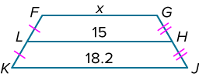

Example 4
Find Missing Values in Trapezoids
Check
In the figure, $\overline{LH}$ is the midsegment of trapezoid FGJK. What is the value of x?

Slide 34
Example 4
Find Missing Values in Trapezoids
Check
In the figure, $\overline{LH}$ is the midsegment of trapezoid FGJK. What is the value of x?
x = 11.8
Notes:
x = 11.8

Slide 35
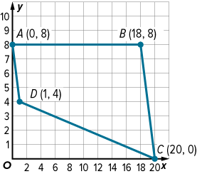
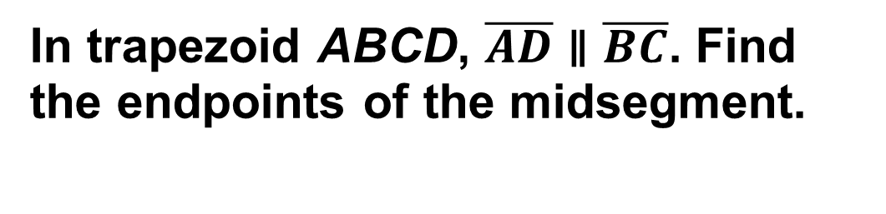
Example 5
Midsegments and Coordinate Geometry
In trapezoid ABCD, $\overline{AD}$ ∥ $\overline{BC}$. Find the endpoints of the midsegment.

Slide 36

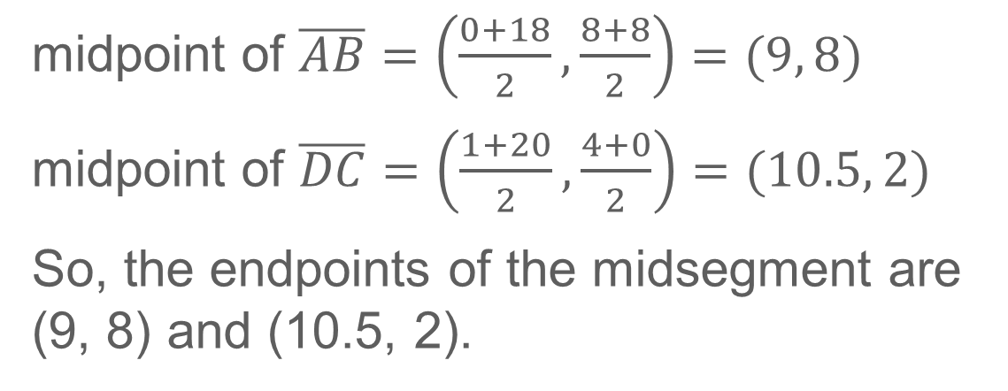
Example 5
Midsegments and Coordinate Geometry
You can use the Midpoint Formula to find the midpoints of $\overline{AB}$ and $\overline{DC}$. These midpoints are the endpoints of the midsegment of trapezoid ABCD.
midpoint of $\overline{AB}=\left(\frac{0+18}{2}, \frac{8+8}{2}\right)=(9, 8)$
midpoint of $\overline{DC}=\left(\frac{1+20}{2}, \frac{4+0}{2}\right)=(10.5, 2)$
So, the endpoints of the midsegment are (9, 8) and (10.5, 2).

Slide 37
Example 5
Midsegments and Coordinate Geometry
Think About It!
If the bases of a trapezoid are contained by the lines y = x + 4 and y = x − 8, what equation represents the line containing the midsegment?

Slide 38
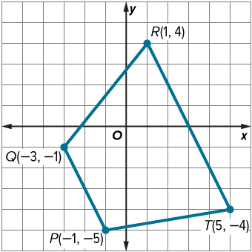
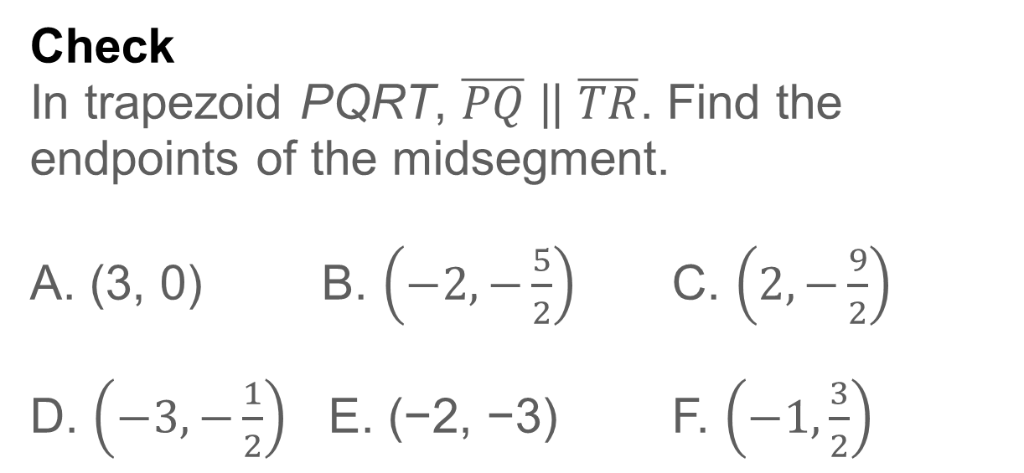
Example 5
Midsegments and Coordinate Geometry
Check
In trapezoid PQRT, $\overline{PQ}$|| $\overline{TR}$. Find the endpoints of the midsegment.
A. (3, 0) B. $\left(−2,−\frac{5}{2}\right)$ C. $\left(2,−\frac{9}{2}\right)$
D. $\left(−3,−\frac{1}{2}\right)$ E. (−2, −3) F. $\left(−1,\frac{3}{2}\right)$

Slide 39
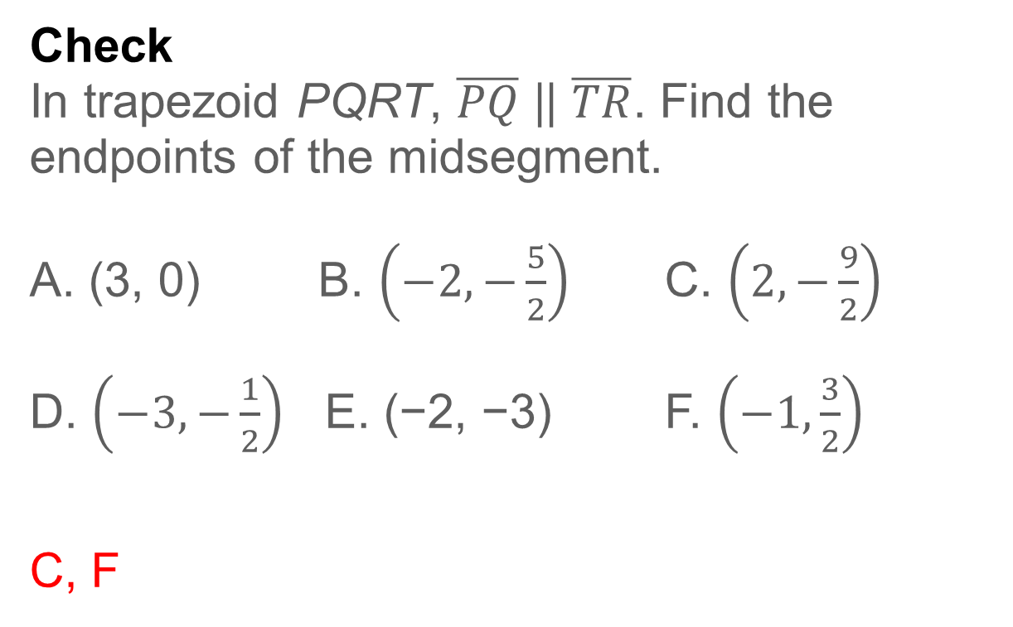
Example 5
Midsegments and Coordinate Geometry
Check
In trapezoid PQRT, $\overline{PQ}$|| $\overline{TR}$. Find the endpoints of the midsegment.
A. (3, 0) B. $\left(−2,−\frac{5}{2}\right)$ C. $\left(2,−\frac{9}{2}\right)$
D. $\left(−3,−\frac{1}{2}\right)$ E. (−2, −3) F. $\left(−1,\frac{3}{2}\right)$
C, F
Notes:
C, F

Slide 40
Learn
Kites
A kite is a convex quadrilateral with exactly two distinct pairs of adjacent congruent sides. Unlike a parallelogram, the opposite sides of a kite are not congruent or parallel.
Theorems: Kites
Theorem 7.25
If a quadrilateral is a kite, then its diagonals are perpendicular.
Theorem 7.26
If a quadrilateral is a kite, then exactly one pair of opposite angles is congruent.

Slide 41
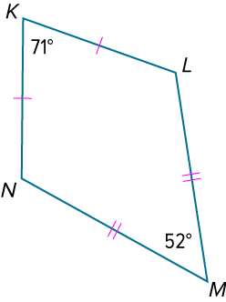
Example 6
Find Angle Measures in Kites
If KLMN is a kite, find m∠N.

Slide 42
Example 6
Find Angle Measures in Kites
Because a kite can only have one pair of opposite congruent angles and ∠K ≇ ∠M, ∠N ≅ ∠L. So, m∠N = m∠L. You can write and solve an equation to find m∠N.

Slide 43
Example 6
Find Angle Measures in Kites
m∠K + m∠L + m∠M + m∠N = 360° | Polygon Interior Angles Sum
 | Theorem
71° + m∠N + 52° + m∠N = 360° | Substitution
2m∠N + 123° = 360° | Simplify.
2m∠N = 237° | Subtract.
m∠N = 118.5° | Divide each side by 2.

Slide 44
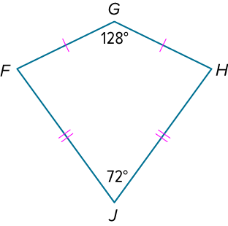
Example 6
Find Angle Measures in Kites
Check
If FGHJ is a kite, find m∠F.

Slide 45
Example 6
Find Angle Measures in Kites
Check
If FGHJ is a kite, find m∠F.
m∠F = 80°
Notes:
m∠F = 80°

Slide 46
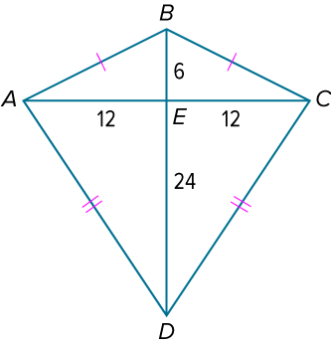
Example 7
Find Lengths in Kites
Quadrilateral ABCD is a kite.
Part A Find AD.
Part B Find the perimeter of kite ABCD.

Slide 47
Example 7
Find Lengths in Kites
Part A Find AD.
Because the diagonals of a kite are perpendicular, they divide ABCD into four right triangles. You can use the Pythagorean Theorem to find AD, the length of the hypotenuse of right △AED.

Slide 48
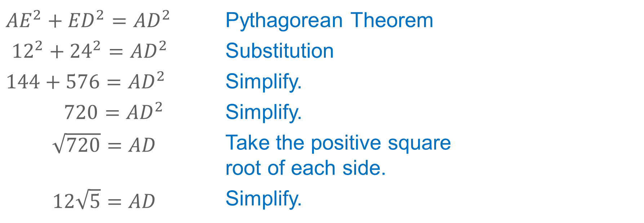
Example 7
Find Lengths in Kites
${AE}^{2}+{ED}^{2}={AD}^{2}$ | Pythagorean Theorem
${12}^{2}+{24}^{2}={AD}^{2}$ | Substitution
$144+576={AD}^{2}$ | Simplify.
$720={AD}^{2}$ | Simplify.
$\sqrt{720}=AD$ | Take the positive square root of each side.
$12\sqrt{5}=AD$ | Simplify.

Slide 49
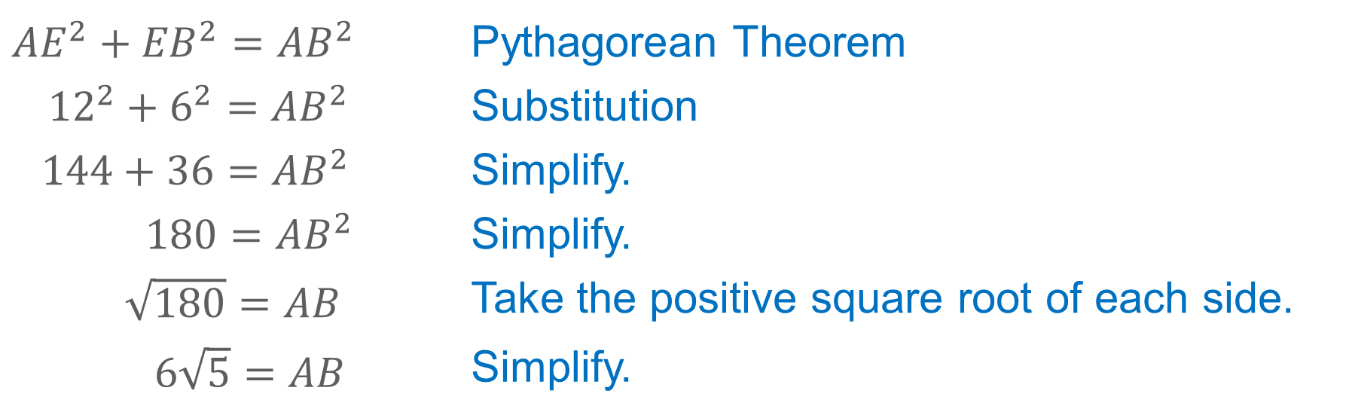
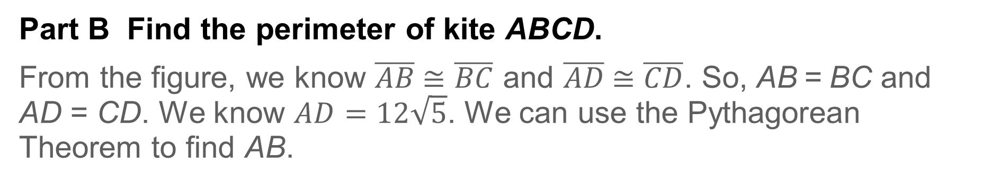
Example 7
Find Lengths in Kites
Part B Find the perimeter of kite ABCD.
From the figure, we know $\overline{AB}$≅ $\overline{BC}$ and $\overline{AD}$≅ $\overline{CD}$. So, AB = BC and AD = CD. We know $AD=12\sqrt{5}$. We can use the Pythagorean Theorem to find AB.
${AE}^{2}+{EB}^{2}={AB}^{2}$ | Pythagorean Theorem
${12}^{2}+6^{2}={AB}^{2}$ | Substitution
$144+36={AB}^{2}$ | Simplify.
$180={AB}^{2}$ | Simplify.
$\sqrt{180}=AB$ | Take the positive square root of each side.
$6\sqrt{5}=AB$ | Simplify.

Slide 50
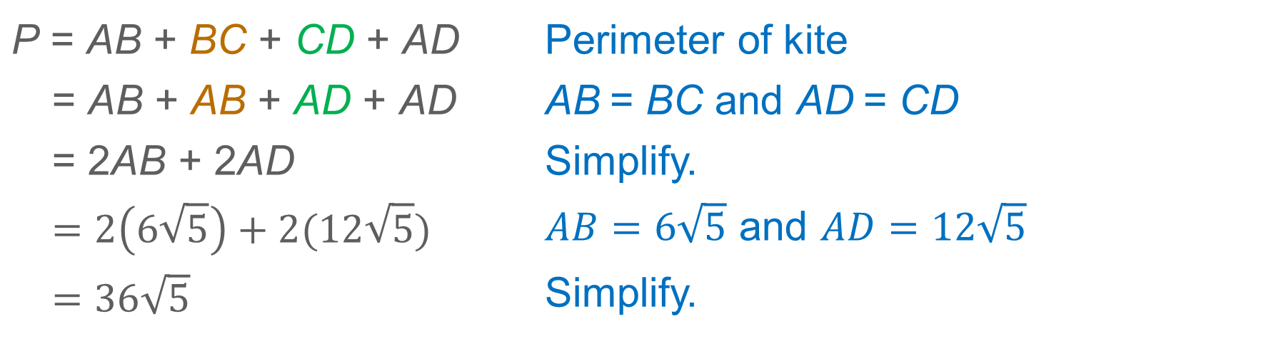
Example 7
Find Lengths in Kites
Use the values of AB and AD to find the perimeter of kite ABCD.
P = AB + BC + CD + AD | Perimeter of kite
= AB + AB + AD + AD | AB = BC and AD = CD
= 2AB + 2AD | Simplify.
$$=2\left(6\sqrt{5}\right)+2(12\sqrt{5})$$ | $AB=6\sqrt{5}$ and $AD=12\sqrt{5}$
$=36\sqrt{5}$ | Simplify.

Slide 51
Example 7
Find Lengths in Kites
Talk About It!
How can you find the area of kite ABCD? Justify your argument.

Slide 52
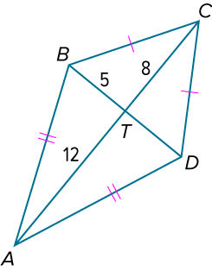
Example 7
Find Lengths in Kites
Check
Quadrilateral ABCD is a kite.
Part A Find CD.
Part B Find the perimeter of kite ABCD.

Slide 53
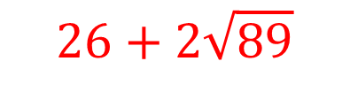

Example 7
Find Lengths in Kites
Check
Quadrilateral ABCD is a kite.
Part A Find CD.
Part B Find the perimeter of kite ABCD.
$$\sqrt{89}$$
$$26+2\sqrt{89}$$
Notes:
$$\sqrt{89}$$
$$26+2\sqrt{89}$$

Slide 54
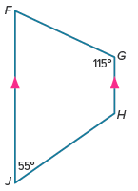
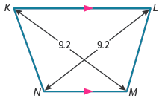
Exit Ticket
Is each trapezoid isosceles? Justify your answer.
1. | 2.

Slide 55
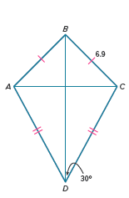
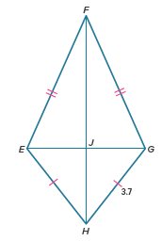
Exit Ticket
Find the specified lengths and angle measures.
3. AB and m∠BDA | 4. EH and m∠EJF

Slide 56
Exit Ticket
Is each trapezoid isosceles? Justify your answer.
1. | 2.
No; missing angle measures are 65° and 125°. Because the pairs of base angles are not congruent, the trapezoid is not isosceles.
Yes; Theorem 7.23
Notes:
1. No; missing angle measures are 65° and 125°. Because the pairs of base angles are not congruent, the trapezoid is not isosceles.
2. Yes; Theorem 7.23

Slide 57
Exit Ticket
Find the specified lengths and angle measures.
3. AB and m∠BDA | 4. EH and m∠EJF
6.9; 30° | 3.7; 90°
Notes:
6.9; 30°
3.7; 90°

