Slide 1
Section 3-9
Proving Lines Parallel

Slide 2
Warm Up
Find the slope of the line that goes through the given points.
1. (0, 3), (2, −5)
2. (1, 2), (−4, 2)
3. (6, −1), (−4, −3)
Describe the slopes of lines with the following relationships.
4. parallel
5. perpendicular

Slide 3
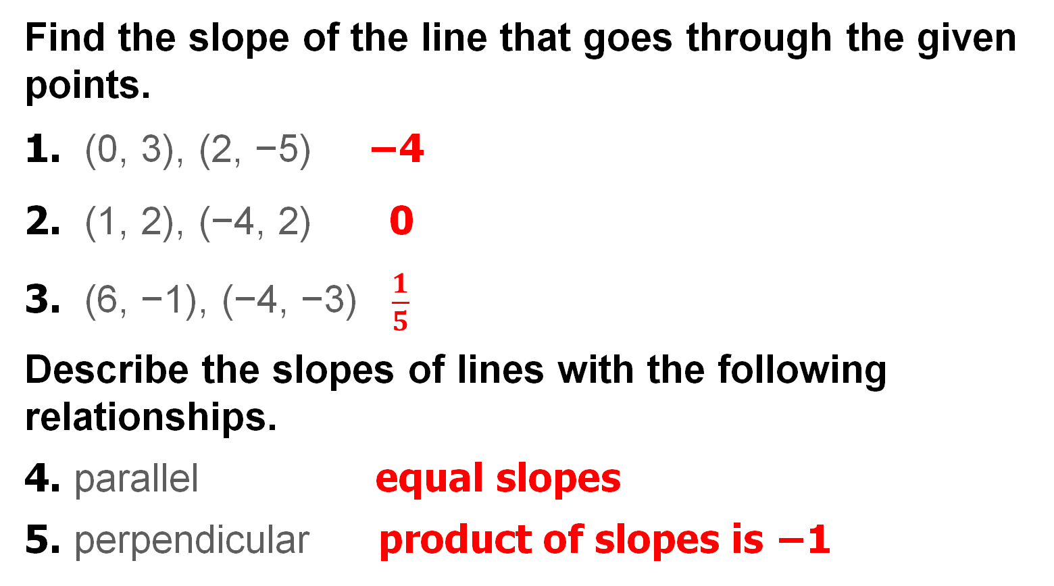
Warm Up
Find the slope of the line that goes through the given points.
1. (0, 3), (2, −5) −4
2. (1, 2), (−4, 2) 0
3. (6, −1), (−4, −3) $\frac{1}{5}$
Describe the slopes of lines with the following relationships.
4. parallel equal slopes
5. perpendicular product of slopes is −1
Notes:
−4
0
$\frac{1}{5}$
equal slopes
product of slopes is −1

Slide 4
Florida’s B.E.S.T. Standards for Mathematics
MA.912.GR.1.1
Prove relationships and theorems about lines and angles. Solve mathematical and real-world problems involving postulates, relationships and theorems of lines and angles.

Slide 5
Florida’s Mathematical Thinking and Reasoning Standards
MA.K12.MTR.1.1
Actively participate in effortful learning both individually and collectively.
MA.K12.MTR.5.1
Use patterns and structure to help understand and connect mathematical concepts.

Slide 6
Lesson Objectives
Content Objective
Students identify and use parallel lines by using angle relationships.
Language Objectives
Students use interior and exterior to explain how to identify and use parallel lines by using angle relationships.
To support sense-making, students participate in MLR2: Collect and Display.

Slide 7
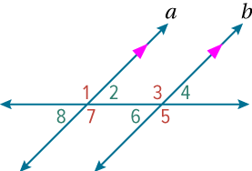
Learn
Identifying Parallel Lines
Corresponding angles are congruent when the lines cut by the transversal are parallel. The converse of this relationship is also true. Parallel lines that are cut by a transversal create several pairs of congruent angles. These special angle pairs can be used to prove that a pair of lines is parallel.

Slide 8
Learn
Identifying Parallel Lines
Theorem 3.19: Converse of Corresponding Angles Theorem
If two lines are cut by a transversal so that corresponding angles are congruent, then the lines are parallel.
If ∠1 ≅ ∠3, ∠2 ≅ ∠4, ∠5 ≅ ∠7, and ∠6 ≅ ∠8, then 𝒶 ∥ 𝒷.

Slide 9
Learn
Identifying Parallel Lines
Theorem 3.20: Alternate Exterior Angles Converse
If two lines in a plane are cut by a transversal so that a pair of alternate exterior angles is congruent, then the lines are parallel.
If ∠1 ≅ ∠5, then 𝒶 ∥ 𝒷.

Slide 10
Learn
Identifying Parallel Lines
Theorem 3.21: Consecutive Interior Angles Converse
If two lines in a plane are cut by a transversal so that a pair of consecutive interior angles is supplementary, then the lines are parallel.
If m∠7 + m∠6 = 180°, then 𝒶 ∥ 𝒷.

Slide 11
Learn
Identifying Parallel Lines
Theorem 3.22: Alternate Interior Angles Converse
If two lines in a plane are cut by a transversal so that a pair of alternate interior angles is congruent, then the lines are parallel.
If ∠7 ≅ ∠3, then 𝒶 ∥ 𝒷.

Slide 12
Learn
Identifying Parallel Lines
Theorem 3.23: Perpendicular Transversal Converse
If two lines in a plane are perpendicular to the same line, then the lines are parallel.

Slide 13
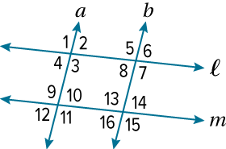
Example 1
Identify Parallel Lines
Use the given information to determine which lines, if any, are parallel. State the postulate or theorem that justifies your answer.
a. ∠2 ≅ ∠8
b. ∠3 ≅ ∠11
c. ∠12 ≅ ∠14

Slide 14
Example 1
Identify Parallel Lines
a. ∠2 ≅ ∠8
∠2 and ∠8 are alternate interior angles of lines 𝒶 and 𝒷.
Because ∠2 ≅ ∠8, 𝒶 ∥ 𝒷 by the Alternate Interior Angles Converse.

Slide 15
Example 1
Identify Parallel Lines
b. ∠3 ≅ ∠11
∠3 and ∠11 are corresponding angle of lines 𝓁 and 𝓂. Because
∠3 ≅ ∠11, 𝓁 ∥ 𝓂 by the Converse of the Corresponding Angles Theorem.

Slide 16
Example 1
Identify Parallel Lines
c. ∠12 ≅ ∠14
∠12 and ∠14 are alternate exterior angles of lines 𝒶 and 𝒷.
Because ∠12 ≅ ∠14, 𝒶 ∥ 𝒷 by the Alternate Exterior Angles Converse.

Slide 17
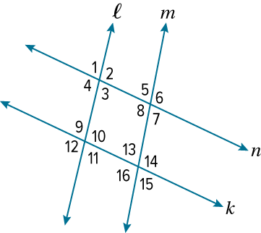
Example 1
Identify Parallel Lines
Check
Use the given information to determine which lines, if any, are parallel. State the postulate or theorem that justifies your answer.

Slide 18
Example 1
Identify Parallel Lines
Check
a. ∠1 ≅ ∠15
A. 𝓁 ∥ 𝓂; Alternate Exterior Angles Converse
B. 𝓃 ∥ 𝓀; Alternate Exterior Angles Converse
C. 𝓁 ∥ 𝓂 ; Converse of Corresponding Angles Theorem
D. It is not possible to determine whether the lines are parallel.

Slide 19
Example 1
Identify Parallel Lines
b. m∠3 + m∠10 = 180°
c. ∠3 ≅ ∠5
A. 𝓁 ∥ 𝓂; Alternate Interior Angles Converse
B. 𝓁 ∥ 𝓂; Consecutive Interior Angles Converse
C. 𝓃 ∥ 𝓀; Alternate Interior Angles Converse
D. It is not possible to determine whether the lines are parallel.

Slide 20
Example 1
Identify Parallel Lines
Check
a. ∠1 ≅ ∠15 D
A. 𝓁 ∥ 𝓂; Alternate Exterior Angles Converse
B. 𝓃 ∥ 𝓀; Alternate Exterior Angles Converse
C. 𝓁 ∥ 𝓂 ; Converse of Corresponding Angles Theorem
D. It is not possible to determine whether the lines are parallel.
Notes:
D

Slide 21
Example 1
Identify Parallel Lines
b. m∠3 + m∠10 = 180°
𝓃 ∥ 𝓀; Consecutive Interior Angles Converse
c. ∠3 ≅ ∠5 A
A. 𝓁 ∥ 𝓂; Alternate Interior Angles Converse
B. 𝓁 ∥ 𝓂; Consecutive Interior Angles Converse
C. 𝓃 ∥ 𝓀; Alternate Interior Angles Converse
D. It is not possible to determine whether the lines are parallel.
Notes:
𝓃 ∥ 𝓀; Consecutive Interior Angles Converse
A

Slide 22
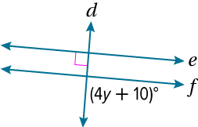
Example 2
Use Angle Relationships
Find the value of y so that ℯ || 𝒻. Identify the postulate or theorem you used.

Slide 23
Example 2
Use Angle Relationships
From the figure, you know that line 𝒹 is perpendicular to line ℯ. For lines ℯ and 𝒻 to be parallel, line 𝒻 must also be perpendicular to line 𝒹 by the Perpendicular Transversal Converse. If line 𝒻 is perpendicular to line 𝒹, then
(4y + 10)° = 90°. Solve for y.
90° = (4y + 10)° | Definition of perpendicular
80° = 4y° | Subtract 10° from each side.
20 = y | Divide each side by 4°.

Slide 24
Example 2
Use Angle Relationships
Think About It!
Your classmate argues that we do not have enough information to determine the correct value of y. She says that the two angles are not corresponding angles; therefore, it does not help to assume that the two angles are congruent. Describe the error.
What feedback can you provide to help her correct the error?

Slide 25
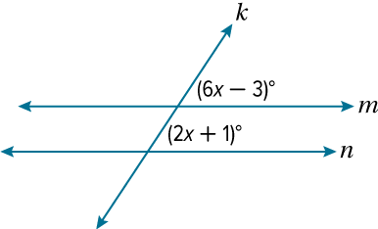
Example 2
Use Angle Relationships
Check
a. Find the value of x so that 𝓂 ∥ 𝓃. Identify the postulate or theorem you used.

Slide 26
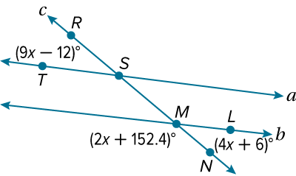
Example 2
Use Angle Relationships
b. Find m∠LMN so that 𝒶 ∥ 𝒷. Identify the postulate or theorem you used.
A. 3.6°
B. 20.4°
C. 100°
D. 159.6°

Slide 27
Example 2
Use Angle Relationships
Check
a. Find the value of x so that 𝓂 ∥ 𝓃. Identify the postulate or theorem you used.
x = 1; Converse of Corresponding Angles Theorem
Notes:
x = 1; Converse of Corresponding Angles Theorem

Slide 28
Example 2
Use Angle Relationships
b. Find m∠LMN so that 𝒶 ∥ 𝒷. Identify the postulate or theorem you used. B
A. 3.6°
B. 20.4°
C. 100°
D. 159.6°
I used the Alternate Exterior Angles Converse.
Notes:
B; I used the Alternate Exterior Angles Converse.

Slide 29
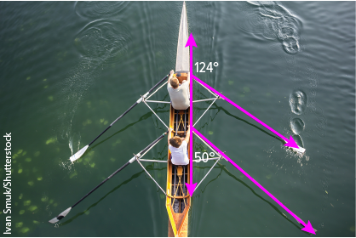
Example 3
Prove Lines Parallel
The angle pair relationships formed by a transversal can be used to prove that two lines are parallel.
ROWING To move in a straight line with maximum efficiency, rowers’ oars should be parallel. Refer to the photo at the right. Is it possible to prove that any of the oars are parallel? Justify your answer.

Slide 30
Example 3
Prove Lines Parallel
The angle that forms a linear pair with the 50° angle has a measure of 180° − 50° or 130° .
The angle measuring 130° is the corresponding angle to the 124° angle. Because the corresponding angles are not congruent, the lines are not parallel.
Therefore, it is not possible to prove that the oars are parallel.

Slide 31
Example 3
Prove Lines Parallel
Think About It!
What other information can be used to show that the oars are not parallel?

Slide 32
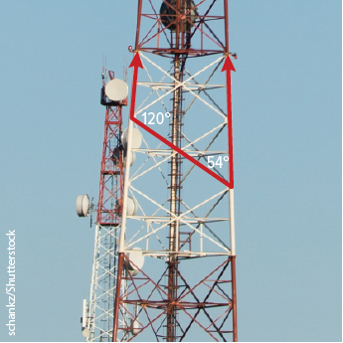
Example 3
Prove Lines Parallel
Check
ANTENNAS Is it possible to prove that the support poles of the antenna complex are parallel? Justify your answer.
A. No; because the consecutive interior angles are not supplementary, the support poles cannot be parallel.
B. No; because the alternate interior angles are not supplementary, the support poles cannot be parallel.
C. Yes; because the alternate interior angles are supplementary, the support poles are parallel.
D. Yes; because the consecutive interior angles are congruent, the support poles are parallel.

Slide 33
Example 3
Prove Lines Parallel
Check
ANTENNAS Is it possible to prove that the support poles of the antenna complex are parallel? Justify your answer. A
A. No; because the consecutive interior angles are not supplementary, the support poles cannot be parallel.
B. No; because the alternate interior angles are not supplementary, the support poles cannot be parallel.
C. Yes; because the alternate interior angles are supplementary, the support poles are parallel.
D. Yes; because the consecutive interior angles are congruent, the support poles are parallel.
Notes:
A

Slide 34
Exit Ticket
Lines 𝒶 and 𝒷 are cut by transversal 𝓉. Find the value of x that makes 𝒶 ∥ 𝒷.
1. ∠2 and ∠5 are alternate exterior angles. m∠2 = (6x – 8)° and m∠5 = (4x + 16)°.
2. ∠3 and ∠6 are corresponding angles. m∠3 = (5x + 23)° and m∠6 = (8x – 1)°.

Slide 35
Exit Ticket
3. ∠4 and ∠8 are alternate interior angles. m∠4 = (30x + 7)° and m∠8 = (34x − 7)°.
4. How can you tell whether two lines cut by a transversal are parallel?

Slide 36
Exit Ticket
Lines 𝒶 and 𝒷 are cut by transversal 𝓉. Find the value of x that makes 𝒶 ∥ 𝒷.
1. ∠2 and ∠5 are alternate exterior angles. m∠2 = (6x – 8)° and m∠5 = (4x + 16)°. 12
2. ∠3 and ∠6 are corresponding angles. m∠3 = (5x + 23)° and m∠6 = (8x – 1)°. 8
Notes:
12
8

Slide 37
Exit Ticket
3. ∠4 and ∠8 are alternate interior angles. m∠4 = (30x + 7)° and m∠8 = (34x − 7)°. 3.5
4. How can you tell whether two lines cut by a transversal are parallel?
Sample answer: Find a pair of alternate interior, alternate exterior, or corresponding angles. If the angles are congruent, then the lines are parallel.
Notes:
3.5
Sample answer: Find a pair of alternate interior, alternate exterior, or corresponding angles. If the angles are congruent, then the lines are parallel.

