Slide 1
Parts of Similar Triangles

Slide 2
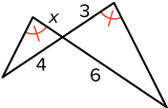
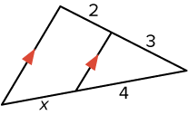

Warm Up
Solve for x.
1. $\frac{x}{12}=\frac{2}{8}$
2. $\frac{6}{5}=\frac{12}{x}$
3. $\frac{x + 2}{12}=\frac{3}{8}$
4. 5.

Slide 3

Warm Up
Solve for x.
1. $\frac{x}{12}=\frac{2}{8}$ 3
2. $\frac{6}{5}=\frac{12}{x}$ 10
3. $\frac{x + 2}{12}=\frac{3}{8}$ $2\frac{1}{2}$
4. 2 5. $\frac{8}{3}$
Notes:
3
10
$2\frac{1}{2}$
2
$\frac{8}{3}$

Slide 4
Florida’s B.E.S.T. Standards for Mathematics
MA.912.GR.1.6 Solve mathematical and real-world problems involving congruence or similarity in two-dimensional figures.

Slide 5
Florida’s Mathematical Thinking and Reasoning Standards
MA.K12.MTR.4.1
Engage in discussions that reflect on the mathematical thinking of self and others.

Slide 6
Lesson Objectives
Content Objective
Students solve problems and prove theorems about parts of similar triangles by using triangle similarity.
Language Objectives
Students explain how to solve problems and prove theorems about parts of similar triangles by using triangle similarity with If.
To maximize linguistic and cognitive meta-awareness, students participate in MLR5: Co-Craft Questions and Problems.

Slide 7
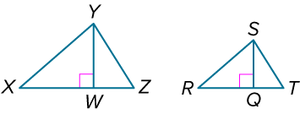
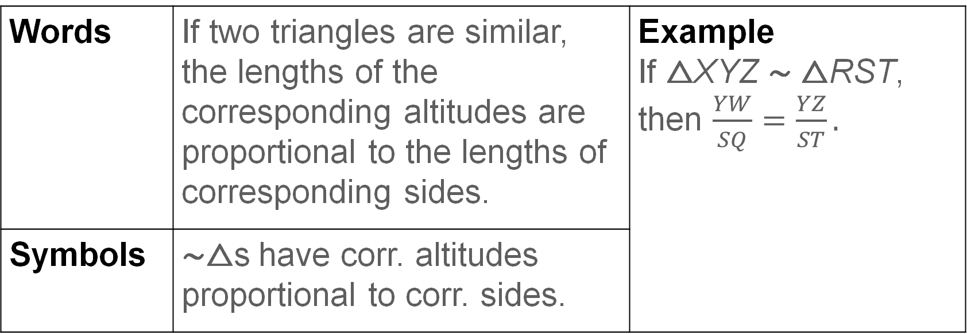
Learn
Parts of Similar Triangles
Theorems: Parts of Similar Triangles
Theorem 8.9
Words | If two triangles are similar, the lengths of the corresponding altitudes are proportional to the lengths of corresponding sides. | Example If △XYZ ∼ △RST, then $\frac{YW}{SQ}=\frac{YZ}{ST}.$
Symbols | ∼△s have corr. altitudes proportional to corr. sides.

Slide 8
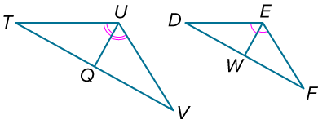
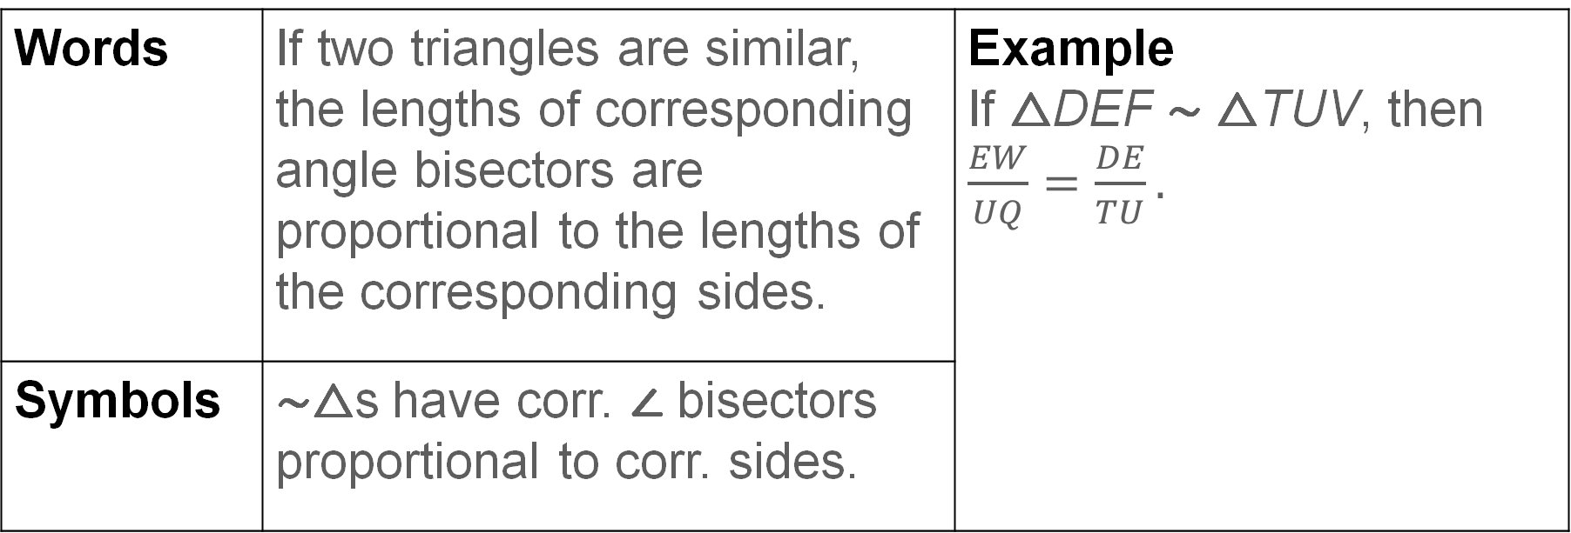
Learn
Parts of Similar Triangles
Theorem 8.10
Words | If two triangles are similar, the lengths of corresponding angle bisectors are proportional to the lengths of the corresponding sides. | Example If △DEF ∼ △TUV, then $\frac{EW}{UQ}=\frac{DE}{TU}.$
Symbols | ∼△s have corr. ∠ bisectors proportional to corr. sides.

Slide 9
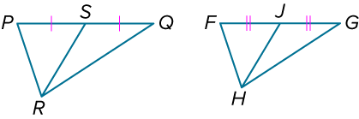
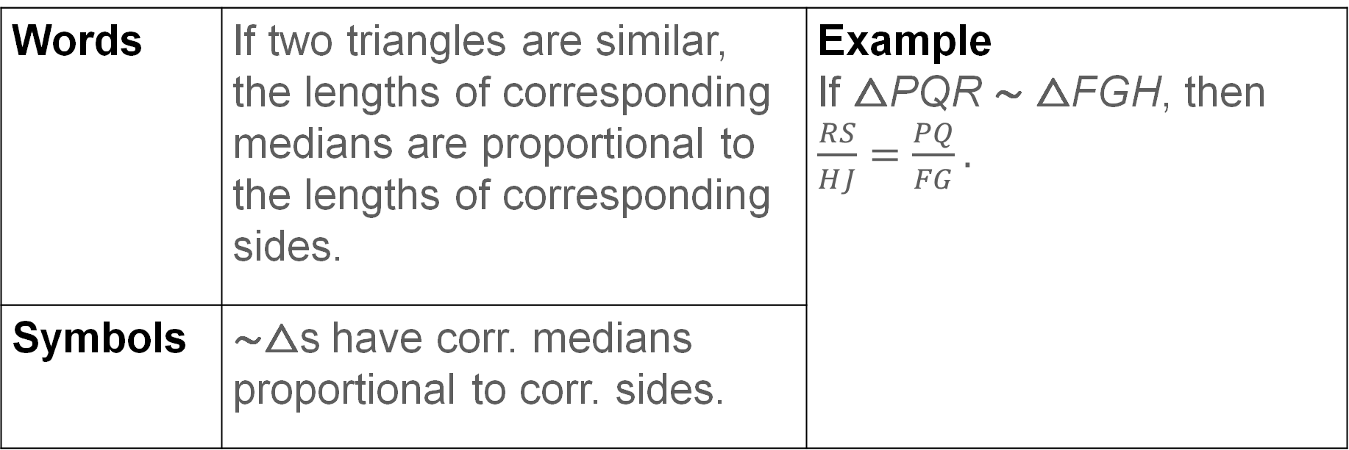
Learn
Parts of Similar Triangles
Theorem 8.11
Words | If two triangles are similar, the lengths of corresponding medians are proportional to the lengths of corresponding sides. | Example If △PQR ∼ △FGH, then $\frac{RS}{HJ}=\frac{PQ}{FG}.$
Symbols | ∼△s have corr. medians proportional to corr. sides.

Slide 10
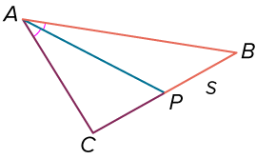
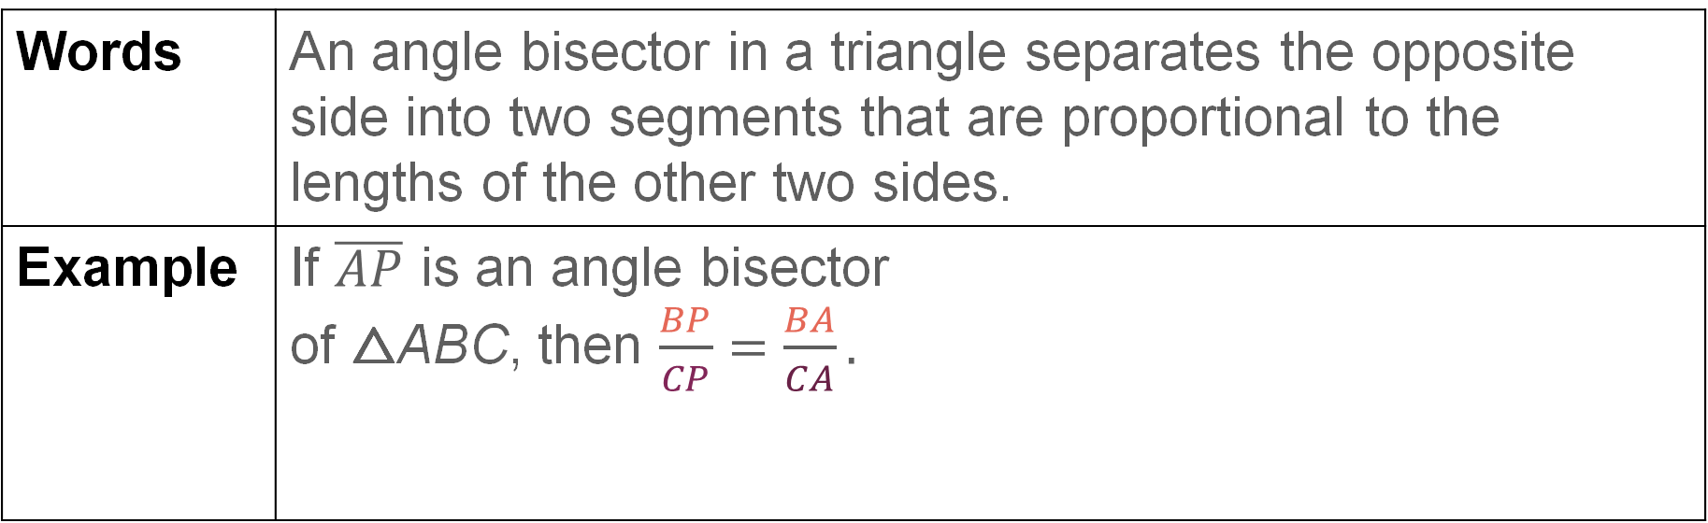
Learn
Parts of Similar Triangles
An angle bisector of a triangle also divides the side opposite the angle proportionally.
Theorem 8.12: Triangle Angle Bisector
Words | An angle bisector in a triangle separates the opposite side into two segments that are proportional to the lengths of the other two sides.
Example | If $\overline{AP}$ is an angle bisector of △ABC, then $\frac{BP}{CP}=\frac{BA}{CA}.$

Slide 11
Learn
Parts of Similar Triangles
Talk About It!
What other proportion can be written using the Triangle Angle Bisector Theorem?

Slide 12
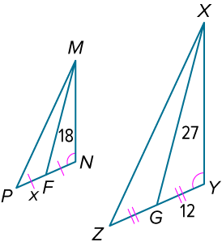
Example 1
Use Special Segments in Similar Triangles
In the figure, △MNP ∼ △XYZ. Find the value of x.

Slide 13
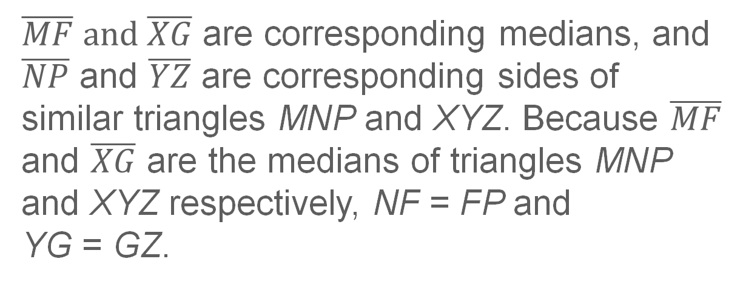
Example 1
Use Special Segments in Similar Triangles
$\overline{MF} and \overline{XG}$ are corresponding medians, and $\overline{NP}$ and $\overline{YZ}$ are corresponding sides of similar triangles MNP and XYZ. Because $\overline{MF}$ and $\overline{XG}$ are the medians of triangles MNP and XYZ respectively, NF = FP and YG = GZ.

Slide 14
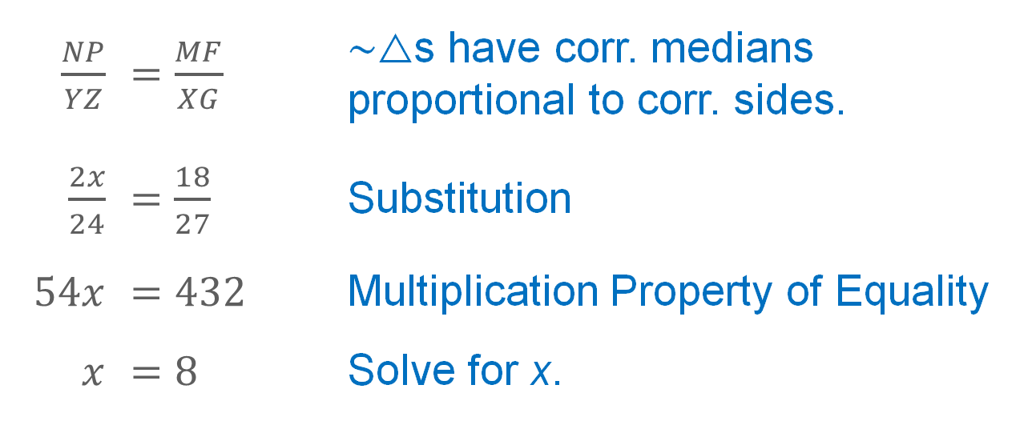
Example 1
Use Special Segments in Similar Triangles
$\frac{NP}{YZ}$ | $=\frac{MF}{XG}$ | ∼△s have corr. medians proportional to corr. sides.
$\frac{2x}{24}$ | $=\frac{18}{27}$ | Substitution
$$54x$$ | $$=432$$ | Multiplication Property of Equality
$$x$$ | $$=8$$ | Solve for x.

Slide 15
Apply Example 2
Use Similar Triangles to Solve Problems
PHOTOGRAPHY A digital camera projects an image through its lens and onto its sensor, where it is converted into a digital image. The distance between the camera’s lens and its sensor is known as the focal length and is adjusted depending on the size of the object being photographed and its distance from the camera lens. Ms. Elgin sets her camera up 3 meters away from her subject, who is 1.6 meters tall. If the sensor on her camera is 4.8 millimeters tall, what is the optimal focal length?

Slide 16
Apply Example 2
Use Similar Triangles to Solve Problems
Talk About It!
Share your method with a partner. How does your method compare to theirs?

Slide 17
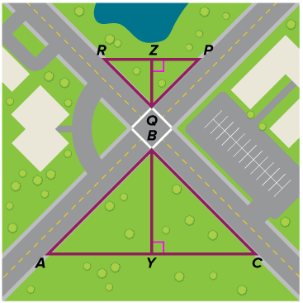
Apply Example 2
Use Similar Triangles to Solve Problems
Check
TRAFFIC ENFORCEMENT A police officer is determining where to park his vehicle to observe traffic at the red light. If AC = 512 feet, RP = 384 feet, and Y is 201 feet from B, how far is Z from Q?

Slide 18
Apply Example 2
Use Similar Triangles to Solve Problems
Check
TRAFFIC ENFORCEMENT A police officer is determining where to park his vehicle to observe traffic at the red light. If AC = 512 feet, RP = 384 feet, and Y is 201 feet from B, how far is Z from Q?
150.75 ft
Notes:
150.75 ft

Slide 19
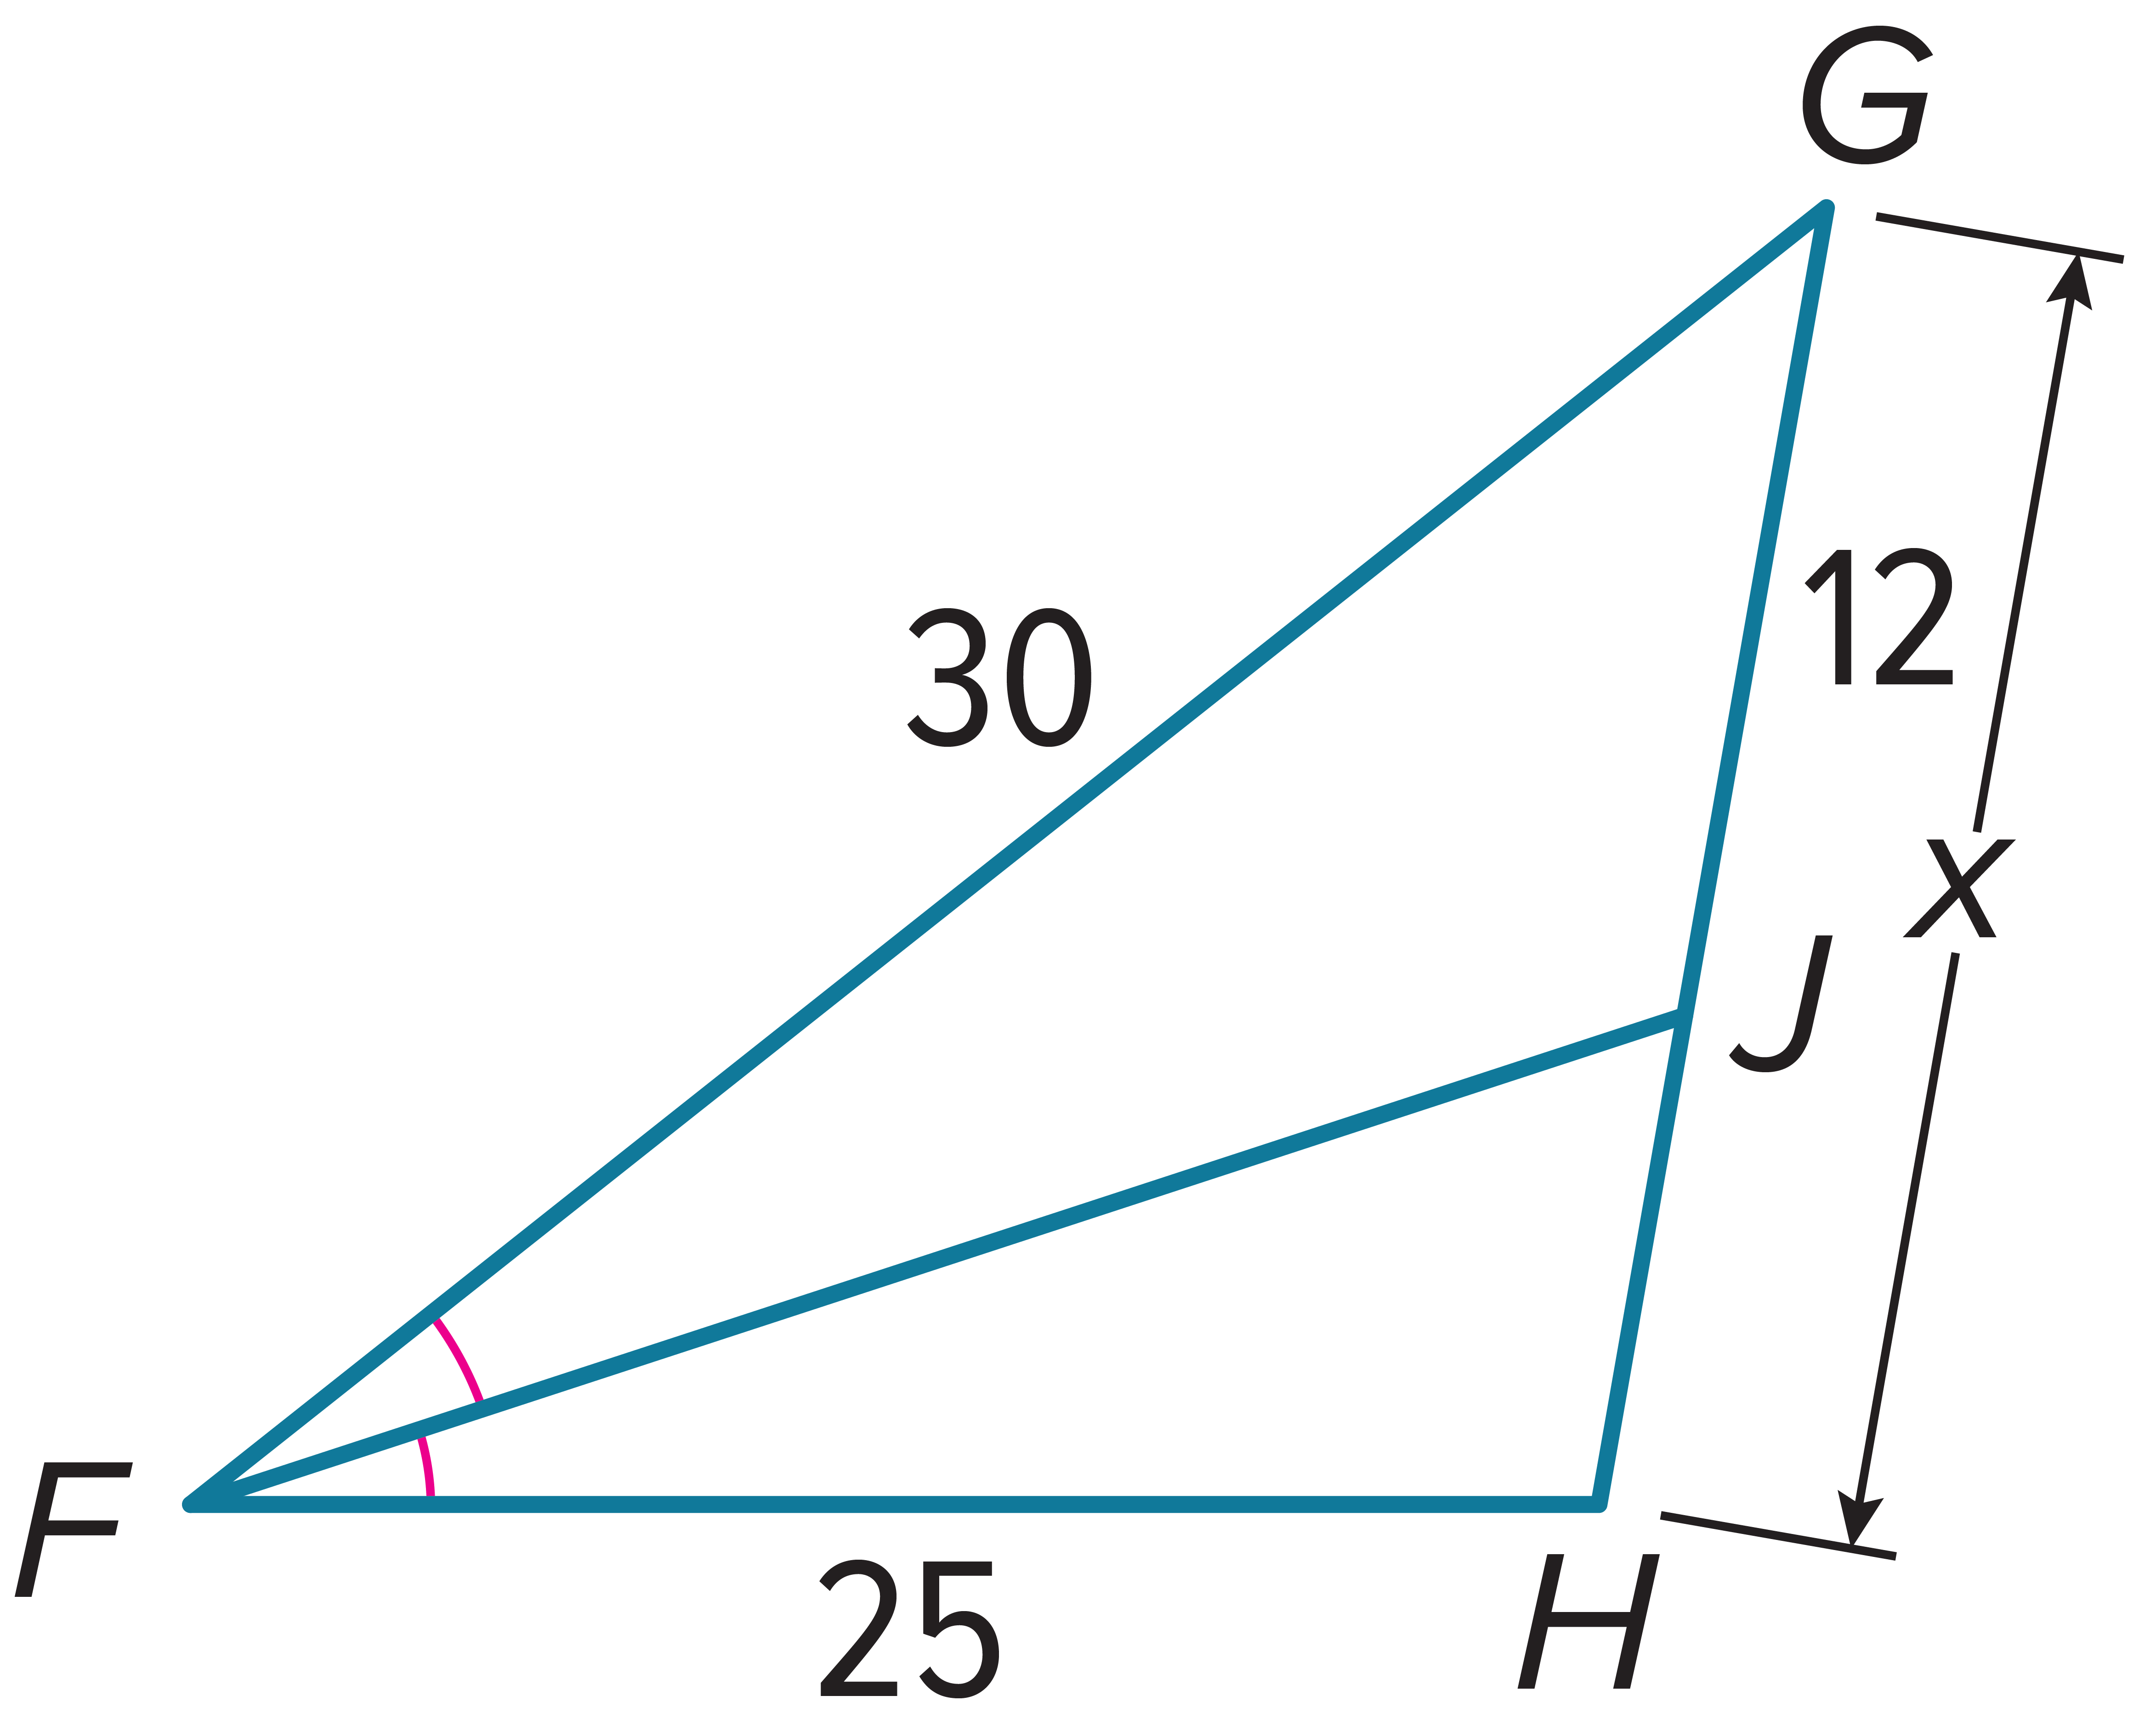
Example 3
Use the Triangle Angle Bisector Theorem
Find the value of x.

Slide 20
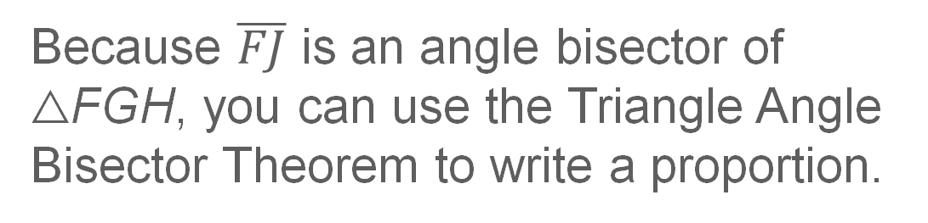
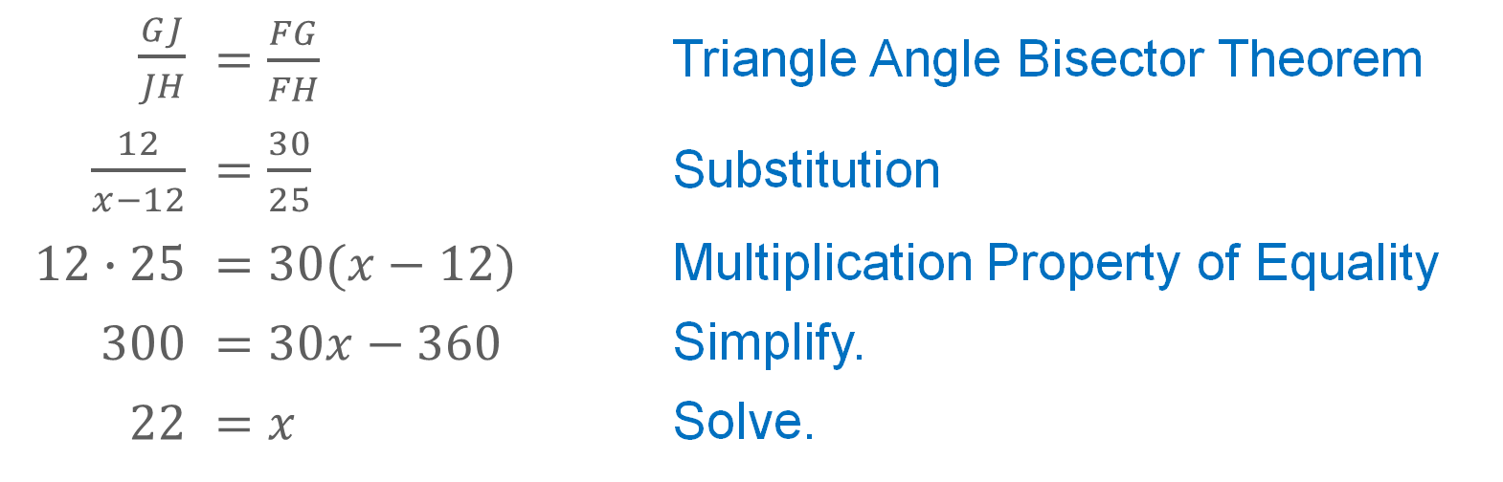
Example 3
Use the Triangle Angle Bisector Theorem
Because $\overline{FJ}$ is an angle bisector of △FGH, you can use the Triangle Angle Bisector Theorem to write a proportion.
$\frac{GJ}{JH}$ | $=\frac{FG}{FH}$ | Triangle Angle Bisector Theorem
$\frac{12}{x−12}$ | $=\frac{30}{25}$ | Substitution
$12∙25$ | $=30(x−12)$ | Multiplication Property of Equality
$$300$$ | $$=30x−360$$ | Simplify.
$$22$$ | $$=x$$ | Solve.

Slide 21
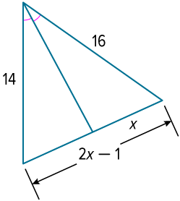
Example 3
Use the Triangle Angle Bisector Theorem
Check
Find the value of x.

Slide 22
Example 3
Use the Triangle Angle Bisector Theorem
Check
Find the value of x.
x = 8
Notes:
x = 8

Slide 23
Exit Ticket
Complete each theorem.
1. Theorem 8.11: If two triangles are ? , the lengths of corresponding medians are proportional to the lengths of corresponding sides.
2. Theorem 8.9: If two triangles are similar, the lengths of corresponding altitudes are proportional to the lengths of corresponding ? .
3. Theorem 8.10: If two triangles are similar, the lengths of corresponding ? are proportional to the lengths of corresponding sides.

Slide 24
Exit Ticket
Complete each theorem.
1. Theorem 8.11: If two triangles are ? , the lengths of corresponding medians are proportional to the lengths of corresponding sides. similar
2. Theorem 8.9: If two triangles are similar, the lengths of corresponding altitudes are proportional to the lengths of corresponding ? . sides
3. Theorem 8.10: If two triangles are similar, the lengths of corresponding ? are proportional to the lengths of corresponding sides. angle bisectors
Notes:
similar
sides
angle bisectors

