Slide 1
Section 3-5
Proving Segment Relationships

Slide 2
Warm Up
Give the correct order for the set of statements.
Prove: The sum of any two consecutive integers is an odd number.
1. Since 2 times a number is always even, adding 1 makes it odd. So 2n + 1 is odd.
2. Let n and n + 1 represent any two consecutive integers.
3. Since 2n + 1 is odd, the sum of any two consecutive integers is an odd number.
4. n + n + 1 = 2n + 1

Slide 3
Warm Up
Give the correct order for the set of statements.
Prove: The sum of any two consecutive integers is an odd number.
1. Since 2 times a number is always even, adding 1 makes it odd. So 2n + 1 is odd.
2. Let n and n + 1 represent any two consecutive integers.
3. Since 2n + 1 is odd, the sum of any two consecutive integers is an odd number.
4. n + n + 1 = 2n + 1 2, 4, 1, 3
Notes:
2, 4, 1, 3

Slide 4
Florida’s B.E.S.T. Standards for Mathematics
MA.912.GR.1.1
Prove relationships and theorems about lines and angles. Solve mathematical and real-world problems involving postulates, relationships and theorems of lines and angles.

Slide 5
Florida’s Mathematical Thinking and Reasoning Standards
MA.K12.MTR.4.1
Engage in discussions that reflect on the mathematical thinking of self and others.
MA.K12.MTR.5.1
Use patterns and structure to help understand and connect mathematical concepts.

Slide 6
Lesson Objectives
Content Objective
Students prove theorems about line segments.
Language Objectives
Students use true and false to talk about proving theorems about line segments.
To cultivate conversation, students participate in MLR7: Compare and Connect.

Slide 7
Learn
Segment Addition
When you use a ruler to measure the length of an object, you match the mark for zero at one endpoint of the object. Then you look for the ruler mark that corresponds to the other endpoint. This illustrates the Ruler Postulate.

Slide 8
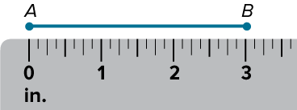
Learn
Segment Addition
Postulate 3.8: Ruler Postulate
Words | The points on any line or line segment can be put into one-to-one correspondence with real numbers.
Example | Given any two points A and B on a line, if A corresponds to zero, then B corresponds to a positive real number.

Slide 9

Learn
Segment Addition
In this figure, point B is said to be between points A and C. You can also say that AB + BC = AC by the Segment Addition Postulate.

Slide 10

Learn
Segment Addition
Postulate 3.9: Segment Addition Postulate
Words | If A, B, and C are collinear, then point B is between A and C if and only if AB + BC = AC.
Example

Slide 11
Learn
Segment Addition
Think About It!
Determine whether the statement is true or false. If it is false, provide a counterexample.
If A, B, C, D, and E are collinear with AC = 10, B between A and C, C between B and D, D between C and E, and AC = BD = CE, then AB = BC = DE.

Slide 12

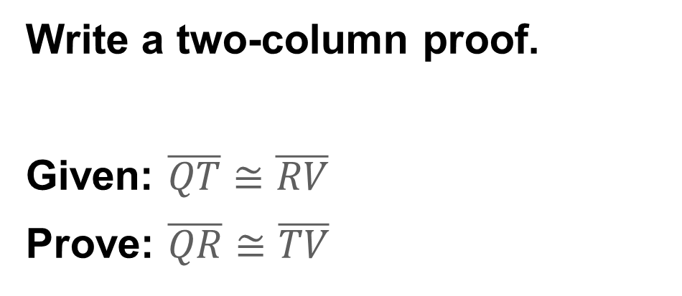
Example 1
Segment Addition Postulate
Write a two-column proof.
Given: $\overline{QT}$ ≅ $\overline{RV}$
Prove: $\overline{QR}$ ≅ $\overline{TV}$

Slide 13
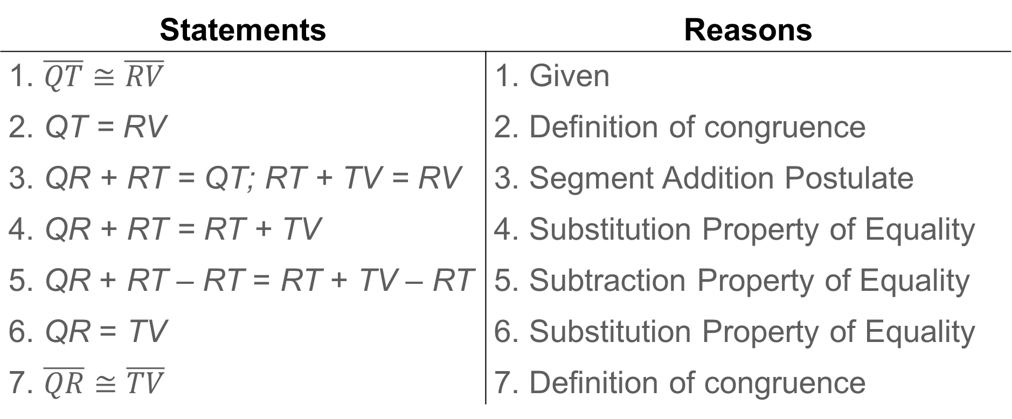
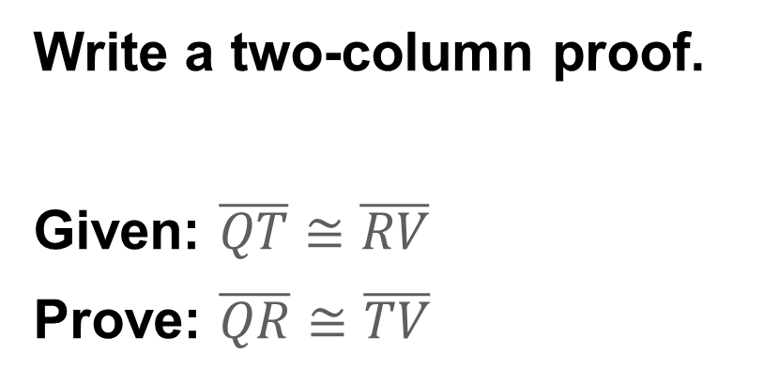
Write a two-column proof.
Given: $\overline{QT}$ ≅ $\overline{RV}$
Prove: $\overline{QR}$ ≅ $\overline{TV}$
Example 1
Segment Addition Postulate
Proof:
Statements | Reasons
1. $\overline{QT}≅\overline{RV}$ 2. QT = RV 3. QR + RT = QT; RT + TV = RV 4. QR + RT = RT + TV 5. QR + RT – RT = RT + TV – RT 6. QR = TV 7. $\overline{QR}≅\overline{TV}$ | 1. Given 2. Definition of congruence 3. Segment Addition Postulate 4. Substitution Property of Equality 5. Subtraction Property of Equality 6. Substitution Property of Equality 7. Definition of congruence

Slide 14
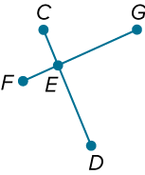
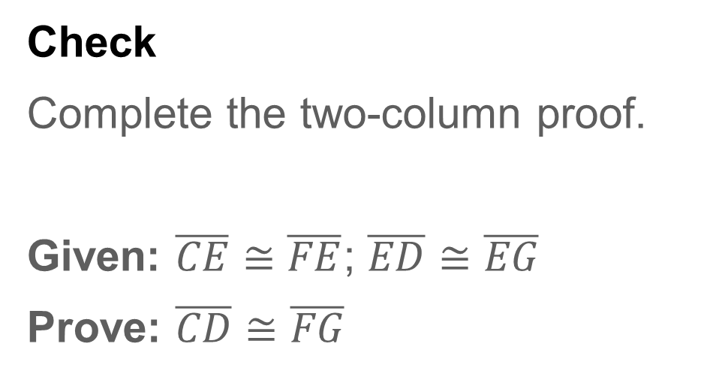
Example 1
Segment Addition Postulate
Check
Complete the two-column proof.
Given: $\overline{CE}≅\overline{FE}$; $\overline{ED}≅\overline{EG}$
Prove: $\overline{CD}≅\overline{FG}$

Slide 15
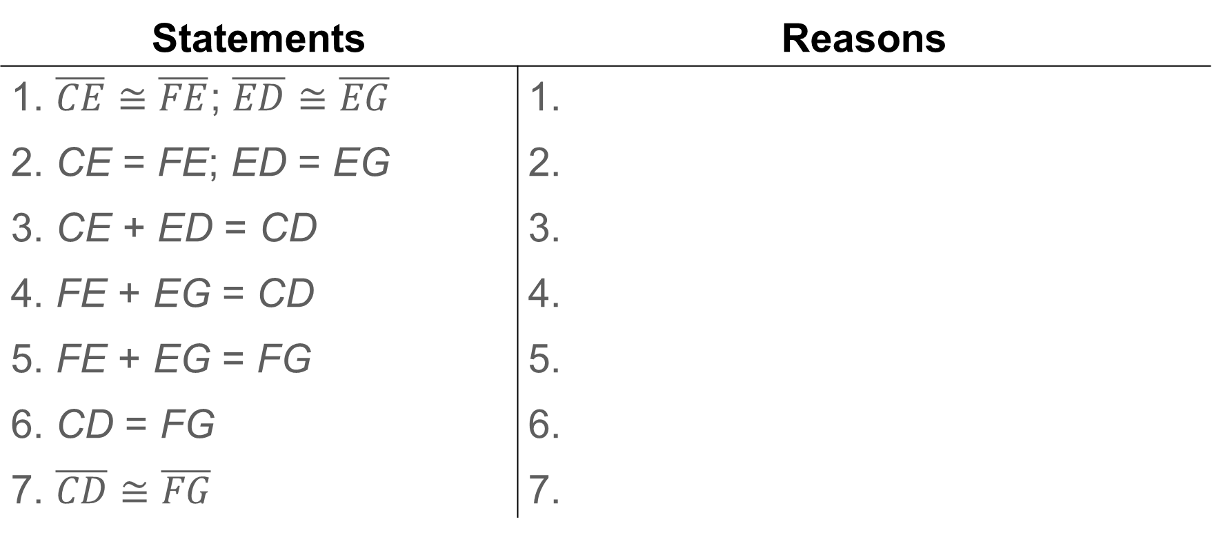
Example 1
Segment Addition Postulate
Proof:
Statements | Reasons
1. $\overline{CE}≅\overline{FE}$; $\overline{ED}≅\overline{EG}$ 2. CE = FE; ED = EG 3. CE + ED = CD 4. FE + EG = CD 5. FE + EG = FG 6. CD = FG 7. $\overline{CD}$ ≅ $\overline{FG}$ | 1. 2. 3. 4. 5. 6. 7.

Slide 16
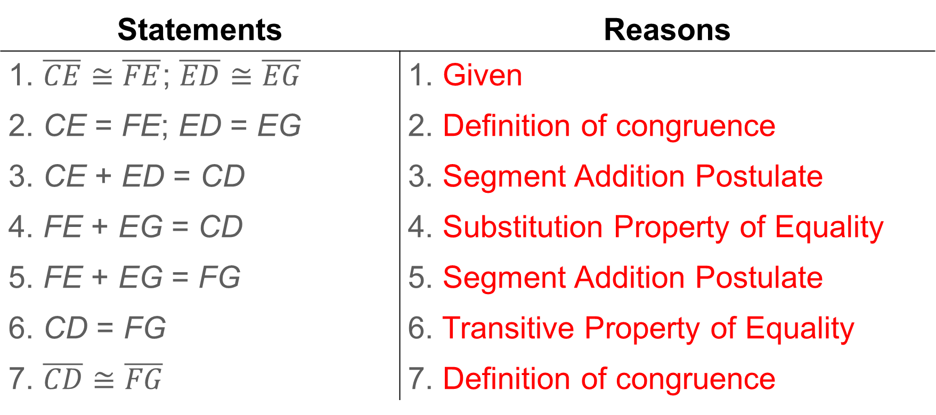
Example 1
Segment Addition Postulate
Proof:
Statements | Reasons
1. $\overline{CE}≅\overline{FE}$; $\overline{ED}≅\overline{EG}$ 2. CE = FE; ED = EG 3. CE + ED = CD 4. FE + EG = CD 5. FE + EG = FG 6. CD = FG 7. $\overline{CD}$ ≅ $\overline{FG}$ | 1. Given 2. Definition of congruence 3. Segment Addition Postulate 4. Substitution Property of Equality 5. Segment Addition Postulate 6. Transitive Property of Equality 7. Definition of congruence
Notes:
1. Given
2. Definition of congruence
3. Segment Addition Postulate
4. Substitution Property of Equality
5. Segment Addition Postulate
6. Transitive Property of Equality
7. Definition of congruence

Slide 17
Learn
Segment Congruence
You learned that segment measures are reflexive, symmetric, and transitive. Because segments with the same measure are congruent, these properties apply to segment congruence.

Slide 18
Learn
Segment Addition
Talk About It!
Is there an Addition Property of Congruence? Explain.

Slide 19

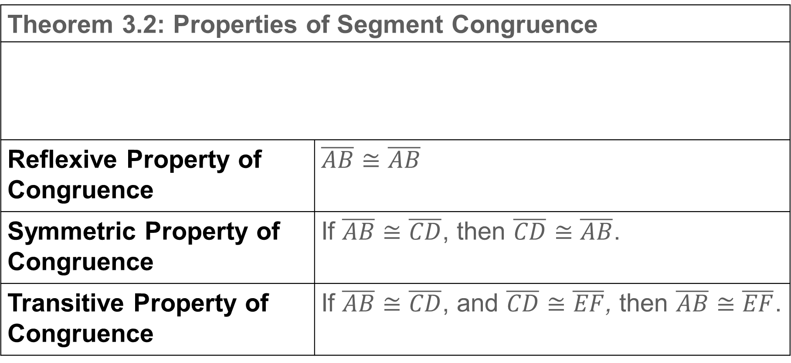
Learn
Segment Addition
Theorem 3.2: Properties of Segment Congruence
Reflexive Property of Congruence | $$\overline{AB}≅\overline{AB}$$
Symmetric Property of Congruence | If $\overline{AB}≅\overline{CD}$, then $\overline{CD}≅\overline{AB}$.
Transitive Property of Congruence | If $\overline{AB}≅\overline{CD}$, and $\overline{CD}≅\overline{EF}$, then $\overline{AB}≅\overline{EF}$.

Slide 20
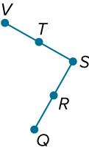
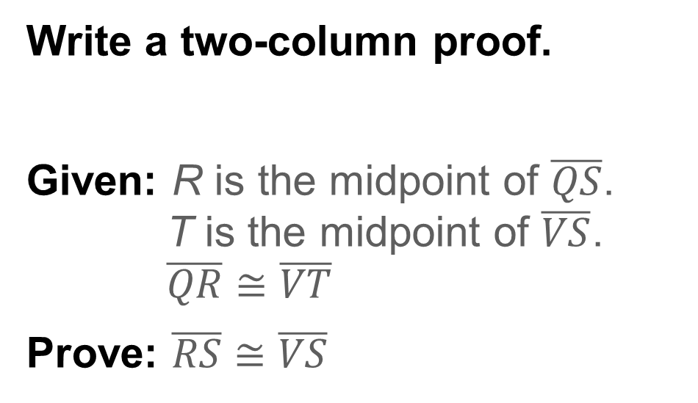
Example 2
Prove Segment Congruence
Write a two-column proof.
Given: R is the midpoint of $\overline{QS}$.
T is the midpoint of $\overline{VS}$.
$\overline{QR}≅\overline{VT}$
Prove: $\overline{RS}≅\overline{VS}$

Slide 21
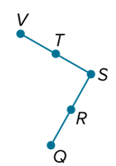
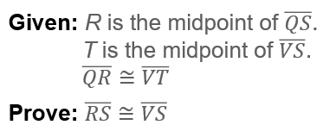
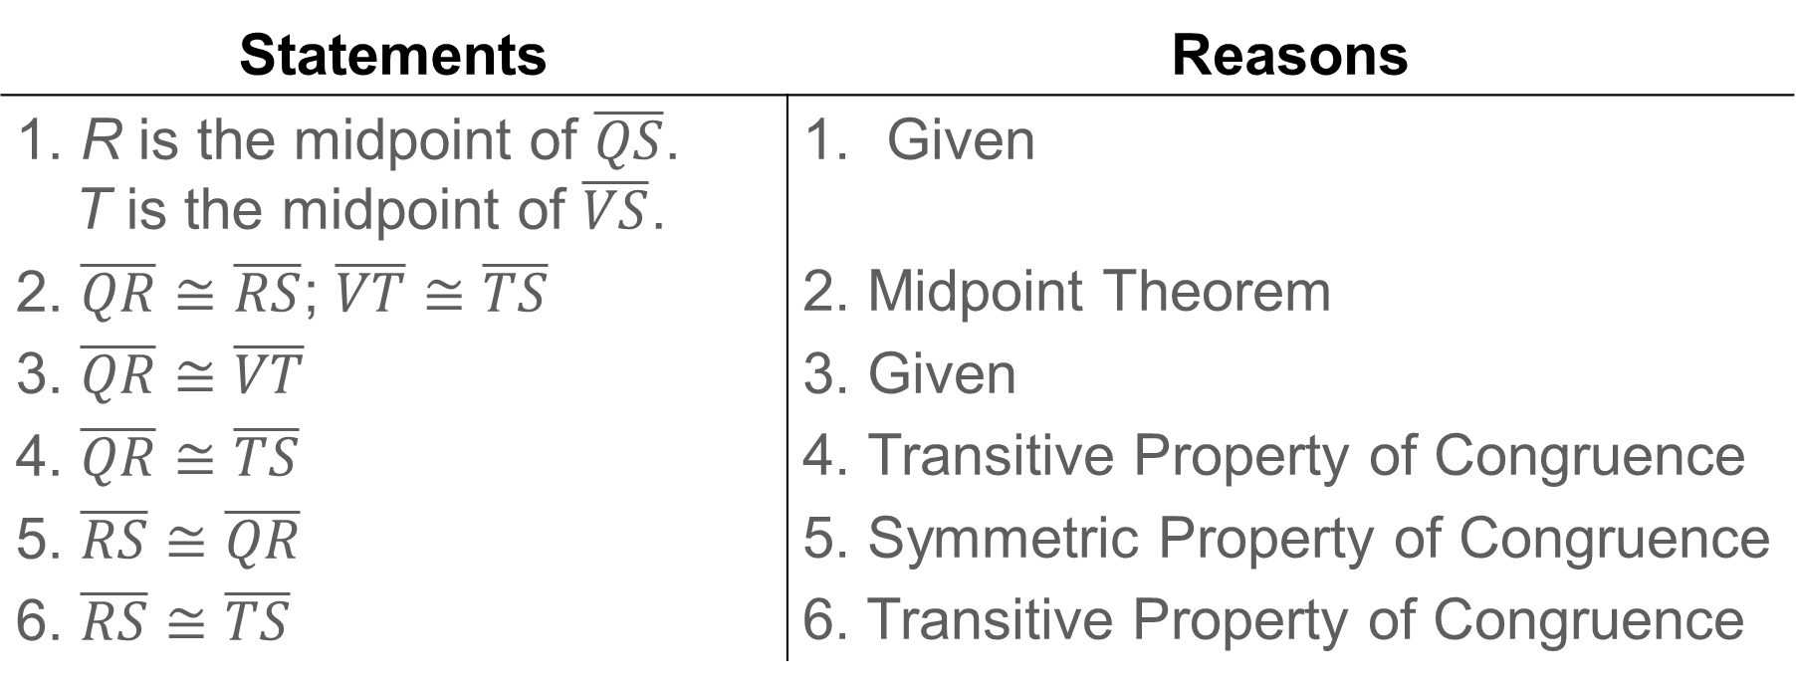
Example 2
Proof:
Statements | Reasons
1. R is the midpoint of $\overline{QS}$. T is the midpoint of $\overline{VS}$. 2. $\overline{QR}≅\overline{RS}$; $\overline{VT}≅\overline{TS}$ 3. $\overline{QR}≅\overline{VT}$ 4. $\overline{QR}≅\overline{TS}$ 5. $\overline{RS}$ ≅ $\overline{QR}$ 6. $\overline{RS}$ ≅ $\overline{TS}$ | Given 2. Midpoint Theorem 3. Given 4. Transitive Property of Congruence 5. Symmetric Property of Congruence 6. Transitive Property of Congruence

Slide 22
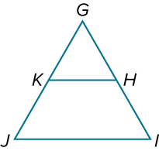
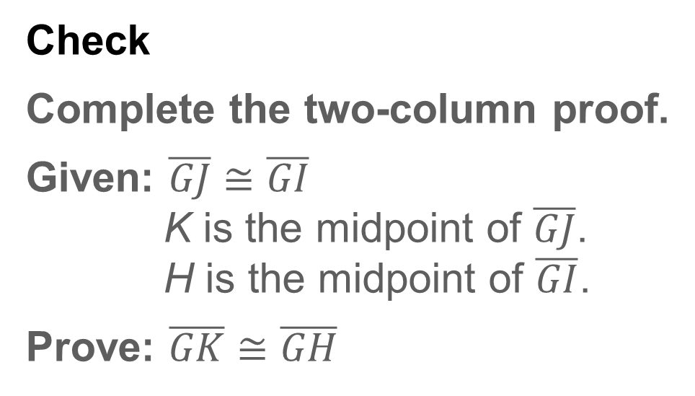
Example 2
Prove Segment Congruence
Check
Complete the two-column proof.
Given: $\overline{GJ}≅\overline{GI}$
K is the midpoint of $\overline{GJ}$.
H is the midpoint of $\overline{GI}$.
Prove: $\overline{GK}≅\overline{GH}$

Slide 23
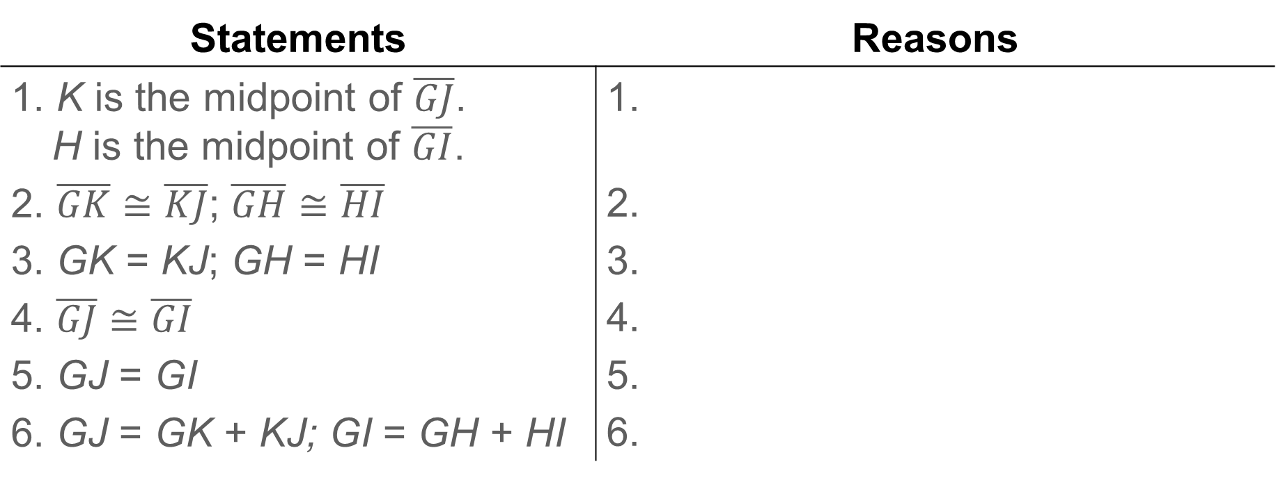
Example 2
Prove Segment Congruence
Proof:
Statements | Reasons
1. K is the midpoint of $\overline{GJ}$. H is the midpoint of $\overline{GI}$. 2. $\overline{GK}≅\overline{KJ}$; $\overline{GH}≅\overline{HI}$ 3. GK = KJ; GH = HI 4. $\overline{GJ}$ ≅ $\overline{GI}$ 5. GJ = GI 6. GJ = GK + KJ; GI = GH + HI | 1. 2. 3. 4. 5. 6.

Slide 24
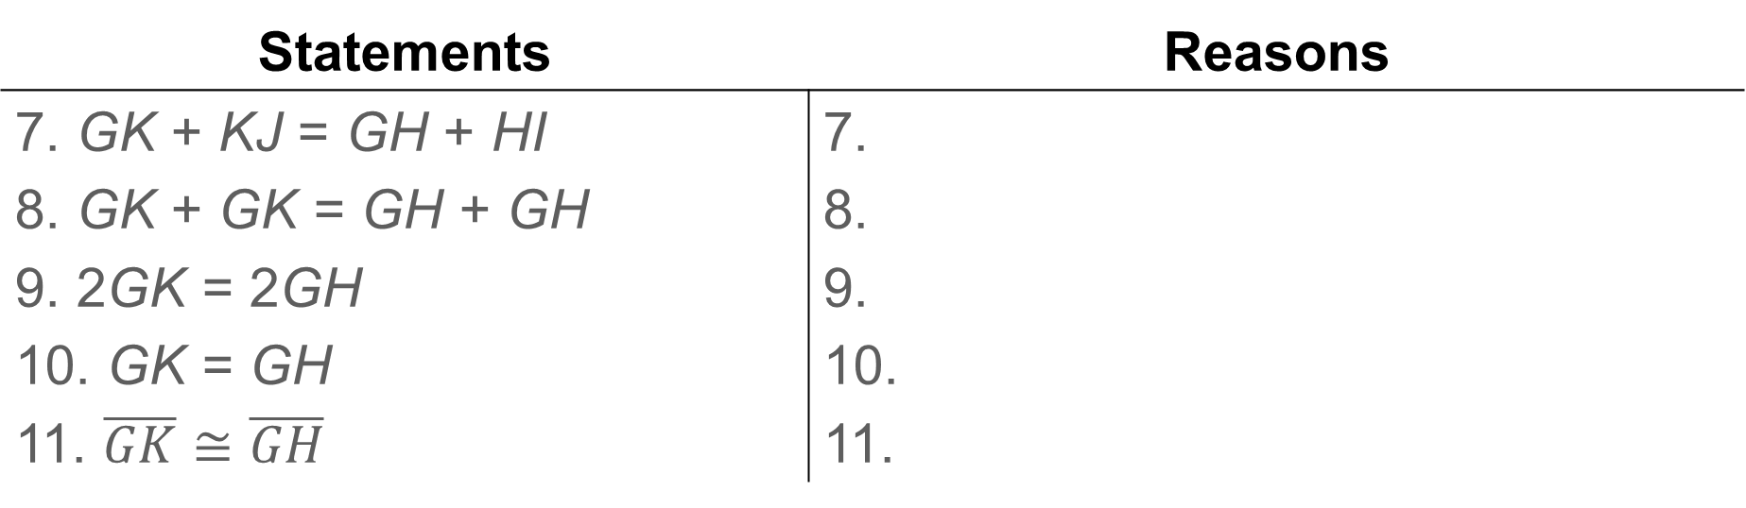
Example 2
Prove Segment Congruence
Proof:
Statements | Reasons
7. GK + KJ = GH + HI 8. GK + GK = GH + GH 9. 2GK = 2GH 10. GK = GH 11. $\overline{GK}≅\overline{GH}$ | 7. 8. 9. 10. 11.

Slide 25
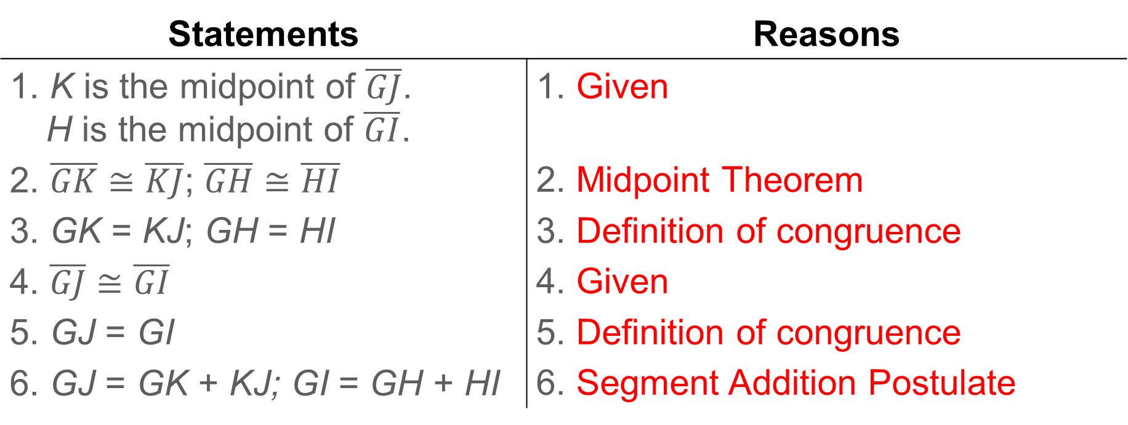
Example 2
Prove Segment Congruence
Proof:
Statements | Reasons
1. K is the midpoint of $\overline{GJ}$. H is the midpoint of $\overline{GI}$. 2. $\overline{GK}≅\overline{KJ}$; $\overline{GH}≅\overline{HI}$ 3. GK = KJ; GH = HI 4. $\overline{GJ}≅\overline{GI}$ 5. GJ = GI 6. GJ = GK + KJ; GI = GH + HI | 1. Given 2. Midpoint Theorem 3. Definition of congruence 4. Given 5. Definition of congruence 6. Segment Addition Postulate
Notes:
1. Given
2. Midpoint Theorem
3. Definition of congruence
4. Given
5. Definition of congruence
6. Segment Addition Postulate

Slide 26
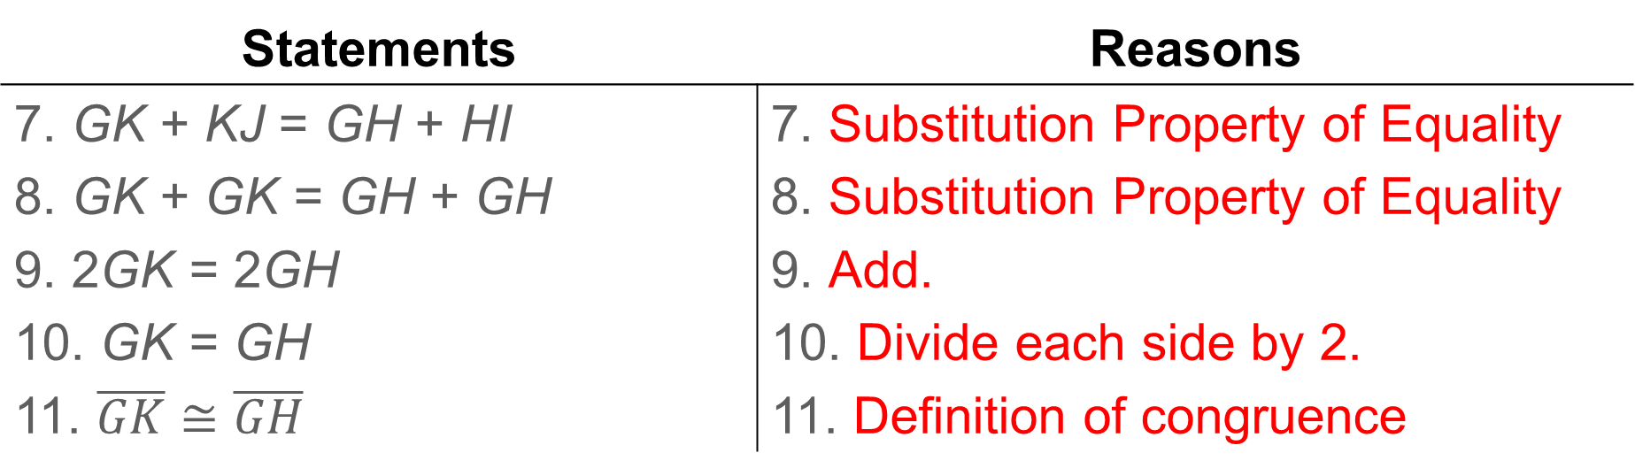
Example 2
Prove Segment Congruence
Proof:
Statements | Reasons
7. GK + KJ = GH + HI 8. GK + GK = GH + GH 9. 2GK = 2GH 10. GK = GH 11. $\overline{GK}≅\overline{GH}$ | 7. Substitution Property of Equality 8. Substitution Property of Equality 9. Add. 10. Divide each side by 2. 11. Definition of congruence
Notes:
7. Substitution Property of Equality
8. Substitution Property of Equality
9. Add.
10. Divide each side by 2.
11. Definition of congruence

Slide 27
Example 2
Prove Segment Congruence
Two-column proofs and flow proofs are considered formal proofs. A formal proof is a logical argument that includes all of the steps and corresponding justifications needed to prove a relationship. An informal proof is a simplified proof that summarizes the logical reasoning used to prove a relationship. In an informal proof, some steps that are considered obvious may be skipped and some reasons or justifications may be omitted. A narrative proof is a type of informal proof that can contain bullet points, lists, calculations, or paragraphs.

Slide 28
Example 3
Determine Congruence
PLANNING Marcellus is planning a birthday party. He measures a length of ribbon for a balloon, and then uses this ribbon to measure and cut a second ribbon. He continues this pattern of using the last ribbon that he cut to measure the next ribbon until 10 ribbons have been cut for balloons. Is the last ribbon that he cut the same length as the first ribbon? Justify your argument by using a narrative proof.

Slide 29
Example 3
Determine Congruence
Yes; because the first ribbon is the same length as the second ribbon and the third ribbon is the same length as the second ribbon, the first ribbon is the same length as the third ribbon by the Transitive Property of Congruence.
This logic can be applied until the last ribbon is shown to be the same length as the first ribbon.

Slide 30
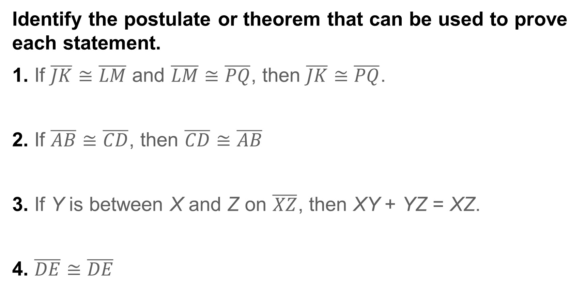
Exit Ticket
Identify the postulate or theorem that can be used to prove each statement.
1. If $\overline{JK}≅\overline{LM}$ and $\overline{LM}≅\overline{PQ}$, then $\overline{JK}≅\overline{PQ}$.
2. If $\overline{AB}≅\overline{CD}$, then $\overline{CD}≅\overline{AB}$
3. If Y is between X and Z on $\overline{XZ}$, then XY + YZ = XZ.
4. $\overline{DE}≅\overline{DE}$
Notes:
No
No
Yes
Yes
No

Slide 31
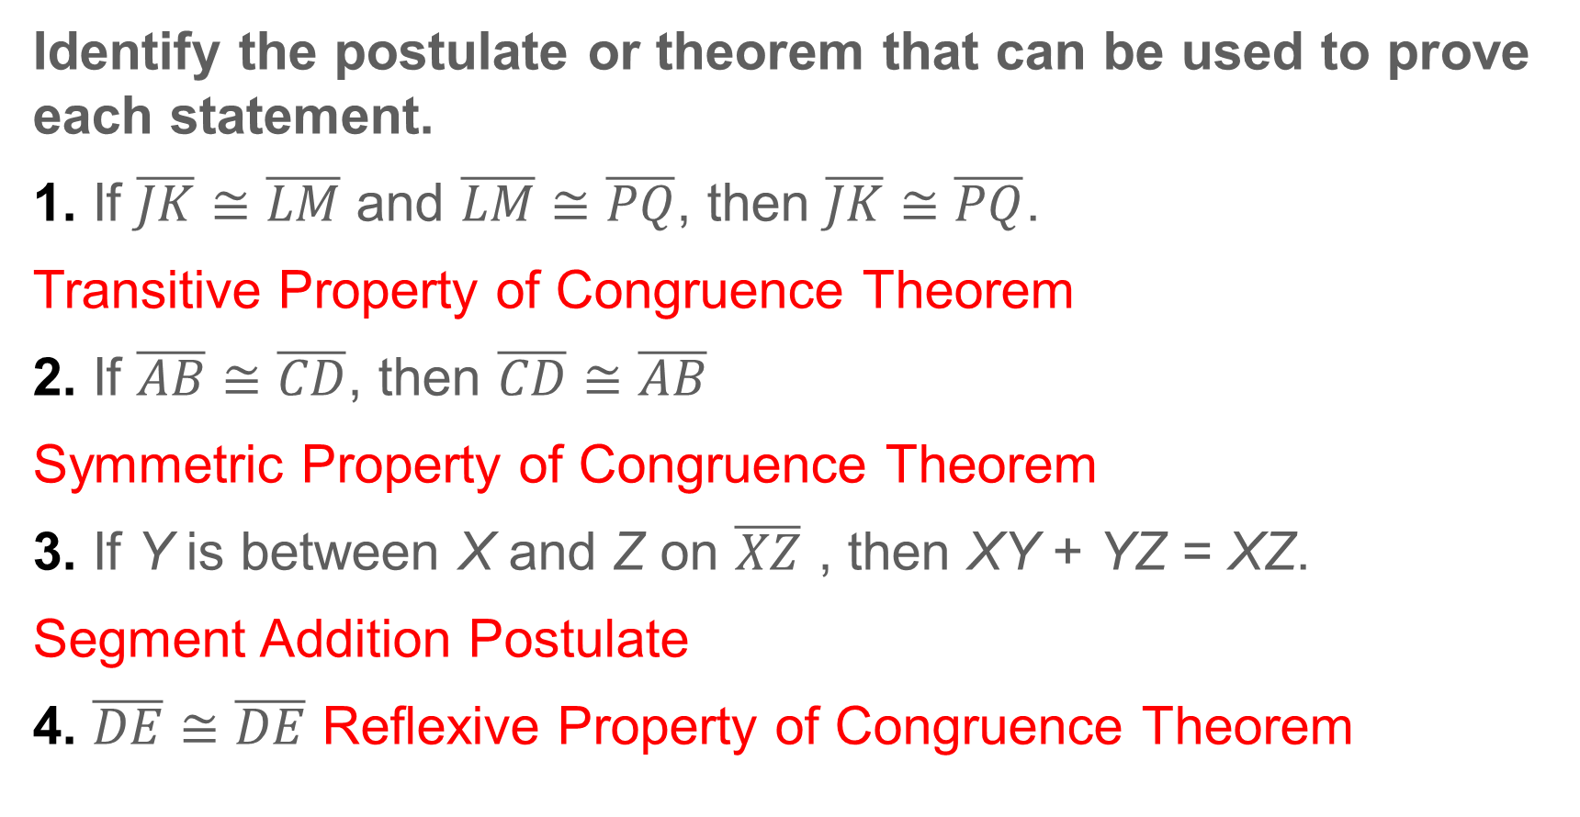
Exit Ticket
Identify the postulate or theorem that can be used to prove each statement.
1. If $\overline{JK}≅\overline{LM}$ and $\overline{LM}≅\overline{PQ}$, then $\overline{JK}≅\overline{PQ}$.
Transitive Property of Congruence Theorem
2. If $\overline{AB}≅\overline{CD}$, then $\overline{CD}≅\overline{AB}$
Symmetric Property of Congruence Theorem
3. If Y is between X and Z on $\overline{XZ}$ , then XY + YZ = XZ.
Segment Addition Postulate
4. $\overline{DE}≅\overline{DE}$ Reflexive Property of Congruence Theorem
Notes:
Transitive Property of Congruence Theorem
Symmetric Property of Congruence Theorem
Segment Addition Postulate
Reflexive Property of Congruence Theorem

