Slide 1
Applying Similarity to Solid Figures

Slide 2
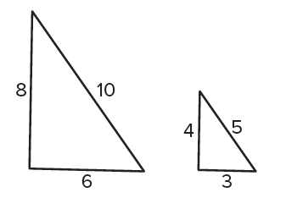
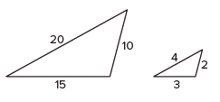
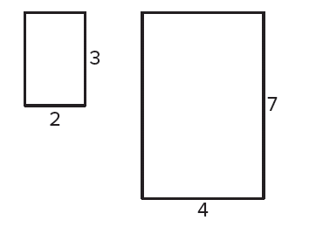
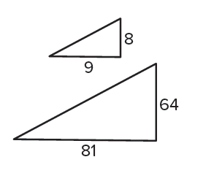
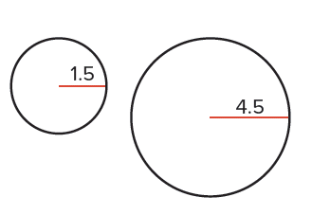
Warm Up
Determine whether the figures are similar. Note that the figures may not be drawn to scale.
1. 2. 3.
4. 5.

Slide 3
Warm Up
Determine whether the figures are similar. Note that the figures may not be drawn to scale.
1. 2. 3.
4. 5.
yes
yes
no
yes
no
Notes:
yes
yes
no
yes
no

Slide 4
Florida’s B.E.S.T. Standards for Mathematics
MA.912.GR.4.3
Extend previous understanding of scale drawings and
scale factors to determine how dilations affect the area of two-dimensional figures and the surface area or volume of three-dimensional figures.

Slide 5
Florida’s Mathematical Thinking and Reasoning Standards
MA.K12.MTR.4.1
Engage in discussions that reflect on the mathematical thinking of self and others.

Slide 6
Lesson Objectives
Content Objective
Students find measures of similar figures and solids
by using scale factors.
Language Objectives
Students use If …, then … statements to explain how to find measures of similar figures and solids by using scale factors.
To maximize linguistic and cognitive meta-awareness, students participate in MLR5: Co-Craft Questions and Problems.

Slide 7
Learn
Similar Two-Dimensional Figures
Recall that if two polygons are similar, then their perimeters are proportional to the scale factor between them. The areas of two similar polygons share a different relationship.

Slide 8

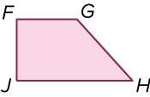
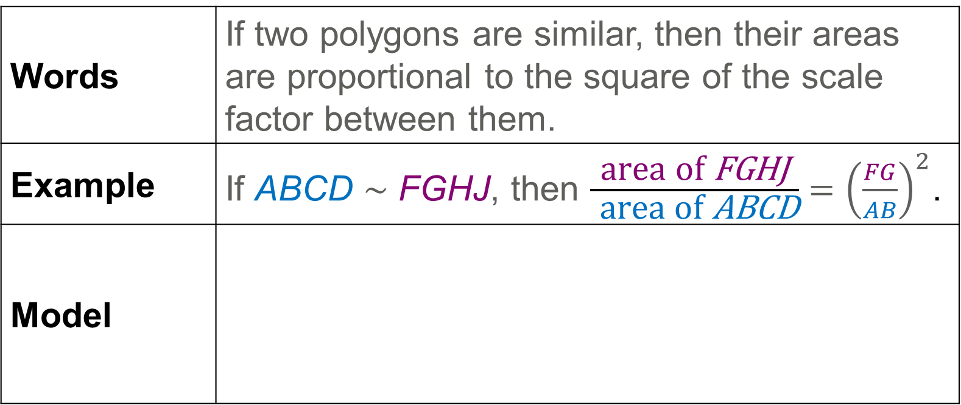
Learn
Similar Two-Dimensional Figures
Theorem 11.1: Areas of Similar Polygons
Words | If two polygons are similar, then their areas are proportional to the square of the scale factor between them.
Example | If ABCD ∼ FGHJ, then $\frac{\text{area} \text{of} \text{FGHJ}}{ \text{area} \text{of} \text{ABCD}}={\left(\frac{FG}{AB}\right)}^{2}$.
Model

Slide 9
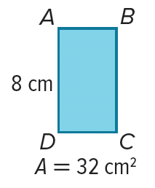

Example 1
Use Similar Figures to Find Area
▭ABCD and ▭JKLM are similar rectangles. Find the area of ▭JKLM.

Slide 10
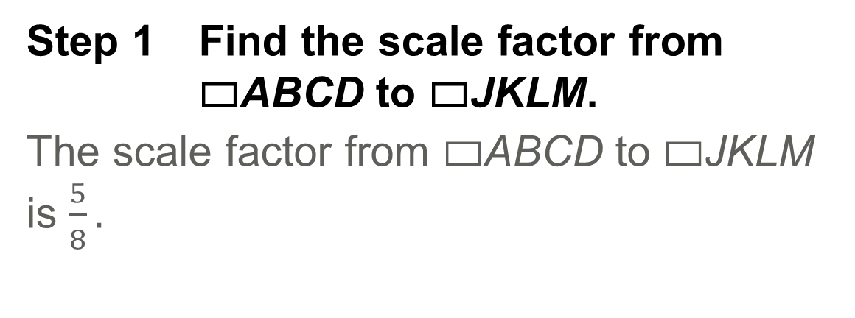
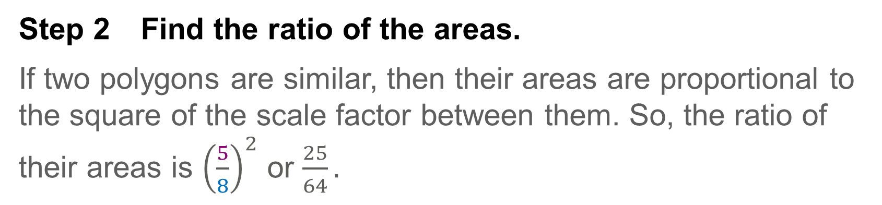
Example 1
Use Similar Figures to Find Area
Step 1 Find the scale factor from ▭ABCD to ▭JKLM.
The scale factor from ▭ABCD to ▭JKLM is $\frac{5}{8}.$
Step 2 Find the ratio of the areas.
If two polygons are similar, then their areas are proportional to the square of the scale factor between them. So, the ratio of their areas is ${\left(\frac{5}{8}\right)}^{2}$ or $\frac{25}{64}.$

Slide 11
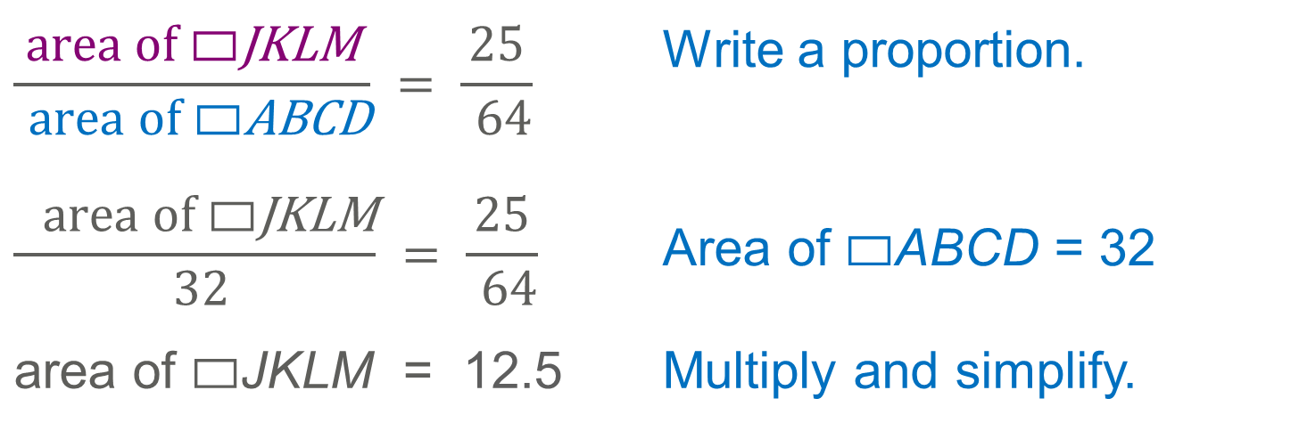
Example 1
Use Similar Figures to Find Area
Step 3 Find the area.
$$\frac{\text{area} \text{of} \text{▭}\text{JKLM}}{ \text{area} \text{of} \text{▭}\text{ABCD}} = \frac{\text{25}}{ \text{64}}$$ | Write a proportion.
$$\frac{ \text{area} \text{of} \text{▭}\text{JKLM}}{ \text{32}} = \frac{\text{25}}{ \text{64}}$$ | Area of ▭ABCD = 32
area of ▭JKLM = 12.5 | Multiply and simplify.
So, the area of ▭JKLM is 12.5 square centimeters.

Slide 12
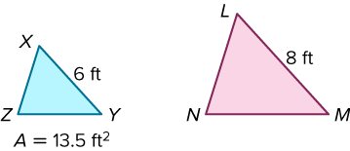
Example 1
Use Similar Figures to Find Area
Check
△XYZ and △LMN are similar triangles. Find the area of △LMN.

Slide 13
Example 1
Use Similar Figures to Find Area
Check
△XYZ and △LMN are similar triangles. Find the area of △LMN.
A = 24 ft²
Notes:
A = 24 ft²

Slide 14
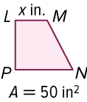
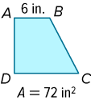
Example 2
Use Areas of Similar Figures
Trapezoids LMNP and ABCD are similar. Find the scale factor of trapezoid ABCD to trapezoid LMNP and the value of x.
Part A Find the scale factor.
Part B Find the value of x.

Slide 15

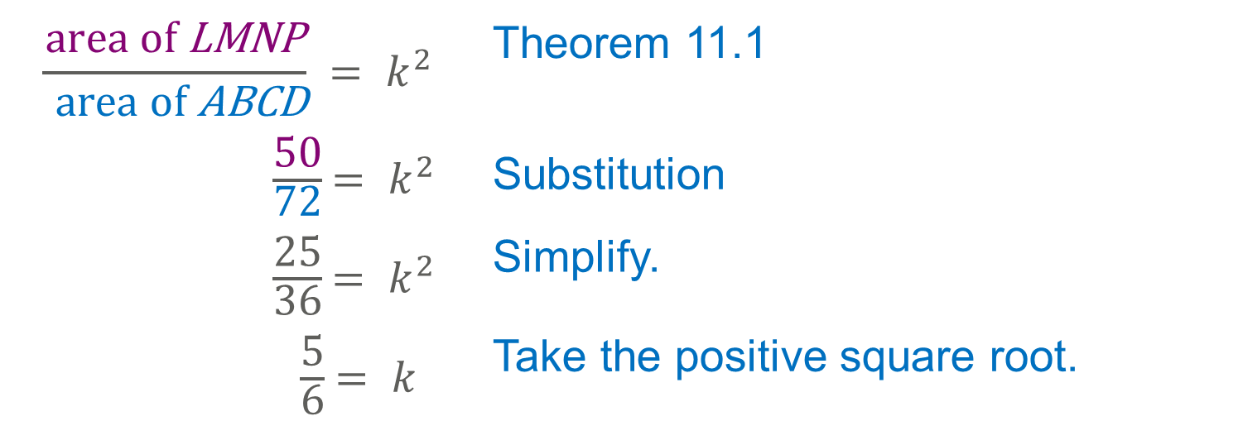
Example 2
Use Areas of Similar Figures
Part A Find the scale factor.
Let k be the scale factor from trapezoid ABCD to trapezoid LMNP.
$$\frac{\text{area} \text{of} \text{LMNP}}{ \text{area} \text{of} \text{ABCD}} {= k}^{2}$$ | Theorem 11.1
$\frac{\text{50}}{\text{72}}$ ${= k}^{2}$ | Substitution
$\frac{\text{25}}{\text{36}}$ ${= k}^{2}$ | Simplify.
$\frac{\text{5}}{\text{6}}$ $= k$ | Take the positive square root.
$$\frac{5}{6}.$$
So, the scale factor from ABCD to LMNP is

Slide 16
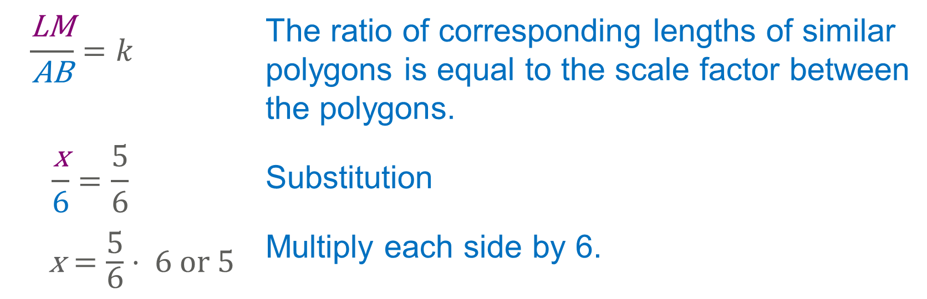
Example 2
Use Areas of Similar Figures
Part B Find the value of x.
Use the scale factor to find x.
$$\frac{\text{LM}}{\text{AB}}=k$$ | The ratio of corresponding lengths of similar polygons is equal to the scale factor between the polygons.
$$\frac{\text{x}}{\text{6}}=\frac{\text{5}}{\text{6}}$$ | Substitution
$\text{x}=\frac{\text{5}}{\text{6}}$ ⋅ 6 or 5 | Multiply each side by 6.
The value of x is 5.

Slide 17
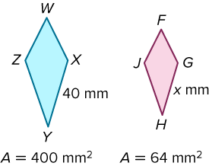
Example 2
Use Areas of Similar Figures
Check
Quadrilaterals WXYZ and FGHJ are similar. Find the scale factor from quadrilateral WXYZ to quadrilateral FGHJ and the value of x.

Slide 18
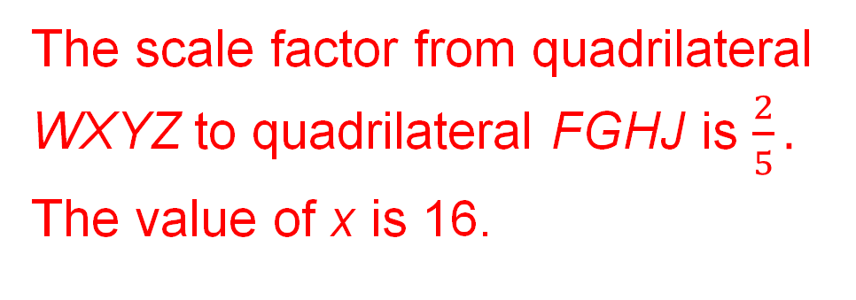
Example 2
Use Areas of Similar Figures
Check
Quadrilaterals WXYZ and FGHJ are similar. Find the scale factor from quadrilateral WXYZ to quadrilateral FGHJ and the value of x.
The scale factor from quadrilateral
WXYZ to quadrilateral FGHJ is $\frac{2}{5}.$
The value of x is 16.
Notes:
The scale factor from quadrilateral WXYZ to quadrilateral FGHJ is $\frac{2}{5}.$ The value of x is 16.

Slide 19
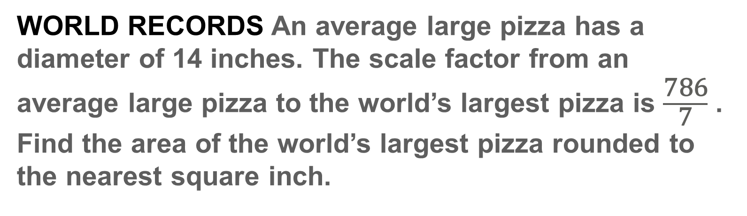
Example 3
Use Similar Figures to Solve Problems
WORLD RECORDS An average large pizza has a diameter of 14 inches. The scale factor from an average large pizza to the world’s largest pizza is $\frac{\text{786}}{\text{7}}$ . Find the area of the world’s largest pizza rounded to the nearest square inch.

Slide 20
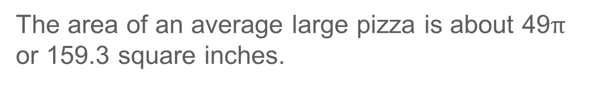
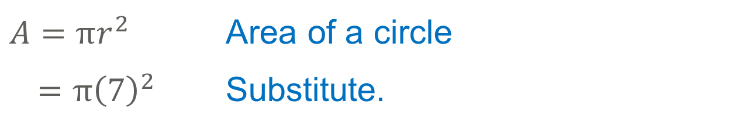
Example 3
Use Similar Figures to Solve Problems
Step 1 Find the area of an average large pizza.
$$A=πr^{2}$$ | Area of a circle
$=π{\left(7\right)}^{2}$ | Substitute.
The area of an average large pizza is about 49$π$ or 159.3 square inches.

Slide 21
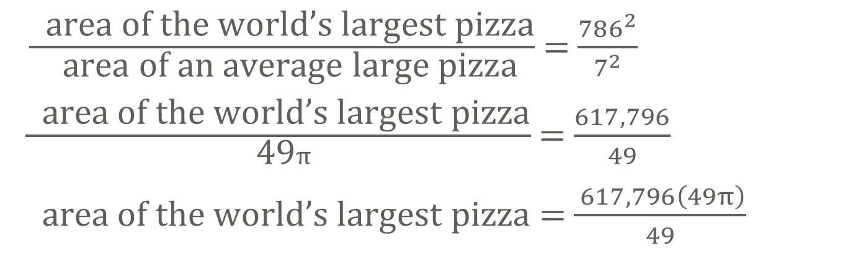
Example 3
Use Similar Figures to Solve Problems
Step 2 Find the area of the world’s largest pizza.
Use the scale factor to find the area of the world’s largest pizza rounded to the nearest square inch.
$\frac{ \text{area} \text{of} \text{the} \text{world}\text{’}\text{s} \text{largest} \text{pizza}}{ \text{area} \text{of} \text{an} \text{average} \text{large} \text{pizza}}$ = $\frac{{786}^{2}}{7^{2}}$
$\frac{ \text{area} \text{of} \text{the} \text{world}\text{’}\text{s} \text{largest} \text{pizza}}{\text{ 49}π}$ = $\frac{617,796}{49}$
$\text{area} \text{of} \text{the} \text{world}\text{’}\text{s} \text{largest} \text{pizza}$ = $\frac{ 617,796\left(49π\right)}{49}$
The area of the world’s largest pizza is about 1,940,863 ${in}^{2}$.

Slide 22
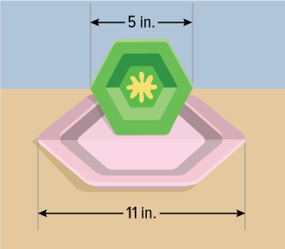
Example 3
Use Similar Figures to Solve Problems
Check
TOYS Giovanna is comparing the size of a hexagonal dinner plate to her sister’s toy hexagonal plate. The area of the dinner plate is about 78.6 square inches. What is the area of the toy plate to the nearest square inch?

Slide 23
Example 3
Use Similar Figures to Solve Problems
Check
TOYS Giovanna is comparing the size of a hexagonal dinner plate to her sister’s toy hexagonal plate. The area of the dinner plate is about 78.6 square inches. What is the area of the toy plate to the nearest square inch?
A ≈ 16.2 in²
Notes:
A ≈ 16.2 in²

Slide 24
Learn
Similar Three-Dimensional Solids
Similar solids have exactly the same shape but not necessarily the same size. All spheres are similar, and all cubes are similar.
In similar solids, the corresponding linear measures, such as height and radius, are proportional to the scale factor between them.

Slide 25
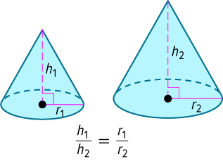
Learn
Similar Three-Dimensional Solids
Similar Solids
Two solids are similar if and only if they have the same shape and the ratios of their corresponding linear measures are equal.

Slide 26
Learn
Similar Three-Dimensional Solids
Talk About It!
Explain why all spheres are similar.

Slide 27
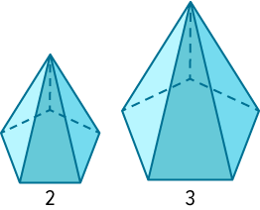
Learn
Similar Three-Dimensional Solids
Theorem 11.2
Words | If two similar solids have a scale factor of a : b, then the surface areas have a ratio of a² : b², and the volumes have a ratio of a³ : b³.
Example | scale factor 2:3 ratio of surface area 4:9 ratio of volumes 8:27

Slide 28
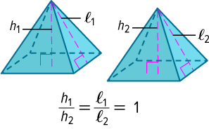
Learn
Similar Three-Dimensional Solids
Key Concept : Characteristics of Congruent Solids
Two solids are congruent solids if and only if they have the following characteristics. Corresponding angles are congruent. Corresponding edges are congruent. Corresponding faces are congruent. Volumes are equal.

Slide 29



Example 4
Use Similar Solids to Find Volume
The three cones are similar. Find the volume of each cone.

Slide 30
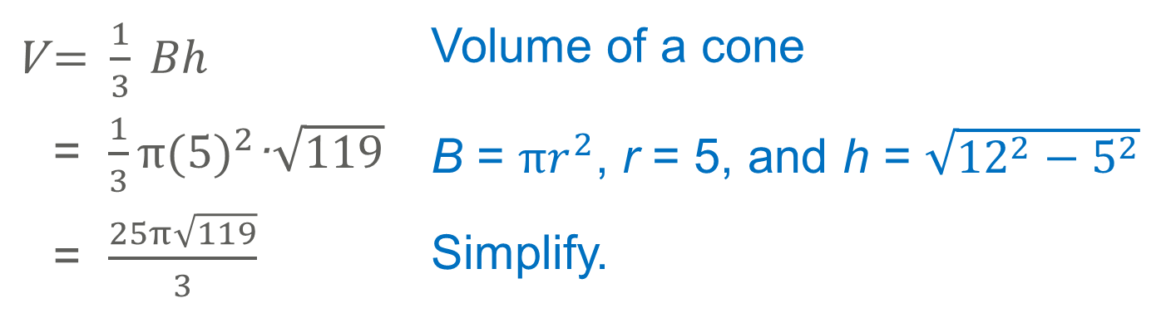
Example 4
Use Similar Solids to Find Volume
Step 1 Find the volume of Cone 1.
V = $\frac{1}{3} Bh$ | Volume of a cone
= $\frac{1}{3}π{(5)}^{2}$·$\sqrt{119}$ | B = $πr^{2}$, r = 5, and h = $\sqrt{{12}^{2}−5^{2}}$
= $\frac{25π\sqrt{119}}{3}$ | Simplify.

Slide 31
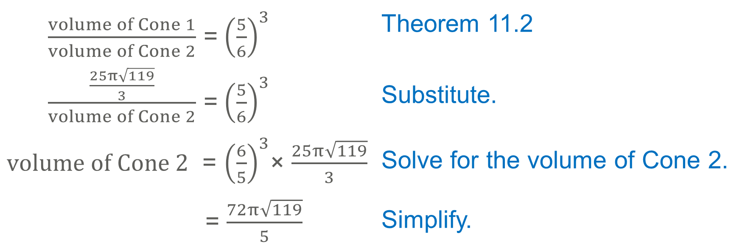
Example 4
Use Similar Solids to Find Volume
Step 2 Find the volume of Cone 2.
Cone 2 is similar to Cone 1. The scale factor from Cone 2 to Cone 1 is 5:6. Find the volume of Cone 2.
$\frac{volume of Cone 1}{volume of Cone 2}$ = ${\left(\frac{5}{6}\right)}^{3}$ | Theorem 11.2
$\frac{\frac{25π\sqrt{119}}{3}}{volume of Cone 2}$ = ${\left(\frac{5}{6}\right)}^{3}$ | Substitute.
$volume of Cone 2$ = ${\left(\frac{6}{5}\right)}^{3}$× $\frac{25π\sqrt{119}}{3}$ | Solve for the volume of Cone 2.
= $\frac{72π\sqrt{119}}{5}$ | Simplify.

Slide 32
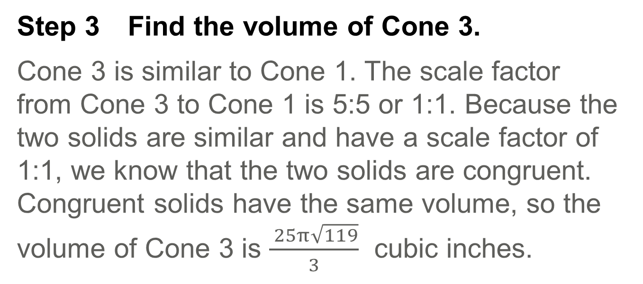
Example 4
Use Similar Solids to Find Volume
Step 3 Find the volume of Cone 3.
Cone 3 is similar to Cone 1. The scale factor from Cone 3 to Cone 1 is 5:5 or 1:1. Because the two solids are similar and have a scale factor of 1:1, we know that the two solids are congruent. Congruent solids have the same volume, so the volume of Cone 3 is $\frac{ 25π\sqrt{119}}{3}$ cubic inches.

Slide 33
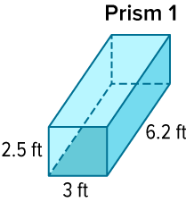
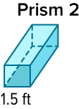
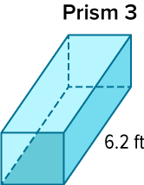
Example 4
Use Similar Solids to Find Volume
Check
The three prisms are similar. Find the exact volume of each prism.

Slide 34
Example 4
Use Similar Solids to Find Volume
Check
The three prisms are similar. Find the exact volume of each prism.
Prism 1: V = 46.5 ft³
Prism 2: V = 5.8125 ft³
Prism 3: V = 46.5 ft³
Notes:
Prism 1: V = 46.5 ft³
Prism 2: V = 5.8125 ft³
Prism 3: V = 46.5 ft³

Slide 35
Example 5
Use Similar Solids to Solve Problems
Two similar rectangular prisms with square bases have surface areas of 98 square centimeters and 18 square centimeters. If one base edge of the larger rectangular prism measures 9 centimeters, what is the perimeter of one base of the smaller prism?

Slide 36

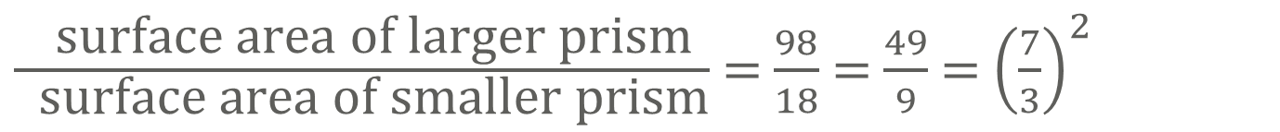
Example 5
Use Similar Solids to Solve Problems
First, find the scale factor.
$\frac{ \text{surface} \text{area} \text{of} \text{larger} \text{prism}}{ \text{surface} \text{area} \text{of} \text{smaller} \text{prism}}$ = $\frac{98}{18}$ = $\frac{49}{9}$ = ${\left(\frac{7}{3}\right)}^{2}$
The scale factor is $\frac{7}{3}$ .

Slide 37
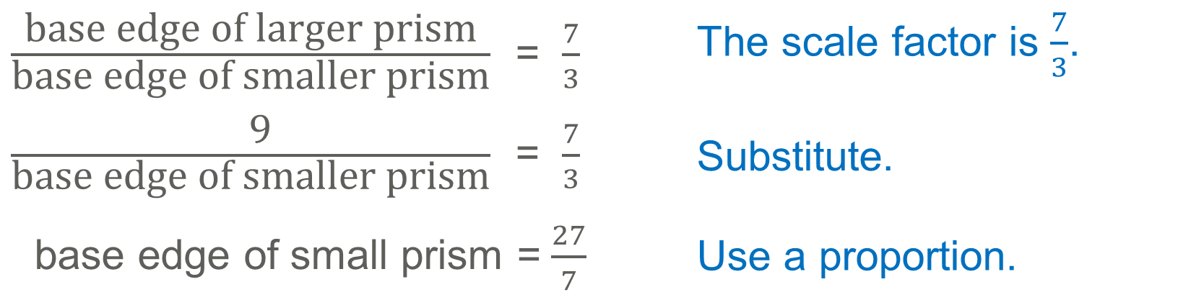
Example 5
Use Similar Solids to Solve Problems
Then, find the length of the base edge of the small prism.
$\frac{\text{base} \text{edge} \text{of} \text{larger} \text{prism}}{\text{base} \text{edge} \text{of} \text{smaller} \text{prism}}$ = $\frac{7}{3}$ | The scale factor is $\frac{7}{3}$.
$\frac{ \text{9}}{\text{base} \text{edge} \text{of} \text{smaller} \text{prism}}$ = $\frac{7}{3}$ | Substitute.
base edge of small prism = $\frac{27}{7}$ | Use a proportion.
The base edge of the smaller prism is $\frac{27}{7}$ centimeters.

Slide 38
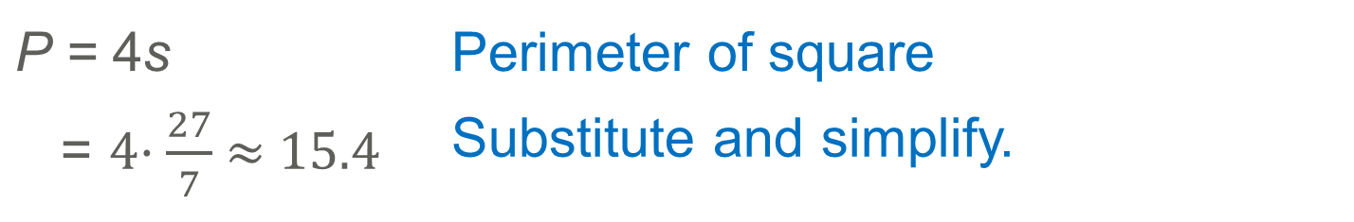
Example 5
Use Similar Solids to Solve Problems
Find the perimeter of the base of the smaller prism to the nearest tenth.
P = 4s | Perimeter of square
= 4· $\frac{27}{7}$ ≈ 15.4 | Substitute and simplify.
The perimeter of the base of the smaller prism is about 15.4 centimeters.

Slide 39
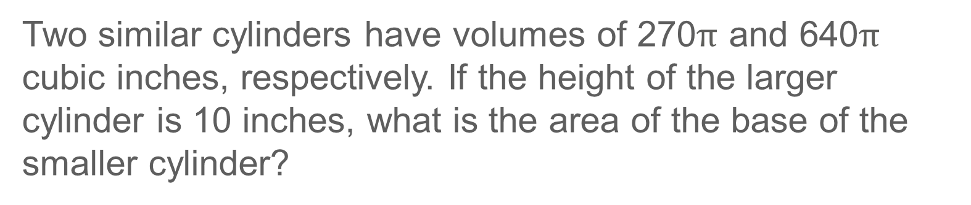
Example 5
Use Similar Solids to Solve Problems
Check
Two similar cylinders have volumes of 270$π$ and 640$π$ cubic inches, respectively. If the height of the larger cylinder is 10 inches, what is the area of the base of the smaller cylinder?

Slide 40
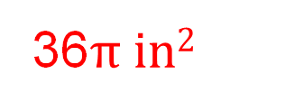
Example 5
Use Similar Solids to Solve Problems
Check
Two similar cylinders have volumes of 270$π$ and 640$π$ cubic inches, respectively. If the height of the larger cylinder is 10 inches, what is the area of the base of the smaller cylinder?
36$π in2$
Notes:
36$π in2$

Slide 41
Pause and Reflect
Did you struggle with anything in this lesson? If so, how did you deal with it?
Notes:
Yes; 31.3 feet

Slide 42
Exit Ticket
Complete the table.
1.
2.
3.
Similar Shapes | Scale Factor | Ratio of Heights | Ratio of Lateral Areas | Ratio of Surface Areas | Ratio of Volumes
regular prisms | 2:5
cylinders |  |  | 49:9
square pyramids |  |  |  |  | 64:27

Slide 43
Exit Ticket
Complete the table.
1.
2.
3.
Similar Shapes | Scale Factor | Ratio of Heights | Ratio of Lateral Areas | Ratio of Surface Areas | Ratio of Volumes
regular prisms | 2:5 | 2:5 | 4:25 | 4:25 | 8:125
cylinders | 7:3 | 7:3 | 49:9 | 49:9 | 343:27
square pyramids | 4:3 | 4:3 | 16:9 | 16:9 | 64:27
Notes:
2:5, 4:25, 4:25, 8:125
7:3, 7:3, 49:9, 343:27
4:3, 4:3, 16:9, 16:9

