Slide 1
Angles of Polygons

Slide 2
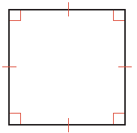


Warm Up
Classify each polygon by the number of sides. Then say whether it is convex or concave, regular or not regular.
1.
2.
3.

Slide 3
Warm Up
Sketch each polygon.
4. regular polygon
5. concave octagon
6. triangle that is not regular

Slide 4
Warm Up
Classify each polygon by the number of sides. Then say whether it is convex or concave, regular or not regular.
1.
2.
3.
quadrilateral, convex,
regular
pentagon, concave not regular
hexagon, convex
not regular
Notes:
quadrilateral, convex, regular
pentagon, concave, not regular
hexagon, convex, not regular

Slide 5
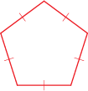


Warm Up
Sketch each polygon.
4. regular polygon
5. concave octagon
6. triangle that is not regular

Slide 6
Florida’s B.E.S.T. Standards for Mathematics
MA.912.GR.1.3
Prove relationships and theorems about triangles. Solve mathematical and real-world problems involving postulates, relationships and theorems of triangles.

Slide 7
Florida’s Mathematical Thinking and Reasoning Standards
MA.K12.MTR.7.1
Apply mathematics to real-world contexts.

Slide 8
Lesson Objectives
Content Objective
Students use theorems about the interior and exterior angles of polygons to solve problems and then prove these theorems.
Language Objectives
Students explain how to use theorems about the interior and exterior angles of polygons to solve problems using the verb find.
To optimize output, students participate in MLR1: Stronger and Clearer Each Time.

Slide 9
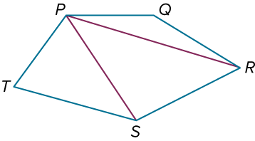
Learn
Interior Angles of Polygons
A diagonal of a polygon is a segment that
connects any two nonconsecutive vertices
within a polygon. The vertices of polygon
PQRST that are not consecutive with vertex P are
vertices R and S. Notice that the diagonals from vertex P separate the polygon into three triangles. The sum of the angle measures of a polygon is the sum of the angle measures of the triangles formed by drawing all of the possible diagonals from one vertex.
By generalizing this observation for a convex polygon with n sides, you can develop the Polygon Interior Angles Sum Theorem.

Slide 10
Learn
Interior Angles of Polygons
Theorem 7.1: Polygon Interior Angles Sum Theorem
The sum of the interior angle measures of an n-sided convex polygon is (n − 2) • 180°.

Slide 11
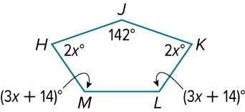
Example 1
Find the Interior Angles Sum of a Polygon
Find the measure of each interior angle of pentagon HJKLM.

Slide 12
Example 1
Find the Interior Angles Sum of a Polygon
Step 1 Find the sum.
A pentagon has 5 sides. Use the Polygon Interior Angles Sum Theorem to find the sum of its interior angle measures.
m∠H + m∠J + m∠K + m∠L + m∠M
= (n − 2) • 180° | Polygon Interior Angles Sum Thm.
= (5 − 2) • 180° | Substitute.
= 540° | Solve.

Slide 13
Example 1
Find the Interior Angles Sum of a Polygon
Step 2 Find the value of x.
Use the sum of the interior angle measures to determine the value of x.
2x° + 2x° + (3x + 14)° + (3x + 14)° + 142° = 540° | Write an equation.
x = 37 | Solve.

Slide 14
Example 1
Find the Interior Angles Sum of a Polygon
Step 3 Find the measure of each angle.
Use the value of x to find the measure of each angle.
m∠J = 142° m∠K = 2(37)° or 74° | m∠L = [3(37) + 14]° or 125°
m∠M = [3(37) + 14]° or 125° | m∠H = 2x° = 2(37)° or 74°

Slide 15
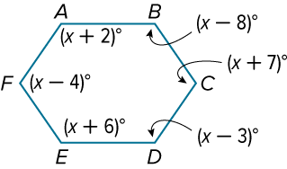
Example 1
Find the Interior Angles Sum of a Polygon
Check
Find the measure of ∠E.
A. 108°
B. 120°
C. 122°
D. 126°

Slide 16
Example 1
Find the Interior Angles Sum of a Polygon
Check
Find the measure of ∠E. D
A. 108°
B. 120°
C. 122°
D. 126°
Notes:
D

Slide 17
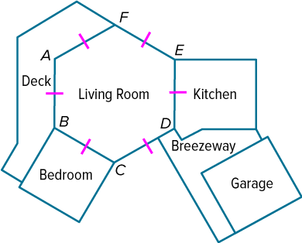
Apply Example 2
Interior Angle Measures of a Regular Polygon
FLOOR PLANS Penny is building a house using a floor plan that she designed. What is the measure of ∠ABC?

Slide 18
Apply Example 2
Interior Angle Measures of a Regular Polygon
Talk About It!
Ask a partner to provide feedback on your work. Are there ways in which you can improve your process?

Slide 19

Apply Example 2
Interior Angle Measures of a Regular Polygon
Check
PONDS Miguel has commissioned a pentagonal koi pond to be built in his backyard. He wants the pond to have a deck of equal width around it. The lengths of the interior deck sides are the same length, and the lengths of the exterior sides are the same. What is the measure of the angle of the pond formed by two sides of the deck?

Slide 20
Apply Example 2
Interior Angle Measures of a Regular Polygon
Check
PONDS Miguel has commissioned a pentagonal koi pond to be built in his backyard. He wants the pond to have a deck of equal width around it. The lengths of the interior deck sides are the same length, and the lengths of the exterior sides are the same. What is the measure of the angle of the pond formed by two sides of the deck? 108°
Notes:
108°

Slide 21
Example 3
Identify the Polygon Given the Interior Angle Measure
The measure of an interior angle of a regular polygon is 144°. Find the number of sides in the polygon.

Slide 22
Example 3
Identify the Polygon Given the Interior Angle Measure
Let n = the number of sides in the polygon. Because all angles of a regular polygon are congruent, the sum of the interior angle measures is 144n°. By the Polygon Interior Angles Sum Theorem, the sum of the interior angle measures can also be expressed as (n − 2) • 180°.
144 n° = (n − 2) • 180° | Write an equation.
n = 10 | Solve.
The polygon has 10 sides, so it is a regular decagon.

Slide 23
Example 3
Identify the Polygon Given the Interior Angle Measure
Check
The measure of an interior angle of a regular polygon is 150°. Find the number of sides in the polygon.

Slide 24
Example 3
Identify the Polygon Given the Interior Angle Measure
Check
The measure of an interior angle of a regular polygon is 150°. Find the number of sides in the polygon.
The polygon has 12 sides.
Notes:
The polygon has 12 sides.

Slide 25
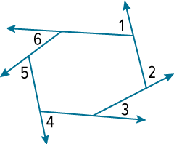
Learn
Exterior Angles of Polygons
Theorem 7.2: Polygon Exterior Angles Sum Theorem
Words | The sum of the exterior angle measures of a convex polygon, one angle at each vertex, is 360°.
Example | m∠1 + m∠2 + m∠3 + m∠4 + m∠5 + m∠6 = 360°

Slide 26
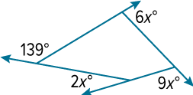
Example 4
Find Missing Values
Find the value of x.

Slide 27
Example 4
Find Missing Values
Use the Polygon Exterior Angles Sum Theorem to write an equation. Then solve for x.
6x° + 9x° + 2x° + 139° = 360° | Write an equation.
x = 13 | Solve.

Slide 28
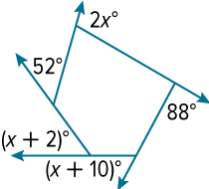
Example 4
Find Missing Values
Check
Find the value of x.
A. 45 B. 52 C. 93 D. 97

Slide 29
Example 4
Find Missing Values
Check
Find the value of x. B
A. 45 B. 52 C. 93 D. 97
Notes:
B

Slide 30
Example 5
Find Exterior Angle Measures of a Polygon
Find the measure of each exterior angle of a regular dodecagon.

Slide 31
Example 5
Find Exterior Angle Measures of a Polygon
A regular dodecagon has 12 congruent sides and 12 congruent interior angles. The exterior angles are also congruent, because angles supplementary to congruent angles are congruent.
Let n = the measure of each exterior angle and write and solve an equation.
12n = 360° | Polygon Exterior Angles Sum Theorem
n = 30° | Solve.
The measure of each exterior angle of a regular dodecagon is 30°.

Slide 32
Example 5
Find Exterior Angle Measures of a Polygon
Check
What is the measure of each exterior angle of a regular octagon?

Slide 33
Example 5
Find Exterior Angle Measures of a Polygon
Check
What is the measure of each exterior angle of a regular octagon?
45°
Notes:
45°

Slide 34
Exit Ticket
Make an argument showing that every convex polygon can be divided into n − 2 triangles, and therefore, the Polygon Interior Angles Sum Theorem makes sense.

Slide 35
Exit Ticket
Make an argument showing that every convex polygon can be divided into n − 2 triangles, and therefore, the Polygon Interior Angles Sum Theorem makes sense.
Because the maximum number of diagonals that can be drawn from any one vertex of an n-sided convex polygon is n − 3, and because each diagonal is a boundary between two triangles, the number of triangles is 1 greater than the number of diagonals. Therefore, the number of triangles would be n − 3 + 1 or n − 2.
Notes:
Because the maximum number of diagonals that can be drawn from any one vertex of an n-sided convex polygon is n − 3, and because each diagonal is a boundary between two triangles, the number of triangles is 1 greater than the number of diagonals. Therefore, the number of triangles would be n − 3 + 1 or n − 2.

