Slide 1
Introduction of Trigonometry 9-3

Slide 2
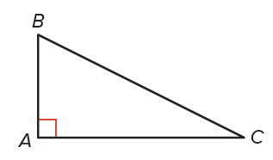
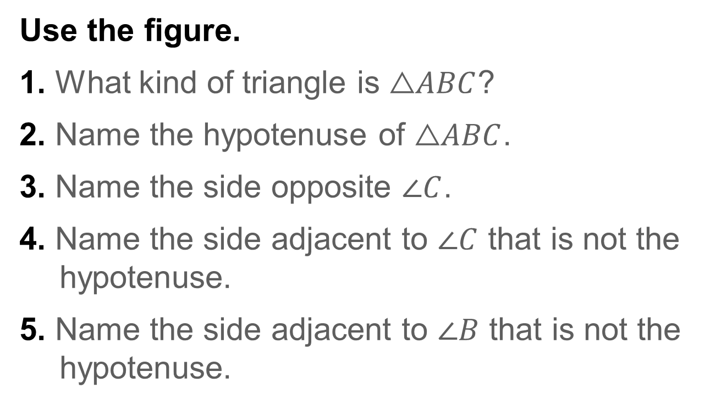
Warm Up
Use the figure.
1. What kind of triangle is $\text{△}ABC$?
2. Name the hypotenuse of $\text{△}ABC$.
3. Name the side opposite $\text{∠}C$.
4. Name the side adjacent to $\text{∠}C$ that is not the hypotenuse.
5. Name the side adjacent to $\text{∠}B$ that is not the hypotenuse.

Slide 3
Florida’s B.E.S.T. Standards for Mathematics
MA.912.T.1.1
Define trigonometric ratios for acute angles in right triangles.
MA.912.T.1.2
Solve mathematical and real-world problems involving right triangles using trigonometric ratios and the Pythagorean Theorem.

Slide 4
Florida’s Mathematical Thinking and Reasoning Standards
MA.K12.MTR.2.1
Demonstrate understanding by representing problems in multiple ways.
MA.K12.MTR.4.1
Engage in discussions that reflect on the mathematical thinking of self and others.
MA.K12.MTR.5.1
Use patterns and structure to help understand and connect mathematical concepts.

Slide 5
Lesson Objectives
Content Objective
Students will solve problems using the trigonometric ratios and inverse trigonometric ratios for acute angles.
Language Objectives
Students talk about solving problems using the trigonometric ratios and inverse trigonometric ratios for acute angles with distance, length, and angle
To support sense-making, students participate in MLR2: Collect and Display.

Slide 6
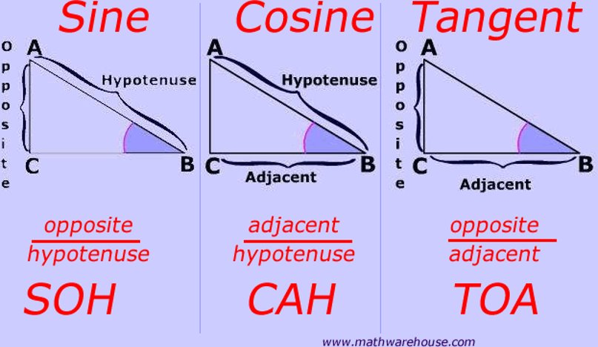
The word trigonometry comes from the Greek terms trigon, meaning triangle, and metron, meaning measure. So the study of trigonometry involves triangle measurement. A trigonometric ratio is a ratio of the lengths of two sides of a right triangle.
The names of the three most common trigonometric ratios are given on the next few slides.

Slide 7
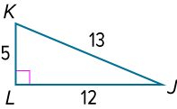
Example 1A
Find Trigonometric Ratios
Find sin J, cos J, tan J, sin K, cos K, and tan K. Express each ratio as a fraction and as a decimal to the nearest hundredth.

Slide 8
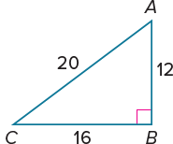
Example 1B
Find Trigonometric Ratios
Check
Find sin A, cos A, tan A, sin C, cos C, and tan C.
Express each ratio as a fraction and as a decimal to the nearest hundredth, if necessary.

Slide 9
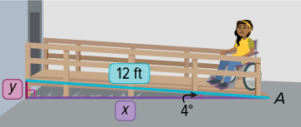
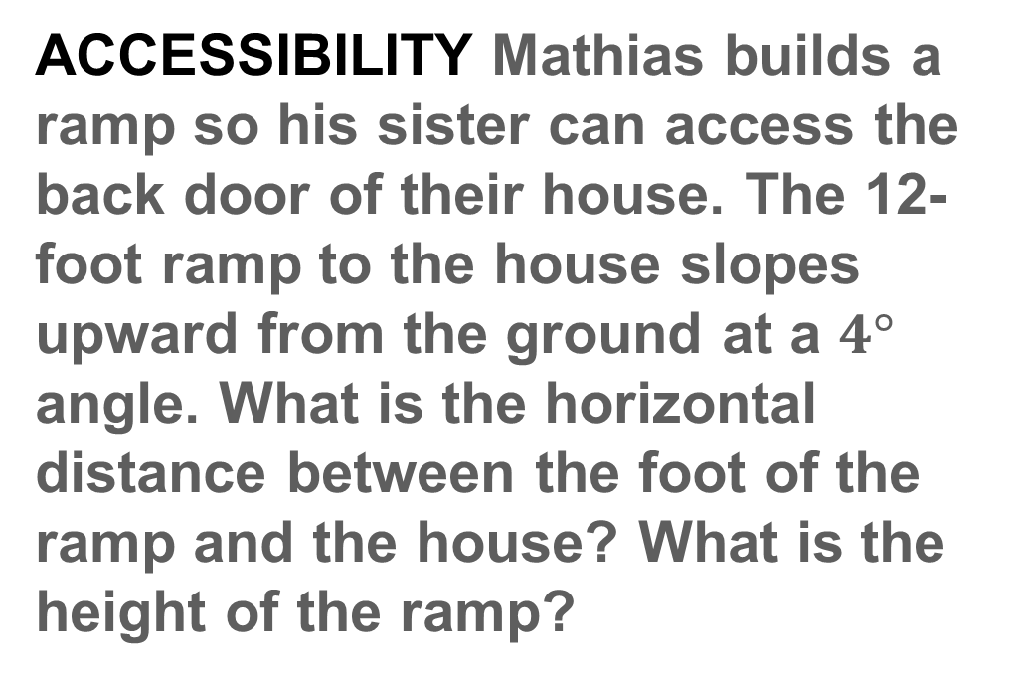
Example 2
Estimate Measures by Using Trigonometry
ACCESSIBILITY Mathias builds a ramp so his sister can access the back door of their house. The 12-foot ramp to the house slopes upward from the ground at a $4°$ angle. What is the horizontal distance between the foot of the ramp and the house? What is the height of the ramp?

Slide 10
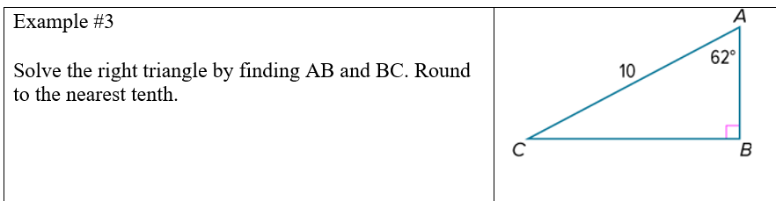

Slide 11
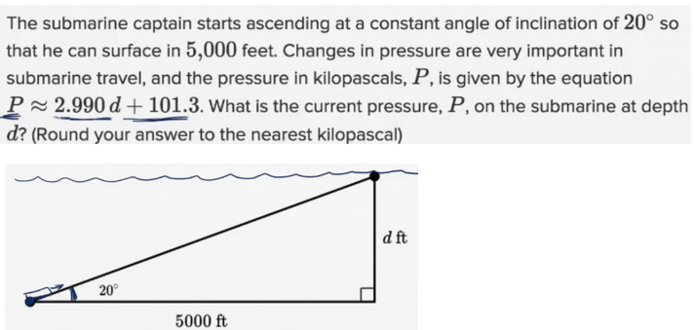
Exit Ticket

