Slide 1
Equations of Circles

Slide 2
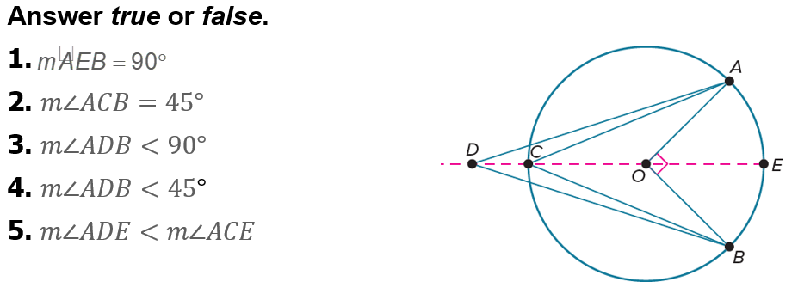
Warm Up

Slide 3
Warm Up
Use the Distance Formula to determine whether each point is within 5 units of (10, 8). Answer within, not within, or exactly 5 units away.
1. (10, 14)
2. (8, 12)
3. (13, 12)
4. (7, 3)
5. (8, 4)

Slide 4
Warm Up
Use the Distance Formula to determine whether each point is within 5 units of (10, 8). Answer within, not within, or exactly 5 units away.
1. (10, 14) not within
2. (8, 12) within
3. (13, 12) exactly 5 units away
4. (7, 3) not within
5. (8, 4) within
Notes:
not within
within
exactly 5 units away
not within
within

Slide 5
Florida’s B.E.S.T. Standards for Mathematics
MA.912.GR.3.2
Given a mathematical context, use coordinate geometry to classify or justify definitions, properties and theorems involving circles, triangles or quadrilaterals.
MA.912.GR.3.3
Use coordinate geometry to solve mathematical and real-world geometric problems involving lines, circles, triangles and quadrilaterals.

Slide 6
Florida’s B.E.S.T. Standards for Mathematics
MA.912.GR.7.2
Given a mathematical or real-world context, derive and create the equation of a circle using key features.
MA.912.GR.7.3
Graph and solve mathematical and real-world problems that are modeled with an equation of a circle. Determine and interpret key features in terms of the context.

Slide 7
Florida’s Mathematical Thinking and Reasoning Standards
MA.K12.MTR.3.1
Complete tasks with mathematical fluency.
MA.K12.MTR.4.1
Engage in discussions that reflect on the mathematical thinking of self and others.
MA.K12.MTR.5.1
Use patterns and structure to help understand and connect mathematical concepts.

Slide 8
Florida’s Mathematical Thinking and Reasoning Standards
MA.K12.MTR.7.1
Apply mathematics to real-world contexts.

Slide 9
Lesson Objectives
Content Objective
Students write and graph the equations of circles using key features.
Language Objectives
Students talk about equations of circles using so.
To cultivate conversation, students participate in MLR8: Discussion Supports.

Slide 10
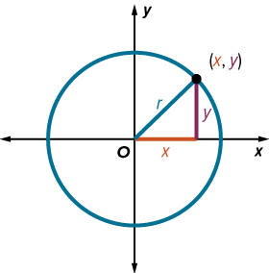
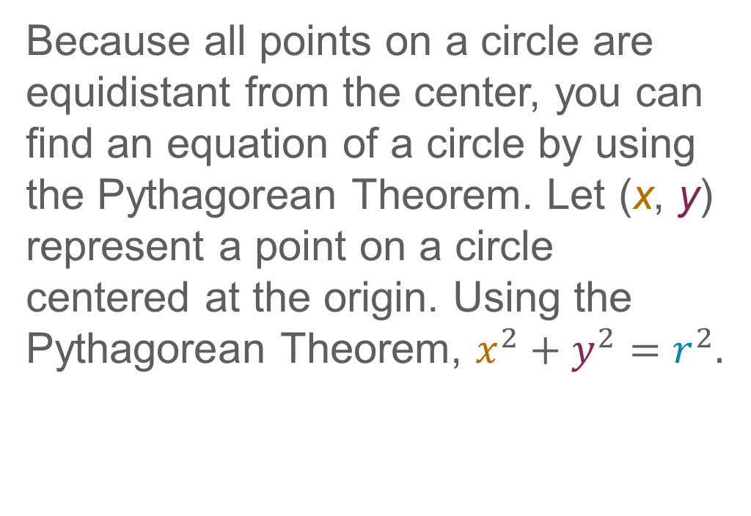
Learn
Equations of Circles
Because all points on a circle are equidistant from the center, you can find an equation of a circle by using the Pythagorean Theorem. Let (x, y) represent a point on a circle centered at the origin. Using the Pythagorean Theorem, $x^{2}+y^{2}=r^{2}.$

Slide 11
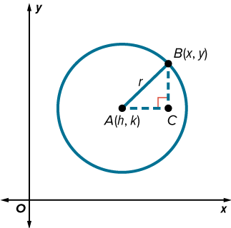
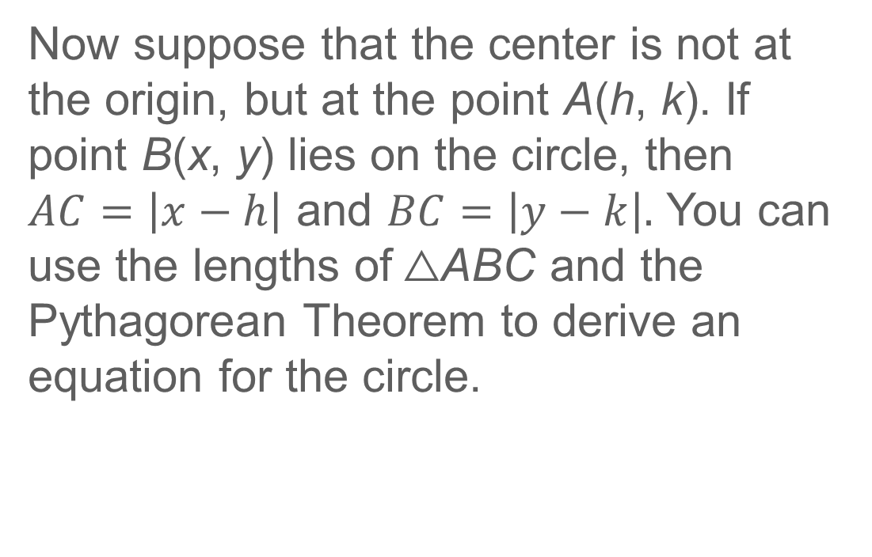
Learn
Equations of Circles
Now suppose that the center is not at the origin, but at the point A(h, k). If point B(x, y) lies on the circle, then $AC=\left|x−h\right|$ and $BC=\left|y−k\right|.$ You can use the lengths of △ABC and the Pythagorean Theorem to derive an equation for the circle.

Slide 12
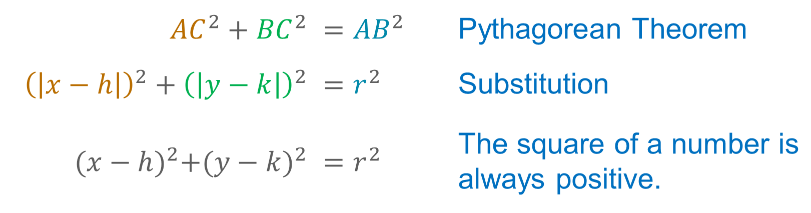
Learn
Equations of Circles
${AC}^{2}+{BC}^{2}$ | $$={AB}^{2}$$ | Pythagorean Theorem
${\left(\left|x−h\right|\right)}^{2}+{\left(\left|y−k\right|\right)}^{2}$ | $$=r^{2}$$ | Substitution
${(x−h)}^{2}+{(y−k)}^{2}$ | $$=r^{2}$$ | The square of a number is always positive.

Slide 13
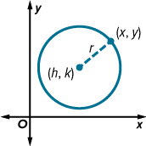
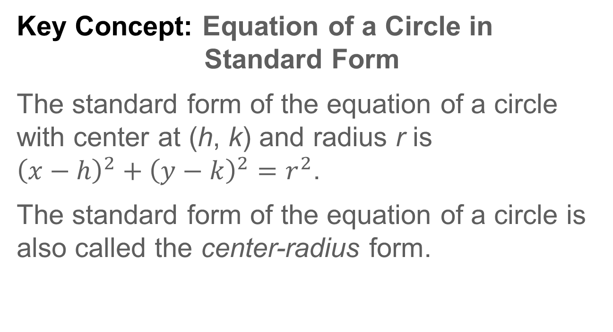
Learn
Equations of Circles
Key Concept: Equation of a Circle in Standard Form
The standard form of the equation of a circle with center at (h, k) and radius r is
${\left(x−h\right)}^{2}+{\left(y−k\right)}^{2}=r^{2}$.
The standard form of the equation of a circle is also called the center-radius form.

Slide 14
Learn
Equations of Circles
Talk About It!
Your classmate says you cannot derive the standard form of the equation of a circle by using the Distance Formula. Describe the error. What feedback can you provide to help them correct the error?

Slide 15
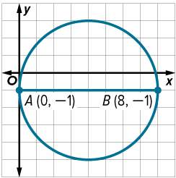
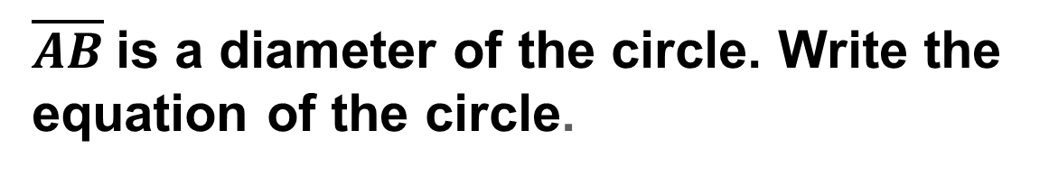
Example 1
Write an Equation by Using the Center and Radius
$\overline{AB}$is a diameter of the circle. Write the equation of the circle.

Slide 16
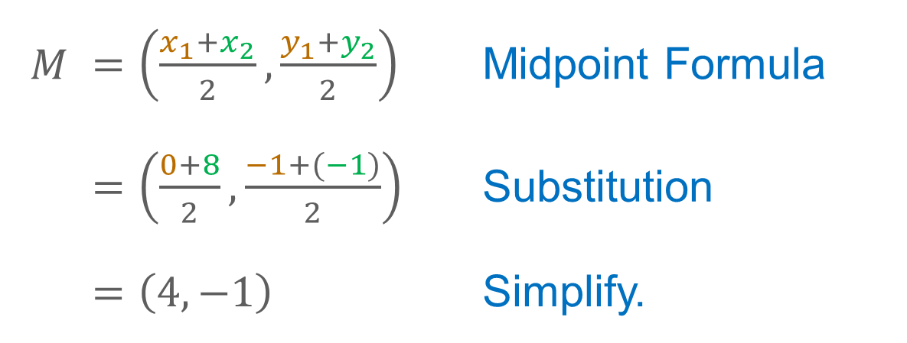
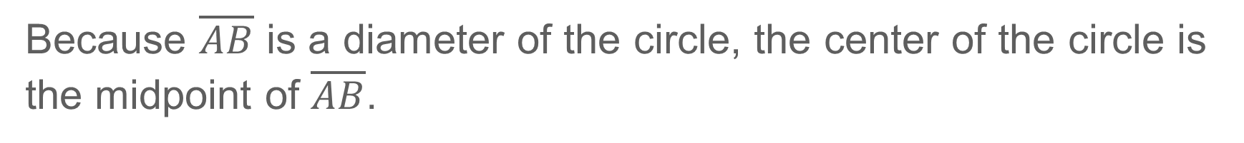
Example 1
Write an Equation by Using the Center and Radius
Because $\overline{AB}$ is a diameter of the circle, the center of the circle is the midpoint of $\overline{AB}$.
$M$ | $=\left(\frac{x_{1}+x_{2}}{2},\frac{y_{1}+y_{2}}{2}\right)$ | Midpoint Formula
 | $=\left(\frac{0+8}{2},\frac{−1+(−1)}{2}\right)$ | Substitution
 | $$=\left(4, −1\right)$$ | Simplify.

Slide 17
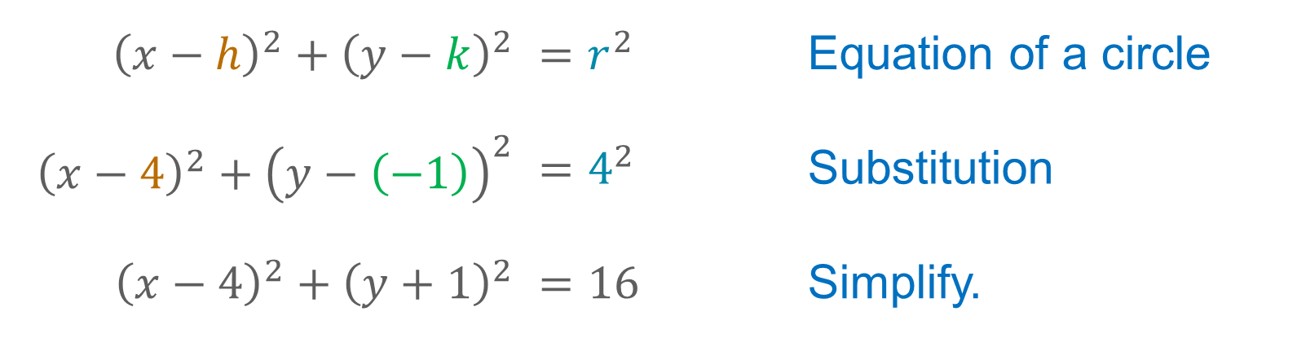
Example 1
Write an Equation by Using the Center and Radius
So, the center is at (4, −1) and the radius is 4.
${\left(x−h\right)}^{2}+{\left(y−k\right)}^{2}$ | $=r^{2}$ | Equation of a circle
${\left(x−4\right)}^{2}+{\left(y−\left(−1\right)\right)}^{2}$ | $=4^{2}$ | Substitution
${\left(x−4\right)}^{2}+{\left(y+1\right)}^{2}$ | $=16$ | Simplify.

Slide 18
Example 2
Write an Equation by Using the Center and a Point
Write the equation of the circle with center at (−3, −5) that passes through (0, 0).

Slide 19
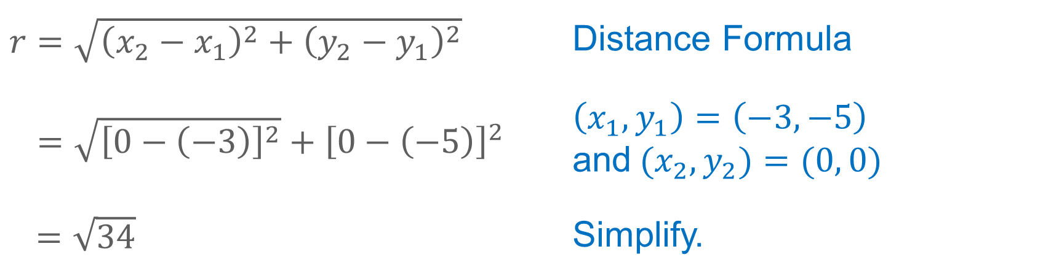
Example 2
Write an Equation by Using the Center and a Point
Step 1 Find the length of the radius.
Find the distance between the points to determine the radius.
$r=\sqrt{{\left(x_{2}−x_{1}\right)}^{2}+{\left(y_{2}−y_{1}\right)}^{2}}$ | Distance Formula
$=\sqrt{{\left[0−\left(−3\right)\right]}^{2}}+{\left[0−\left(−5\right)\right]}^{2}$ | $\left(x_{1}, y_{1}\right)=\left(−3, −5\right)$ and${ (x}_{2},y_{2})=(0, 0)$
$=\sqrt{34}$ | Simplify.

Slide 20

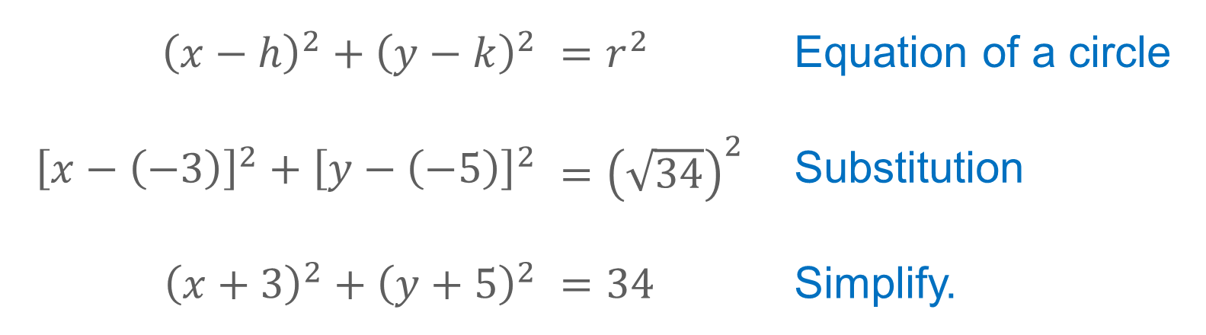
Example 2
Write an Equation by Using the Center and a Point
Step 2 Write the equation of the circle.
Write the equation using h = −3, k = −5, and $r= \sqrt{34}.$
${\left(x−h\right)}^{2}+{\left(y−k\right)}^{2}$ | $=r^{2}$ | Equation of a circle
${\left[x−\left(−3\right)\right]}^{2}+{\left[y−\left(−5\right)\right]}^{2}$ | $={\left(\sqrt{34}\right)}^{2}$ | Substitution
${\left(x+3\right)}^{2}+{\left(y+5\right)}^{2}$ | $=34$ | Simplify.

Slide 21
Example 2
Write an Equation by Using the Center and a Point
Think About It!
Does the graph of a circle represent a function? Justify your reasoning.

Slide 22
Example 2
Write an Equation by Using the Center and a Point
Check
Write the equation of the circle with center at (−2, 4) that passes through (−6, 7). Write your answer in standard form.

Slide 23
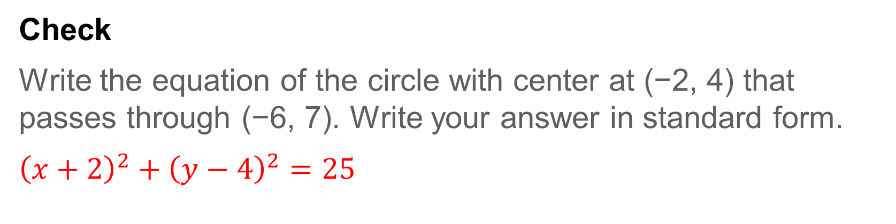
Example 2
Write an Equation by Using the Center and a Point
Check
Write the equation of the circle with center at (−2, 4) that passes through (−6, 7). Write your answer in standard form.
${\left(x+2\right)}^{2}+{\left(y−4\right)}^{2}=25$
Notes:
$${(x+2)}^{2}+{(y−4)}^{2}=25$$

Slide 24
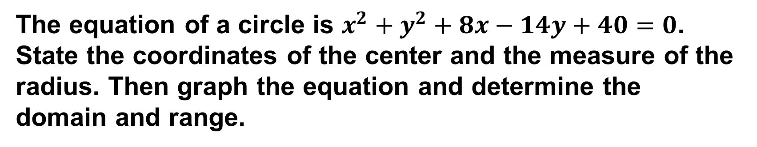
Example 3
Graph a Circle
The equation of a circle is $x^{2}+y^{2}+8x−14y+40=0$. State the coordinates of the center and the measure of the radius. Then graph the equation and determine the domain and range.

Slide 25
Example 3
Graph a Circle
Step 1 Complete the squares.
Write the equation in standard form by completing the squares.
x² + y² + 8x – 14y + 40 | = 0 | Original equation
x² + y² + 8x – 14y | = –40 | Subtract 40 from each side.
x² + 8x + y² – 14y | = –40 | Group terms.
x² + 8x + 16 + y² – 14y + 49 | = –40 + 16 + 49 | Complete the squares.
(x + 4)² + (y – 7)² | = 25 | Factor and simplify.

Slide 26
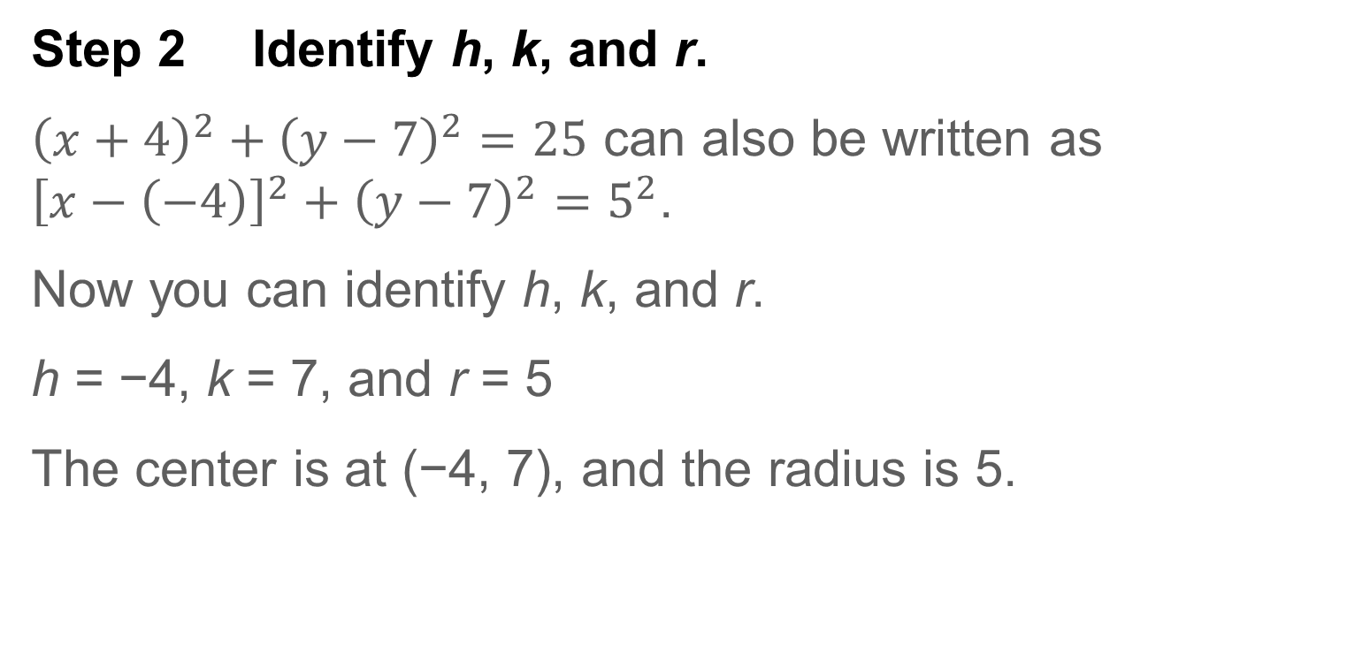
Example 3
Graph a Circle
Step 2 Identify h, k, and r.
${\left(x+4\right)}^{2}+{\left(y−7\right)}^{2}=25$ can also be written as ${\left[x−\left(−4\right)\right]}^{2}+{\left(y−7\right)}^{2}=5^{2}$.
Now you can identify h, k, and r.
h = −4, k = 7, and r = 5
The center is at (−4, 7), and the radius is 5.

Slide 27
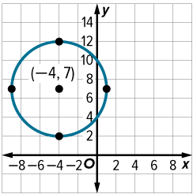
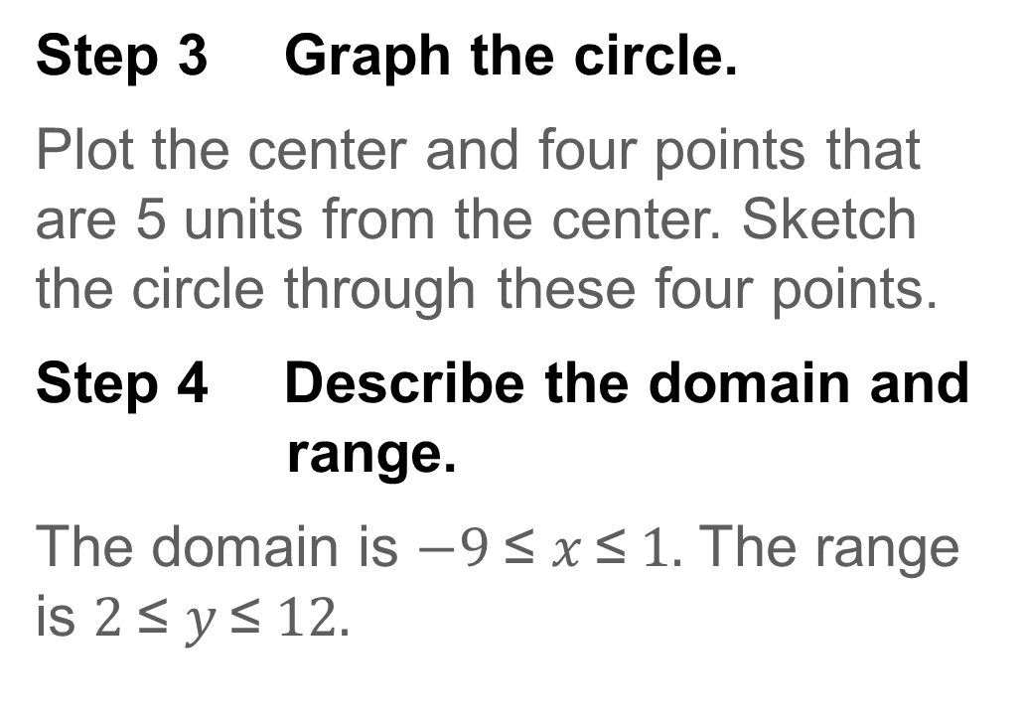
Example 3
Graph a Circle
Step 3 Graph the circle.
Plot the center and four points that are 5 units from the center. Sketch the circle through these four points.
Step 4 Describe the domain and range.
The domain is $−9 \text{≤} x \text{≤} 1.$ The range is $2 \text{≤} y \text{≤} 12.$

Slide 28
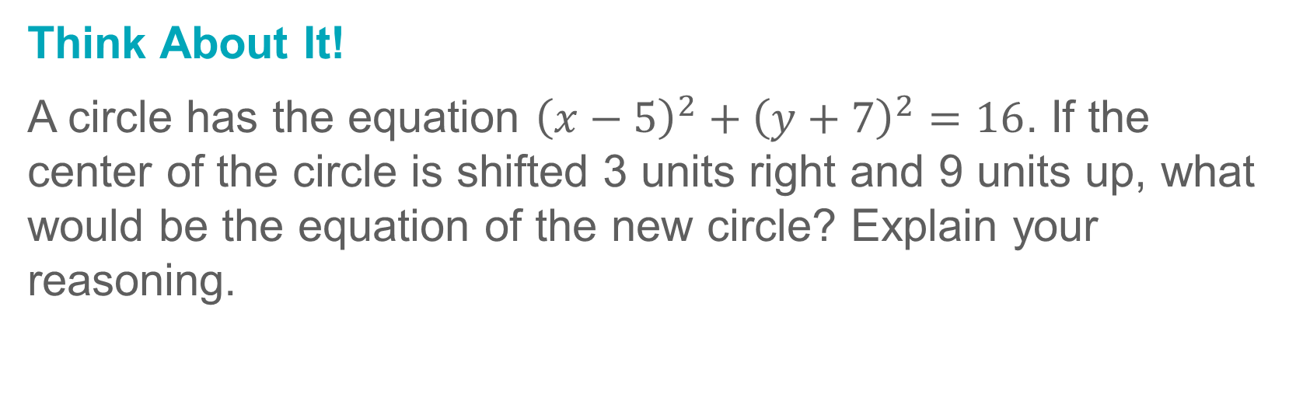
Example 3
Graph a Circle
Think About It!
A circle has the equation ${\left(x−5\right)}^{2}+{\left(y+7\right)}^{2}=16$. If the center of the circle is shifted 3 units right and 9 units up, what would be the equation of the new circle? Explain your reasoning.

Slide 29
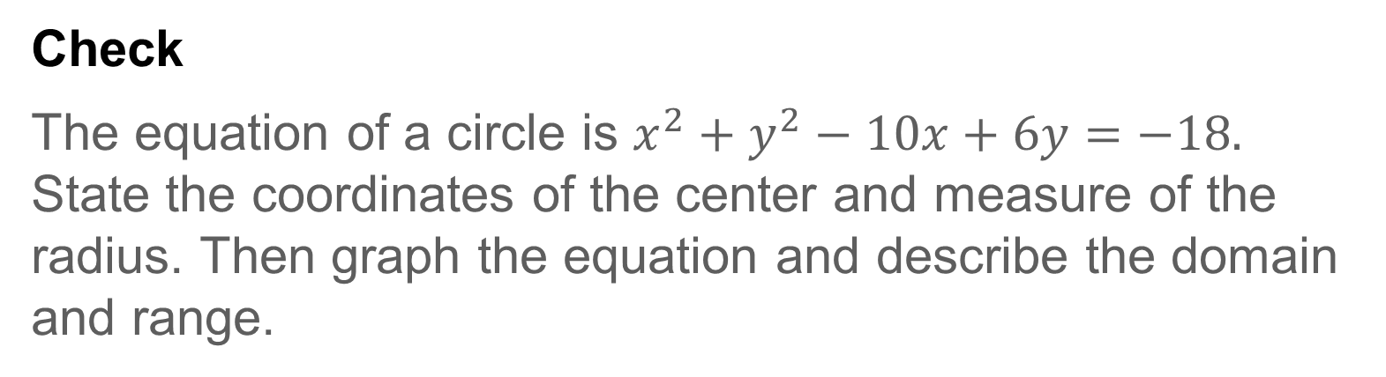
Example 3
Graph a Circle
Check
The equation of a circle is $x^{2}+y^{2}−10x+6y=−18.$ State the coordinates of the center and measure of the radius. Then graph the equation and describe the domain and range.

Slide 30
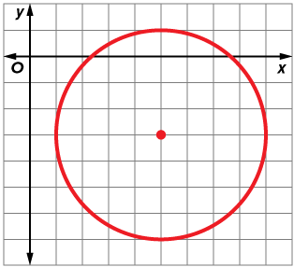

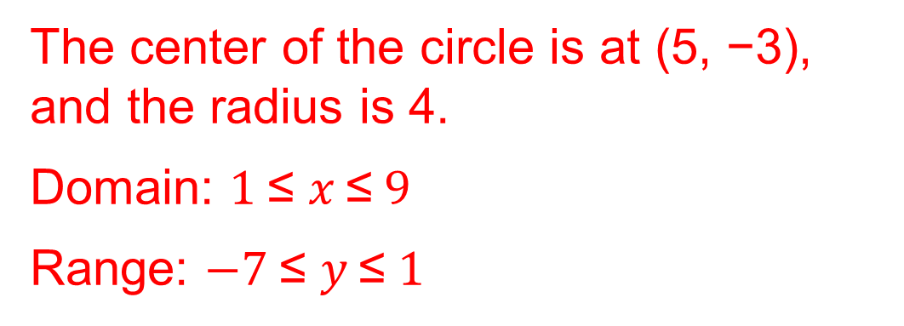
Example 3
Graph a Circle
Check
The equation of a circle is $x^{2}+y^{2}−10x+6y=−18.$ State the coordinates of the center and measure of the radius. Then graph the equation and describe the domain and range.
The center of the circle is at (5, −3), and the radius is 4.
Domain: $1 \text{≤} x \text{≤} 9$
Range: $−7 \text{≤} y \text{≤} 1$
Notes:
The center of the circle is at (5, −3), and the radius is 4.
Domain: $1 \text{≤} x \text{≤} 9$
Range: $−7 \text{≤} y \text{≤} 1$

Slide 31
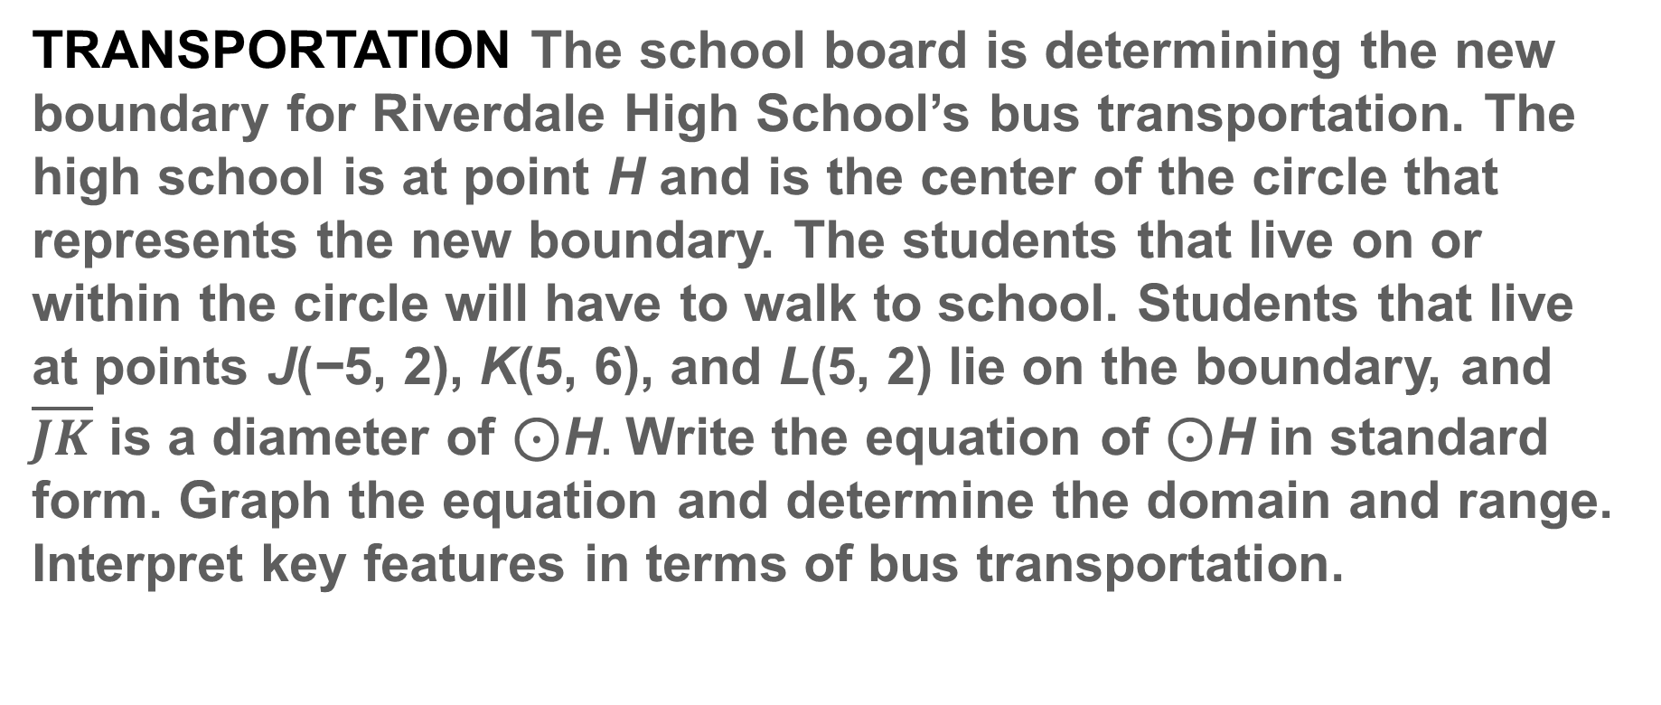
Apply Example 4
Use a Diameter to Write an Equation
TRANSPORTATION The school board is determining the new boundary for Riverdale High School’s bus transportation. The high school is at point H and is the center of the circle that represents the new boundary. The students that live on or within the circle will have to walk to school. Students that live at points J(−5, 2), K(5, 6), and L(5, 2) lie on the boundary, and $\overline{JK}$ is a diameter of ⊙H$.$ Write the equation of ⊙H in standard form. Graph the equation and determine the domain and range. Interpret key features in terms of bus transportation.

Slide 32
Apply Example 4
Use a Diameter to Write an Equation
Talk About It!
Ask a partner to provide feedback on your work. Are there ways in which you can improve your model or process?

Slide 33
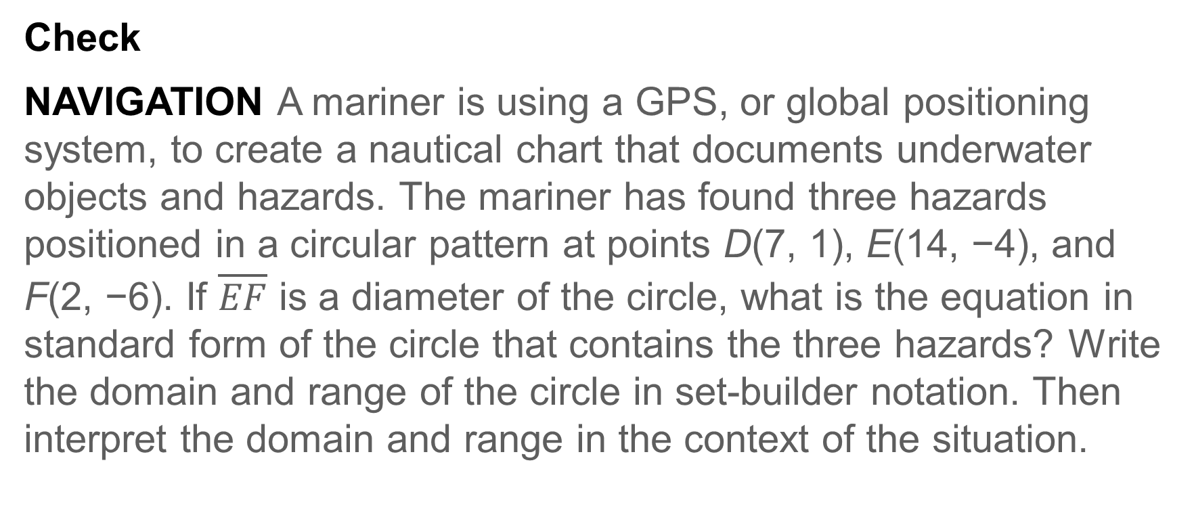
Apply Example 4
Use a Diameter to Write an Equation
Check
NAVIGATION A mariner is using a GPS, or global positioning system, to create a nautical chart that documents underwater objects and hazards. The mariner has found three hazards positioned in a circular pattern at points D(7, 1), E(14, −4), and F(2, −6). If $\overline{EF}$ is a diameter of the circle, what is the equation in standard form of the circle that contains the three hazards? Write the domain and range of the circle in set-builder notation. Then interpret the domain and range in the context of the situation.

Slide 34
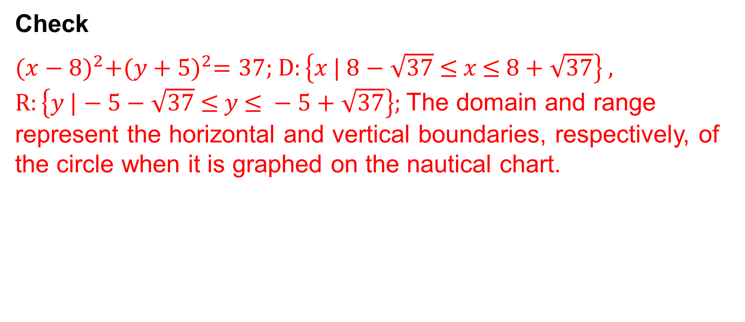
Apply Example 4
Use a Diameter to Write an Equation
Check
${(x−8)}^{2}+{(y+5)}^{2}=37$; $D:\left\{x \text{| }8−\sqrt{37} \text{≤ }x \text{≤ }8+\sqrt{37}\right\}$,
$R:\left\{y \text{|}−5−\sqrt{37} \text{≤} y \text{≤ }−5+\sqrt{37}\right\};$The domain and range represent the horizontal and vertical boundaries, respectively, of the circle when it is graphed on the nautical chart.
Notes:
${(x−8)}^{2}+{(y+5)}^{2}=37;D:\left\{x \text{| }8−\sqrt{37} \text{≤ }x \text{≤ }8+ \sqrt{37}\right\} ,R:\left\{y \text{|}−5−\sqrt{37} \text{≤} y \text{≤} −5+\sqrt{37}\right\};$The domain and range represent the horizontal and vertical boundaries, respectively, of the circle when it is graphed on the nautical chart.

Slide 35
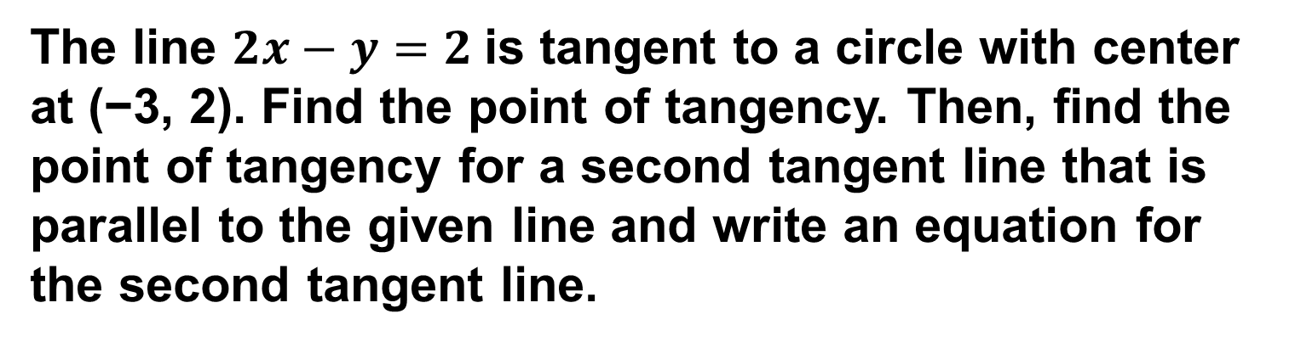
Example 5
Intersections with Circles
The line $2x−y=2$is tangent to a circle with center at (−3, 2). Find the point of tangency. Then, find the point of tangency for a second tangent line that is parallel to the given line and write an equation for the second tangent line.

Slide 36
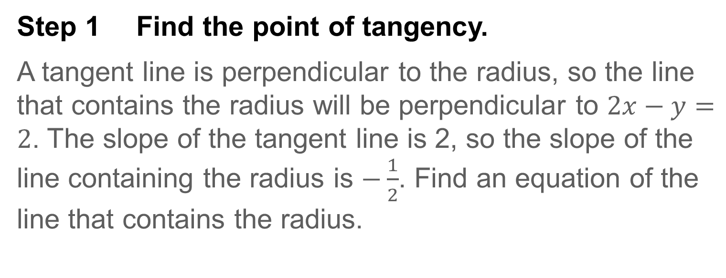
Example 5
Intersections with Circles
Step 1 Find the point of tangency.
A tangent line is perpendicular to the radius, so the line that contains the radius will be perpendicular to $2x−y=2$. The slope of the tangent line is 2, so the slope of the line containing the radius is $−\frac{1}{2}$. Find an equation of the line that contains the radius.

Slide 37
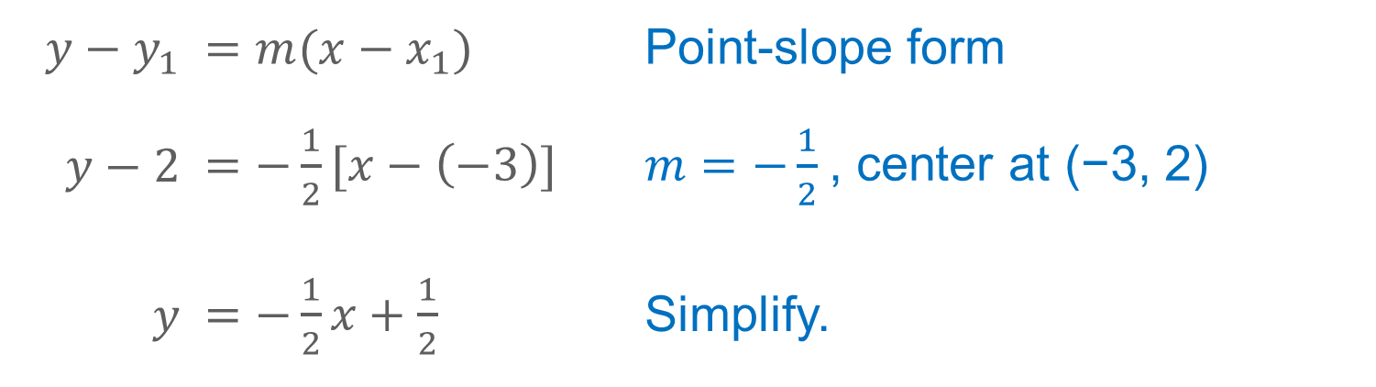
Example 5
Intersections with Circles
$y−y_{1}$ | $$=m(x−x_{1})$$ | Point-slope form
$y−2$ | $=−\frac{1}{2}[x−\left(−3\right)]$ | $m=−\frac{1}{2}$, center at (−3, 2)
$y$ | $=−\frac{1}{2}x+\frac{1}{2}$ | Simplify.

Slide 38
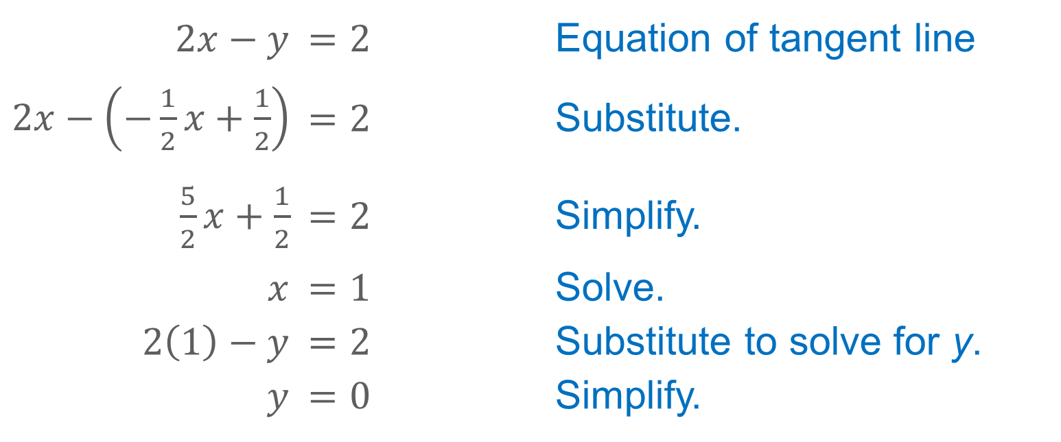
Example 5
Intersections with Circles
The intersection of these two lines will be the point of tangency.
$2x−y$ | $$=2$$ | Equation of tangent line
$2x−\left(−\frac{1}{2}x+\frac{1}{2}\right)$ | $$=2$$ | Substitute.
$\frac{5}{2}x+\frac{1}{2}$ | $$=2$$ | Simplify.
$x$ | $$=1$$ | Solve.
$2\left(1\right)−y$ | $$=2$$ | Substitute to solve for y.
$y$ | $$=0$$ | Simplify.
The point of tangency is at (1,0).

Slide 39
Example 5
Intersections with Circles
Step 2 Find the point of tangency for a second tangent line that is parallel to the given line.
If the second tangent line is parallel to the given line, the point of tangency will be at the opposite end of the diameter that has one endpoint at the original point of tangency. Because the center of the circle is the midpoint of any diameter, use the Midpoint Formula to find the missing endpoint.

Slide 40
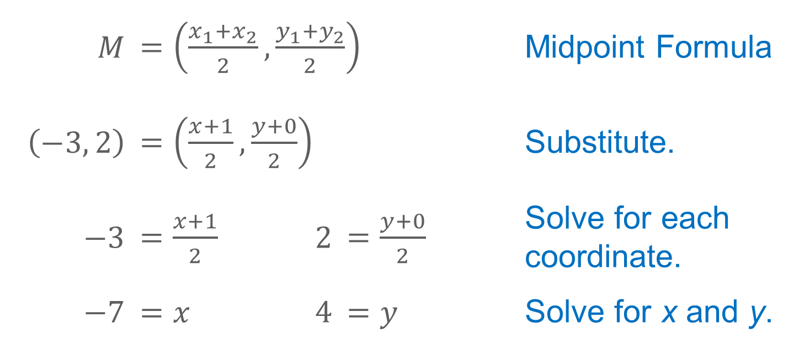
Example 5
Intersections with Circles
$M$ | $=\left(\frac{x_{1}+x_{2}}{2},\frac{y_{1}+y_{2}}{2}\right)$ |  |  | Midpoint Formula
$\left(−3, 2\right)$ | $=\left(\frac{x+1}{2},\frac{y+0}{2}\right)$ |  |  | Substitute.
$−3$ | $=\frac{x+1}{2}$ | $2$ | $=\frac{y+0}{2}$ | Solve for each coordinate.
$−7$ | $=x$ | $4$ | $=y$ | Solve for x and y.
The point of tangency of the second line is (−7, 4).

Slide 41
Example 5
Intersections with Circles
Step 3 Find the equation for the second tangent line.
The slope of the given tangent line is 2, so the slope of the tangent line that is parallel to the given line is 2. Because you know the slope of the parallel line and the point of tangency, you can write an equation of the line.

Slide 42
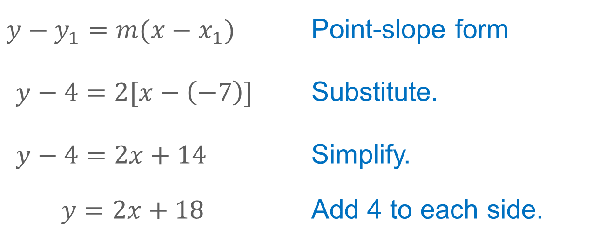
Example 5
Intersections with Circles
$y−y_{1}=m(x−x_{1})$ | Point-slope form
$y−4=2[x−\left(−7\right)]$ | Substitute.
$y−4=2x+14$ | Simplify.
$y=2x+18$ | Add 4 to each side.
This line is tangent to the circle and parallel to the given tangent line.

Slide 43
Example 5
Intersections with Circles
Think About It!
What information would you need to find the points of tangency for tangent lines that are not parallel?

Slide 44
Example 5
Intersections with Circles
Talk About It!
Why are the points of tangency for parallel lines that are tangent to the same circle the endpoints of a diameter?

Slide 45
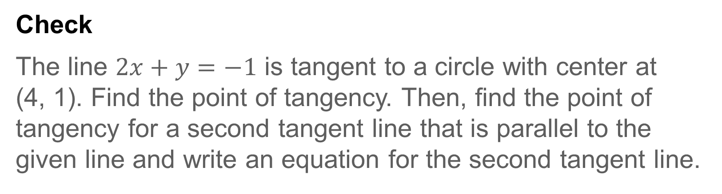
Example 5
Intersections with Circles
Check
The line $2x+y=−1$ is tangent to a circle with center at (4, 1). Find the point of tangency. Then, find the point of tangency for a second tangent line that is parallel to the given line and write an equation for the second tangent line.

Slide 46
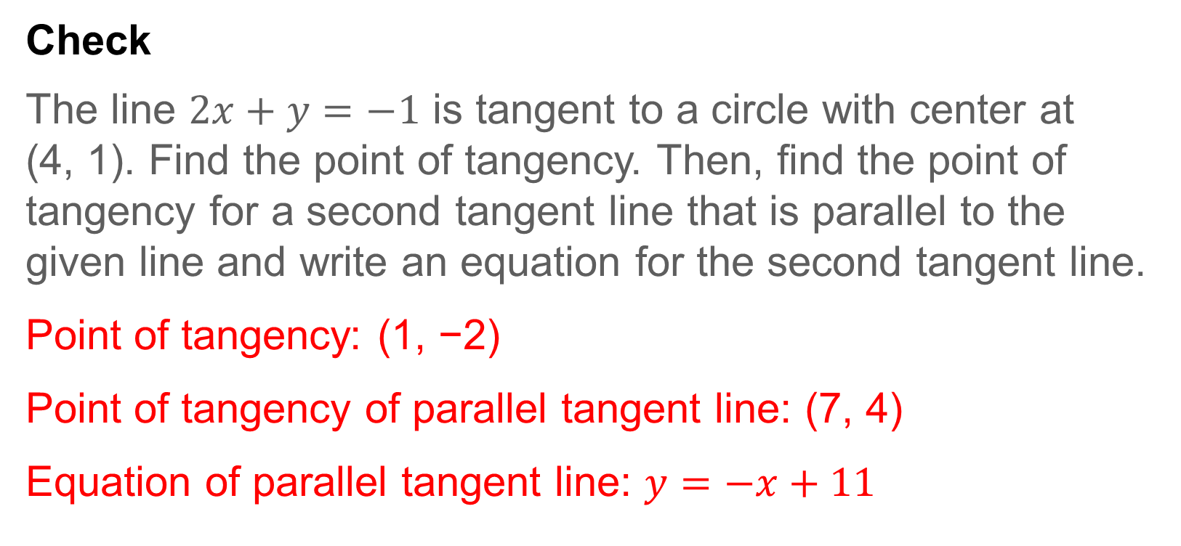
Example 5
Intersections with Circles
Check
The line $2x+y=−1$ is tangent to a circle with center at (4, 1). Find the point of tangency. Then, find the point of tangency for a second tangent line that is parallel to the given line and write an equation for the second tangent line.
Point of tangency: (1, −2)
Point of tangency of parallel tangent line: (7, 4)
Equation of parallel tangent line: $y=−x+11$
Notes:
Point of tangency: (1, −2)
Point of tangency of parallel tangent line: (7, 4)
Equation of parallel tangent line: $y=−x+11$

Slide 47
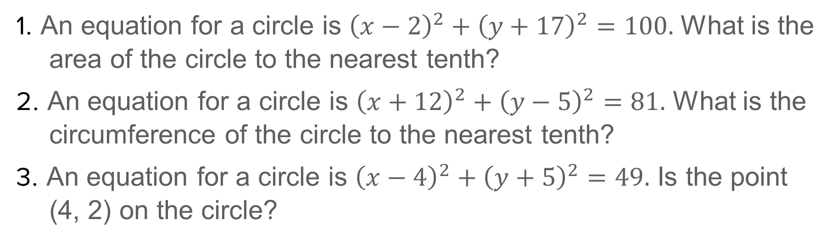
Exit Ticket
1. An equation for a circle is ${\left(x−2\right)}^{2}+{\left(y+17\right)}^{2}=100.$ What is the area of the circle to the nearest tenth?
2. An equation for a circle is ${\left(x+12\right)}^{2}+{\left(y−5\right)}^{2}=81.$ What is the circumference of the circle to the nearest tenth?
3. An equation for a circle is ${\left(x−4\right)}^{2}+{\left(y+5\right)}^{2}=49.$ Is the point (4, 2) on the circle?

Slide 48
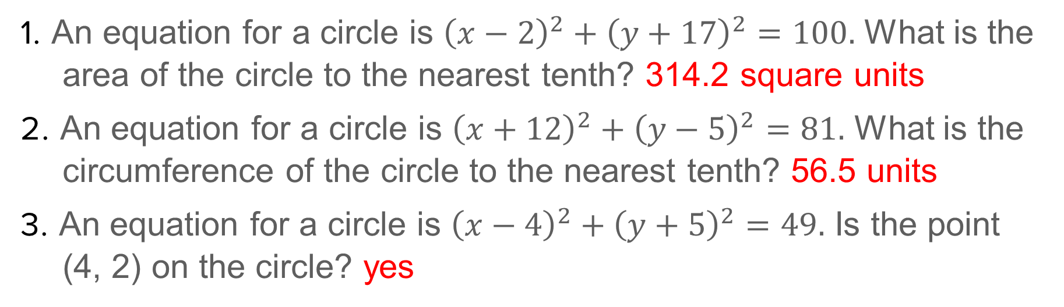
Exit Ticket
1. An equation for a circle is ${\left(x−2\right)}^{2}+{\left(y+17\right)}^{2}=100.$ What is the area of the circle to the nearest tenth? 314.2 square units
2. An equation for a circle is ${\left(x+12\right)}^{2}+{\left(y−5\right)}^{2}=81.$ What is the circumference of the circle to the nearest tenth? 56.5 units
3. An equation for a circle is ${\left(x−4\right)}^{2}+{\left(y+5\right)}^{2}=49.$ Is the point (4, 2) on the circle? yes
Notes:
314.2 square units
56.5 units
yes

